Slide 1


Plans and Prospects for STAR and eSTAR
Oleg Eyser
for the STAR Collaboration
RHIC & AGS Users’ Meeting 2014
Brookhaven National Laboratory

Slide 2
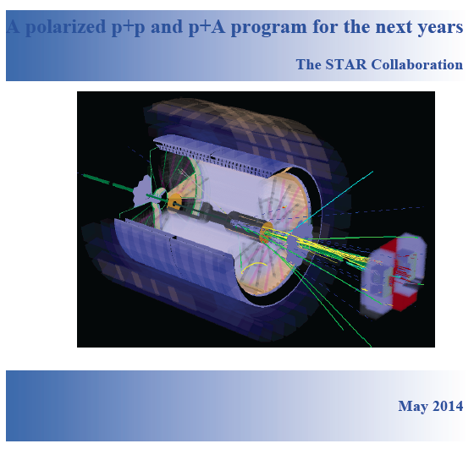
Looking Forward
What is the nature of the spin of the proton?
How do quarks and gluons hadronize into final state particles?
How can we describe the multidimensional landscape of nucleons and nuclei?
What is the nature of the initial
state in nuclear collisions?
https://drupal.star.bnl.gov/STAR/future

Slide 3
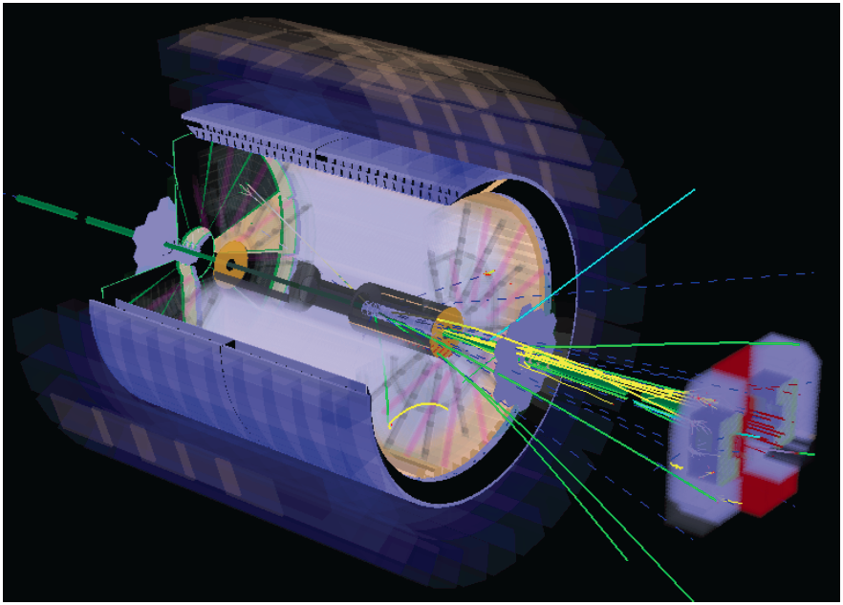

Slide 4
Confined Partons in the Nucleon
Do the large transverse single-spin asymmetries survive at high center-of-mass energies?
Can the sub-process responsible for A_{N} be uniquely identified?
Is the observed p_{T}-dependence of A_{N} consistent with theory expectations in pQCD?
Can the TMD evolution, which is different from the well-known DGLAP evolution, be seen in the RHIC data?
f_{a}
FF_{q}
σ
f_{b}

Slide 5
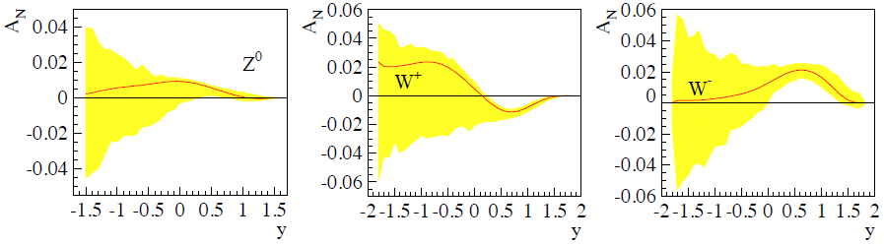
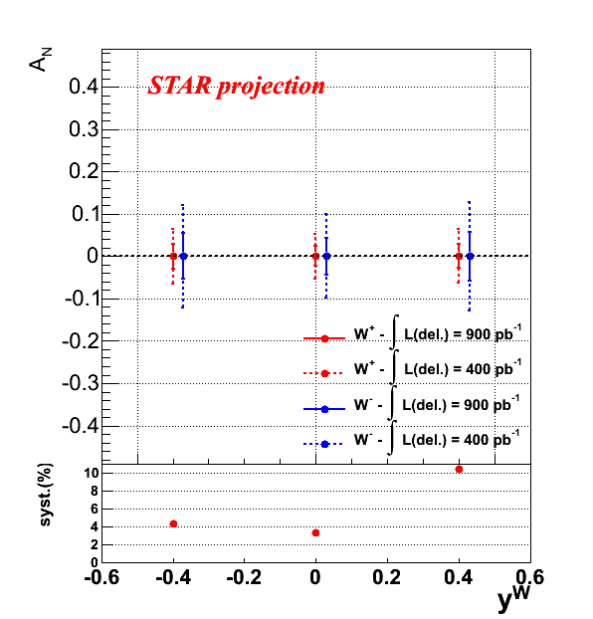
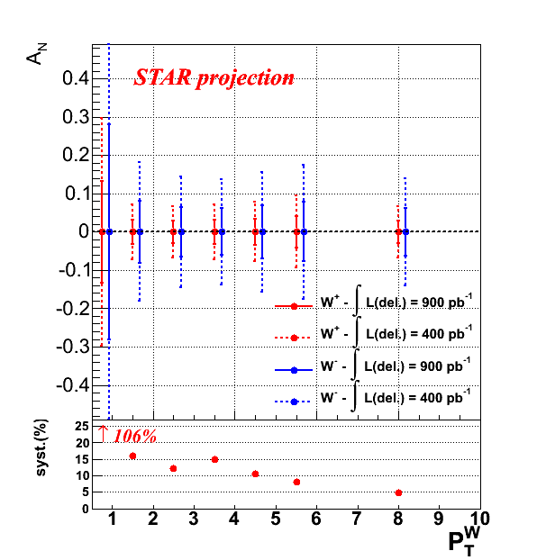

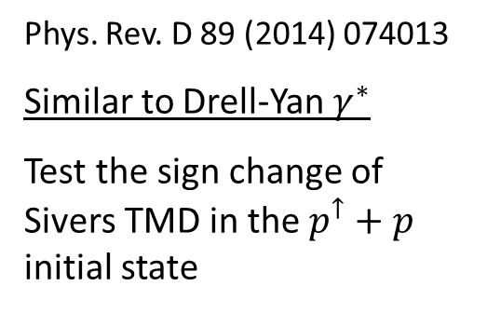
Transverse Spin with $W^{±},Z^{0}$ Bosons
Phys. Rev. D 89 (2014) 074013
Similar to Drell-Yan $γ^{∗}$
Test the sign change of Sivers TMD in the $p^{↑}+p$ initial state

Slide 6
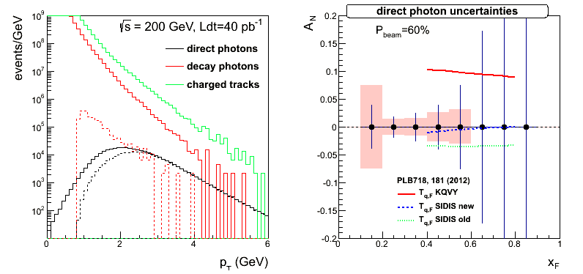
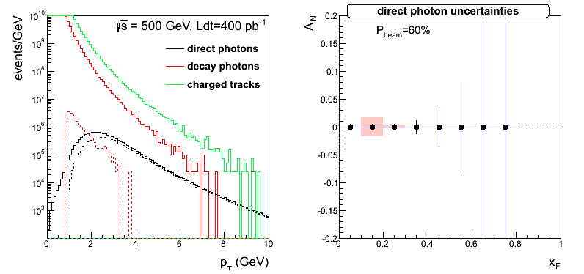
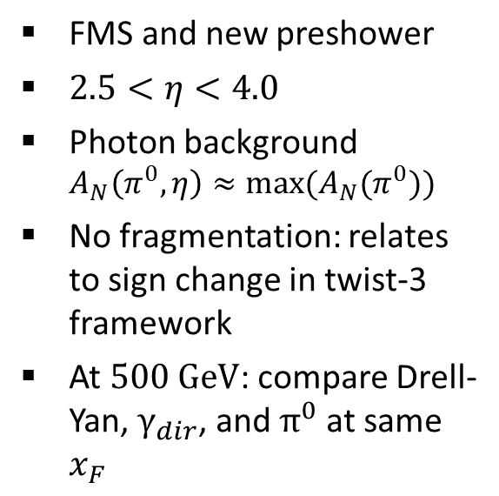
Forward Direct Photons
FMS and new preshower
$2.5<η<4.0$
Photon background
$A_{N}\left(π^{0},η\right)≈{max⁡(A}_{N}(π^{0}))$
No fragmentation: relates to sign change in twist-3 framework
At $500 \text{GeV}$: compare Drell-Yan, $γ_{dir}$, and $π^{0}$ at same $x_{F}$

Slide 7
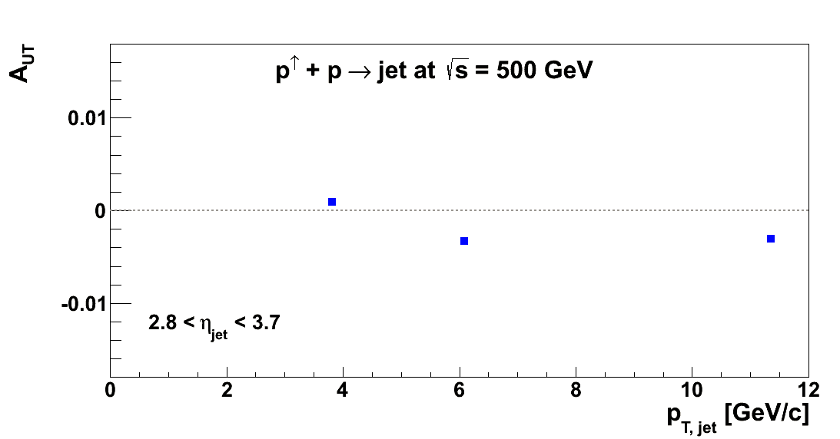
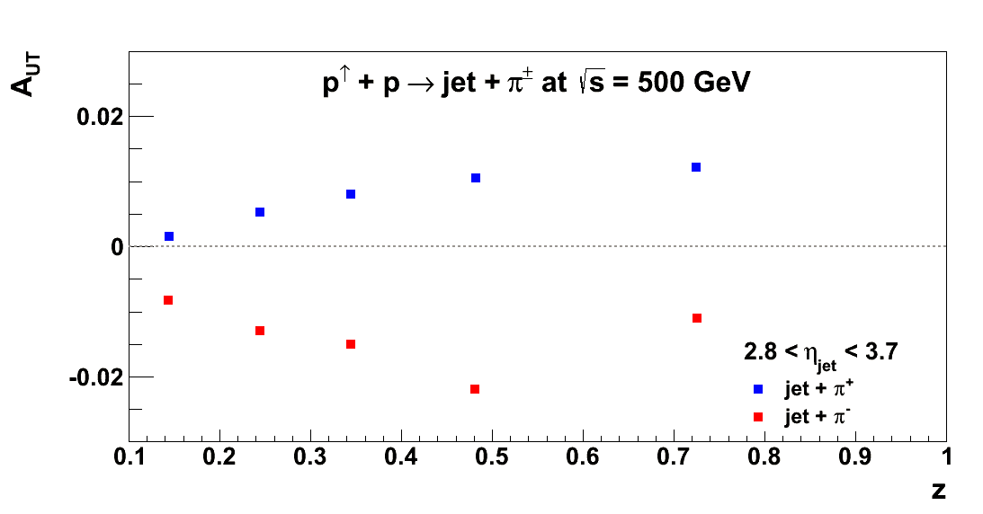
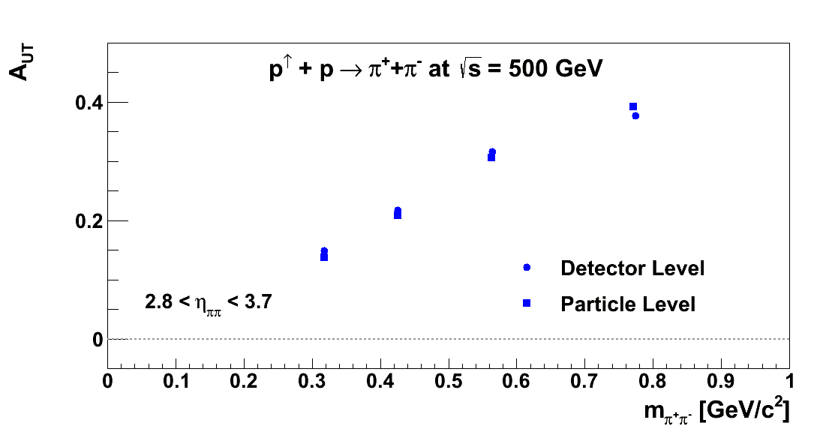
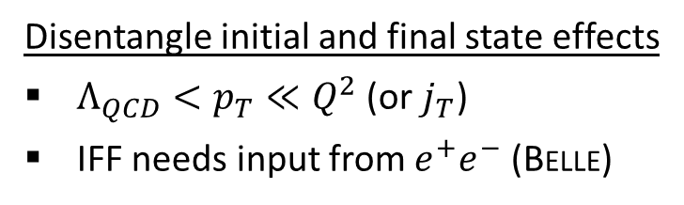
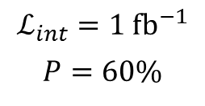

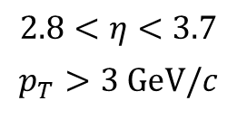

Jets & Correlations
$$2.8<η<3.7$$
$$p_{T}>3 \text{GeV}/c$$
$$ℒ_{int}=1 {\text{fb}}^{−1}$$
$$P=60\%$$
$$\sqrt{s}=500 \text{GeV}$$
Disentangle initial and final state effects
$Λ_{QCD}<p_{T}≪Q^{2}$ (or $j_{T}$)
IFF needs input from $e^{+}e^{−}$ (Belle)
Sivers type^{(*)}
(*) based on parametrization from Alsemino et al.
(+) based on arbitrary parametrization linear in $m$, $x$, and $z$
Interference fragmentation ⁽⁺⁾
Collins type ^{(*)}

Slide 8
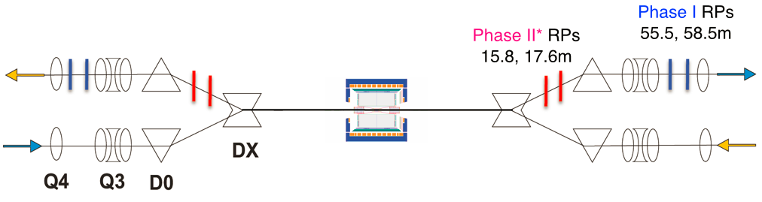
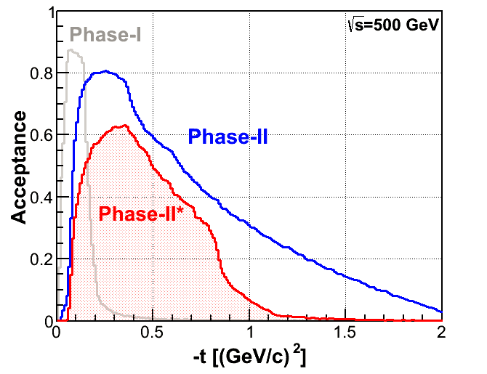
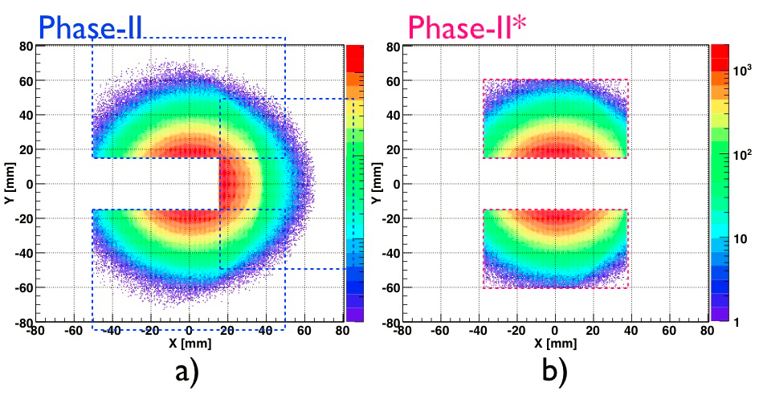
Tagging Forward Protons
Roman pots from pp2pp

Slide 9
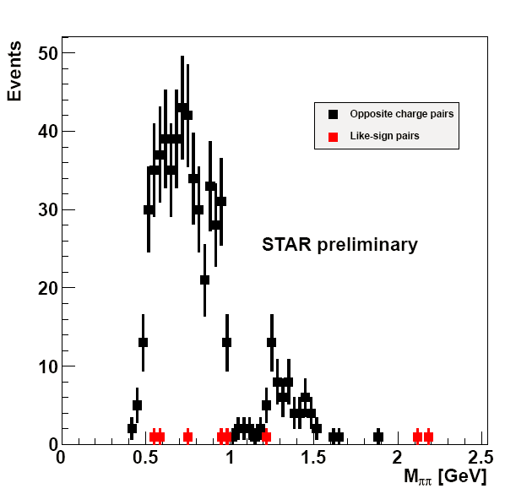
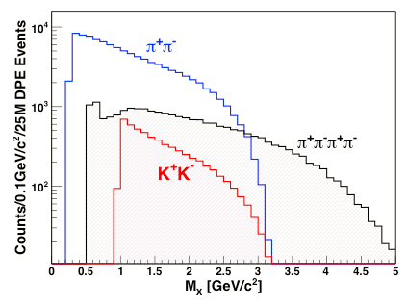
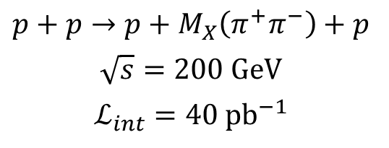
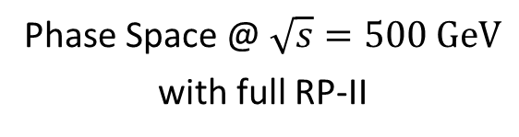
Exclusive Measurements
$$p+p→p+M_{X}\left(π^{+}π^{−}\right)+p$$
$$\sqrt{s}=200 \text{GeV}$$
$$ℒ_{int}=40 {\text{pb}}^{−1}$$
Phase Space @ $\sqrt{s}=500 \text{GeV}$
with full RP-II
opposite charge pairs
same charge pairs
2009

Slide 10
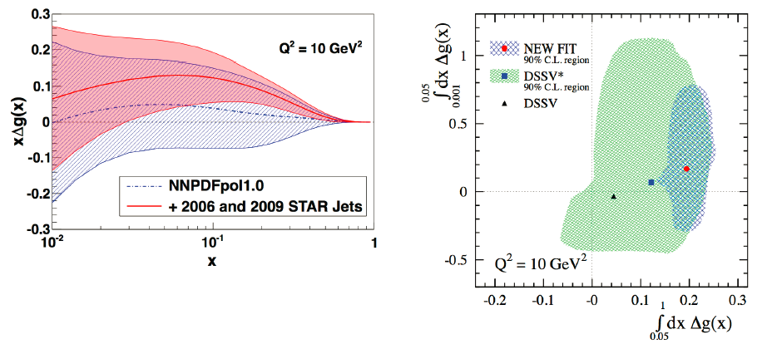
Gluon Polarization
Inclusion of STAR jet data from 2006 and 2009 helps decrease uncertainties
More data on tape already
Need to reach lower x for further improvement

Slide 11
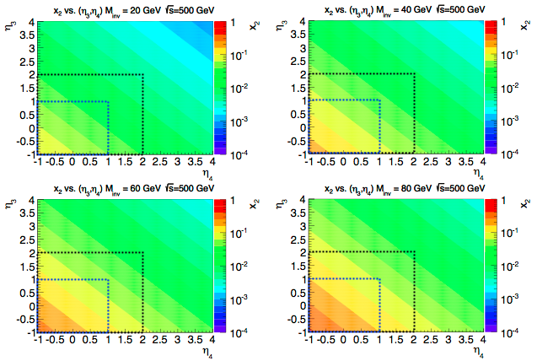

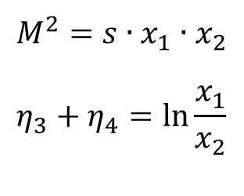

Di-Jet Kinematics from QCD $2→2$
$$x_{2}$$
Recorded data
Published data
$$M^{2}=s∙x_{1}∙x_{2}$$
$$η_{3}+η_{4}=\ln{\frac{x_{1}}{x_{2}}}$$

Slide 12
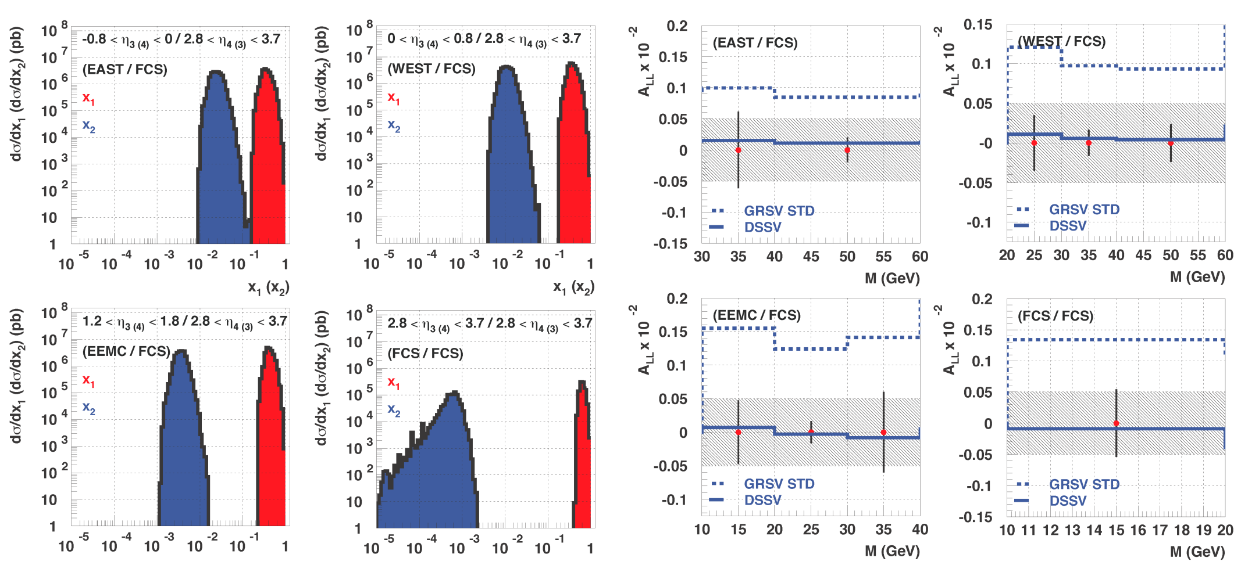
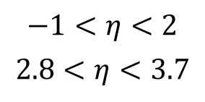
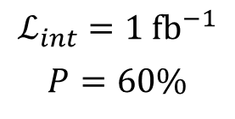
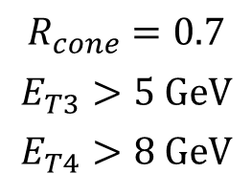

Di-Jets with additional FCS
$$R_{cone}=0.7$$
$$E_{T3}>5 \text{GeV}$$
$$E_{T4}>8 \text{GeV}$$
$$−1<η<2$$
$$2.8<η<3.7$$
$$ℒ_{int}=1 {\text{fb}}^{−1}$$
$$P=60\%$$
$$\sqrt{s}=500 \text{GeV}$$

Slide 13
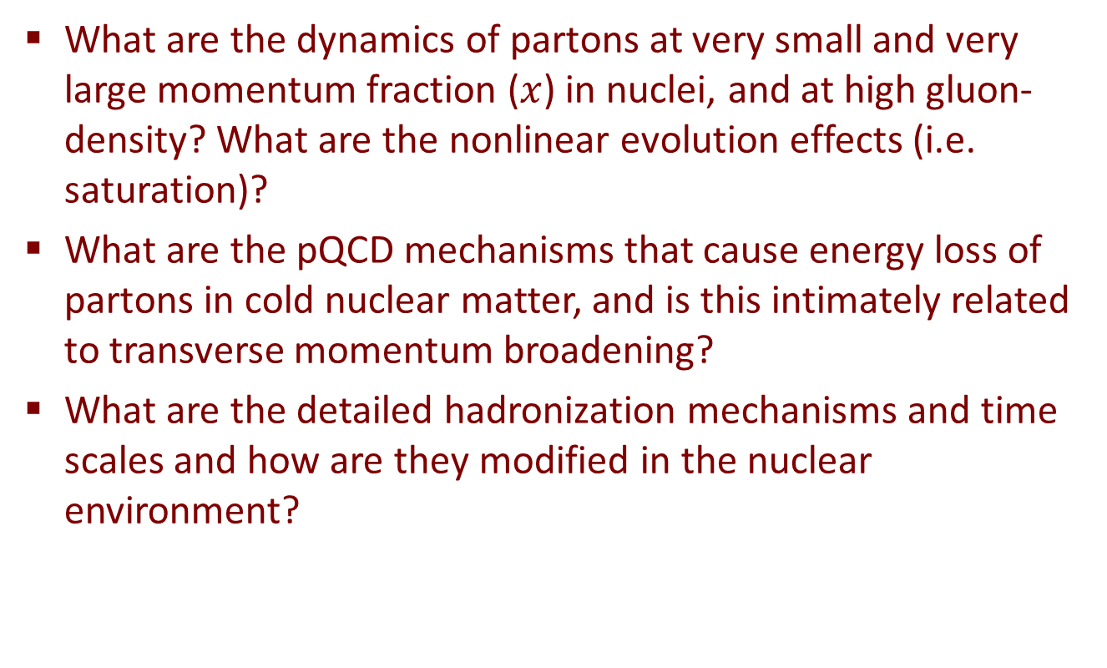
Cold Nuclear Matter
What are the dynamics of partons at very small and very large momentum fraction ($x$) in nuclei, and at high gluon-density? What are the nonlinear evolution effects (i.e. saturation)?
What are the pQCD mechanisms that cause energy loss of partons in cold nuclear matter, and is this intimately related to transverse momentum broadening?
What are the detailed hadronization mechanisms and time scales and how are they modified in the nuclear environment?

Slide 14
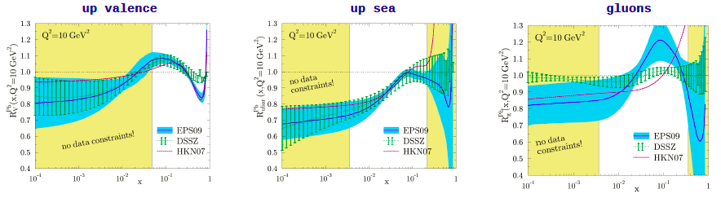
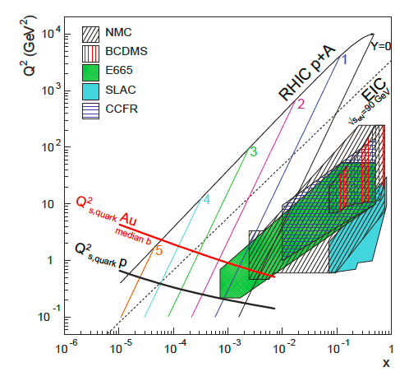
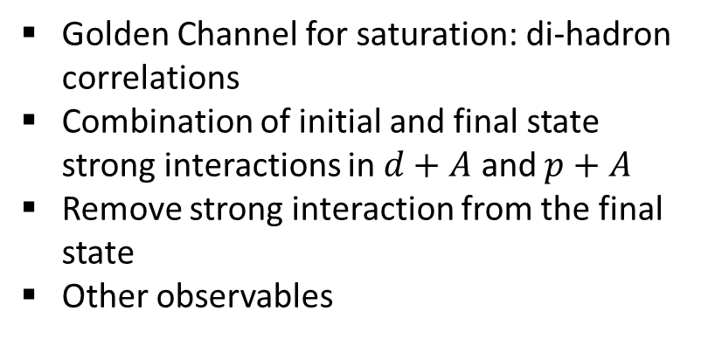
Low-x and High Gluon Densities
Golden Channel for saturation: di-hadron correlations
Combination of initial and final state strong interactions in $d+A$ and $p+A$
Remove strong interaction from the final state
Other observables

Slide 15
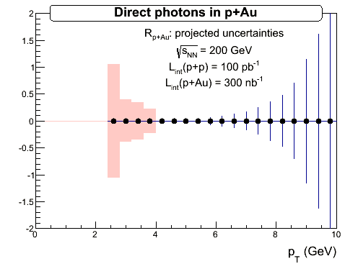
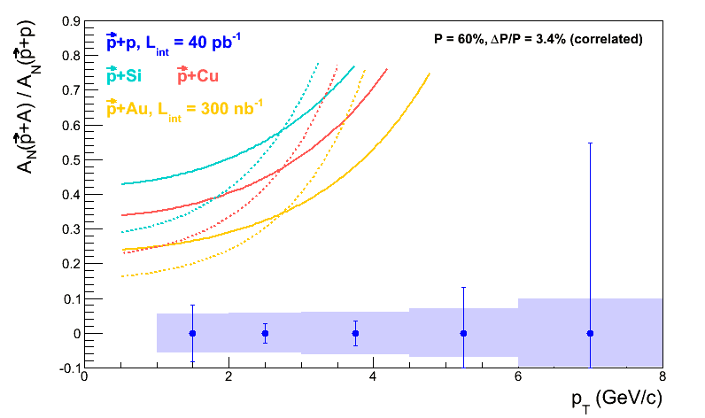
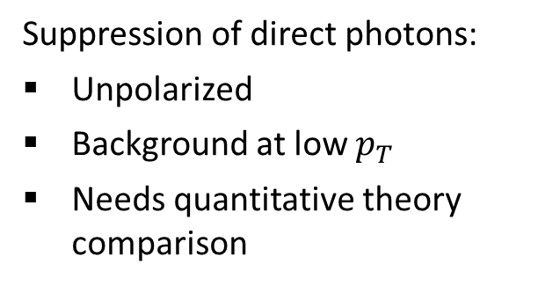
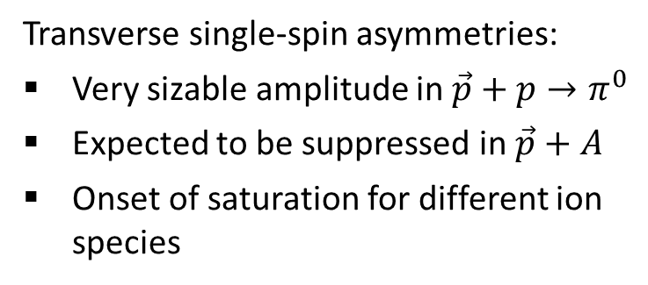
Saturation Signatures
Transverse single-spin asymmetries:
Very sizable amplitude in ${\vec{p}+p→π}^{0}$
Expected to be suppressed in $\vec{p}+A$
Onset of saturation for different ion species
Suppression of direct photons:
Unpolarized
Background at low $p_{T}$
Needs quantitative theory comparison

Slide 16
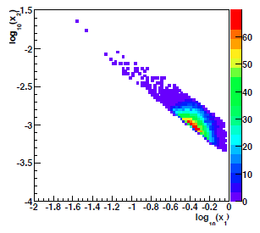
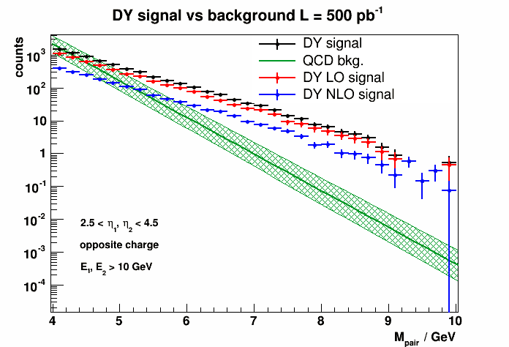
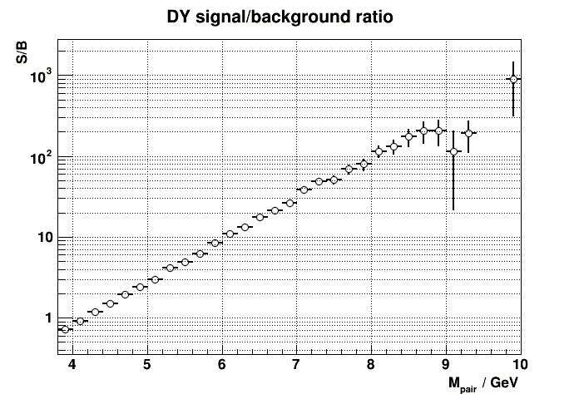

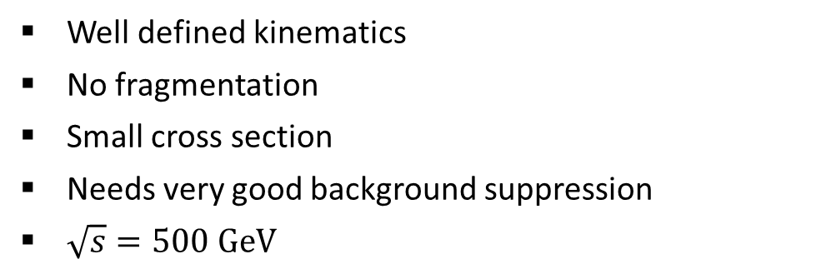

Drell-Yan Measurement
Well defined kinematics
No fragmentation
Small cross section
Needs very good background suppression
$\sqrt{s}=500 \text{GeV}$
$$2.5<η<4.0$$
increase
mass
$$4.0<m_{DY}<6.0 \text{GeV}/c^{2}$$

Slide 17
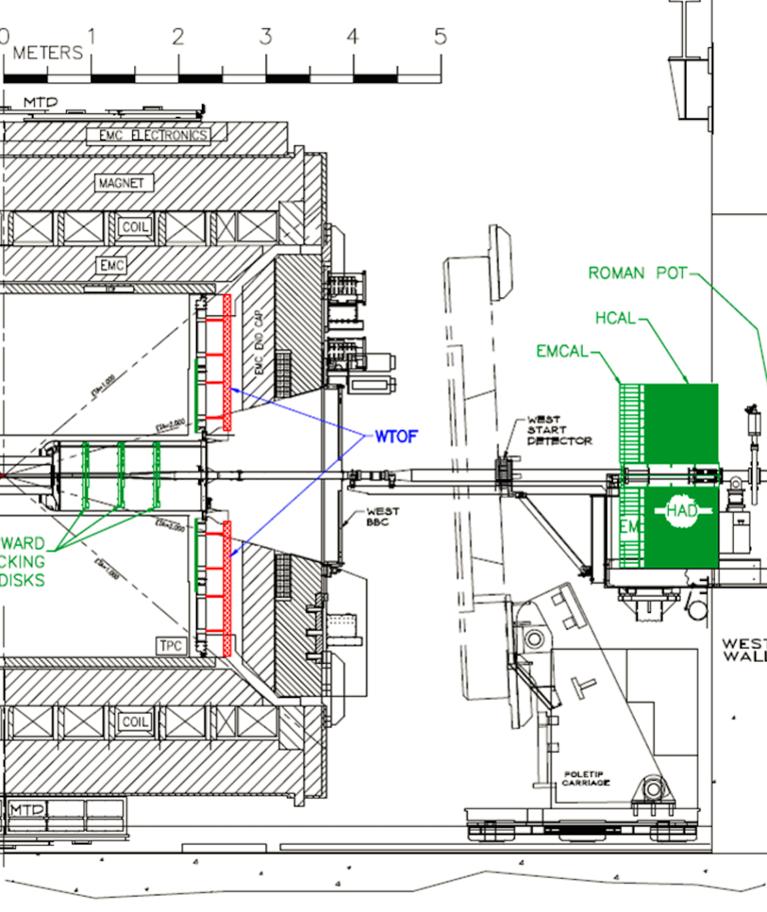
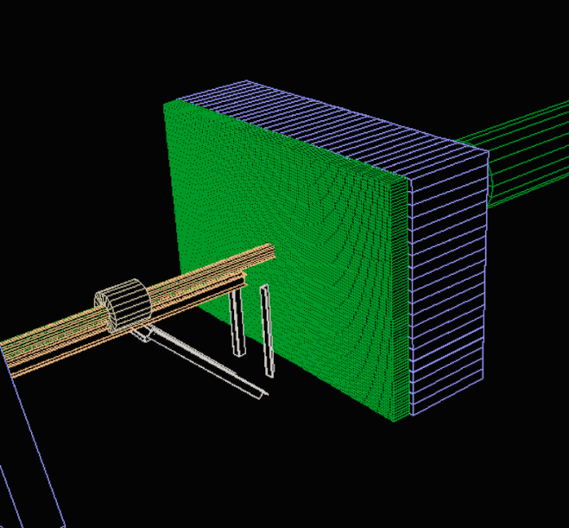
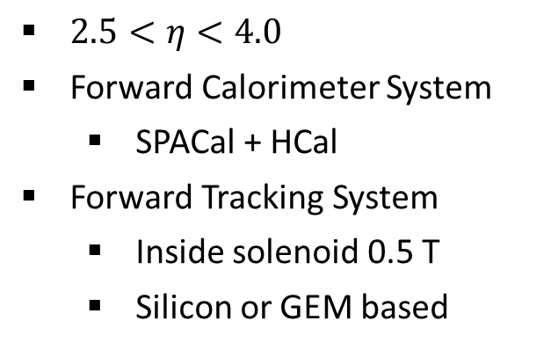
Detector Upgrades
$2.5<η<4.0$
Forward Calorimeter System
  SPACal + HCal
Forward Tracking System
  Inside solenoid 0.5 T
  Silicon or GEM based

Slide 18
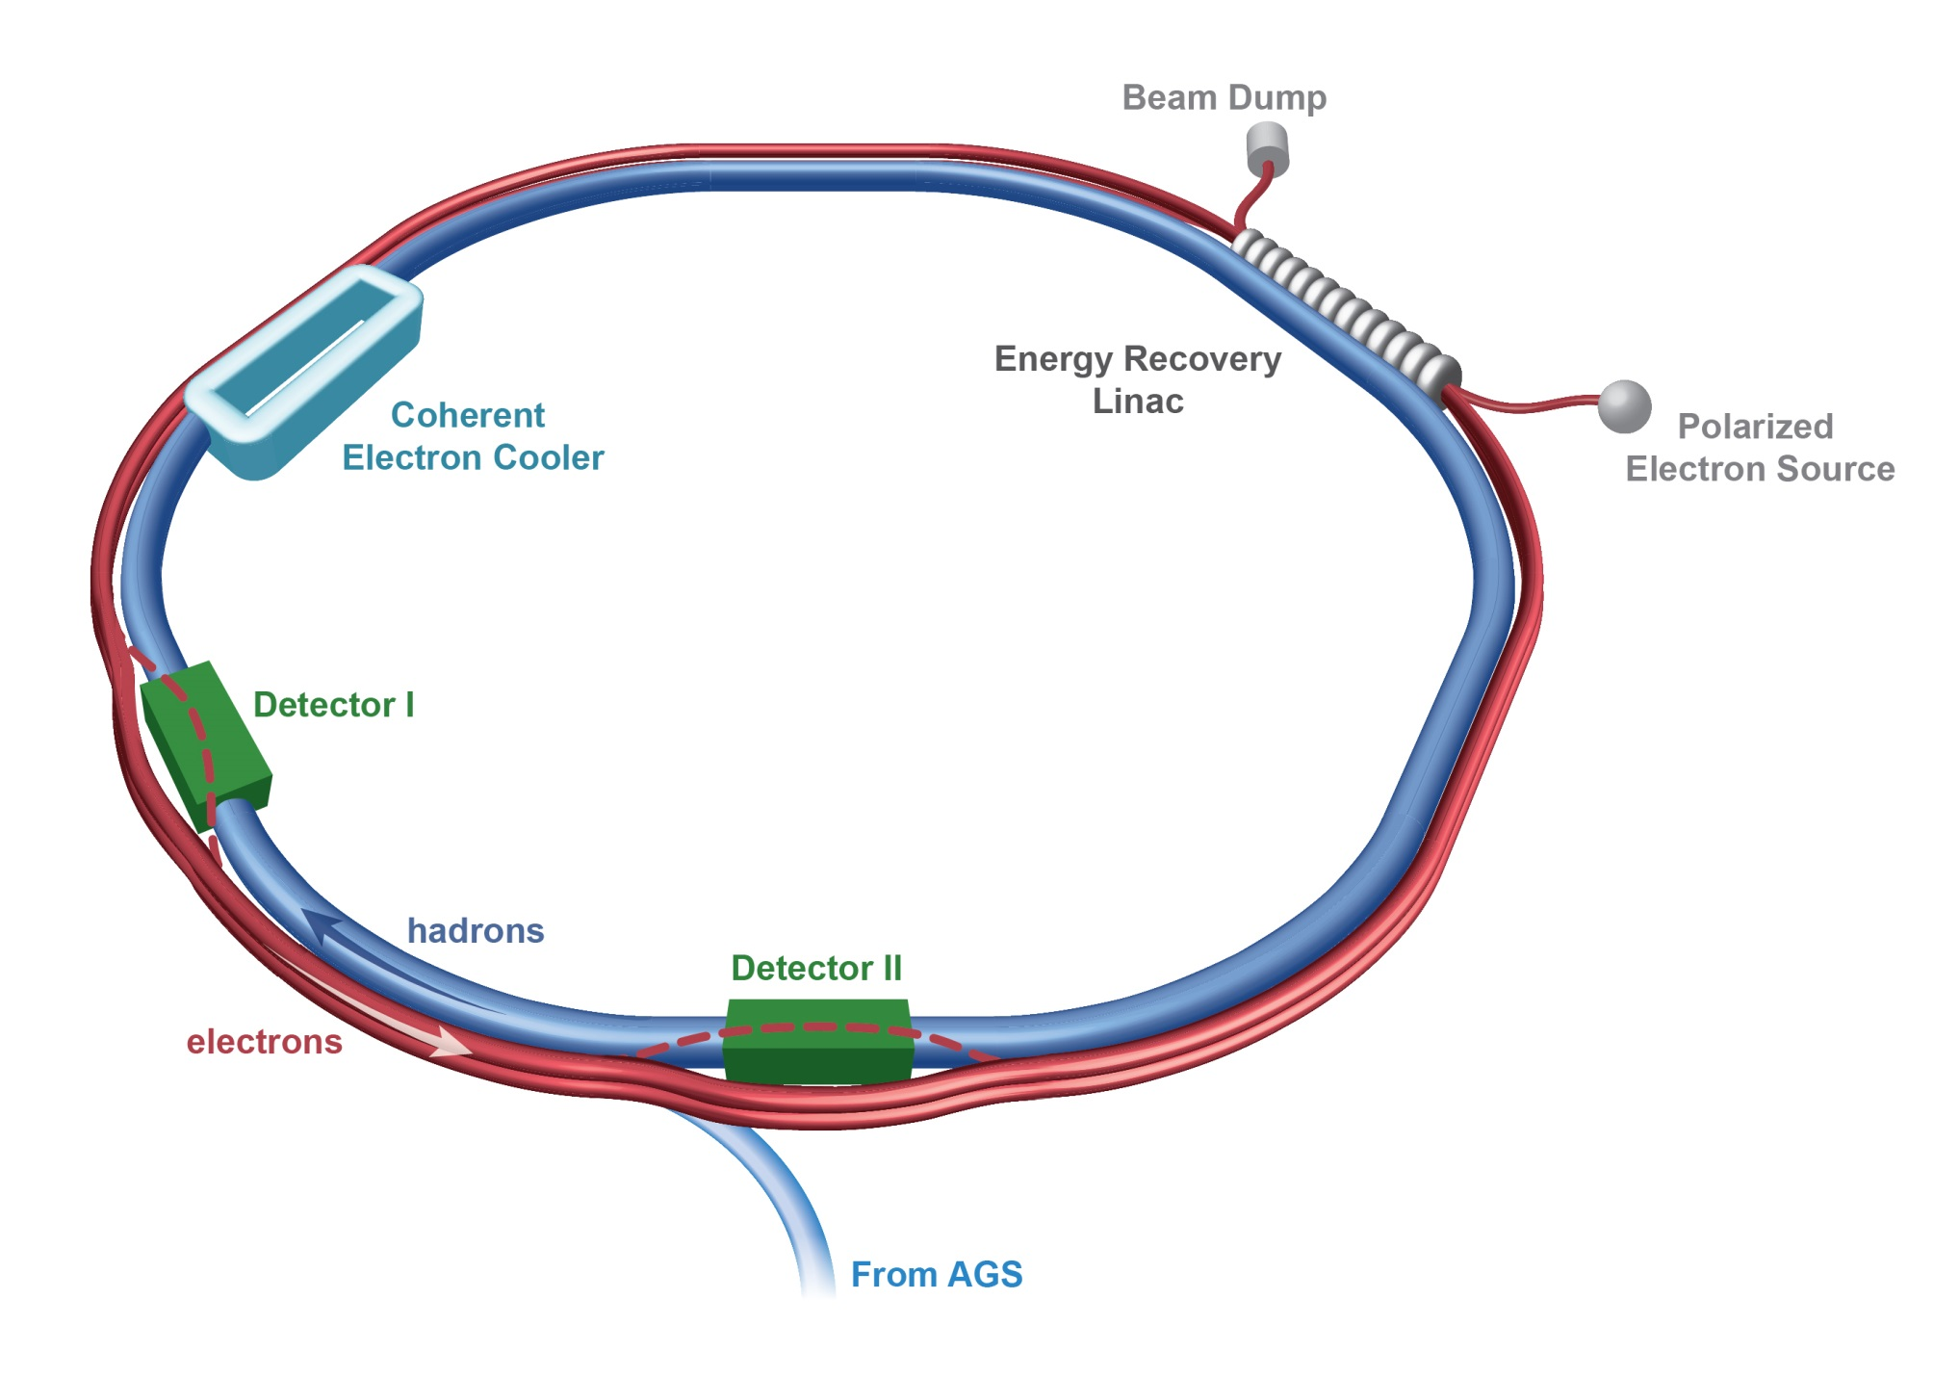
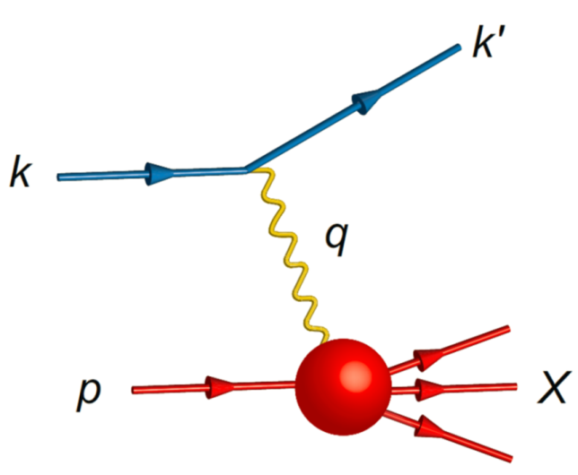

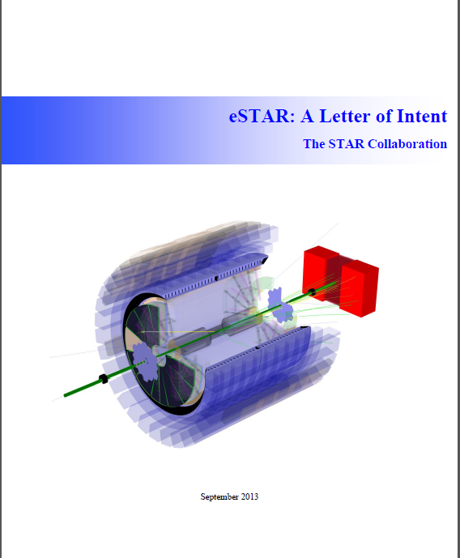
https://drupal.star.bnl.gov/STAR/future
arxiv:1212.1701

Slide 19
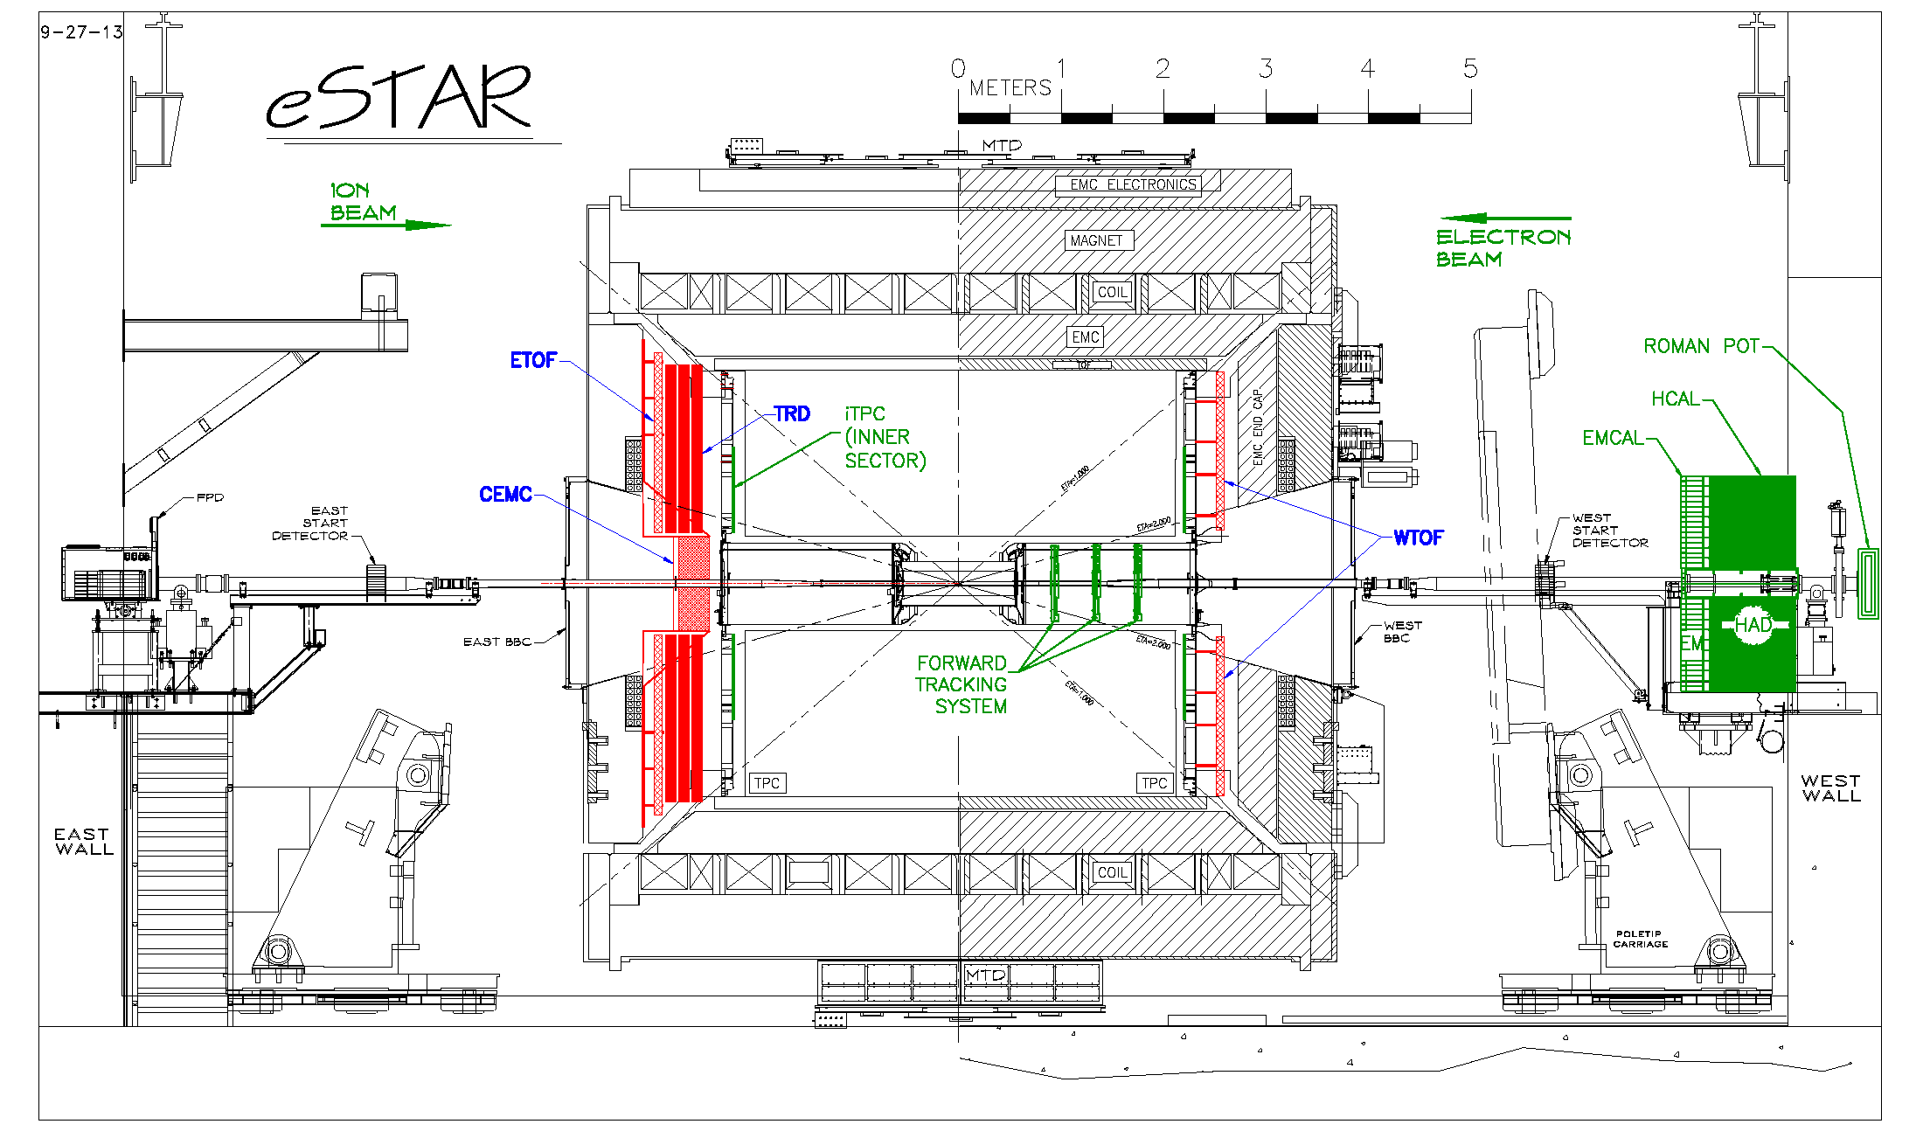


eSTAR Baseline Configuration
$$\vec{p_{e}}$$
$$\vec{p_{p}}$$

Slide 20
Kinematic Coverage
$$σ_{r}= \frac{d^{2}σ}{dxdQ^{2}} \frac{x Q^{4}}{2{πα}^{2}[1+{(1−y)}^{2}]}=F_{2}\left(x,Q^{2}\right)− \frac{y}{1+{\left(1−y\right)}^{2}}F_{L}\left(x,Q^{2}\right)$$

Slide 21
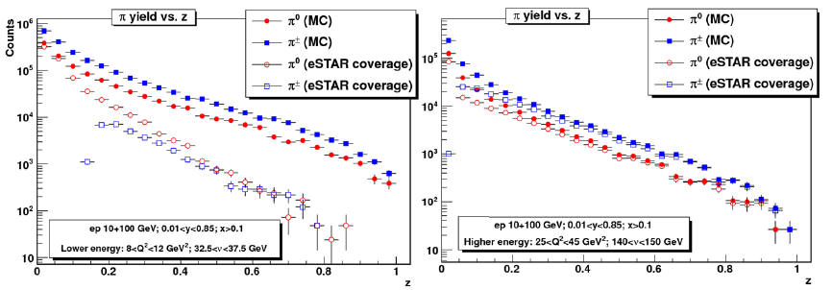
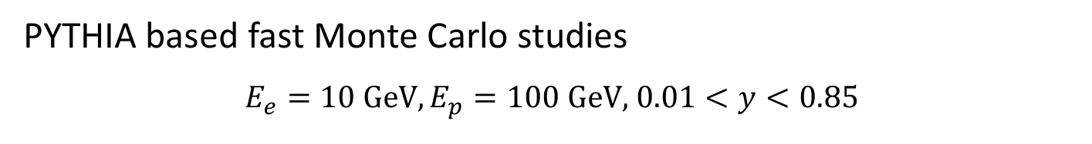


eSTAR SIDIS Acceptance
PYTHIA based fast Monte Carlo studies
$$E_{e}=10 \text{GeV}, E_{p}=100 \text{GeV}\text{,} 0.01<y<0.85$$
$$8<Q^{2}<12 {\text{GeV}}^{2}$$
$$32.5<ν<37.5 \text{GeV}$$
$$25<Q^{2}<45 {\text{GeV}}^{2}$$
$$140<ν<150 \text{GeV}$$

Slide 22




Exclusive Processes: DVCS
GPD
$$H\left(x,ξ,t\right)$$
$$E\left(x,ξ,t\right)$$
Spatial distribution
$$f\left(x,b_{T}^{2}\right)$$
$$e\left(x,b_{T}^{2}\right)$$
Fourier
transform

Slide 23



Exclusive Vector Meson Production
$$φ,ρ→$$
$$J/ψ→$$

Slide 24

Summary
STAR has presented a scientific program for future polarized $p^{↑}+p$ and $p+A$ collisions at RHIC which can transition into an eSTAR/eRHIC era
Upgrades are focused on the forward kinematic region with a calorimeter system and tracking
Projections have been shown for $p+p$ collisions of $100 {\text{p}\text{b}}^{−1} (1 {\text{f}\text{b}}^{−1})$ at $\sqrt{s}=200 \text{GeV} (500 \text{GeV})$ with a beam polarization of $P=60\%$ and additional $2.5 {\text{p}\text{b}}^{−1}$of $p+A$ collisions
Measurements will help improve our understanding of nucleons and nuclei and address fundamental aspects of the partonic structure, especially at very small and very large $x$
eSTAR can deliver a broad range of key measurements that have been identified as flagship cases in the EIC community white paper
https://drupal.star.bnl.gov/STAR/future

Slide 25


Slide 26


Di-Jets with Barrel & Endcap
$$−1<η<2$$

Slide 27



$$A_{N}(Z^{0})$$

