Slide 1




Beam-Energy and Centrality Dependence of Directed Flow of Identified Particles
Prashanth Shanmuganathan
(for the STAR Collaboration)
Kent State University, USA
      DATA TO BE PRESENTED
      v₁(y) and dv₁/dy|_{y=0} presented for
Au+Au √s_{NN} : 7.7, 11.5, 14.5, 19.6, 27 & 39 GeV
10-40 % collisions and 9 centrality bins
Particle species: p, anti-p, π±, Λ, anti-Λ, K±, K⁰_{S}

Slide 2

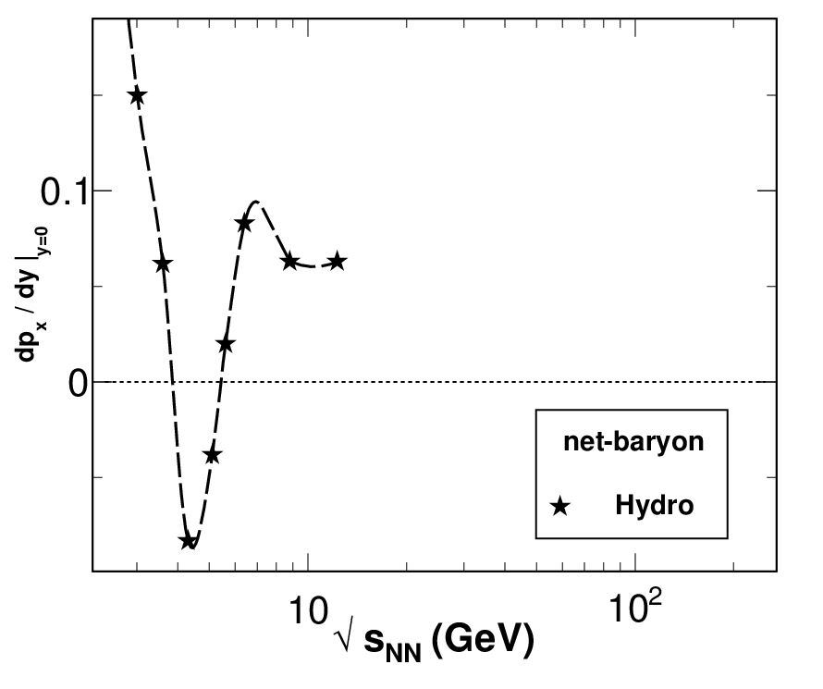
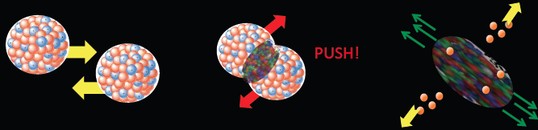
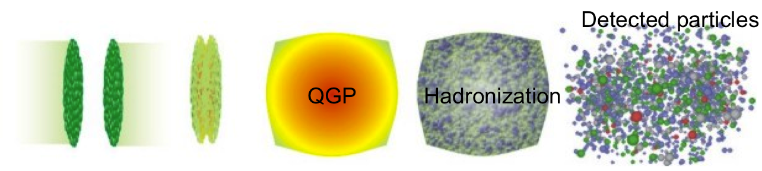
Directed flow (v₁)
H. Stoecker,
Nucl. Phys. A 750, 121 (2005).
v₁, produced early, gives info about EOS
Hydro with 1st-order phase transition shows dip in directed flow vs. beam energy due to sudden softening of EOS
Isochronous freeze-out
Proton v₁ probes interplay of baryon transport and hydro behavior
New Λ data offer more insight into transport of baryons

Slide 3
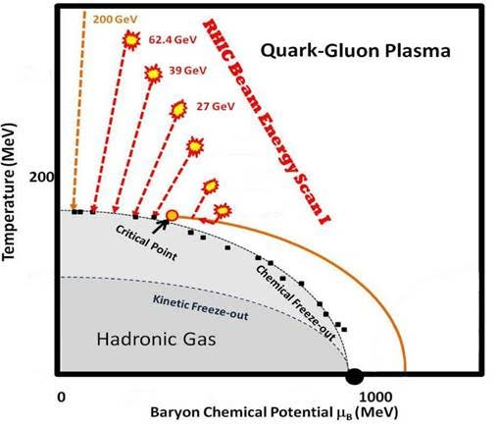
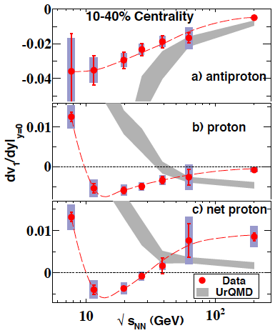
BES Program at STAR and Directed Flow
Goals of BES : Explore QCD phase diagram
Map turn-off of QGP signatures
Search for Critical Point
Search for First-Order Phase Transition
Data: Au+Au collisions
√s_{NN}(GeV) | 7.7 | 11.5 | 14.5 | 19.6 | 27 | 39
Events (10⁶) Minimum-bias | 4 | 12 | 20 | 36 | 70 | 130
https://drupal.star.bnl.gov/STAR/starnotes/public/sn0493
https://drupal.star.bnl.gov/STAR/starnotes/public/sn0598
Rapidity-odd v₁ at AGS energies positive and large for p, Λ - PRL 86, 2533 (2001)
For 10-40 % centrality, proton dv₁/dy vs. beam energy changes sign, with a minimum. Net protons change sign twice
Pion and antiproton slope remain negative.
EOS softening?
PRL 112, 162301 (2014)

Slide 4
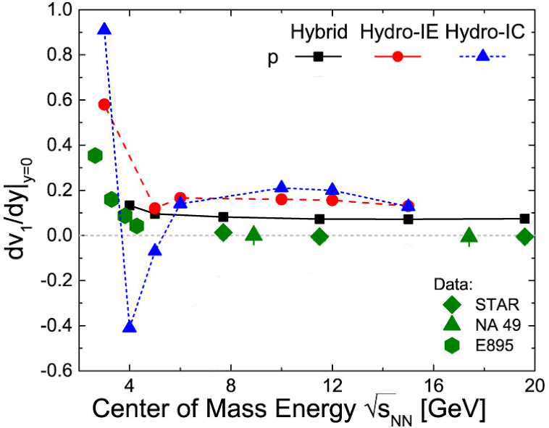
Frankfurt Hybrid Model
IC =Isochronous freeze-out (sim. to 2005 hydro).
IE =Iso-ρ_{E} freeze-out (ρ_{E} is energy density)
All three model cases have 1st order PT
J. Steinheimer et al., PRC 89, 054913 (2014).
Sign change, minimum and error bars for STAR protons are all invisible with this vertical scale
All three model cases disagree strongly with experiment

Slide 5
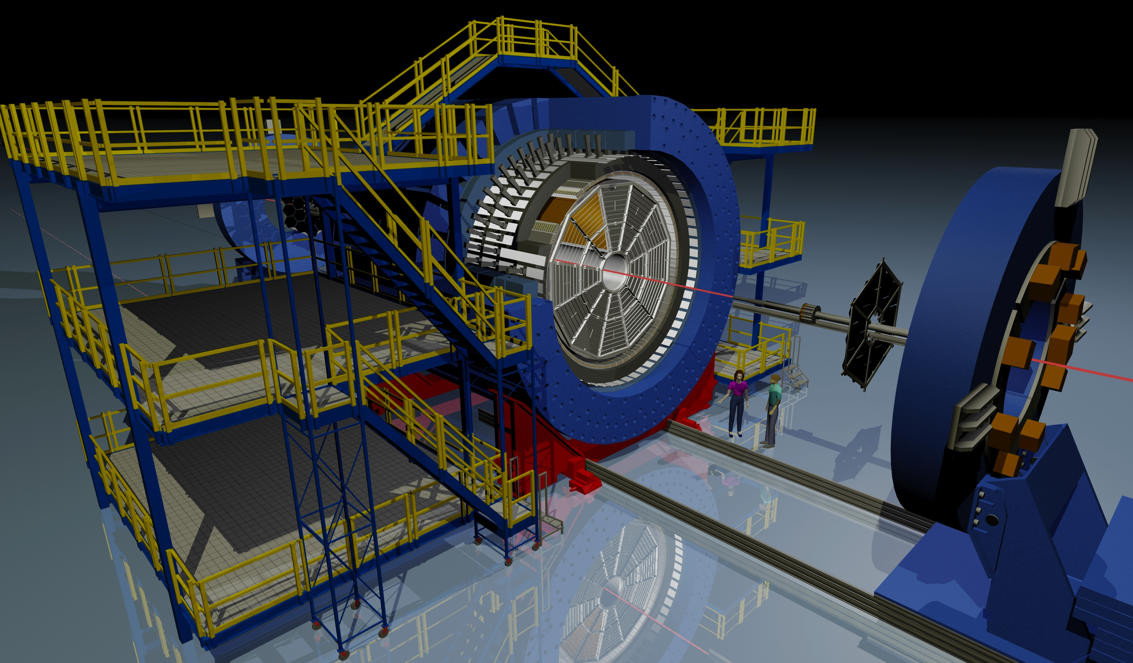
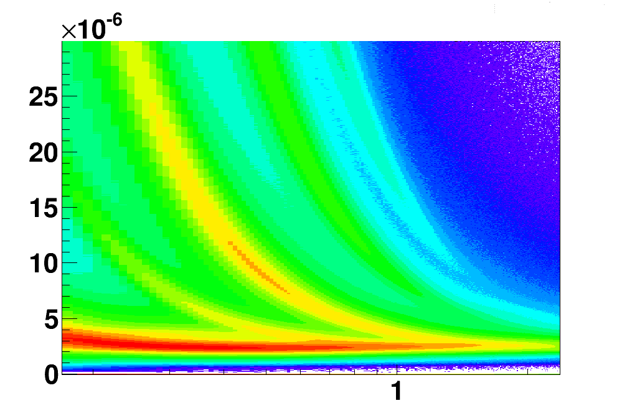
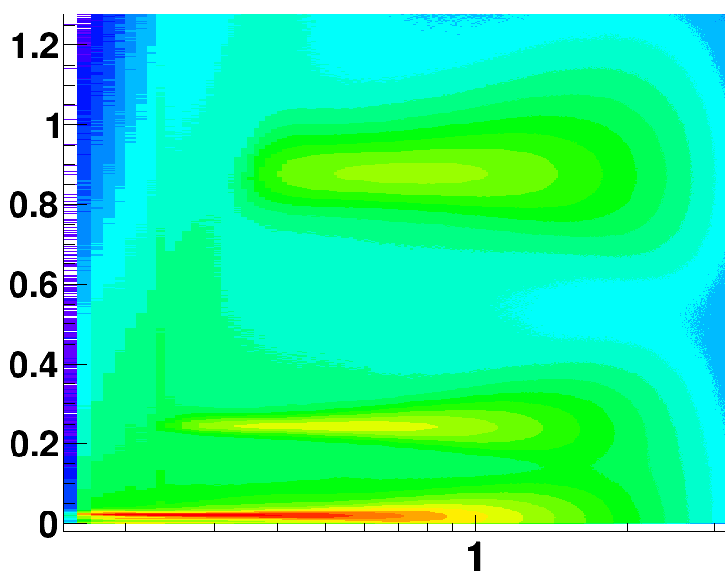
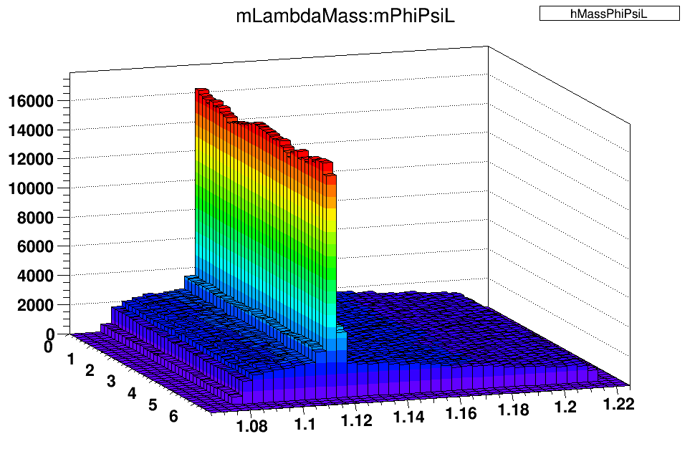



STAR & Particle Identification
Long lived: p, K, π
Requires TPC & TOF hits
dE/dx cut of nσ ≤ 2
p : 0.4 < p_{T} < 2.0 GeV/c
K± & π± : p_{T} > 0.2 GeV/c
p < 1.6 GeV/c
TPC
BBC
TOF
Short lived : Λ & K⁰_{S}
Invariant mass technique
Mixed-event background
V0 topological cuts
TPC and/or ToF hits for daughters
0.2 < p_{T} < 5.0 GeV/c
Uniform & Large Acceptance
Full azimuthal coverage
|η| < 1 coverage
M. & A.Schmah
p
√S_{NN}=39 GeV
TPC
√S_{NN}=39 GeV
TOF
Invariant mass of Lambda (11.5 GeV)
p
dE/dx(keV/cm)
mass² (GeV/c²)²
K⁺
K⁺
π⁺
π⁺
p (GeV/c)
p (GeV/c)
PID using energy loss in TPC dE/dx
PID using time of flight and momentum from TPC

Slide 6
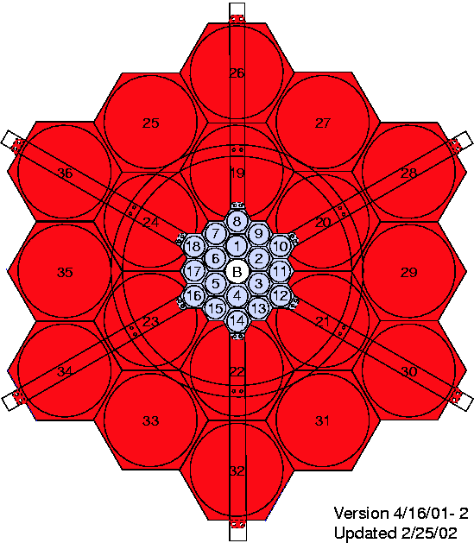
Event Plane Estimation
STAR preliminary
1st-order reaction plane estimated using East & West BBC detectors
  Coverage: 3.3 < |η| < 5.0
  η gap between TPC and BBC reduces non-flow
BBC event plane resolution improves at lower energies due to strong v₁ signal near beam rapidities aligning with BBC acceptance
Non-flat BBC Ψ₁ distribution corrected by shifting method
(Voloshin, Poskanzer, Snellings, arXiv:0809.2949)
Resolution of Ψ₁
η<0
BBC East
IP
η>0
BBC West

Slide 7
v₁ vs. rapidity for 10-40% centrality
7.7 GeV
11.5 GeV
14.5 GeV
19.6 GeV
27 GeV
39 GeV
p
v₁
STAR preliminary
Λ
rapidity

Slide 8
v₁ vs. rapidity for 10-40% centrality
7.7 GeV
11.5 GeV
14.5 GeV
19.6 GeV
27 GeV
39 GeV
p
STAR preliminary
Λ
v₁
p-bar
Λ-bar
÷ 5
rapidity

Slide 9
v₁ vs. rapidity for 10-40% centrality
7.7 GeV
11.5 GeV
14.5 GeV
19.6 GeV
27 GeV
39 GeV
p
STAR preliminary
Λ
p-bar
v₁
Λ-bar
÷ 5
K+
K-
K⁰_{S}
rapidity

Slide 10
v₁ vs. rapidity for 10-40% centrality
7.7 GeV
11.5 GeV
14.5 GeV
19.6 GeV
27 GeV
39 GeV
p
STAR preliminary
Λ
p-bar
Λ-bar
v₁
÷ 5
K+
K-
K⁰_{S}
π+
π-
rapidity

Slide 11
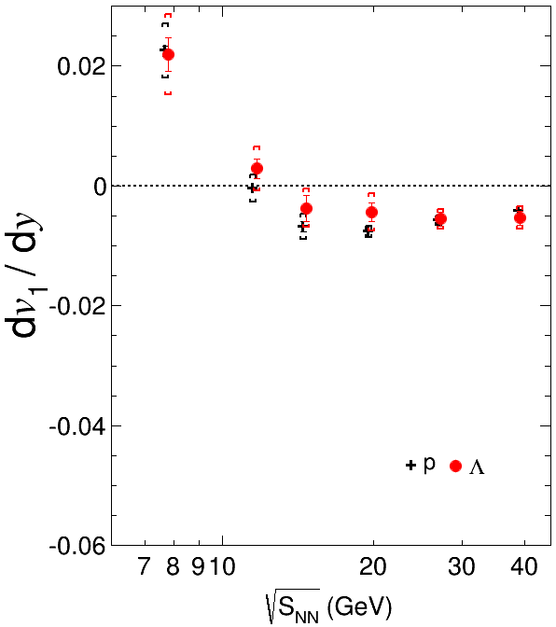
dv₁/dy vs. Beam Energy for 10-40% centrality
STAR preliminary
A linear fit over |y| ≤ 0.8 used to find dv₁/dy for all species & energies
Λ follows p within errors
Published STAR analysis uses linear term in cubic fit, but results are same within errors

Slide 12
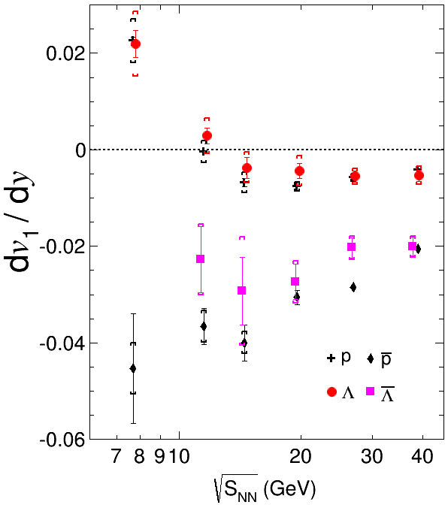

dv₁/dy vs. Beam Energy for 10-40% centrality
STAR preliminary
A linear fit over |y| ≤ 0.8 used to find dv₁/dy for all species & energies
Λ follows p within errors
Anti-p and anti-Λ have negative slope for all BES energies

Slide 13
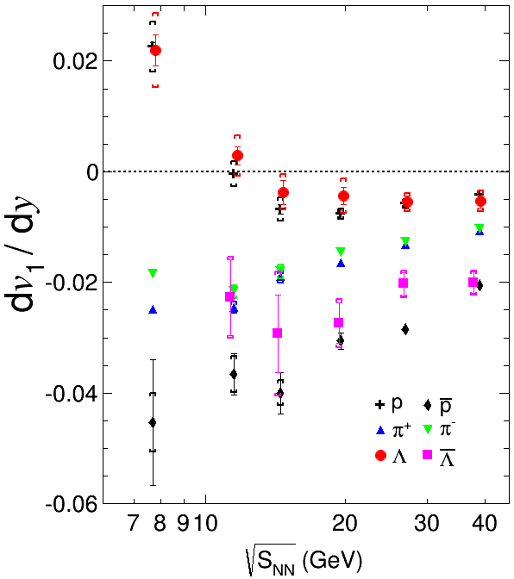
dv₁/dy vs. Beam Energy for 10-40% centrality
STAR preliminary
A linear fit over |y| ≤ 0.8 used to find dv₁/dy for all species & energies
Λ follows p within errors
Anti-p and anti-Λ have negative slope for all BES energies
Charged pions have negative slope for all BES energies

Slide 14
dv₁/dy vs. Beam Energy for 10-40% centrality
STAR preliminary
A linear fit over |y| ≤ 0.8 used to find dv₁/dy for all species & energies
Λ follows p within errors
Anti-p and anti-Λ have negative slope for all BES energies
Charged pions have negative slope for all BES energies
Measurements at 14.5 GeV for all particles follow smooth trend of earlier BES data

Slide 15
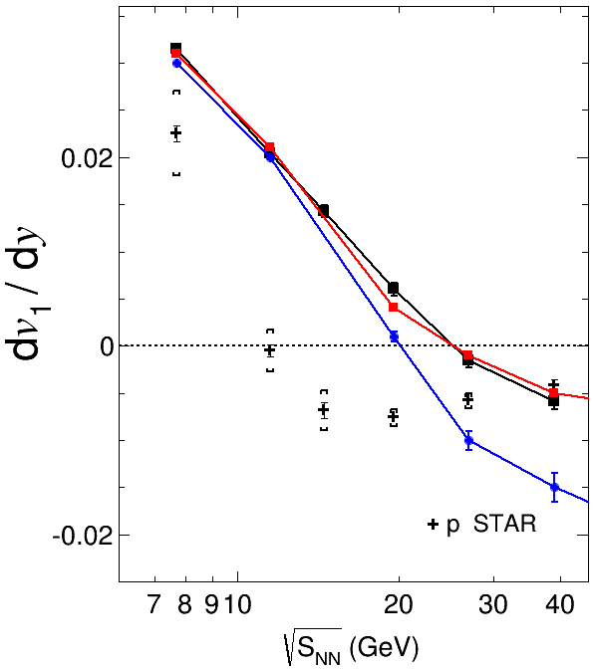
dv₁/dy vs. Beam Energy for 10-40% centrality
STAR preliminary
Hybrid Model for p is off-scale at the top, at all energies
PHSD (crossover PT) qualitatively similar to hadronic (HSD & UrQMD)
Model (with/without PT) shows
  No proton minimum
  Beam energy of sign change is too high
  Thus, conclusion about PT needs further model development
STAR preliminary
HSD
UrQMD
PHSD
PHSD/HSD: V. P. Konchakovski et al. Phys. Rev. C 90, 014903 (2014).
UrQMD (ver 3.3p2) events are generated with default settings.
S. A. Bass et al., Prog. Part. Nucl. Phys. 41, 255 (1998); M. Bleicher et al., J. Phys. G 25, 1859 (1999).

Slide 16
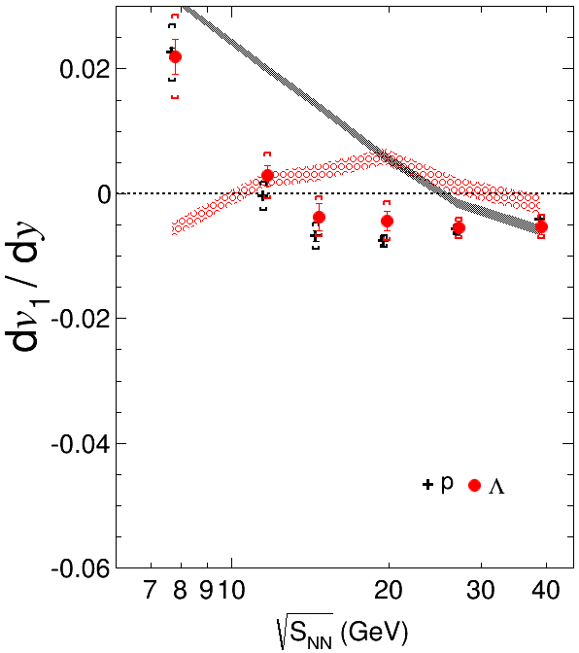
dv₁/dy vs. Beam Energy for 10-40% centrality
STAR preliminary
Hybrid Model for p is off-scale at the top, at all energies
PHSD (crossover PT) qualitatively similar to hadronic (HSD & UrQMD)
Model (with/without PT) shows
  No proton minimum
  Beam energy of sign change is too high
  Thus, conclusion about PT needs further model development
UrQMD p
UrQMD Λ
UrQMD p & Λ deviate strongly below 20 GeV, unlike data
UrQMD (ver 3.3p2) events are generated with default settings.
S. A. Bass et al., Prog. Part. Nucl. Phys. 41, 255 (1998); M. Bleicher et al., J. Phys. G 25, 1859 (1999).

Slide 17
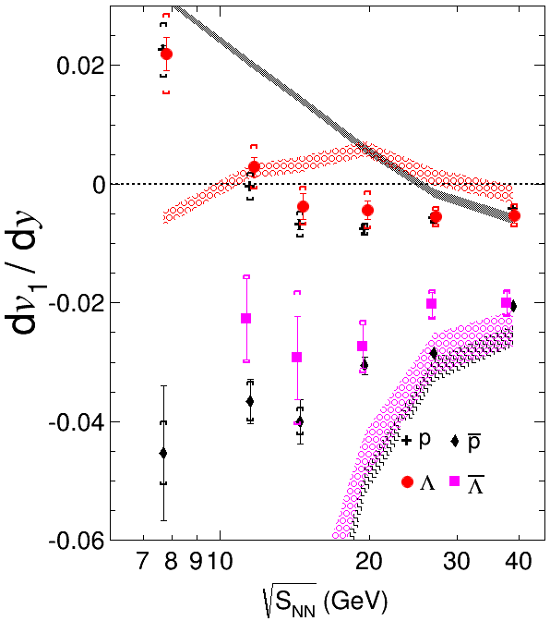
dv₁/dy vs. Beam Energy for 10-40% centrality
STAR preliminary
Hybrid Model for p is off-scale at the top, at all energies
PHSD (crossover PT) qualitatively similar to hadronic (HSD & UrQMD)
Model (with/without PT) shows
  No proton minimum
  Beam energy of sign change is too high
  Thus, conclusion about PT needs further model development
UrQMD p
UrQMD Λ
Anti-p
UrQMD p & Λ deviate strongly below 20 GeV, unlike data
Anti-Λ
UrQMD anti-p & anti-Λ have qualitatively similar trend at higher BES energies
UrQMD (ver 3.3p2) events are generated with default settings.
S. A. Bass et al., Prog. Part. Nucl. Phys. 41, 255 (1998); M. Bleicher et al., J. Phys. G 25, 1859 (1999).

Slide 18
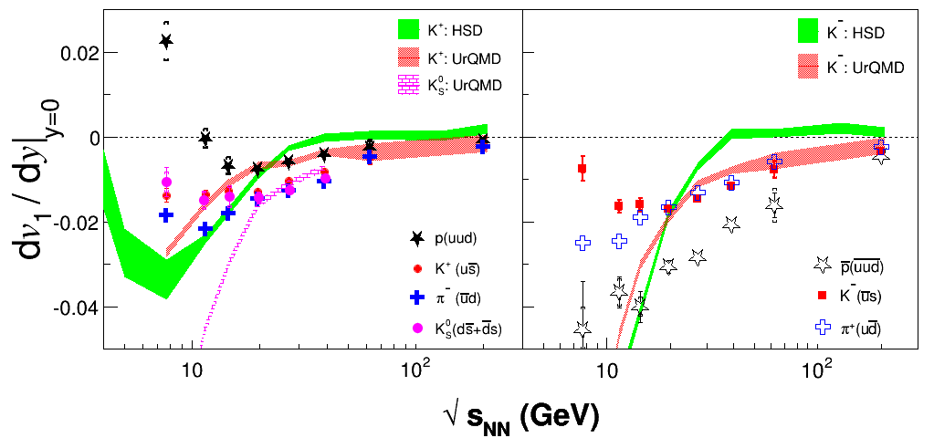
dv₁/dy vs. Beam Energy for 10-40% centrality
STAR preliminary
HSD: W. Cassing et al., arXiv:1408.4313
Particles in left panel (p, π⁻, K⁺) have more quarks from stopped initial nucleons than antiparticles in right panel
K⁰_{S} lies mid-way between K⁺ and K–

Slide 19
Net-kaon vs. net-proton
Assume final-state particles have two quark components, one from produced q-qbar pairs, another from stopped baryons
We try to disentangle the two contributions to the slope of directed flow, F, via net-p and net-K:
F_{p} = r₁ F_{anti-p} + (1 – r₁) F_{net-p}
F_{K+} = r₂ F_{K–} + (1 – r₂) F_{net-K}
where r₁(y) =observed anti-p over p
and r₂(y) =observed K – over K⁺
STAR preliminary
dv₁/dy|_{y=0} for net-K and net-p are consistent with each other down to ~14.5 GeV, and deviate at lower energies
dv₁/dy for net-K & net-p are consistent for √s_{NN} ≥ 14.5 GeV due to quark transport from beam rapidities
Cause of split between net-p & net-K dv₁/dy at low √s_{NN} is unclear

Slide 20
dv₁/dy vs. centrality for π±, p, Λ
p
Λ
π⁺
STAR preliminary
dv₁/dy for p, Λ strongly depends on centrality
Minimum in slope vs beam energy is statistically significant only for p at intermediate centrality
Different centralities may probe different regions of phase diagram --> important for BES-II

Slide 21
Summary
We present v₁(y) and midrapidity dv₁/dy at 7.7, 11.5, 14.5, 19.6, 27 and 39 GeV in Au+Au collisions for p, anti-p, Λ, anti-Λ, K±, K⁰, π±, at 9 centralities
dv₁/dy|_{y=0} for both p, Λ shows sign change and strongly depends on beam energy and collision centrality
There are distinct qualitative features in 10-40% centrality dv1/dy for baryons (sign change & minimum), antibaryons (always negative), mesons (negative & smaller magnitude)
Net-p & net-K is similar for √s_{NN} ≥ 14.5 GeV (reflects quark transport?). Below ~14.5 GeV, net-p dv₁/dy changes sign to positive while net-K stays negative
Models with and without phase transitions don’t reproduce notable qualitative features of data (especially p, Λ)

Slide 22
Backup

Slide 23
dv₁/dy vs. centrality for π±, p, Λ
STAR preliminary
UrQMD tends to follow qualitative trends in centrality for p and Λ

