Slide 1
Forward Calorimeter Prototype
Daniel Brown, for the STAR collaboration

Slide 2
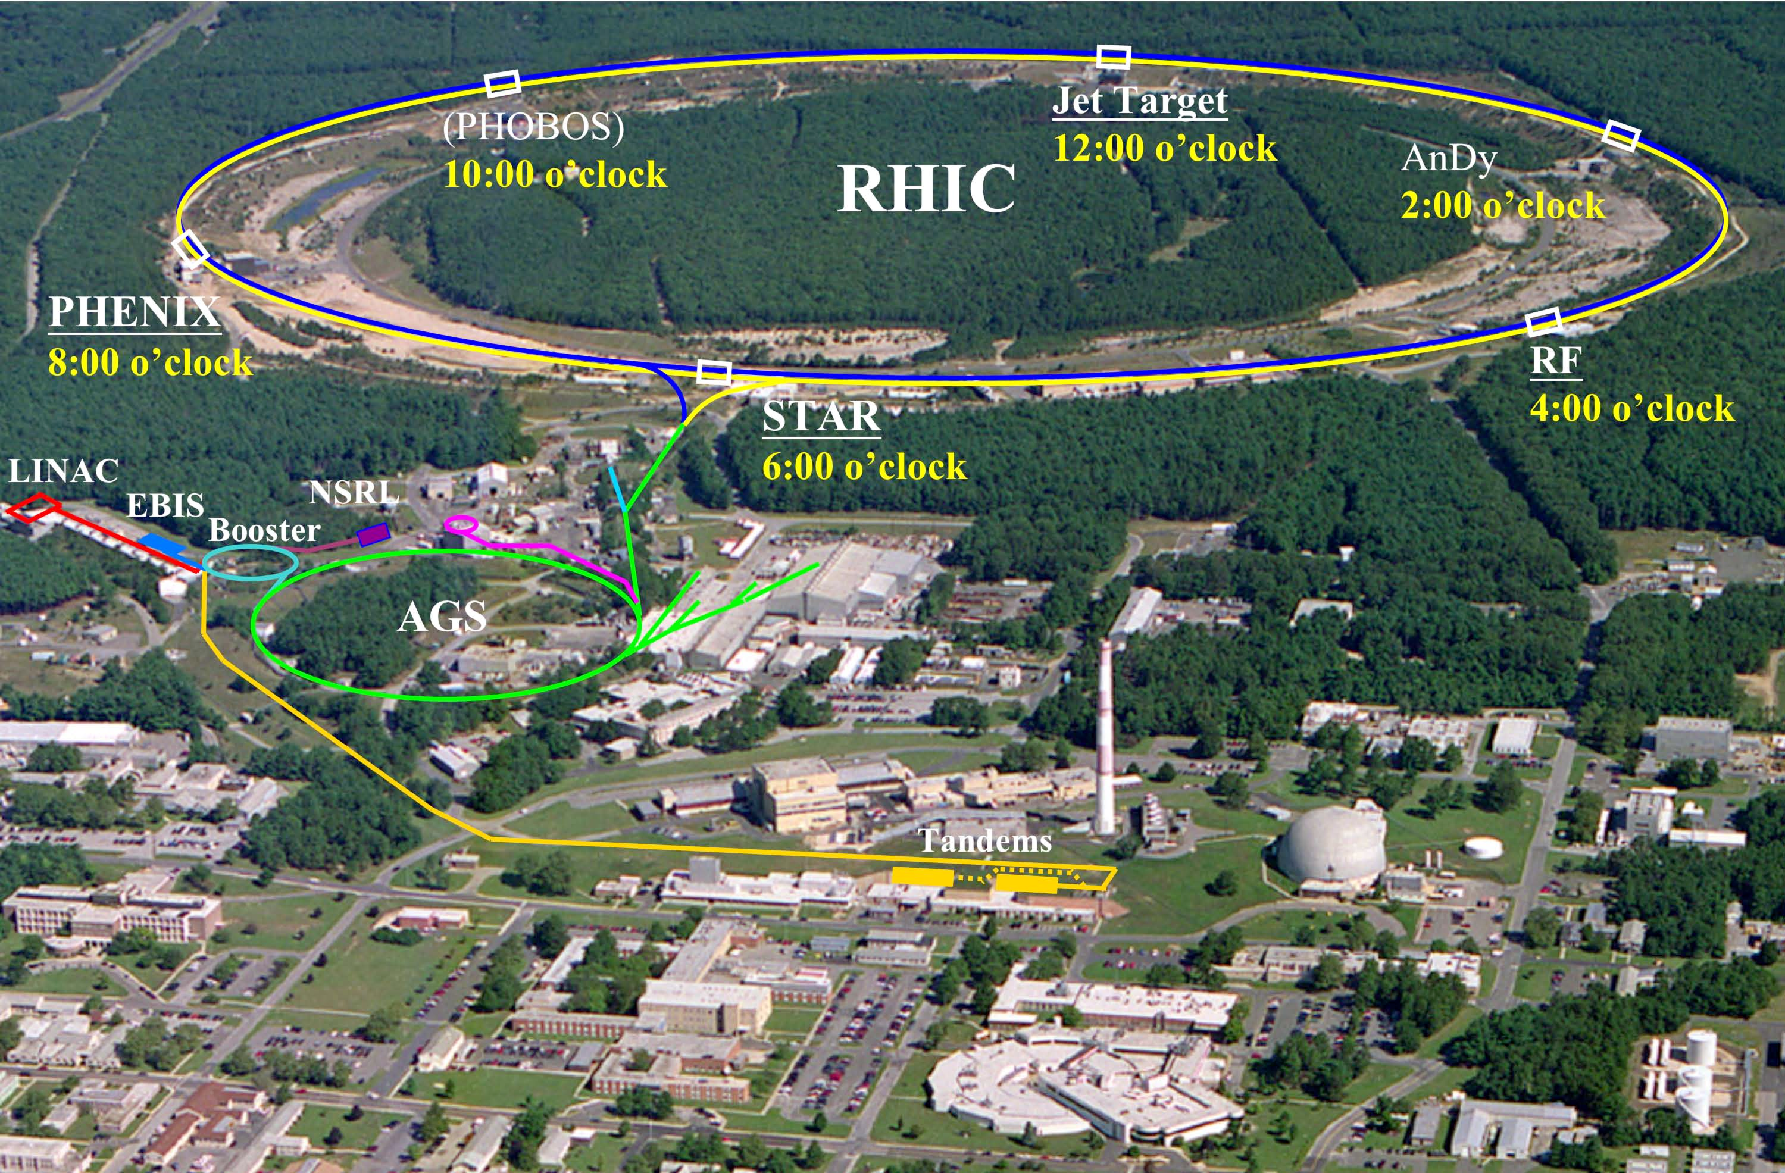
The Prototype
AGS-E864 Collaboration Lead Calorimeter from IP2
Installed for STAR Run16
Specifications
2x3 Lead Block Stack
10cmx10cmx117cm blocks
Spaghetti Calorimetry
Spatial Resolution – 54 pixels at 3.3cmx3.3cm
9 Fresnel Lenses + Silicon Photomultiplier (SiPM)
18 Fresnel Lenses + Photomultiplier Tube (PMT)
27 Acrylic Light Guides + Photomultiplier Tube
Nuclear Interaction Length – 7 Interaction Lengths
Hadronic Resolution – 34%/Sqrt[E]

Slide 3
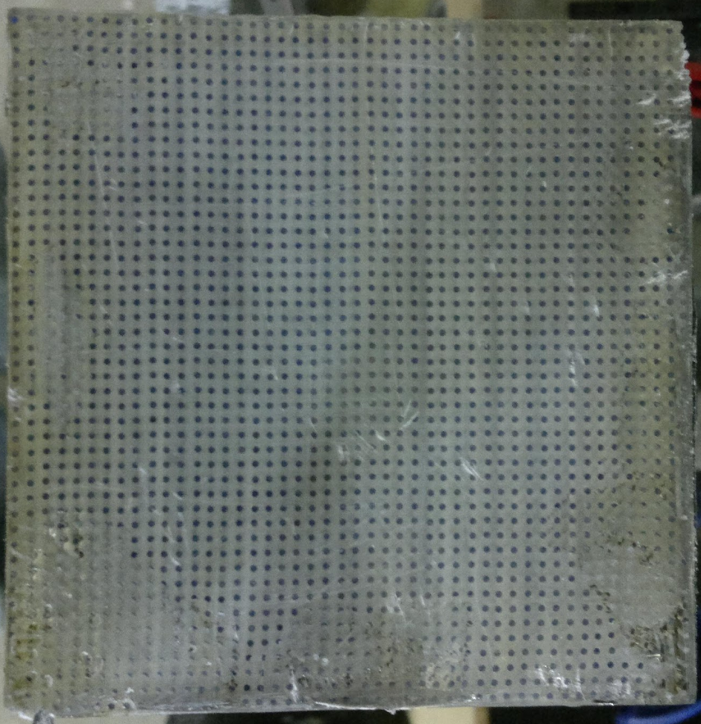
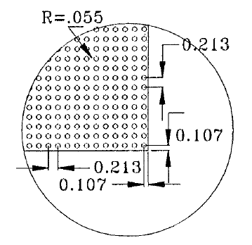
The Prototype
AGS-E864 Collaboration Lead Calorimeter from IP2
Installed for STAR Run16
Specifications
2x3 Lead Block Stack
10cmx10cmx117cm blocks
Spaghetti Calorimetry
Spatial Resolution – 54 pixels at 3.3cmx3.3cm
9 Fresnel Lenses + Silicon Photomultiplier (SiPM)
18 Fresnel Lenses + Photomultiplier Tube (PMT)
27 Acrylic Light Guides + Photomultiplier Tube
Nuclear Interaction Length – 7 Interaction Lengths
Hadronic Resolution – 34%/Sqrt[E]
117 cm
10 cm
10 cm

Slide 4
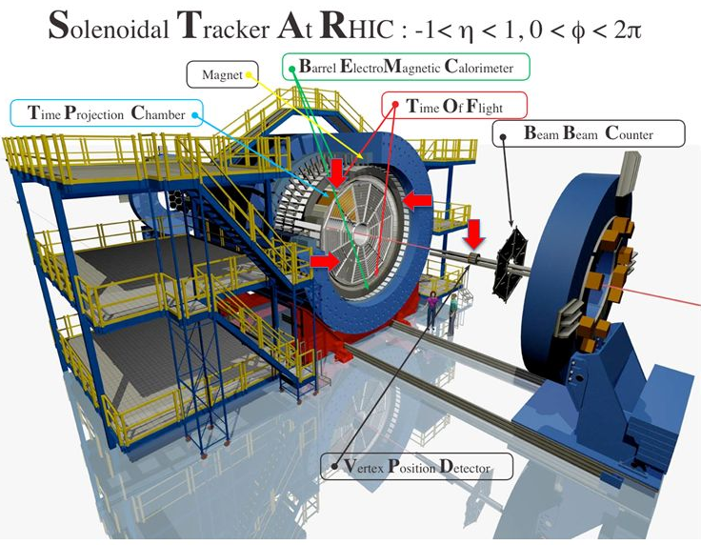
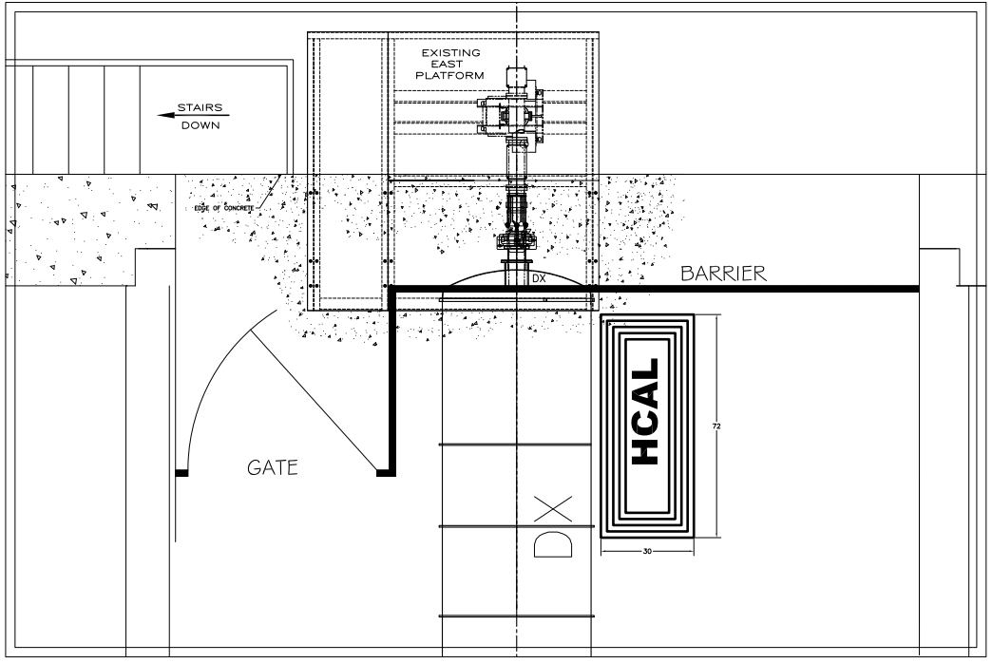
Prototype Detector Location
North side of the east tunnel
Less iron → lower fringe field effects
FCal

Slide 5
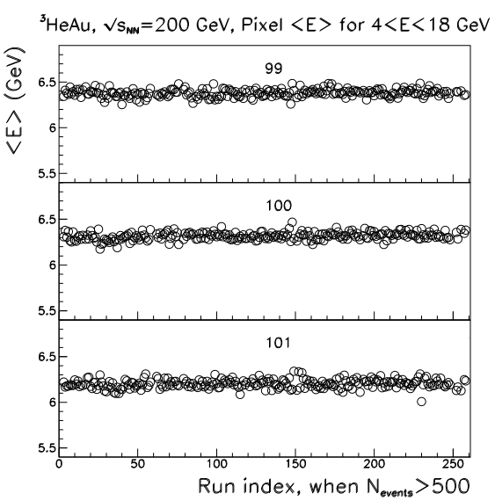
Prototype Goals
Reaffirming Run 14 Data
2014 Run Data Shown – Highly Stable
Retain Stability – “Set it and forget it”
Hardware Tests
Mu-Metal Shielding
Fresnel Light Guides
Silicon Photomultipliers
Neutral Pion Finding
Calibration
Average energy deposition per run,
for entire 200 GeV 3He+Au operation
as a function of run number, for three
selected pixels which are close to beam pipe.

Slide 6
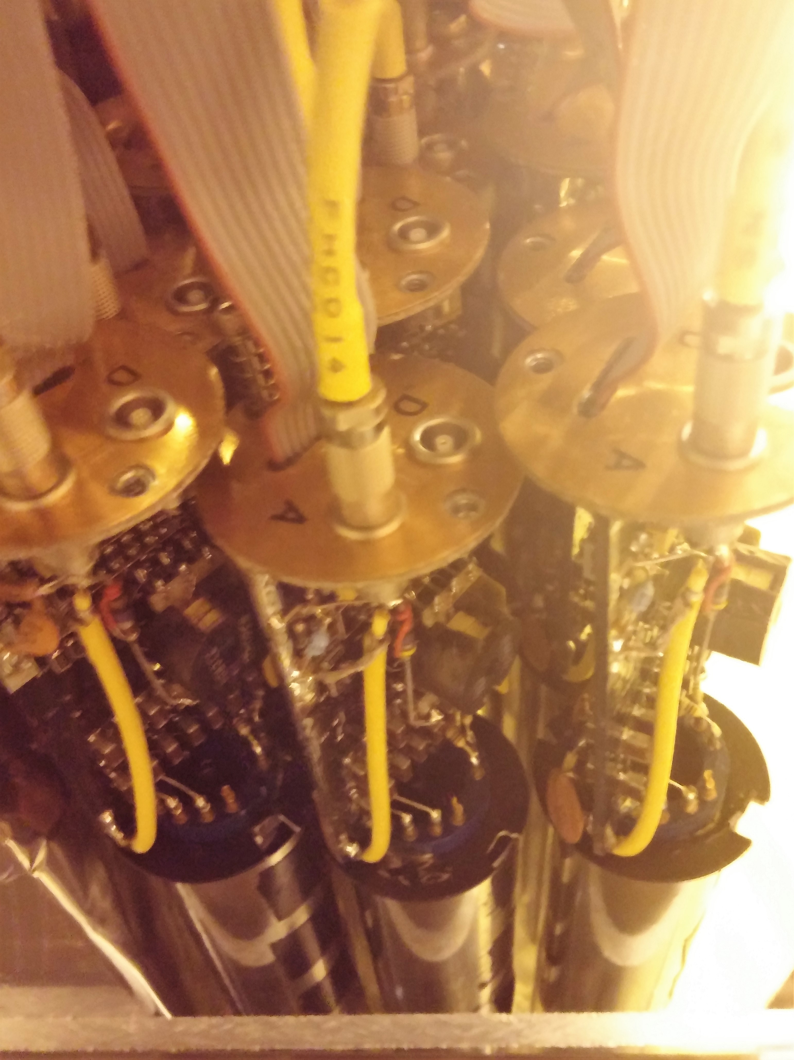
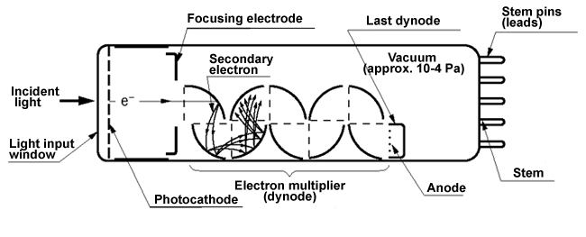
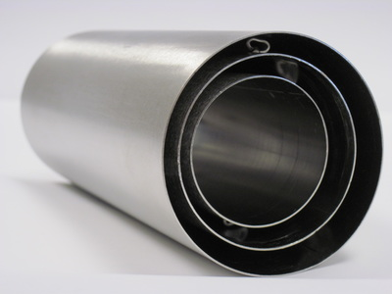
Mu-Metal Shielding
Magnetic field effects on photomultiplier tubes (PMTs)
Magnetic field alters cascade in PMTs
Magnetic field shielding
Known passive shielding
Amount required
Interaction with optical system
Notes:
http://www.mu-metal.com/uploads/5/4/5/0/54501895/7134668.jpg
https://www.hamamatsu.com/us/en/technology/innovation/photocathode/index.html

Slide 7
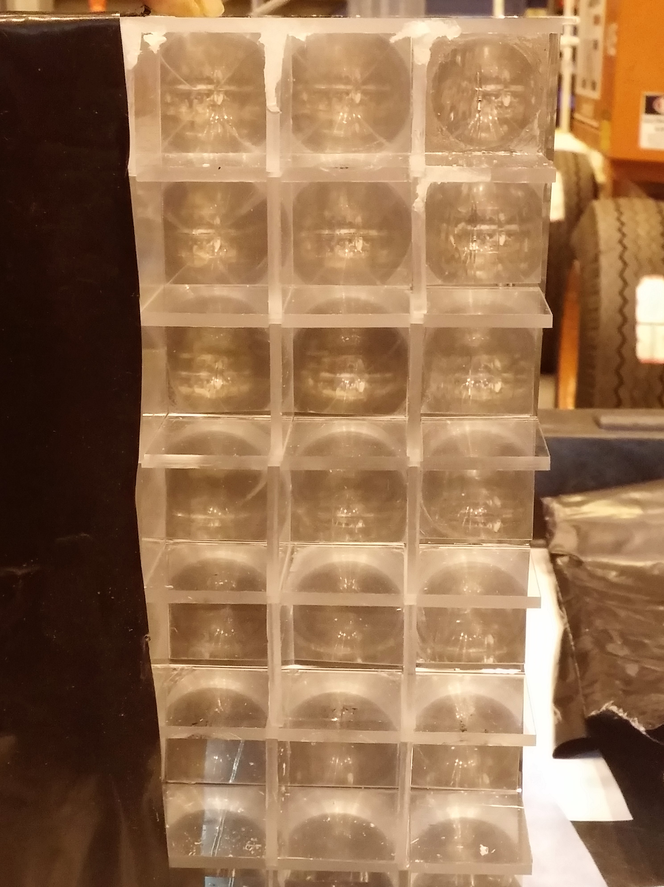
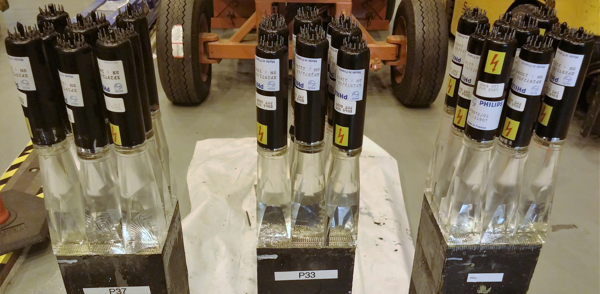
Fresnel Lens Light Guides
Alternative to acrylic light guide
Replaceable parts
Commercial item
Can be machined to fit
Can be installed after stacking
Notes:
Fresnel Images: http://hyperphysics.phy-astr.gsu.edu/hbase/geoopt/imggo/fresnel.gif
http://www.pnta.com/lighting/lenses/6-fresnel-lens/

Slide 8
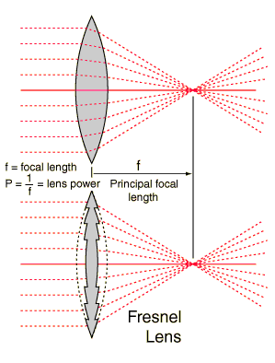
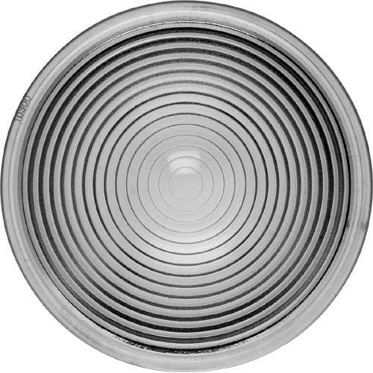
Fresnel Lens Light Guides
Alternative to acrylic light guide
Replaceable parts
Commercial item
Can be machined to fit
Can be installed after stacking
Notes:
Fresnel Images: http://hyperphysics.phy-astr.gsu.edu/hbase/geoopt/imggo/fresnel.gif
http://www.pnta.com/lighting/lenses/6-fresnel-lens/

Slide 9
Fresnel Lens Light Guides
Alternative to acrylic light guide
Replaceable parts
Commercial item
Can be machined to fit
Can be installed after stacking
Notes:
Fresnel Images: http://hyperphysics.phy-astr.gsu.edu/hbase/geoopt/imggo/fresnel.gif
http://www.pnta.com/lighting/lenses/6-fresnel-lens/

Slide 10
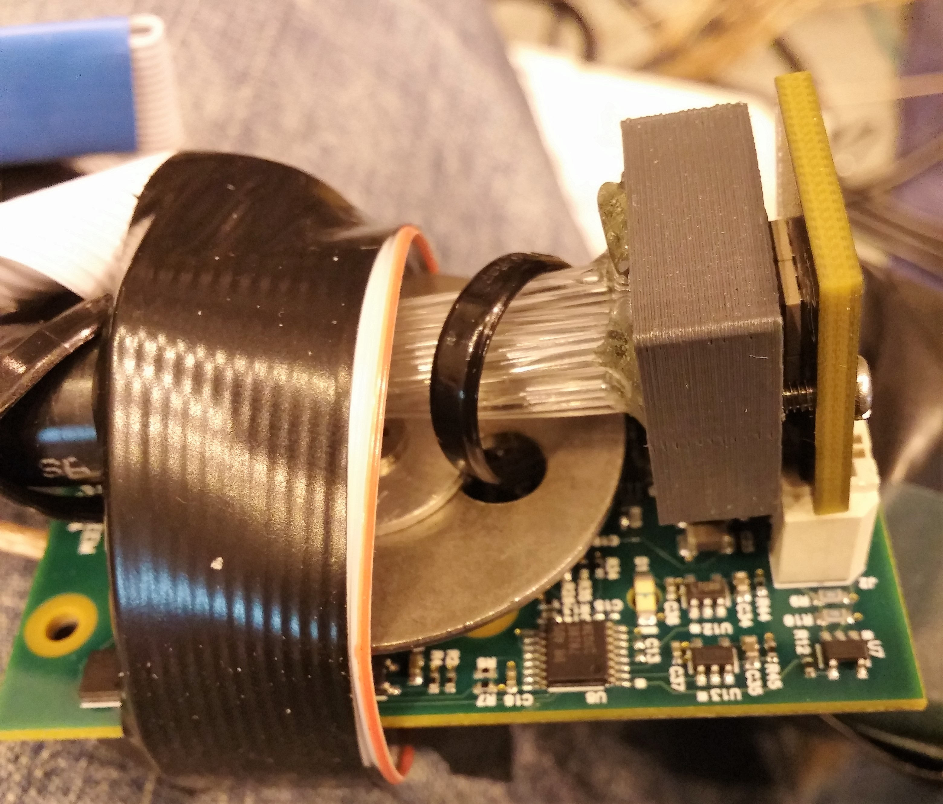
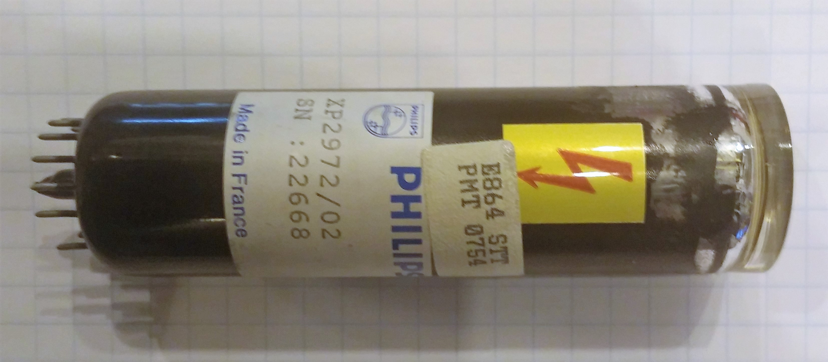
Silicon Photomultipliers (SiPMs)
Compared to photomultiplier tubes
Magnetic field effects
Lower cost
Smaller
Stability over time
Radiation resistance

Slide 11
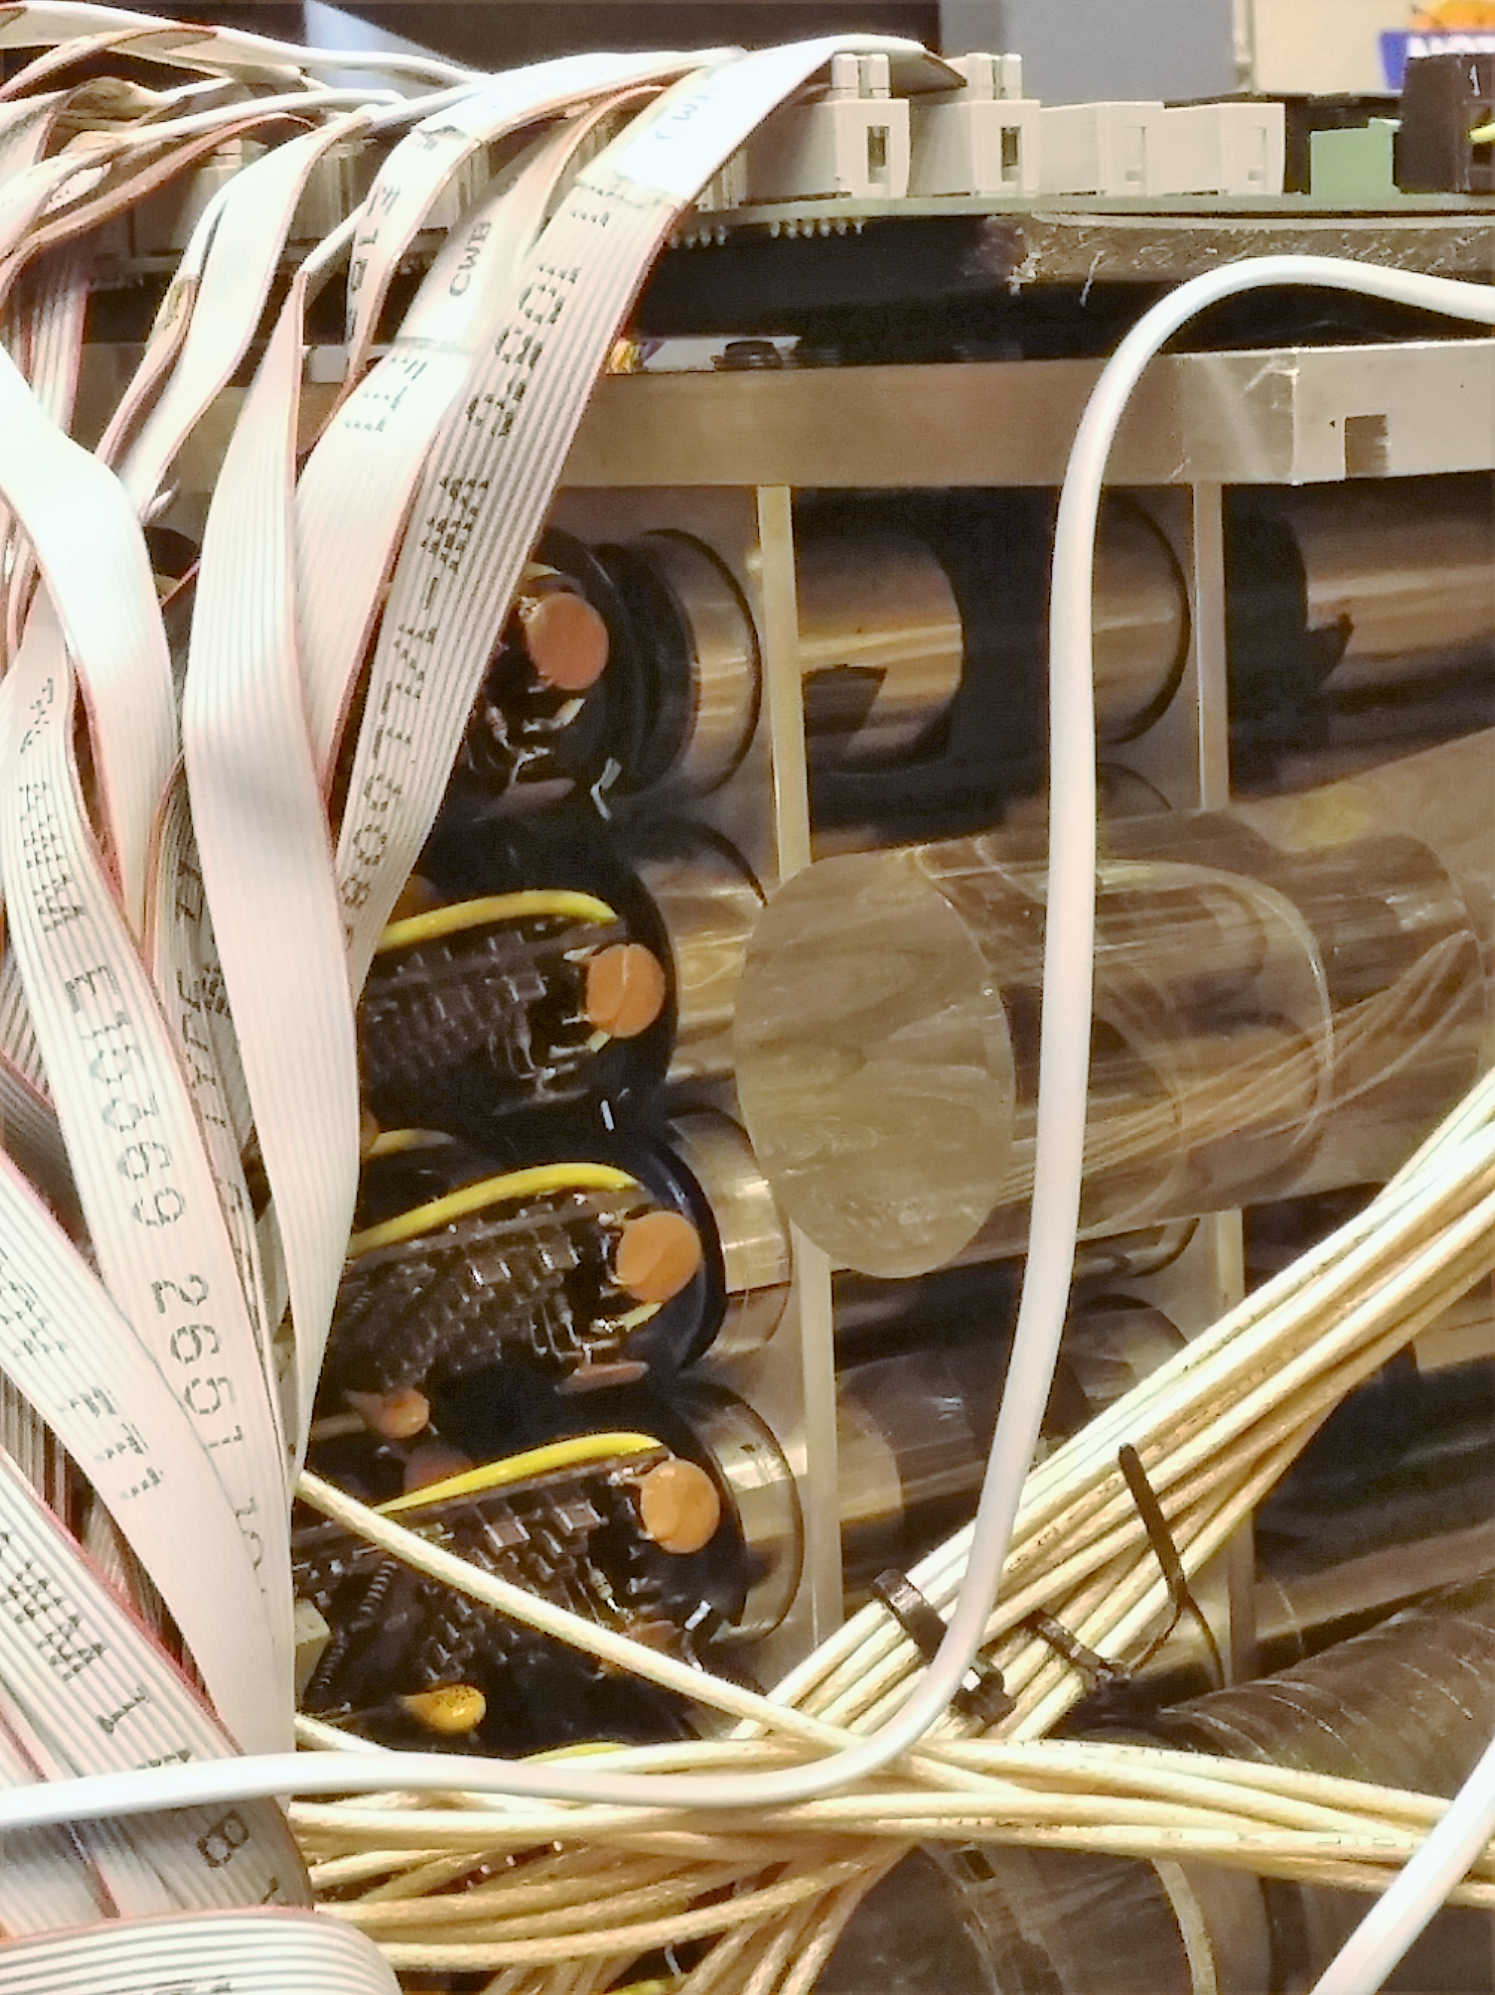
Results
Mu-Metal Shielding
Acrylic light guides limit length
Fits into Fresnel lens system
8 degree tilt reduces field effects
Optimal minimal recess of 5.8cm
Reduces magnetic field effects to <5%
Fresnel Lens Light Guides
Greater light levels than acrylic light guides
More secure photomultiplier tubes
Allows for proper recession distance

Slide 12
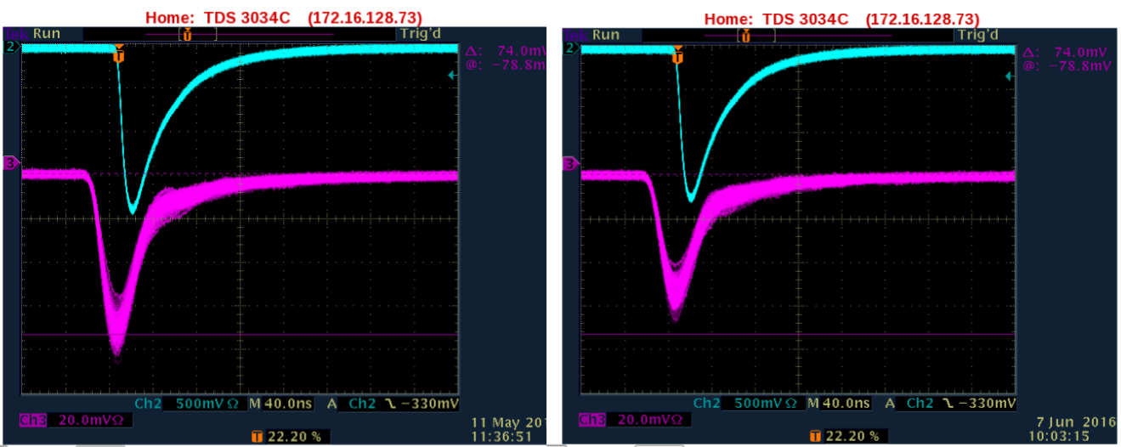
Results
Silicon Photomultipliers Testing over 28 days
Changes due to radiation – Not stable Blue: PMT
Not suitable for this application due to placement Magenta: SiPM

Slide 13
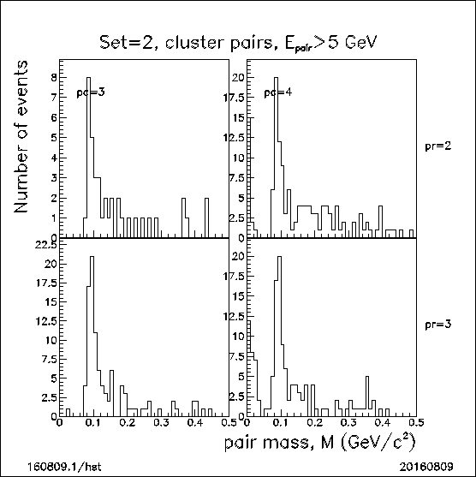
Results
Neutral pion finding STAR Trigger used
Early results Au+Au Collisions used
Used for calibration No Centrality explicitly selected
π⁰ → γ + γ 12% of available data used
Further calibration needed 4 Cells of Run16 data
Pixelization

Slide 14
Conclusions
Mu-Metal
Provides adequate shielding
Gain shifts reduced to <5%
Allows use of PMTs close to the beam pipe
Fresnel Lens Light Guides
Increase light levels
Allows easy installation of components
Allows easy replacement of components
More secure PMTs
Silicon Photomultipliers
Gain changes over time
Not suitable
Neutral Pion Finding
Reconstruction possible
Used for calibration
Further calibration needed
Results
Results were positive
Investigation of installation possibilities underway

Slide 15
SiPM Test Procedure
“A blue LED is pulsed continuously at ~100 Hz. Both an xp2262 and a 36x1-mm diameter fiber bundle view the pulsed LED. The phototube is ch=2 and the SiPM array is ch=3 on the escope. A script acquires e-scope images every ~20min [I do not recall the precise "sleep" time in the script], and stamps the acquired file with UNIX time. A separate script records your readable I2C values from your SiPM FEE every ~20min, and stamps a log file with UNIX time. From that we get leakage current.”

Slide 16
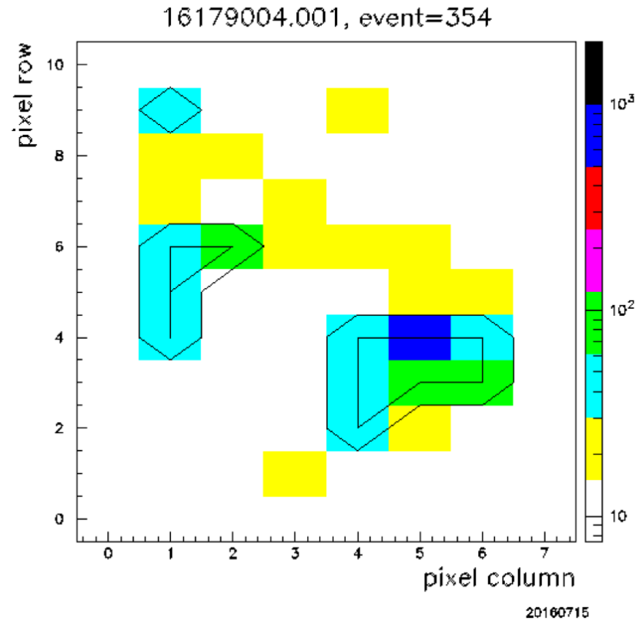
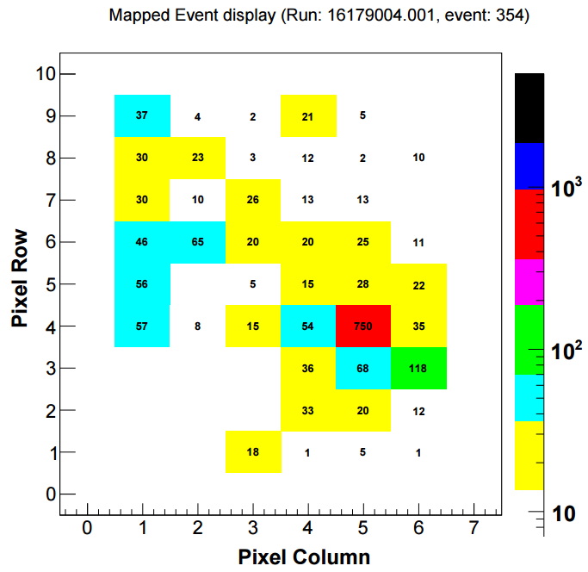
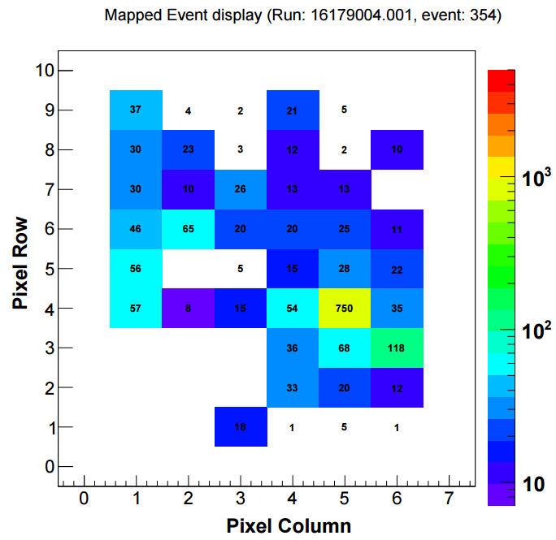
Code Conversion and Data Analysis
Finishing converting code to C++ / ROOT
Open analysis to everyone
2016 Prototype data analysis
Side by side comparisons
Reaffirm 2014 data

Slide 17
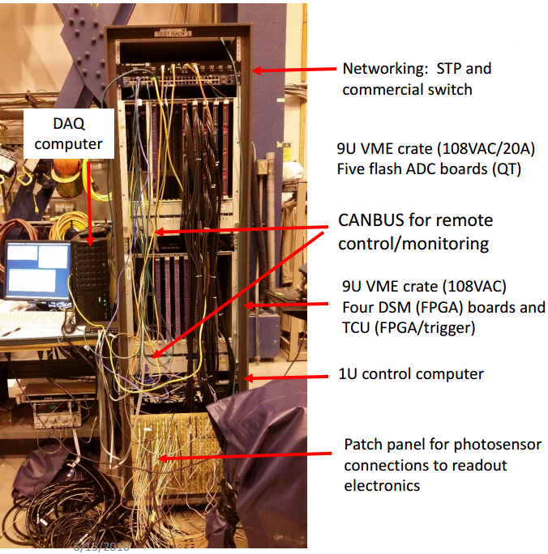
Data Acquisition
Electronics designed/built by Berkeley group
[H. Crawford, et al.] for STAR digital trigger
DAQ written for IP2 effort by C. Perkins
DAQ/digital trigger system previously used at IP2
In 2011-13. Last used at FermiLab for T1064
All items powered from 108VAC
Installed in Wide Angle Hall east side
All components remotely controlled via
CANBUS (VME) or network-power switch

