Slide 1
Transverse Single-Spin Asymmetries for Jet-like events at Forward Rapidities in p+p Collisions at √s = 500 GeV with the STAR Experiment
Mriganka Mouli Mondal (for STAR Collaboration)
Texas A&M University
Outline :
Forward Meson Spectrometer in the STAR experiment
Transverse Single Spin Asymmetries (TSSA)
EM-Jets measured from FMS photons
A_{N} measurements from run-11 at √s = 500 GeV

Slide 2
RHIC : the world’s first polarized proton collider
Beams: √s 200 - 500 GeV pp; 50-60% polarization for year 2011
Hydrogen Jet Polarimeter
Carbon Polarimeters
Siberian Snakes
PHENIX
Spin Flipper
STAR
Spin Rotators
Siberian Snakes
Tune Jump Quads
Polarized Source
Helical Partial Snake
LINAC
AGS
200 MeV Polarimeter
BOOSTER
Strong Snake
AGS Internal Polarimeter
RF Dipole
AGS pC Polarimeter

Slide 3
Forward ECALs in STAR
FMS
Forward Meson Spectrometer (FMS) :
-- Pb glass EM calorimeter covering 2.5< η <4.0
-- Detect 𝜋⁰,η, direct photons and jet-like events in the kinematic region where asymmetries are known to be large.
Notes:
Caution: The pi in “pi^0” is in some font that isn’t on my PC. You might want to change it to a more common one.

Slide 4
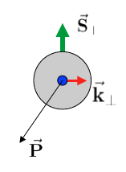
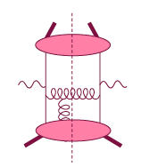
TSSA - 2 theoretical frameworks
Spin-dependent transverse momentum
dependent (TMD) function S_{T}.(Pxk_{T})
Brodsky, Hwang, Schmidt, 02
Collins, 02, Ji, Belitsky, Yuan, 02
Twist-3 quark-gluon correlations
Efremov & Teryaev: 1982 & 1984
Qiu & Sterman: 1991 & 1999
Intermediate Q_{T}
Q>>Q_{T}/p_{T}>>Λ_{QCD}
Transverse
momentum
dependent
Q>>Q_{T}>=Λ_{QCD}
Q>>p_{T}
Collinear/
twist-3
Q,Q_{T}>>Λ_{QCD}
p_{T}~Q
Efremov, Teryaev;
Qiu, Sterman
Sivers fct.
Q_{T}/P_{T}
Λ_{QCD}
<<
Q_{T}/P_{T}
<<
Q
Need only 1 scale
Q² or p_{t}
But
should be of reasonable size
should be applicable to
most pp observables
A_{N}(π⁰/γ/jet)
Need 2 scales
Q² and p_{t}
Remember pp:
most observables one scale
Exception:
DY, W/Z-production
Notes:
For a 10-minute talk, you might choose to show the entire slide at once, rather than animating in the middle stuff.

Slide 5
π⁰ A_{N} Measurements at Forward Rapidity
Inclusive π0 production
Transverse Single Spin Asymmetry
x_{F} = 2p_{Z}/√s
Rising A_{N} with X_{F}
A_{N} nearly independent of √s
No evidence of fall in A_{N} with increasing P_{T}
CIPANP 2012,
Steve Heppelmann

Slide 6
Run-2011 data
p+p √s = 500 GeV transverse datasets
Jet algorithm : anti-kt
R-parameter : 0.7
p_{T}^{EM-Jet} > 2.0 GeV/c
FMS photons with p_{T} > 0.001 GeV fed into anti-kt
Leading EM-Jets : Multi-photon Jets with highest
energy
EM-Jets used to find asymmetry within
2.8<η^{EM-Jet}<4.0
40 GeV < Energy^{EM-Jet} < 100 GeV
# Jets
Structure in EM-Jet p_{T} :
-- Acceptance non uniformity in small and large tower boundary
-- Different trigger threshold influence different p_{T} region
Notes:
Moved the subscript “T” in p_T earlier. Inserted spaces in “1 GeV” and “40 GeV”; also added GeV to “100 GeV”

Slide 7
EM-Jet characteristics
EM-Jet Energy 60-80 GeV
# Jets
dE/d(ΔR) (arbitrary scale)
No. of photons in leading EM-Jets
EM-Jet Energy 60-80 GeV
Z _{ϒϒ}<0.8, no. photons =2
# Jets
dE/d(ΔR) distribution of EM-Jets
2-photon jets are mostly π⁰
Events with more than 2 photons show jet-like
energy flow
ϒϒ invariant mass 2-photon EM-jets

Slide 8
A_{N} from fits
A_{N} is calculated from p0 + p1 cos(ϕ) fits over each fill
p0 = relative luminosity, p1 = asymmetry
A_{N}’s are corrected for polarization values from fill to fill
Weighted A_{N} and χ²/NDF are calculated over entire fills
EM-Jet Energy = 55-57.5 GeV
For 2-photon isolated π⁰
Individual point and χ²/NDF from
averages over ~18 fills

Slide 9
A_{N} vs. EM-Jet Energy
π⁰-Jets –
2γ-EM-Jets with
m_{γγ} <0.3
Z_{γγ} <0.8
EM-Jets –
with no. photons >2
Isolated π⁰’s have large asymmetries consistent with previous observation (CIPANP-2012 Steven Heppelmann)
https://indico.triumf.ca/contributionDisplay.pycontribId=349&sessionId=44&confId=1383
Asymmetries for jettier events are much smaller
Notes:
Deleted “form” (which was supposed to be “from”); changed spacing a bit in the pi^0-Jets text box

Slide 10
A_{N} vs. EM-Jet Energy
π⁰-Jets –
2γ-EM-Jets with
m_{γγ} <0.3
Z_{γγ} <0.8
2ϒ-EM-Jets (η + continuum) –
with m_{γγ} > 0.3
EM-Jets –
with no. photons >2
Isolated π⁰’s have large asymmetries consistent with previous observation (CIPANP-2012 Steven Heppelmann)
https://indico.triumf.ca/contributionDisplay.pycontribId=349&sessionId=44&confId=1383
Asymmetries for jettier events are much smaller
Notes:
Same edits as previous page. Can you change the order of the symbols in the legend so the pi^0s are first and EM-Jets follow, as was the case in the previous slide?

Slide 11
A_{N} for different # photons in EM-Jets
1-photon events, which include a large π⁰ contribution in this analysis, are similar to 2-photon events
Three-photon jet-like events have a clear non-zero asymmetry, but substantially smaller than that for isolated π⁰’s
A_{N} decreases as the event complexity increases (i.e., the "jettiness”)
A_{N} for #photons >5 is similar to that #photons = 5
Notes:
Resized the text box a bit; the left side was covered by the figure on my PC

Slide 12
Summary
EM-Jets are reconstructed from photons detected in the FMS at STAR.
Jets with isolated π⁰ have large asymmetry as seen before.
Three-photon jet-like events have a clear non-zero asymmetry, but substantially smaller than that for isolated π⁰’s.
A_{N} decreases as the event complexity increases(i.e., the "jettiness”).

Slide 13
Backup slides

Slide 15
PRD 86-051101

Slide 16
PYTHIA simulations
Systematics arising from intermixing of event classes

Slide 17
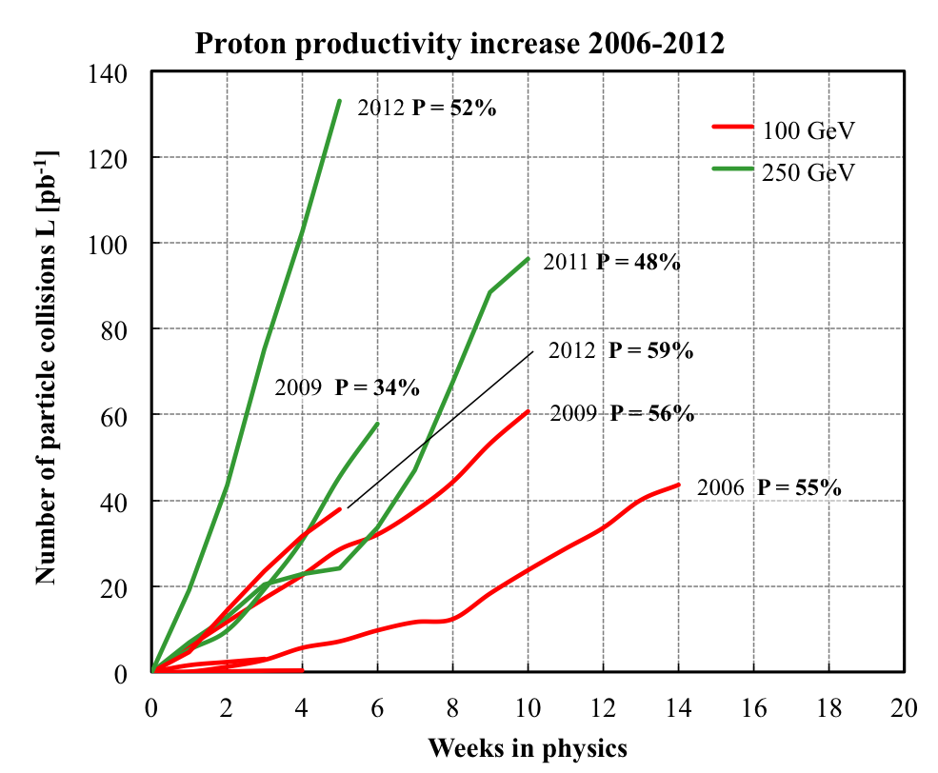
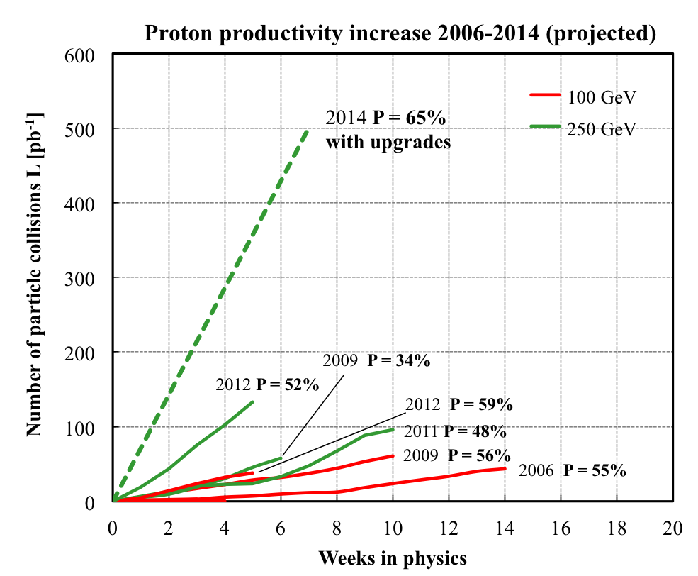
>=
L_{avg}: +15%
P_{avg}: +8%
2013 P~55%

