Slide 1
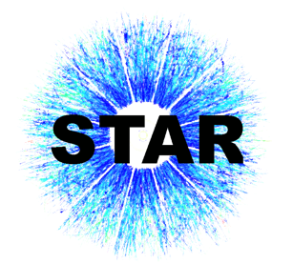
Charmed Meson Reconstruction using Silicon Trackers in STAR Experiment at RHIC
Motivation
STAR Detector
Microvertexing
Results
Summary and Future
Jaiby Joseph for the STAR Collaboration
Kent State University

Slide 2
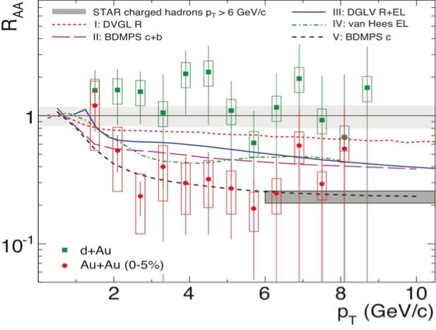
Why Charm Mesons?
Heavy quarks are produced during the early stages of collision mainly through gluon fusion.
They are unaffected by chiral symmetry restoration
Their production cross-section scales with binary collisions
Heavy quarks are ideal to probe the medium created in HI collisions.
STAR Phys. Rev. Lett. 98 (2007) 192301, nucl-ex/0607012v3
Their measurement through semi-leptonic decay channel shows suppression levels comparable to light quarks at p_{T} ≥ 6 GeV[1]
R_{AA}(n.p.e.) ~ R_{AA}(h±)!
This contradicts theoretical predictions
Dead-cone effect[2]
A measurement of charm elliptic flow, v₂ can tell us if thermalization is reached during early stages of collision.
Need to understand the mechanism of parton energy loss and Thermalization
[1] B. I. Abelev et al (STAR Collaboration), Phys.Rev.Lett.98:192301,2007; Erratum-ibid.106:159902,2011
Adare A et al. (PHENIX Collaboration) 2010 arXiv:1005.1627
[2] Dokshitzer, Yuri L. and Kharzeev, D. E., Phys. Lett. B519

Slide 3
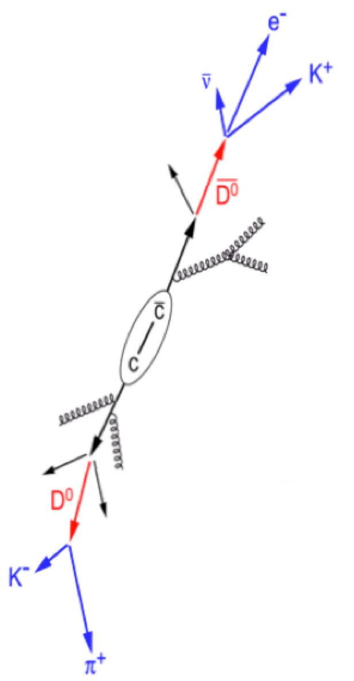
Measurement through Indirect & Direct Methods
Indirect measurement through Semi-leptonic decay channels:
D⁰ → e⁺ + X (BR : 6.9 %)
D^{+/-}→ e^{+/-} + X (BR : 17.2%)
Direct measurement through
Hadronic decay channels
D⁰( ) → K⁻π⁺(K⁺π⁻) (BR : 3.8 %)
D^{+/-} → Kππ (BR : 9.2%)
✔ Large p_{T} range.
✔ Relative contribution of electrons from B and D mesons are unknown.
✔ C and B contributions separated.
Limited to low momentum range.
Challenging for charm mesons due to small decay length
Measurement using azimuthal correlation of D
mesons with e⁻
Azimuthal correlation of open
charm mesons with non-photonic
Electron can be utilized to disentangle
the charm and bottom contributions[3]
✔ Triggers on high p_{T} electrons
[3] Phys. Le.. B671(2008) 361, Phys. Rev. Le.. 105 (2010) 202301

Slide 4
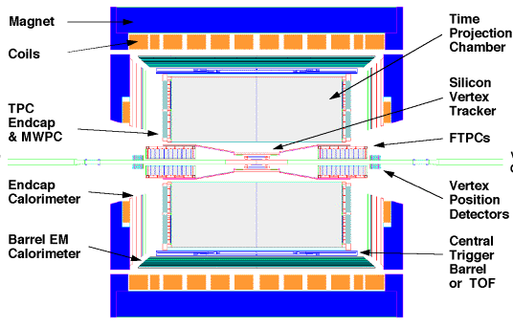
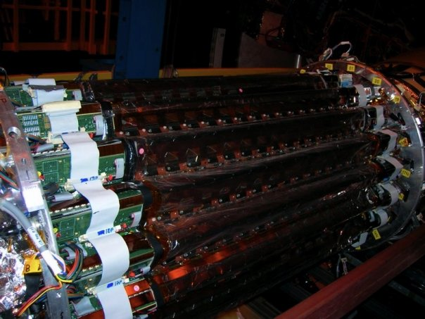
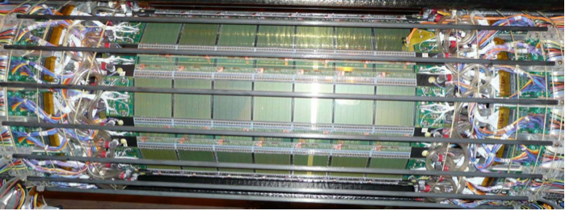
STAR detector (in 2007)
SSD
TPC
SVT
The tracking system consisted of :
TPC : provides momentum, particle identification
Silicon detectors :
1 layer of silicon strip detectors (SSD) and 3 layers of silicon drift detectors (SVT).
high spatial resolution : pointing resolution of 250µm in transverse direction (at 1GeV) was achieved[*] (next slide).
was not designed (thickness, geometry) for charm measurement.
[*] Fisyak Y V et al. 2008 J. Phys. Conf. Ser. 119 032017
Notes:
4

Slide 5
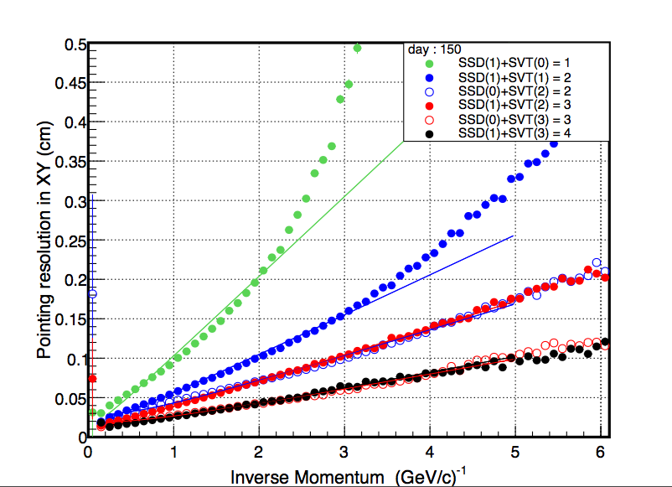
Distance of Closest Approach resolution
run 7 Au+Au@200GeV (MinBias trigger).
DCA resolution as a function of inverse momentum.
Reflect the resolution and Multiple Coulomb Scattering.
STAR preliminary
Including the silicon detectors in the tracking improves the pointing resolution.
with 4 silicon hits, the pointing resolution to the interaction point ~ 250 μm at P = 1GeV/c.

Slide 6
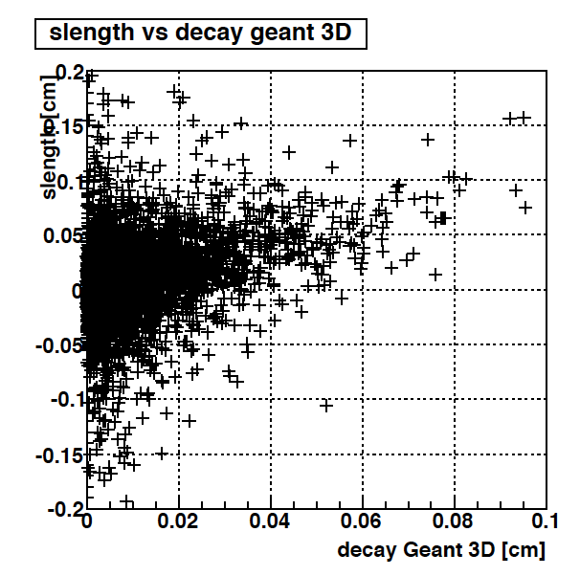
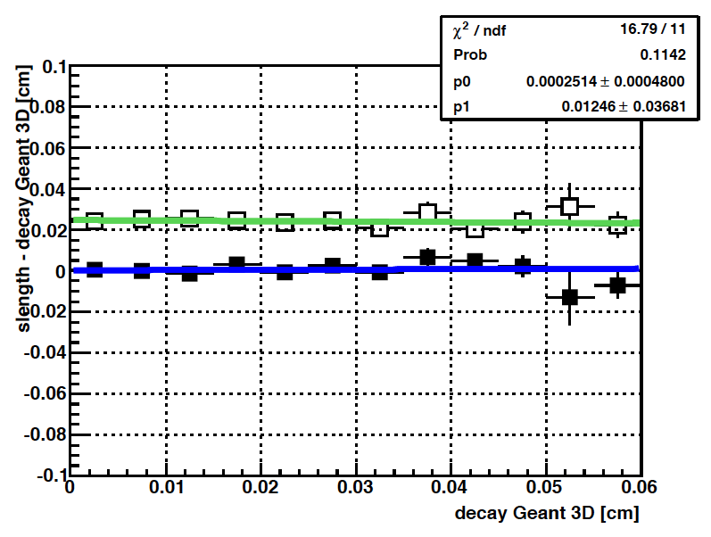
Microvertexing using STAR Silicon Detectors
We tried a full topological reconstruction of the charm decay. The method uses a constrained fit for decay vertex reconstruction[*]
The code uses full track/error information.
Reco vs. MC [cm]
Reco - MC [cm]
Mean of the difference reconstructed -MC
Rms of the difference reconstructed -MC
There is no systematic shift in reconstructed quantities.
The standard deviation of the distribution is flat at ~ 250 μm , which is of the order of the resolution of (SSD+SVT).
[*] Decay Chain Fitting with a Kalman Filter,W. D. Hulsbergen (arxiv:physics,0503191)

Slide 7
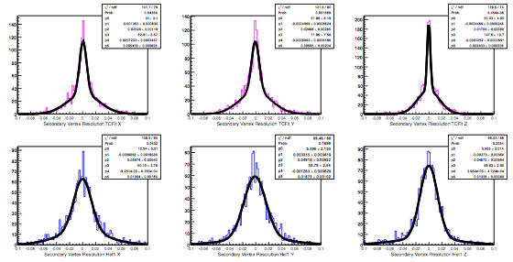
Secondary Vertex Resolution Plots (x,y,z)
X
Y
Z
entries
entries
Fit Method
(central region)
σ_{XY} ~ 55μm
σ_{Z} ~ 25μm
entries
(cm)
(cm)
(cm)
Helix Swimming Method
(central region)
σ_{XY} ~ 150μm
σ_{Z} ~ 135μm
entries
entries
entries
(cm)
(cm)
(cm)
Simulation results shows that a factor of two was gained in secondary vertex Resolution
J. Vanfossen

Slide 8
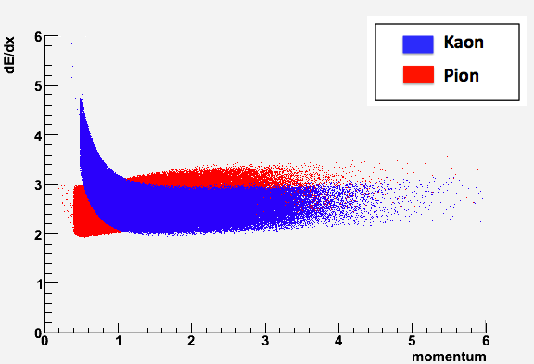
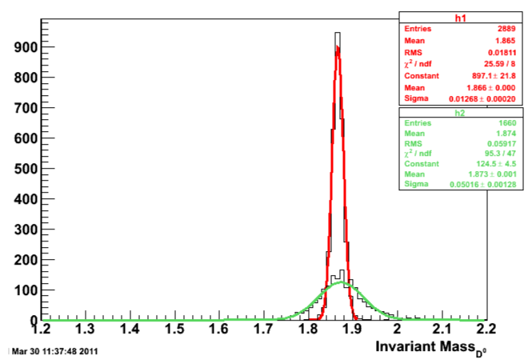
D⁰/D⁰bar Cross-feed (Monte Carlo using power law p_{T} D⁰)
■ The D⁰ candidates are built by combining a K⁻ and π⁺ track (D⁰ K⁻pi⁺)
■ Because of the overlapping dE/dx bands of Kaon and Pion tracks, at intermediate momenta
a K⁻ can be indentified as π⁻
a π⁺ can be identified as a K⁺
➔ Therefore, K⁻π⁺ K⁺π⁻ and can contribute to the the D⁰bar mass window and a pseudo-enhancement.
K⁻π⁺
K⁺π⁻
■ The X-feed is reduced
with a tighter cut on |nσ| (better PID)
with increase in p_{T}
■ X-feed has a strong dependence on the Kaon opening angle, Cos(θ*)
The estimated overall X-feed (Ratio of reconstructed pairs with wrong signs to all pairs) ~ 35%

Slide 9
Data Production
Initial analysis of the Au-Au dataset (34 Million Events) is complete. Although the cuts used were not optimized, we got preliminary results from this production (next slides). A new production of run-7 data using the microvertexing code was just completed. Analysis is in progress.
Highlights of this new production/analysis set-up:
We calculate the flow parameter, v₂
All charge combinations (D⁰, D⁰bar, ++,--) are included for study of systematics
Optimized cuts
New Cuts
Event Level: Primary vertex position along the beam axis : |zvertex| < 10 cm
Resolution of the primary vertex position along the beam axis:|σ_{zvertex}|< 200µm
Track: Ratio TPC hits Fitted/Possible > 0.51
Pseudo-rapidity :|η|<1.2
dEdxTrackLength>40 cm
Silicon Hits: SiHit > 1, radius of 1st Hit < 9cm if SiHit = 2
else, radius of 1st Hit < 13cm
DCA to Primary vertex (transverse),DCA_{xy}< .2 cm
Track momenta: p_{K}+p_{π} > 1.5GeV
Particle ID: |nσ_{K}|<2.5, |nσ_{π}|<2.5
D⁰ candidate: |y(D⁰)| <1
DECAY FIT level: Probability of fit >0.05 && |sLength|<.2cm

Slide 10
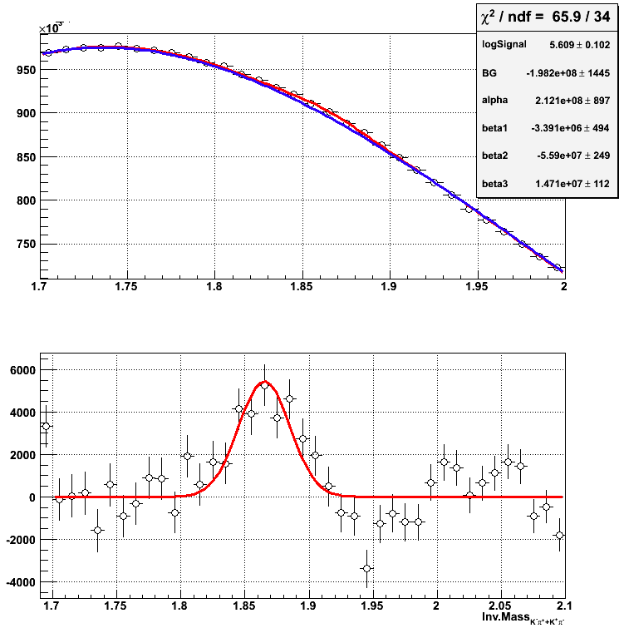
D⁰+D⁰bar signal in 2007 Data (MinBias Files)
34 Million Events used for this analysis.
Kinematic fit yields an improved significance of 10σ for combined D⁰+D⁰bar.
The signal is somewhat sensitive to the degree of the pol. Fit.
Need a robust backgr. estimation method (new production)
Pol3 + gaus
pol3
STAR PRELIMINARY
STAR PRELIMINARY
Inv Mass _{(K-π+ + K+π-)}(GeV)

Slide 11
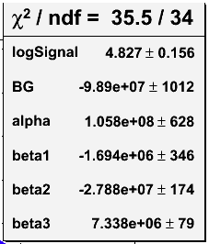
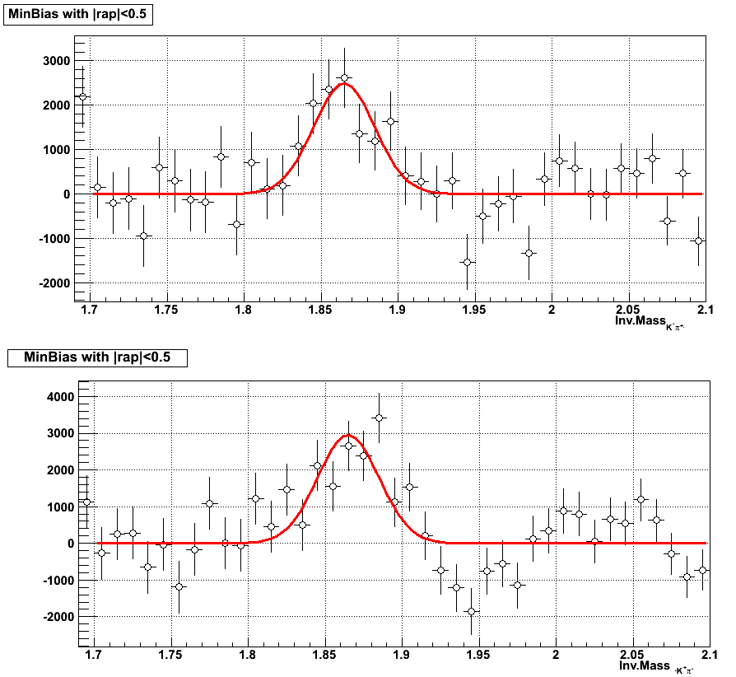
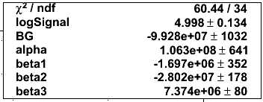
D⁰ and D⁰bar separately
STAR PRELIMINARY
Inv Mass _{K-π+}(GeV)
Inv Mass _{K+π-}(GeV)
Preliminary D0bar/D0 ratio ~ 1.05±0.19(stat.)
Notes:
Add comment

Slide 12
Summary
We present progress on a method for full Topological reconstruction of open charm mesons.
Ongoing efforts to measure cross-section (with smaller errors) and some D⁰ flow(v₂)
Method developed is baseline for analyses involving the future upgrade of STAR – Heavy Flavor Tracker (HFT), which will provide unambiguous measurement of charm.
Thank you

Slide 13
Back-Up

Slide 14
Cuts from Previous Production
2007 Production MinBias
cut changed
new cut
Cuts in New Production
EVENT level
triggerId : 200001, 200003, 200013
Primary vertex position along the beam axis :
|zvertex| < 10 cm
Resolution of the primary vertex position along the beam axis:
|σ_{zvertex}|< 200µm
TRACKS level
Number of hits in the vertex detectors :
SiliconHits>2 (tracks with sufficient DCA resolution)
Transverse Momentum of tracks:
p_{T} >.5GeV/c
Momentum of tracks:
p >.5GeV/c
Number of fitted:
TPC hits > 20
Pseudo-rapidity :|η|<1 (SSD acceptance)
dEdxTrackLength>40 cm
DCA to Primary vertex (transverse),
DCA_{xy}< .1 cm
EVENT level
triggerId : 200001, 200003, 200013
Primary vertex position along the beam axis :
|zvertex| < 10 cm
Resolution of the primary vertex position along the beam axis:
|σ_{zvertex}|< 200µm
selects the best vertex only (highest Rank)
TRACKS level
Number of hits in the vertex detectors: SiliconHits >1
Radius of first hit on track :
< 9 cm if number of silicon hits =2
< 13 cm else
SvtHits < 4, SsdHits < 2
Momentum of tracks
pK+pPi >1.5GeV/c
Ratio TPC hits Fitted/Possible > 0.51
TpcHits fitted > 25
Pseudo-rapidity :|η|<1.2
dEdxTrackLength>40 cm
DCA to Primary vertex (transverse),
DCA_{xy}< .2 cm

Slide 15
Cuts from Previous production
Continued..
Cuts in New Production
D⁰ candidate
|y(D⁰)|<1
|cos(θ*)|<0.8
1.2 < Mass_{D0} < 2.2
DECAY FIT level
Probability of fit >0.05 && |sLength|<.2cm
error of decay length: dslength < 0.1cm
Particle ID : ndEdx :|nσ_{K}|<2.5, |nσ_{π}|<2.5
DECAY FIT level
Probability of fit >0.1 && |sLength|<.1cm
Particle ID : ndEdx :|nσ_{K}|<2, |nσ_{π}|<2
In both productions we made a pico file for further analysis.

Slide 16
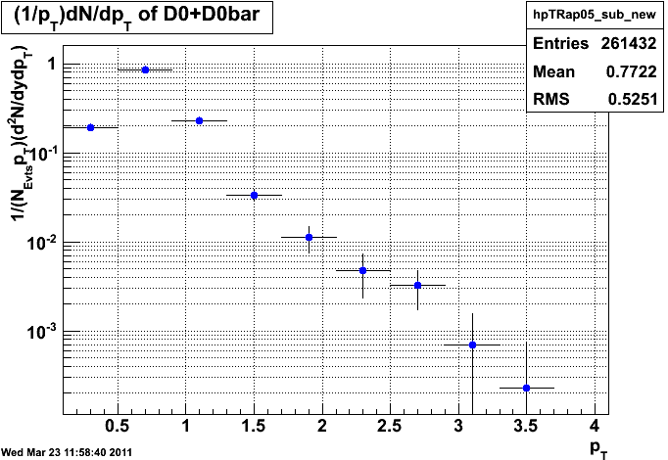
D⁰ –p_{T} distribution
Uncorrected p_{T} spectra for D⁰+D⁰bar
D⁰ p_{T} is done by subtracting from the central mass peak the normalized sum of the side bands.

Slide 17
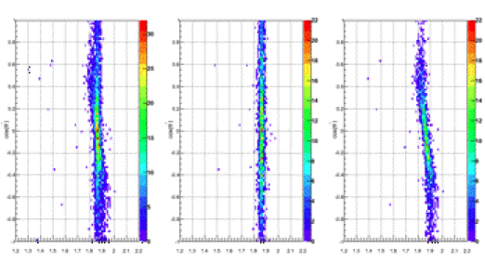
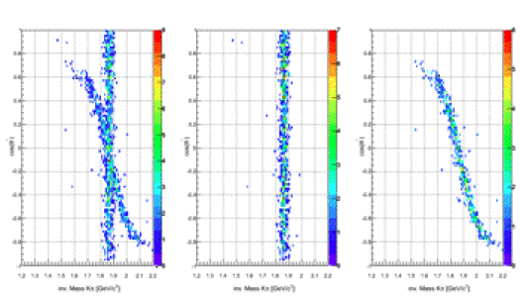
Cross-feed Vs Kaon Opening Angle in the CM frame
p_{T}^{D0}<0.5
ALL
K⁻π⁺
K⁺π⁻
Cos(θ*)
For Low p_{T}^{D0}:
Both true pairs and misidentified pairs have the distribution going from -1 to 1
For High p_{T}^{D0}:
The true pairs have the same distribution(-1,1)
Misidentified pairs have shortened tails (-0.8,0.8)
Inv Mass
p_{T}^{D0}<2.0
ALL
K⁻π⁺
K⁺π⁻
Cos(θ*)
The Cut* |Cos(θ*)|<0.6, can be limited to the low p_{T} D⁰s.
Inv Mass
* The cut |Cos(θ*)|<0.6 removes the poorly reconstructed soft tracks.

