Slide 1


Outline
Dihadron fragmentation functions (DFF) within reconstructed jets in p+p collisions at √s= 200 GeV
Definitions
Motivation
The STAR experiment/Dataset
Results
Summary
Muhammad Elnimr
for the STAR collaboration
Wayne State University
APS April meeting
Feb. 16th 2010

Slide 2
Definitions
Single-hadron FF (SFF):
  D(z₁)=dN/dz₁ inside the jet
    z₁ = p_{T}/E_{jet}
Dihadron FF (DFF):
  D(z₁,z₂)=d²N/dz₁dz₂ pairs inside the jet
      z₁ = p_{T1}/E_{jet ,} z₂ = p_{T2}/E_{jet}
Energy of the jet
Transverse momentum of the hadron

Slide 3
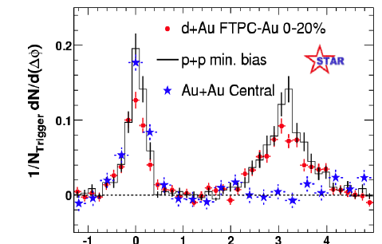
Motivation I
Away-side is suppressed in central Au+Au compared to p+p/d+Au
  Why study DFF?
    Near-side is the same for Au+Au compared to p+p/d+Au !
      Surface bias or other physics phenomena???
      Near-side pairs come from the same jet.
    Ratio of DFF/Single-FF is interesting since:
2<p_{T}(assoc.)<p_{T} (trig.)
4<p_{T} (trig.) <6 GeV/c
ΔΦ
Phys. Rev. Lett. 91 (2003) 072304
  DFF in A+A compared to p+p:
    How is DFF modified in A+A compared to p+p?
      Theoretical predictions are needed!

Slide 4
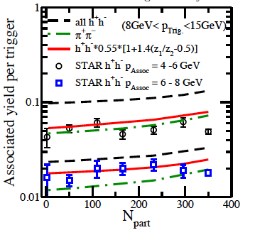
Motivation II
DFF in Au+Au
Near-Side Au+Au at 200 GeV
  Based on the paper by A. Majumder PRD 72, 034007 (2005).
  DFF in Au+Au (dense matter):
    Caveat: The jet energy is not really known.
  DFF in A+A with fully reconstructed jets is needed (in a more differential way)!
  But first: test our understanding of DFF in vacuum (e⁺e⁻/pp). This work!
nucl-th/0503019v1
Notes:
Shown is the

Slide 5
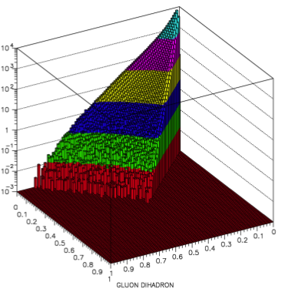
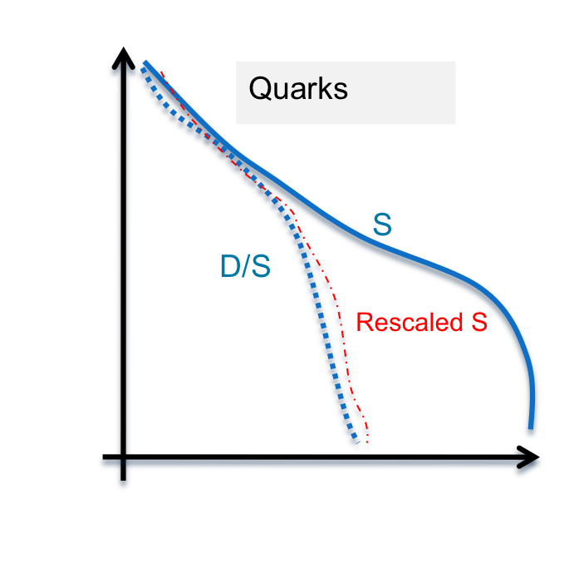
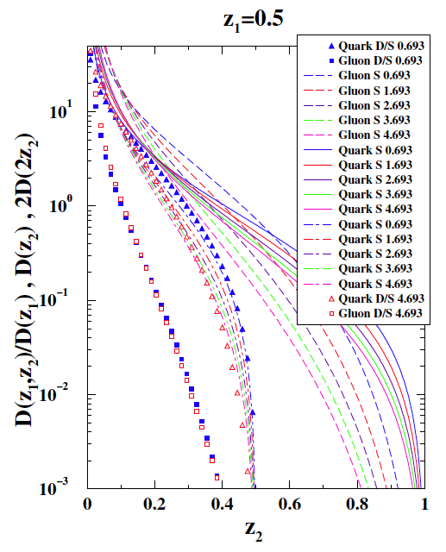
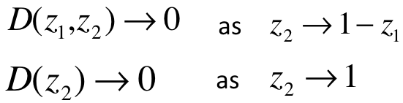
Motivation III
DFF in vacuum
D(z₁, z₂)
p+p at 200 GeV and R=0.4
  DGLAP is used to derive DFF for different energy scales.
  DGLAP agrees well with JETSET.
  D(z₁,z₂)/D(z₁) is to be compared to D(z₂).
    A rescaled D(z₂) need to be used instead:
      1/(1-z₁)D(z₂/(1-z₁))
  D(z₁,z₂)/D(z₁) ….[D/S] agrees with the rescaled D(z₂) for quarks only.
z₁
z₂
1
Z₁>Z₂
Gluons
qg and gg dominate at low p_{T}.
qq and qg dominate at high p_{T}.
Gluons
`
`
S
`
D/S
`
W. Vogelsang hep-ph:0704.1677v1
Quarks

Slide 6
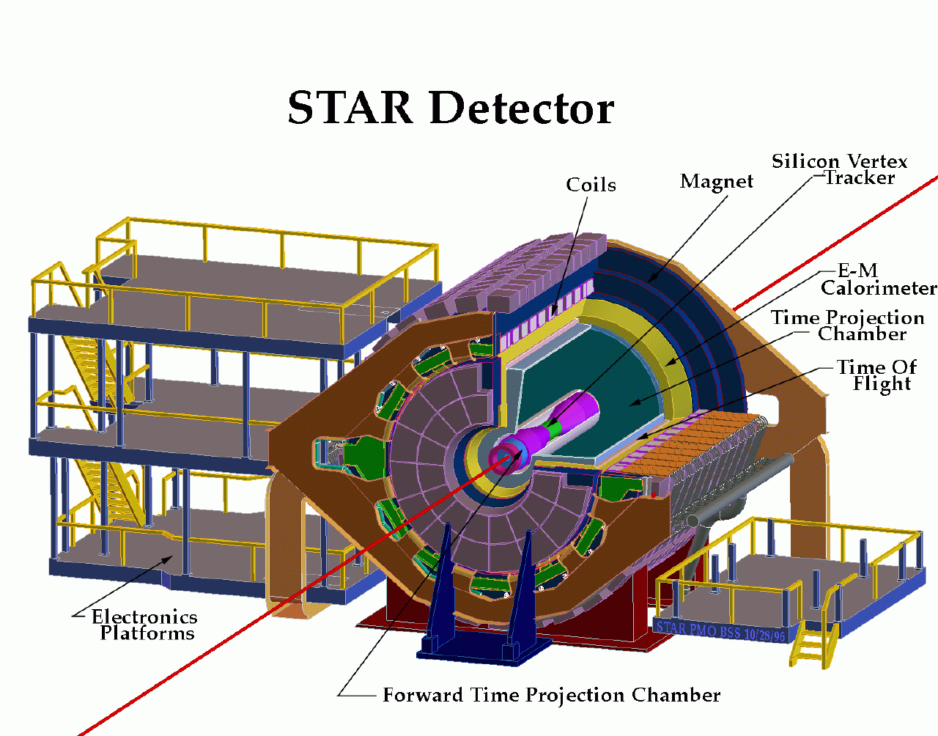
The STAR experiment
  Data Set:
    p+p collisions (Run VI) at √s=200 GeV
  Jet finding uses:
    Barrel electromagnetic calorimeter: -1.0< η <1.0, 0< φ <2π
    TPC: -1.3< η <1.3, 0< φ <2π
  Trigger:
    Jet Patch trigger:
      Patch of 20x20 BEMC towers: E >7.8 GeV, ΔφxΔη=1x1
  Jet Reconstruction algorithms:
    Cone algorithm: Midpoint Cone
    Recombination algorithms: FastJet package (Kt, Anti-KT) arXiv:0802.1189
  Jet cuts:
    R_{jet}=0.7, |η_{jet}|<0.3 (1-R_{jet})
    EMC trigger= Neutral energy bias:
      Recoil jets (away jets) are being used, |Δφ_{jet-patch}|>2.6
      Jet energy is not corrected for resolution or any detector effects (missing energy..)
  Jet algorithms show similar results
    AKT=KT=SISCone=MidpointCone
    Only two are shown: Mipoint Cone and AKT

Slide 7
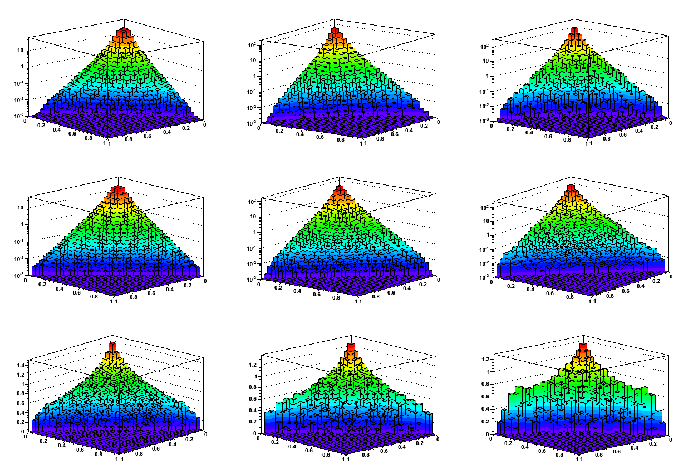
Dihadron fragmentation function (DFF)
10<E_{jet}<20 GeV
20<E_{jet}<30 GeV
30<E_{jet}<40 GeV
z₁≥z₂
D(z_{1,} z₂)
z₁+z₂≤1
D(z₁) D(z₂)

Slide 8
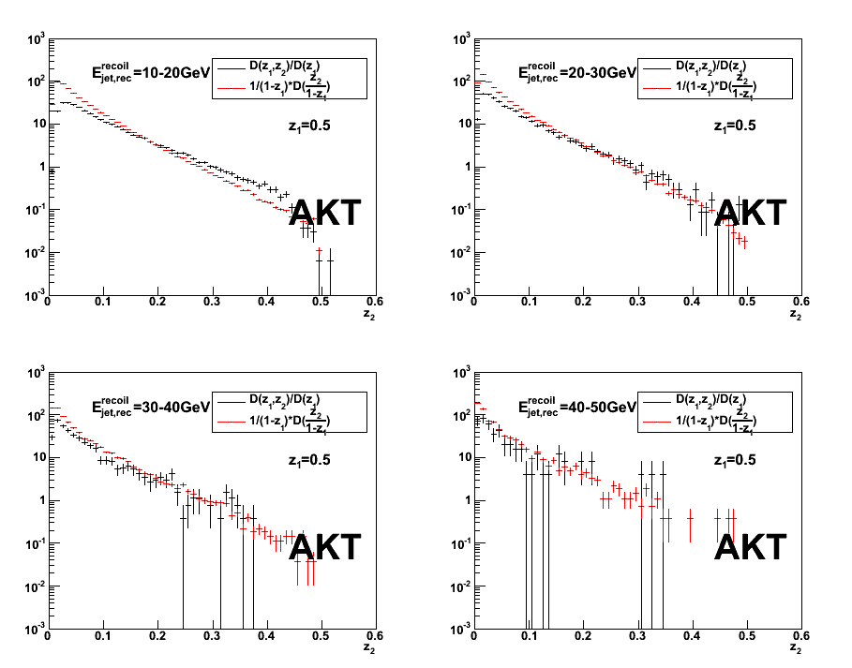
Comparison of D(z₁,z₂)/D(z₁) and D(z₂/1-z₁), z₁=0.5
AKT Finder
E < 20 GeV:
  Poor agreement
E > 20 GeV:
Good Agreement
Approximate Scaling for 0.05<z2<0.45
As per Majumder et al
Indicates quark dominance.
Statistical errors only
STAR preliminary
Note:
Scaling expected to break down near kinematical boundaries, e.g. z<0.05 or z>0.45

Slide 9
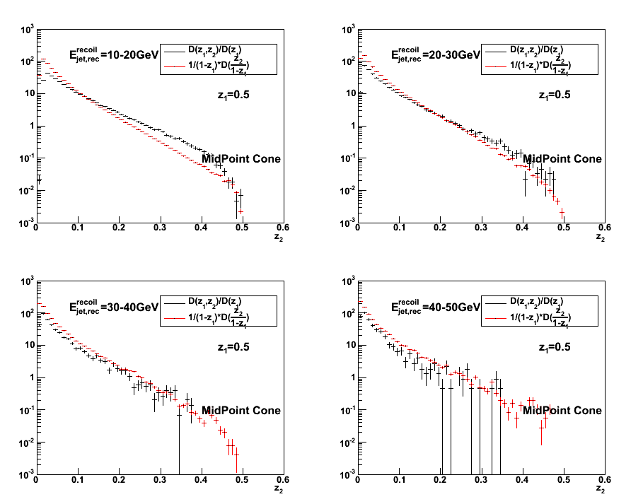
Comparison of D(z₁,z₂)/D(z₁) and D(z₂/1-z₁), z1=0.5
Mid-Point Finder
Results similar as those obtained with the AKT finder
Result essentially independent of jet finder.
STAR preliminary

Slide 10
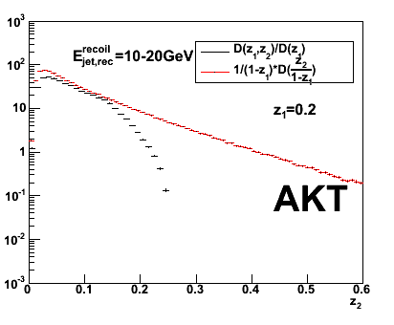
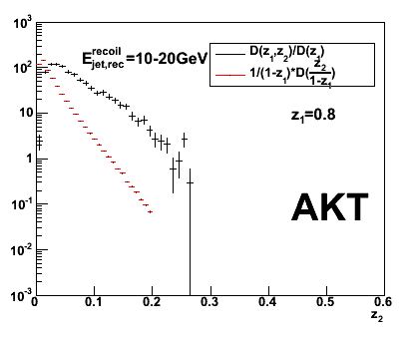
Comparison of D(z₁,z₂)/D(z₁) and D(z₂/1-z₁), z1=0.2 & 0.8
STAR preliminary
Scaling observed for z₂<0.15 and z₁=0.2
Scaling violation for z₁=0.8
z₁–dependence not understood yet.
But provide additional information on the jet structure since
z₁=0.2
z₂<z₁
z₁=0.8
z₂< z₁
z₂<1-z₁
D(z₁,z₂)/D(z₁)D(z₂/1-z₁) ≠ 1

Slide 11
Summary/Outlook
First measurements of (real) dihadron fragmentation functions in p+p.
Serves as reference for similar measurement in A+A.
For z₁=0.5 reasonable agreement for jets >20 GeV.
  According to Majumder, Quark jet dominance.
Outlook:
  Comparison with Pythia Simulations (including detector acceptance)
  Correct for acceptance, efficiency, and resolution effects.

Slide 12
BACK UP

Slide 13
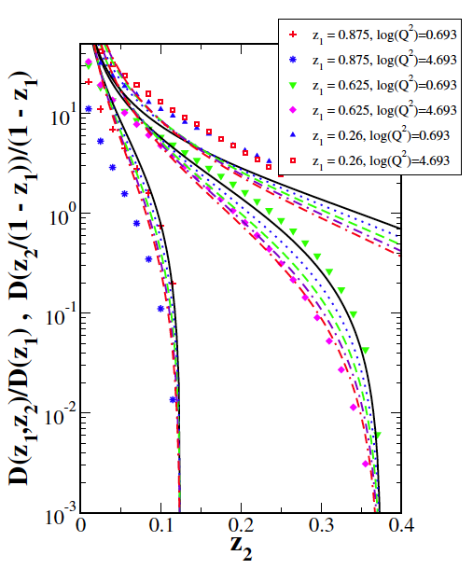
Lines (dashed,dotted,etc…)
Z₁=0.26
Z₁=0.625
Points
Z₁=0.875

