Slide 1
Measurement of Multiplicity Asymmetry Correlation Between Positive and Negative Particles in Au+Au and d+Au
Quan Wang, Purdue University
For the STAR Collaboration
Motivation: Local Parity Violation (LPV)
Charge asymmetry observables
Analysis details
Results
Summary

Slide 2
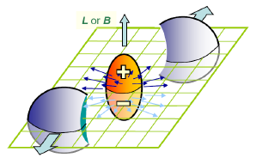
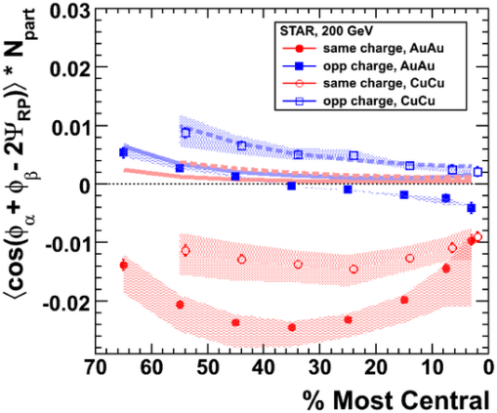
Motivation and Observables
UP
LEFT
RIGHT
EP
DOWN
LPV effects in UD. LR is null-reference.
LPV expectations:
A_{+UD} and A_{-UD} are anti-correlated
‹A₊A₋›_{UD} < ‹A₊A₋›_{LR}
Additional dynamical fluctuation broadens A_{±UD} distributions
‹A±²›_{UD} > ‹A±²›_{LR}
Chiral magnetic effect:
LPV + large magnetic field
charge separation along the system angular momentum.
Kharzeev et al. NPA 803 (2008) 227

Slide 3
Analysis Details
Data set
Y4 MinBias 200GeV Au+Au data (8.5M events)
Y3 MinBias 200GeV d+Au data
Cuts: standard STAR event and track cuts
To avoid self-correlation effect:
EP: η<0; Asym η>0
EP: η>0; Asym η<0
η<0
η>0

Slide 4
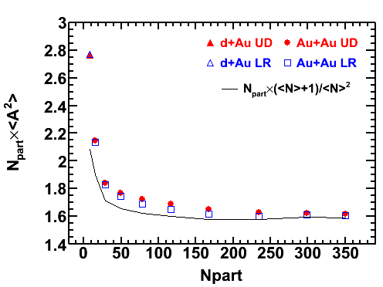
Stat. Fluc. Effect in ‹A²›
STAR preliminary
Stat. fluc. effect
Thanks to V. Koch.

Slide 5
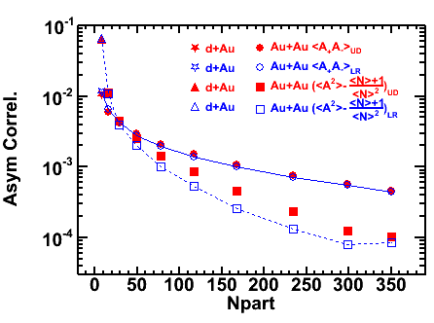
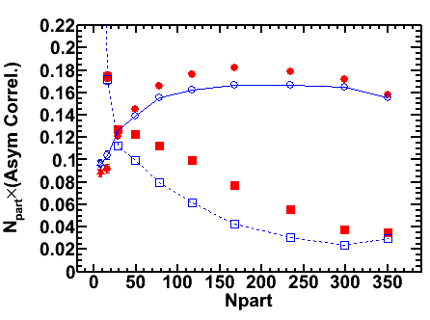
Results: ‹A²›-(‹N›+1)/‹N›² and ‹A₊A₋›
STAR preliminary
STAR preliminary
Strong charge asymmetry correlations present.
UD is always larger than LR.
LPV expects: ‹A²›_{UD} > ‹A²›_{LR}
LPV expects: ‹A₊A₋›_{UD} < ‹A₊A₋›_{LR}
Data consistent with
LPV expectation
Data inconsistent with
LPV expectation

Slide 6
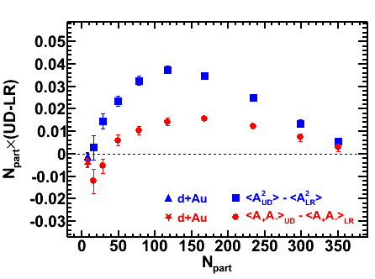
Difference UD-LR
Observations:
‹A²›_{UD} > ‹A²›_{LR} consistent with LPV expectation
‹A₊A₋›_{UD} > ‹A₊A₋›_{LR} inconsistent with LPV expectation
Similar centrality dep.
STAR preliminary
Possible causes: correlation overlaid with v₂ (F. Wang, 0911.1482)
Charge balance (S. Pratt): ~-v₂/N*‹cos2Δφ_{BF}›, only in ‹A₊A₋›.
Momentum conservation (S. Pratt): ~ v₂/N, in both ‹A₊A₋› and ‹A²›.
Path-length dependent jet-quenching, opacity.
Try to investigate those effects experimentally, by studying UD-LR vs E-by-E bulk v₂, and high-p_{T} v₂ (indicative of jet-quenching).

Slide 7
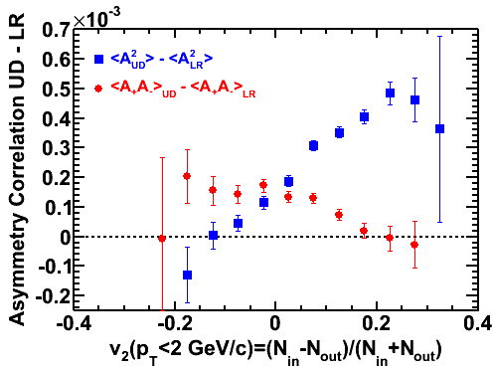
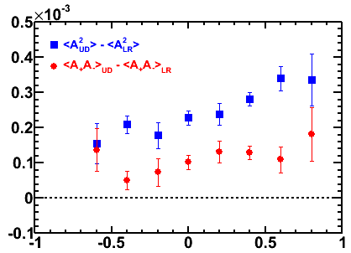
UD–LR vs Event-by-Event Anisotropy
20-40% centrality
20-40% centrality
STAR preliminary
STAR preliminary
(N_{in}-N_{out})/(N_{in}+N_{out}) at low p_{T} (p_{T}<2GeV/c)
(N_{in}-N_{out})/(N_{in}+N_{out}) at high p_{T} (p_{T}>2GeV/c)
‹A²› and ‹A₊A₋› opposite trend in low-p_{T} v₂!
Same trend in high-pt v₂.
More b-to-b same-charge pairs in-plane reducing ‹A²_{LR}›? → Increasing trend
More opposite-charge pairs in-plane enhancing ‹A₊A₋›_{LR}? → Decreasing trend
Stronger jet-quenching out-of-plane enhance UD correlation for both ‹A²_{UD}› and ‹A₊A₋›_{UD}?

Slide 8
Summary
Charge asymmetry correlations are all positive.
‹A²›_{UD} > ‹A²›_{LR}: consistent with LPV expectation ‹A₊A₋›_{UD} > ‹A₊A₋›_{LR}: inconsistent with LPV expectation
UD-LR v.s. E-by-E v₂:
‹A²› and ‹A₊A₋› have same trend with high-p_{T} v₂
‹A²› and ‹A₊A₋› have opposite trend with low-p_{T} v₂
Physics mechanisms need further investigations

Slide 9
Backup

Slide 10
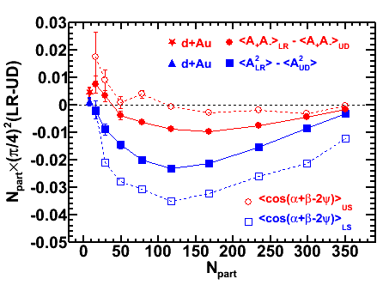
LR-UD Compared to PV Correlator
LR-UD: including all possible terms, cos(a+b-2ψ) is only one term.
Charge asymmetry correlation = correlator + higher order terms
Correlator calculated in the same η region (half the TPC) as Asym correl.
Qualitatively same as LPV papers (full TPC).
Asymmetry correlation ≠ correlator.
Higher order effects may be significant..
STAR preliminary
Different observables.
Same data. Numerical difference due to different observables

Slide 11
Stat. Fluc. Effect in ‹A²›

Slide 12
High pT “v2” sensitive to jet-quenching
Out of plane
N events
Jet-quenching
In plane
In plane
EP
Out of plane
-1
+1
High-pt v₂
“v2”=(Nin-Nout)/(Nin+Nout)
Larger “v2” indicates more jet-quenching effect.

