Slide 1



Non-photonic electron production in p+p collisions at √s=200 GeV
Xiaozhi Bai for the STAR collaboration
Central China Normal University
University of Illinois at Chicago
APS April Meeting 2015,Baltimore,MD

Slide 2
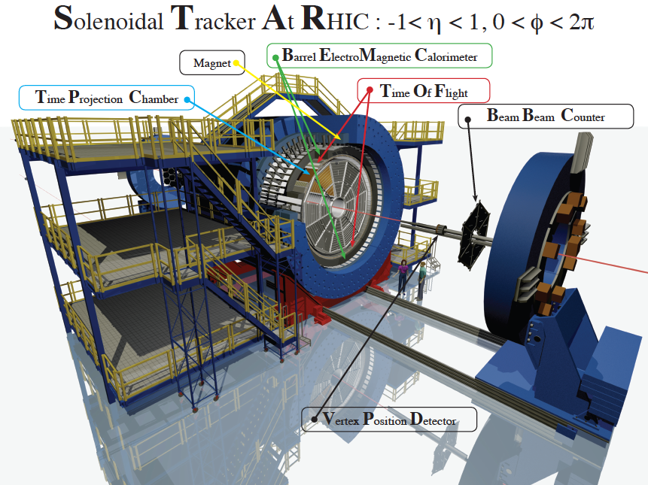
Outline
Motivation
Data Analysis for Non-photonic electron (NPE)
NPE spectrum
Summary and outlook

Slide 3
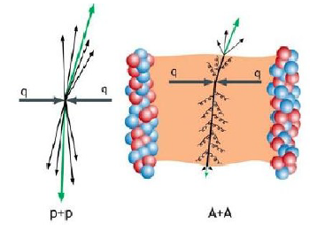
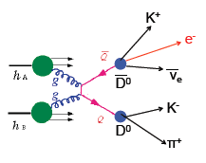
Motivation
Heavy flavor particles:
Large mass, produced dominantly by
hard scatterings in the early stage
Excellent probe for the Quark-Gluon Plasma (QGP)
Heavy flavor production in p+p collisions
Baseline for studies in heavy ion collisions, e.g. R_{AA}
Test the validity and constrain the parameters of
pQCD calculations of heavy quark production
Non-photonic electrons
Produced from semi-leptonic decays of open heavy flavor hadrons
A good proxy to study open heavy flavor production

Slide 4
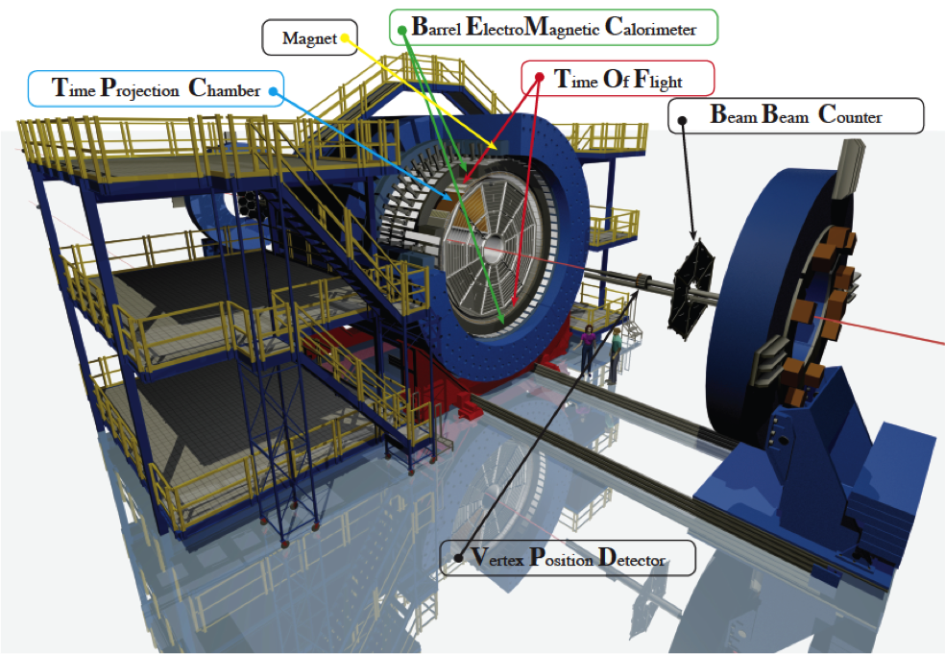
STAR Detector
Time Projection Chamber (TPC)
large acceptance: |η|<~1.3, 0<Φ<2π
tracking, momentum
electron ID through energy loss dE/dx
Barrel Electromagnetic Calorimeter (BEMC)
large acceptance: |η|<1, 0<Φ<2π
electron ID through E/p and shower shape
triggering on high p_{T} (2.5 GeV/c<p_{T}) electron
Time Of Flight (TOF)
large acceptance: |η|<0.9, 0<Φ<2π
electron ID through flight time
at low p_{T} (p_{T}<2.5 GeV/c)

Slide 5
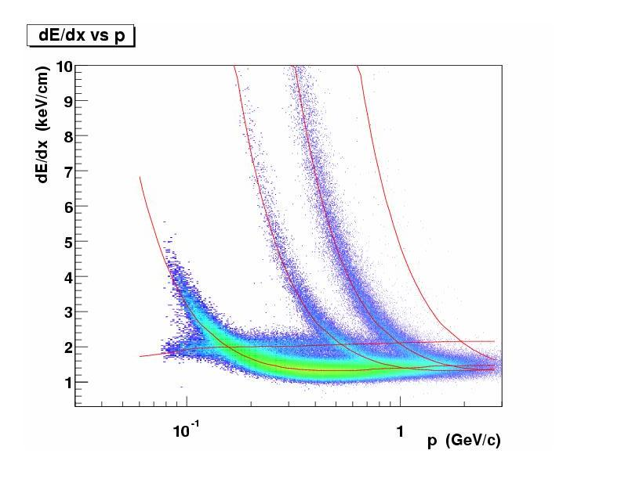
STAR Detector
Time Projection Chamber (TPC)
large acceptance: |η|<~1.3, 0<Φ<2π
tracking, momentum
electron ID through energy loss dE/dx
Barrel Electromagnetic Calorimeter (BEMC)
large acceptance: |η|<1, 0<Φ<2π
electron ID through E/p and shower shape
triggering on high p_{T} (2.5 GeV/c<p_{T}) electron
Time Of Flight (TOF)
large acceptance: |η|<0.9, 0<Φ<2π
electron ID through flight time
at low p_{T} (p_{T}<2.5 GeV/c)
Au+Au 200 GeV
p
d
k
π
e,μ

Slide 6
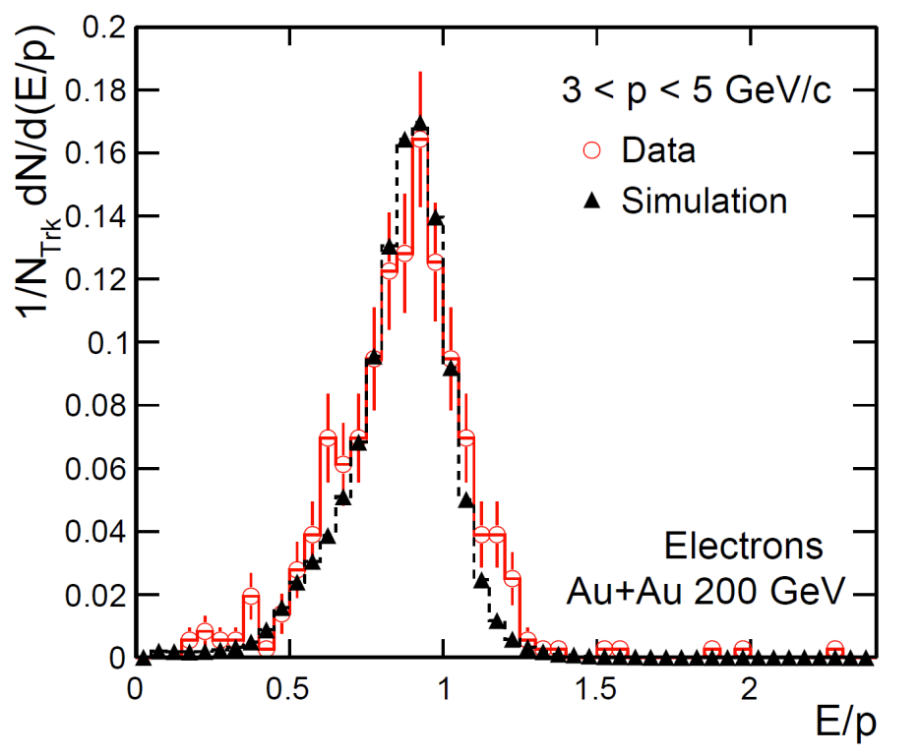
STAR Detector
Time Projection Chamber (TPC)
large acceptance: |η|<~1.3, 0<Φ<2π
tracking, momentum
electron ID through energy loss dE/dx
Barrel Electromagnetic Calorimeter (BEMC)
large acceptance: |η|<1, 0<Φ<2π
electron ID through E/p and shower shape
triggering on high p_{T} (2.5 GeV/c<p_{T}) electron
Time Of Flight (TOF)
large acceptance: |η|<0.9, 0<Φ<2π
electron ID through flight time
at low p_{T} (p_{T}<2.5 GeV/c)

Slide 7
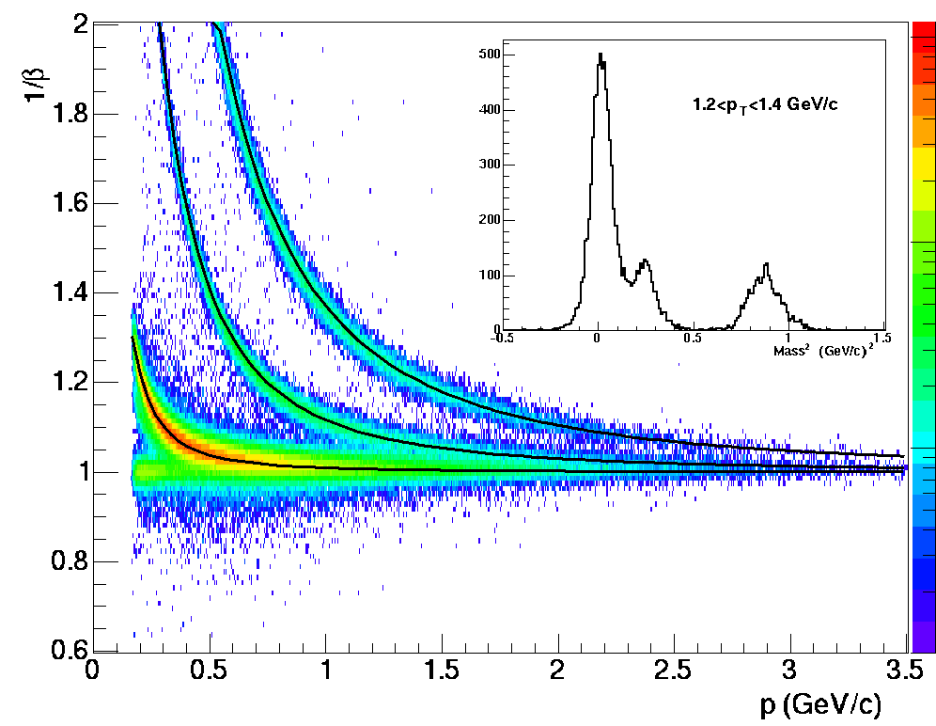
STAR Detector
Time Projection Chamber (TPC)
large acceptance: |η|<~1.3, 0<Φ<2π
tracking, momentum
electron ID through energy loss dE/dx
Barrel Electromagnetic Calorimeter (BEMC)
large acceptance: |η|<1, 0<Φ<2π
electron ID through E/p and shower shape
triggering on high p_{T} (2.5 GeV/c<p_{T}) electron
Time Of Flight (TOF)
large acceptance: |η|<0.9, 0<Φ<2π
electron ID through flight time
at low p_{T} (p_{T}<2.5 GeV/c)
p
k
π
e,μ
Au+Au 200 GeV

Slide 8
Dataset and electron selection
Fast detector BEMC select (or trigger on) interesting events
High tower trigger event: an event with an energy deposition in a single tower of the BEMC above a certain threshold
Data samples in p+p collisions at √s = 200 GeV from Run 2012
Trigger threshold | Number of Events | Sampled Luminosity
11<ADC (2.6 GeV<E_{T}) | 38 M | 1.4 pb⁻¹
18<ADC (4.2 GeV<E_{T}) | 40 M | 24 pb⁻¹

Slide 9
Analysis procedure
Non-photonic electron(from open heavy flavor decay ) bottom and charm hadrons via semi-leptonic decay.
Inclusive electron
Gamma conversion (~54%)
π⁰ Dalitz Decay (~36%)
η Dalitz Decay (~10%)
After all the ePID cuts: Hadron contamination
PHE
All ePID cuts and
Invariant mass cuts
Not 100% reconstructed
: electrons from open heavy flavor decay
purity: purity of inclusive electron
ε_{photonic :}photonic electron reconstruction efficiency
The NPE invariant cross section:

Slide 10
Inclusive electron and photonic electron
-1<nσ_{e}<3
STAR 2012 p+p √s=200 GeV
STAR 2012 p+p √s=200 GeV
STAR 2012 p+p √s=200 GeV
STAR 2012 p+p √s=200 GeV
STAR Preliminary
STAR Preliminary
STAR Preliminary
STAR 2012 p+p √s=200 GeV
STAR 2012 p+p √s=200 GeV
STAR Preliminary

Slide 11
Raw spectra and detector efficiency
STAR 2012 p+p √s=200 GeV
STAR 2012 p+p √s=200 GeV
STAR 2012 p+p √s=200 GeV
ε_{dEdx} TPC ePID cut efficiency from data
ε_{EMC} EMC ePID cut efficiency from data
ε_{Trg} High tower trigger efficiency from MC simulation
ε_{Trk} TPC tracking efficiency from MC simulation

Slide 12
NPE cross section
STAR Preliminary
STAR Preliminary
            Consistent with pQCD FONLL calculation and previous STAR results.
This analysis has better precision and extended to a higher p_{T} range
[1] STAR collaboration, Phys. Rev. D 83 (2011) 52006
[2] R.E.Nelson, R.Vogt, and A.D.Frawley, Phys.Rev.C 87 (2013) 014908

Slide 13
Summary and outlook
            A new and improved NPE cross section measurement in p+p collisions at √s=200 GeV at STAR.
            Results consistent with pQCD FONLL calculation and previous STAR results.
            The data analysis is ongoing to measure the NPE cross section for p_{T}<2.5 GeV/c, using 700M MinBias events collected during year 2012 run.
            NPE invariant yield will be used as the baseline reference for the
            Nuclear modification factor R_{AA} in Au+Au collisions.

Slide 14
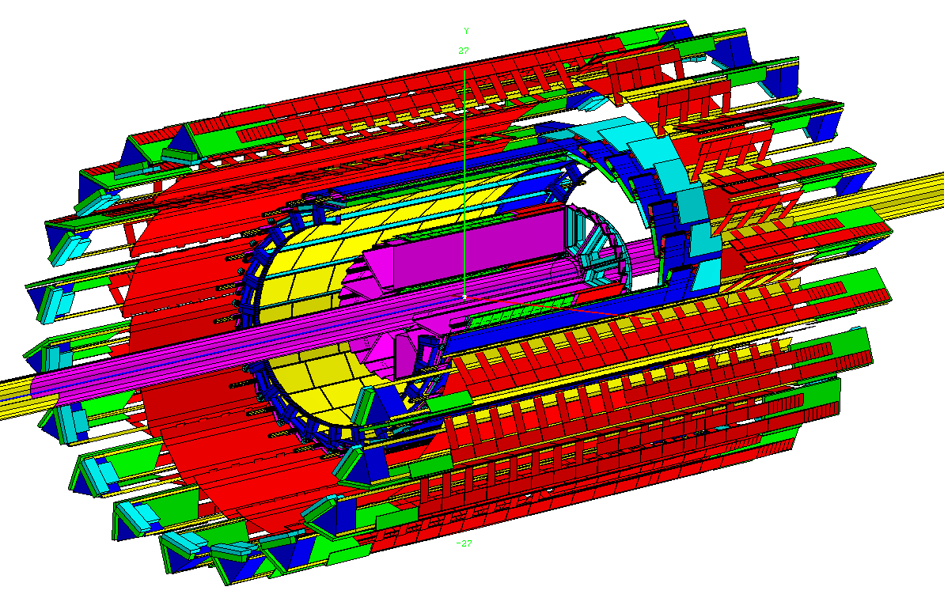
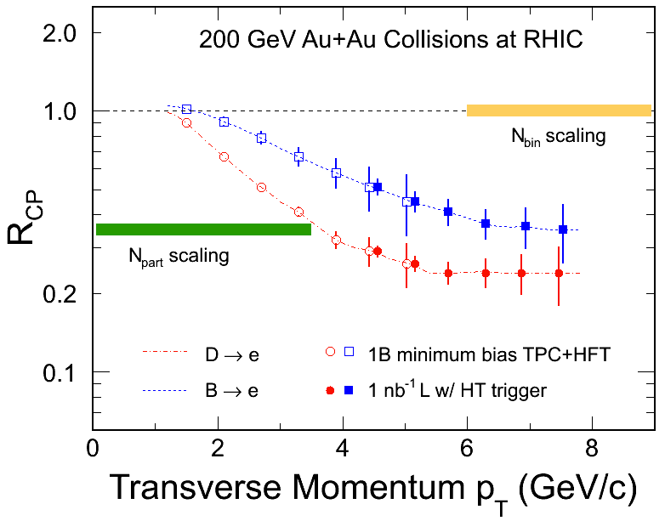
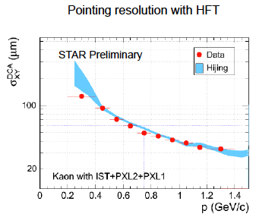
Detector upgrade: Heavy Flavor Tracker
IST at 14cm
Simulation with HFT
PXL at 2.9 and 8cm
SSD at 22 cm
High precision R_{AA} and v₂ of Non-photonic electron from charm and bottom hadrons decay separately

