Slide 1
Two-, Three-, and Jet-Hadron Correlations at STAR
Rencontres de Moriond – La Thuile, Mar 20-27 2011
Kolja Kauder for the STAR Collaboration

Slide 2
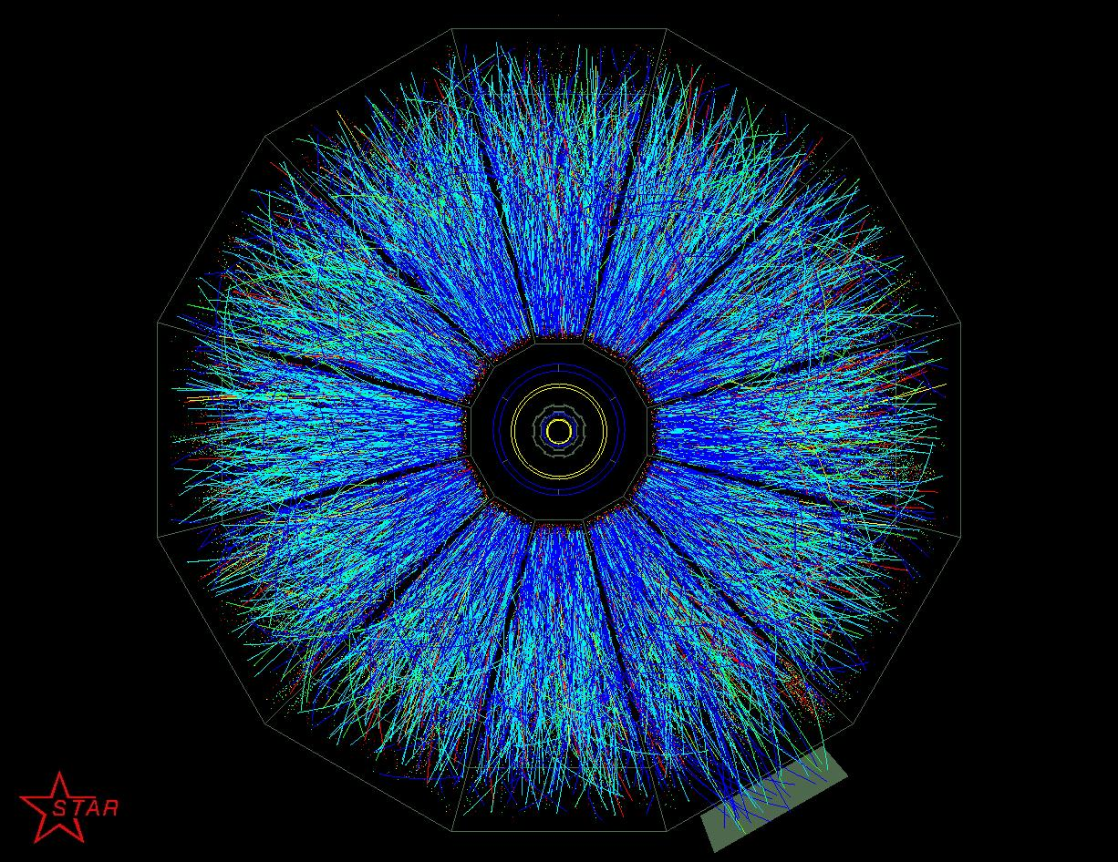
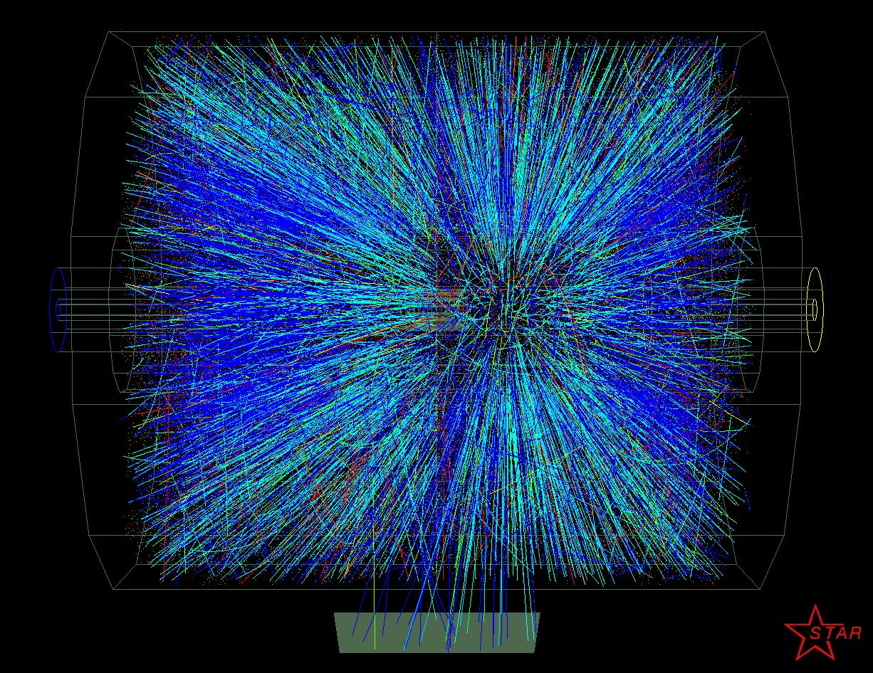
The STAR Detector
Full azimuthal acceptance
Extended pseudorapidity acceptance |η|<1
Au+Au, 200 GeV

Slide 3
Jet Tomography
associates
associates
Untriggered

Slide 4
Jet Tomography
associates
associates
Trigger
associates
Triggered

Slide 5
Jet Tomography
associates
associates
“jet-axis”
trigger (T2)
primary
trigger (T1)
associates
2+1

Slide 6
Jet Tomography
associates
associates
associates
Jet trigger
Jet-hadron

Slide 7
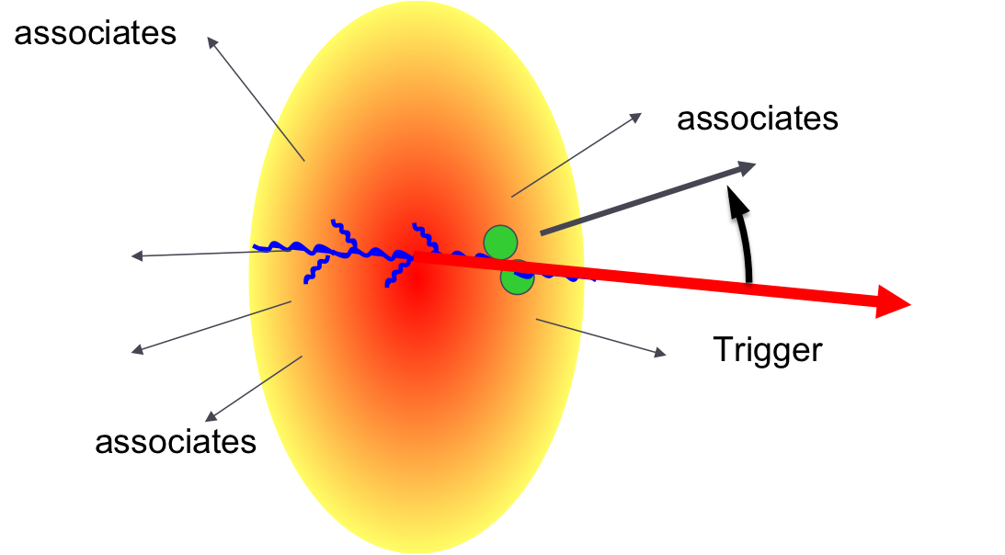
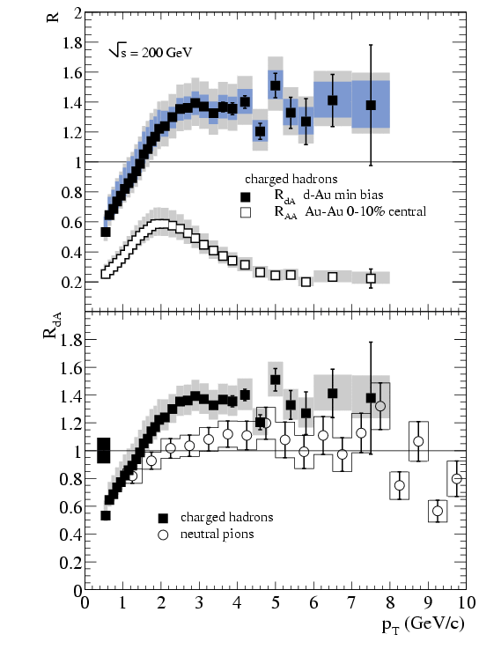
Jet Quenching in Heavy Ion Collisions
STAR
PRL 91, 072303 (2003)
PRL 91, 072304 (2003)
4 < p_{T}^{trig} < 6 GeV/c
2 < p_{T} ^{assoc}<p_{T} ^{trig}
Ratio of Au+Au and binary-scaled pp yields
Dramatic suppression of high-p_{T} particle production. Not seen in cold nuclear matter (e.g. d+Au)
Beautiful evidence for a dense QCD medium – but what is the mechanism of suppression?
Away-side around Δφ=π is strongly suppressed in Central Au+Au in this p_{T} bin
Medium effect, as d+Au is similar to pp
Notes:
Whether the observed suppression is tied to absorption or energy loss of scattered high momentum partons by a dense partonic medium [22], to absorption at a later hadronic stage [23], or to some other mechanism is as yet unclear.

Slide 8
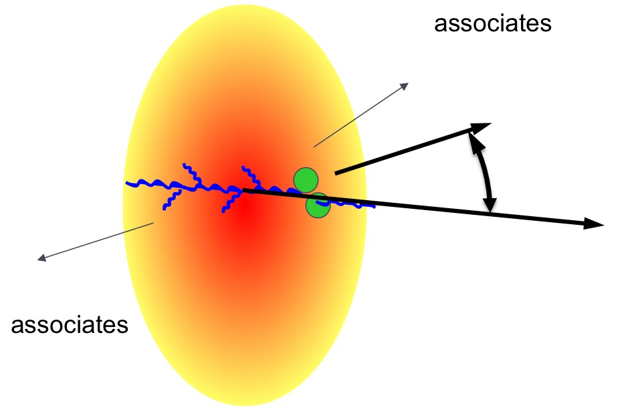
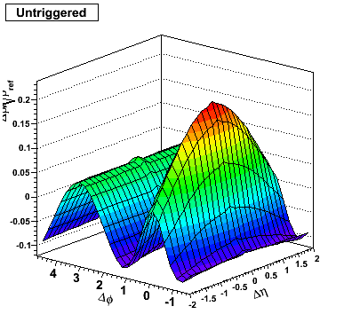
Untriggered Correlation
Structures
Near side “ridge like” structure
Away side structure
Untriggered
p_{T} > 0.15 GeV/c
STAR preliminary
Au+Au 200GeV
0-10% Central
Same side structure is an elongated 2D Gaussian
How does it evolve with momentum?
Notes:
At first glance we see those structures. The same side structure is not a ridge exactly.
Bullet 2, what do we know: because we have the entire momentum range? Should I rather have mike’s plot?

Slide 9
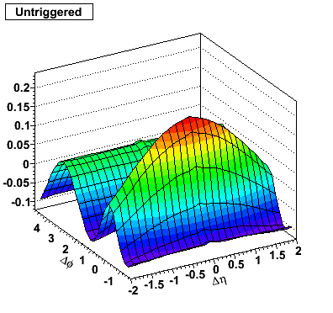
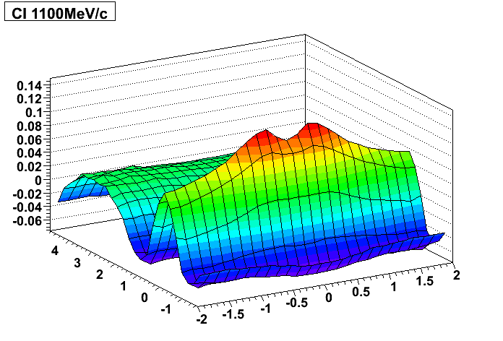
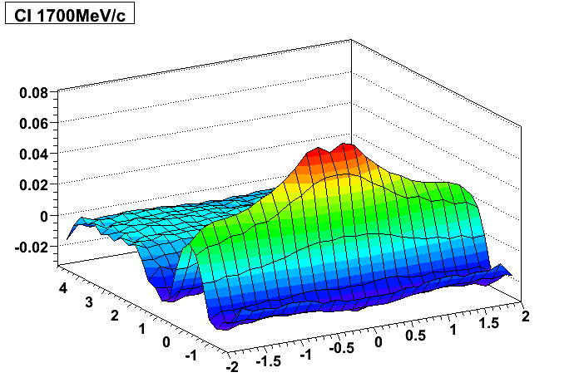
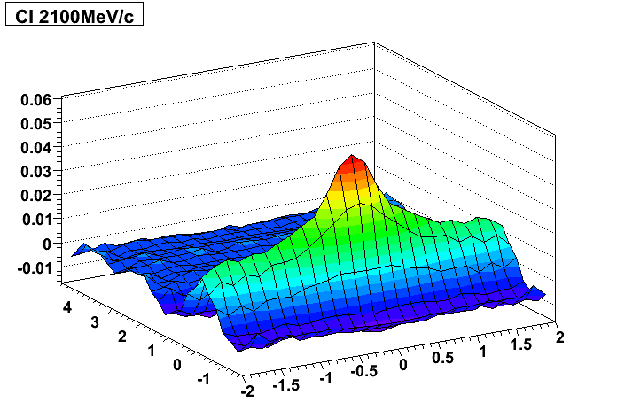
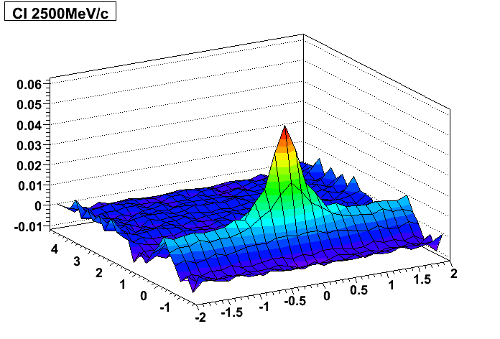
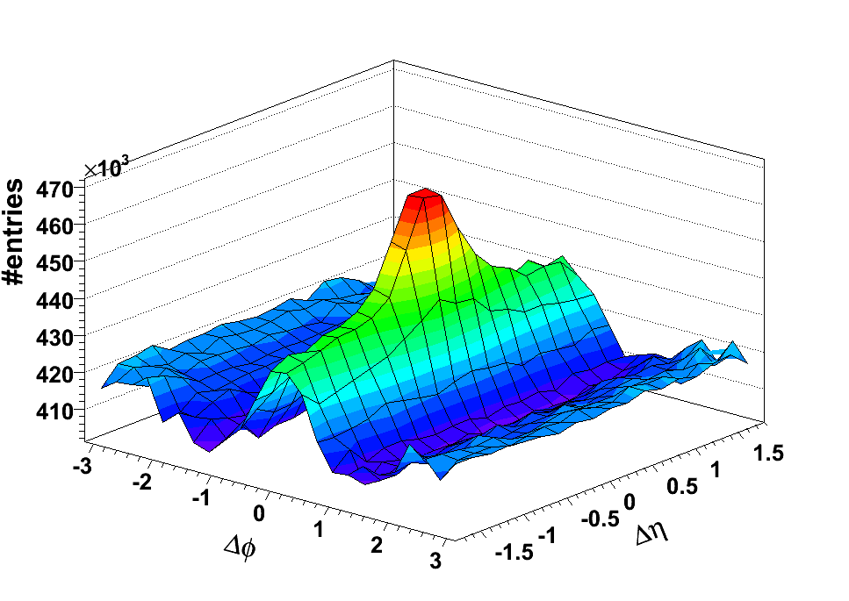
Ridge Evolution
p_{T} > 0.15 GeV/c
p_{T} > 1.10 GeV/c
p_{T} > 1.70 GeV/c
STAR Preliminary
STAR Preliminary
STAR Preliminary
Δφ
Δη
Δφ
Δφ
Δη
Δη
Au+Au 200GeV
0-10% Central
p_{T} > 2.10 GeV/c
p_{T} > 2.50 GeV/c
STAR Preliminary
STAR Preliminary
Δφ
Δη
Δφ
Δη
Δη
Δφ
Jet-like peak emerging
Jet/Ridge ratio grows with p_{T}
Ridge becomes flatter
Triggered
3 < p_{T}^{trig} < 4 GeV/c
2 < p_{T} ^{assoc}<p_{T} ^{trig}
9

Slide 10
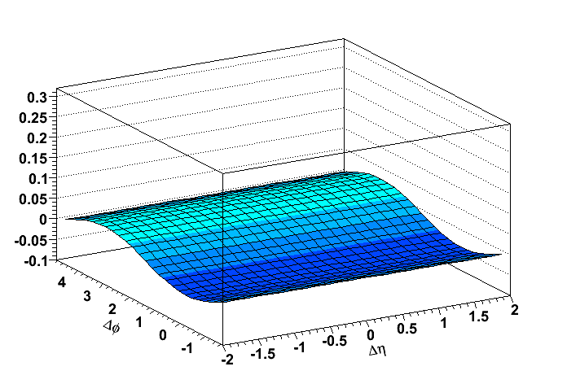
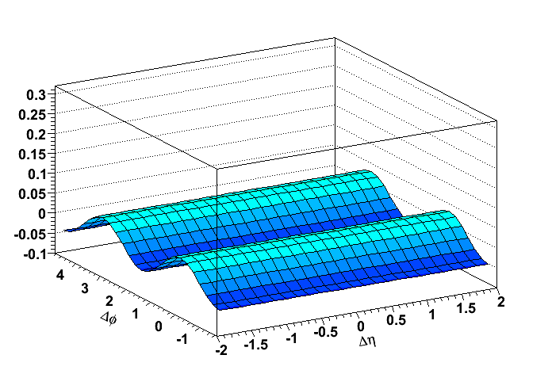
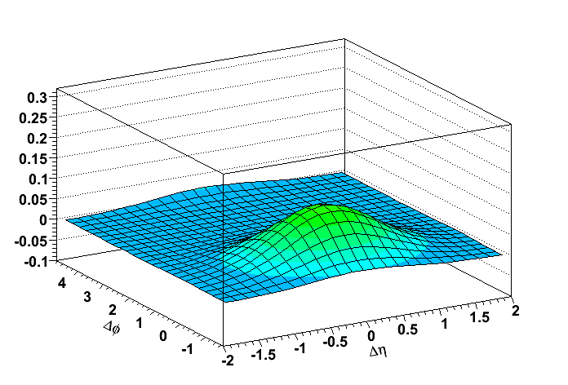
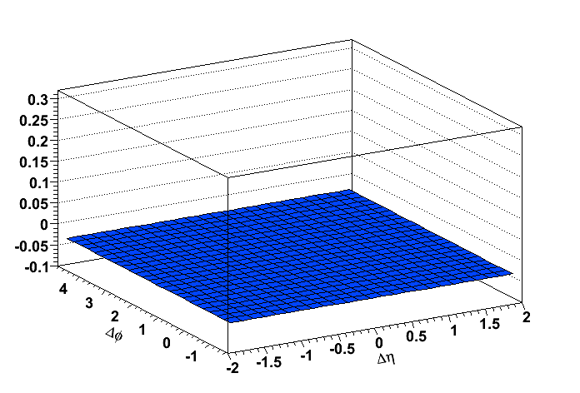
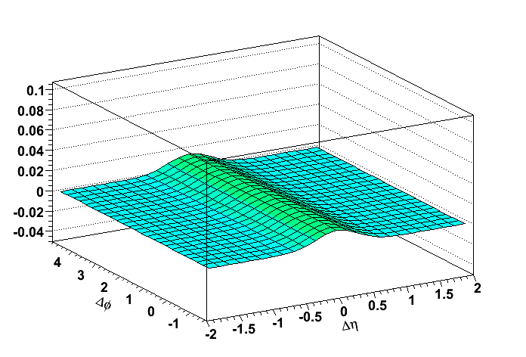
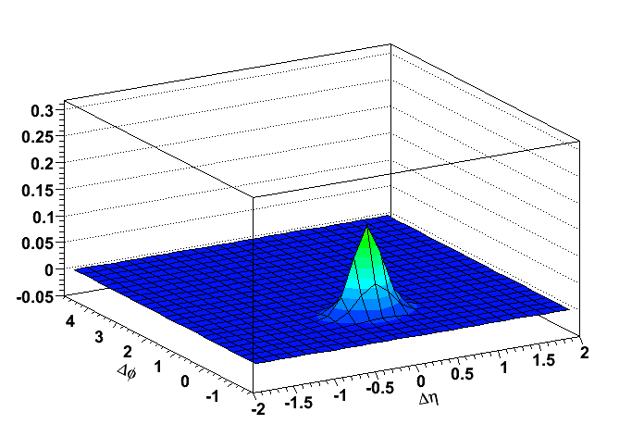
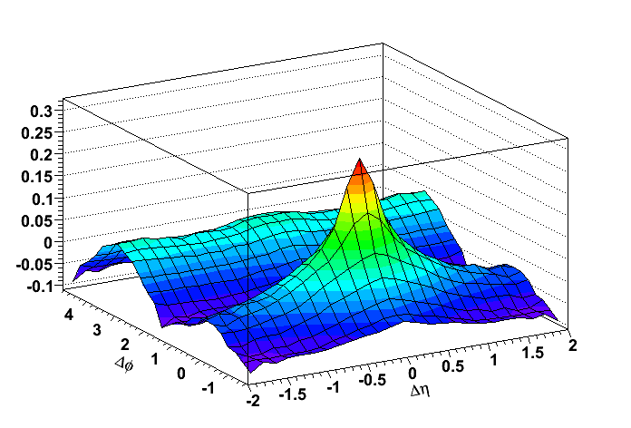
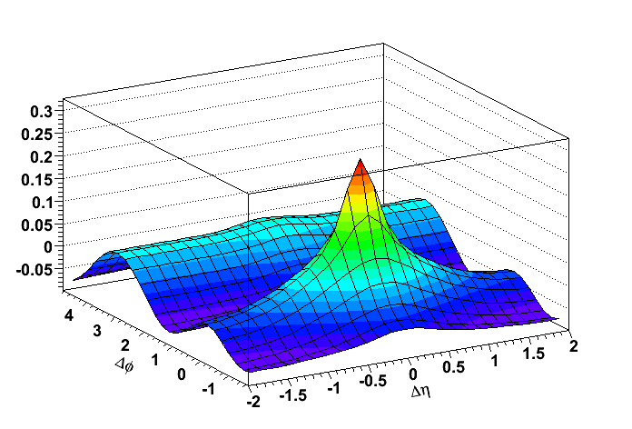
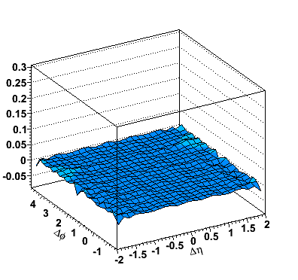
Decomposition
cos(Δφ)
cos(2 Δφ)
2d Gaussian
Ridge and Flow
STAR Preliminary
STAR Preliminary
STAR Preliminary
Offset
1d Gaussian
Exponent
STAR Preliminary
STAR Preliminary
STAR Preliminary
Fit function ingredients
Jet + const
Data
Fit
Residual
Cu+Cu 200 GeV
30 – 40% Central
STAR Preliminary
STAR Preliminary
STAR Preliminary
χ²/#dof ≈ 1.6
10
Notes:
The simplest justification of the fit function is to look at the residual. A separate study have been done to check the uniqueness of the fit. Q: Why we require chi2/NDF ~ 1 for the fit to be a good fit?

Slide 11
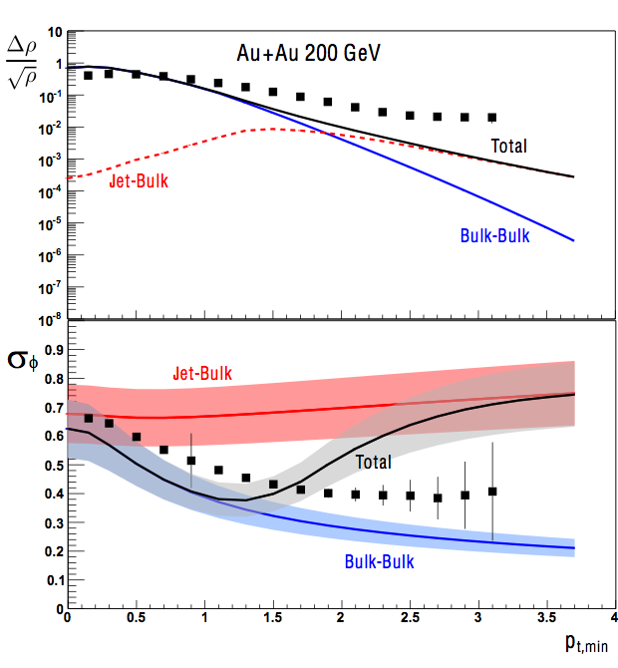
Comparison to Theory
One model, originally for the soft ridge:
Color Glass Condensate flux tubes and radial flow Gavin, McLerran and Moschelli: Phys.Rev.C79:051902,2009; Bulk-Bulk
Hybrid model to extend to higher p_{T} Moschelli and Gavin: Nucl.Phys.A836:43-58,2010; Jet-Bulk
Gaussian amplitude
Yield
Gaussian φ width
σ_{φ}
Ridge amplitude diverges from pure medium effect (Bulk-Bulk)
Extension to Jet-Bulk partially reconciles this.
The p_{T} evolution of the ridge Δφ width is still not conclusively captured
Jet-Jet correlations are not yet taken into account
11

Slide 12
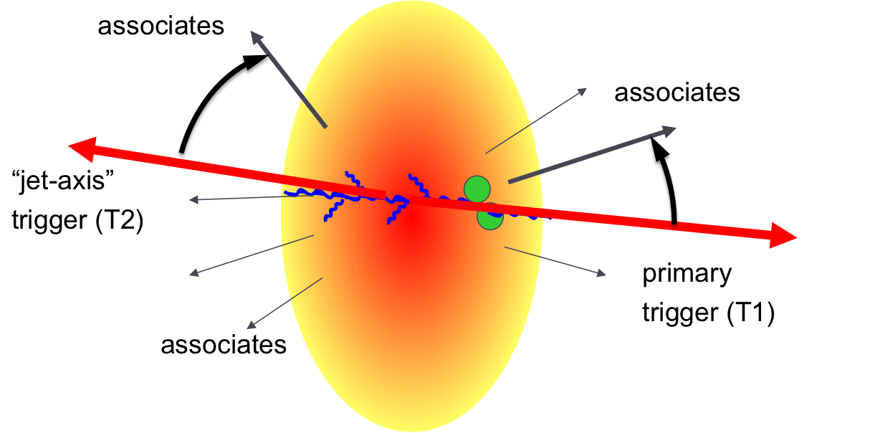
Di-Jets through Correlations
Trigger 1: 5-10 GeV/c
Trigger 2: p_{T} > 4 GeV/c, back-to-back with Trigger 1
Associated particles p_{T} > 1.5 GeV/c
200 GeV Au+Au (red and blue) and d+Au (black)
Red: Same-side Blue: Away-side
Red: Same-side Blue: Away-side
Red: Same-side Blue: Away-side
Δφ
Δη
pT
No evidence of medium modifications
Are all di-jets from the surface, purely tangential?
arXiv:1102.2669

Slide 13
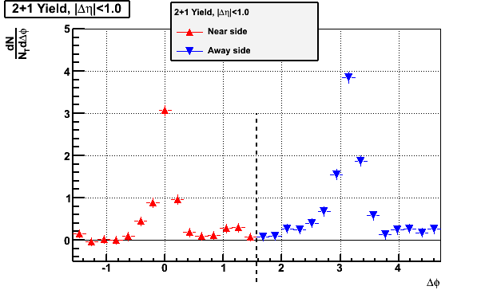
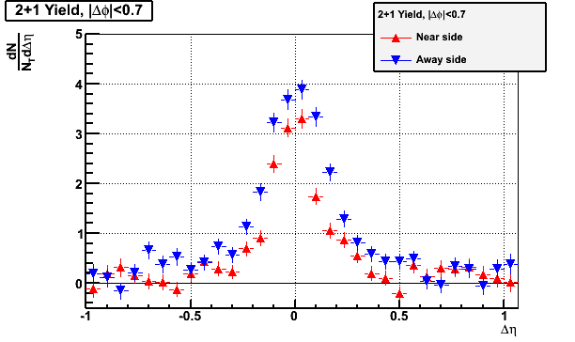
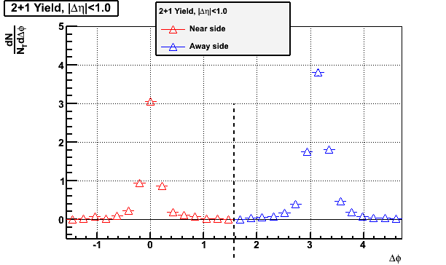
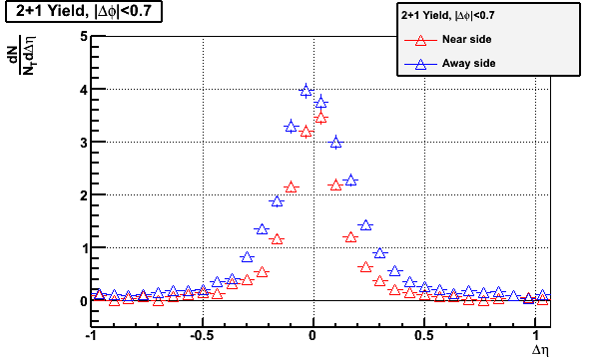
Large Energy Differential
Red: Same-side, Blue: Away-side
Au+Au
vs.
d+Au
High Tower triggered
200 GeV AuAu & d+Au
Trigger1: E_{T}>10 GeV Trigger2: p_{T}>4 GeV/c, Associate: p_{T}>1.5 GeV/c
Δφ
Δη
STAR Preliminary
Errors are statistical
Δφ
Δη
Still very little modification evident in shape and yield
Not consistent with theoretical expectations of significant energy deposition

Slide 14
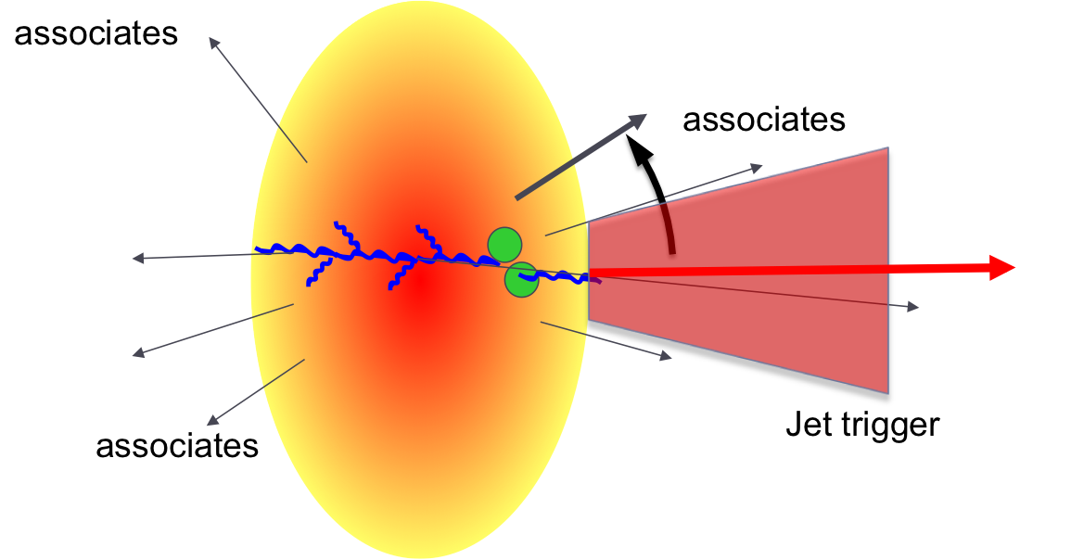
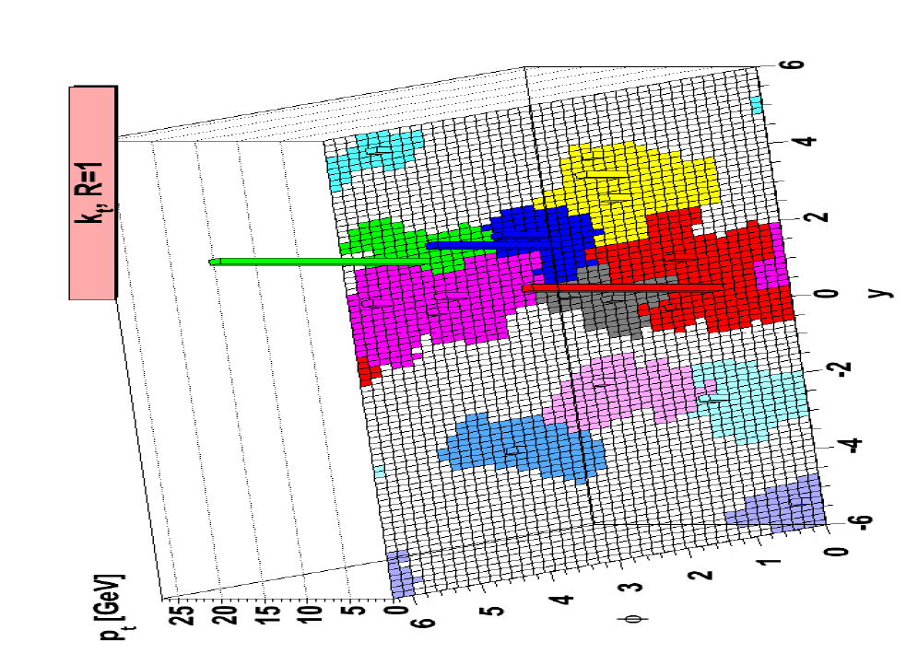
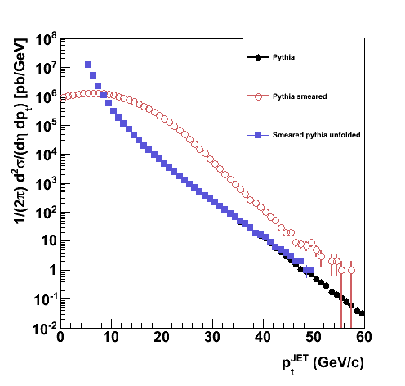
Full Jet Reconstruction
Reconstruct jets from distribution of clusters from anti-k_{T} (or k_{T}) jetfinder
Pythia
smeared
unfolded
Many advantages, but also many challenges
Underlying event fluctuations distort true cross-section
Correct with data-driven unfolding

Slide 15
Jet Quenching in Jet-h
0.2 < p_{T} ^{assoc}<1 GeV/c
1 < p_{T} ^{assoc}<2.5 GeV/c
2.5 GeV/c < p_{T} ^{assoc}
Au+Au 0-20% HT
STAR preliminary
Au+Au 0-20% HT
STAR preliminary
Au+Au 0-20% HT
STAR preliminary
200 GeV
p_{T}^{jet} > 20 GeV/c
Closed symbols Au+Au
Open symbols pp
Enhancement at low p_{T} –
balanced by suppression at high p_{T}
*No flow corrections applied in these plots.

Slide 16
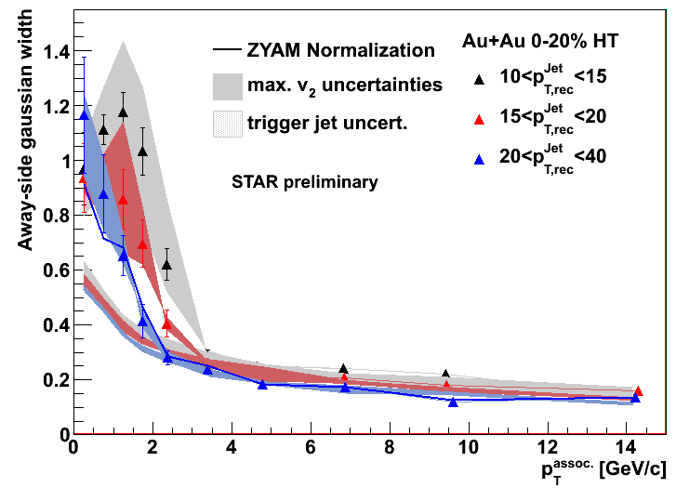
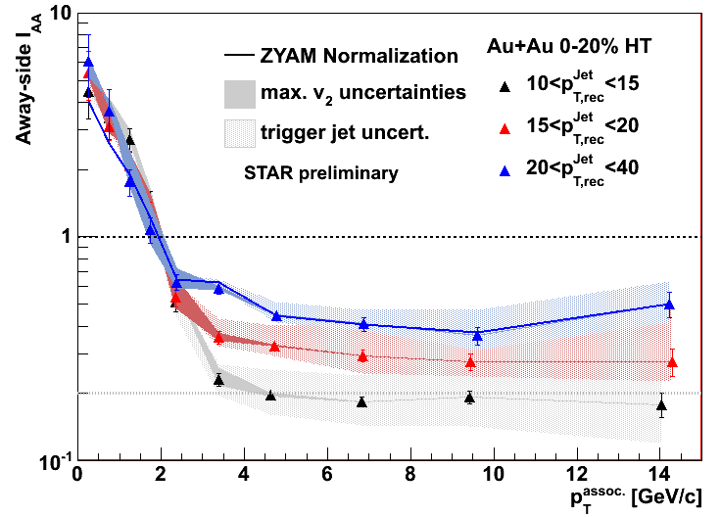
Away-side
Width
I_{AA}
Jets traversing the medium are softened and broadened
Jet Quenching in Action

Slide 17
Summary
Di-hadron correlations:
Evolution from “soft” to “hard” ridge – study shape, yield, spectra
Observe emerge of jet-like peak – unmodified?
2+1 is one example of how three-hadron correlations give more detailed insight into medium effects such as jet-quenching and the ridge:
Dijet triggers, view both sides of a hard scattering.
Similar near- and away-side triggers suggest strong surface bias
Full jet reconstruction in Heavy Ions is coming of age:
Jet-h correlations show softening and broadening of away-side jets
Near-side modification, reaction plane dependence, jet 2+1 and more are underway

Slide 18
Backup

Slide 19
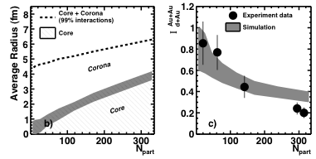
Eclipsing
From skin depth infer how dijet rate is attenuated from single jet rate.

Slide 20
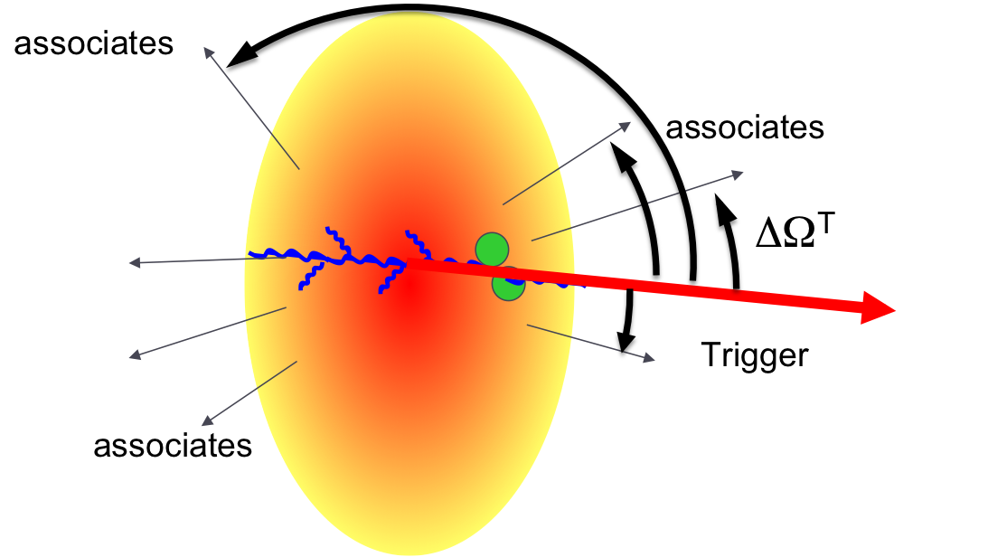
The Hard Ridge
Phys. Rev. C 80, 064912 (2009)
Au+Au 0-10%: √s_{NN} = 200GeV
Constant yield over wide range of Δη and p_{t,trig}
Spectrum and particle ratios similar to bulk
Not present in pp and d+Au at RHIC energies
Jet
Ridge
3 < p_{T}^{trig} < 4 GeV/c
2 < p_{T} ^{assoc}<p_{T} ^{trig}
Notes:
In STAR dihedron correlations, we observe a ridge like structure on the same side. It carries a jet like structure comparable to d+Au. Absolute yields of jet and ridge structures were obtained (reference).
Q: Need to know more about the last sentence
Q: Is this plot background subtracted? In general this means taking out/correcting for the correlated pairs that contributes via other sources. I need to discuss the Putschke’s wwnd08 presentation.

Slide 21
Untriggered Ridge
STAR preliminary
0 – 10%: Au+Au 200 GeV
What do we know: (M. Daugherity for STAR Collaboration, QM 2008)
Strong centrality variations of the same side structure
Multiple particle production mechanisms contribute to correlation function in
soft sector
Why is it interesting:
The same side structure is an elongated 2D Gaussian
Significant soft particle contribution
Notes:
At first glance we see those structures. The same side structure is not a ridge exactly.
Bullet 2, what do we know: because we have the entire momentum range? Should I rather have mike’s plot?

Slide 22
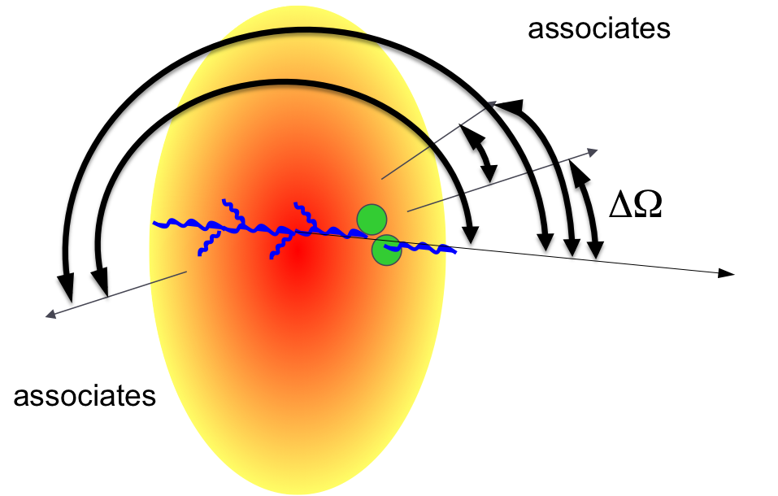
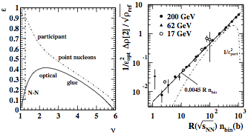
Quadrupole evolution
2D fit model with 8 free parameters
Sharp peak near (0,0) (from electrons) ignored
Elliptic flow v2{2D} from quadrupole term
Same-Side gaussian dominates non-flow
Δη dependence distinguishes flow from non-flow
'Nonflow' contribution can be interpreted as minijets
Au+Au 200GeV
p_{T} integrated
Extracted quadrupole term has a simple parameterization in terms of optical eccentricity
Possible factorization?
Eur. Phys. J. C (2009) 62: 175-181
arXiv:0907.2686

Slide 23
Jet Tomography
associates
associates
Trigger
associates
1+2
(neglected in this talk)

Slide 24
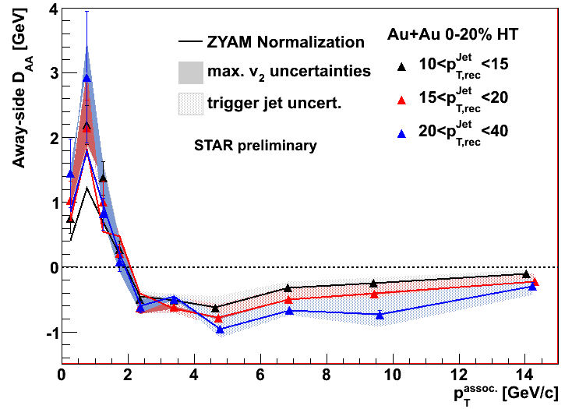
DAA

Slide 25
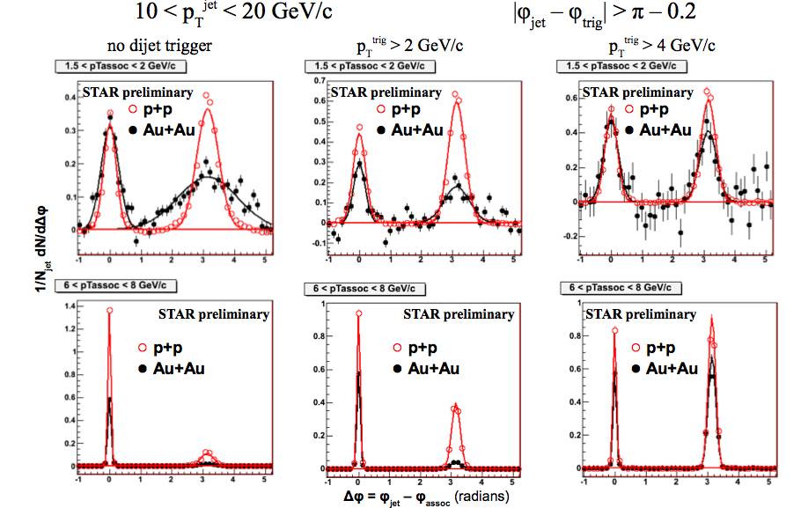
Jet-h 2+1

