Slide 1
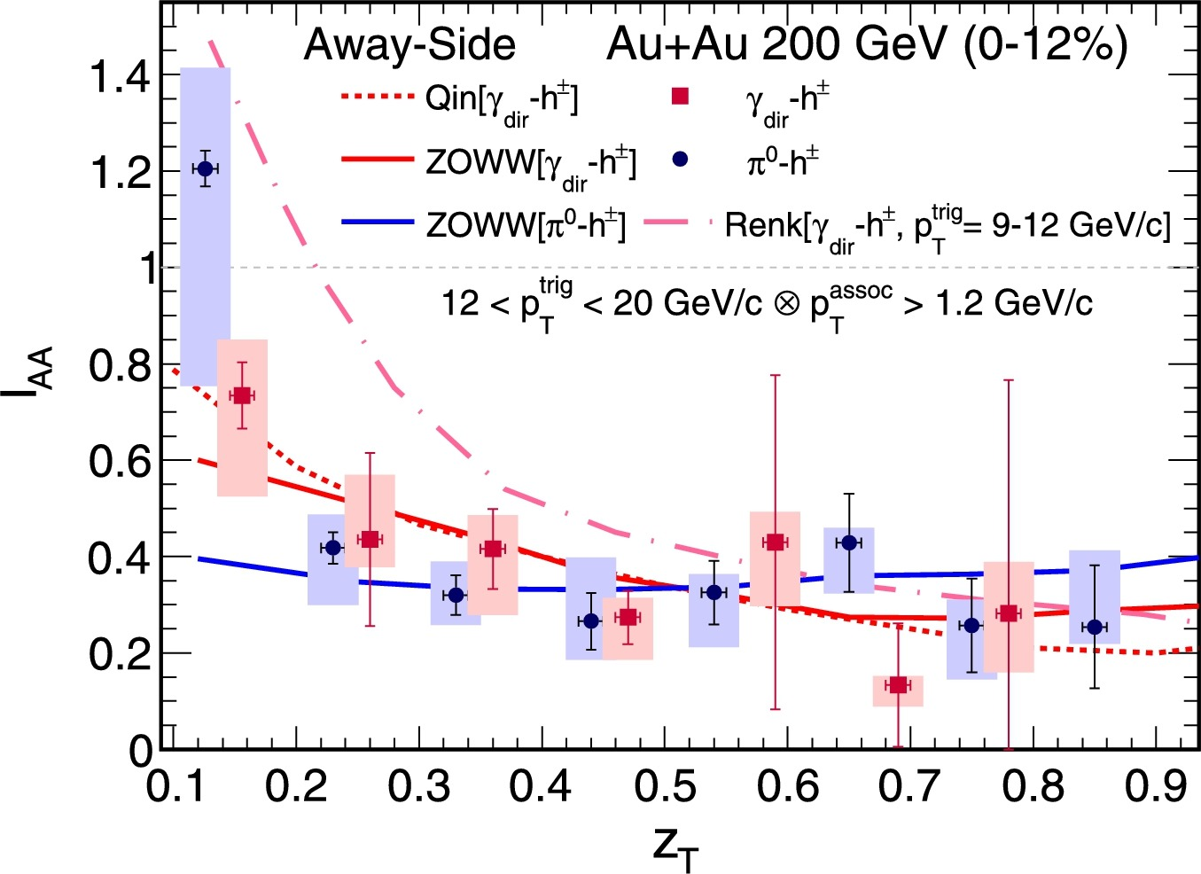
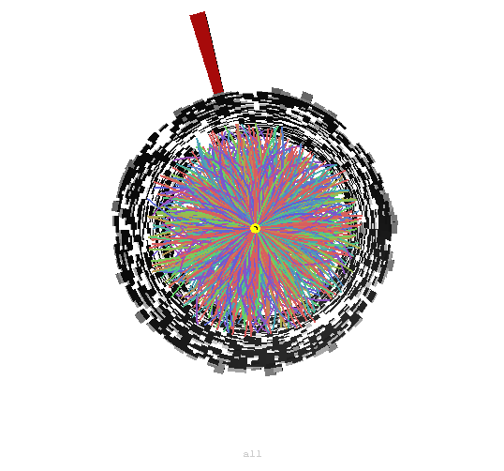
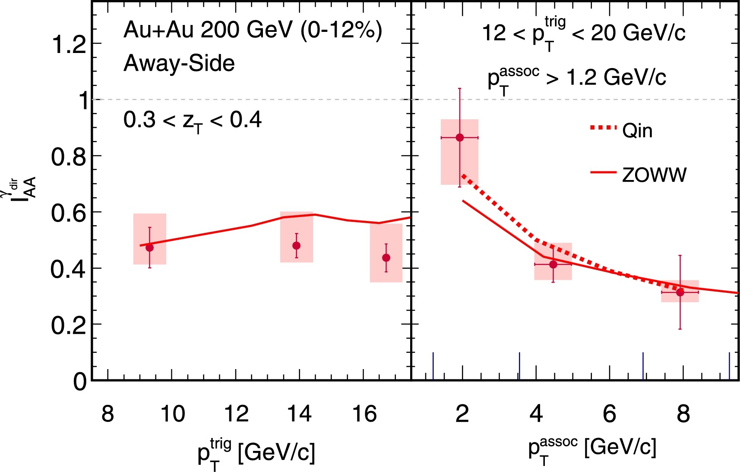
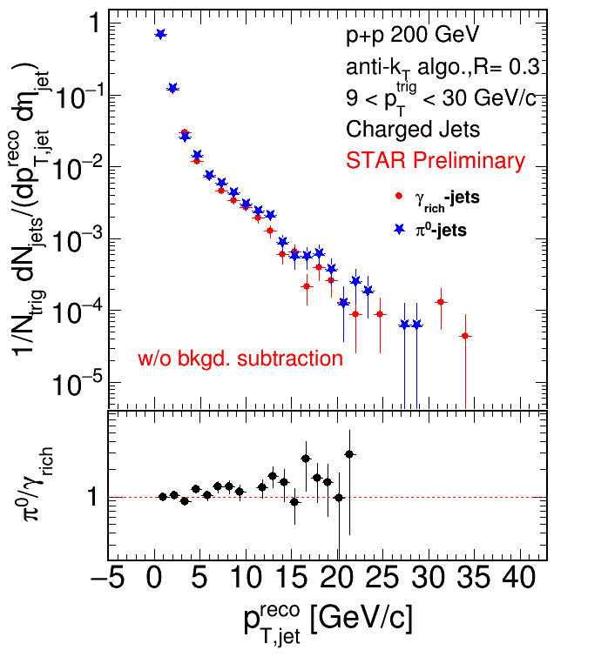
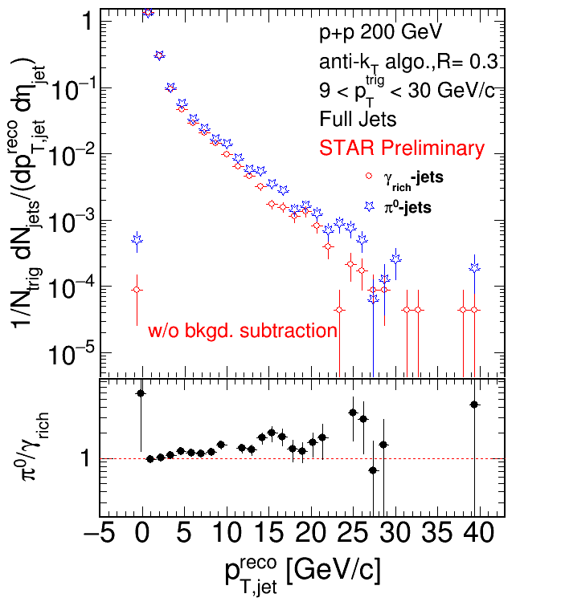
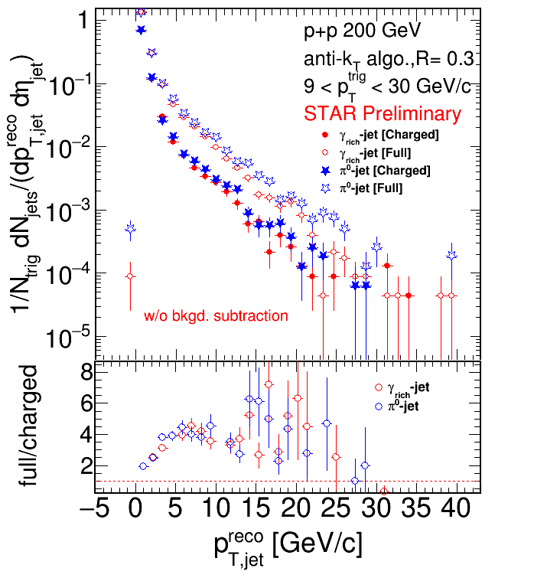
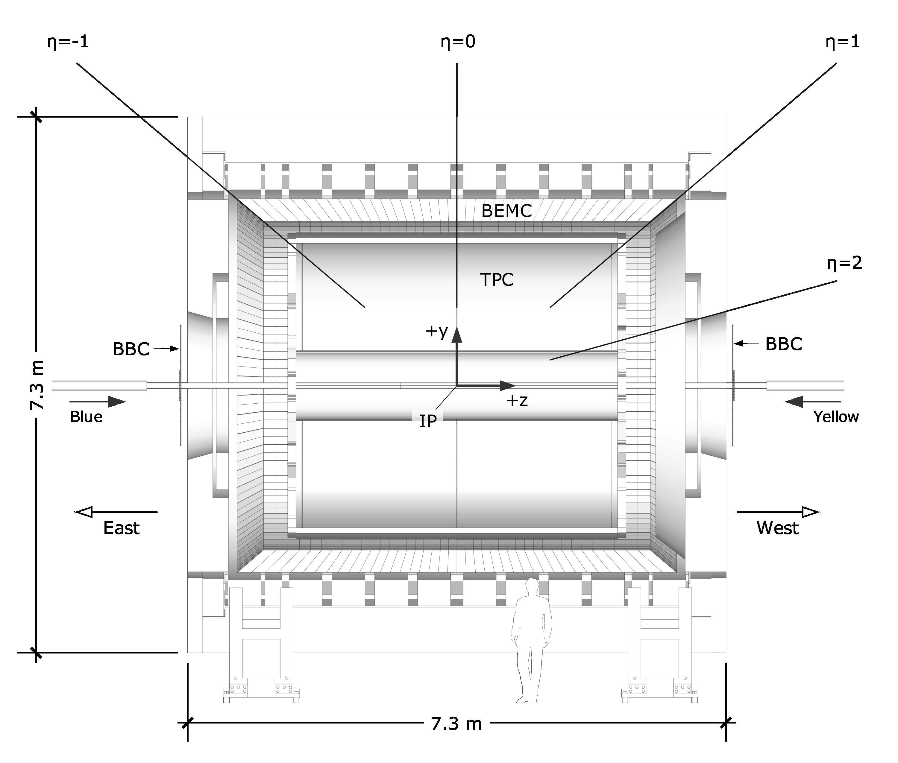
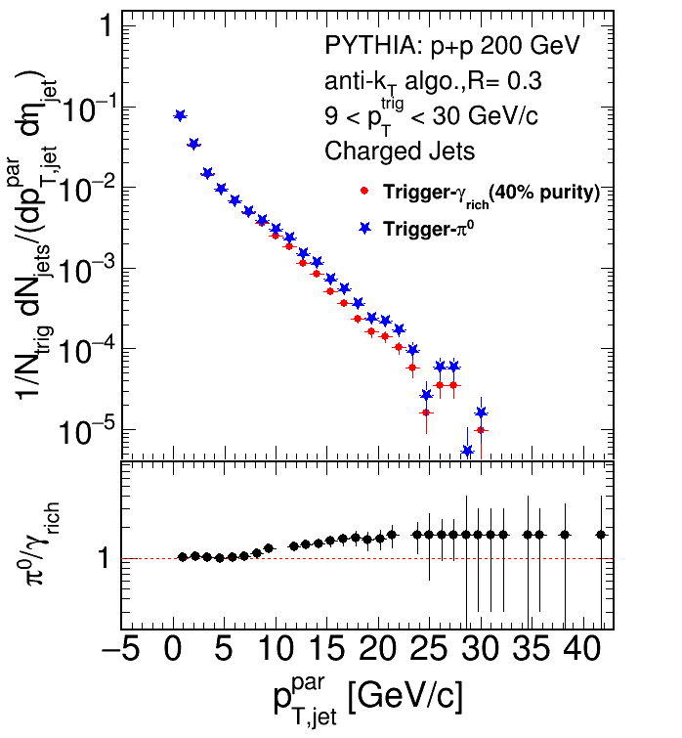
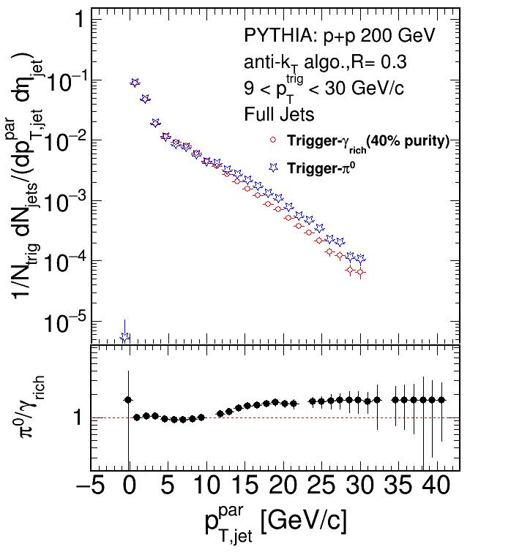
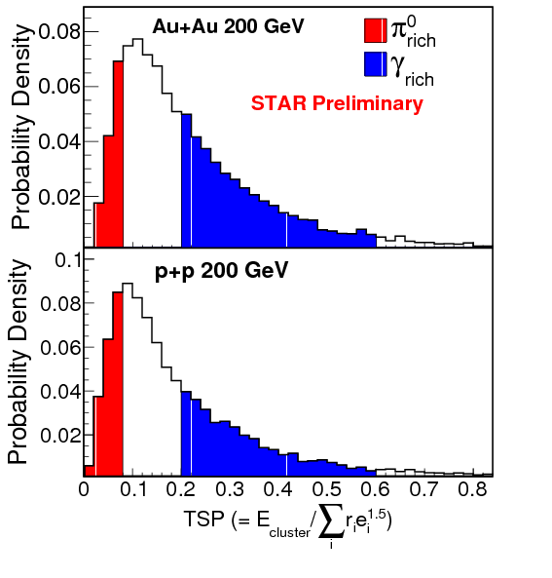
Reconstruction of Neutral-Triggered Full Recoil Jets in $\sqrt{s}=200$ GeV p+p Collisions at the STAR Experiment
Derek Anderson, for the STAR Collaboration
Abstract
In heavy-ion collisions, the study of recoil jets tagged by high transverse-momentum “direct photons” ($γ_{dir}$) provides a calibrated probe of partonic energy loss in the hot, dense medium produced in such collisions. Since a $γ_{dir}$ does not interact strongly with the medium, it closely approximates the initial energy of the recoiling parton. Moreover, the comparison of $γ_{dir}$-tagged recoil jets to $π^{0}$-tagged recoil jets may shed light on the path-length and color-factor dependence of in-medium partonic energy loss. To establish a vacuum fragmentation reference, we present the measurement of the yields of full recoil jets (recoil jets consisting of both charged and neutral particles) in p+p collisions. Jets are reconstructed using the STAR Time Projection Chamber and Barrel Electromagnetic Calorimeter in p+p collisions at $\sqrt{s}=200$ GeV tagged by neutral-particle triggers recorded during the running year 2009. To assay the effect of reconstructing full jets versus charged-only jets in such studies, the yields of charged recoil-jets are compared to the yields of full recoil-jets.
Motivation
Jet Reconstruction
Direct photons ($γ_{dir}$) offer a channel to study medium-induced energy loss [1]
To leading order, $γ_{dir}$ do not interact strongly with medium
Measured energy of a $γ_{dir}$ closely approximates $E_{0}$ of recoiling parton
Comparing the quenching of jets recoiling from $γ_{dir}$ to those recoiling from energetic $π^{0}$
$π^{0}$ biased towards surface emission while $γ_{dir}$ have no such bias [2]
$π^{0}$ mostly recoil from gluon jets [3, 4]
$γ_{dir}$ mostly recoil from quark jets
On average, jets recoiling from $γ_{dir}$ should be less quenched than those recoiling from energetic $π^{0}$
Recent measurement of $I_{AA}$ by the STAR collaboration [5]
Difference not observed within uncertainty!
Now pursuing full jet reconstruction of jets recoiling from $γ_{dir}$ and energetic $π^{0}$ in Au+Au collisions
p+p collisions serve as control in which no medium is produced
Jet reconstructed from
TPC tracks with $p_{T}^{trk}∈\left(0.2, 30\right)$ GeV/c and $\left|η_{trk}\right|<1$
BEMC towers with $E_{T}^{twr}∈\left(0.2, 30\right)$ GeV (after “100% Hadronic Correction”) and $\left|η_{twr}\right|<1$
Clustered using FastJet 3.0.6 [7]
Jet candidates satisfy:
$A_{jet}>0.2$ and $p_{T,jet}^{raw}>0.2$ GeV/c
$\left|η_{jet}\right|<1−R$
Jet $p_{T}$ adjusted for background energy density with:
$$p_{T, jet}^{reco}=p_{T, jet}^{raw}−ρ∙A_{jet}$$
Where
$$ρ≡median\left\{{p_{T,jet}^{raw,i}(k_{T})}/{A_{jet}^{i}(k_{T})}\right\}$$
$π−π/4$
Trigger
Tower
Recoil
Jets
$π+π/4$
Recoil Jet: any jet satisfying
$$\left|Δφ−π\right|<π/4$$
Charged Jets: jets composed solely of charged tracks
Full Jets: jets composed of charged tracks and neutral towers
The STAR Experiment
Time Projection Chamber (TPC):
Charged particle (track) $p_{T}$
Barrel Electro-Magnetic Calorimeter (BEMC):
Neutral particle (tower) $E_{T}$
Used to trigger on p+p collisions containing energetic $γ_{dir}$ or $π^{0}$
Energetic $γ_{dir}$- and $π^{0}$-triggers satisfy:
$E_{T}^{trg}∈(9, 30)$ GeV
$\left|η_{trg}\right|<0.9$
Data not corrected for efficiency and bkgd. Fluctuations
$p_{T, jet}^{par}$ indicates same quantity as $p_{T, jet}^{reco}$but at particle-level
Pythia: [8]
Neutral Triggers
Barrel Shower Maximum Detector (BSMD):
Used to distinguish between the $γ_{dir}$ and $π^{0}$ via their TSP
Transverse Shower Profile (TSP):
$$TSP=\frac{E_{cluster}}{\sum_{i}{e_{i}r_{i}^{1.5}}}$$
$E_{cluster}$ is total energy of cluster
$e_{i}$ and $r_{i}$ are energy and distance to cluster center of i^{th} BSMD strip
Data are split into two samples:
One a 95% pure sample of $π^{0}$ satisfying $TSP∈(0, 0.08)$
One with an enhanced fraction of $γ_{dir}$ ($γ_{rich}$) satisfying $TSP∈\left(0.2, 0.6\right)$ [5]:
$$\frac{N^{γ_{dir}}}{N^{γ_{rich}}}\sim 40\%$$
$$∴γ_{rich}=0.4⋅γ_{dir}+0.6⋅π^{0}$$
Conclusions and Future Work
Full recoil jets have been reconstructed in p+p collisions at $\sqrt{s}=200$ GeV for $γ_{rich}$- and $π^{0}$-triggers
Modest difference in yields observed due to difference in production mechanisms
Qualitative features consistent with Pythia
In the near future:
Detector effects will be corrected using unfolding procedure
Uncorrelated background will be subtracted
Soon full recoil jet reconstruction in Au+Au collisions will be pursued
Please see the talk by Nihar Sahoo!
[Parallel Session 1.4: Jets and High-pT Hadrons (I)]
[6]
References
[1] X.-N. Wang, Z. Huang, and I. Sarcevic, Phys. Rev. Lett. 77, 231 (1996)
[2] T. Renk, Phys. Rev. C 80, 014901 (2009)
[3] D. Florian et al., Phys. Rev. D 91, 014035 (2015)
[4] T. Kaufmann et al., Phys. Rev. D 92, 054015 (2015) [5] L. Adamczyk et al. (STAR Collaboration), Phys. Lett. B 760, 689-696 (2016)
[6] N. Sahoo, Nucl.Phys. A956, 621-624 (2016)
[7] M. Cacciari, G. P. Salam, and G. Soyez, Eur. Phys. J. C72, 1896 (2012)
[8] T. Sjöstrand, S. Mrenna and P. Z. Skands, Comput. Phys. Commun. 178, 852 (2008)
The STAR Collaboration
drupal.star.bnl.gov/STAR/presentations

