Slide 1
Measurement of Upsilon production cross section in d+Au collisions at √s_{NN}=200 GeV
Anthony Kesich
STAR Collaboration
University of California, Davis
April APS Meeting
May 1, 2011

Slide 2
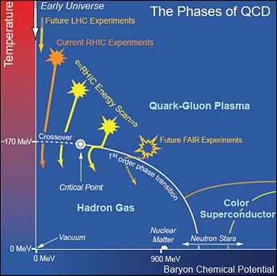
Quarkonia as a Temperature Probe
T/T_{C}
1/⟨r⟩ [fm⁻¹]
2
ϒ(1S)
χ_{b}(1P)
1.2
J/ψ(1S) ϒ’(2S)
≤T_{C}
χ_{b}’(2P)
ϒ’’(3S)
χ_{c}(1P)
Ψ’(2S)
A .Mocsy, 417th WE-Heraeus-Seminar,2008
A. Mocsy and P.Petreczky, PRL 99, 211602 (2007)
Quarkonia suppression is a proposed signature of QGP formation
Degree of suppression is a probe of initial QGP temperature
Need d+Au measurements to constrain cold nuclear matter effects
e.g. Shadowing, Cronin effect

Slide 3
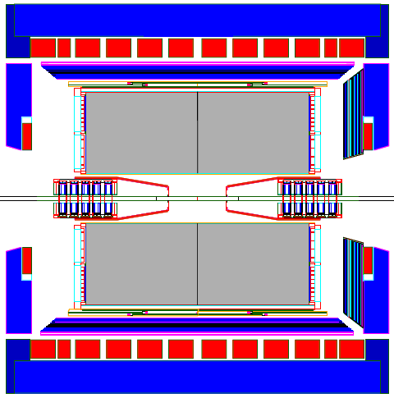
STAR Detector
Time Projection Chamber
Gas Ionization Tracker
Used for eID
Full coverage in φ
|η|<1
No Silicon Tracker!
Reduces EM material budget from 0.06 to 0.01 radiation lengths
Electromagnetic Calorimeter
Fast detector
Used for triggering and eID
Full coverage in φ
|η|<1
Notes:
6% radiation length vs 1% in material budget without SVT

Slide 4
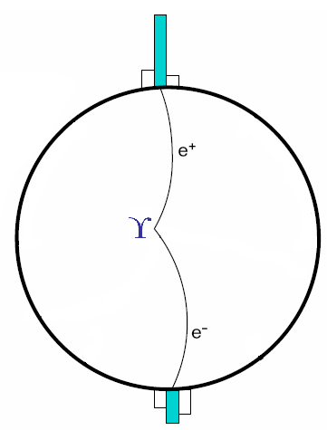
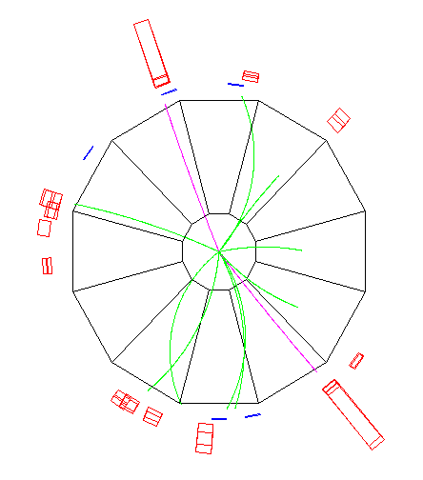
Upsilon Trigger
E₁ Cluster
Called every time we see a high energy tower (>3.5 GeV)
Looks for an associated high energy cluster
Required opening angle larger than 90°
Cuts on reconstructed mass
Only looks at the electromagnetic calorimeters
L0 Trigger Tower
pp
θ
E₂ Cluster
Data

Slide 5
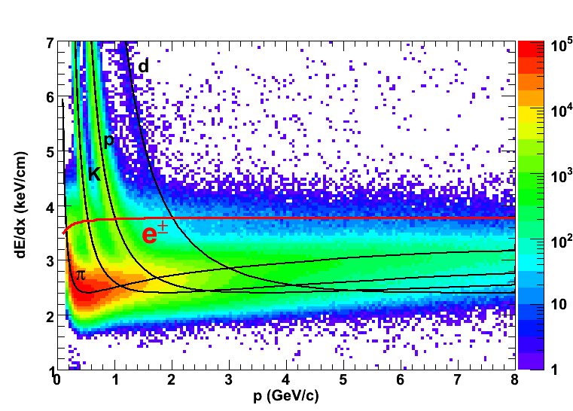
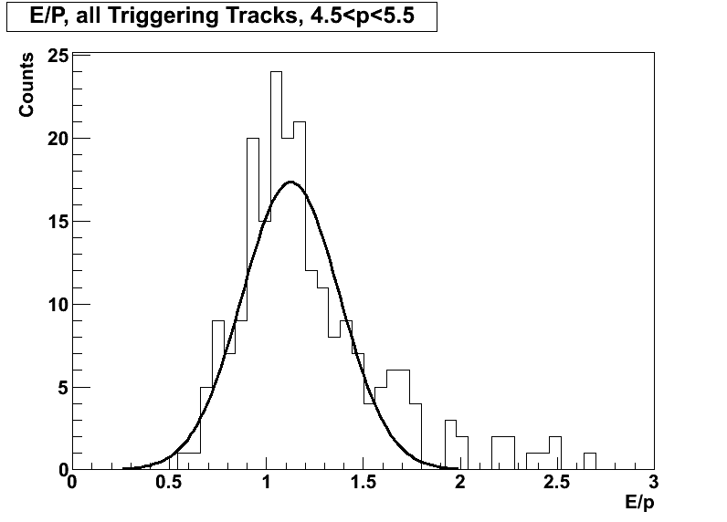
Electron Identification
Matched to tower
Tight dE/dx cut for purer sample (nσ_{e}>0)
Purity is ~95%
Three Methods:
Match ionization track in TPC to a calorimeter cluster
Measure ionization energy loss in TPC
Calculate E/p using the TPC and calorimeters

Slide 6
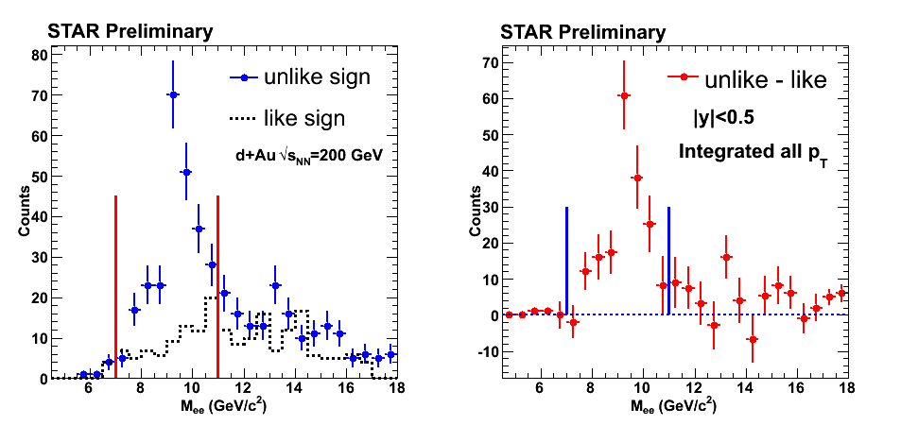
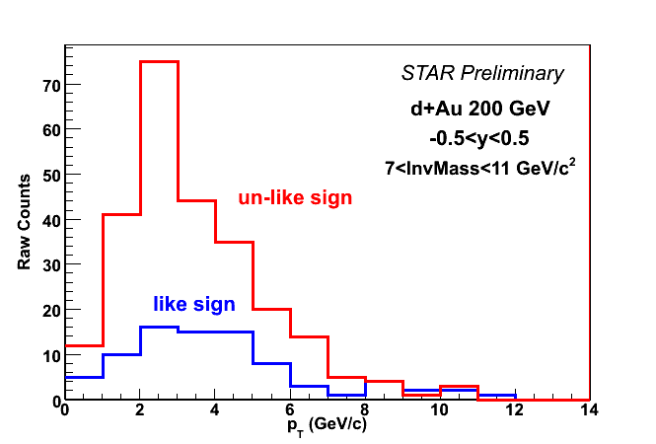
Observed Upsilon Signal
Signal + Background ⇒ unlike-sign electron pairs
Background ⇒ like-sign electron pairs
ϒ(1S+2S+3S) total yield: integrated from 7 to 11 GeV from background-subtracted m_{ee} distribution
Raw Yield: 172 +/- 20 (stat.)
Strong signal (8σ significance)

Slide 7
Efficiencies
ε_{ϒ}=ε_{acc}×ε_{L0+L2}×ε²_{(TPC reco)}×ε² _{(eID cut)} × ε_{mass}
ε_{acc} | 0.34±0.025
ε_{L0+L2} | 0.71±0.05
ε²_{(TPC reco)} | 0.72±0.07
ε²_{(eID cut)} | 0.87±0.04
ε_{mass} | 0.96±0.04
ε_{ϒ} | 0.15±0.02
ε_{acc} is the efficiency of EMC detector and the geometrical acceptance
ε_{L0+L2} is the efficiency trigger system
ε_{(TPC reco)} is efficiency of e reco in TPC
ε_{mass} is efficiency of mass cut
ε_{(eID cut)} is efficiency of eID cuts

Slide 8
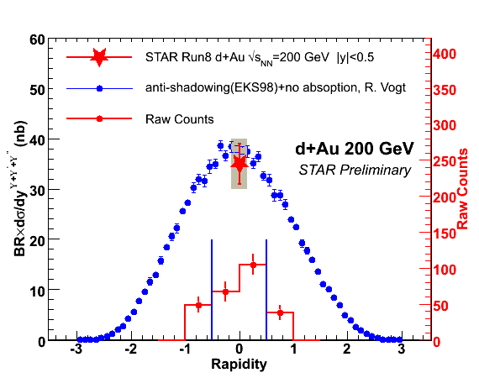
Upsilon d+Au Cross Section
N_{ϒ} | 172 ± 20
ε_{ϒ} | 0.15 ± 0.02
∫Ldt | 32 nb⁻¹
dy | 1.0
σ=35 ± 4(stat.) ± 5(syst.) nb

Slide 9
Nuclear Modification Factor
Measure of suppression vs. binary scaled pp collisions
R_{dAu}=1 means no cold nuclear effects
R_{dAu}=0 is full suppression
σ_{pp}=42 mb, σ_{dAu}=2.2 b
From Glauber model: <N_{bin}>=7.5±0.4
pp Y->ee mid-rapidity cross section: 114±38±24 pb
PRD 82 012004 (2010)
R_{dAu}=0.78±0.28(stat.)±0.20(syst.)

Slide 10
Summary and Outlook
Run 8 d+Au greatly increased our available data in a low material environment
Measured R_{dAu}=0.78±0.28(stat.)±0.20(syst.)
Consistent with minimal cold nuclear matter shadowing
Additional statistics (∼×3) in Run 9 pp 200 GeV will further shrink the R_{dAu} uncertainty

