Slide 1
Beam Energy Scan Results from STAR
Bingchu Huang (for the STAR Collaboration)
University of Illinois at Chicago

Slide 2
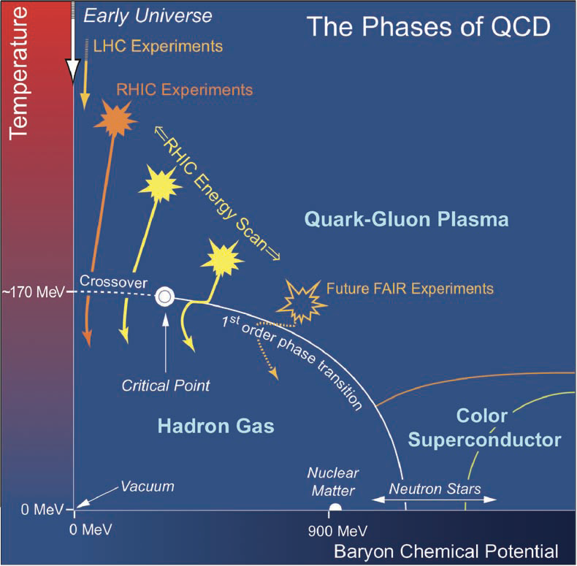
Explore the QCD phase diagram
Vary collision energy to change temperature and baryon chemical potential.
Search for turn-off signatures of sQGP.
Search for 1st order phase transition from partonic to hadronic phase.
Search for possible critical point.

Slide 3
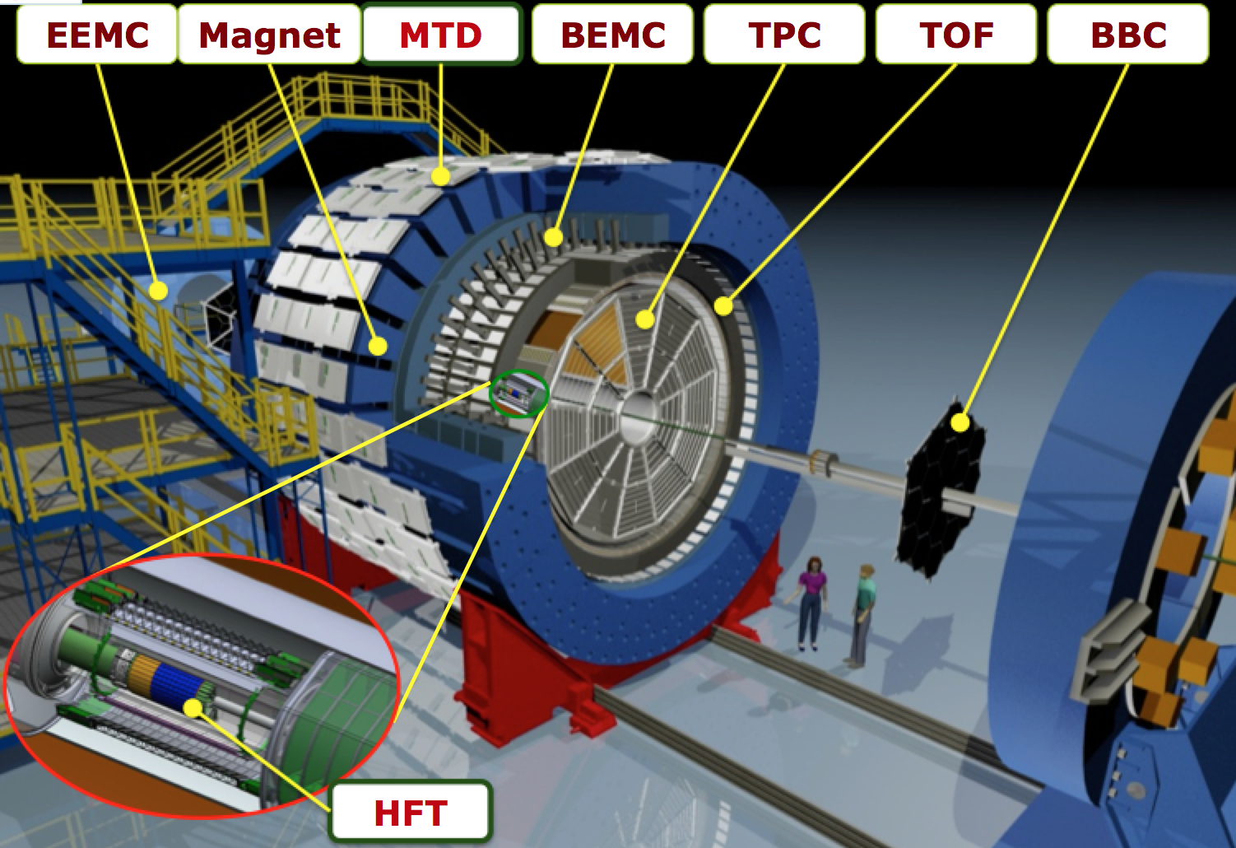
Beam Energy Scan Phase I at RHIC
√s (GeV) | nEvents (M) 0-80% | Year | μB (MeV) | T (MeV) | μB/T
7.7 | 4 | 2010 | 420 | 140 | 3.020
11.5 | 12 | 2010 | 315 | 152 | 2.084
14.5 | 20 | 2014 | 266 | 156 | 1.705
19.6 | 36 | 2011 | 205 | 160 | 1.287
27 | 70 | 2011 | 155 | 163 | 0.961
39 | 130 | 2010 | 115 | 164 | 0.684
62.4 | 67 | 2010 | 70 | 165 | 0.439
200 | 350 | 2010 | 20 | 166 | 0.142
μB, T: J. Cleymans et al., Phys. Rev. C 73, 034905 (2006).
STAR BES White paper: SN0598

Slide 4
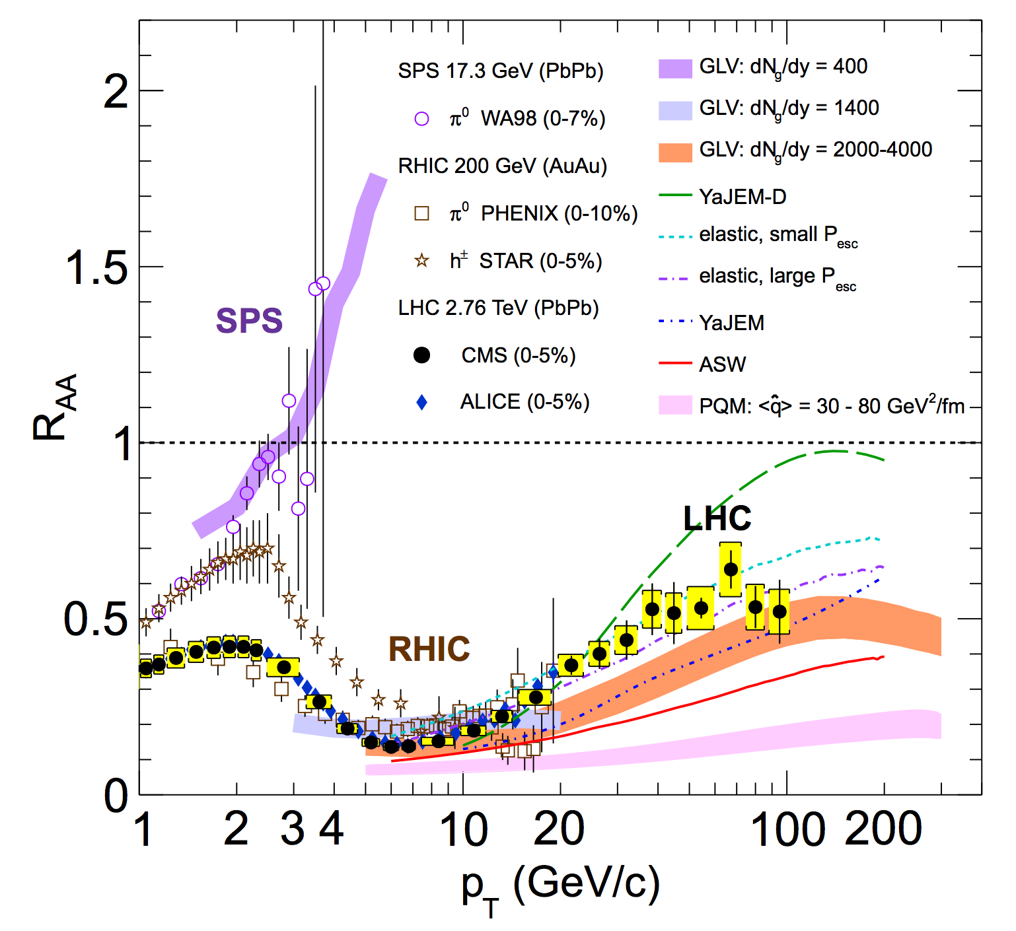
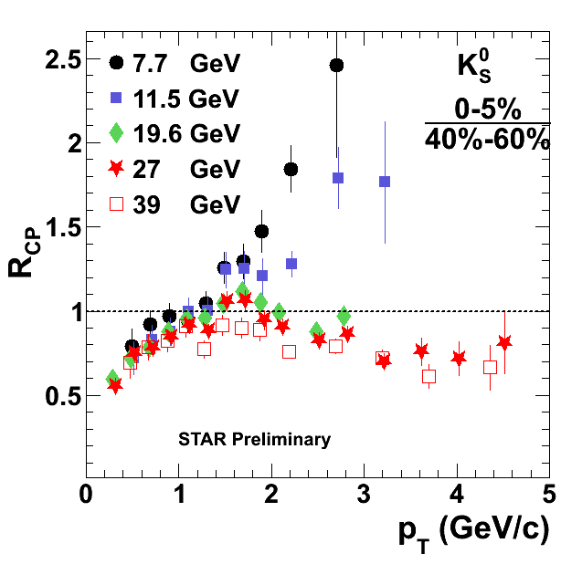
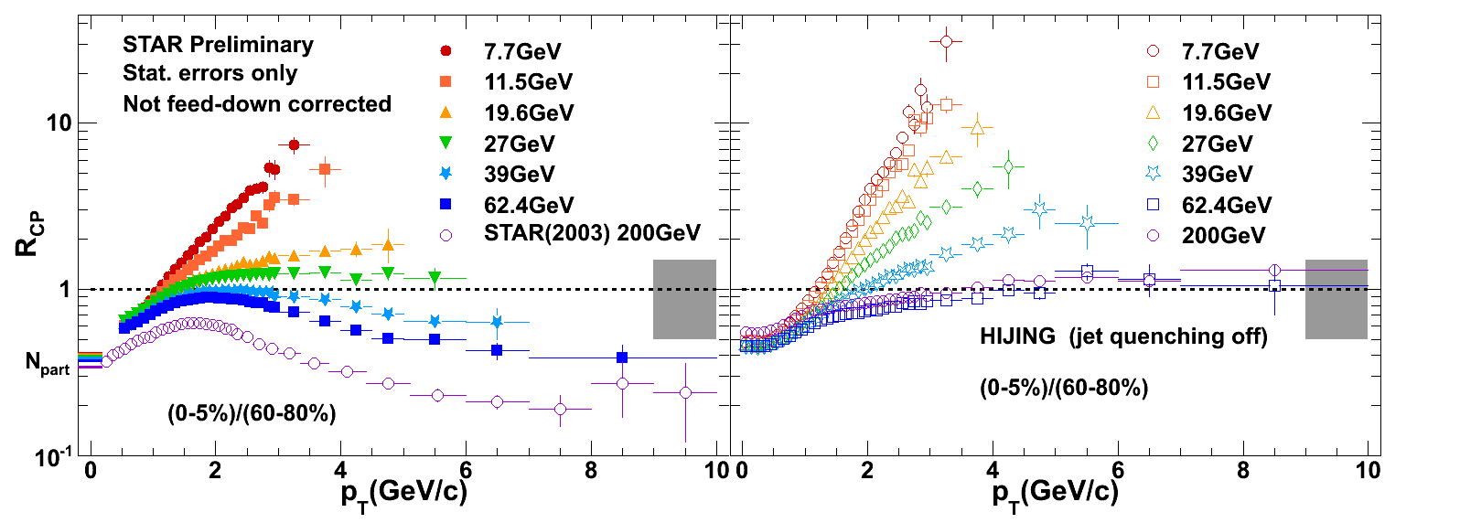
High p_{T} hadron suppression
Deconfined state of dense medium at RHIC top energy and LHC.
Enhanced high pT (>2 GeV/c) production at lower energies.
No jet quenching in HIJING at lower BES energies.
EPJ 72 (2012) 1945

Slide 5
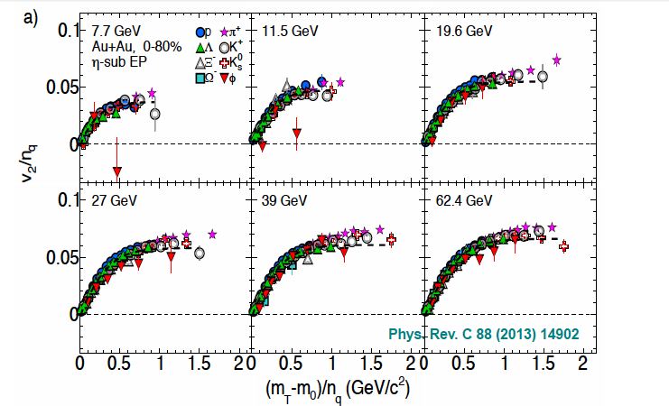
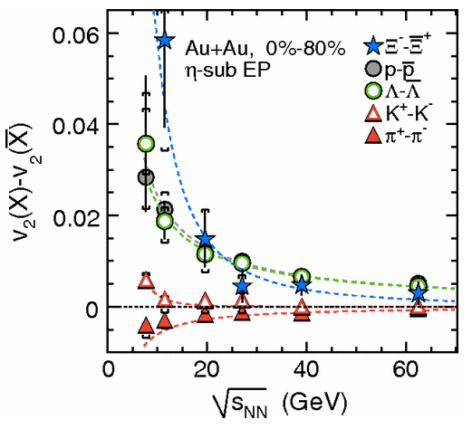
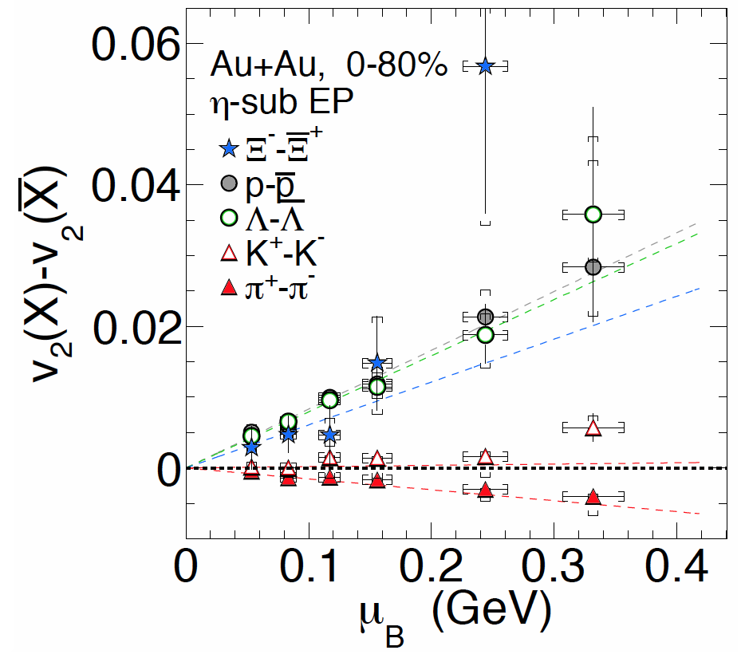
Azimuthal Anisotropy
Phys.Rev.Lett. 110 (2013) 142301
NCQ scaling as seen for 200 GeV not observed for 11.5 GeV.
Split of particle-antiparticle at lower beam energy.
Linear dependence on the μ_{B}.

Slide 6
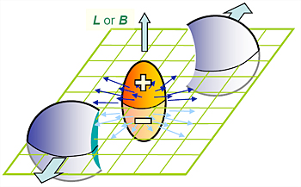
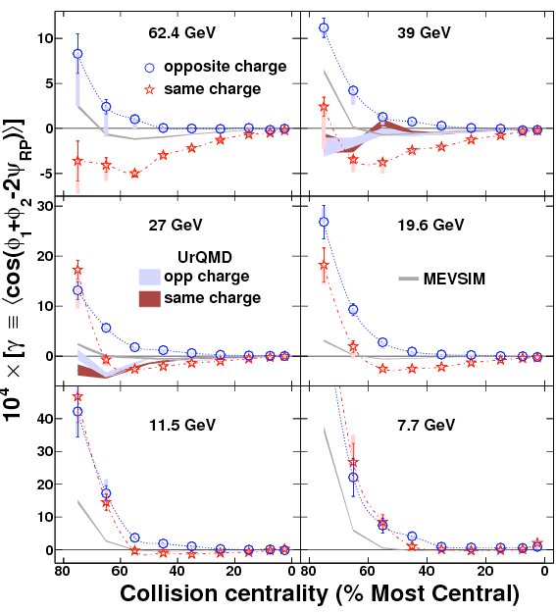
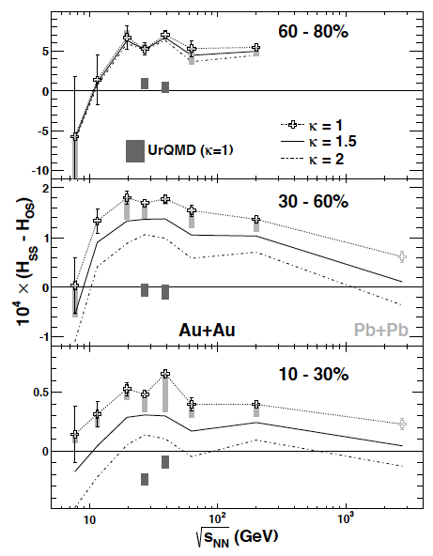
Charge correlations
External Magnetic Filed:
Charge separation, Chiral Magnetic Effect (CME)
Chiral charge separation, Chiral Separation effect (CSE).
Flow Vorticity:
Chiral Vortical Effect (CVE).
Charge correlations vanishes at lower energies where haronic phase become dominant.
Phys.Rev.Lett. 113, 052302 (2014)

Slide 7
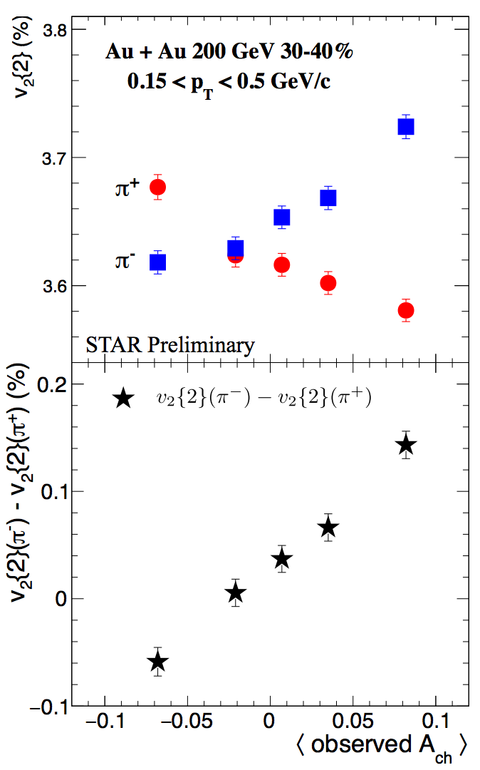
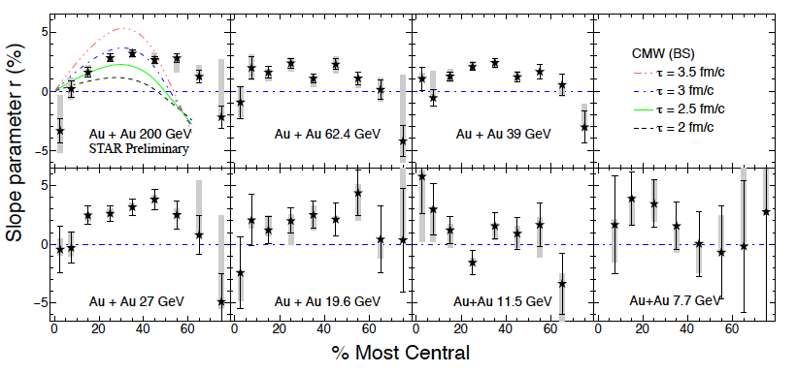
Charged pion v₂ separation
CMW: Chiral Magnetic Wave Model
Y. Burnier et al., arXiv:1208.2537 [hep-ph]
The centrality dependence of difference between v₂(π+) and v₂(π-) vs. charge asymmetry is observed for Au+Au collisions at √s_{NN} ≥ 27 GeV, as expected by CMW model predictions.

Slide 8
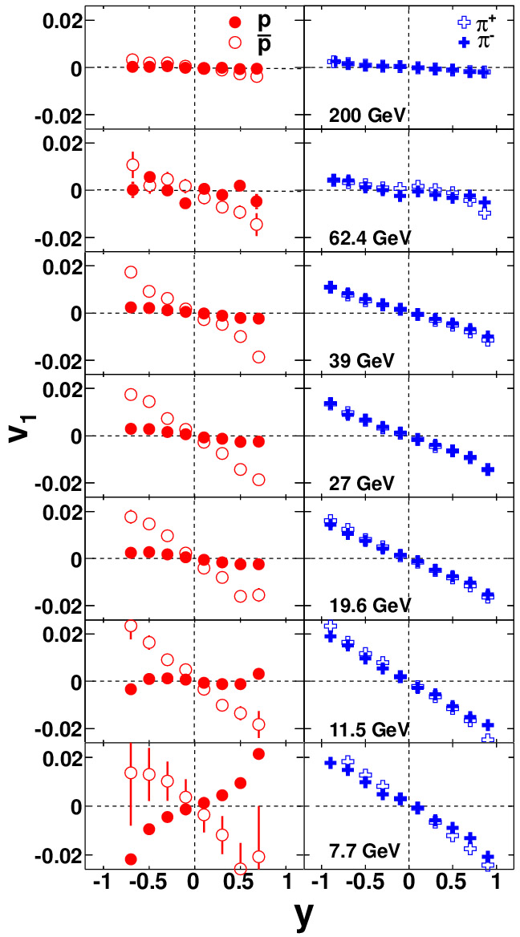
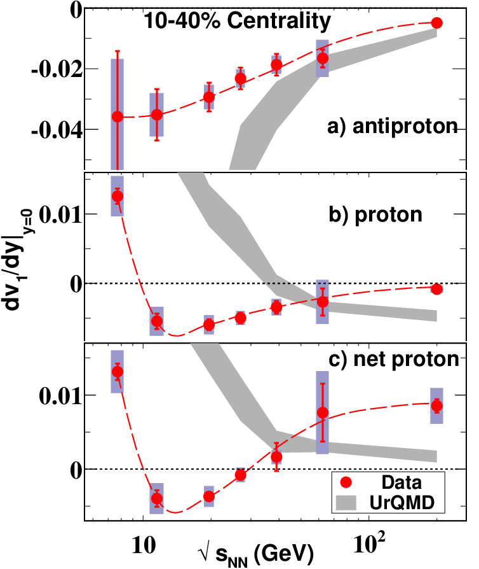
Direct flow v₁
PRL 112 (2014) 162301
Consistent with general theoretical expectations from 1st order phase transition.

Slide 9
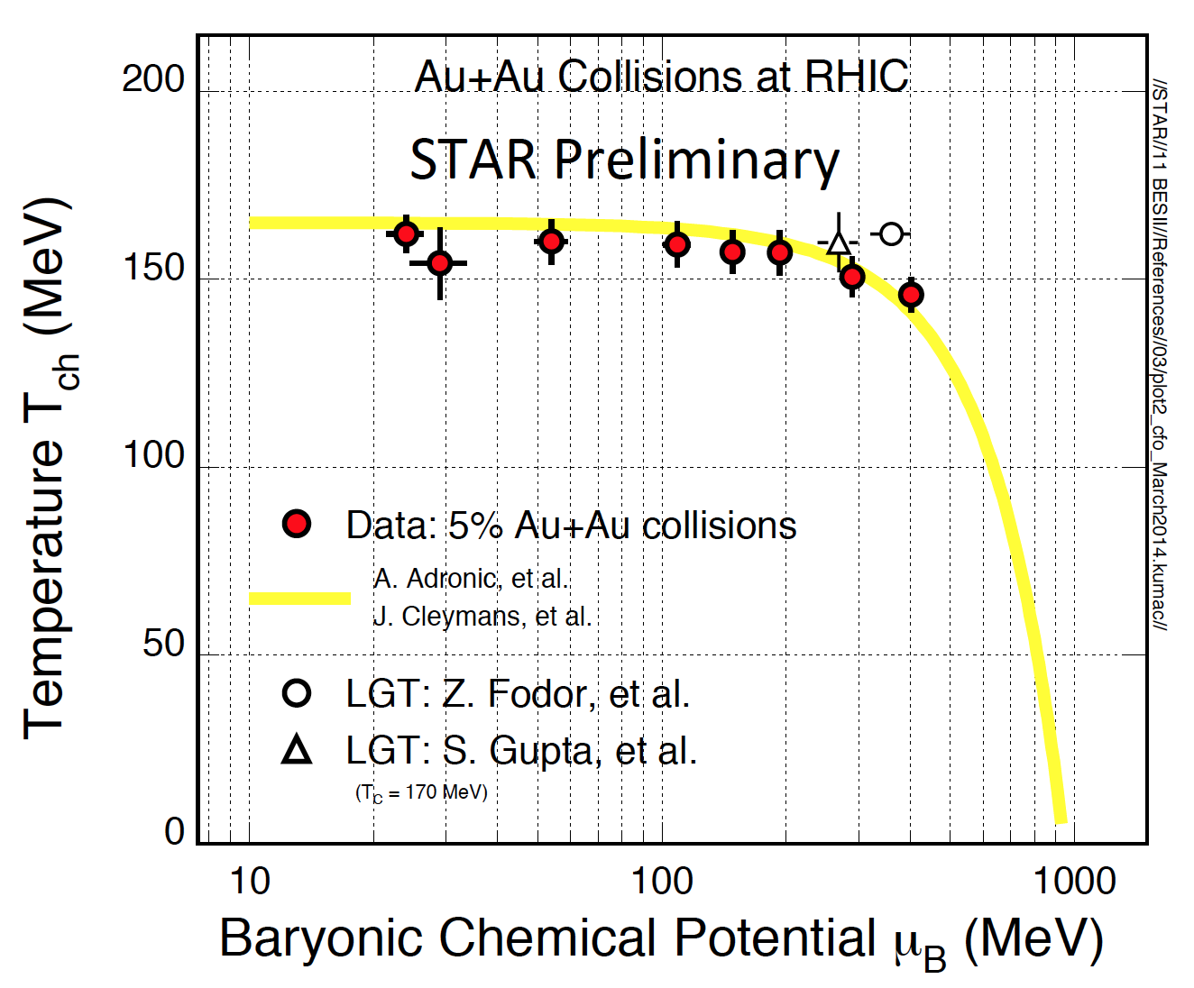
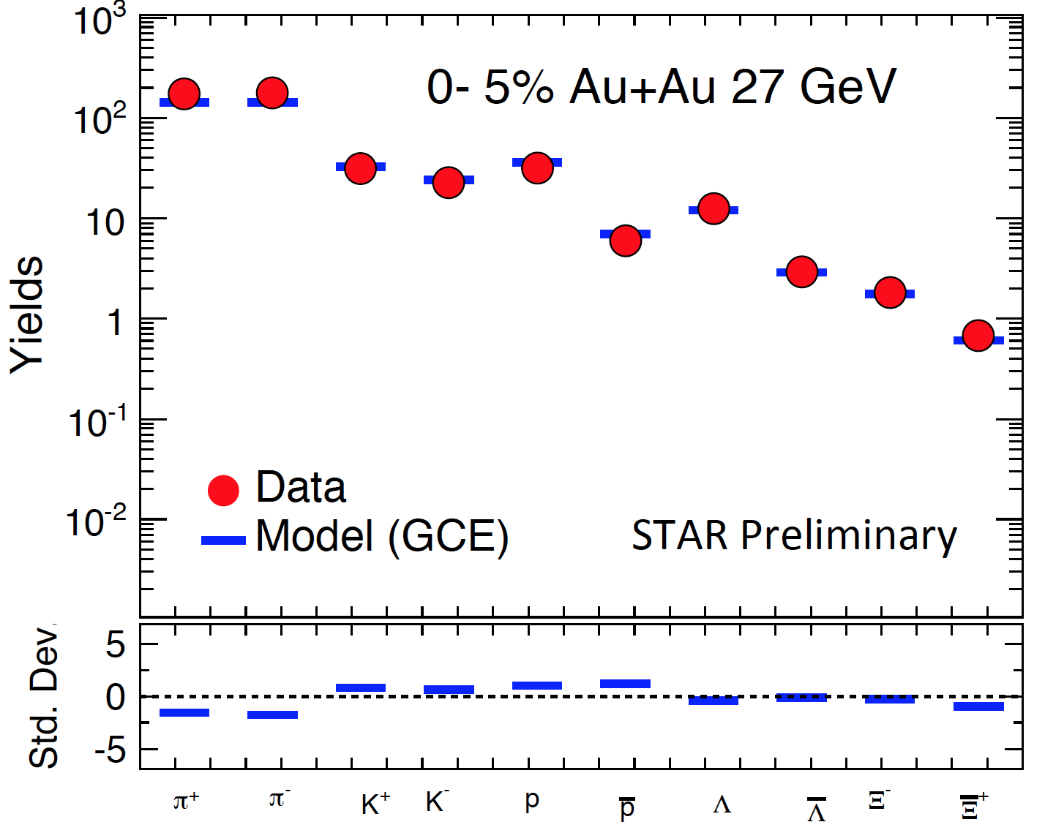
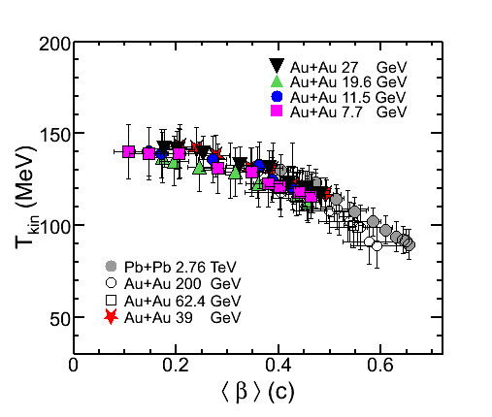
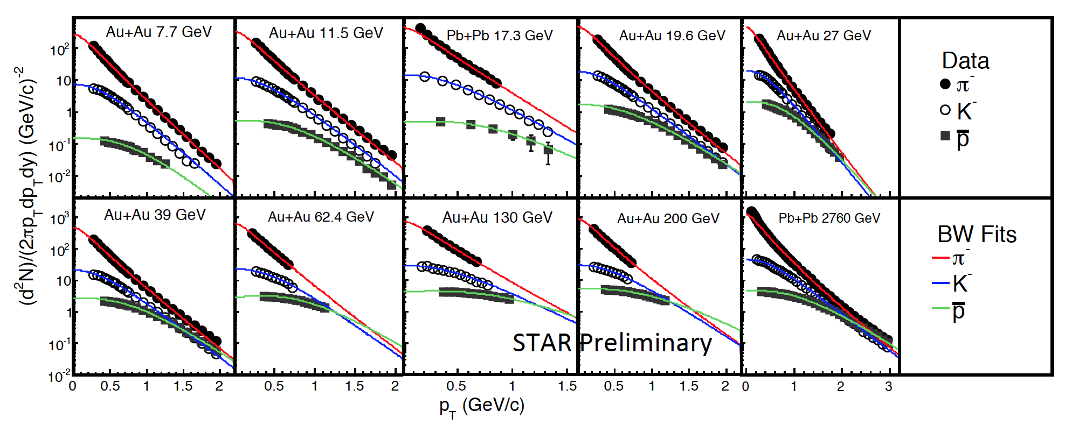
Freeze-out Parameters
Chemical freeze-out thermodynamic parameters:
Extract from particle yields.
T_{ch}:variation is small
T_{kin}: lower in central
β: larger in central, stronger in larger energy.
Kinectic freeze-out thermodynamic parameters:
Extract from shape of particle momentum.

Slide 10
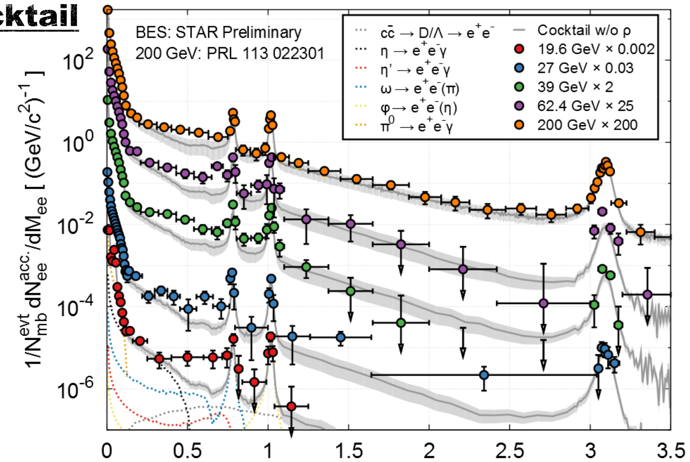
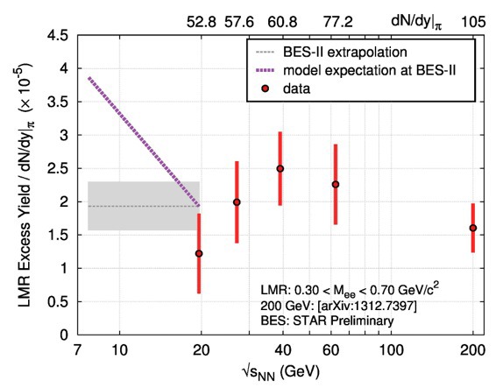
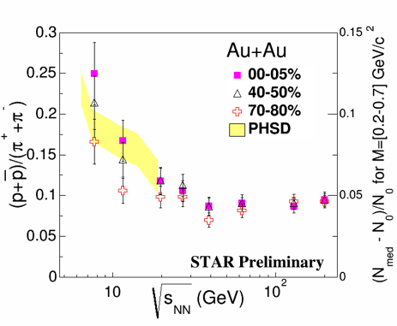
Chiral phase transition
Dielectron invariant mass M_{ee} (GeV/c²)
LMR excesses over cocktail observed from 200 down to 19GeV.
Excess enhancement factor might be directly related to total baryon density.

Slide 11
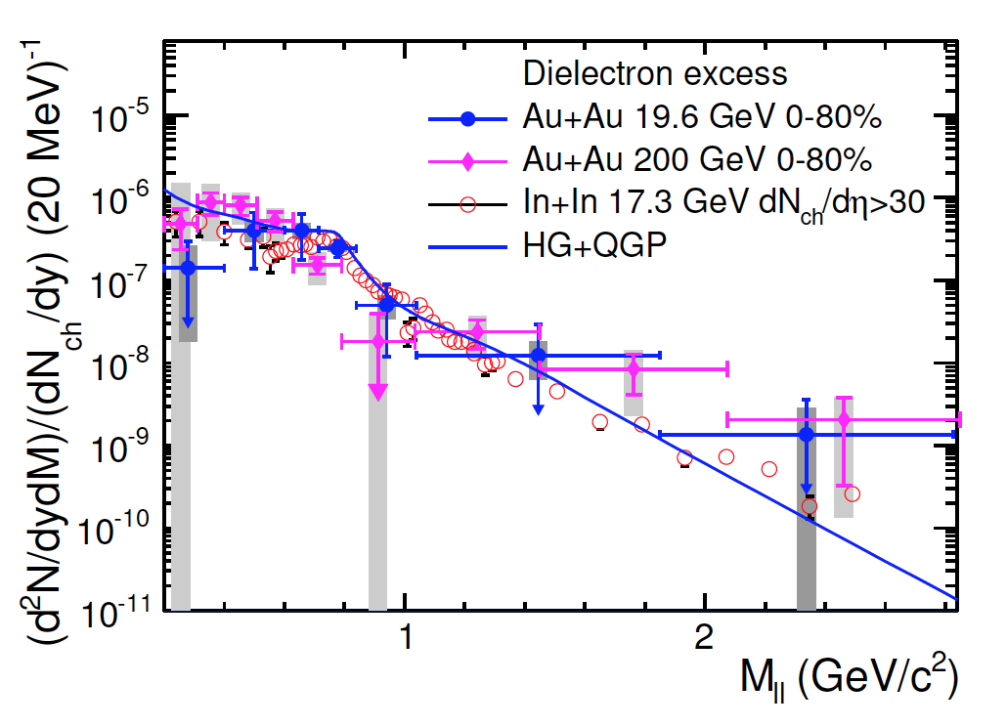
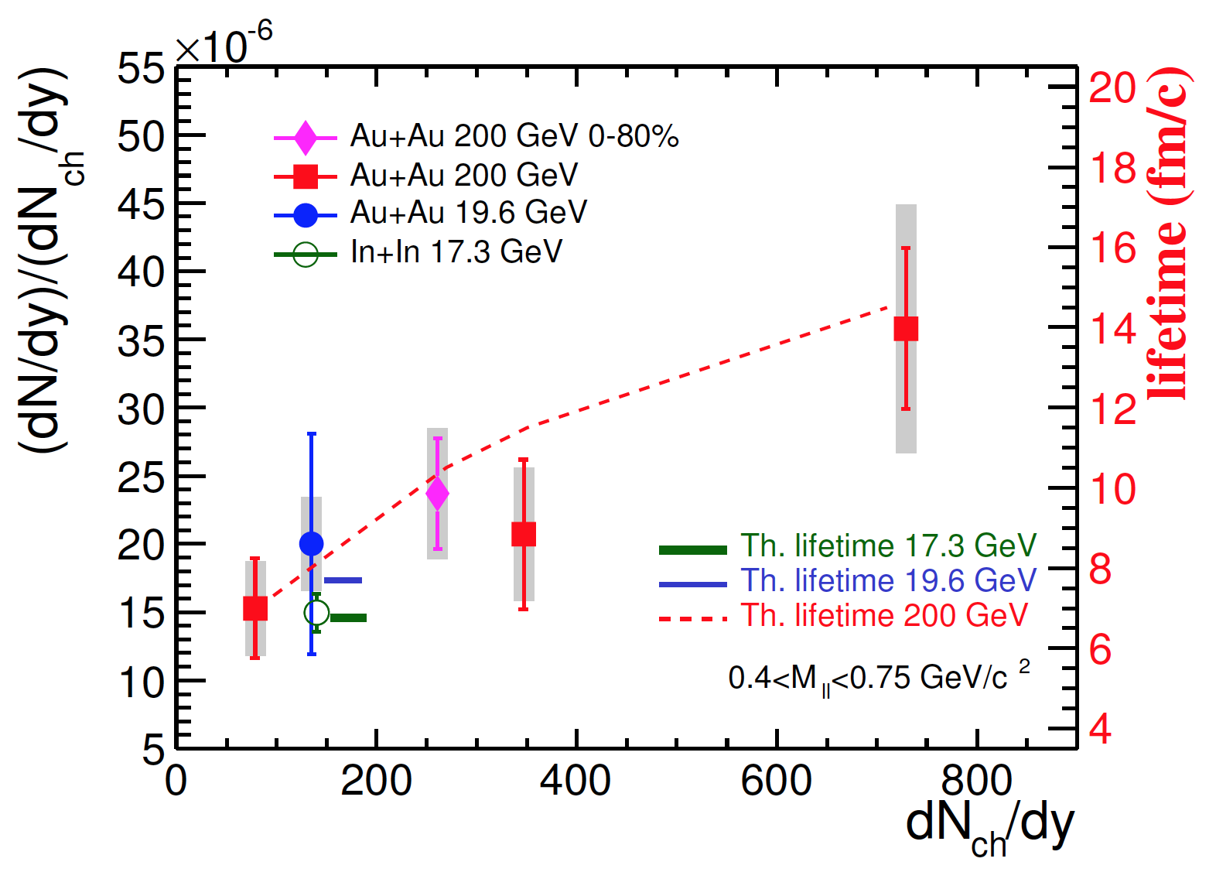
Energy dependence of dilepton excess
arXiv:1501.05341
19.6GeV consistent with SPS results
Excess shape at low mass described by rho in-medium broadening
Excess yields (after detector correction) are sensitive to early system lifetime: integrated over duration at the high temperature

Slide 12
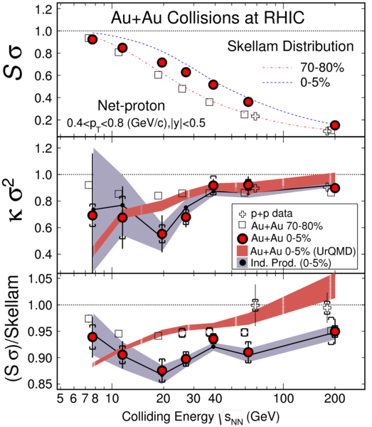
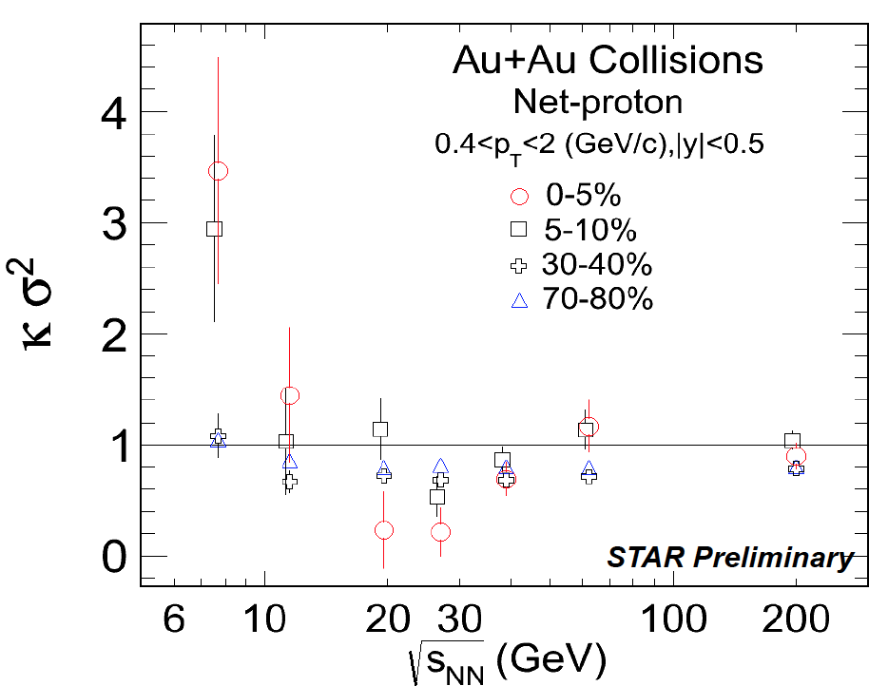
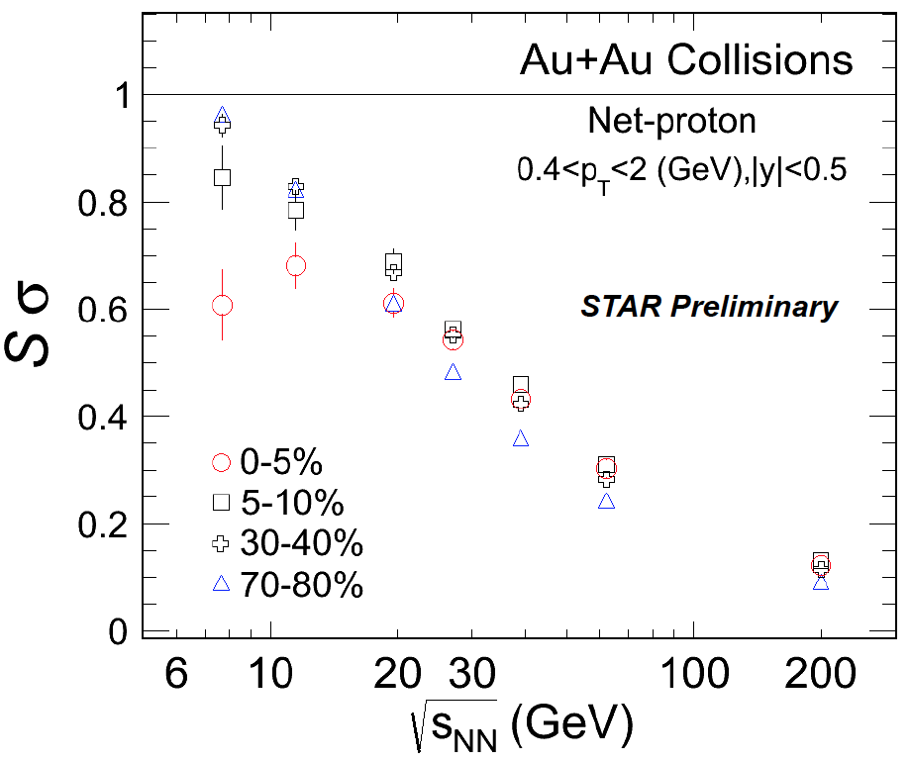
Net proton high moments
Searching for critical point.
New results with efficiency correction:
Statistic errors only.
Non-monotonic behavior
Phys. Rev. Lett. 112 (2014) 32302

Slide 13
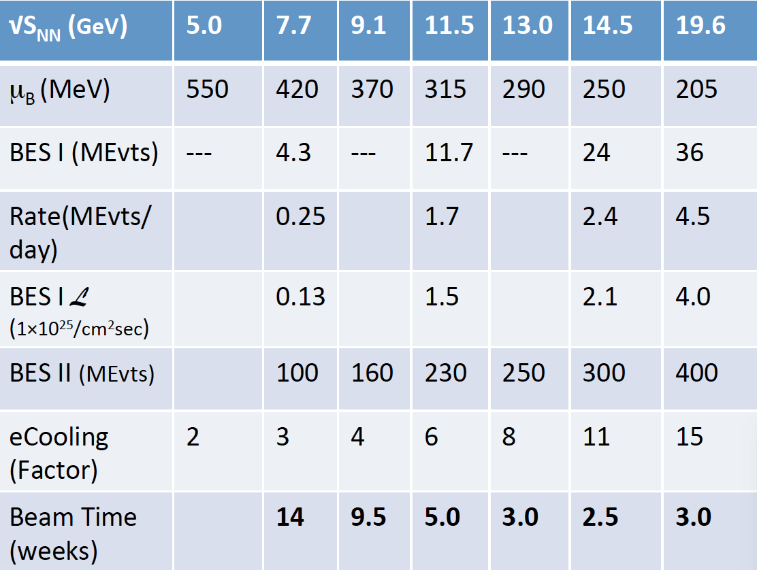
Upgrades for BES II
Detector upgrades:
iTPC.
ETOF.
EPD.
Collider upgrade:
eCooling.
Plan to have 22 cryo-week runs in 2018 and 2019.

Slide 14
Summary
BES program explores an interesting μ_{B} range of the QCD phase diagram.
Signatures consistent with partonic interaction dominant for higher beam energies (>27 GeV) and hadronic interaction dominant for lower beam energies (<11.5 GeV).
Non-monotonic behavior observed in slope v1 results.
Non-monotonic variation in high moments of net proton.

