Slide 1
STAR Isobar Blind Analysis Method
James L. Drachenberg for the STAR Collaboration
BNL Isobar Results Seminar
August 31, 2021
OUTLINE
Considerations
Data-taking for blind analysis
Analysis blinding steps
After unblinding
Summary
Supported in part by

Slide 2
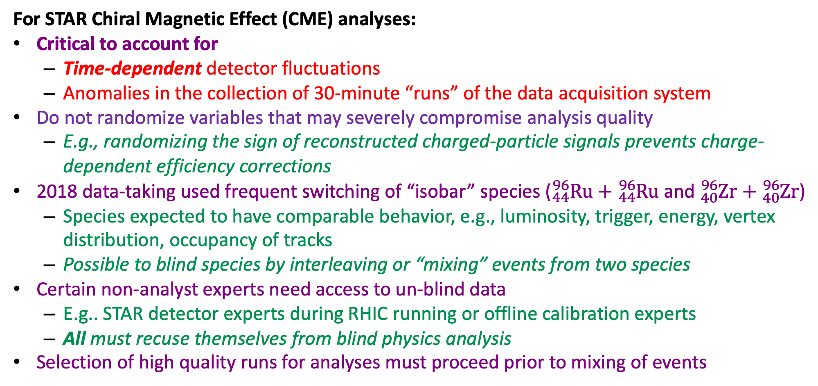
Important Considerations
For STAR Chiral Magnetic Effect (CME) analyses:
Critical to account for
  Time-dependent detector fluctuations
  Anomalies in the collection of 30-minute “runs” of the data acquisition system
Do not randomize variables that may severely compromise analysis quality
  E.g., randomizing the sign of reconstructed charged-particle signals prevents charge-dependent efficiency corrections
2018 data-taking used frequent switching of “isobar” species (${}_{44}^{96}{Ru}+{}_{44}^{96}{Ru}$ and ${}_{40}^{96}{Zr}+{}_{40}^{96}{Zr}$)
  Species expected to have comparable behavior, e.g., luminosity, trigger, energy, vertex distribution, occupancy of tracks
  Possible to blind species by interleaving or “mixing” events from two species
Certain non-analyst experts need access to un-blind data
  E.g.. STAR detector experts during RHIC running or offline calibration experts
  All must recuse themselves from blind physics analysis
Selection of high quality runs for analyses must proceed prior to mixing of events

Slide 3
Vital Stats
2017 BNL NPP Program Advisory Committee recommended blind analyses of CME studies of Run-18 isobar data
Published analysis blinding manuscript:
Methods for a blind analysis of isobar data collected by the STAR collaboration,
J. Adam et al. (STAR Collaboration), Nuclear Science and Techniques 32, 48 (2021).
Methods developed and accepted by collaboration in January 2018, well before 2018 data-taking
Step-0, Initial steps
  Calibrations and quality assurance (QA) of data acquisition “runs” by calibration experts
  “Mock data challenge”: Sanity-check of feasibility and implementation
Step-1, “The Reference”
  Provide output files composed of collision data from a mix of the two isobar species
  As much as possible, order of collision “events” respects time-dependent changes in detector conditions
  Analysis code and time-dependent QA tuned and frozen
Step-2, “The run by run QA sample”
  Provide files that blind the isobar species but do not “mix” data from different data acquisition runs
  Only allow “run-by-run” corrections and code alteration directly resulting from these corrections
Step-3, Full un-blinding
Notes:
Verbally specify why 1% of data

Slide 4
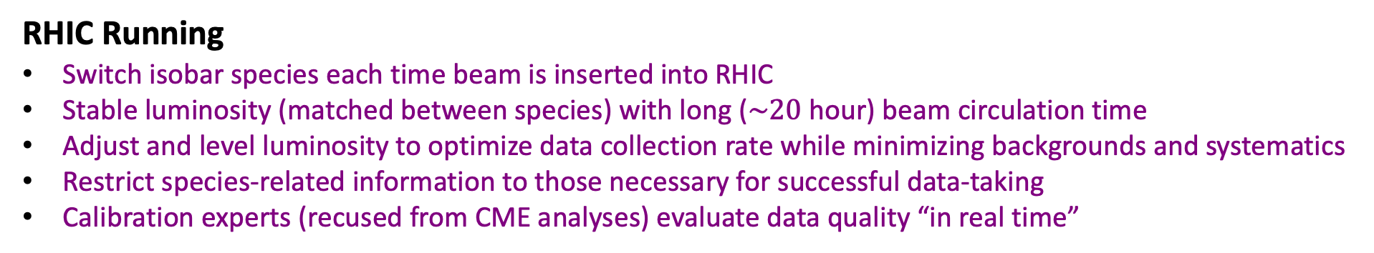
Data-taking for Isobar Collisions
RHIC Running
Switch isobar species each time beam is inserted into RHIC
Stable luminosity (matched between species) with long ($\sim 20$ hour) beam circulation time
Adjust and level luminosity to optimize data collection rate while minimizing backgrounds and systematics
Restrict species-related information to those necessary for successful data-taking
Calibration experts (recused from CME analyses) evaluate data quality “in real time”

Slide 5
Step-0: Initial Steps
“The Tune-up”
Calibrations and quality run selection by un-blind experts
Develop software infrastructure to implement the blinding procedure
  Event mixing procedure and run-numbers encrypted
  Additional information obfuscated in data
    Event ID, run ID, event timestamp, collision species, hit/coincidence/background rates from certain detectors
“Mock data challenge”
  Sanity-check of feasibility and implementation
  Utilize blinding procedures on 2018 27 GeV Au+Au data
  Analysts tune code on “mock data”
    Check that data blinding infrastructure works as intended
    Verify the appropriate information is blinded as intended
    Ensure appropriate information is accessible to analysts
    Check that analysis codes run properly on “blind” data structures
    Confirm “blind" and “unblind" results are the same
      sanity check of procedures
STAR, NST 32, 48 (2021)
Notes:
Verbally point out that the obfuscated “additional information” provides a way to confirm that we understand which species is which after un-blinding

Slide 6
Step-1: Isobar Blind and Mixed
“The Reference”
Provide output files composed of events from a mix of the two isobar species
  Mixing procedure encrypted and known only by two computing experts (recused)
As much as possible, order of events respects time-dependent change in run conditions
Analysis code and time-dependent QA tuned
Critical analysis needs enabled by this step:
  Extraction of time-dependent spectra for quality assessment
  Detection of time-dependent anomalies
  Measurement of peak widths relevant to momentum resolution
Following completion of Step-1, analysis codes are frozen and committed to the repository
Before moving to Step-2, codes are documented and reviewed by the isobar paper review committee

Slide 7
Step-2: Isobar Blind
“The run by run QA sample”
Provide data files that obscure the species but do not mix events across different runs
  Limit the number of events to prevent deciphering species by simple counting
Only run-by-run corrections and code alteration directly resulting from these corrections are allowed at this stage
Additional bad runs identified based on physics quantities and discarded
  Analysts perform run-by-run QA using a predefined and frozen algorithm
This step enables analysts to perform QA using quantities relevant to their specific analysis
Following completion of Step-2…
Analysis codes are reviewed, frozen, and committed to the repository
Fully un-blind data are released and analyzed with the frozen codes
Only changes to correct “mistakes” are allowed after unblinding
  Errors in arithmetic
  Unintended departures from documented and approved procedures, cuts, corrections, and systematic uncertainty estimates

Slide 8
Summary
STAR has developed a procedure for the CME isobar blind analyses
  Step-0: Calibrations, run-QA, and mock data challenge
  Step-1: Isobar blind and mixed (analysis codes tuning)
  Step-2: Isobar blind and un-mixed (run-by-run QA and correction)
  Step-3: Full un-blinding (physics analysis)
Development and implementation has been a substantial, collective undertaking
  Innovative RHIC running
  New software and computing infrastructure
  Cooperation across analysis groups, physics working groups, committees, etc.
Thank you to all who supported the effort!

