Slide 1

Open charmed mesons production at STAR
Jaroslav Bielčík
for STAR collaboration
Czech Technical University
in Prague
5-th Int. workshop on heavy flavor production in heavy-ion collisions
Utrecht, November 2012

Slide 2
Outline
Motivation.
STAR detector and analysis.
D⁰ and D* in p+p 500 GeV collisions.
D⁰ in Au+Au 200 GeV collisions.
Summary.

Slide 3
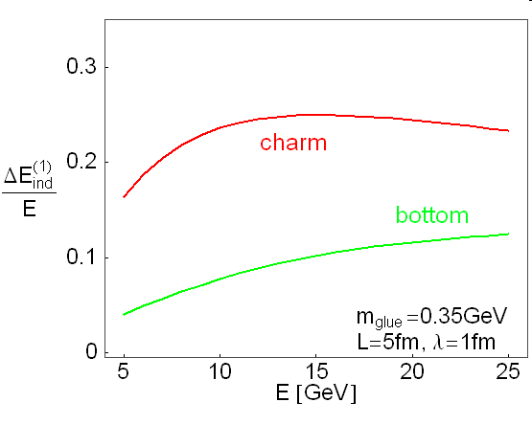
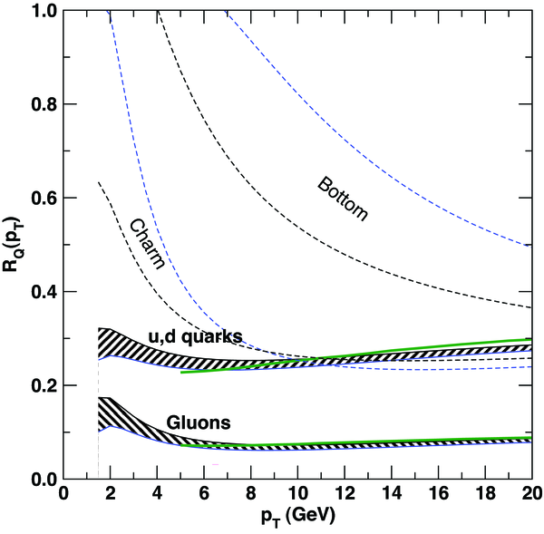
Heavy quarks as a probe of QGP
Radiative energy loss
p+p data: → baseline of heavy ion measurements. → test of pQCD calculations.
Due to their large mass heavy quarks are primarily produced by gluon fusion in early stage of collision.
→ production rates calculable by pQCD.
M. Gyulassy and Z. Lin, PRC 51, 2177 (1995)
heavy ion data:
Studying energy loss of heavy quarks. → independent way to extract properties of the medium.
Dead cone effect.
Charm flow → medium thermalization
light
M.Djordjevic PRL 94 (2004)
Wicks et al, Nucl. Phys. A784 (2007) 426

Slide 4
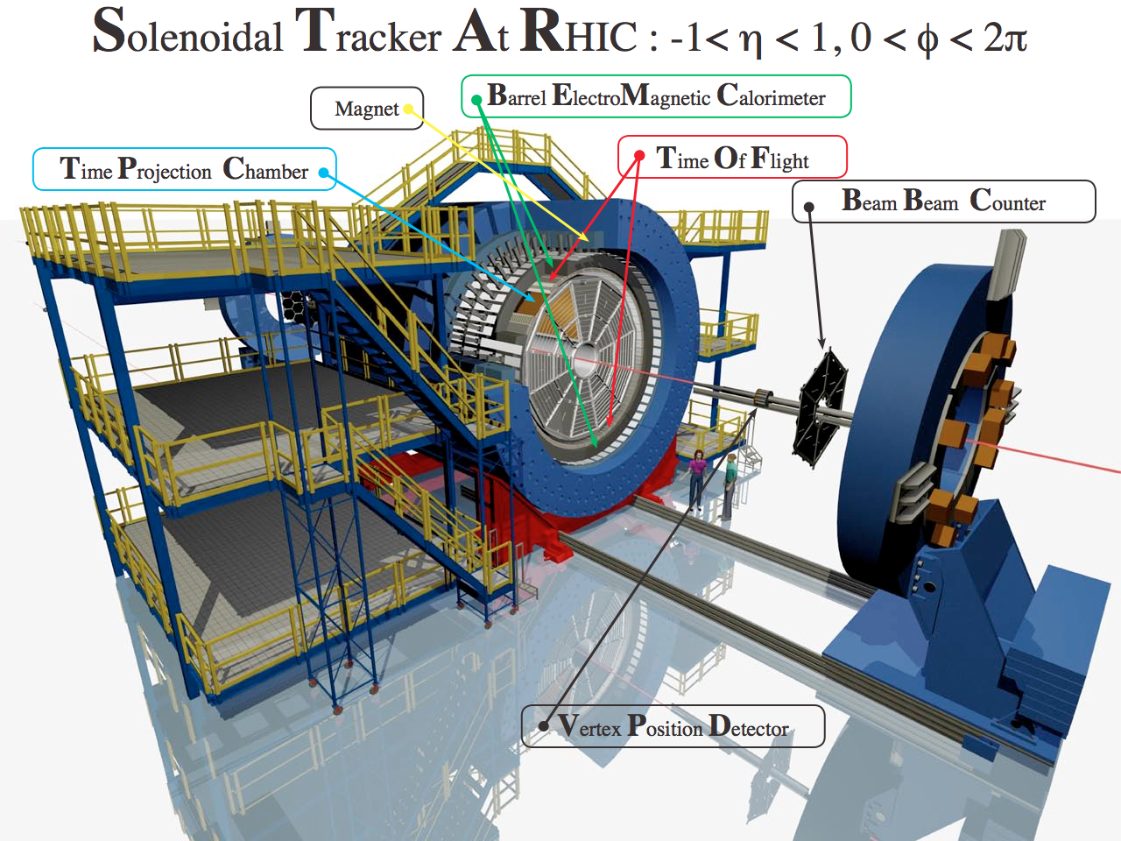
The STAR Detector
VPD: minimum bias trigger.
TPC: PID, tracking
TOF: PID.
BEMC: remove pile-up tracks.
Vertex Position Detector

Slide 5
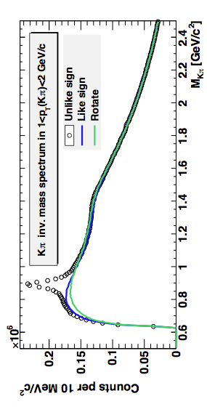
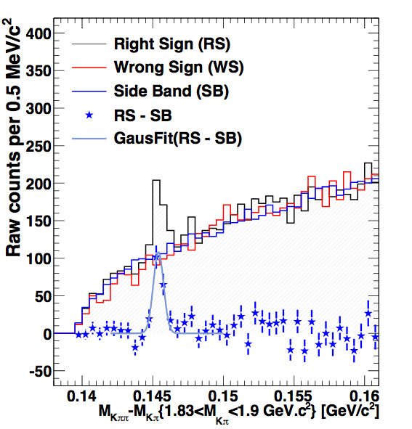
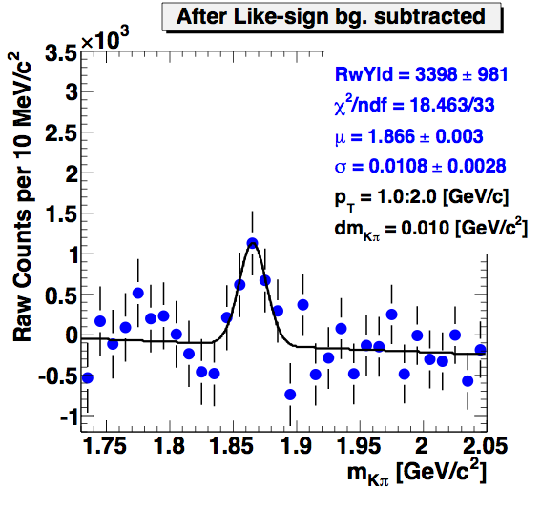
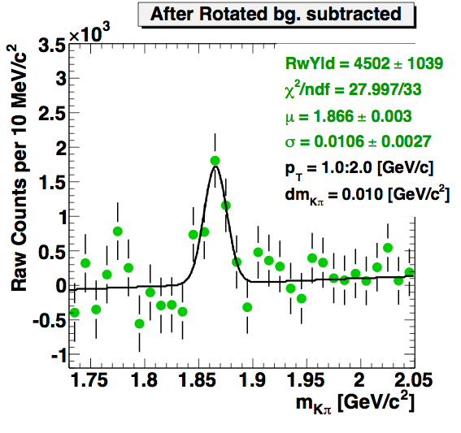
D⁰ and D* signal in p+p 500 GeV
K*⁰
K₂*(1430)
STAR preliminary
D⁰
STAR preliminary
right sign : 1.83<M(Kπ)<1.9 GeV/c²
wrong sign : K⁻π⁺π⁻ + K⁺π⁻π⁺
side band : 1.7<M(Kπ)<1.8 + 1.92<M(Kπ)<2 GeV/c²
Minimum bias 1.53 nb⁻¹
Consistent results from two background methods.
STAR preliminary
STAR preliminary

Slide 6
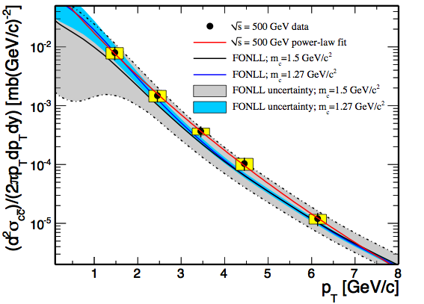


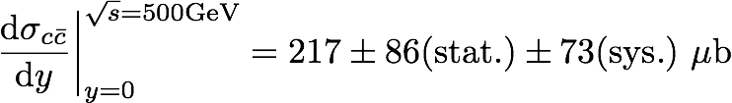
D⁰ and D* p_{T} spectra in p+p 500 GeV
D⁰ yield scaled by N_{D0}/N_{cc}= 0.565^{[1]}
D* yield scaled by N_{D*}/N_{cc}= 0.224^{[1]}
STAR preliminary
[1] C. Amsler et al. (Particle Data Group), PLB 667 (2008) 1.
[2] FONLL calculation:
Ramona Vogt
µF = µR = mc, |y| < 1
6

Slide 7
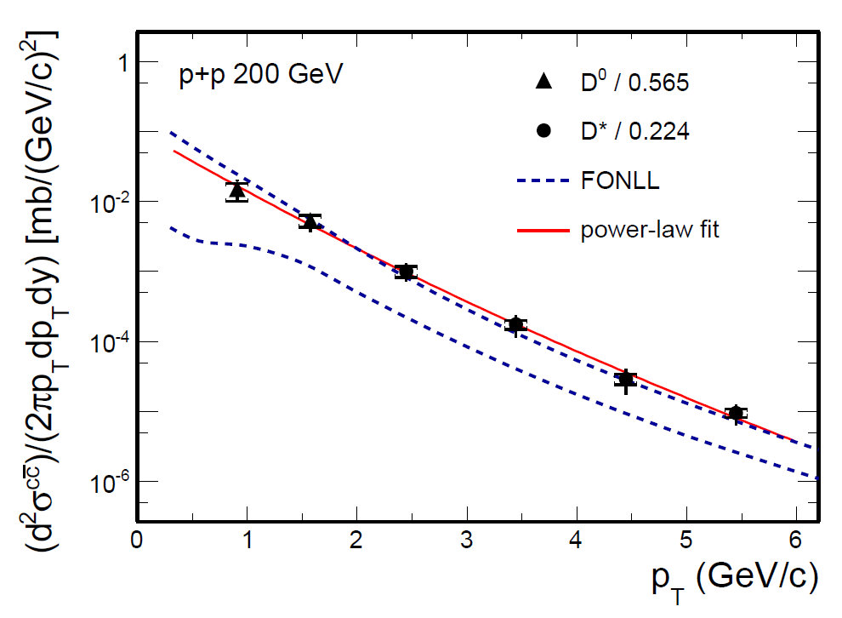
D⁰ and D* p_{T} spectra in p+p 200 GeV
Phys. Rev. D 86 (2012) 072013.
D⁰ scaled by N_{cc} / N_{D0} = 1 / 0.565^{[1]}
D* scaled by N_{cc} / N_{D*} = 1 / 0.224^{[1]}
Consistent with FONLL^{[2]} upper limit.
The charm cross section at mid-rapidity:
[1] C. Amsler et al. (Particle Data Group), PLB 667 (2008) 1.
[2] Fixed-Order Next-to-Leading Logarithm: M. Cacciari, PRL 95 (2005) 122001.
7

Slide 8
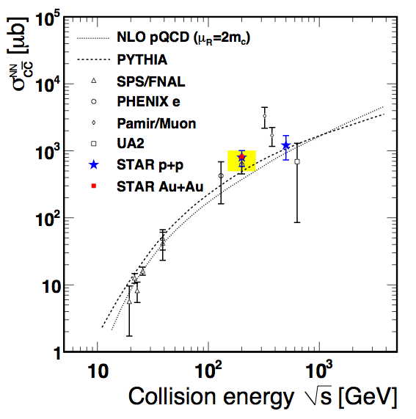
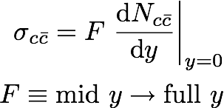
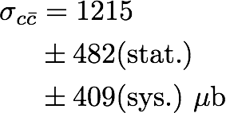

Total charm cross section
500 GeV, F = 5.6
200 GeV, F = 4.7
STAR preliminary

Slide 9
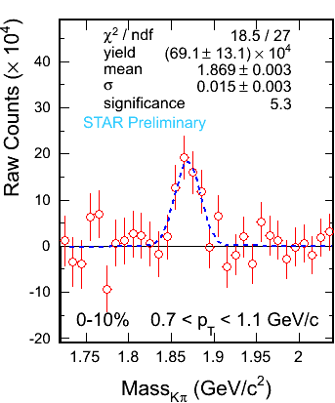
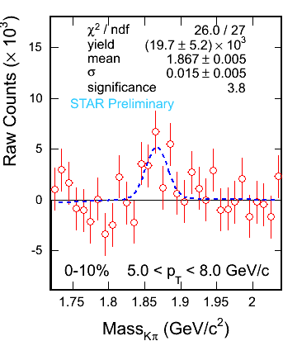
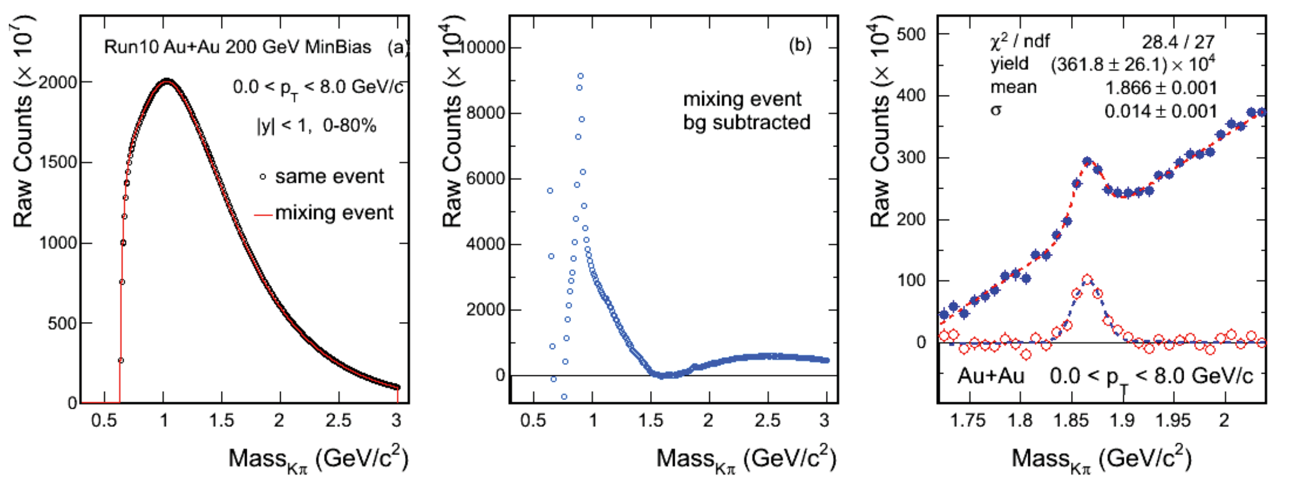


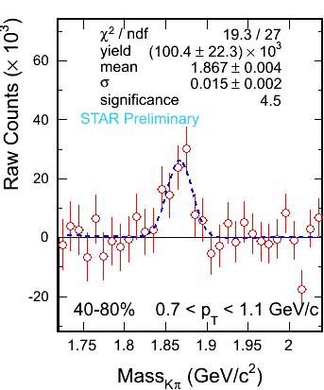
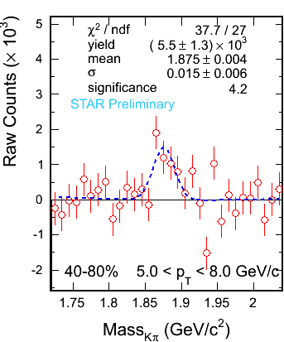
D⁰ signals in Au+Au 200 GeV
Combining data from Year2010 & 2011.
Total: ~ 800 M Min. bias events.
Significant signals are observed
in collisions of all centralities.
David Tlusty
9

Slide 10
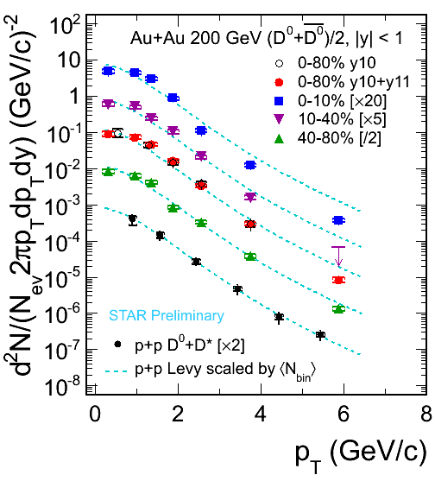
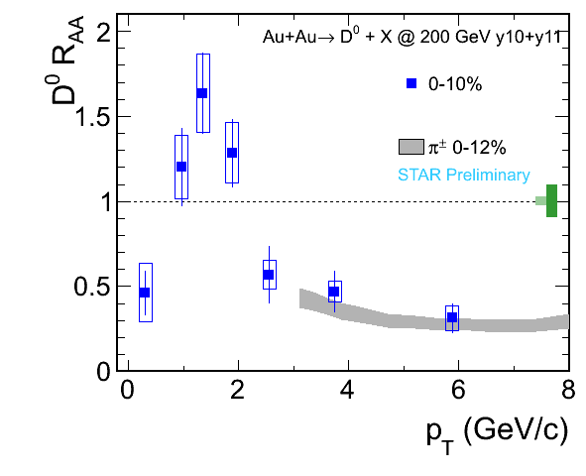
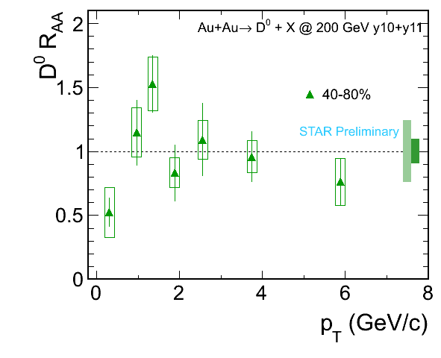
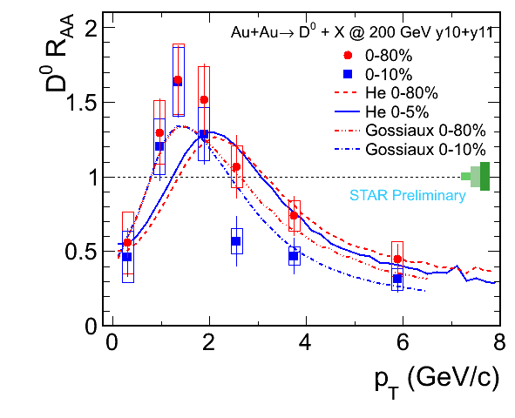
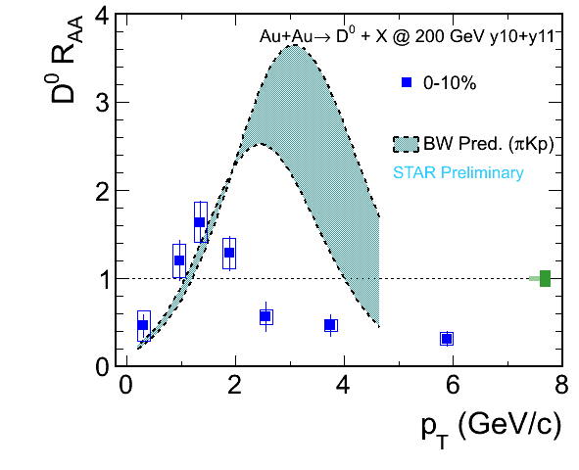
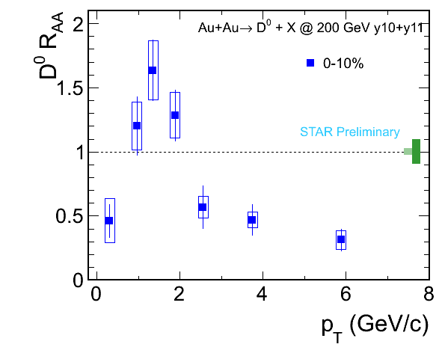
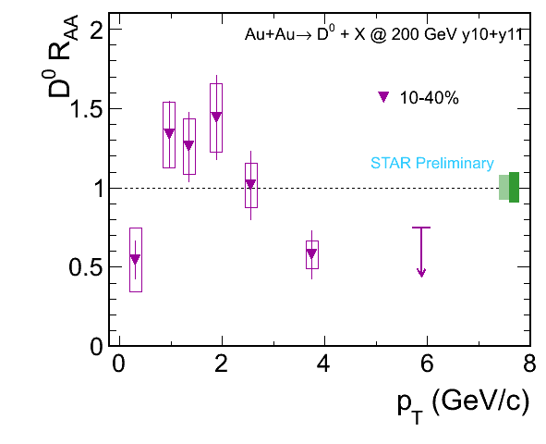
D⁰ spectra in Au+Au 200 GeV
He,Fries,Rapp: PRC86,014903;
arXiv:1204.4442; private comm.
P. Gossiaux: arXiv: 1207.5445
Suppression at high p_{T} in central and mid-central collisions.
D⁰ freeze out earlier than light hadron and/or
D⁰ does not have much radial flow as light quarks.
Enhancement at intermediate p_{T} ~ models suggest radial flow of light quarks coalescence with charm.
10

Slide 11
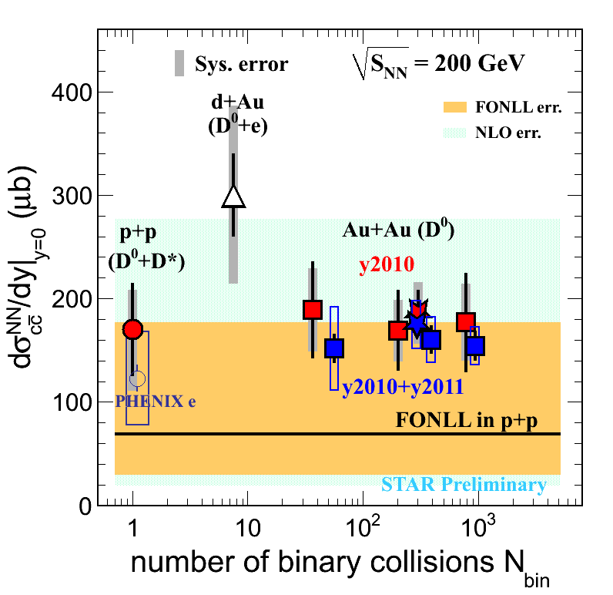
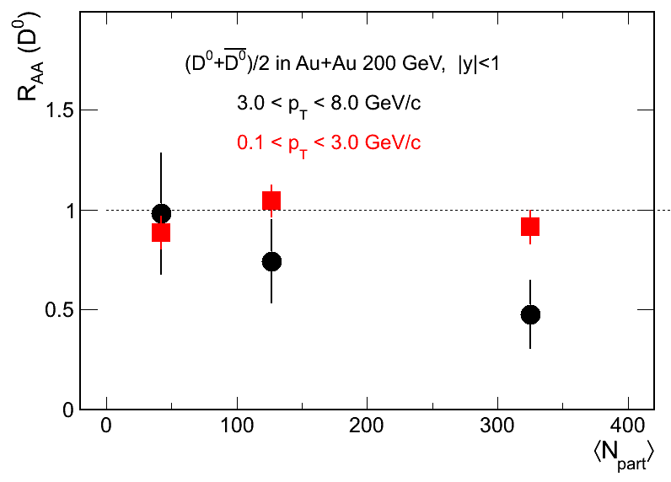
Charm cross section versus N_{bin} at 200 GeV
Year 2003 d+Au 16M : D⁰ + e
Year 2009 p+p 105M : D⁰ + D*
Year 2010 + 2011 Au+Au 800M : D⁰
Assuming N_{D0} / N_{cc} = 0.56 does not change for total cross section.
The charm cross section at mid-rapidity:
The total charm cross section:
STAR Preliminary
Low p_{T} consistent with unity.
High p_{T} suppressed in most central collisions
[1] STAR d+Au: J. Adams, et al., PRL 94 (2005) 62301
[2] FONLL: M. Cacciari, PRL 95 (2005) 122001.
[3] NLO: R. Vogt, Eur.Phys.J.ST 155 (2008) 213
[4] PHENIX e: A. Adare, et al., PRL 97 (2006) 252002.
Charm cross section follows number of binary collisions scaling =>
Charm quarks are mostly produced via initial hard scatterings.

Slide 12
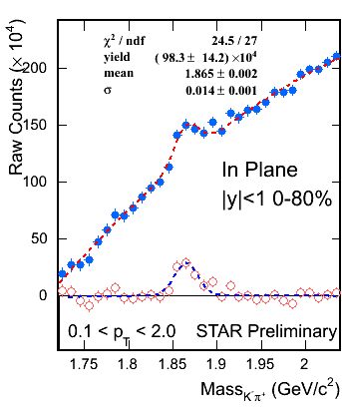
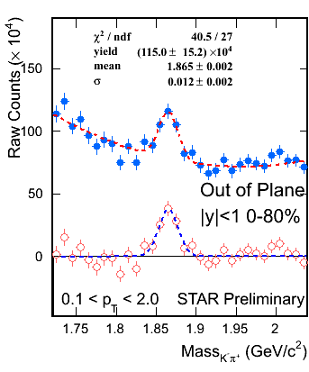
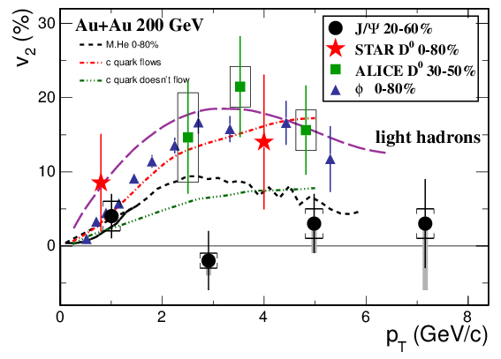
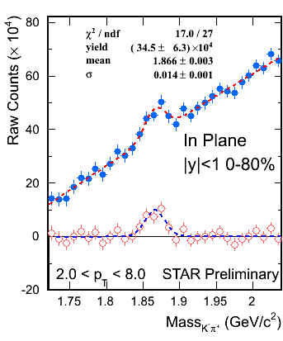
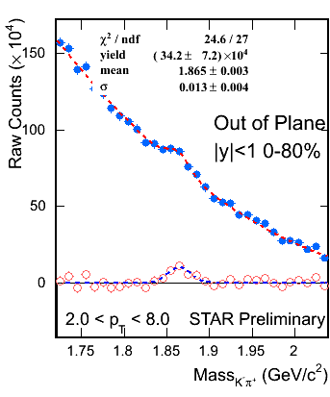
D⁰ v₂ measurement in Au+Au 200 GeV
Need HFT for more precise measurement:
- to study the coalescence scenarios.
- to study the energy dependence.
y
x
12

Slide 13
Summary and Outlook
The charm cross section per nucleon-nucleon collision in mid-rapidity is measured to be
Charm cross sections at mid-rapidity follow number of binary collisions scaling, which indicates charm quarks are mostly produced via initial hard scatterings.
Observed large high-p_{T} suppression of heavy quark production in D⁰ meson measurement in 200 GeV central Au+Au collisions. Similar to light quarks.
Preliminary measurement of v₂ for D⁰.
HFT upgrade with increasing RHIC luminosity is expected to provide much more precise measurement on open heavy flavors.
13

Slide 14
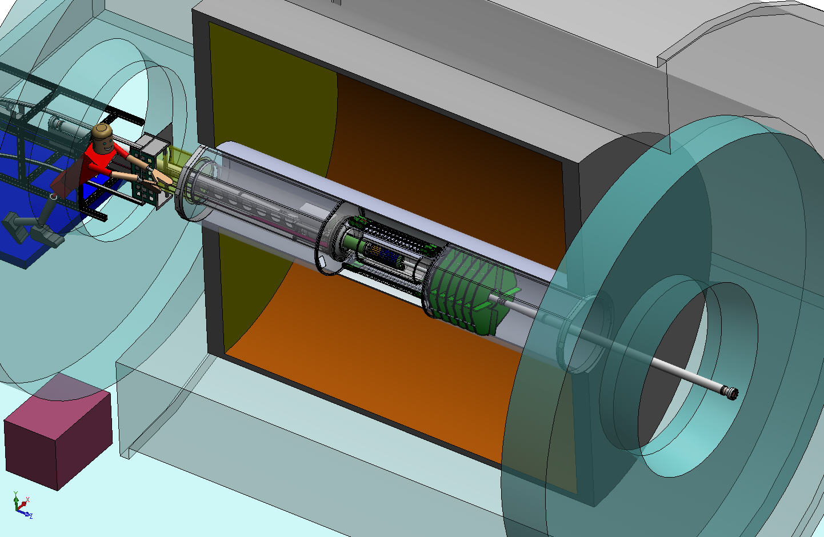

Heavy Flavor Tracker
HFT
SSD
IST
PXL
Inner Field Cage
Outer Field Cage
FGT
TPC Volume
Detector | Radius (cm) | Hit Resolution R/ϕ - Z (μm - μm) | Radiation length
SSD | 22 | 20 / 740 | 1% X₀
IST | 14 | 170 / 1800 | <1.5% X₀
PIXEL | 8 | 12 / 12 | ~0.4% X₀
 | 2.5 | 12 / 12 | ~0.4% X₀
Solenoid
EAST
WEST
14

Slide 15
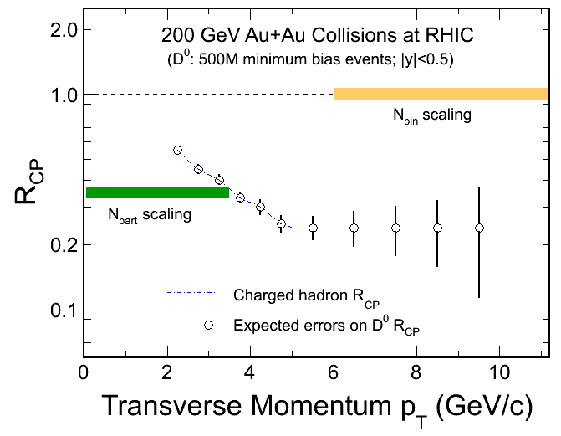
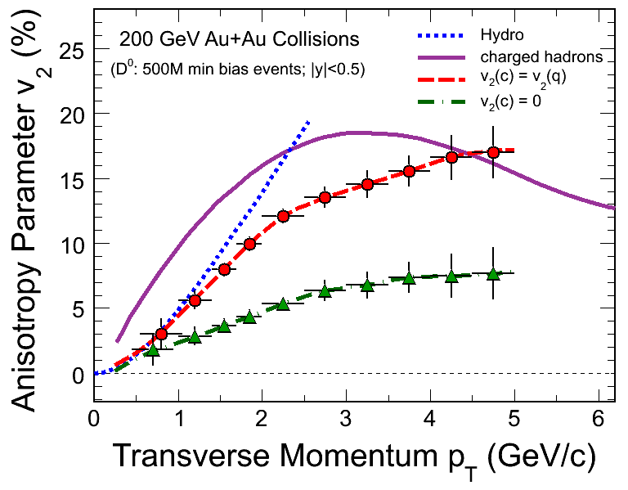
Physics projections – punchline for Y13,14
R_{CP}=a*N10%/N(60-80)%
Assuming D⁰ R_{cp} distribution as charged hadron.
500M Au+Au m.b. events at 200 GeV.
Charm R_{AA}
Energy loss mechanism!
Color charge effect!
Interaction with QCD matter!
Assuming D⁰ v₂ distribution from quark coalescence.
500M Au+Au m.b. events at 200 GeV.
- Charm v₂
Medium thermalization degree
Drag coefficients!
15

