Slide 1
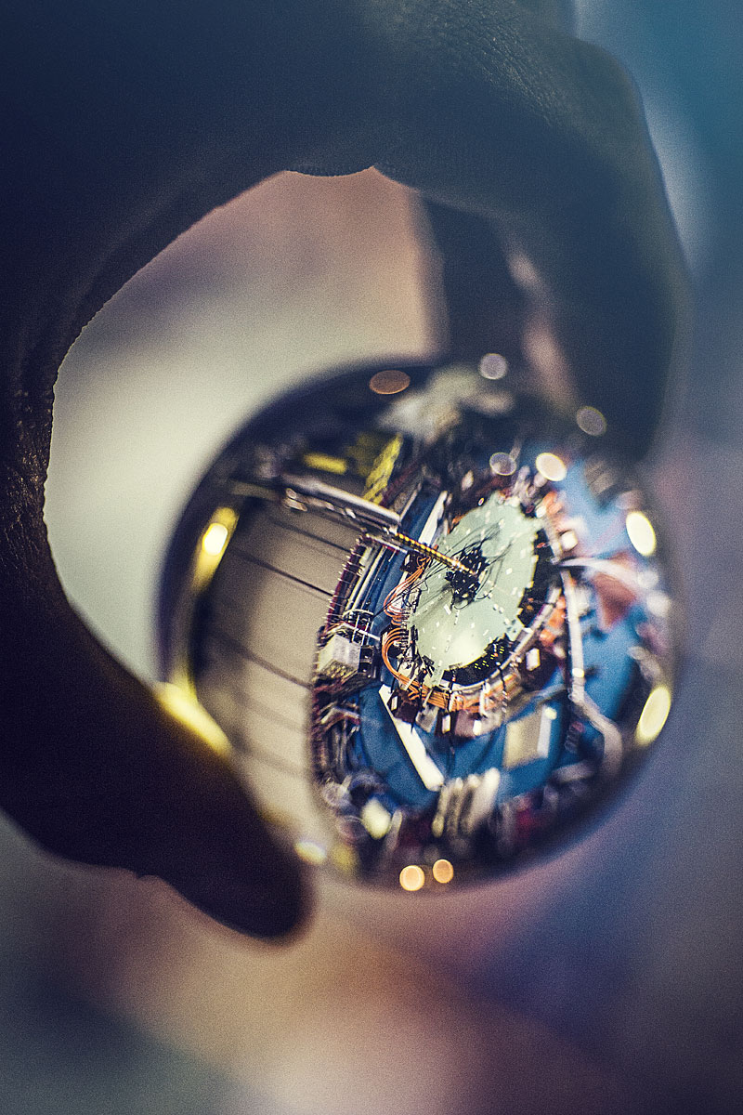
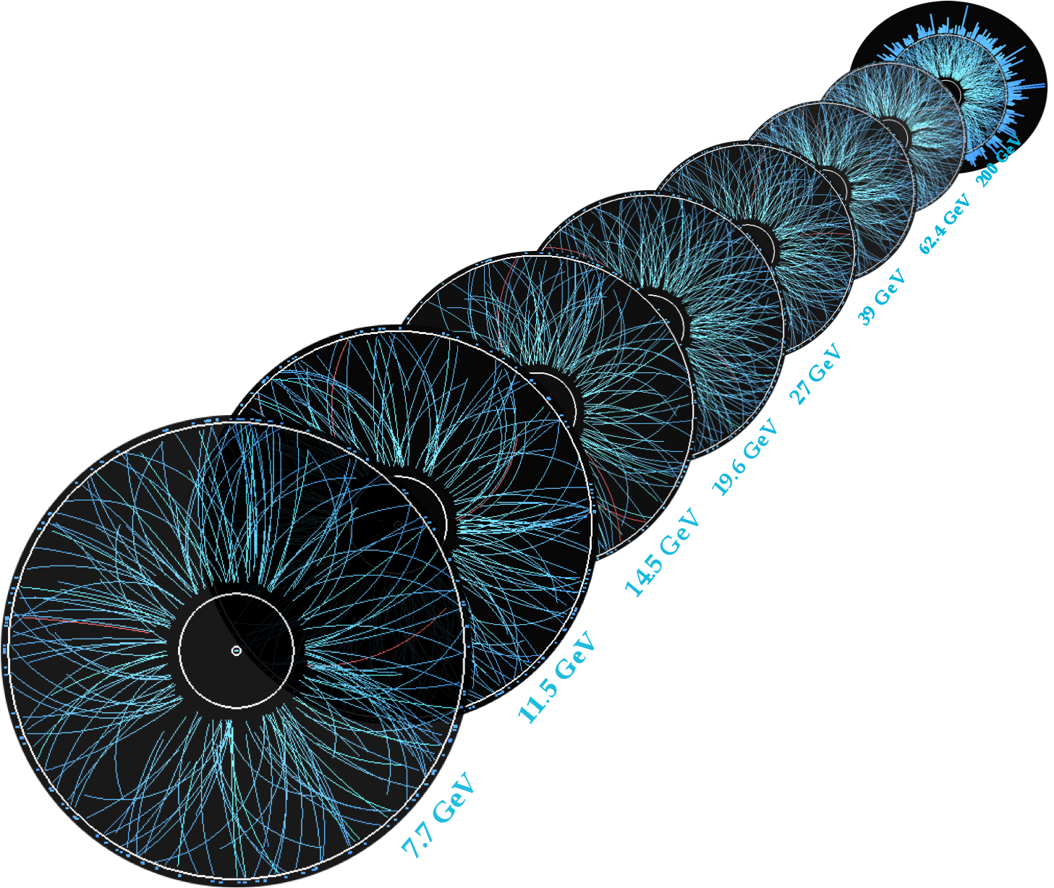

STAR Plan for future Heavy-Ion Physics
Zhangbu Xu
for the STAR Collaboration
  2021+ Unique Physics cases
    nPDF
    forward jets/γ/DY
    Viscosity [η/s(T)]
    multiple harmonics and
    rapidity correlations
    Vorticity
    Rapidity dependence of Global Hyperon Polarization
    Luminosity
    dilepton yields, Chiral Symmetry
    resolving photon puzzle
    Conductivity
    Create and Probe Magnetic Field
Joe Caggiano
www.star.bnl.gov

Slide 2


Current STAR Detector System
EEMCESMD
Magnet
MTD
BEMC
BSMD
TPC
TOF
BBC
FMS
FPS
RP
ZDC
NSAC 2015 RECOMMENDATION #I:
The upgraded RHIC facility provides unique capabilities that must be utilized to explore the properties and phases of quark and gluon matter in the high temperatures of the early universe and to explore the spin structure of the proton.
HFT
x10³ increases in DAQ rate (4000Hz) since 2000, most precise Silicon Detector(HFT 2014-16)

Slide 3
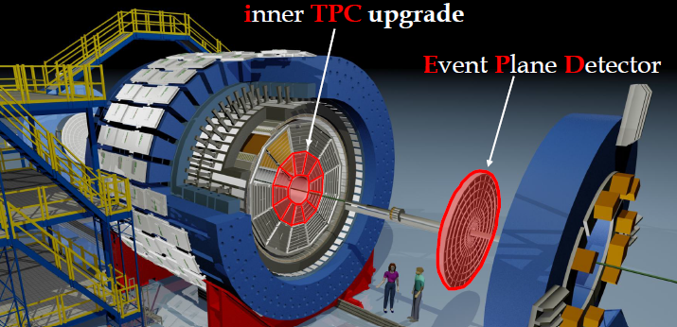
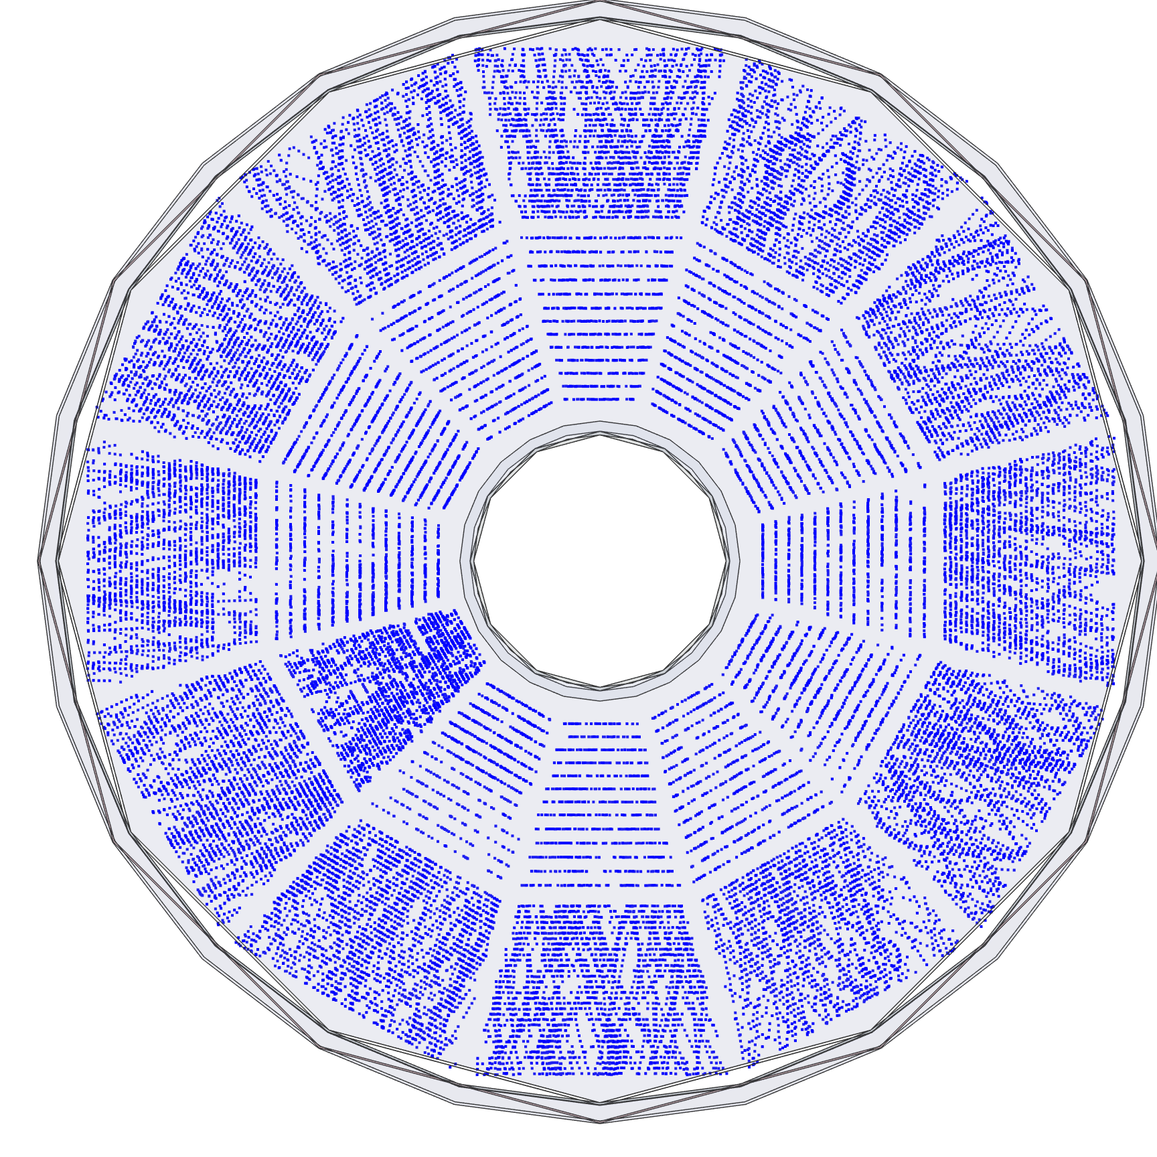
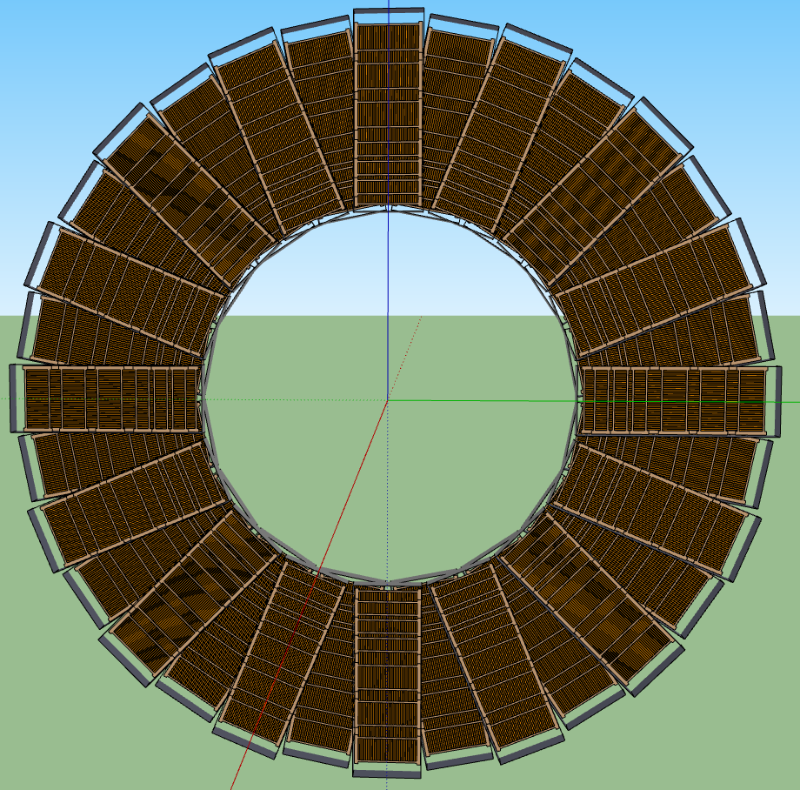
STAR Major Upgrades for BES-II
Endcap TOF
EPD:
Improves trigger
Reduces background
Allows a better and independent reaction plane measurement critical to BES physics
iTPC:
Rebuilds the inner sectors of the TPC
Continuous Coverage
Improves dE/dx
Extends η coverage from 1.0 to 1.5
Lowers p_{T} cut-in from 125 MeV/c to 60 MeV/c
EndCap TOF:
Rapidity coverage is critical
PID at η = 0.9 to 1.5
Improves the fixed target program
Provided by CBM-FAIR
Tracking and PID
From rapidity±1
Extend to (±)1.5

Slide 4
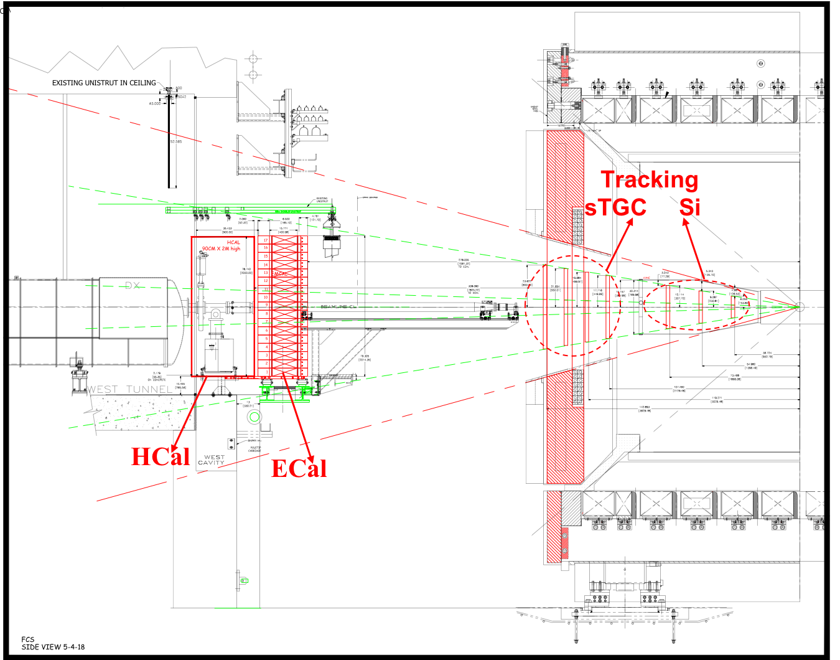
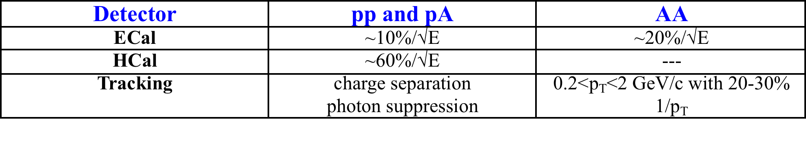
The STAR Forward Upgrade
Forward Tracking System:
3 Silicon disks: at 90, 140, 187 cm from IR
Built on successful experience with STAR IST
Single-sided double-metal mini-strip sensors
Existing IST FEE, DAQ and cooling system
4 sTGC disks: at 270, 300, 330, 360 cm from IP
Position resolution: ~100 mm
Readout: reuse current STAR TPC electronics
1st sTGC prototype to be installed in STAR in 2019
  1/4 size of ATLAS sTGC
Forward Calorimeter System:
ECal:
reuse PHENIX PbSC calorimeter with new readout on front phase
HCal:
sandwich iron-scintillator plate sampling Calo
Same readout for both calorimeters → cost
Side View

Slide 5
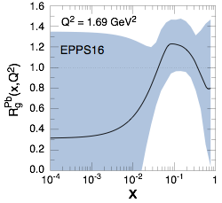
Nuclear PDF and Initial Conditions for A+A collisions
measure nPDF in a x-Q² region where nuclear effects are large
  Q² > Q_{s}² over a wide range in x
Forward upgrade essential
Current knowledge
pA@RHIC: unique kinematics

Slide 6
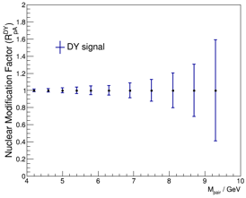
Forward DY and Photon Measurements
DY and direct photon R_{pA} give significant constraints on nPDF
Important input for initial condition in heavy-ion collisions
Forward upgrade essential

Slide 7
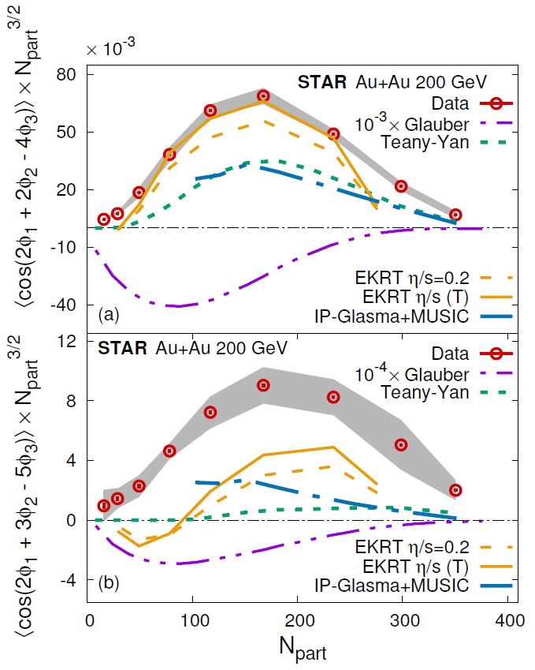
Temperature Dependent Viscosity
L. Adamczyk et al 1701.06497
2015 US Nuclear Long Range Plan (#22):
comparative analyses of the wealth of bulk observables
being measured hint that the hotter QGP created at the LHC
has a somewhat larger viscosity.
This temperature dependence will be more tightly constrained
by upcoming measurements at RHIC and the LHC.
Niemi et al., PRL 106 (2011)212302

Slide 8
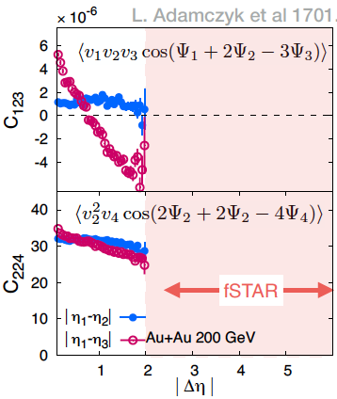
Multiple Flow Harmonic Correlations
Sparse RHIC data for higher order flow harmonics (v₃, v₄, v₅) & rapidity density correlations/fluctuations
L. Adamczyk et al 1701.06497
Why do we need wider window in rapidity?
Flow like correlations are early time
long-range → large Δη
Background comes from Jets & non-flow
→ small Δη
Precise extraction of flow (azimuthal correlations)
requires measurements over wide window of rapidity
Forward upgrade essential

Slide 9
Rapidity Decorrelation and Initial State Fluctuations
Forward upgrade + EPD
essential
Rapidity decorrelation sensitive to initial state fluctuations
Observe large flow decorrelation in longitudinal direction at RHIC
(3+1)D hydrodynamics tuned for LHC, over-predicts decorrelation at RHIC
Large uncertainty at RHIC with FTPC and FMS

Slide 10
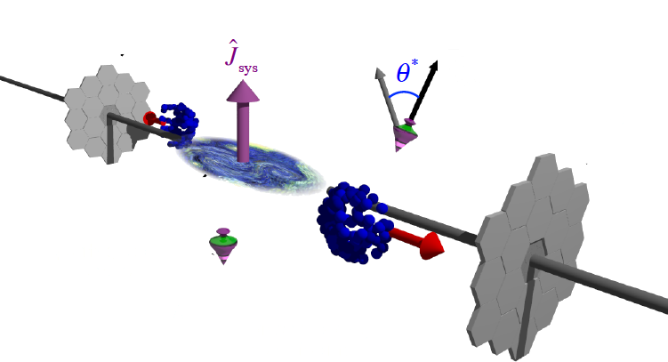
Global Hyperon Polarization in QGP
new tool to study QGP and relativistic Quantum fluid Vorticity in general
First observation of quadrupole
structure of polarization along beam
direction;
“sign” opposite to hydro prediction
STAR, PRC 98 (2018) 14910
Non-zero global angular momentum
transfer to hyperon polarization
STAR Preliminary

Slide 11
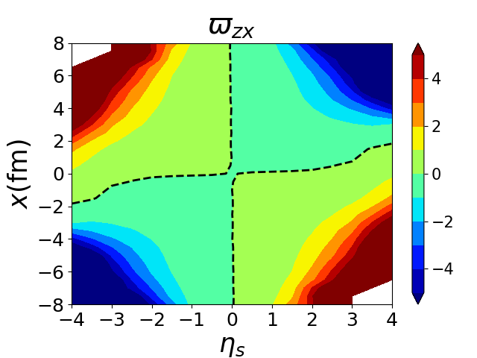
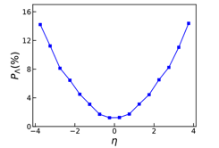
Rapidity Dependent Global Polarization
Polarization increases with viscosity and decreases
with thermalization,
Rapidity dependence is key;
Different models predict opposite rapidity trend
Forward upgrade + EPD + iTPC essential
Hydrodynamic calculations:
Li,Pang,Wang & Xia, PRC 96 (2017) 054908; (private comm.)
F. Beccattini et al. EPJC 75(2015)406; arXiv:1501.04468
HIJING with energy flow:
Deng & Huang, PRC 93 (2016) 064907

Slide 12
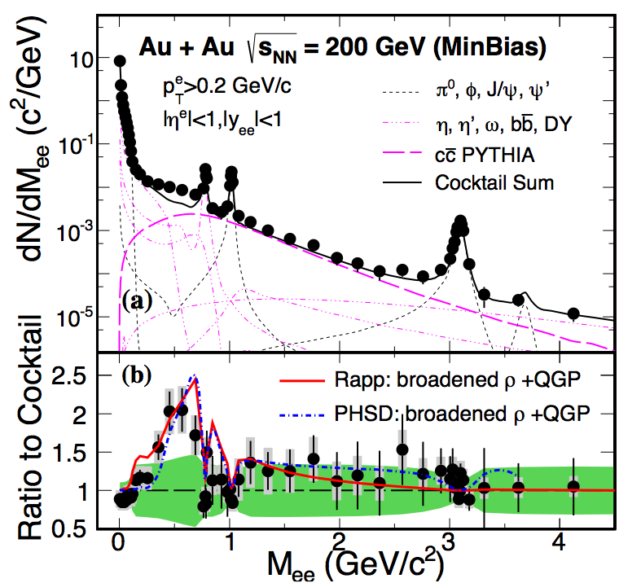
Quantifying Chiral Symmetry Restoration and Thermal Radiation
PHENIX, arXiv:1805.04084
Photon Puzzle:
yields of photons above model prediction at RHIC
photon v₂ systematically above model
STAR at RHIC:
virtual photon spectra match Model
Low-mass dilepton excess matches model
Important to resolve the puzzle
STAR, PRL113(2014)
STAR, PLB 770 (2017) 451

Slide 13
Thermal Dilepton at Low and Intermediate Mass
Mid-rapidity:
e⁺e⁻ measurement at μ_{B}~0
Connection to chiral symmetry restoration
Thermal radiation from QGP:
Low-mass di-lepton emission:
T, total baryon density, and life time; more importantly
dynamics of approaching Chiral Symmetry
The slope T in IMR:
the true average temperature T of the medium.
(no blue shift by flow)
Improvement:
Factor 2 smaller systematic uncertainties
Factor 5.5 more statistics
iTPC upgrade essential

Slide 14
QGP as conductor
D. Kharzeev

Slide 15
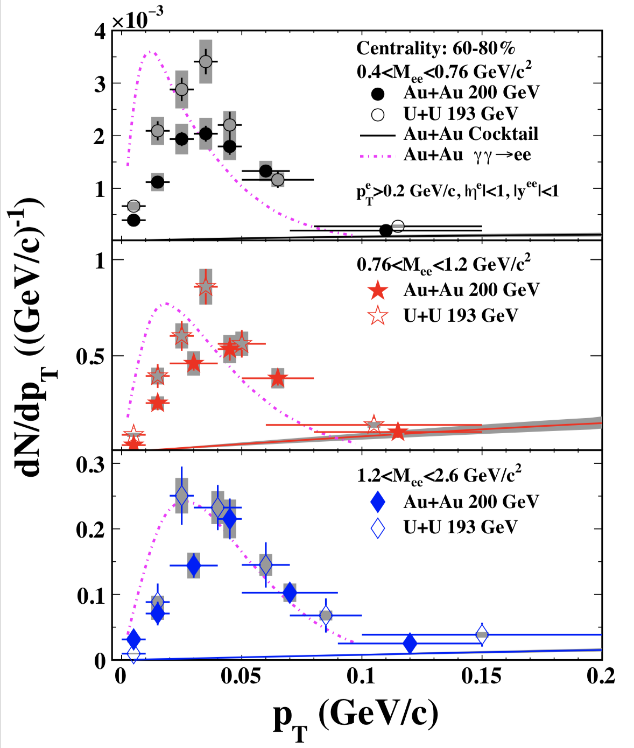
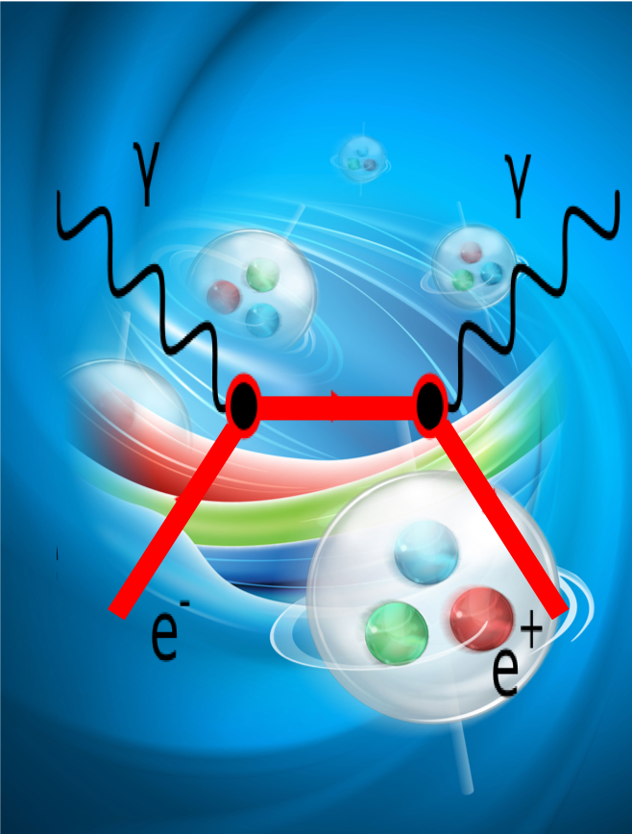
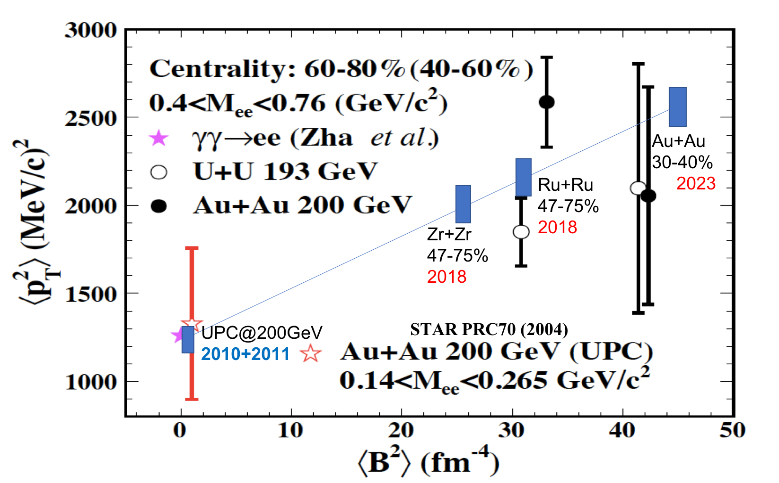
Probe Magnetic Field and QGP Conductivity
STARlight Model
data
e+e- pair from Photon-photon collisions
generated by the passing of target and projectile
nuclei, accompanying formation of QGP
Spectra peaks at p_{T}=30-50MeV,
right magnitude to be very sensitive to
magnetic field
Clean probe with unique characteristics
iTPC upgrade
essential
Need more
statistics
for mid-central
centrality

Slide 16
Summary on STAR future 2021+
Side View
    Quantitatively improve
    nuclear PDF
    Quantifying QGP properties of
    Viscosity, understanding mechanics of Vorticity and polarization
    Quantifying degree of freedom
    and resolving photon puzzle
    Potential new study of QGP properties: Conductivity
    Jets, Quarkonia, Beam Energy Scan phase II and many
    other measurements
Unique Detector Capability and
beam species/energies
To address fundamental physics

Slide 17
Backup slides

Slide 18
STAR Public documents on future programs and upgrades
SN0696-May. 1, 2018,STAR Collaboration Beam Use Request for Runs 19 and 20
SN0669-May. 11, 2017,The STAR midrapidity pp, pA, AA physics program beyond BES-II
SN0688-Mar. 9, 2018,Results from Large Scale STAR Raw Data Reconstruction on NERSC HPC
SN0670-May. 15, 2017, STAR Collaboration Beam Use Request for run 18 and run 19
SN0657-May. 30, 2016, The STAR Beam Use Requests for run 17 and run 18 (2016)
The RHIC Cold QCD Plan from 2017 to 2023: A portal to the EIC - Jan. 2016, draft: December 2015
SN0666-May. 1, 2016,An Event Plane Detector for STAR
SN0665-Sep. 16, 2016,Physics Program for the STAR/CBM eTOF Upgrade
SN0648 - January, 2016, STAR Forward Calorimeter and Forward Tracking Systems beyond BES-II
SN0644 - Nov. 29, 2016, Technical Design Report for the iTPC Upgrade
SN0640-Oct. 19, 2015, Physics Opportunities with STAR in 2020+
SN0639-Oct. 15, 2015, Letter of Interest: CBM TOF as STAR Endcap TOF for BES-II at RHIC
SN0625-May. 19, 2015, RHIC Beam Use Request for runs 16 and 17
SN0619-Feb. 18, 2015, A Proposal for STAR Inner TPC Sector Upgrade (iTPC)
SN0617-Jan. 19, 2015, a case for run16 pp510 (supplementary material)
e-Print: arXiv:1502.02730,
The Hot QCD White Paper: Exploring the Phases of QCD at RHIC and the LHC
e-Print: arXiv:1501.06477, Exploring the properties of the phases of QCD matter - research opportunities and priorities for the next decade
SN0606-Jun. 2, 2014, STAR Beam Use Request (BUR) for run-15 and run-16
SN0605-Jun. 1, 2014, A polarized p+p and p+A program for the next years
SN0598-Mar. 28, 2014, Studying the Phase Diagram of QCD Matter at RHIC
SN0592-Oct. 1, 2013, eSTARLetter of Intent
2014 Computing plan https://drupal.star.bnl.gov/STAR/starnotes/private/psn0622
SN0588-Aug. 21, 2013, EsNETHEP/NP Science Network Requirements 2013
STAR Decadal Plan, December 2010, https://drupal.star.bnl.gov/STAR/starnotes/public/sn0645

Slide 19
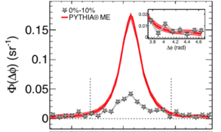
Recent Highlights
STAR, PRC 96 (2017)
Charm Flow v₀,v₁, v₂
Jet Deflection Angle
CME Background Estimates
R_{AA} of Separated Upsilon States
Δφ

