Slide 1
The STAR iTPC upgrade for Beam Energy Scan II
F.Videbæk
Brookhaven National Lab
for the STAR Collaboration
Motivation
iTPC upgrade
Physics of BES II
Summary
DNP Fall 2015 meeting

Slide 2
Exploring the QCD phase diagram
Theory predicts:
A cross-over at μ_{B} ~0
At high μ_{B}, the transition is first order
Critical point: where first order transition ends . Thought to be around √s_{NN} 8-20 GeV
Search for
Turn-off of sQGP signature
Signs of 1st order phase transition
The QCD critical point
RHIC Beam Energy Scan Phase 1 (BES I) Vary temperature T and baryon chemical potential μ_{B}
Carried out 2010-2014
- 7 lower energies for Au+Au
Notes:
Chiral symmetry restorations – in dileptons

Slide 3
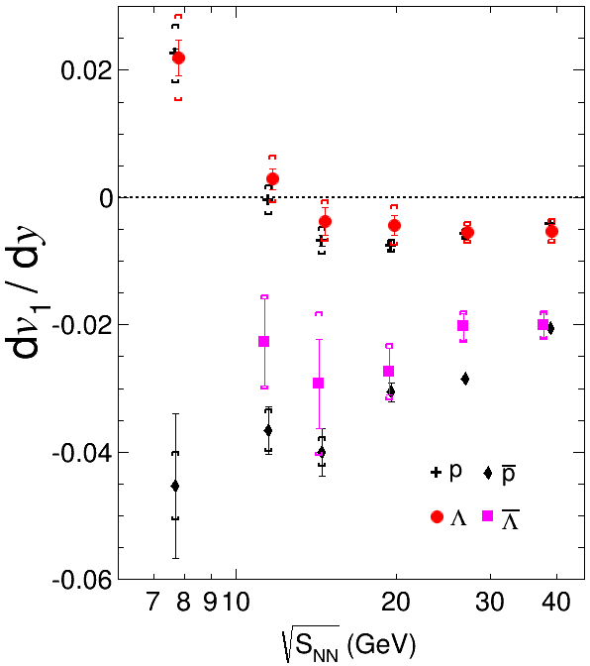
Search for Phase Transition : directed flow
STAR preliminary
A linear fit over |y| ≤ 0.5 used to find dv₁/dy for all species & energies
The dip in dv₁/dy indicates an interplay between hydro and baryon dynamics (EOS)
Λ follows p within errors

Slide 4
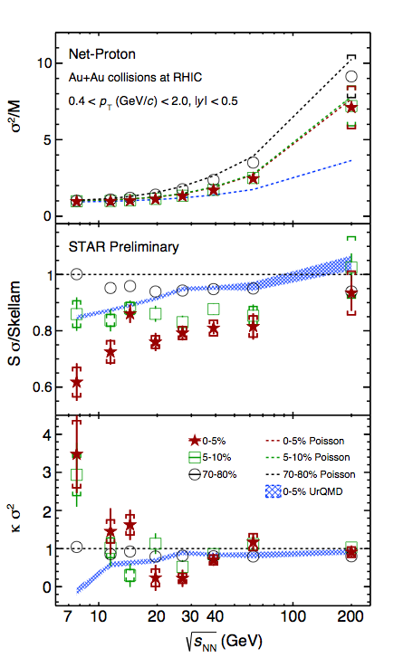
Cumulant Ratio of Net-Proton multiplicity distributions
Collision Energy Dependence
Looking for fluctuation in S and κ
σ²/M increases with increasing energy, consistent with Poisson expectation
Non-monotonic behavior of net-proton κσ² seen in top 5% central collisions
Peripheral collisions show smooth trend
UrQMD (no Critical Point), shows suppression at lower energies - due to baryon number conservation
Uncertainties requires better measurements – motivation for BES II
J.Thaeder, QM2015
Notes:
19.6 GeV is 1.88 sigma from baseline 1
27 GeV is 3.0 sigma from baseline 1 --t

Slide 5
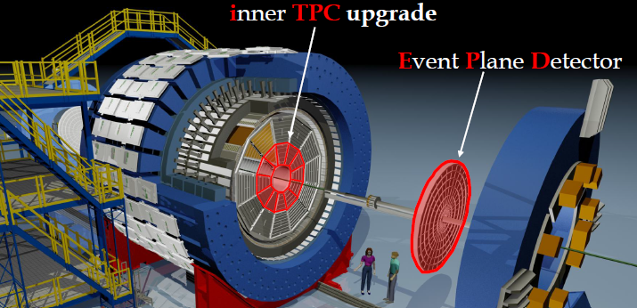
Upgrade Plans for BES II
i
TPC
E
P
D
iTPC upgrade:
Sparse pads cover full area;
better dE/dx;
-1 < η < 1 -1.5 < η < 1.5;
p_{T} >125 MeV/c p_{T} > 60 MeV/c.
EPD upgrade:
1.8 < eta < 4.2
Greatly improved Event Plane info (esp. 1st-order EP);
Better trigger & b/g reduction.

Slide 6
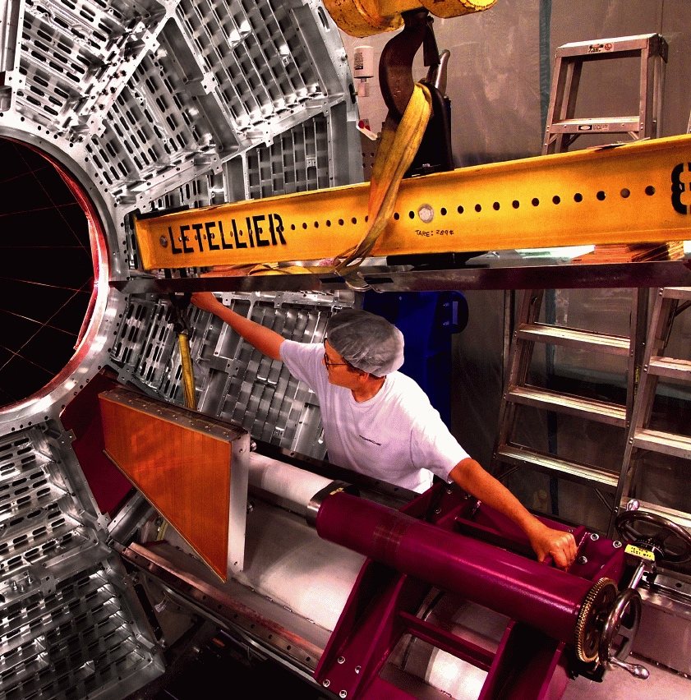
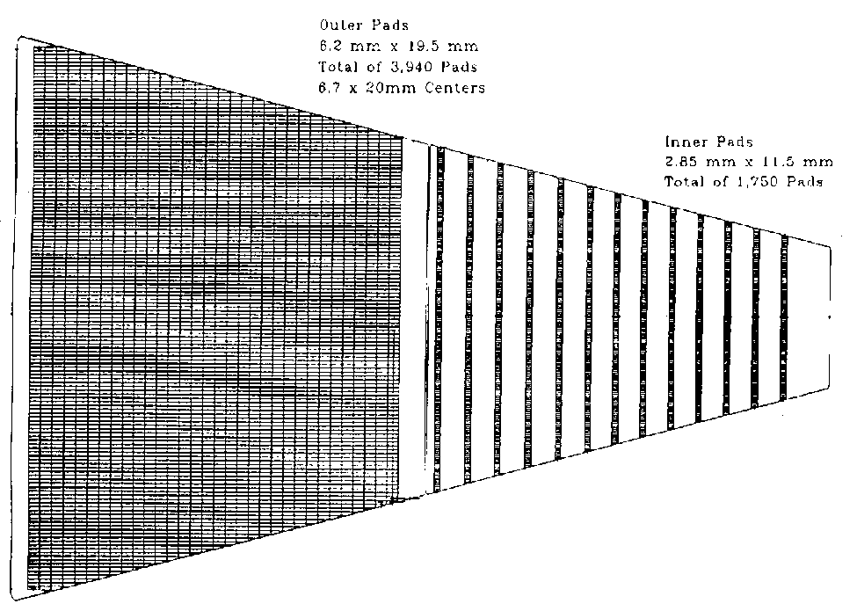
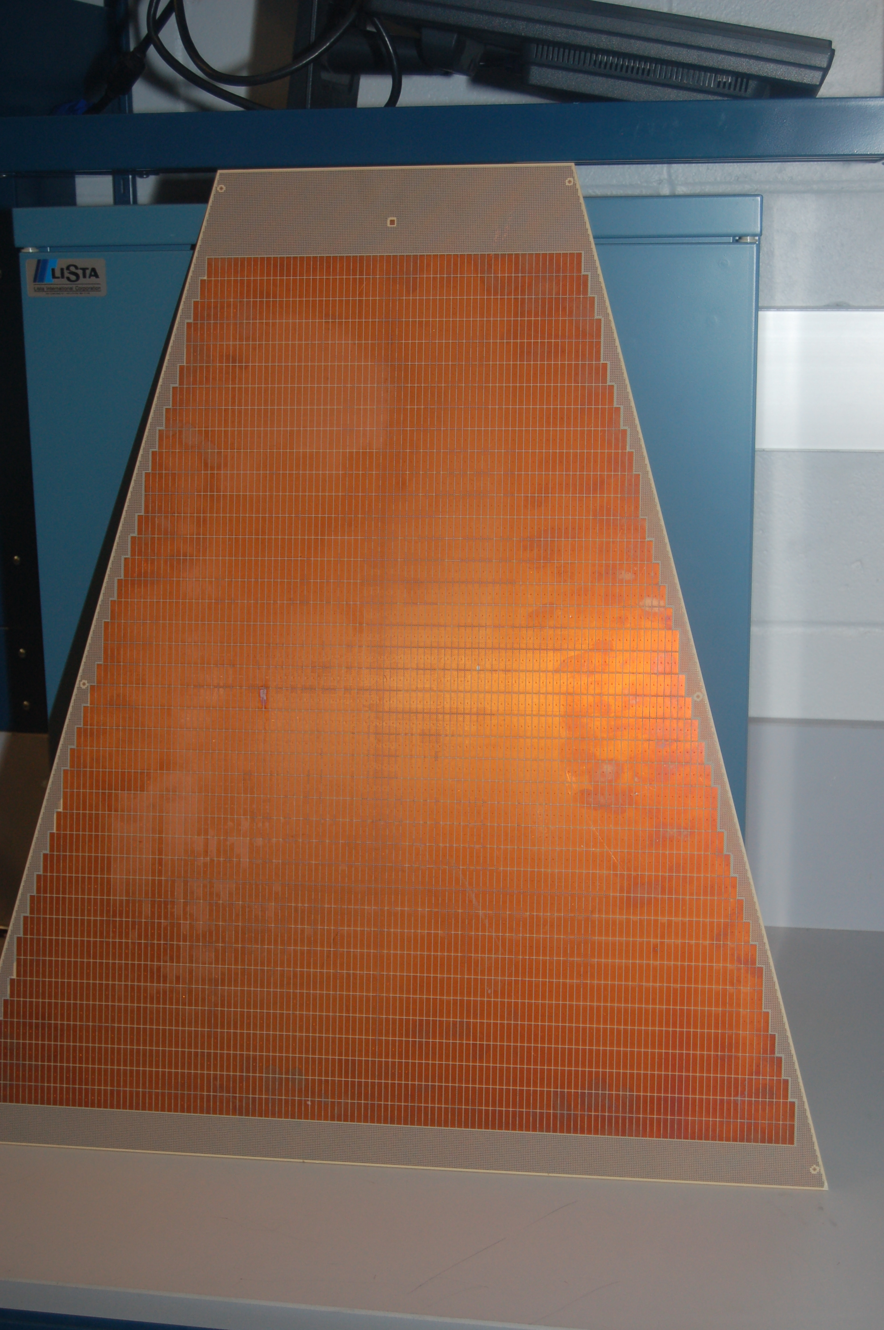
The iTPC in a nut shell
Inner sector 1/12
The upgrade increases #channels in the 24 inner sectors by about a factor of two.
Provide complete coverage for a inner sector
New electronics for inner sectors
Pad plane layout for one sector
Outer Inner
current
future

Slide 7
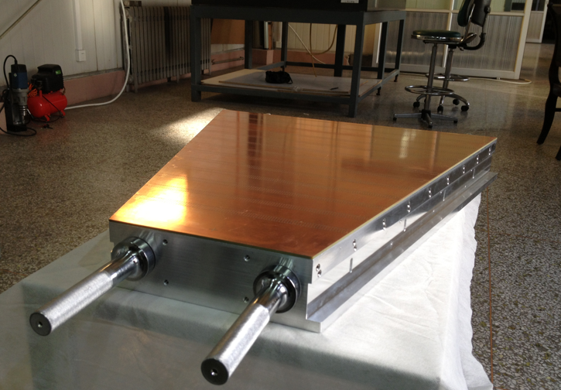
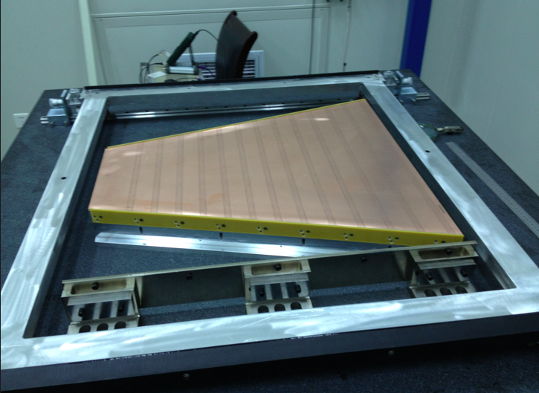
TPC sectors
Only modify is position of slots.
Pure construction project, little or no engineering and design left
- but work in retrieving old knowledge
improvements in electrostatics between inner and outer sector
Ready for construction
Prototype – original layout
Padplane glued onto strongback
Wire mounting prototype at Shandong University, China

Slide 8
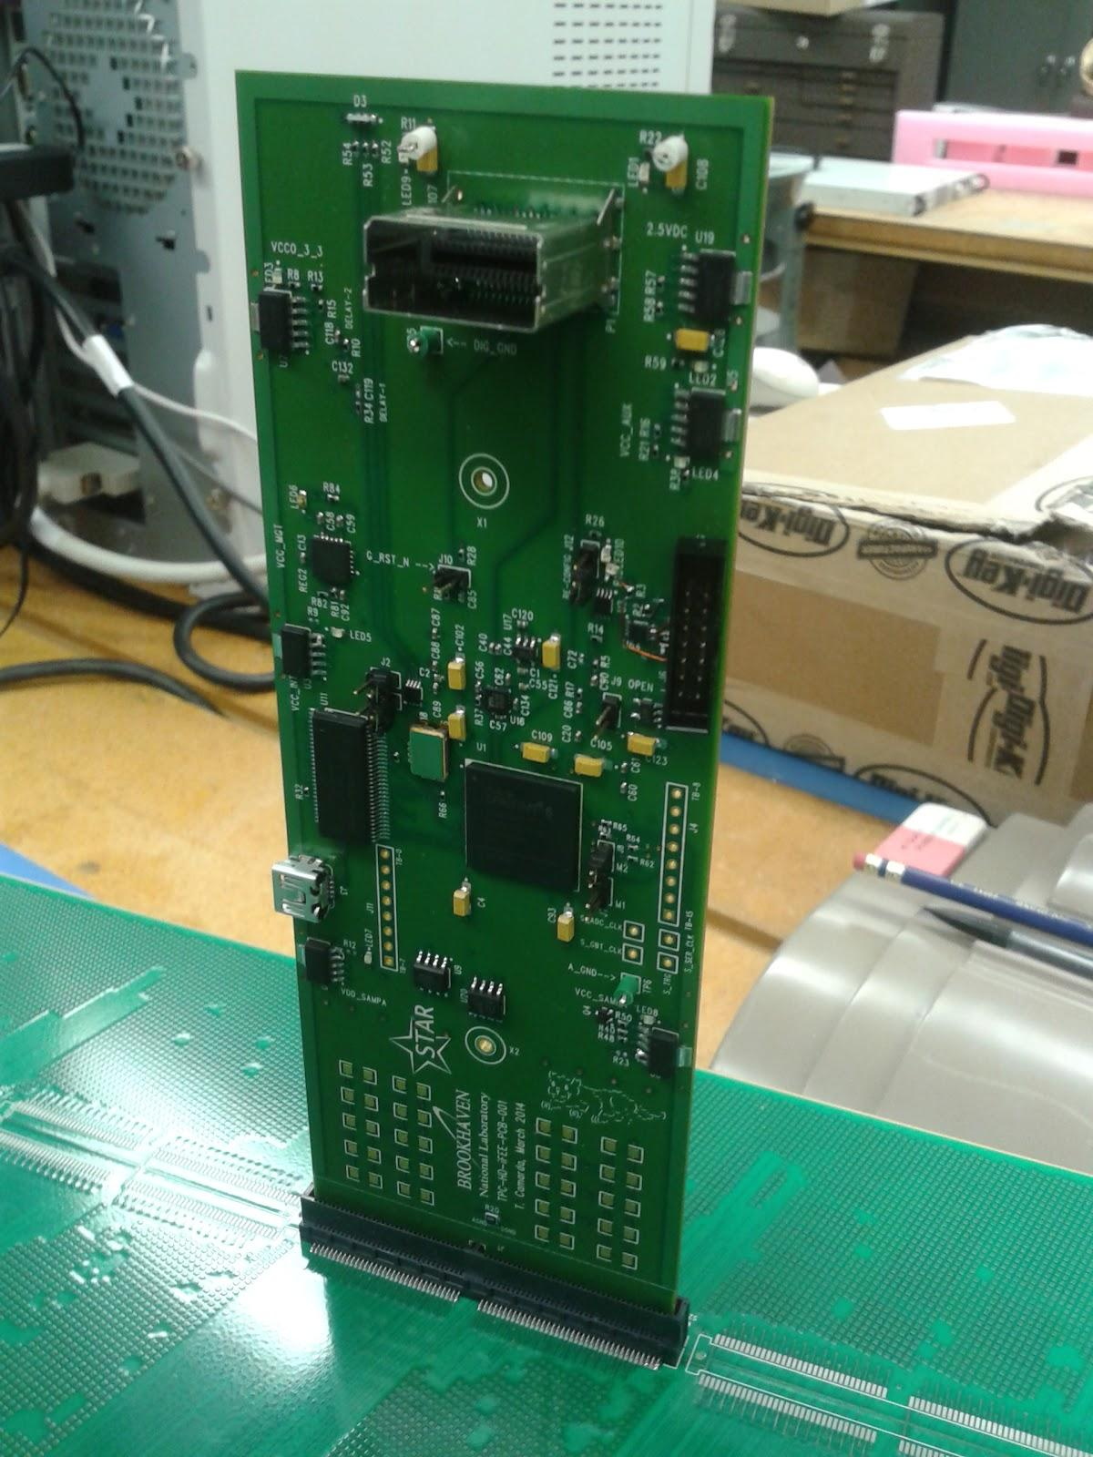
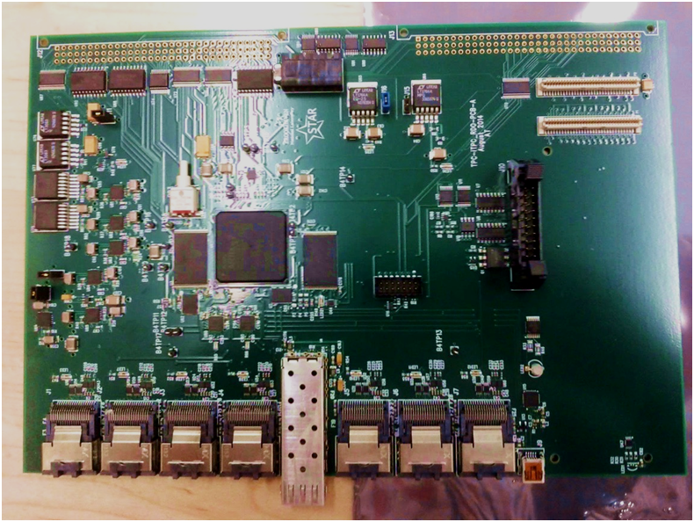
Electronics
iFEE based on current FEE layout, but using ALICE SAMPA chip
Twice #channels per FEE
RDO similar to existing
Developments over several years by BNL electronics group
RDO prototype
Pre-prototye iFEE electronic card shown plugged into the padplane

Slide 9
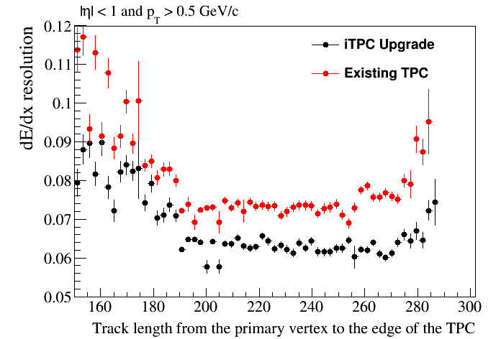
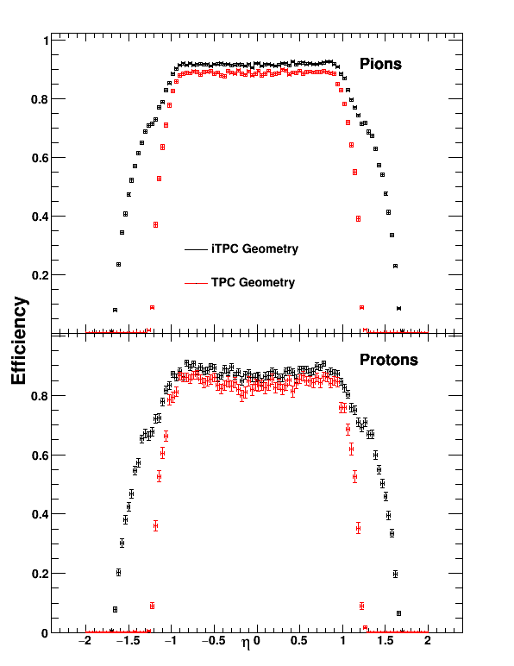
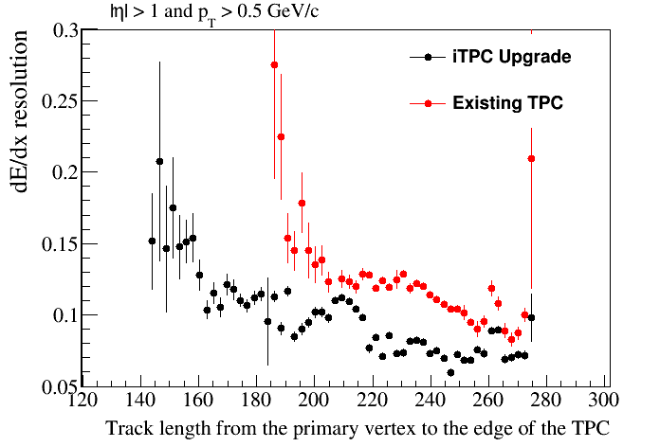
Improved performance
Increase rapidity coverage |η| < 1 to |η| < 1.5
Increased efficiency for |η| >1 both in p_{T} and particle specie
Improved dE/dx
7.5->6.2%

Slide 10
Net-proton cumulants in BES II
BES I has revealed non-trivial energy dependence
Rapidity length of correlation is important
Measure as fct. of Δy_{p} in wide range is needed to establish true nature of correlation
Subject actively pursued theoretically
Notes:
Since correlation function it is y2-y1 i.e. twice coverage

Slide 11
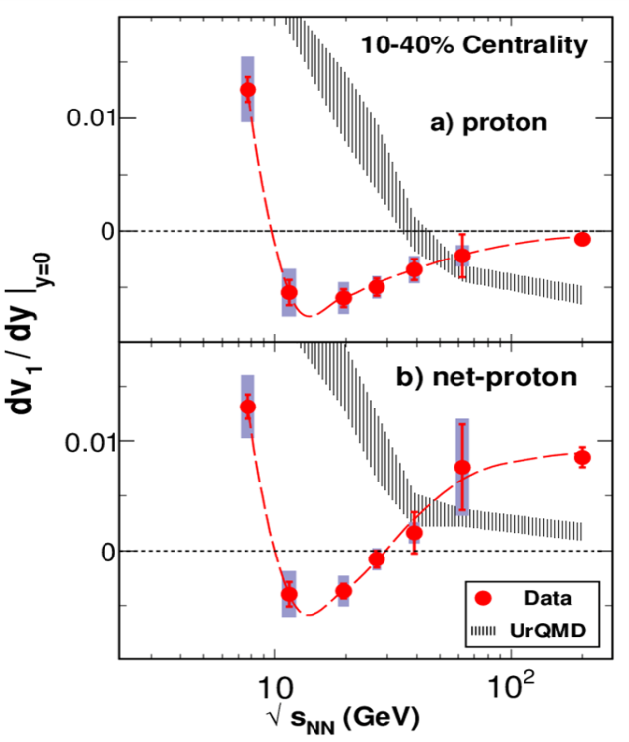
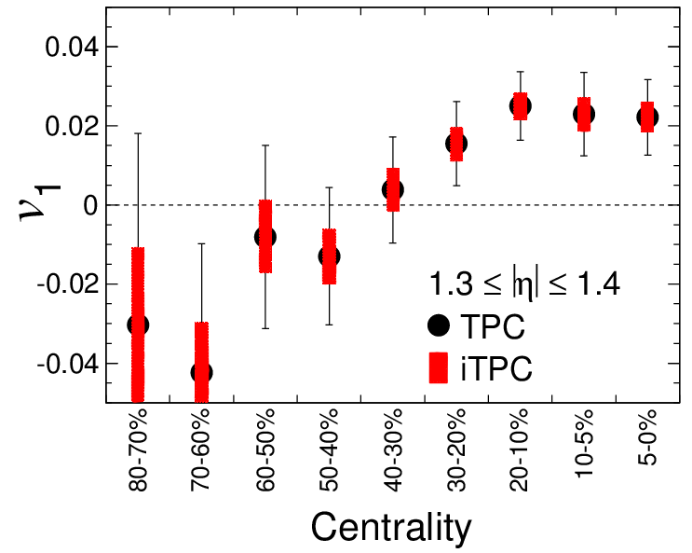
BES II directed flow
The Forward v₁ measurement as a function of centrality explicitly showing the improvements due to the coverage of the iTPC.
[Simulations based on UrQMD at 19.6 GeV]
Directed flow for protons and net-protons BES-I
PRL 112,162301 (2014)

Slide 12
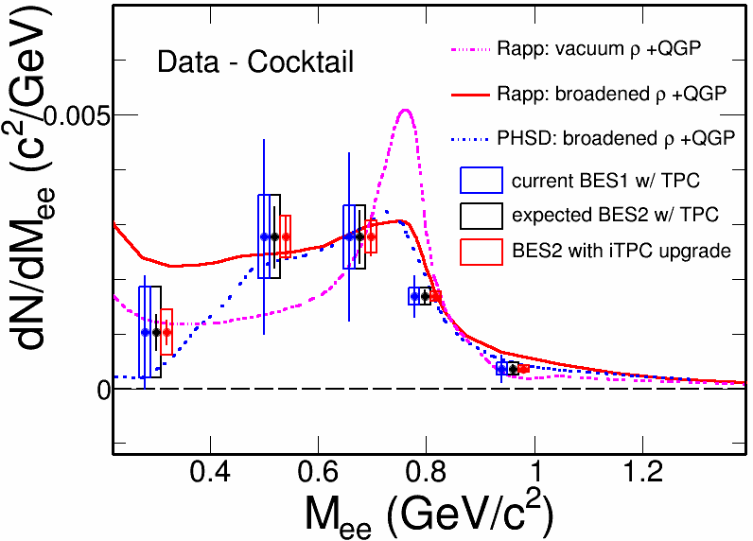
Di-electron measurements in BES II
Improved dE/dx will reduced the dominant systematic error on current data significantly
Systematically study continuum from 7.7-19.6 GeV
Distinguish model with different rho-meson broadening
Study effect of total baryon density on LMR excess

Slide 13
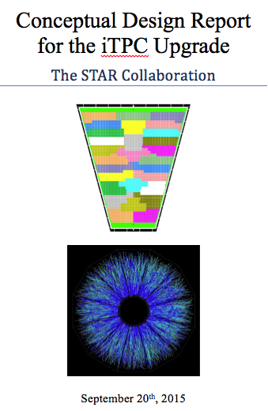
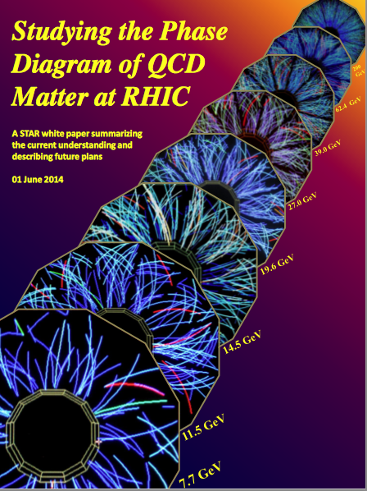
Summary
STAR concluded the first Beam Energy Scan at RHIC in collider mode
Second Phase to be executed in 2019 & 2020 with significant physics potential
Much improved statistics and improved physics results due to the iTPC upgrade
A complete construction plan is ready
Energy (GeV) | MB events (BES I) (M) | MB events (BES II) (M)
7.7 | 4 | 100
9.1 | - | 160
11.5 | 12 | 230
14.5 | 20 | 300
19.6 | 36 | 400
Notes:
Add the table of events..

Slide 14
Backup

Slide 15
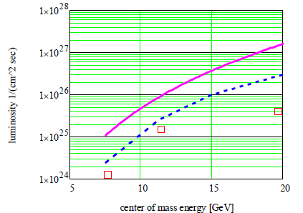
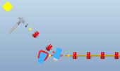
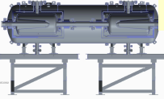
Low Energy Electron Cooling at RHIC
Electron Cooling can raise the luminosity by a factor of 3-10 in the range from 5 – 20 GeV
Long Bunches increase luminosity by factor of 2-5
RHIC with cooling and long bunches (V_{z} = +/- 1m)
Stage I √s_{NN} = 5-9 GeV
Stage II -- 3 MeV booster cavity √s_{NN} = 9-20 GeV
Minimum Projection
BES I Performance
100 MHz SRF Gun
SRF Cavity
11.2 m
cooling section
electron
u-turn,
delay line
250 kW Beam dump
11.2 m cooling section
58 m from IP2
energy
correction
cavity
gun
3 MeV booster
cavity needed for
2nd stage.

