Slide 1

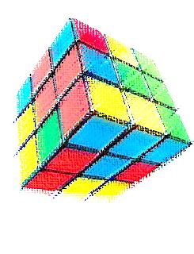


Measuring Transversity In P+P
Hadrons
$$\vec{S}$$
Hadrons
Quark
Anselm Vossen
CIPANP 2012

Slide 2
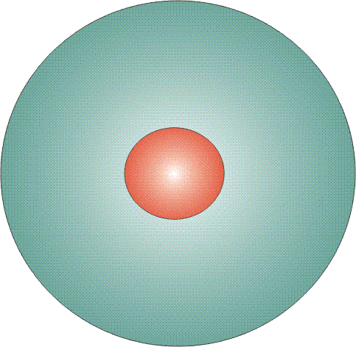
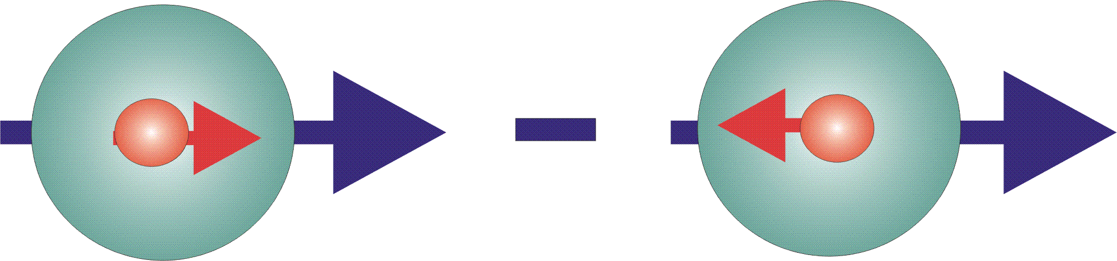

Parton Distribution Functions
The three leading order, collinear PDFs
q(x)
f₁^{q} (x)
unpolarized PDF
quark with momentum x=p_{quark}/p_{proton} in a nucleon
well known – unpolarized DIS
Δq(x)
g₁^{q}(x)
helicity PDF
quark with spin parallel to the nucleon spin in a longitudinally polarized nucleon
known – polarized DIS
transversity PDF
quark with spin parallel to the nucleon spin in a transversely polarized nucleon
Δ_{T}q(x)
h₁^{q}(x)
chiral odd, poorly known
Cannot be measured inclusively
Extract from semi-inclusive
measurements

Slide 3

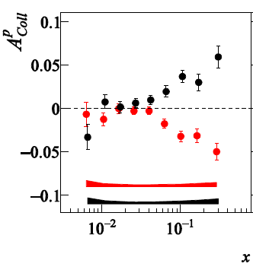
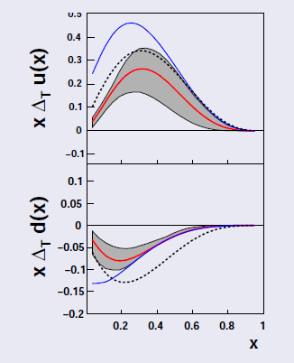
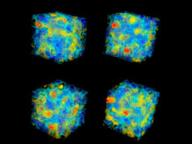

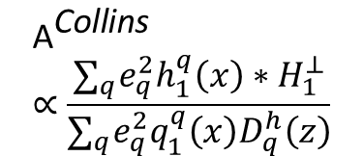
Extracting Transversity from Data and the Lattice
We can connect observables to first order calculations on the lattice
  First step: Tensor charge g_{T} $=\int_{−1}^{1}{h_{1}\left(x\right)dx}$, can come from lattice and experiment
  First order calculations need connection to experiment
  Parton distributions on the light-cone → compare moments
Why p+p?: High x_{Bj} (forward), Q², test understanding of p+p
$${\text{A}}^{\text{Collins}}∝\frac{∑_{q}e_{q}^{2}h_{1}^{q}\left(x\right)∗H_{1}^{⊥}}{∑_{q}e_{q}^{2}q_{1}^{q}\left(x\right)D_{q}^{h}\left(z\right)}$$
Global
Fit with
FFs from
Belle
Chiral odd-cannot be measured inclusively
Notes:
It is of course nice to describe the nucleon structure in terms of these distribution functions but I want to go away from the parametrization, towards real understanding

Slide 4
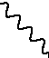
Why is so hard to measure?
–
Boost suppresses transverse spin vector
Semi-classic picture: Rotating charge
Leptonic probe is ‘too fast’ to see transverse spin
To probe: knock out quark and use effect generated by angular moment conservation
Notes:
Coupling to the spin mag moment is suppressed in relativistic collisions

Slide 5
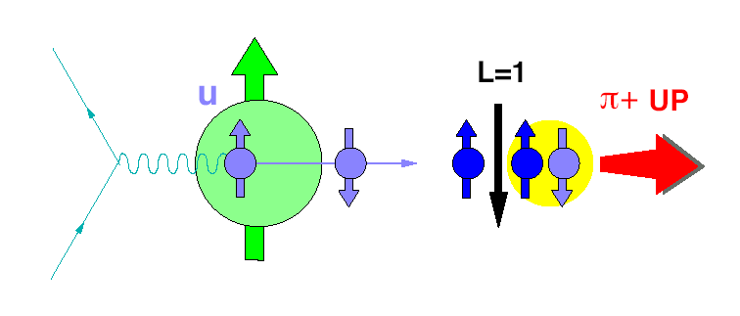
Artru Model for Collins Fragmentation
A simple model to illustrate that spin-orbital angular
momentum coupling can lead to left right asymmetries in spin-dependent fragmentation:
Proton spin
is pointing up!
String breaks and
a dd-pair with spin
1 is inserted.
L = -1
π⁺ picks up L=-1 to
compensate for the
pair S=1 and is emitted
up.
u-quark absorbs
photon/gluon and
flips it’s Spin.
In Di-hadron measurements:
Can have relative angular momentum
Advantage: Collinear framework applicable

Slide 6
Collins Effect In Jets
pbeam
Look for spin dependent azimuthal distributions of charged pions inside the jets! First proposed by F. Yuan in Phys.Rev.Lett.100:032003.
Measure average weighted yield:
S⊥
ΦS
pπ
jT
Φh
–pbeam
PJET

Slide 7
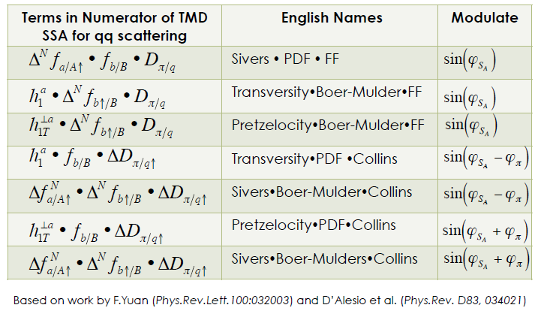
More Correlation Measurements: of Pions in Jets
What about predictions, also for di-hadrons?

Slide 8
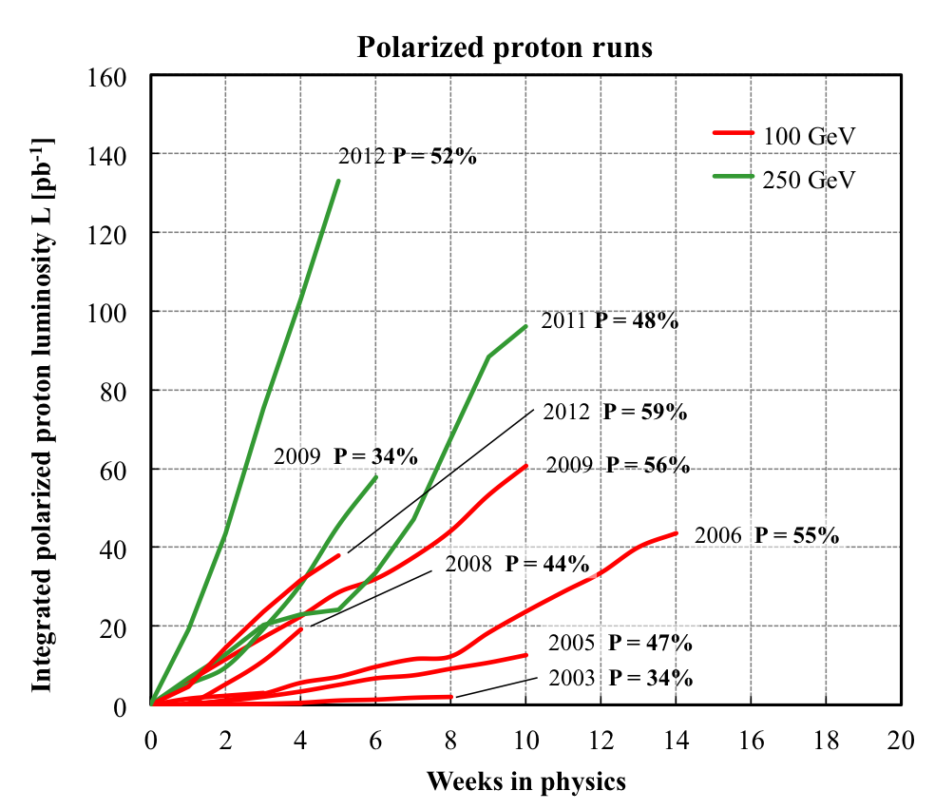
The RHIC Polarized Collider
Absolute Polarimeter (H↑ jet)
RHIC pC Polarimeters
E-Lens and Spin Flipper
A_{N}DY/ BRAHMS
Siberian Snakes
Siberian Snakes
PHENIX
STAR
Spin Rotators
(longitudinal polarization)
Spin Rotators
(longitudinal polarization)
Pol. H⁻ Source
LINAC
EBIS
BOOSTER
Helical Partial Siberian Snake
200 MeV Polarimeter
AGS
AGS pC Polarimeter
Strong AGS Snake
See http://www.phy.bnl.gov/cnipol/fills/
Versatility:
Polarized p+p Sqrt(s) collisions at 62.4 GeV, 200 GeV and 500 GeV
Recent Spin Runs:
2011 500 GeV, longitudinal at Phenix, transverse at STAR ~30 pb^-1 sampled
2012 200 GeV, Phenix and STAR, transverse ~20 pb^-1 sampled (at STAR: ~x10 statistics)

Slide 9

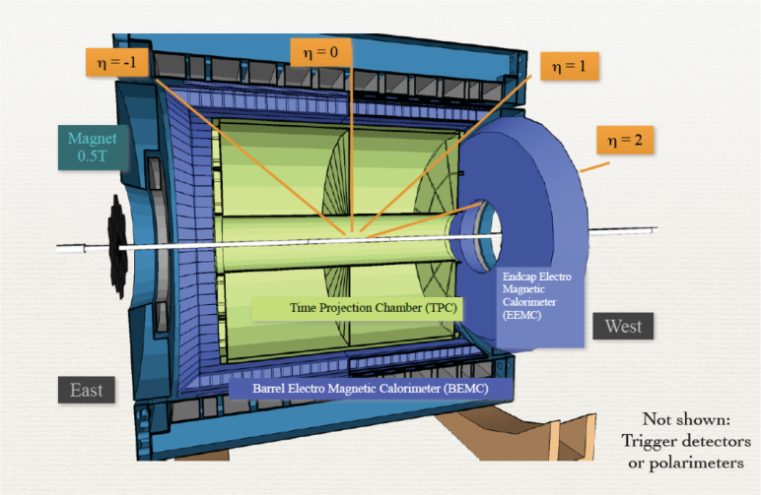
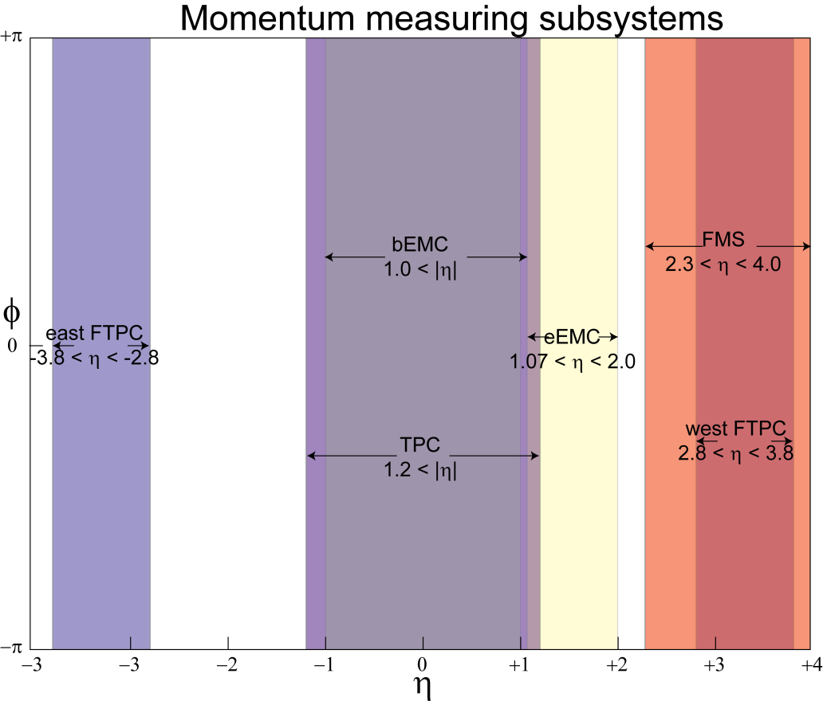
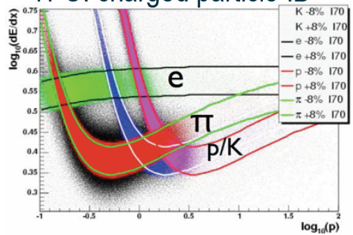
FMS
Central Region (-1<eta<1)
  Identified Pions, eta
  Jets
Endcap (1<eta<2)
  Pi0, eta, (some) jets
FMS (2<eta<4)
  Pi0, eta
Full azimuth spanned with nearly contiguous electromagnetic calorimetry from -1<η<4
⇒ approaching full acceptance detector
PID (Barrel) with dE/dx, in the future: ToF pi/K separation up to 1.9 GeV

Slide 10
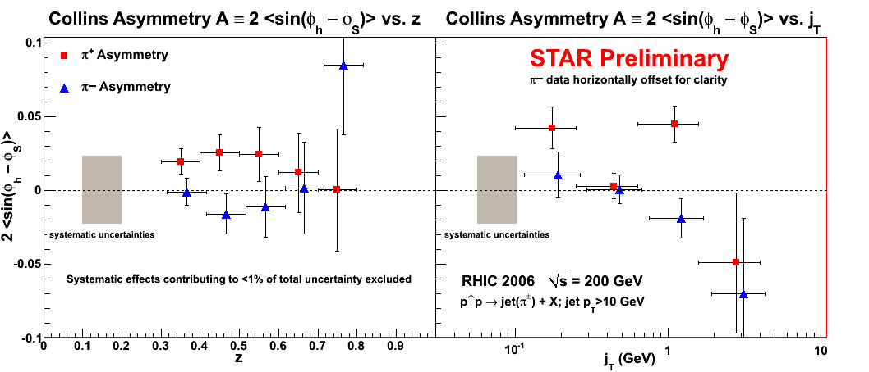
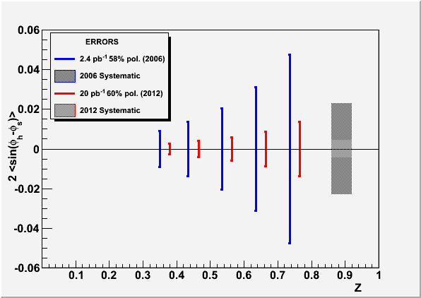
First Step: Mid-rapidity Collins analysis
Run 12 Projections
z: fractional momentum of the hadron
j_{T}: transverse momentum from the jet-axis

Slide 11

Using Hadron Pairs:
Interference Fragmentation Function in p-p
φ_{R}-φ_{S}
X
c
a
b
X
$$A_{UT}∝h_{1}∙H_{1}^{<}$$
φ_{S}
: Angle between polarisation vector and event plane

Slide 12
Transversity from di-Hadron SSA
Physics asymmetry
Unpolarized
quark distribution
Known from DIS
Hard scattering
cross section
from pQCD
Transversity
to be extracted
IFF + Di-hadron FF
measured in e+e-

Slide 13

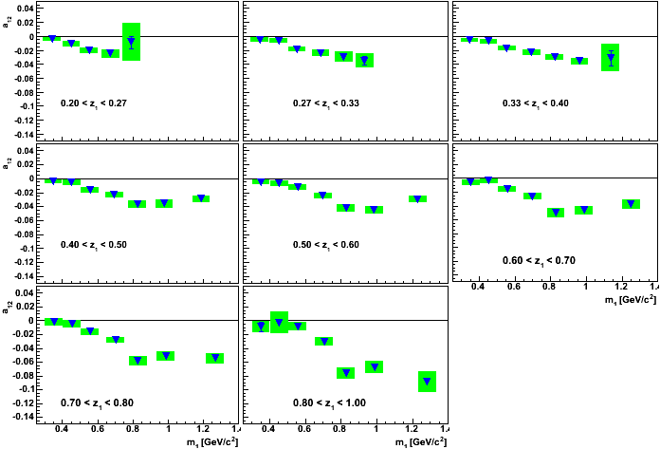
Results or IFF at (z₁x m₁) Binning
A. V.. et. al, PRL 107, 072004(2011)

Slide 14
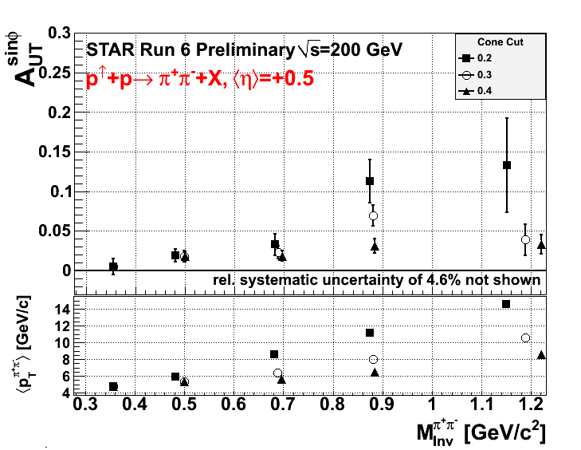
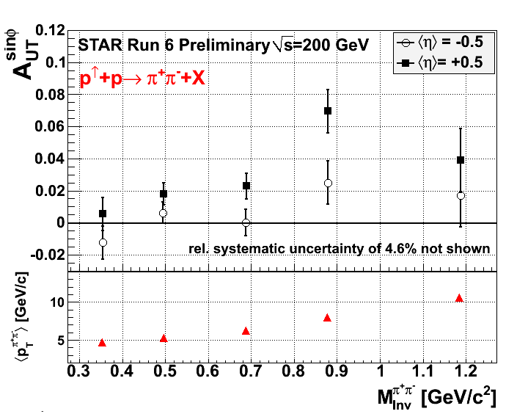
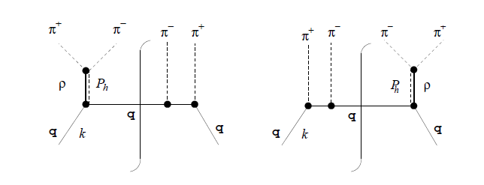
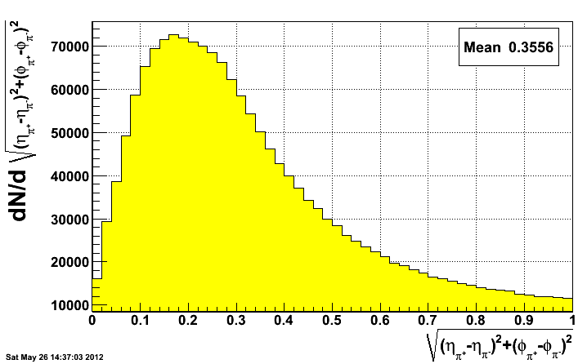
NEW: STAR shows significant Signal!

Slide 15
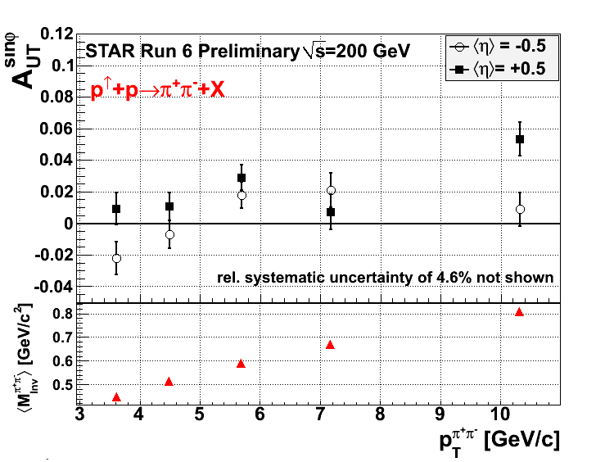
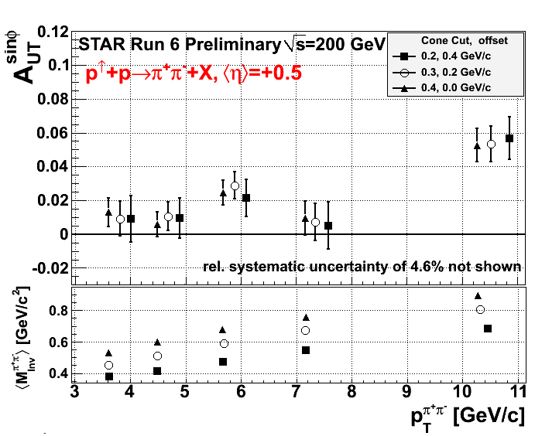

Slide 16
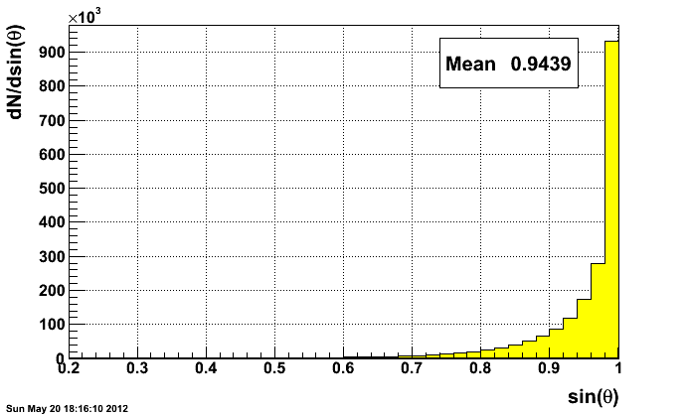
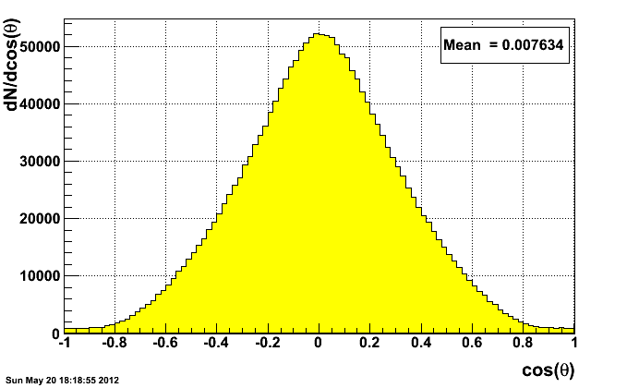
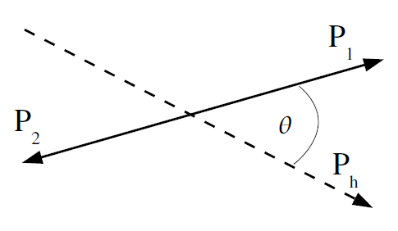

Decay Angle Distributions

Slide 17
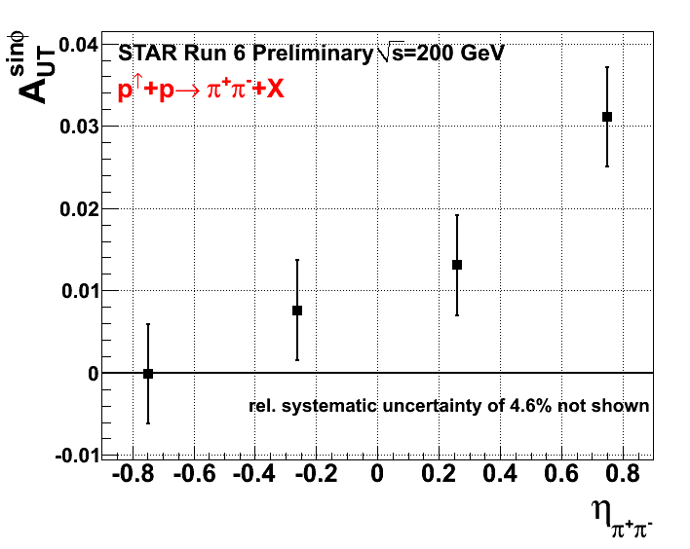
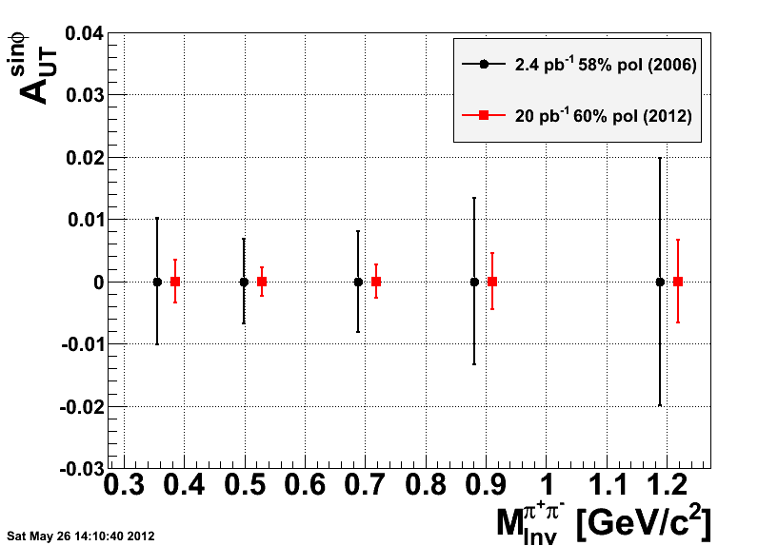
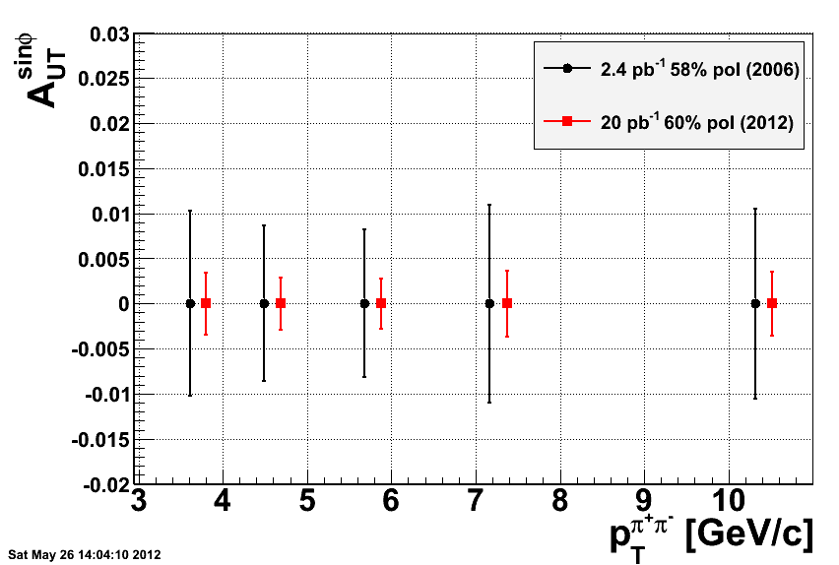
π⁺/π⁻
π⁺/π⁻
Additional precision data from this years run
+ increased kinematic reach

Slide 18
Summary & Outlook
First signal of transversity in p+p collisions in single and di-hadron Correlations observed
p+p: high scale, high x_{Bj}
2012 Data will allow precision measurement, comparison with SIDIS (e.g. factorization in Collins)
Future measurements
  π⁰ combinations
  (more) forward measurements
  Additional modulations of cross-section

Slide 20
Backup

Slide 21
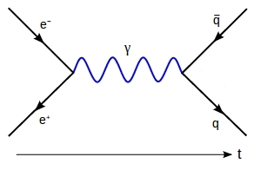

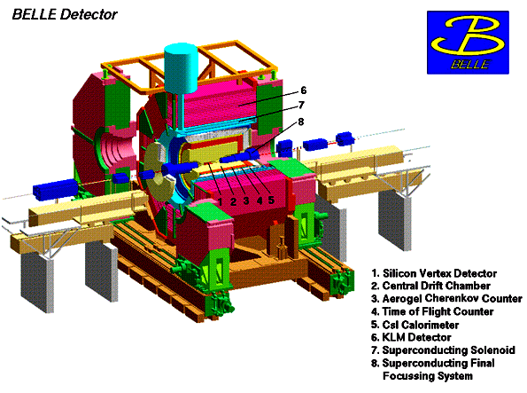
Measurements of Fragmentation Functions in e+e- at Belle
KEK-B: asymmetric e⁺ (3.5 GeV) e⁻ (8 GeV) collider:
-√s = 10.58 GeV, e⁺e⁻→Υ(4S)→B‾B
-√s = 10.52 GeV, e+e-→ qqbar (u,d,s,c) ‘continuum’
ideal detector for high precision measurements:
- tracking acceptance θ [17 °;150°]: Azimuthally symmetric
- particle identification (PID): dE/dx, Cherenkov, ToF, EMcal, MuID
Available data:
  ~1.8 *10⁹ events at 10.58 GeV,
  ~220 *10⁶ events at 10.52 GeV
Belle detector
KEKB
Notes:
Check number of events for continuum

Slide 22
Measuring transverse spin dependent di-Hadron Correlations
In unpolarized e⁺e⁻ Annihilation into Quarks
electron
Interference effect in e⁺e⁻
quark fragmentation
will lead to azimuthal
asymmetries in di-hadron
correlation measurements!
Experimental requirements:
Small asymmetries ➔
very large data sample!
Good particle ID to high
momenta.
Hermetic detector
ϕ₂
q₁
ϕ₁
z₂
q₂
z₁
quark-2
spin
quark-1
spin
z_{1,2} relative pion pair
momenta
positron
Notes:
22

Slide 23
Results or IFF at (z₁x m₁) Binning
AV et. al, PRL 107, 072004(2011)

Slide 24
Origin of Single Spin Asymmetries
h
f_{a}
q
FF_{q}
σ
Can initial and/or final state effects generate large transverse spin asymmetries? (A_{N} ~10⁻¹)
f_{b}
X’
Proton Structure
pQCD
small spin
dependence
fragmentation
function
Notes:
Lets look what we’re probing when we’re measureing transverse ssa’s

Slide 25
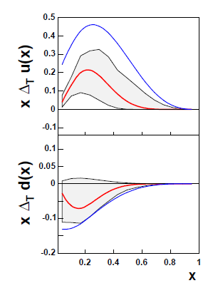
Transverse Spin Structure Functions
Transversity correlation between transverse proton spin and quark spin
S_{p}– S_{q} coupling
Quark transverse
spin distribution
Collins FF
J. C. Collins, Nucl. Phys. B396, 161 (1993)
One of three collinear parton distribution functions needed to describe the spin structure of the nucleon at leading order
Chiral odd quantity: needs chiral odd partner-> FF
Inaccessible in inclusive measurements: poorly known
Anselmino et. al., PRD75 054032
Notes:
Structure functions that govern these effectx

Slide 26
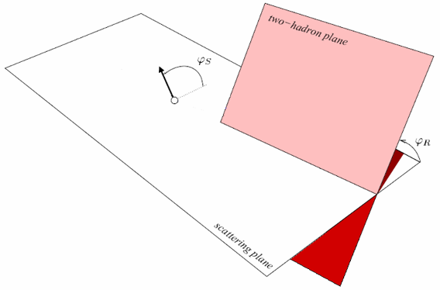
Di-Hadron Correlations
: Angle between polarisation vector and event plane
Bacchetta and Radici, PRD70, 094032 (2004)

