Slide 1
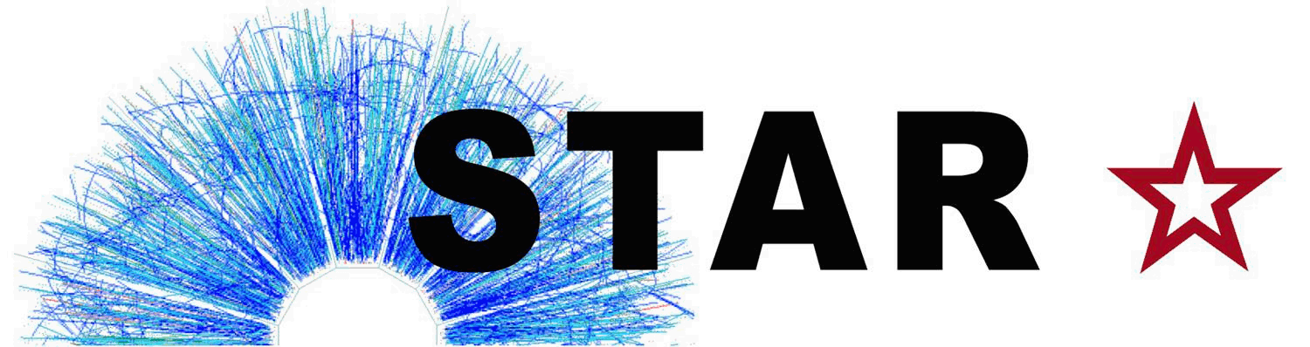
Dilepton measurements with
5th Workshop of the APS Topical Group on Hadronic Physics
Denver, CO. April 11, 2013.

Slide 2
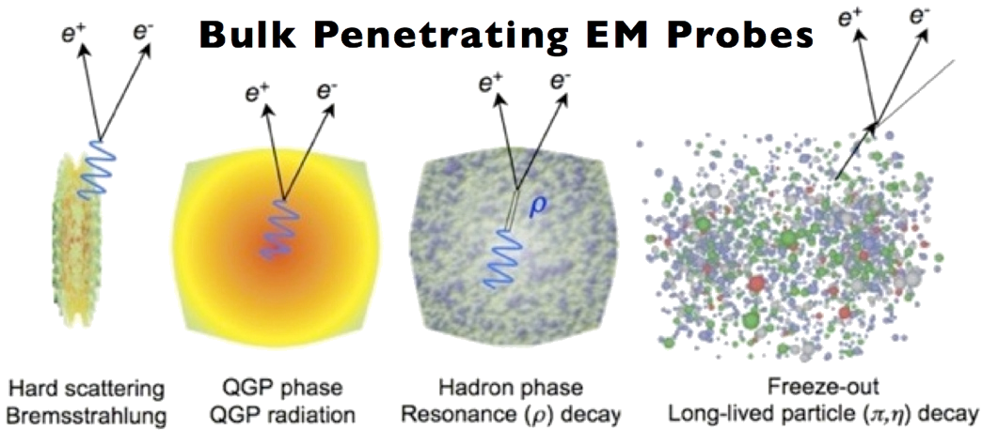
Dileptons in Heavy Ions
Dileptons: Penetrating probes at all time scales
  Very low cross-section with QCD medium
  Window into all stages of system evolution
Chronological hierarchy
  Low Mass Range (LMR)
    M_{ee} < 1.1 GeV/c² :
      in-medium modification of vector mesons
      chiral symmetry restoration?
  Intermediate Mass Range (IMR)
    1.1 < M_{ee} < 3 GeV/c²
      heavy-flavor modification
      QGP thermal radiation
  High-mass Range (HMR)
    M_{ee} > 3 GeV/c²
      primordial production, e.g. Drell-Yan
      Quarkonia suppression

Slide 3
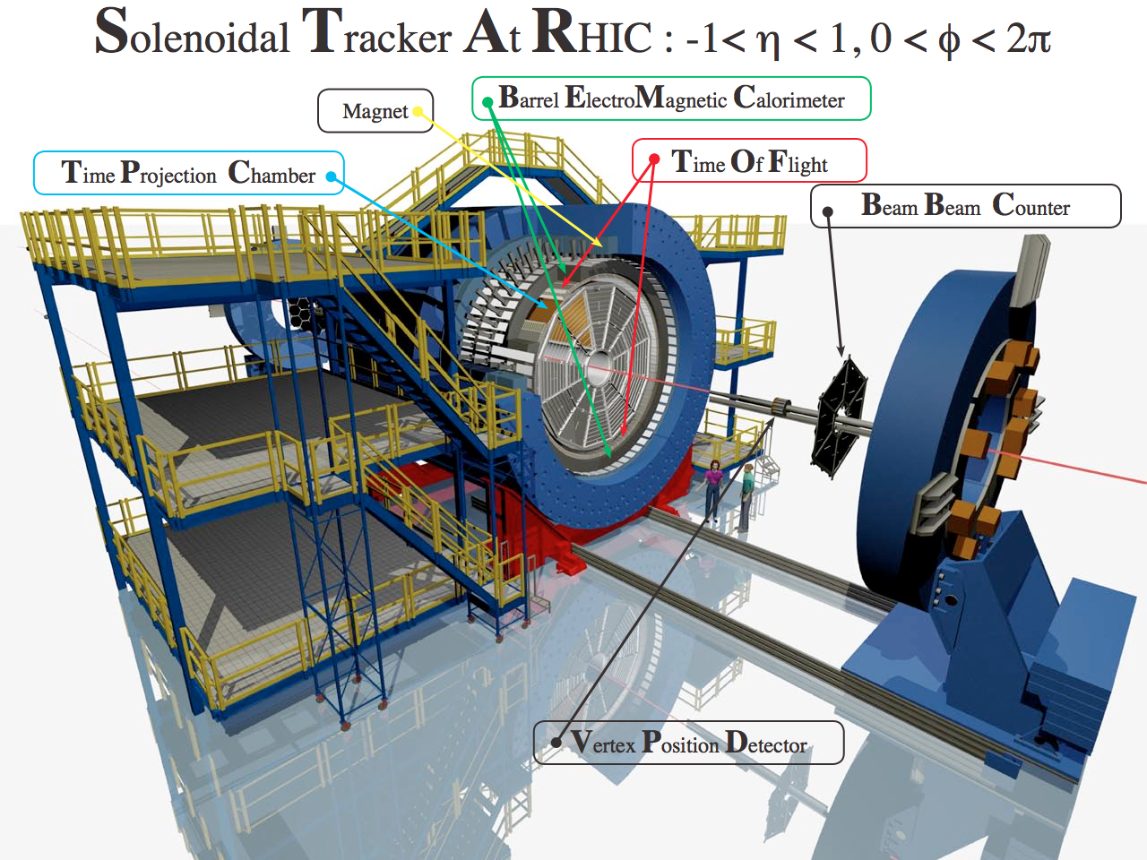
Measuring Dileptons in STAR
Minimum bias triggers
  pp: BBC
  AA: VPD, ZDC
TPC:
    Tracking
    PID
TOF: PID
BEMC:
    Trigger (High E_{T})
    PID
Vertex Position Detector

Slide 4
Low and Intermediate Mass in pp at 200 GeV
p+p Reference data crucial:
  Many sources
  Need good baseline
Cocktail simulation: 9 ingredients
    L. Ruan (STAR), Nucl. Phys. A855 (2011) 269
  Cocktail Consistent with data
  Charm contribution dominates IMR
    Charm σ from M_{ee}: 0.92 ± 10 ± 0.26 mb
      Consistent with STAR D measurement
Uncertainties:
  vertical bars: statistical
  boxes: systematic
  grey band: cocktail syst. (14-33%)
  not shown: 11% normalization
Phys. Rev. C 86, 024906 (2012)

Slide 5
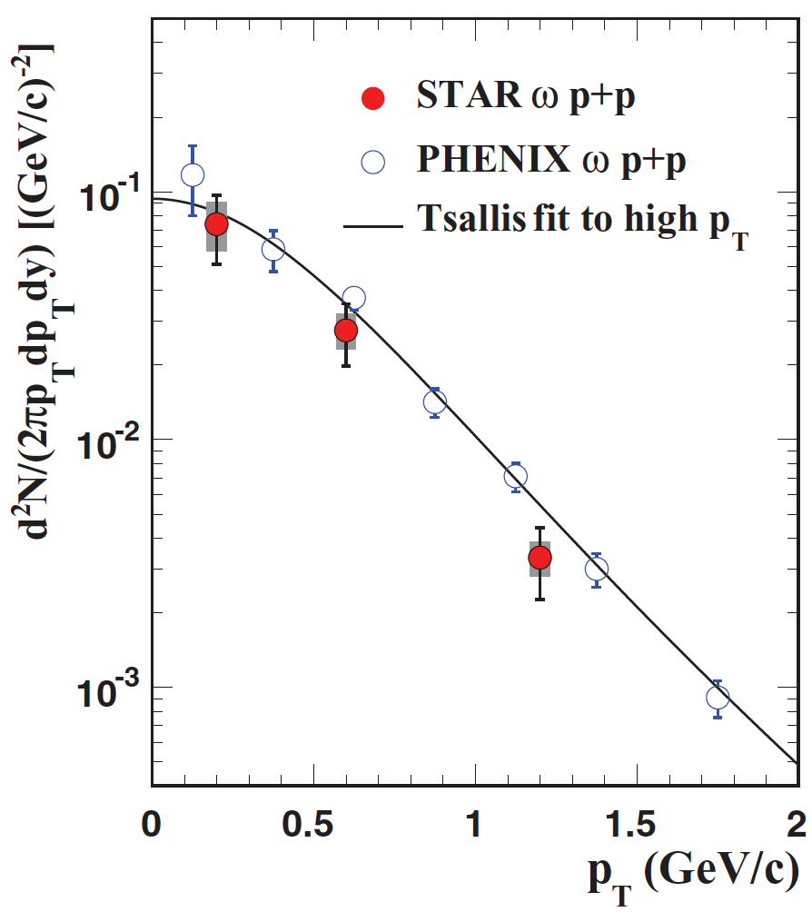
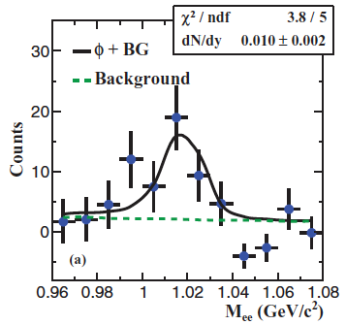
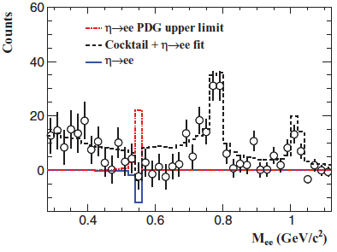
Meson yields from ee in pp
11% normalization unc. not shown
Phys. Rev. C 86, 024906 (2012)
: dN/dy = 0.10 ± 0.02 ± 0.02
  Consistent with previous results from PHENIX
: dN/dy = 0.010 ± 0.002 ± 0.002
: dN/dy = [2.1 ± 0.7 ± 0.7 ]×10⁻⁵
New limit on BR : < 1.7 ×10⁻⁵ (Previous: 2.7 ×10⁻⁵ )

Slide 6
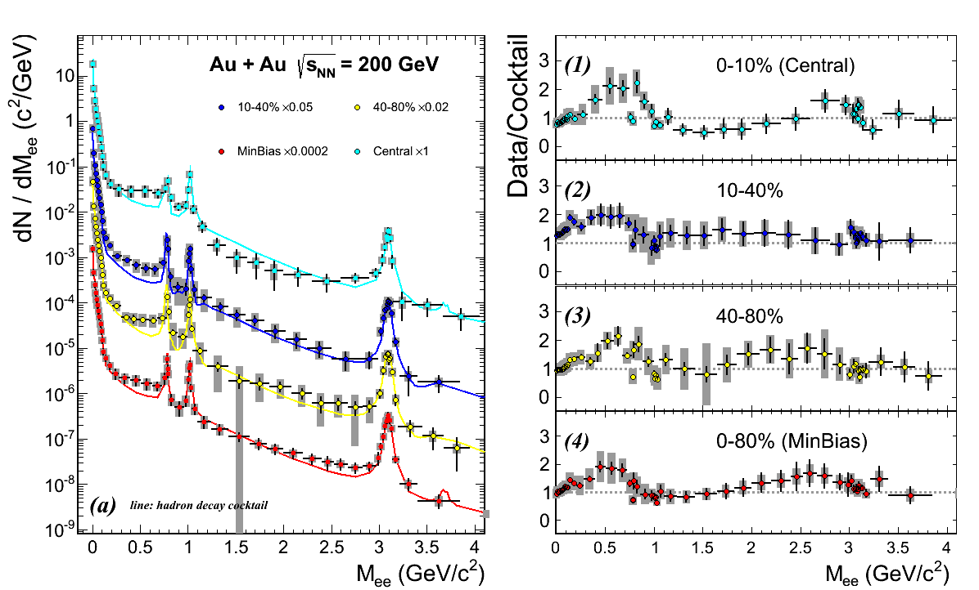
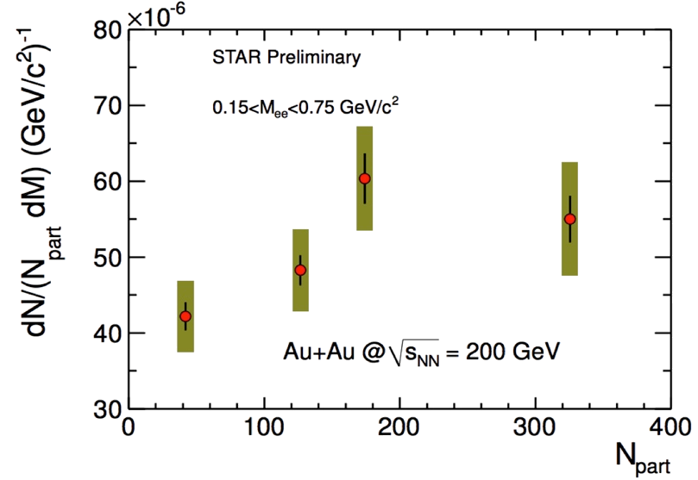
Low and Intermediate Mass in AuAu 200 GeV
Low mass
  enhancement compared to cocktail
    w/o ρ meson
  Seen at all centralities
Intermediate mass
  Cocktail consistent with data within ~2s
  Hints of suppression in central?
    Charm? Themal dileptons?
    Future detector upgrades: HFT+MTD
LMR enhancement
scaled by N_{part}

Slide 7
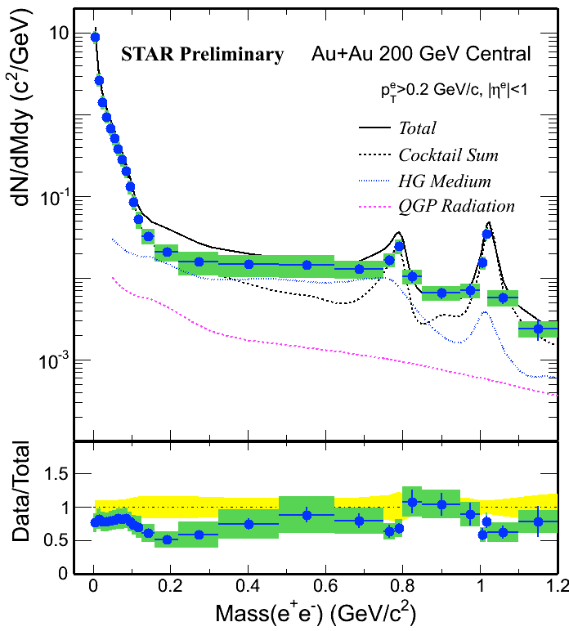
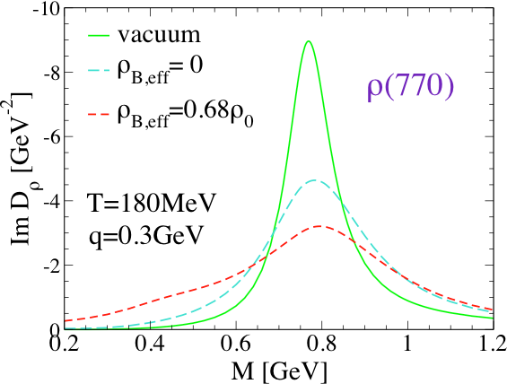
Comparison to models
STAR central AuAu at 200 GeV
Model: Rapp et al. (Priv. comm.) based on
    R. Rapp, PRC 63 (2001) 054907
    R. Rapp & J. Wambach, EPJ A 6 (1999) 415
  Evolution of QGP and Hadron Gas
    Hadronic phase: ρ “melts” when extrapolated close to phase-transition boundary
Cocktail + HG + QGP
  consistent with data within uncertainties
Rapp, Wambach, van Hees
arXiv:0901.3289

Slide 8
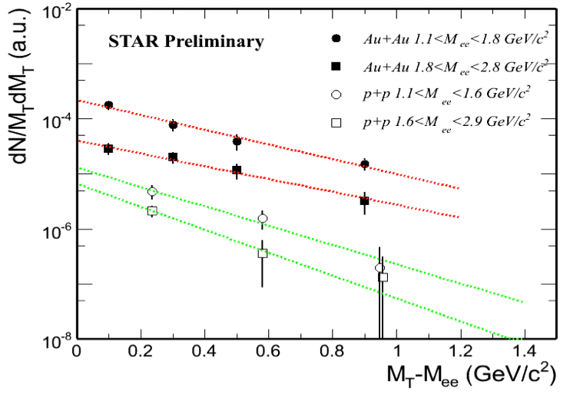
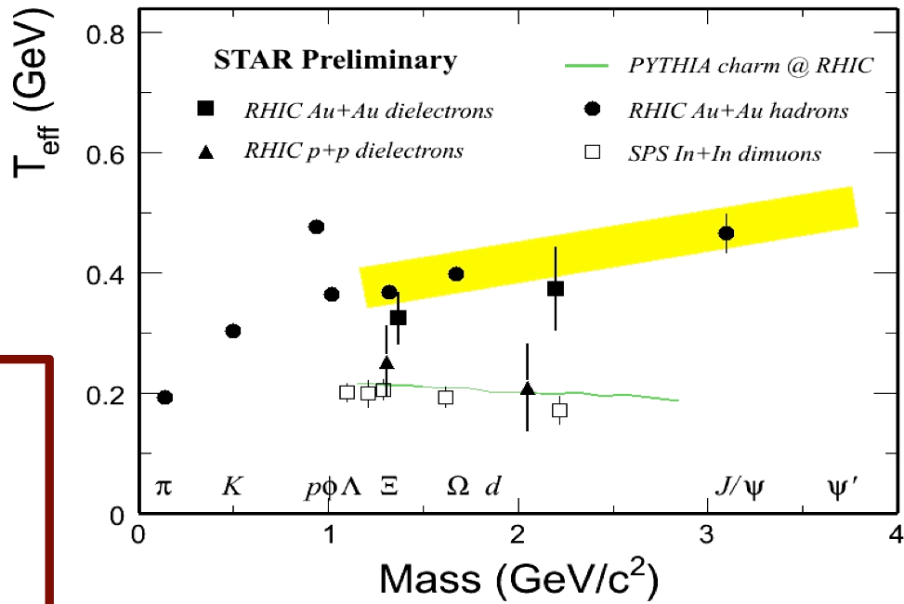
IMR Transverse mass spectra
RHIC pp : Slope consistent with PYTHIA
RHIC Au+Au: T_{eff} larger than pp
  Compare to SPS: In+In 17.2 GeV. NA60 PRL 100 022302 (2008)
    Charm/DY subtracted
    Consistent with pp slope
  Hint of thermal dilepton production and/or charm modification

Slide 9
Dielectron production at lower √s_{NN}
Top RHIC energy: LMR enhancement
  in-medium modification?
  indication of chiral sym. restoration?
Explore LMR at lower energy
  Consistent model description?
Beam energy scan for dielectrons: 2010-2011
  Au+Au: 62.4, 39 and 19.6 GeV
    Data samples : 55M, 99M and 34M min-bias events

Slide 10
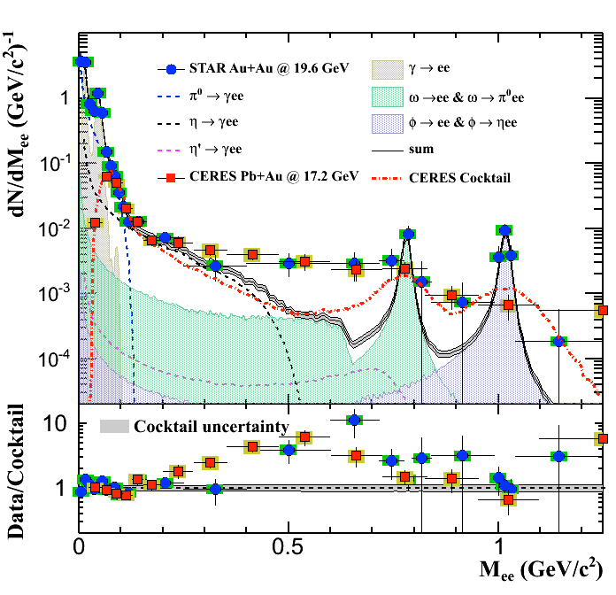
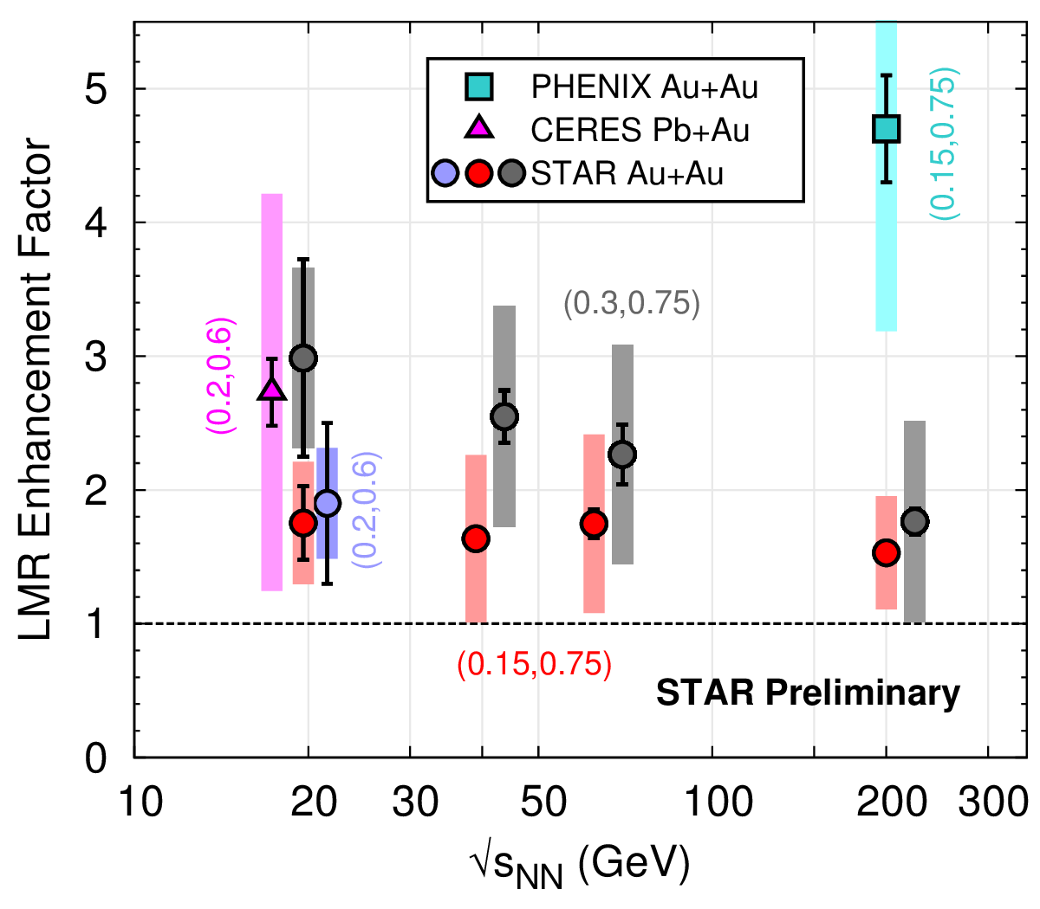
LMR Enhancement vs. √s_{NN}
LMR excess over hadronic cocktail (exc. ρ) observed for all energies.
  Systematic measurement of LMR enhancement factor
STAR enhancement of similar magnitude as observed by CERES
  Note: different kinematic regions, centrality
    STAR Au+Au at 19.6, minbias (0-80%), pT>0.2 GeV/c, |η|<1, |y_{ee}|<1
    CERES Pb+Au at 17.3, centrality (0-28%), pT>0.2 GeV/c, 2.1<η<2.65, θ_{ee}>35mrad

Slide 11
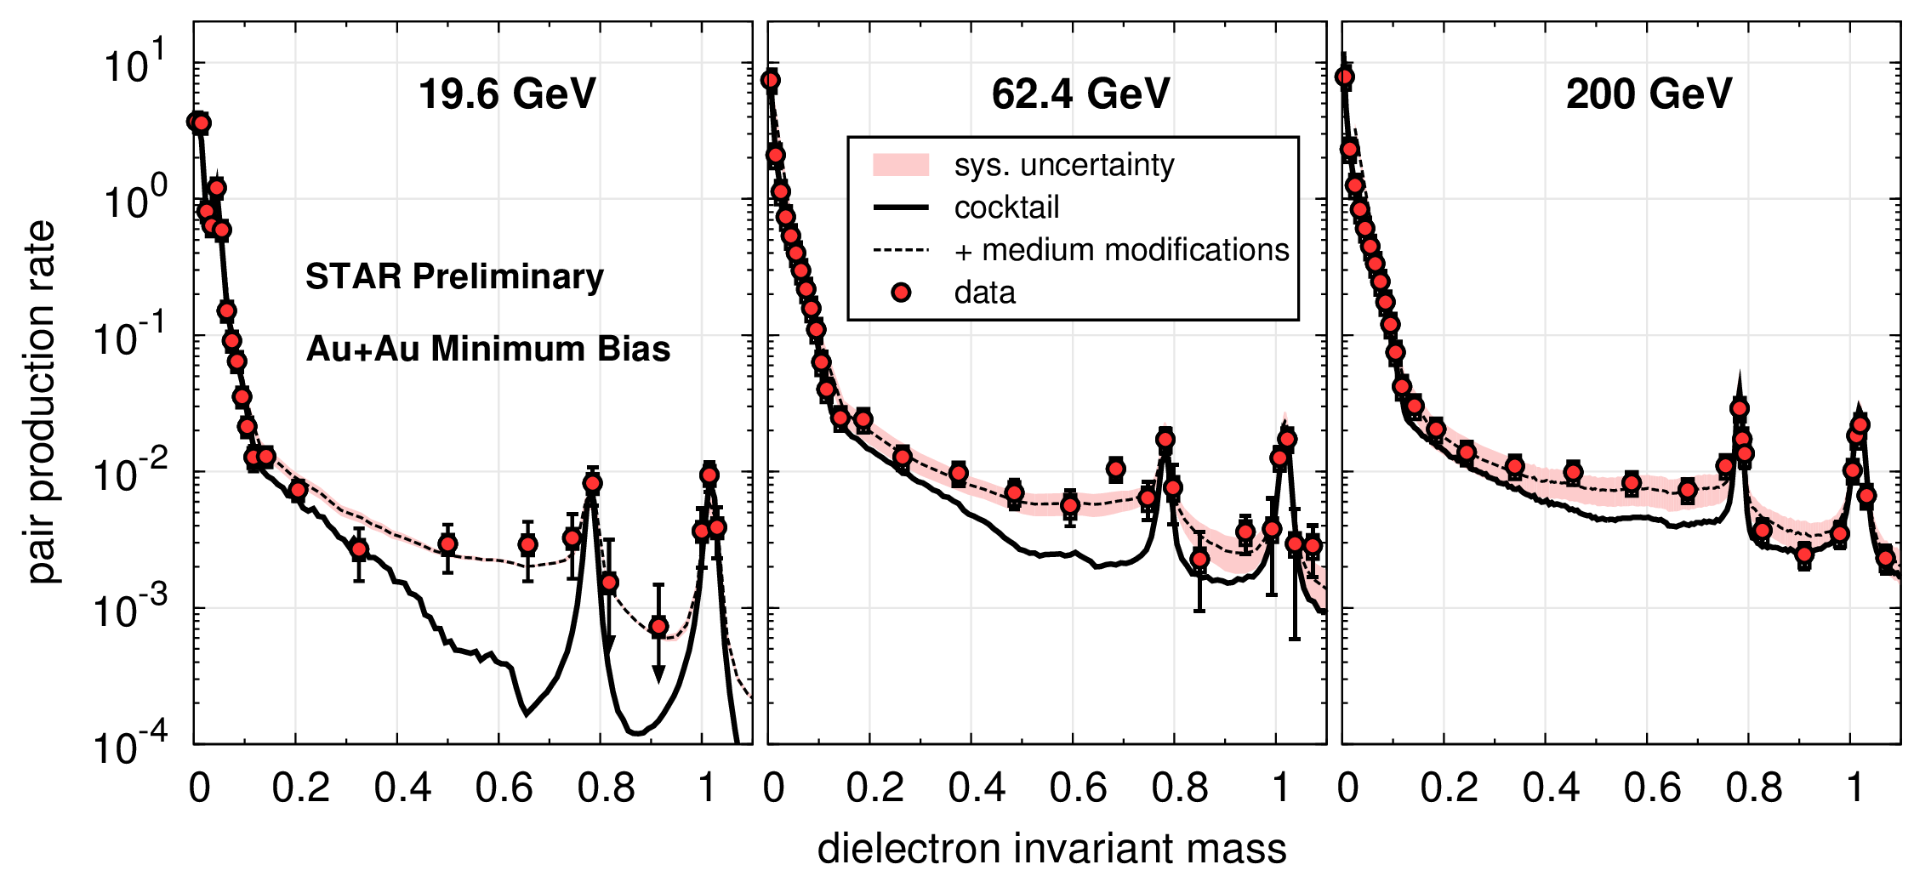
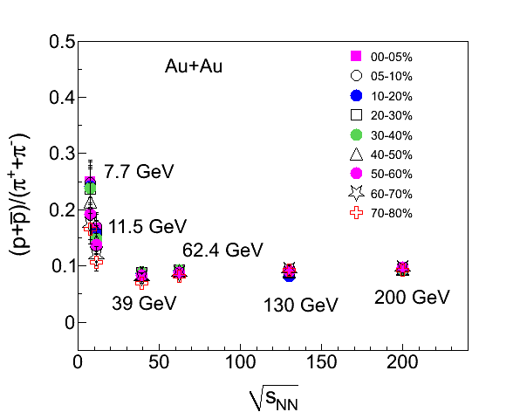
Compare to Theory: in-medium ρ
Robust theoretical description from top RHIC energy down to SPS
  R. Rapp (priv. comm.) cocktail + in-medium ρ.
  Consistent with in-medium ρ broadening
    Expect effect to depend on total baryon density
    Tool to look for chiral symmetry restoration

Slide 12
High Mass: Quarkonium suppression
Expectation: suppression due to hot nuclear effects.
  Color screening (Re V), Landau damping (Im V).
Towards a potential from Lattice QCD
  Quenched calculation: A.Rothkopf, et al. PRL 108 (2012) 162001
  Broadening due to collisions with medium (Im V) possibly more important than screening (Re V).
  Key motivation : Hot QGP medium leads to quarkonium suppression.

Slide 13
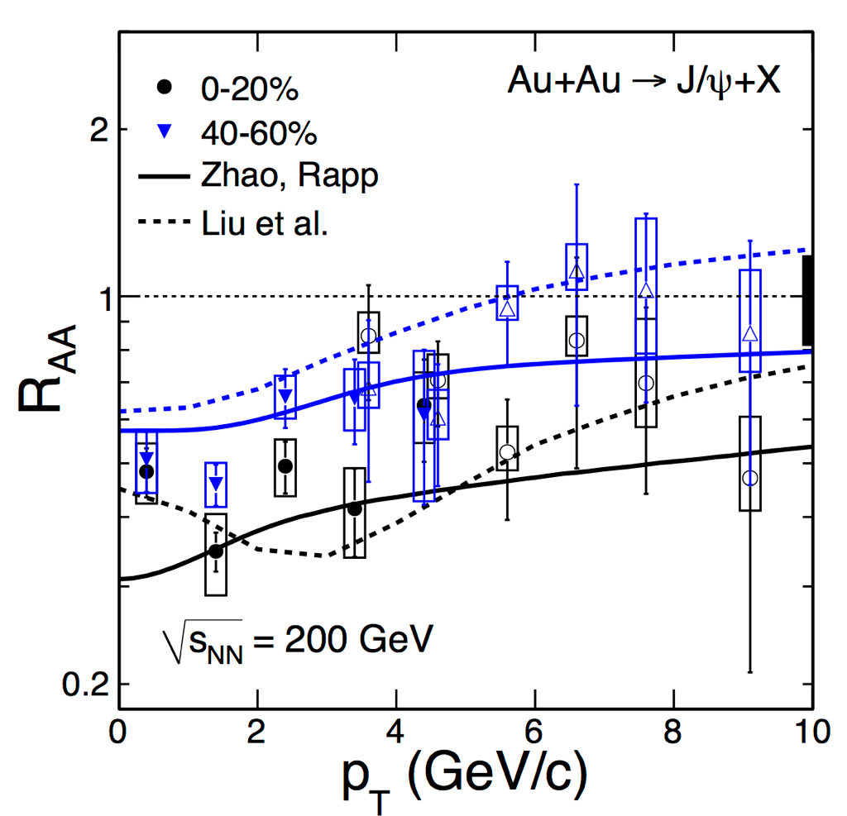
J/ψ in Au+Au collisions
STAR high-p_{T} : arxiv:1208.2736
J/ψ suppression increases with collision centrality and decreases with p_{T}
Low-p_{T} data agrees with two models including color screening and regeneration
    Liu et al., PLB 678:72 (2009) and private comminication
    Zhao et al., PRC 82,064905(2010) and private communication
Study √s dependence of J/ production: shed light on two competing mechanisms

Slide 14
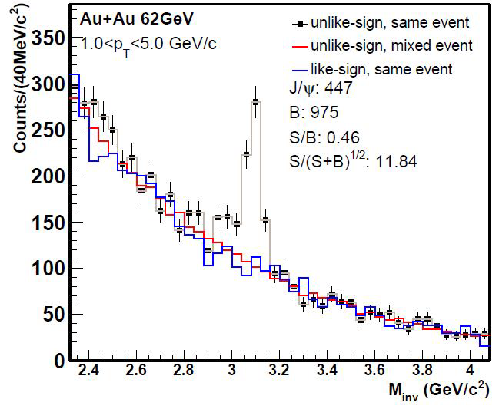
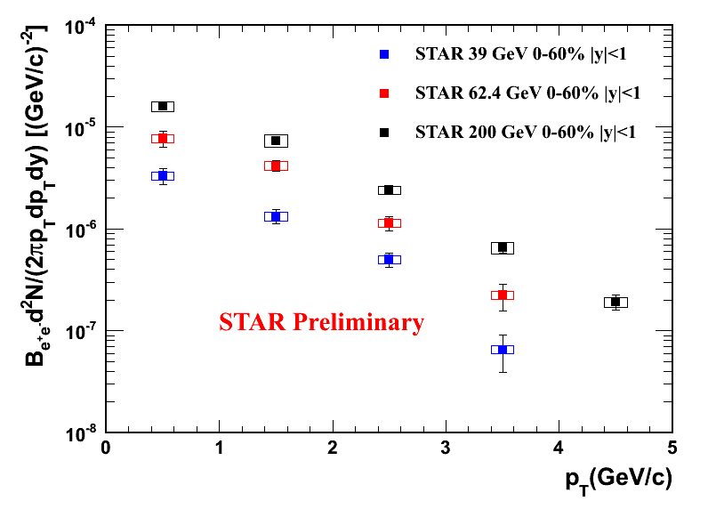
J/ψ study with Beam Energy Scan
39 GeV
  14M EMC triggered events (E_{T}>2.6 GeV) : 62 1/μb
  258M MB events : 30 1/μb
62.4 GeV
  30M EMC triggered events (E_{T}>2.6 GeV) : 97 1/μb
  168M MB events: 18 1/μb
200 GeV
  354M MB events: 62 1/μb

Slide 15
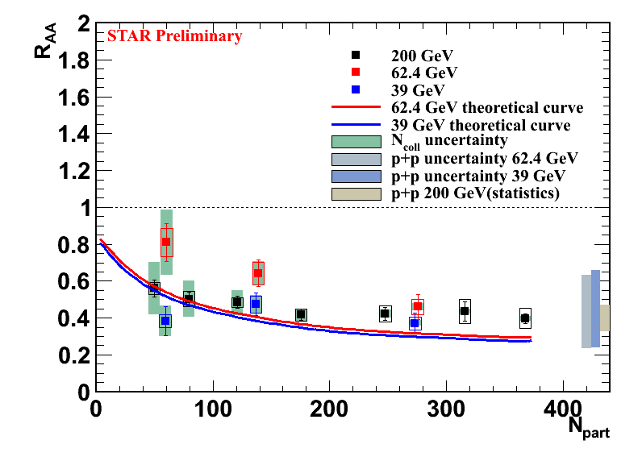
R_{AA} vs. Npart in Beam Energy Scan
Use NLO pQCD calculation: Color Evaporation Model as pp reference
  Due to inconsistent pp Data from different experiments
Compare to theoretical calculation
  Including suppression + regeneration
  Zhao, Rapp, PRC 82 064905
Observation: Suppression remains significant from 39 up to 200 GeV
  No significant energy dependence
  Suppression + Regeneration calculation: consistent with data.
    Needs reduced regeneration, offset by less suppression at lower energy

Slide 16
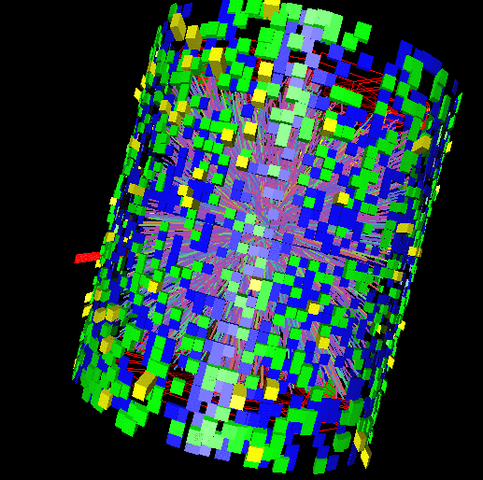
Upsilon measurements
A cleaner probe compared to J/ψ
  co-mover absorption → negligible
  recombination → negligible
  σ_{cc} = ~800 μb
  σ_{bb}= ~ 2μb
Excited states: expect sequential suppression
Challenge: low rate, rare probe
  Need large acceptance, efficient trigger

Slide 17
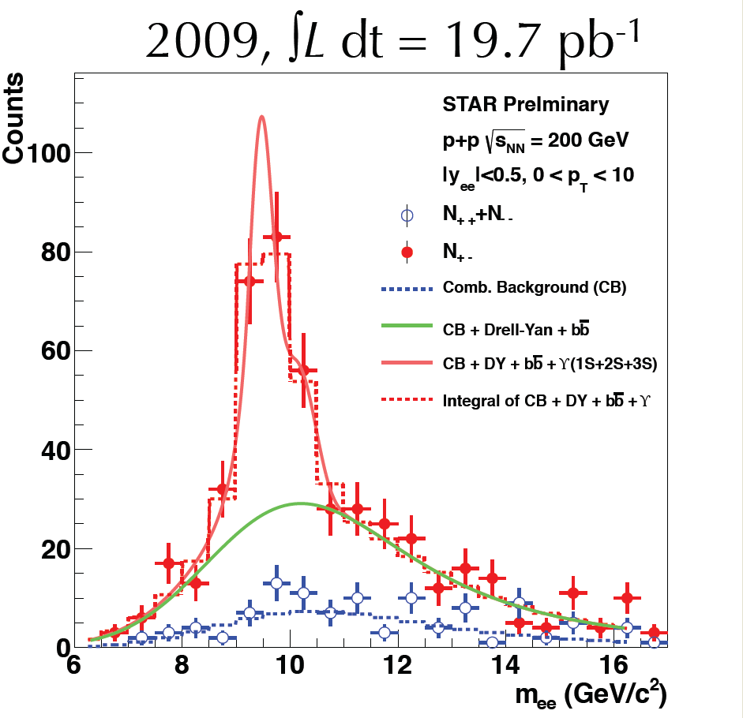
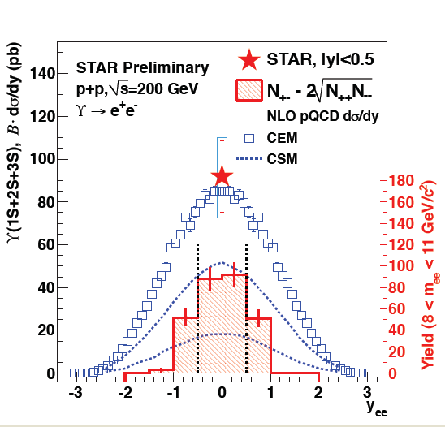
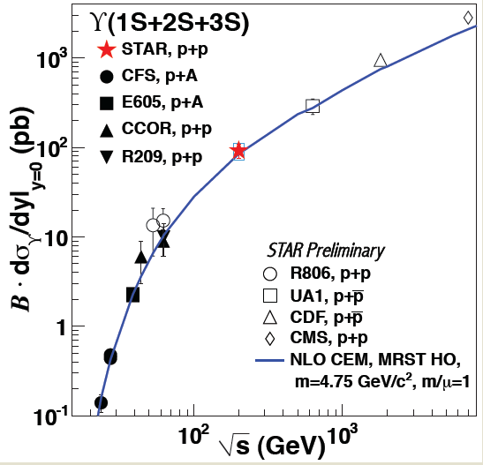
Upsilon pp Reference at 200 GeV
N_{ϒ} total = 145 ± 26(stat.),
Cross section: consistent with pQCD and world data trend

Slide 18
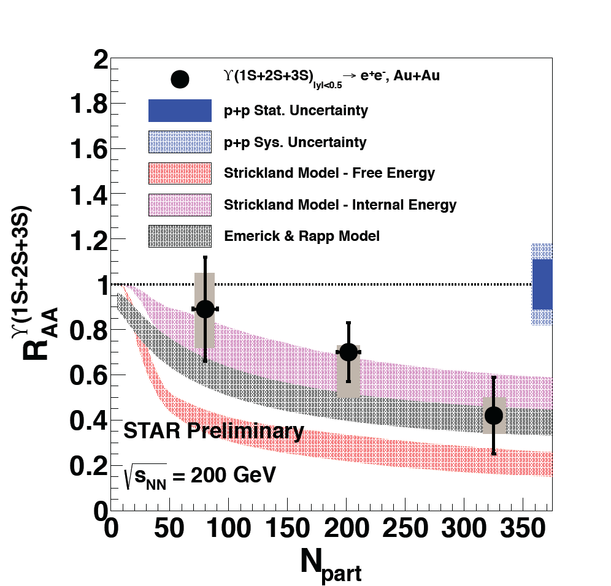
ϒ in Au+Au 200 GeV, R_{AA}
Hint of suppression vs N_{part}
Comparison: Dynamical models with fireball expansion and feed-down
  Strickland et al., NP A 879 (2012) 25
    anisotropic Hydrodynamics
    Assumes:
      T₀ range 428 – 442 MeV
      1/4π < η/S < 3/4π
  Rapp et al., EPJ A 48 (2012) 72
    Kinetic theory + fireball.
    T₀ = 330 MeV
    “Weak Binding” (shown)
      Binding energy changes with T
      Bound state mass : constant
      In-medium open-bottom threshold is reduced
      Motivated by Lattice QCD
    “Strong binding” (not shown)
      Bound states stay with constant mass and binding energy

Slide 19
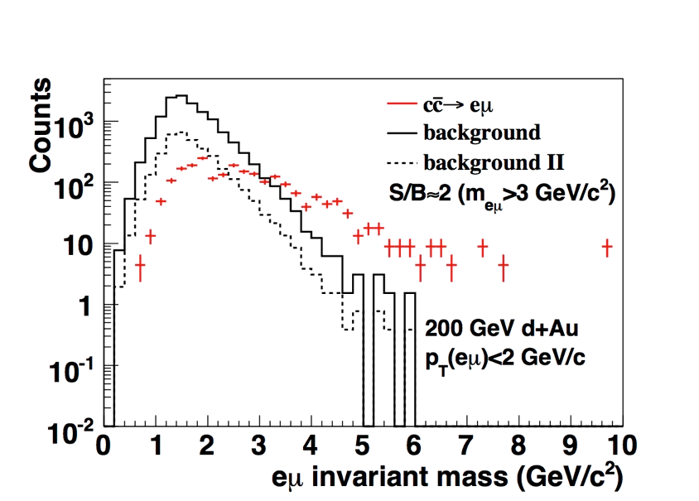
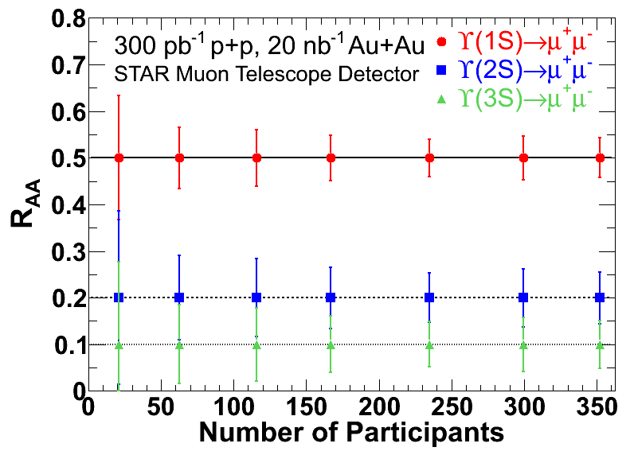
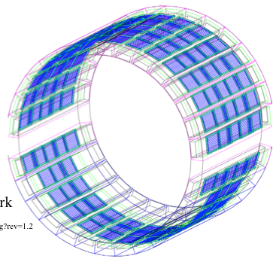
Outlook : Muon measurements
Muon Telescope Detector
  60% currently installed
  Important due to increased material from new vertex detector (HFT)
  IMR: e-m measurements, separate heavy-quark from thermal dileptons
  High mass: open up second channel for Upsilon detection.

Slide 20
Summary
Dielectron measurements: window into QGP medium
Low and Intermediate Mass
  pp and AuAu 200 GeV
    Observe low mass enhancement
  Beam energy scan data : 19.6 – 62.4 GeV
    Low mass enhancement persists down to SPS energies
    Consistent with in-medium broadening at all energies
High mass region: Quarkonia
  J/ψ suppression at 200: increases with centrality, decreases with p_{T}.
  J/ψ suppression observed from 39 to 200 GeV
    Consistent with cancellation between direct suppression & regeneration
  ϒ suppression:
    Hints of suppression with increasing Npart.
    Most central: consistent with suppression of excited states only, ground state survives
New muon detector will complement and enhance dilepton program

