Slide 1
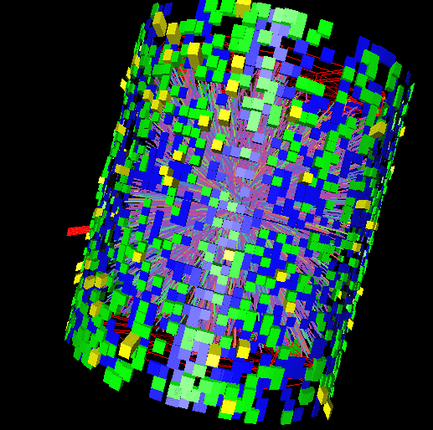
Recent Results from
STAR
Extreme QCD
San Carlos, Sonora, México 20/July/2011

Slide 2
Outline
Recent pp and d+Au results
  Do we understand important baseline processes?
    Jets, heavy flavor, quarkonia
  How different is a cold Nucleus from A protons?
    CNM Effects on Jets, Bottomonium
AA collisions: the importance of the initial geometry
  Fluctuations of the initial state shape
    Azimuthal anisotropy, higher harmonics
    Impact on correlations
Probes from the early, “eXtreme QCD” times at the highest energy
  Jets and heavy flavor passing through hot QGP
    Jet-hadron correlations, heavy quarks and quarkonium in medium
Exploring the “eXtreme QCD” phase diagram with the RHIC Beam-Energy Scan
  Particle-ratio fluctuations, Higher moments of net-proton multiplicity
… and a new particle: The anti-alpha

Slide 3
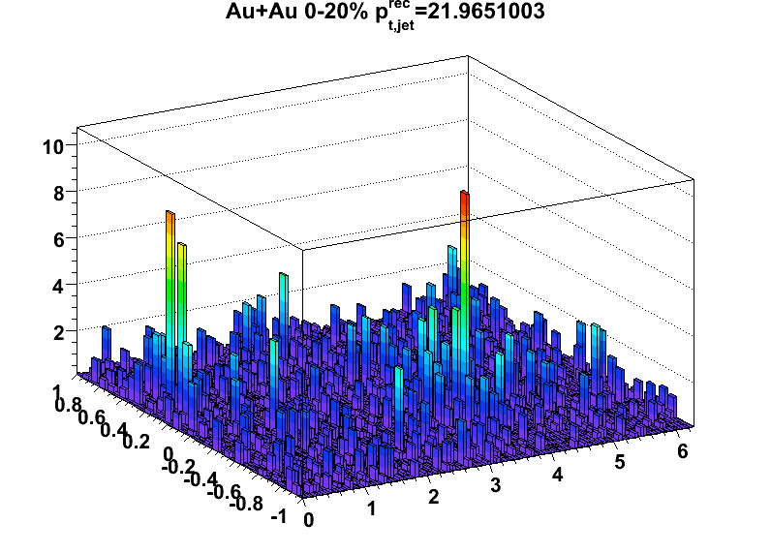
pp Baselines of Key Observables
Jets
  Probe of partonic energy loss in a hot, dense QGP medium
Heavy Flavor
  Do heavy quarks lose less energy as light quarks?
Quarkonia Results
  Quarkonium suppression: sensitive to deconfinement.
Do we understand the production of these observables?
  Large momentum transfers: pQCD should be applicable...

Slide 4
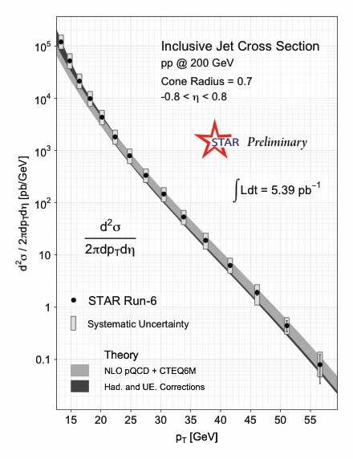
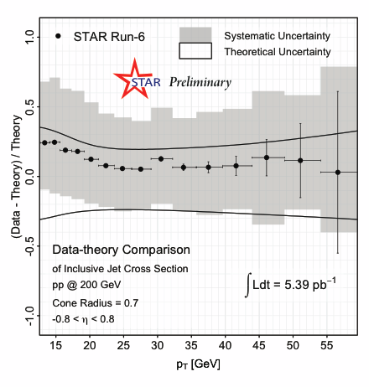
pp Baseline: Understanding Jets
+7.7% Lumi. Uncertainty
Algorithm: Midpoint Cone + Split Merge
pp @ 200 GeV, Midrapidity.
Inclusive Jet Cross Section:
  Well described by NLO pQCD
Energy Resolution: 10-25%
Systematic Uncertainty: ~35% (EMCal)
Hadronization and Underlying Event Corrections: Applied to Theory

Slide 5
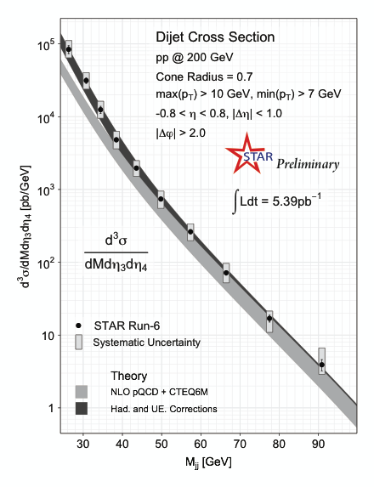
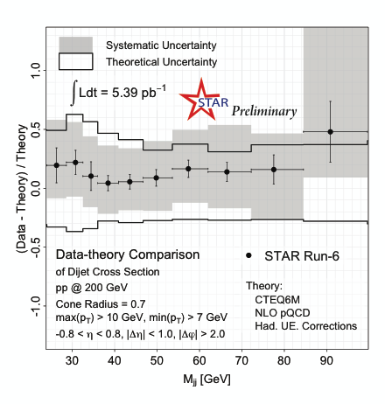
pp Baseline: … and dijets
Hadronization and Underlying Event Corrections: Applied to Theory
Dijet Invariant Mass:
  Well described by NLO pQCD

Slide 6
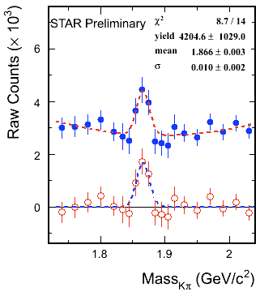
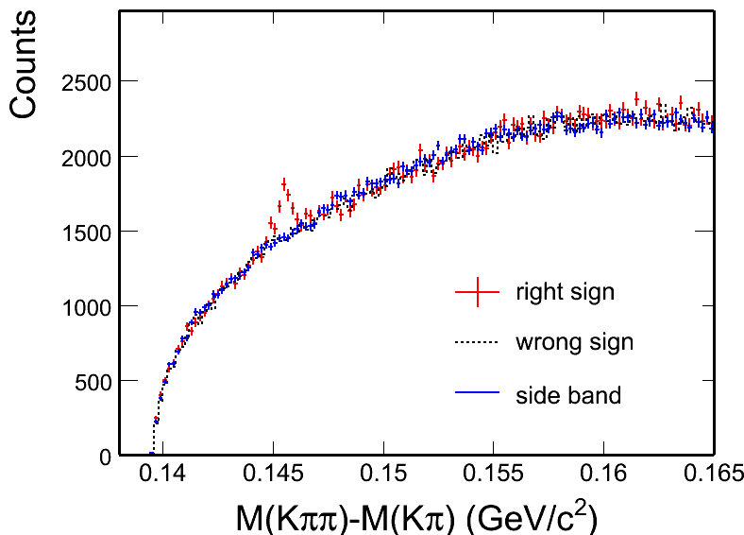
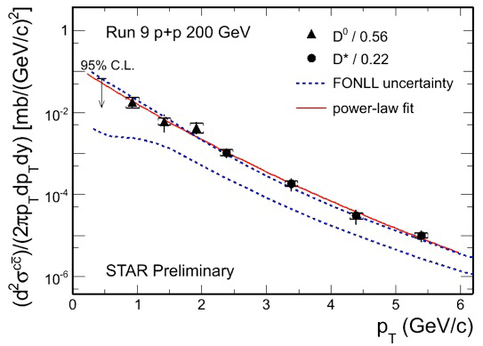
Charm Cross Section in pp: D⁰ and D*
D⁰: 4 σ signal
D*: 8 σ signal
  Factor 2 better than 2006 result.
    STAR, PRD 79 (2009) 112006.
Consistent with FONLL
    M. Cacciari et al., PRL 95 (2005) 122001

Slide 7
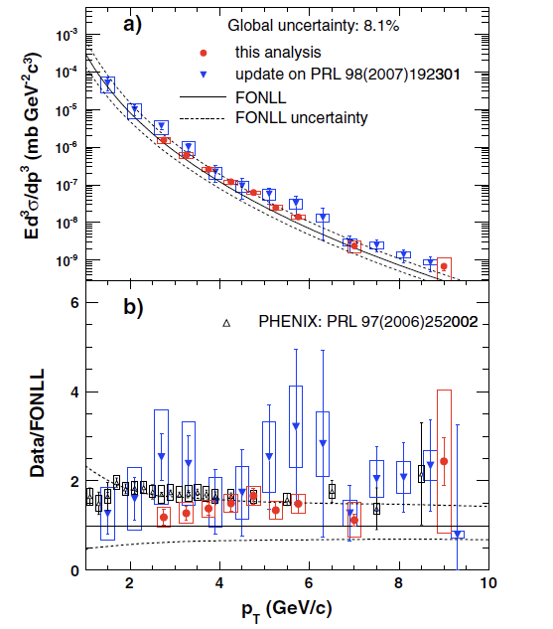
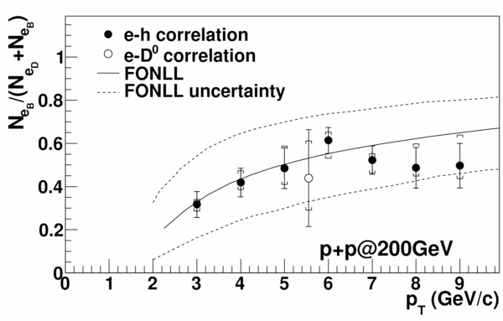
Non-photonic Electrons in pp
STAR Phys. Rev. D 83 (2011) 052006
STAR, PRL 105 (2010) 202301
At pT>1.5 GeV/c, STAR measurements in p+p are consistent with FONLL calculations.
e-h: Bottom contributes significantly to the NPE spectra

Slide 8
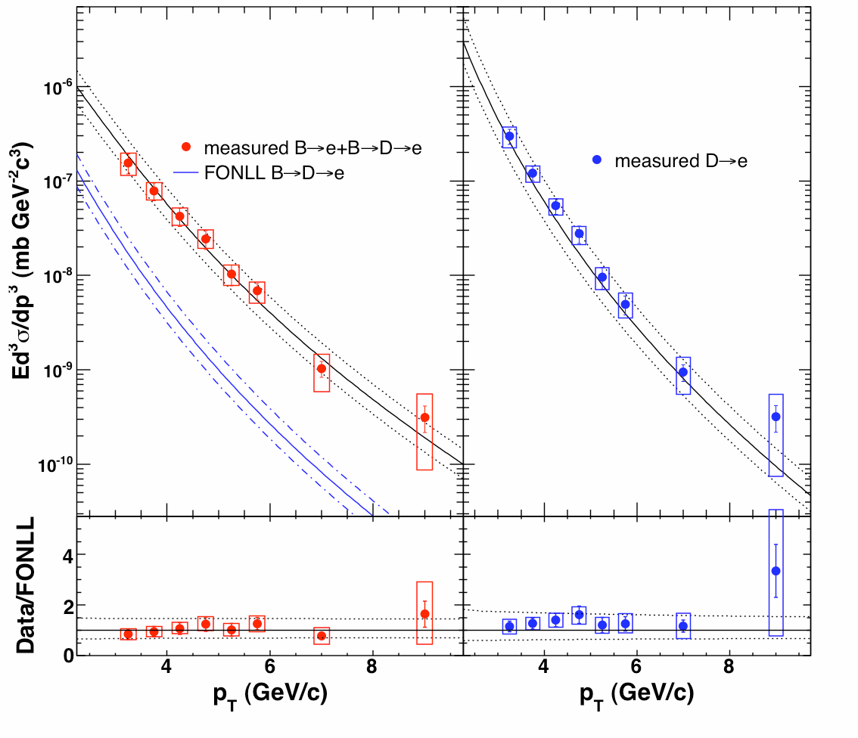
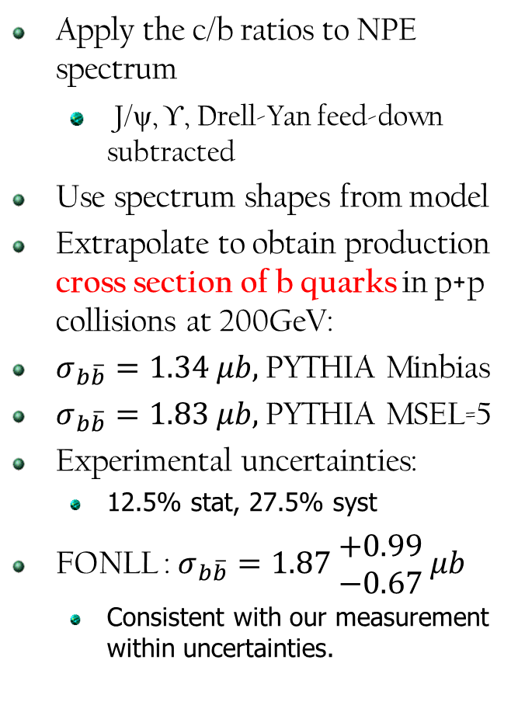
Electrons from charm/bottom in p+p
STAR Phys. Rev. D 83 (2011) 052006
Apply the c/b ratios to NPE spectrum
  J/ψ, ϒ, Drell-Yan feed-down subtracted
Use spectrum shapes from model
Extrapolate to obtain production cross section of b quarks in p+p collisions at 200GeV:
$σ_{b\overline{b}}=1.34 μb,$PYTHIA Minbias
$σ_{b\overline{b}}=1.83 μb,$PYTHIA MSEL=5
Experimental uncertainties:
  12.5% stat, 27.5% syst
FONLL : $σ_{b\overline{b}}=1.87 \begin{matrix}+0.99 \\ −0.67\end{matrix} μb$
  Consistent with our measurement within uncertainties.

Slide 9
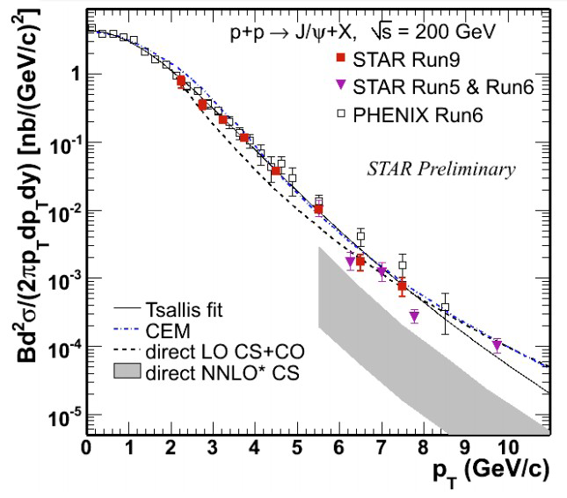
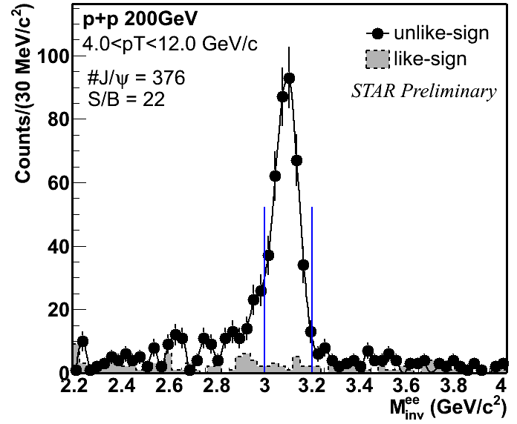
J/ψ spectra in pp
PHENIX: Phys. Rev. D 82, 012001 (2010)
STAR: Phys. Rev. C80, 041902(R) (2009)
Tsallis Blast-Wave model: ZBT et al.,
arXiv:1101.1912; JPG 37, 085104 (2010)
Good agreement between STAR and PHENIX, reach pT ~ 10 GeV/c.
· Color singlet model: direct NNLO still misses the high-pT part
  P. Artoisenet et al., Phys. Rev. Lett. 101, 152001 (2008), and J.P. Lansberg private communication.
· LO CS+CO: leave no room for feeddown at high pT
  G. C. Nayak, M. X. Liu, and F. Cooper, Phys. Rev. D68, 034003 (2003), and private communication.
· CEM describes J/ψ in p+p 200 GeV data well
  M. Bedjidian et al., ArXiv: hep-ph/0311048

Slide 10
d+Au Results:
The control experiment
Understanding
Cold Nuclear Matter Effects

Slide 11
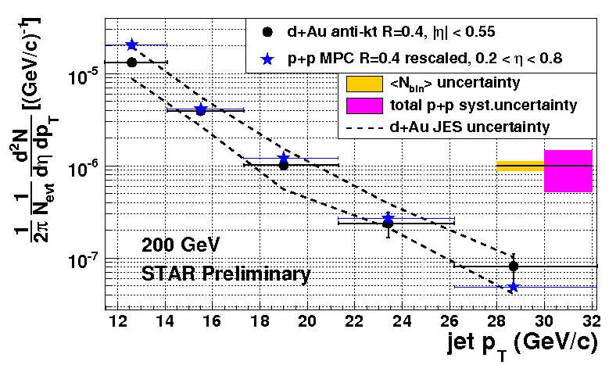
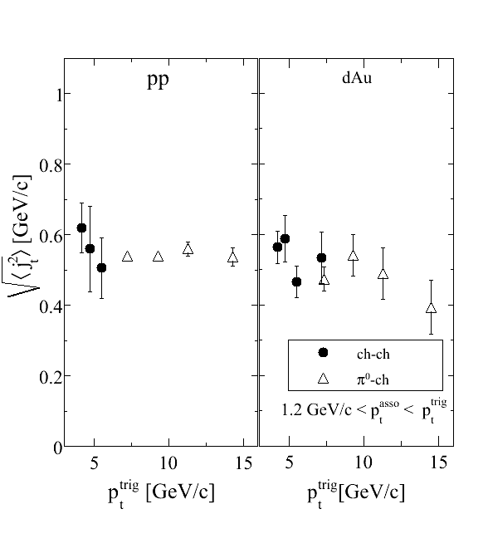
Cold Nuclear Matter effects in d+Au
Jet Cross Sections:
  No strong modification of jet yields in d+Au collisions
  Binary scaling in d+Au
    Note: different algorithms
      d+Au: anti-kt
      pp: mid-point cone
j_{T}: jet fragmentation
  Independent of trigger pT
  Same in d+Au as in pp
  CNM effects : negligible in jet fragmentation
J.Kapitan, QM11
hadrons
j_{t}
j_{t}
Jet
j_{t}

Slide 12
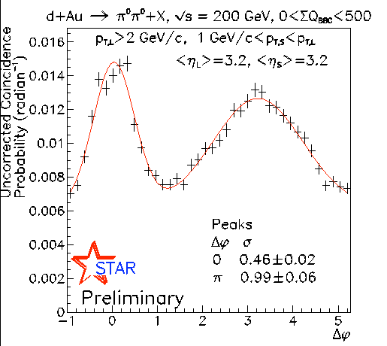
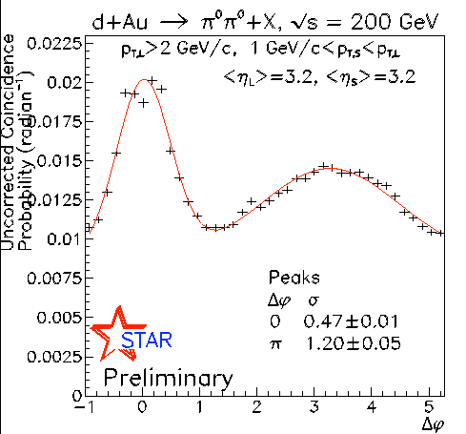
CNM, initial state effects
Peripheral d+Au
Minbias d+Au
Angular correlations of pions in forward region
  Access to low-x region.
  Pedestal is larger than expected from pp
    Consistent with multiple parton interaction in pp production in dAu.
      Phys. Rev. D 83, 034029 (2011)
  Away side: lower in more central events: Gluon saturation, CGC hint

Slide 13
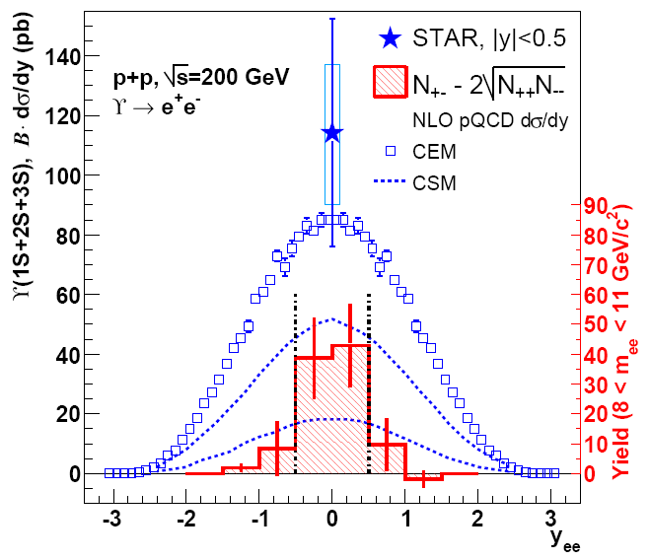
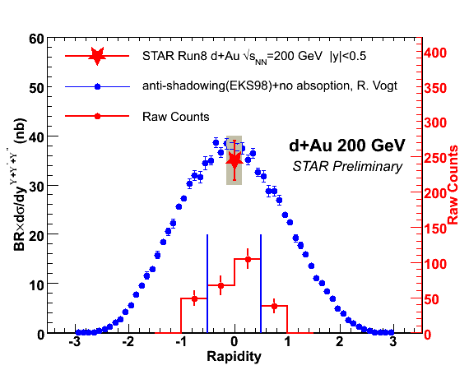
CNM on midrapidity Bottomonium
pp
d+Au
A. Kesich, APS11
BR x dσ/dy=114 ±38(stat.)±24(syst.) pb
Phys. Rev. D 82 (2010) 12004
BR x dσ/dy=35 ± 4(stat.) ± 5(syst.) nb
R_{dAu}=0.78±0.28(stat.)±0.20(syst.)
Upsilon production
  consistent with CEM in pp
  consistent with shadowing predictions in dAu

Slide 14
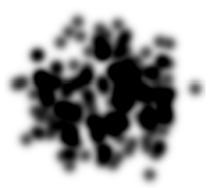
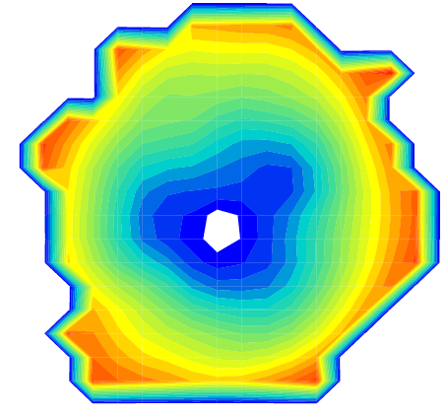
Au+Au Results
First things first: The initial state
and its imprint on correlations
Kowalski, Lappi and Venugopalan, Phys.Rev.Lett. 100:022303
K. Werner, Iu. Karpenko, K. Mikhailov, T. Pierog, arXiv:11043269
Fluctuations imply odd terms aren’t necessarily zero.
v_{n}² will provide information about the system like lifetime, viscosity.
  A.P. Mishra, R. K. Mohapatra, P. S. Saumia, A. M. Srivastava, Phys. Rev. C77: 064902, 2008
  P. Sorensen, WWND, arXiv:0808.0503 (2008); J. Phys. G37: 094011, 2010

Slide 15
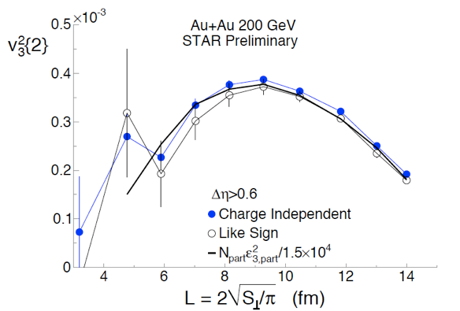
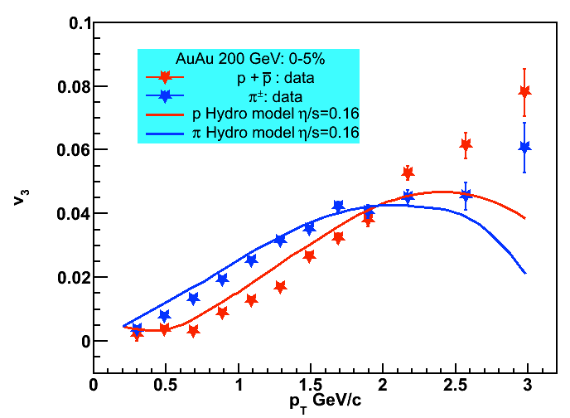
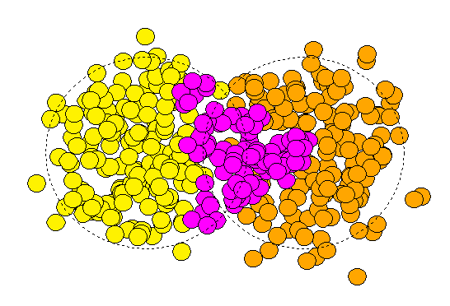
The Au+Au Initial state fluctuates:
Triangular Flow
Large v3 observed
  Centrality variable L
  estimates the transverse size of the system
v₃² for Δη>0.6 rises then falls with centrality
  overlap shape becomes symmetric.
  Similar to v₂
Almond shape of the overlap area appears to couple to n=3
Sensitive to
  initial geometry
  viscosity
Important consequence for two-particle correlations
PR C81:054905, 2010

Slide 16
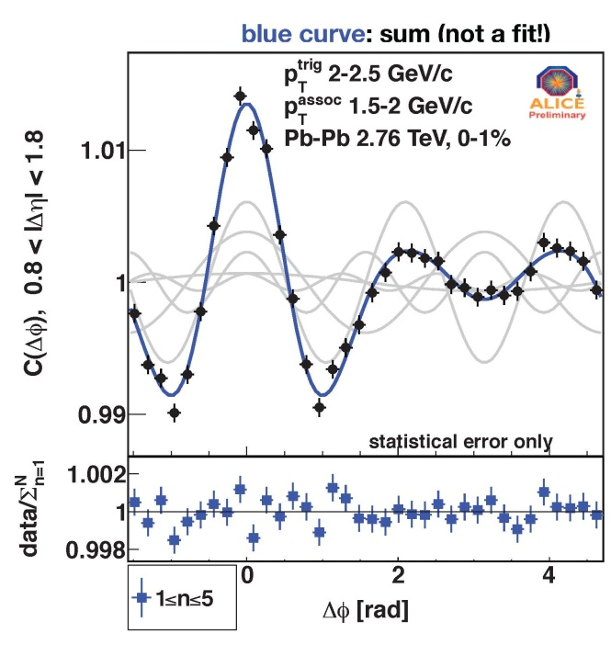
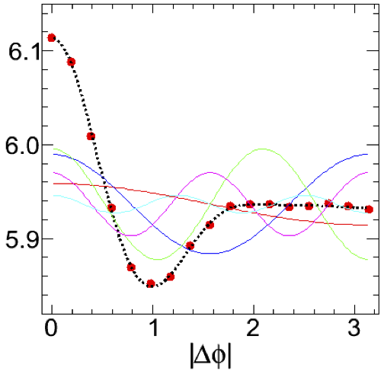

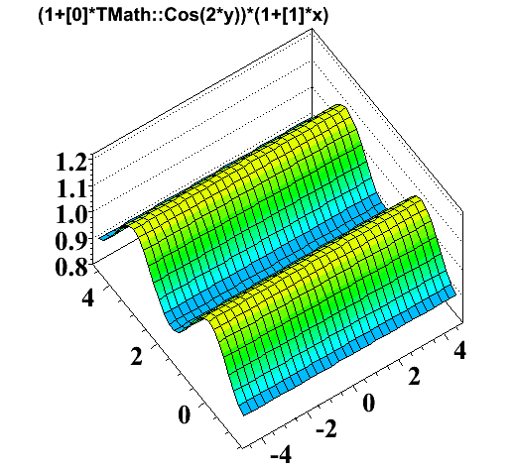
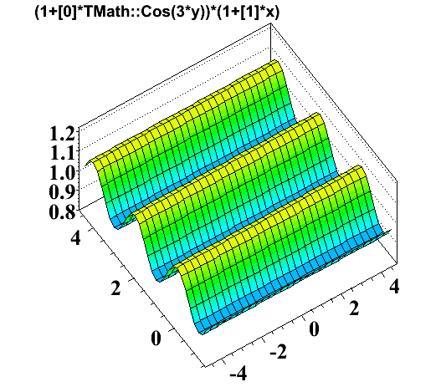
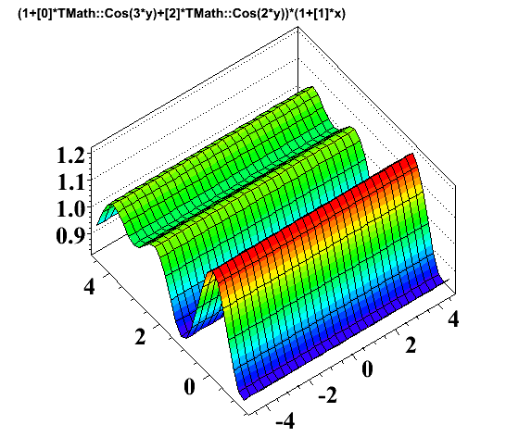
Dihadron Correlations and v_{n} Harmonics at LHC
V_{n}^{f}=v_{n}^{f}(p_{T}^{trig}) x v_{n}^{f}(p_{T}^{assoc})
CMS Preliminary
2<|Δη|<4
ALICE, ATLAS, CMS:
Correlation function can be obtained from sum (not fit) of Fourier Components
  including v₂, v₃, v₄, v₅…

Slide 17
Probing the extremely hot
zone in Au+Au:
Jets
Heavy Flavor
Quarkonia
Beam Energy Scan

Slide 18
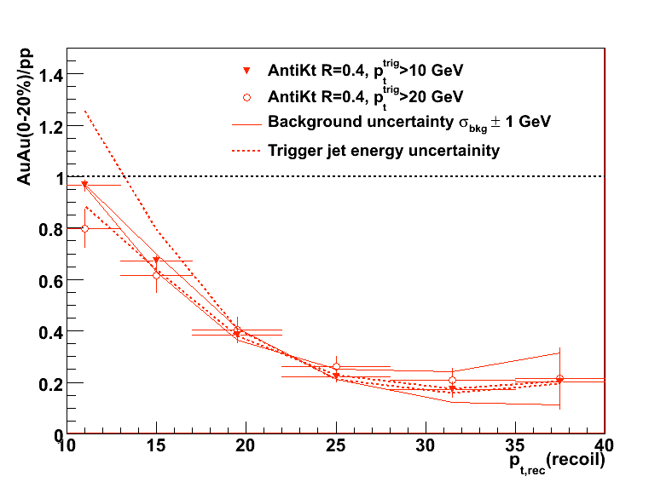
Di-Jets: Away side yield vs. pp
Trigger Jet
Recoil Jet
High Tower Trigger
  Preferentially select single particle with high pT
  Bias towards unmodified jets on trigger side
  Implication: bias towards maximizing path length on away side.
Compare yield of dijets in pp vs Au Au
Observation: significant suppression of away side jet
  Magnitude similar to single particle R_{AA}.
Evidence of parton energy loss/jet broadening

Slide 19
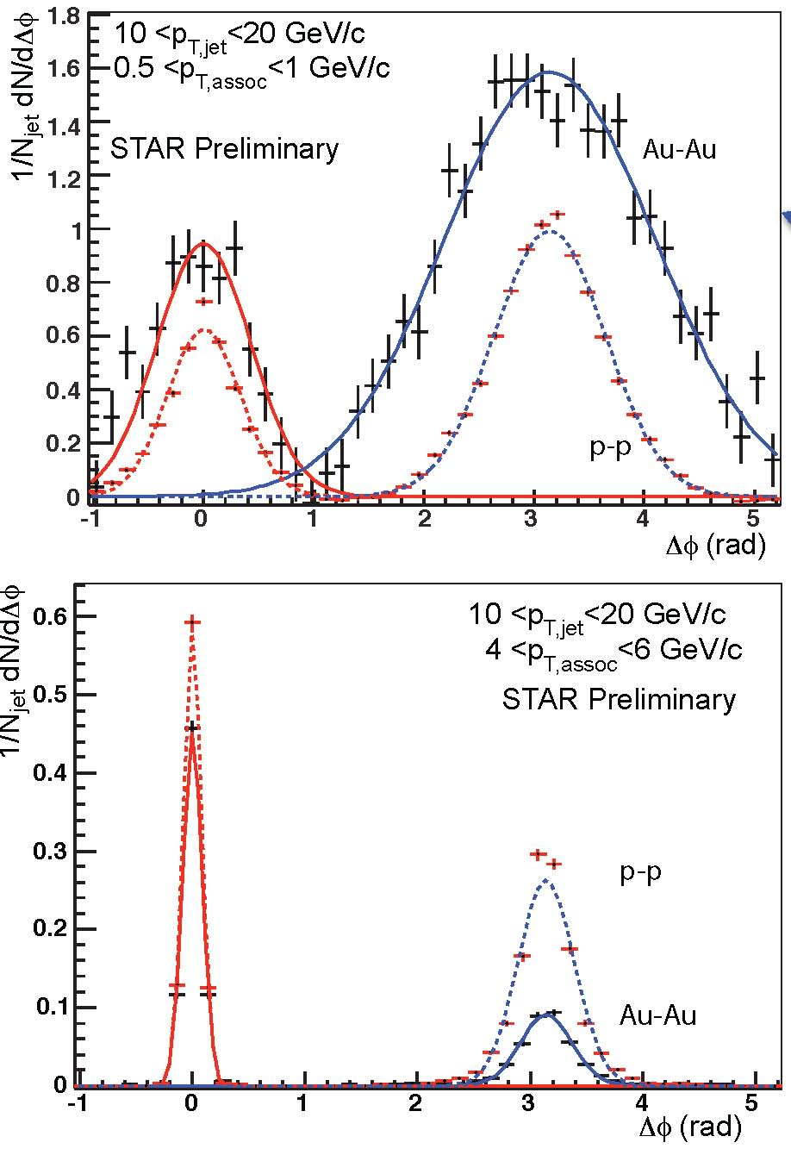
Jet-hadron Correlations
Anti-kt, R=0.4
Au+Au 0-20%
    High Tower Trigger, E_{T}> 5.4 GeV
  Jet p_{T} : 10 - 20 GeV/c
    Left: Softer associated particles
    Right: Harder associated particles
Away side:
  Less particles at higher associated p_{T}
  More particles at lower associated p_{T}
    and at a broader range of angles
A. Ohlson QM11
Δφ
Trigger Jet
Recoil Jet
Direct measurement of modified
fragmentation due to presence of
QGP.

Slide 20
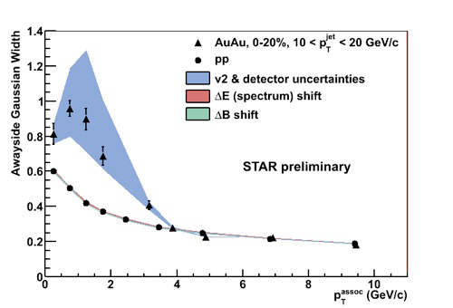
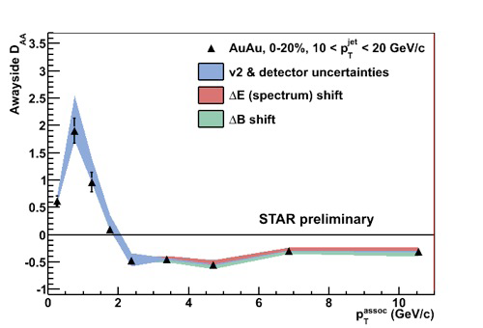

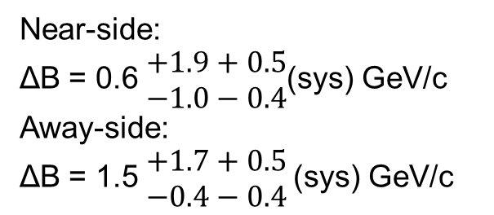
Jets in Au+Au: Jet-h correlations
In pT bins:
Significant broadening and softening of jets
ΔB: High pT suppression largely balanced at low pT enhancement
  Energy lost at high p_{T} is approximately recovered at low p_{T} (and high R)
  Seems to be consistent with radiative energy loss picture
D_{AA} = Au-Au - p-p Energy difference
D_{AA}(p^{assoc}_{T} ) = Y_{AA}(p^{assoc}_{T} ) · p^{assoc}_{T,AA} −
Y_{pp}(p^{assoc}_{T} ) ·p^{assoc}_{T,pp}
A. Ohlson QM11
$$ΔB≡\int{dp_{T}^{ assoc}D_{AA}}$$
Near-side:
ΔB = 0.6 $\begin{matrix}+1.9+0.5 \\ −1.0−0.4\end{matrix}$(sys) GeV/c
Away-side:
ΔB = 1.5 $\begin{matrix}+1.7+0.5 \\ −0.4−0.4\end{matrix}$(sys) GeV/c

Slide 21
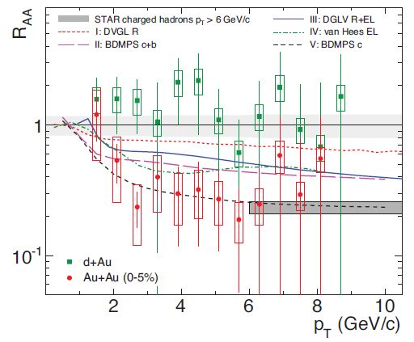
Non-Photonic e⁻: R_{dAu} and R_{AA}
NPE spectra at ~5 GeV show a similar suppression magnitude as light hadrons
What is the mechanism?
  Many effects might play an important role for heavy quark energy loss
  Collisional dissociation of heavy mesons,
  in-medium heavy resonance diffusion,
  multi-body mechanisms...
Experimentally: Can we disentangle charm from bottom?

Slide 22
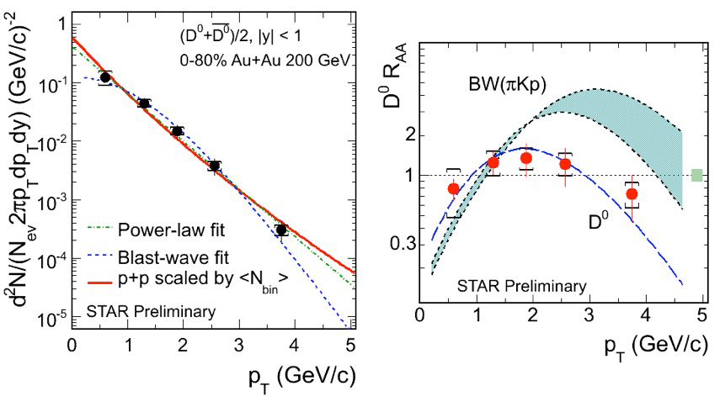
Open Charm in Au+Au collisions!
Y. Zhang, QM11
D⁰ R_{AA} consistent with 1 up to p_{T} = 3 GeV.
Is this consistent with the NPE suppression at ~5 GeV?

Slide 23
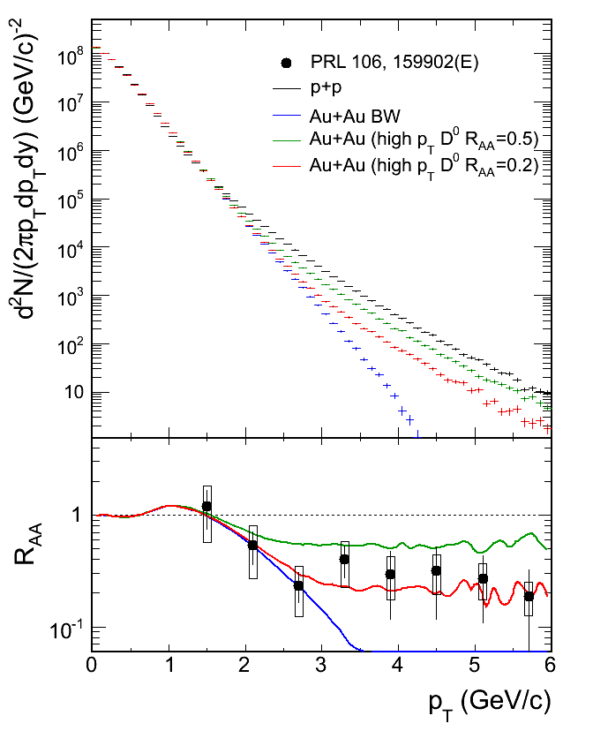
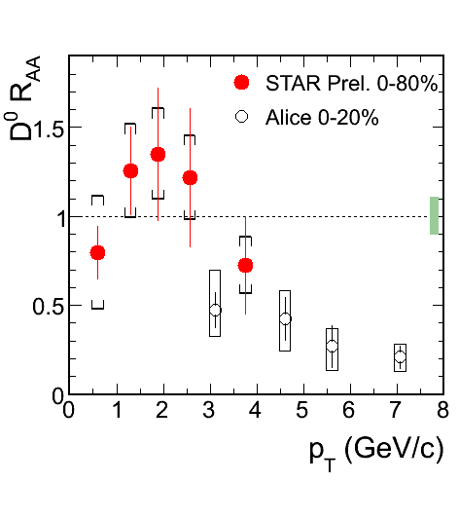
Consistency between NPE and D⁰
Fix Low p_{T} D⁰, vary (unknown) high p_{T} D⁰ yield.
Low pT D⁰ has little constraints on high pT electrons : c suppression at high p_{T}.
  D⁰ R_{AA} consistent with STAR NPE R_{AA} measurements
  Comparison to ALICE:
    Agree within errors in the 3-4 GeV region
    Note: different centrality, but most of the yield is in central bin

Slide 24
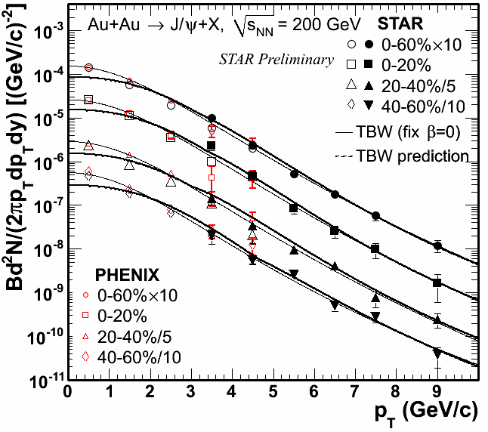
J/ψ in AuAu : p_{T} spectrum
Agreement between STAR (|y| < 1) and PHENIX (|y| < 0.35)
· J/ψ pT range extended to 0 - 10 GeV/c
Softer spectra than prediction based on BW fit to light hadron
→ low-pT regeneration?

Slide 25
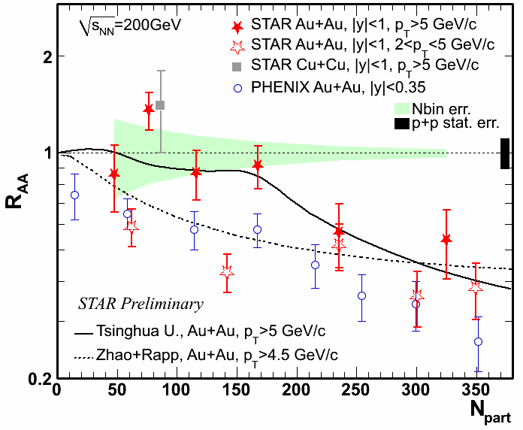
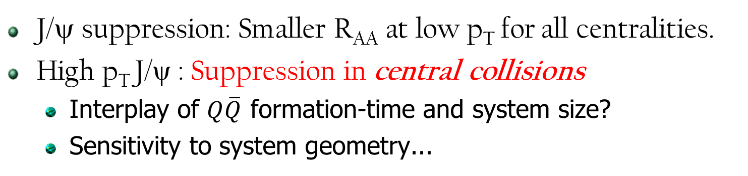
J/ψ R_{AA} vs Centrality.
Cu, R~5 fm
J/ψ formation...
Au, R~7 fm
J/ψ suppression: Smaller R_{AA} at low p_{T} for all centralities.
High p_{T} J/ψ : Suppression in central collisions
  Interplay of $Q\overline{Q}$ formation-time and system size?
  Sensitivity to system geometry...

Slide 26
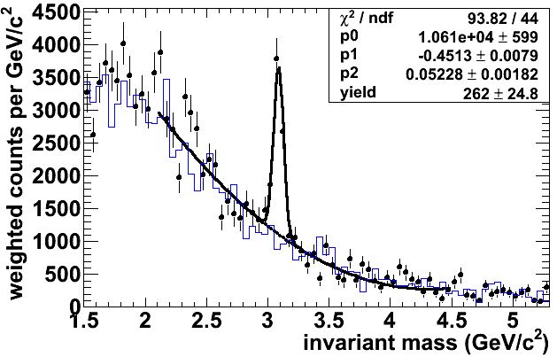
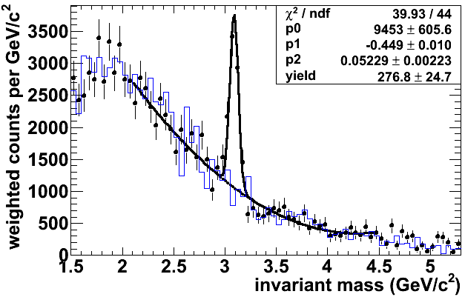
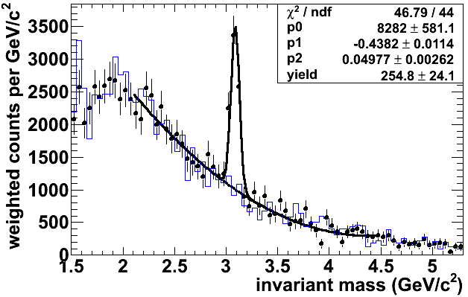
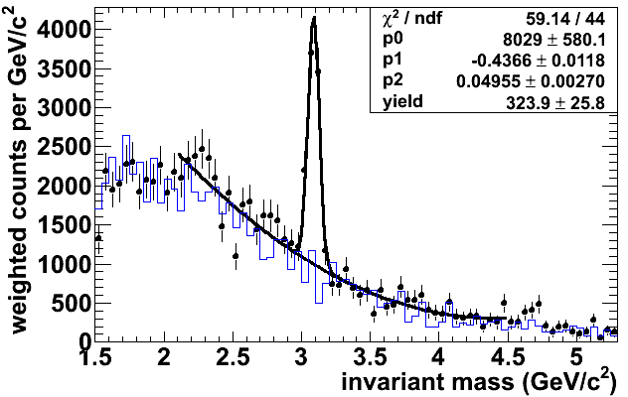
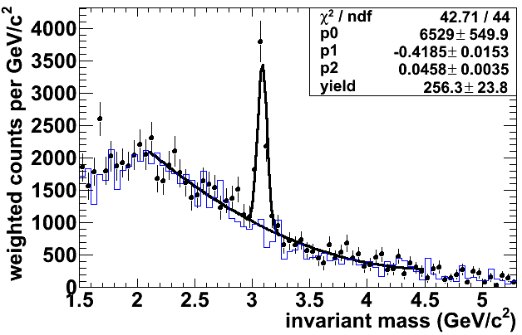
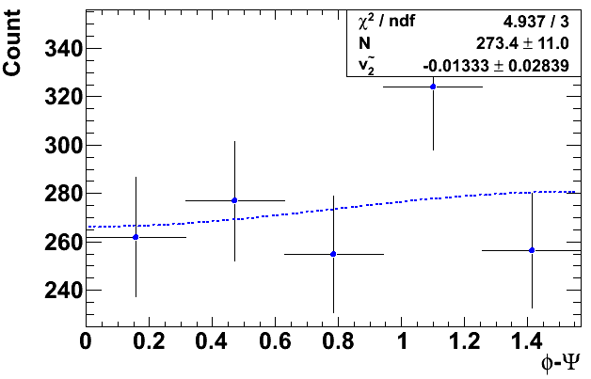

J/ψ in Au+Au: Reaction plane
H.Qiu, QM11
Probe production mechanism
J/ψ v₂:
Extreme limits:
  coalescence: large v₂
  pQCD: small v₂
$$φ−ψ$$
(rad)

Slide 27


A new probe: J/ψ v₂
charged hadrons, STAR, PRL93, 252301 (2004)
φ, STAR, PRL99, 112301 (2007)
Azimuthal anisotropy for heavy quarks
We know
  light mesons flow
  phi ($s\overline{s}$) flows
  ... but J/ψ ($c\overline{c}$) does not!
H.Qiu, QM11
J/ψ : v2 ~ 0 up to pT ~ 8 GeV/c in mid-central 20-60%
Disfavor coalescence from thermalized c quarks.
  Even if produced perturbatively, we know J/ψ yield is suppressed...
    it is thought by hot QCD medium...
    yet medium does not imprint its anisotropy on J/ψ?

Slide 28


Bottomonium in Au+Au
STAR
ϒ suppression: Cleaner probe of deconfinement than J/ψ.
  No regeneration, shadowing small, hadronic absorption negligible.
STAR ϒ Trigger: Allows to sample ~all delivered luminosity
STAR Run 10: 10 σ signal!

Slide 29


ϒ Suppression in Au+Au
ϒ(1S+2S+3S) is suppressed in 0-10%!
  3σ away from R_{AA} = 1
  Note: 33% statistical and 11.4% systematic uncertainty:
    from p+p cross-section
      to be improved: 2009 pp data
Comparison lines:
  Red: 1s / (1s+2s+3s) = 0.69,
    where 1s = BR x σ(1s), etc.
  Blue: (1s-direct)/(1s+2s+3s)
    i.e. no feeddown into 1s
For comparisons to theory:
  Lattice results... ok, but static system.
  Dynamical, lattice-QCD-based ϒ suppression model?
    $Q\overline{Q}$ Diffusion, lifetime, initial geometry, expansion of system
R_{AA} (0-60%)=0.56±0.11(stat)+0.02/-0.14(sys)
R_{AA} (0-10%)=0.34±0.17(stat)+0.06/-0.07(sys)

Slide 30

RHIC Beam-Energy Scan
Search for:
  Turn off signatures of QGP
  QCD Critical point
  Signature for softening of EOS

Slide 31
BES : Milestones / Goals
Turn off signature of QGP
  NCQ scaling of v2
  suppression of RAA
  charge separation w.r.t reaction plane
QCD Critical point
  particle ratio fluctuations
  higher moments of conserved quantities
Signature for softening of EOS
  azimuthal HBT
  azimuthal anisotropy v1, v2, ...
Year | √s_{NN} (GeV) | # of good events
2010 | 7.7 | ~5M
 | 11.5 | ~11M
 | 39 | ~170M
2011 | 19.6 | ~17M
2011 | 27 | ~36M
2012 | 5 | -

Slide 32






STAR: Excellently suited for BES
Large, uniform acceptance
TPC + TOF PID

Slide 33

Search for the QCD Critical Point
In a phase transition near a critical point, an increase in non-statistical fluctuations is expected.
Finite system-size effects may influence fluctuation measurements.
    Finite-size scaling of fluctuations may indicate existence of critical point.
    E.g. Change in behavior of quark susceptibilities.
    Aoki, Endrodi, Fodor, Katz, and Szabó Nature 443, 675-678 (2006)
These may manifest in final-state measurements.
μ_{B} = 0
μ_{B} = 0
Notes:
For instance, Lattice QCD
calculations [37] indicate large fluctuations in the derivatives of the partition functions with respect to baryon, charge,
and strangeness chemical potentials as a function of the temperature of the system. Of particular interest are the
moments of the charge/baryon number/strangeness fluctuations which are obtained theoretically from the second
(quadratic) and fourth (quartic) derivatives of the logarithm of the QCD partition function (2 and 4 respectively),
Fig. 2 and Fig. 3. These fluctuations can be related to event-by-event moments of various observables in heavy-ion
collisions. Fig. 2 and Fig. 3 are calculated for mu_B = 0, such fluctuations are expected to diverge at the Critical Point.

Slide 34



π, K, p ratio fluctuations in BES
T. Tarnowsky, QM11
ν_{dyn}: deviation from Poisson.
Fluctuations in particle ratios
  Sensitive to particle numbers at chemical FO, not kinetic FO
  Volume effects may cancel
Difference (Kaons) with SPS...
NA49 : evidence for dynamical fluctuations
No strong energy dependence of K/π , p/π, K/p fluctuations seen.

Slide 35

Excitation Function for ν_{dyn,K/π}
Differences: acceptance? PID?
TPC+TOF (GeV/c):
  p : 0.2 < p_{T} < 1.4
  K : 0.2 < p_{T} < 1.4
TPC+TOF includes statistical and systematic errors from electron contamination.
  π contamination of kaons < 3%
Difference between STAR and NA49 result: below √s_{NN} = 11.5 GeV.
(NA49 data from C. Alt et al. [NA49 Collab.], Phys. Rev. C 79, 044910 (2009)
Expectation from models:
  Acceptance effects are small.
  UrQMD predicts little energy dependence.
  HSD predicts an energy dependence.
T. Tarnowsky, QM11

Slide 36

Net-Proton Distributions
Near Critical Point
  Correlation length (ξ) and susceptibilities (χ) diverge
  Long wavelength fluctuations
  Lead to low-momentum number fluctuations
  Baryon, Strangeness, & Charge Distributions:
    non-Gaussian.
Higher moments:
  1) Mean
  2) Variance
  3) Skewness (asymmetry about mean)
  4) Kurtosis (peaked/flat compared to Gaussian)
  Proportional to higher powers of ξ
    e.g. χ⁽⁴⁾ ~ ξ⁷
  Product of moment : Volume effect cancels
  Kurtosis x Variance ~ χ⁽⁴⁾/χ⁽²⁾
  Skewness x Sigma ~ χ⁽³⁾/χ⁽²⁾
M. A. Stephanov, PRL 102 (2009) 032301
C. Athanasiou, et al. PR D82 (2010) 074008

Slide 37

Higher Moments of Net Protons
Interest on net protons:
  reflects net-baryons
    conserved quantity
      Neutrons: not needed
      isospin blindness of σ field
        Y. Hatta et al., PRL 91 (2003) 102003
STAR Observation:
  Deviations from Poisson below 39 GeV.
      Note: New, high-stat. 19.6 GeV data not included.
    Potentially can be linked to Chiral phase transition and Critical Point
B. Friman, arXiv:1103.3511
M. A. Stephanov, arXiv:1104.1627

Slide 38



A Final Treat: Discovery of $\overline{{}_{}^{4}{He}}$
18 anti-4He observed via TPC+TOF+HLT analysis
Consistent with both nucleon-coalescence & thermal-production models
Nature 473, 353-356, (19 May 2011)

Slide 39
Conclusions
pp Baseline data vs. predictions
  NLO pQCD describes jets and dijets
  FONLL describes open charm and bare bottom
  Charmonium and Bottomonium
      CEM does ok describing both
d+Au: At mid-rapidity CNM effects are small but evidence for CGC at forward rapidity
Initial geometry fluctuations drive a v₃ term.
  Important for two particle correlations
Jets passing through QGP result in a softer and broader fragmentation
Charm quarks at low pT show little to no suppression
Charmonium at low pT shows little to no v₂, but shows suppression.
  J/ψ At high pT, suppression only in most central events.
Bottomonium is suppressed in central Au+Au. Era of ϒ studies has arrived.
BES: Large acceptance & excellent PID allows for fluctuation measurements.
  Deviations from Poisson statistics below 39 GeV: used to study structure of the QCD phase diagram.
... and we found the Anti-Alpha.

Slide 40
Backup

Slide 41
The STAR Experiment

Slide 42



Particle Identification at STAR
Large acceptance: |η|<1, 0<φ<2π STAR detector and Particle ID
Time Projection Chamber (TPC)
dE/dx, momentum
Time Of Flight detector (TOF)
particle velocity β
Electro‐Magnetic Calorimeter (EMC)
Shower Max Detector

