Slide 1

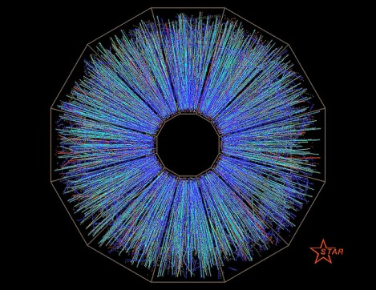

Gluon Polarization in Longitudinally Polarized pp Collisions at STAR
Zilong Chang
For
STAR
Collaboration

Slide 2
Outline
Introduction
Inclusive jet measurements
π⁰ measurements
Di-jet measurements
Conclusion

Slide 3
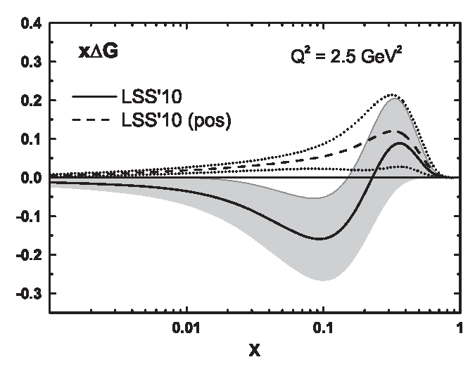
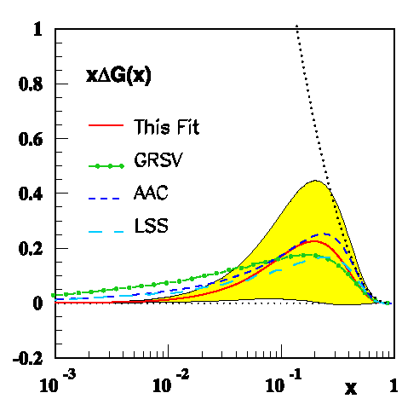
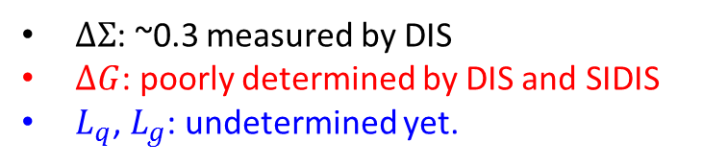

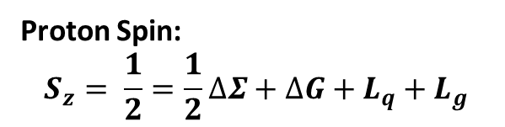
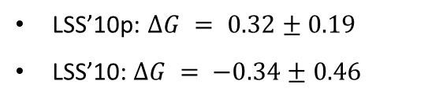
How Gluons Contribute to Proton Spin
Proton Spin:
$$S_{z}= \frac{1}{2}=\frac{1}{2}∆Σ+∆G+L_{q}+L_{g}$$
Leader et al, PRD 82, 114018 (2010) with fit to DIS and SIDIS data
$∆Σ$: ~0.3 measured by DIS
$ΔG$: poorly determined by DIS and SIDIS
$L_{q}$, $L_{g}$: undetermined yet.
Blümlein & Böttcher, NPB 841, 205 (2010) with fit to DIS data only
LSS’10p: $ΔG = 0.32±0.19$
LSS’10: $ΔG = −0.34±0.46$
$ΔG = 0.46±0.43$

Slide 4
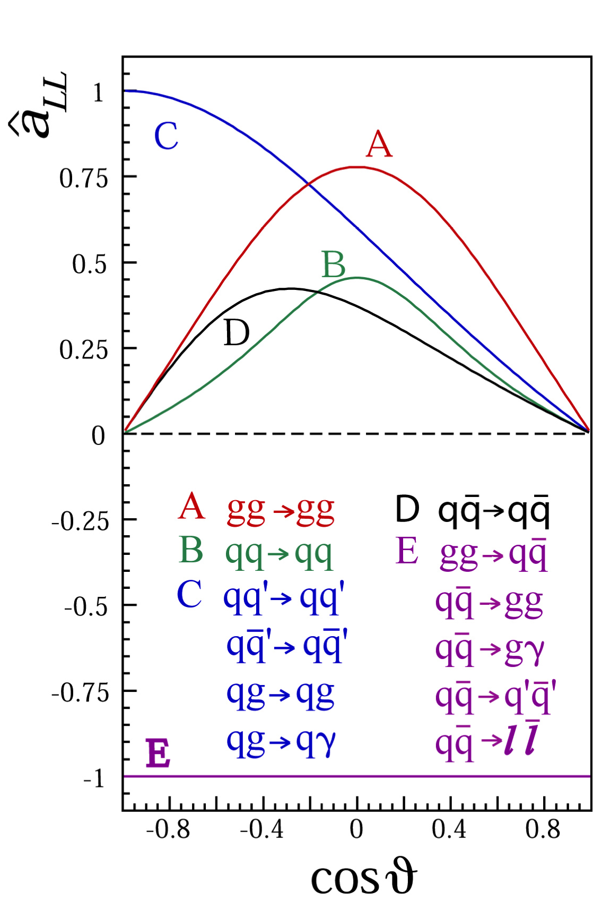



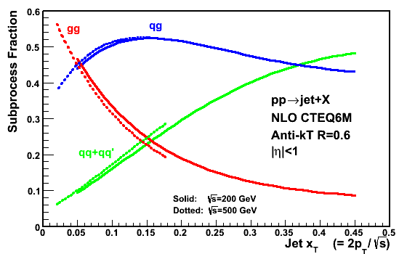

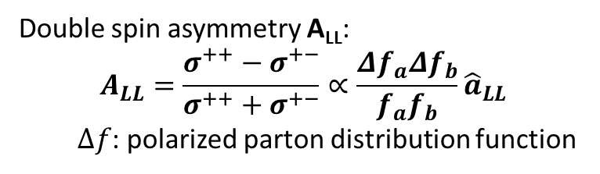
Exploring Gluon Contribution at RHIC
Double spin asymmetry A_{LL}:
$$A_{LL}=\frac{σ^{++}−σ^{+−}}{σ^{++}+σ^{+−}}∝\frac{Δf_{a}Δf_{b}}{f_{a}f_{b}}{\hat{a}}_{LL}$$
  $∆f$: polarized parton distribution function
For most RHIC kinematics, gg and qg dominate, making $A_{LL}$ for jets and π⁰ sensitive to gluon polarization
Mukherjee and Vogelsang, PRD.86.094009

Slide 5
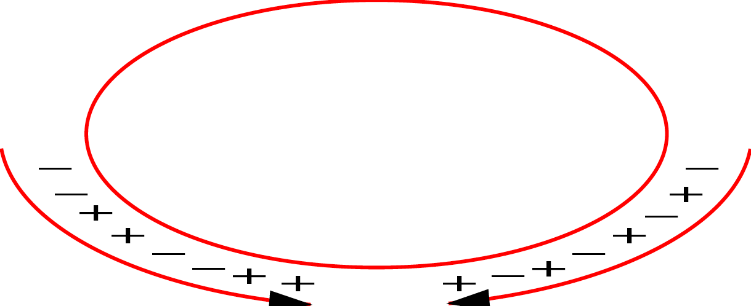
RHIC Facilities
Absolute Polarimeter (H↑ jet)
RHIC pC Polarimeters
PHOBOS
BRAHMS
Siberian Snakes
Siberian Snakes
PHENIX
STAR
Spin Rotators
(longitudinal polarization)
Spin flipper
Spin Rotators
(longitudinal polarization)
Pol. H⁻ Source
Solenoid Partial Siberian Snake
LINAC
BOOSTER
Helical Partial Siberian Snake
AGS Internal Polarimeter
200 MeV Polarimeter
AGS
AGS pC Polarimeters
Rf Dipole
Strong Helical AGS Snake
Spin varies from rf bucket to rf bucket (9.4 MHz)
Spin pattern changes from fill to fill
Spin rotators provide choice of spin orientation
Billions of spin reversals during a fill with little depolarization

Slide 6
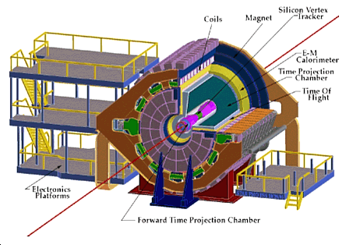
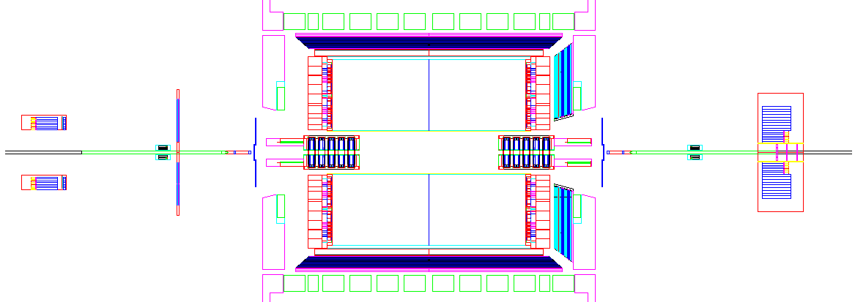
STAR Detectors
BEMC
EEMC
FMS
TPC
VPD
VPD
ZDC
BBC
BBC
ZDC
High precision tracking with Time Projection Chamber
High energy resolution with Barrel Electro-Magnetic Calorimeter, Endcap Electro-Magnetic Calorimeter and Forward Meson Spectrometer
Additional detectors (Beam-Beam Counter, Vertex Position Detector, and Zero Degree Calorimeter) for relative luminosity and local polarimetry

Slide 7
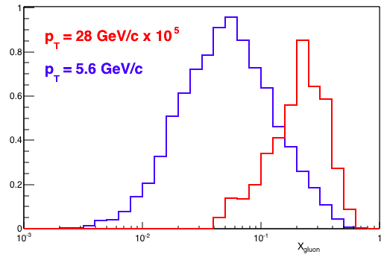
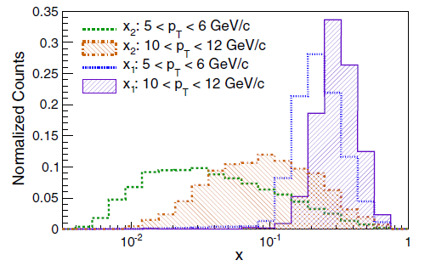
STAR Experiment Unique Access to Gluon Polarization
Longitudinally polarized pp collisions at 200 GeV and 510 GeV allow both cross section and double spin asymmetry A_{LL} measurements on:
  Inclusive Jet
    x down to ~ 0.05 for jets in the mid-rapidity at 200 GeV (x down to ~0.02 at 510 GeV)
  Inclusive π⁰
    x down to ~ 0.02 for forward π⁰ 0.8 < |η| < 2.0 at 200 GeV
  Di-jet
    Correlation unfolds x₁, x₂ at the leading order
Inclusive Jets
√s = 200 GeV
π⁰ √s = 200 GeV
Complementary to each other to achieve large x_{g} coverage of gluon polarization

Slide 8
Inclusive jet measurements
π⁰ measurements
Di-jet measurements

Slide 9

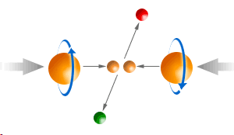
Jet Reconstruction at STAR
Detector
Geant
For 2006 200 GeV data (see back-up)
  Mid-point cone algorithm
  Adapted from Tevatron II – hep-ex/0005012
    Seed energy = 0.5 GeV
    Cone radius R = 0.7 in η-φ space
    Split/merge fraction f = 0.5
Particle
For 2009 200 GeV data
  Anti-k_{T} algorithm
  Cacciari, Salam, and Soyez, JHEP 0804, 063
    Jet parameter R = 0.6
Pythia
For 2012 510 GeV data
  Anti-k_{T} algorithm
    Jet parameter R = 0.5
Parton
Use Pythia + Geant to quantify detector response
Sjostrand, Mrenna, and Skands, JHEP 05, 026

Slide 10
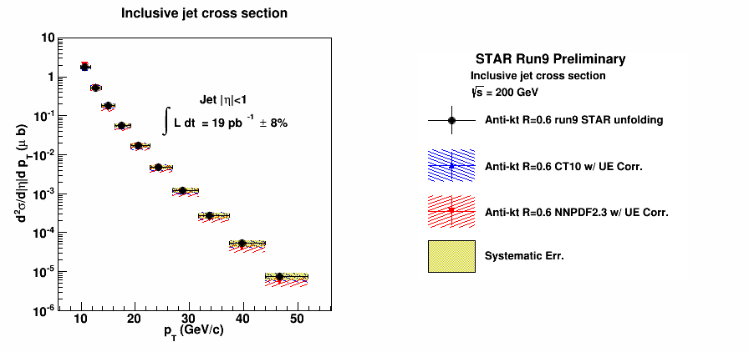
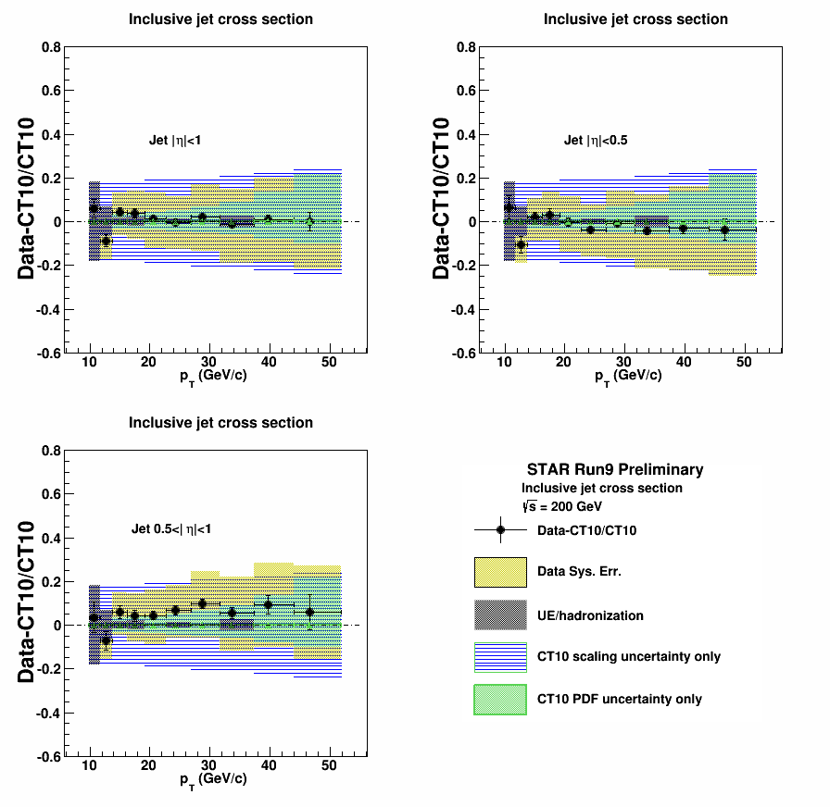
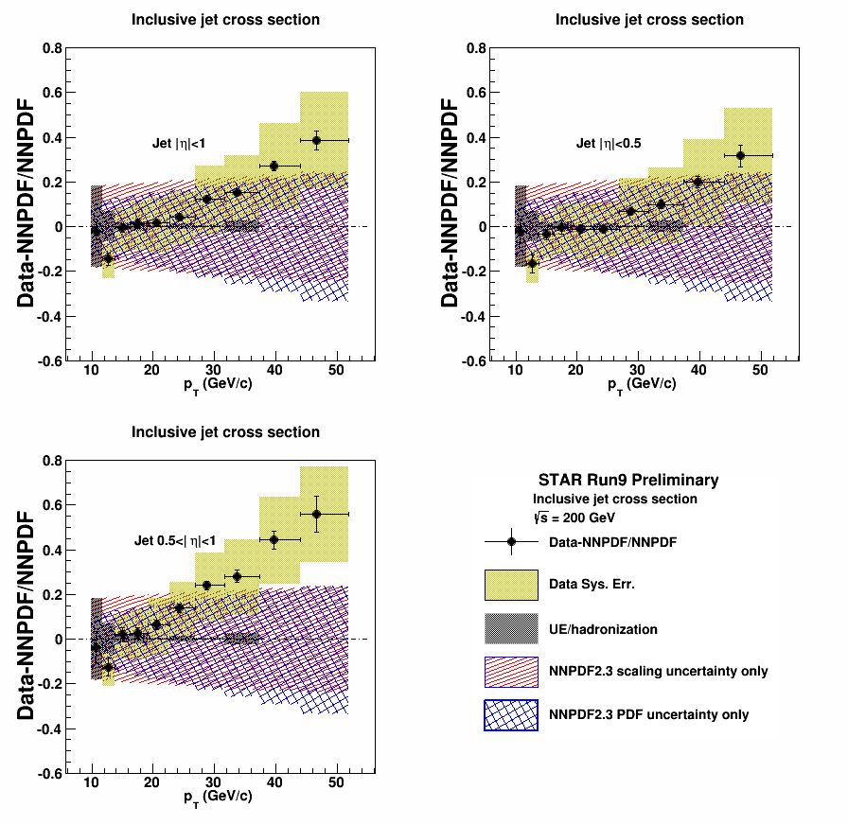
Inclusive Jet Cross Section from 2009 Data
X. Li for the STAR collaboration, DIS 2015
Good agreement with several NLO pQCD calculations after hadronization and underlying event correction is applied
Inclusive jet cross sections also calculated in two sub η ranges 0 < |η| < 0.5 and 0.5 < |η| < 1.0
Jet production well understood at STAR

Slide 11
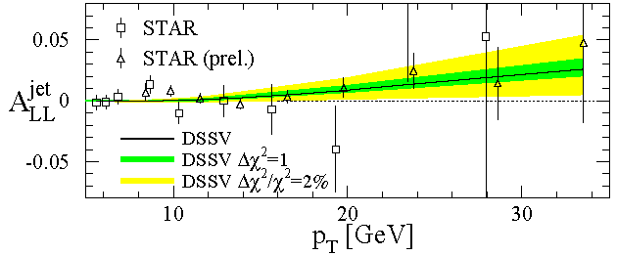
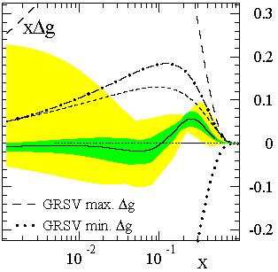
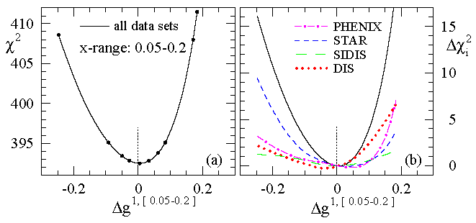
DSSV – First Global Analysis with Polarized Jets Data
de Florian et al., PRL 101, 072001
The first global NLO analysis to include inclusive DIS, SIDIS, and RHIC pp data on an equal footing
Found relatively small gluon polarization within the region 0.05 < x < 0.2 that was sampled by the STAR 2006 data

Slide 12
Improvements for 2009
2009 jet patch trigger upgrades
  Overlapping jet patches and lower E_{T} threshold improve efficiency and reduce trigger bias
    Net increase of 37% in jet acceptance
  Remove beam-beam counter trigger requirement
    Trigger more efficiently at high jet p_{T}
    Measure non-collision background
Increased trigger rate and reduced thresholds enabled by DAQ1000
Sampled ~ 4 times the figure-of-merit relative to 2006
Nearly 20-fold increase in event statistics
Improvements in jet reconstruction
  Subtract 100% of track momentum from struck tower energy (2009) instead of MIP (2006)
  Overall jet energy resolution improved from 23% to 18%
  Switch from mid-point cone with cone radius 0.7 to anti-k_{T} with jet parameter 0.6 (a. less susceptible to soft diffusion and underlying events; b. increase in statistics)

Slide 13
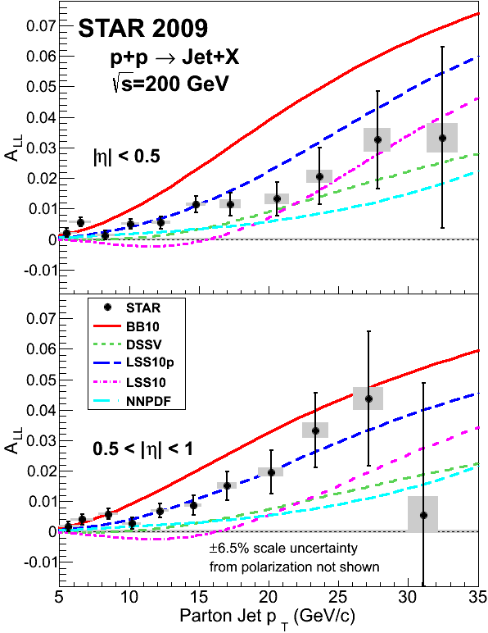
Inclusive Jet A_{LL} from 2009 Data
arXiv:1405.5134
2009 STAR inclusive jet A_{LL} measurements are a factor of 3 (high-p_{T}) to >4 (low-p_{T}) more precise than 2006
A_{LL} falls in the middle among several recent polarized PDF fit predictions
A_{LL} is somewhat larger than predictions from the 2008 DSSV fit
  Points toward positive Δg in the accessible x region

Slide 14
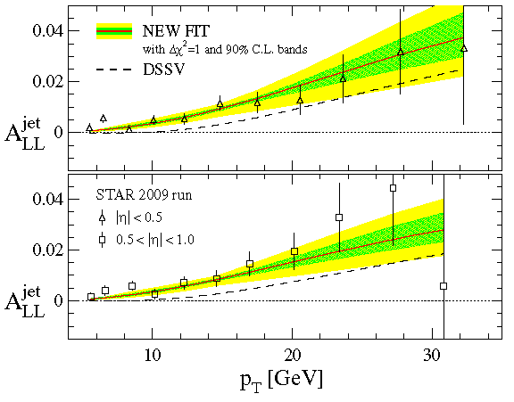
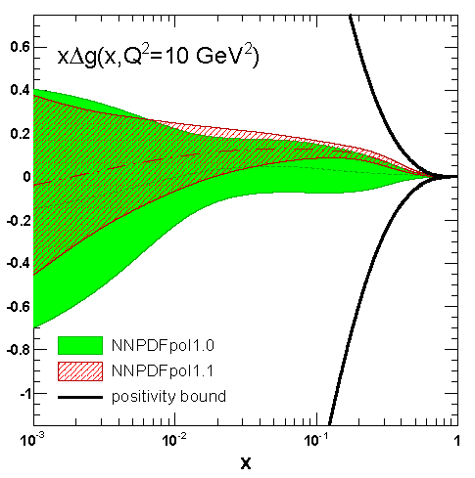
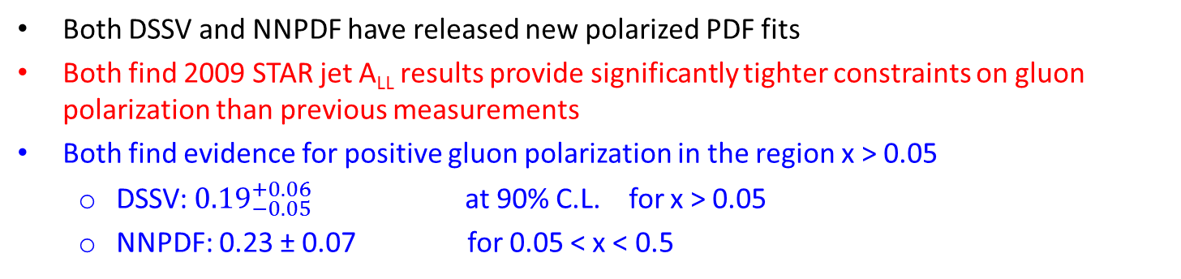
Two New Polarized Distribution Fits
DSSV, PRL 113, 012001
NNPDF, NPB 887.276
Both DSSV and NNPDF have released new polarized PDF fits
Both find 2009 STAR jet A_{LL} results provide significantly tighter constraints on gluon polarization than previous measurements
Both find evidence for positive gluon polarization in the region x > 0.05
  DSSV: ${0.19}_{−0.05}^{+0.06}$ at 90% C.L. for x > 0.05
  NNPDF: 0.23 ± 0.07 for 0.05 < x < 0.5

Slide 15
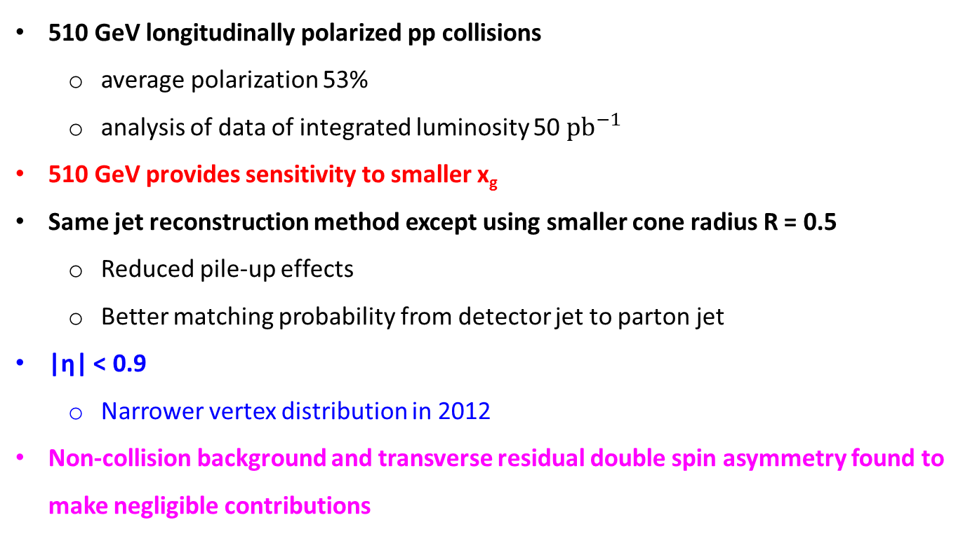
2012 pp 510 GeV Run
510 GeV longitudinally polarized pp collisions
  average polarization 53%
  analysis of data of integrated luminosity 50 ${pb}^{−1}$
510 GeV provides sensitivity to smaller x_{g}
Same jet reconstruction method except using smaller cone radius R = 0.5
  Reduced pile-up effects
  Better matching probability from detector jet to parton jet
|η| < 0.9
  Narrower vertex distribution in 2012
Non-collision background and transverse residual double spin asymmetry found to make negligible contributions

Slide 16
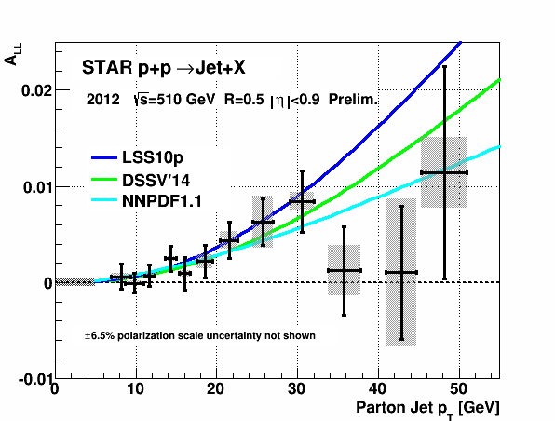
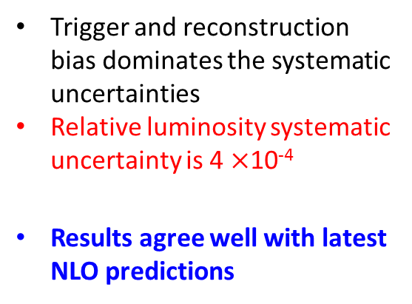
2012 Inclusive Jet A_{LL}
Trigger and reconstruction bias dominates the systematic uncertainties
Relative luminosity systematic uncertainty is 4 $×$10⁻⁴
Results agree well with latest NLO predictions
*systematics will be reduced in the final results (coming soon)

Slide 17
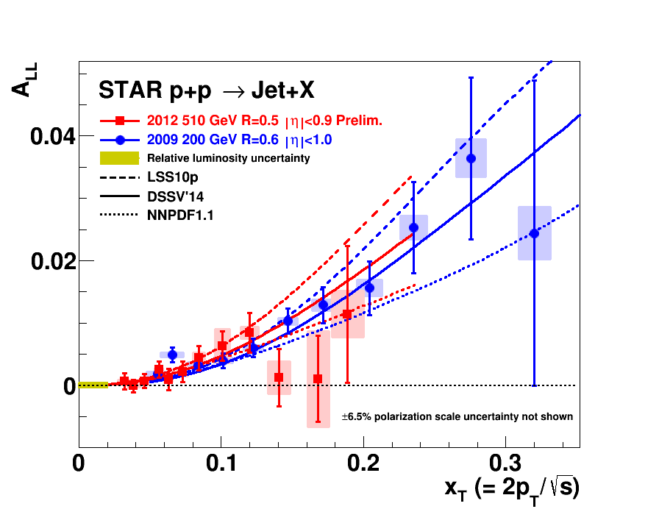
2012 Inclusive Jet A_{LL} with 2009 Data
Higher collision energy extends x_{T} = 2p_{T} / √s to lower region
510 GeV results agree well with 200 GeV data in the overlapping x_{T} region

Slide 18
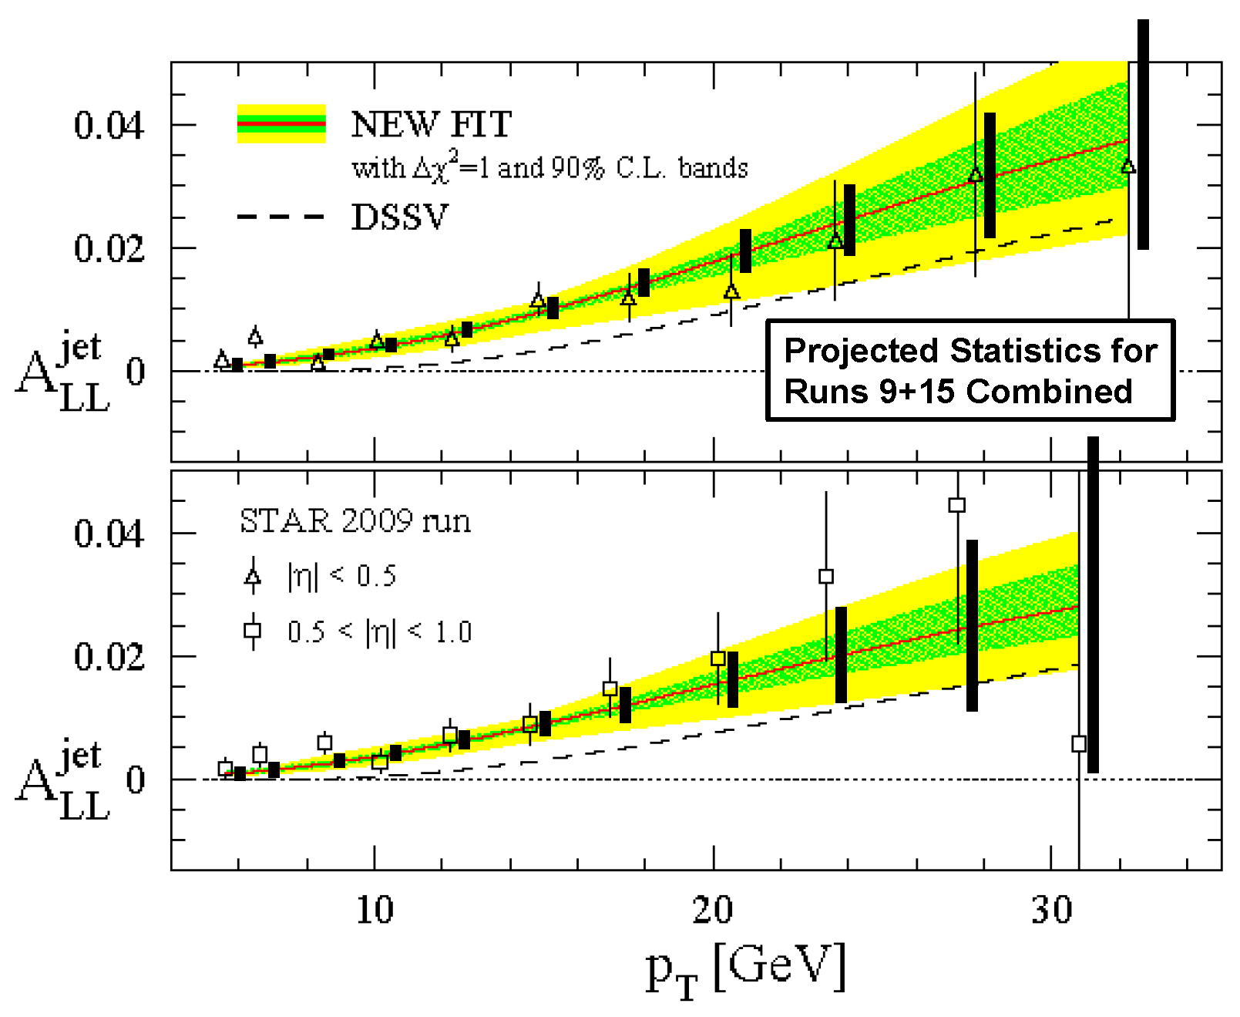
Increased Precision at 200 GeV Coming Soon
STAR also anticipates significant future reductions in the uncertainties for 200 GeV collisions relative to the 2009 results thanks to the RHIC 2015 run

Slide 19
Inclusive jet measurements
π⁰ measurements
Di-jet measurements

Slide 20
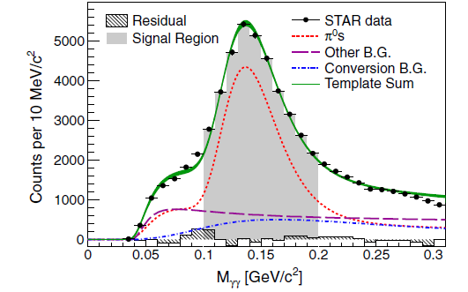
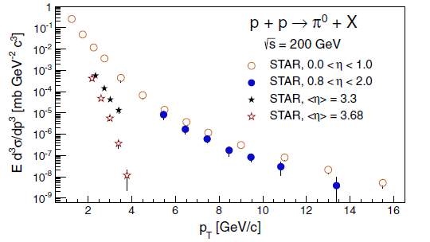
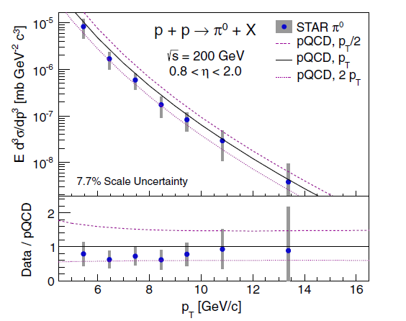
π⁰ Measurements at STAR
PRD.89.012001
Studied π⁰ production at 0.8 < η < 2 in 200 GeV pp collisions from 2006 data
Measure γ from π⁰ decay in electromagnetic calorimeter
STAR has measured the inclusive π⁰ cross section over a wide pseudo-rapidity range

Slide 21
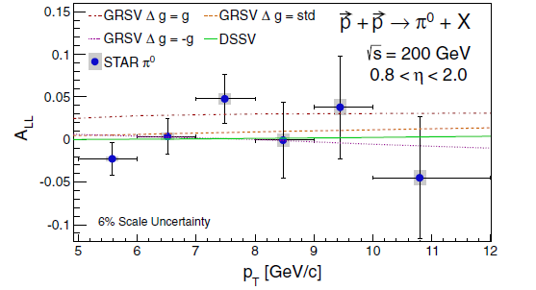
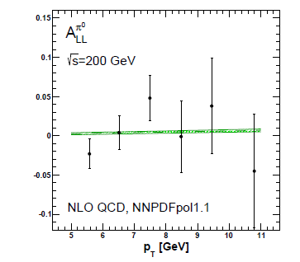
Inclusive π⁰ Double Spin Asymmetry A_{LL}
PRD.89.012001
NPB 887.276: NNPDFpol1.1 prediction with STAR 200 GeV data (0.8 < η < 2.0)
Needs greater precision to constrain NLO fit

Slide 22
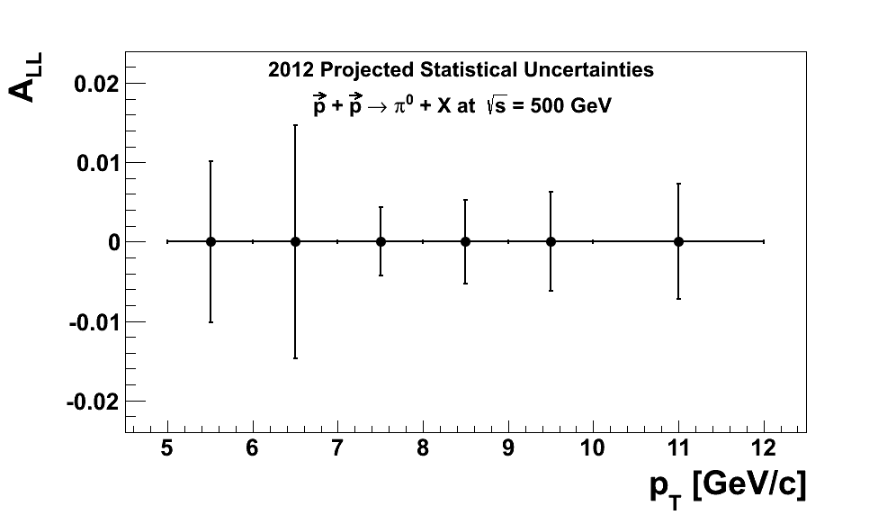
Inclusive π⁰ Double Spin Asymmetry A_{LL}
PRD.89.012001
Will achieve much greater precision with 510 GeV data that are currently being analyzed
  Higher √s also pushes the sensitivity to lower x_{g}
NPB 887.276: NNPDFpol1.1 prediction with STAR 200 GeV data (0.8 < η < 2.0)

Slide 23
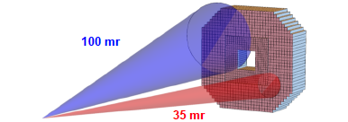
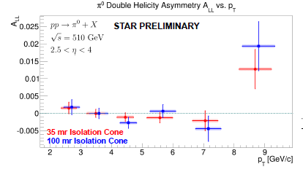
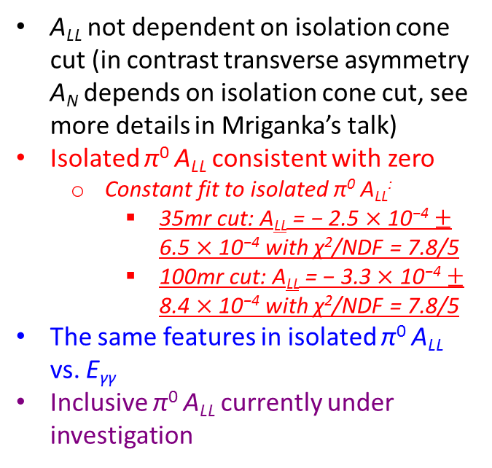
π⁰ Measurements at Further η Region
C. Dilks for the STAR Collaboration, SPIN 2014
π⁰ measured in FMS at 2.5 < η < 4.0 by using 2012 and 2013 510 GeV data
Isolated π⁰ measured by 2-γ isolation cone with cone radius 35 mr and 100 mr
A_{LL} of isolated π⁰ calculated
A_{LL} not dependent on isolation cone cut (in contrast transverse asymmetry A_{N} depends on isolation cone cut, see more details in Mriganka’s talk)
Isolated π⁰ A_{LL} consistent with zero
  Constant fit to isolated π⁰ A_{LL}:
    35mr cut: A_{LL} = − 2.5 $×$ 10⁻⁴ $±$ 6.5 $×$ 10⁻⁴ with χ²/NDF = 7.8/5
    100mr cut: A_{LL} = − 3.3 $×$ 10⁻⁴ $±$ 8.4 $×$ 10⁻⁴ with χ²/NDF = 7.8/5
The same features in isolated π⁰ A_{LL} vs. E_{γγ}
Inclusive π⁰ A_{LL} currently under investigation

Slide 24
Inclusive jet measurements
π⁰ measurements
Di-jet measurements

Slide 25
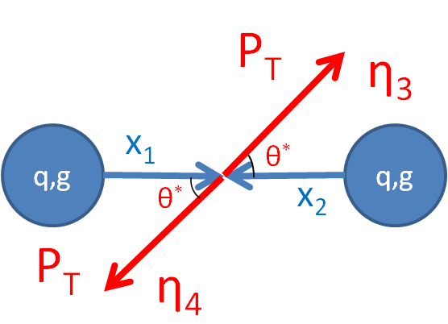
Di-jet Measurements at STAR
Di-jets permit event-by-event calculations of x₁ and x₂ at leading order
Use the same technique to reconstruct di-jets as the inclusive jets

Slide 26
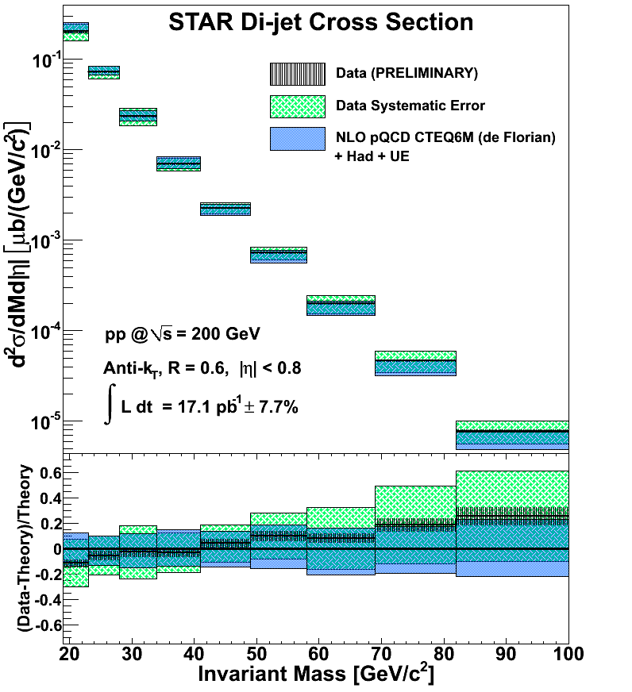
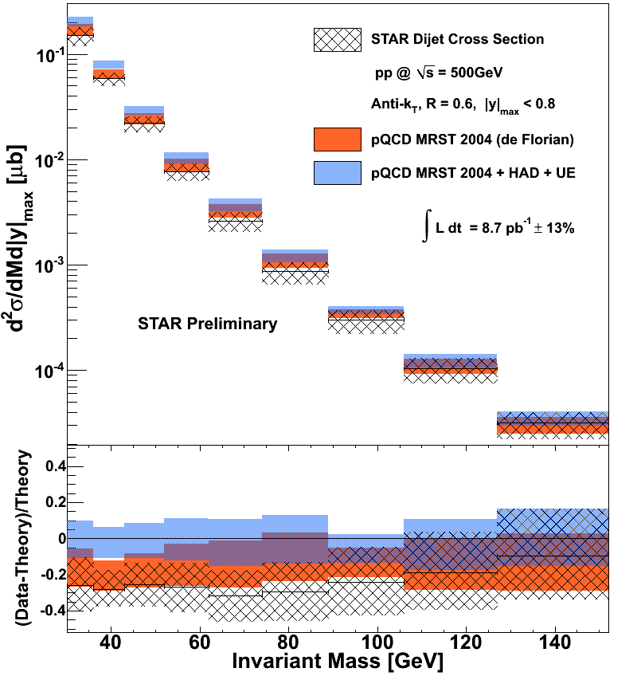
Di-jet Cross Section at 200 GeV and 500 GeV
Di-jet cross section is well-described by NLO pQCD with corrections for hadronization and underlying event
Will have A_{LL} for 2009 di-jets at 200 GeV soon
Also analyzing A_{LL} for di-jets at 510 GeV using data from 2012 and 2013

Slide 27
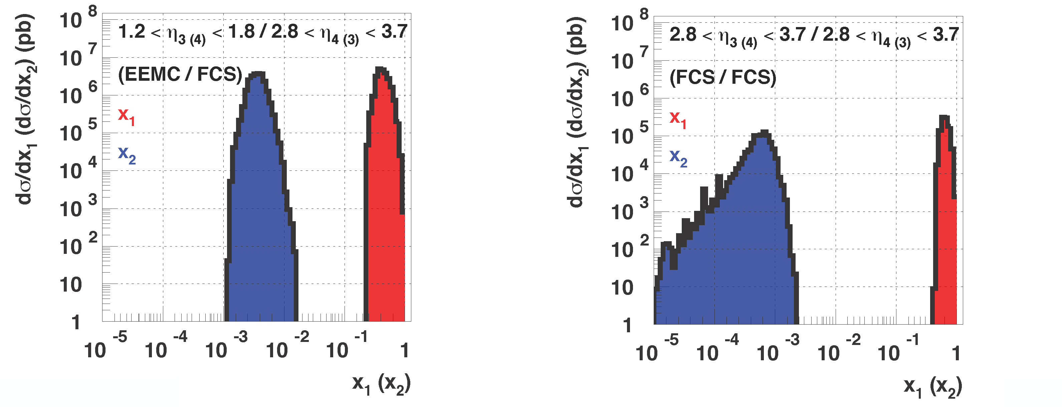
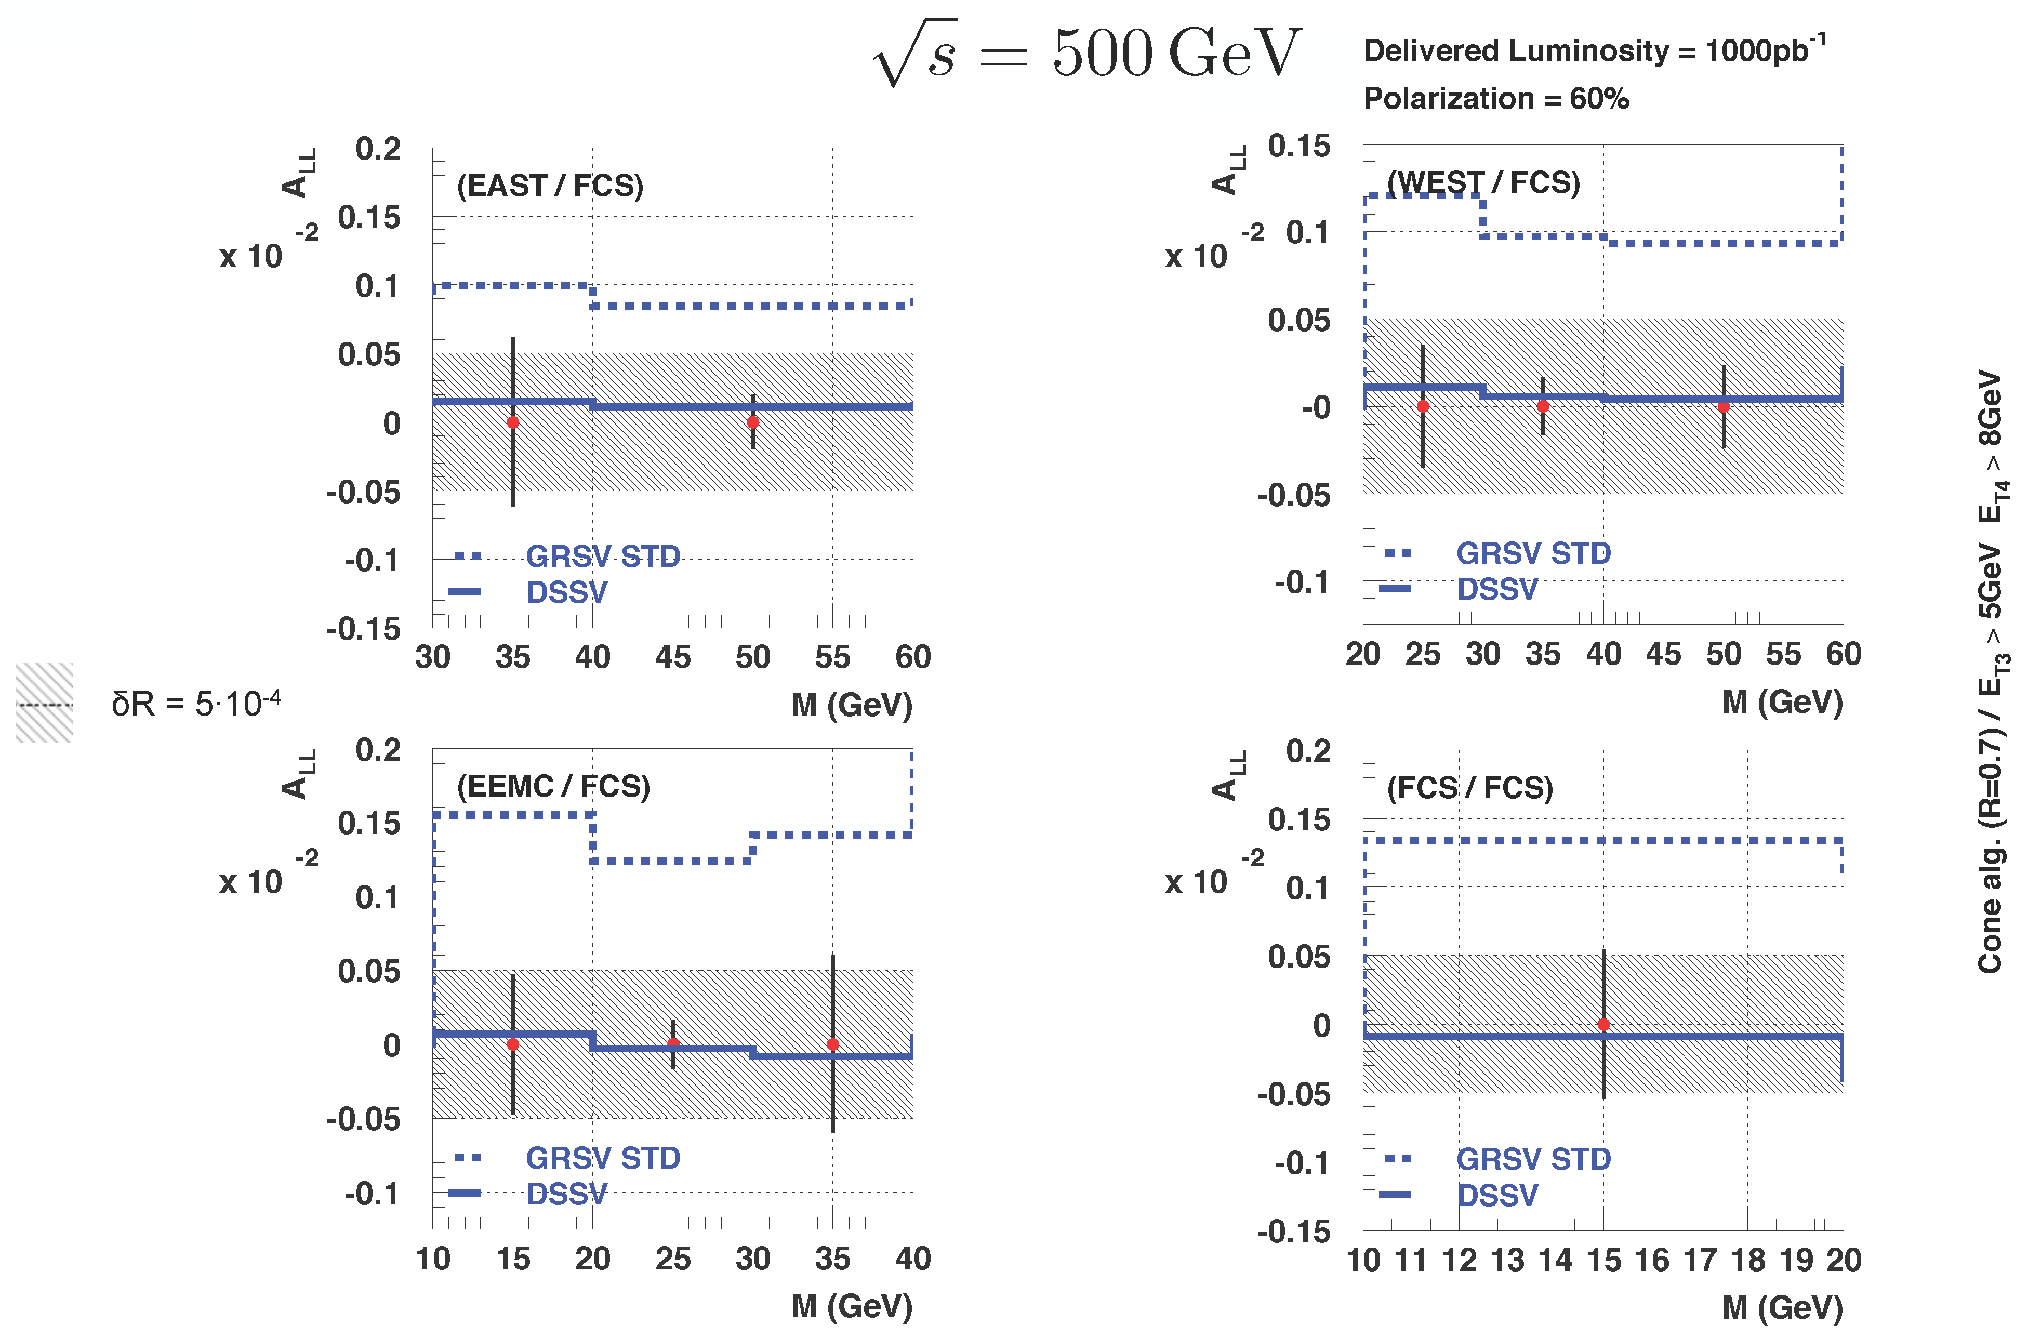
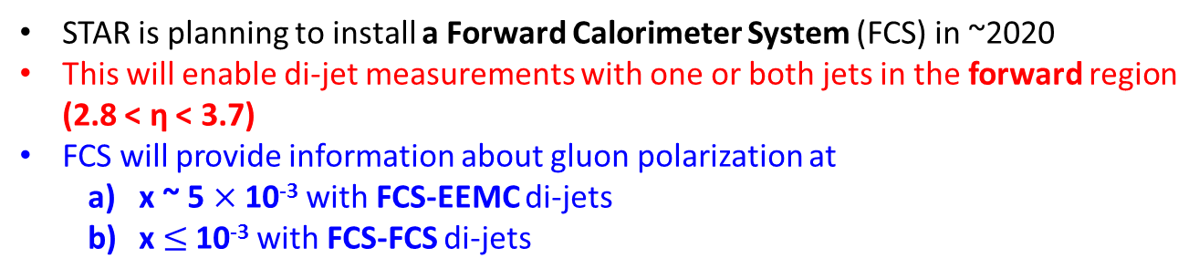
Di-jets in Further Future
STAR is planning to install a Forward Calorimeter System (FCS) in ~2020
This will enable di-jet measurements with one or both jets in the forward region (2.8 < η < 3.7)
FCS will provide information about gluon polarization at
  x ~ 5 $×$ 10⁻³ with FCS-EEMC di-jets
  x $≤$ 10⁻³ with FCS-FCS di-jets
√s = 500 GeV
Cone Algorithm, R = 0.7
E_{T,3} > 5 GeV, E_{T,4} > 8GeV
Assumed integrated luminosity: 1000 pb⁻¹
Assumed polarization: 60%

Slide 28

Di-jets in Further Future
STAR is planning to install a Forward Calorimeter System (FCS) in ~2020
This will enable di-jet measurements with one or both jets in the forward region (2.8 < η < 3.7)
FCS will provide information about gluon polarization at
  x ~ 5 $×$ 10⁻³ with FCS-EEMC di-jets
  x $≤$ 10⁻³ with FCS-FCS di-jets
GRSV ~ 0.05
DSSV ~ −0.01
√s = 500 GeV
Cone Algorithm, R = 0.7
E_{T,3} > 5 GeV, E_{T,4} > 8GeV
Forward di-jets will further constrain $Δ$g at x ~ 10⁻³
Assumed integrated luminosity: 1000 pb⁻¹
Assumed polarization: 60%

Slide 29
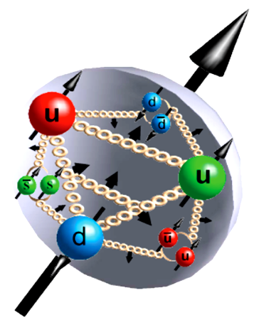
Conclusion
STAR inclusive jet, π⁰, and di-jet A_{LL} measurements are unique to explore gluon contribution to proton spin
STAR 2009 inclusive jet A_{LL} results provide the first experimental evidence for positive gluon polarization in the RHIC range
STAR 2012 510 GeV inclusive jet A_{LL} results extend measurements at lower x_{g} and agree well with STAR 2009 200 GeV data in the overlapping x_{T} range
More results coming up in the near future
  First measurements:
    Di-jet A_{LL} at 200 GeV (2009)
    Di-jet A_{LL} at 510 GeV (2012 and 2013)
    Inclusive π⁰ A_{LL} at 510 GeV (2012 and 2013)
  Improved precision for:
    Inclusive jet A_{LL} at 200 GeV (2015)
In the further future, STAR will use forward di-jets to explore gluon polarization at very low x_{g} (~10⁻³)

Slide 30
Back Up

Slide 31
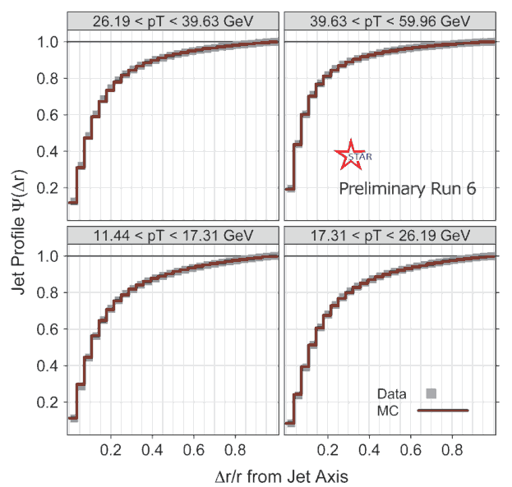
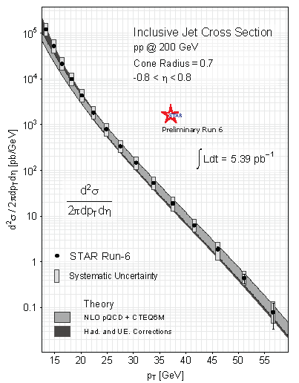
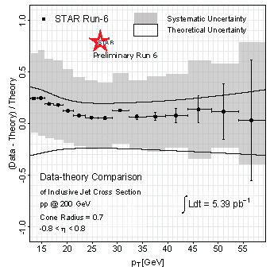
Inclusive Jet Cross Section from 2006 Data
Good agreement between data and simulation
Good agreement with NLO pQCD calculation after hadronization and underlying event correction is applied
Jet production is well understood at RHIC energies

Slide 32
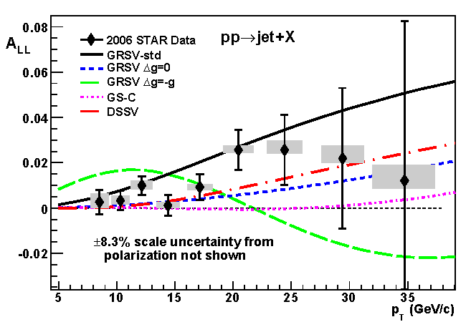

Inclusive Jet A_{LL} from 2006 Data
PRD 86, 032006
STAR inclusive jet A_{LL} from 2006 excluded those scenarios that had a large gluon polarization within the accessible x region

