Slide 1

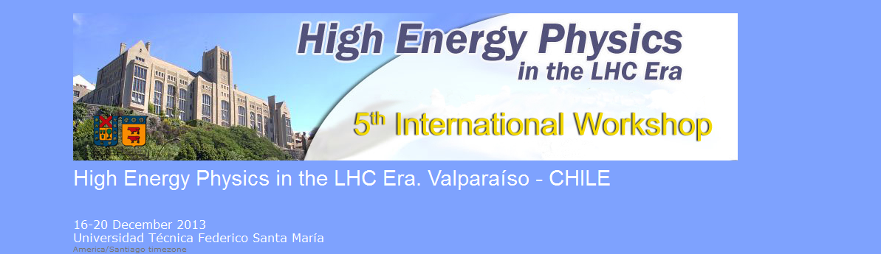

An Overview of Selected Results from the STAR Collaboration
William Christie
(Brookhaven National Laboratory)
For the STAR Collaboration

Slide 2
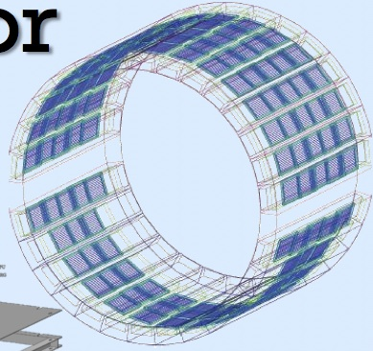

Outline
The STAR detector
Selected Results
  Jet suppression measurements in Au+Au
    Brief history, followed by new techniques & results
  heavy flavor: open charm, J/Ψ, and Υ
  Di-electron measurements
Near term upgrades at STAR
MTD
HFT

Slide 3
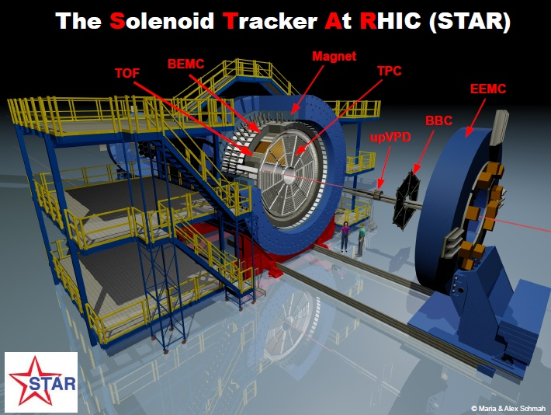
The STAR experiment
Large and uniform acceptance at mid-rapidity
  |η|< 1 and 0< φ< 2π
Excellent particle identification
Fast data acquisition
Upcoming upgrades targeted at heavy-flavor measurements
  improve tracking
  improve muon PID
STAR detectors in these analyses
  TPC (dE/dx)
  TOF (1/β)
  BEMC (E/p)
  VPD, ZDC, FTPC

Slide 4
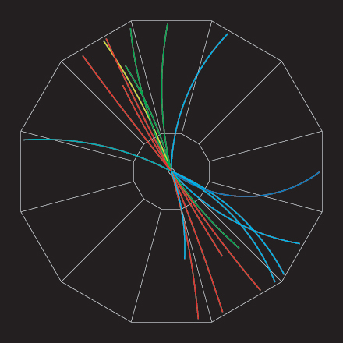
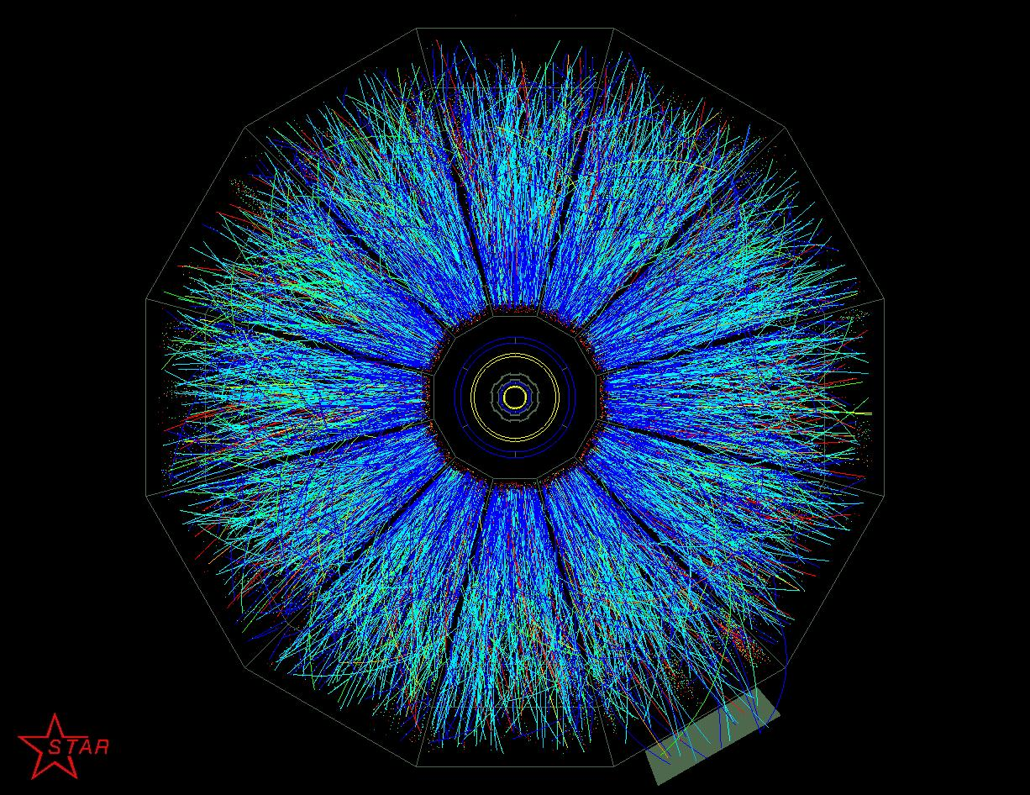
Brief Jet Quenching history in STAR
2002: Single-hadron suppression in Au+Au @ 130 GeV
2002: Disappearance of back-to-back correlations
2003: No suppression in d+Au: final state effect
2005: Little/no dependence on parton flavor
2004-2008: Jet-medium interactions (ridges, cones, …)
2008 - Di hadrons, 3 particle, 2+1, Jet-hadron, Jets
Slide courtesy of J. Dunlop

Slide 5
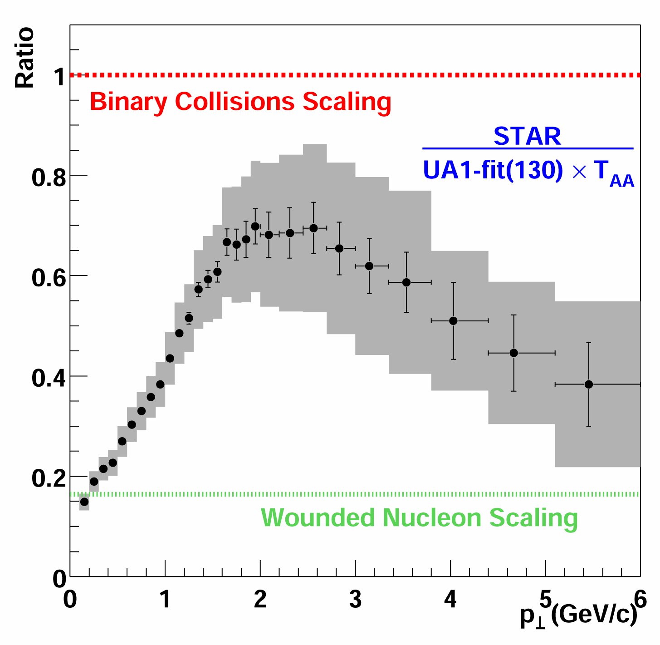
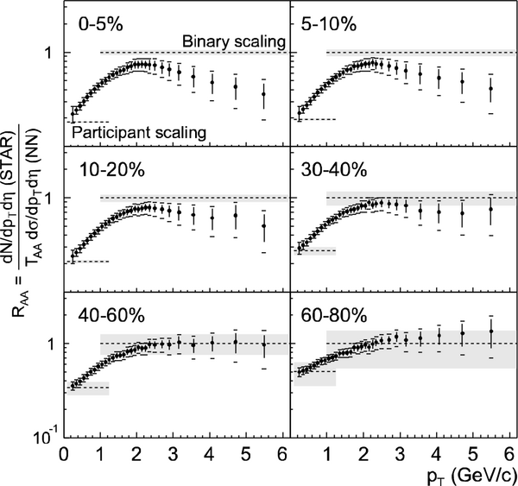
What we knew in 2002
Preliminary: QM2001, J.C. Dunlop et al, Nucl.Phys.A698 (2002) 515
Published: PRL 89 (2002)202301
At 130 GeV: strong suppression of hadrons relative to binary scaling hypothesis

Slide 6
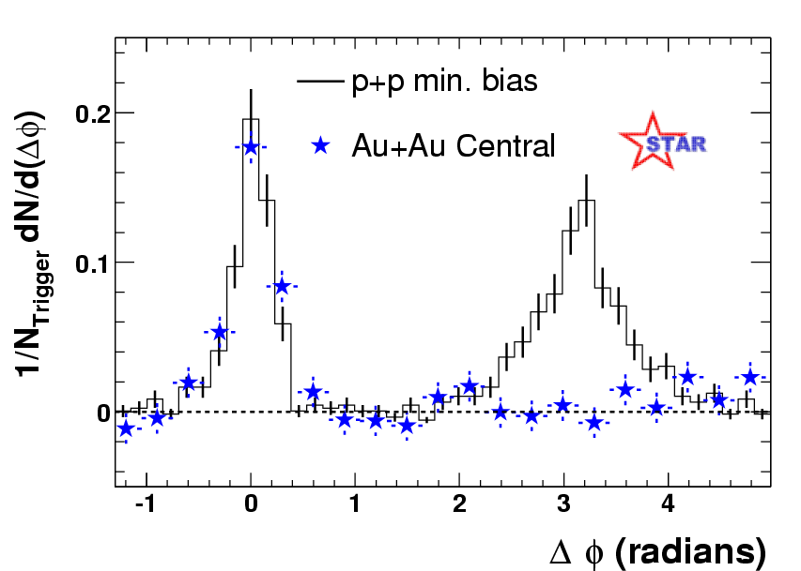

Disappearance of Back-to-Back Jets
Phys. Rev. Lett. 90 (2003) 082302
$\sqrt{S}$ = 200 GeV
Graphic from
D.H. Hardtke
QM2002, Nantes
?
Not only are single particle spectra strongly suppressed, but also the away-side jet
(4 < p_{Ttrig} < 6 or 3 < p_{Ttrig} < 4 GeV/c)
2 < p_{Tassoc} < p_{Ttrig} GeV/c

Slide 7
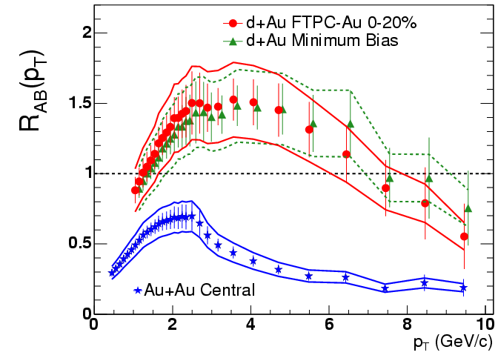
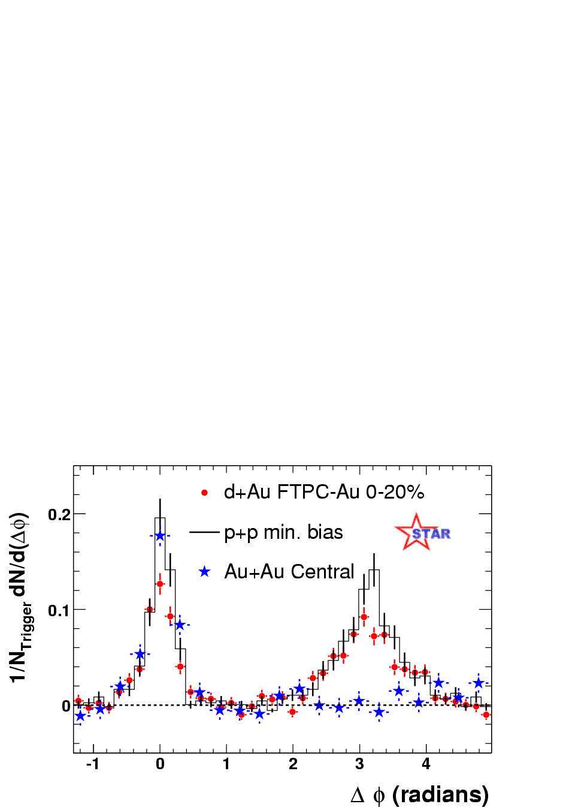
What We Knew – Jet Quenching
STAR
Phys. Rev. Lett. 91, 072304 (2003).
Pedestal&flow subtracted
Inclusive yields and back-to-back di-hadron correlations are very similar in p+p and d+Au collisions
“Jet quenching” is a final-state effect, caused by interactions with the dense medium created at RHIC
Both are strongly suppressed in central Au+Au collisions at 200 GeV
Carl Gagliardi – Hard Probes ‘04
7

Slide 8
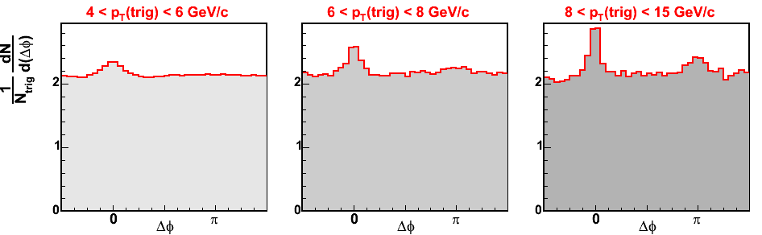
Emergence of away-side peak (2005)
Equivalent to analysis on previous slide
Au+Au, 0-5%
STAR Preliminary
p_{T}(trig)
p_{T}(assoc) > 2 GeV/c
High statistics year 4 dataset allows increase in Q²
Emergence of the away side peak with increased trigger p_{T}

Slide 9
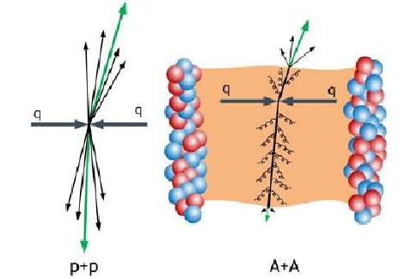
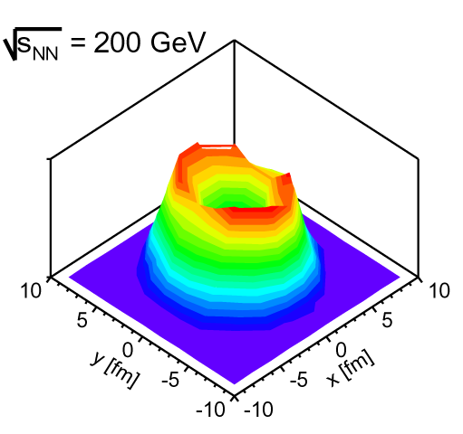
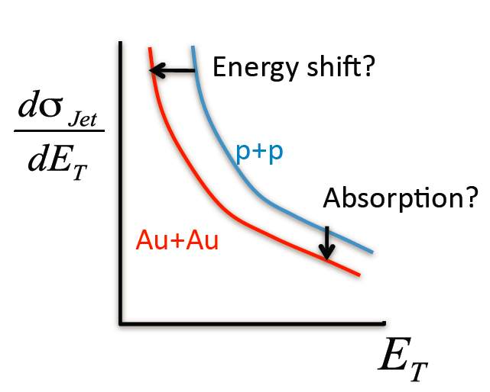
Jets as Probes of Nuclear Matter
pp
AA
In p+p: hard-scattered partons fragment and hadronize into collimated sprays of hadrons, i.e. jets
In A+A: expect jet quenching in hot & dense medium
  softening and broadening of fragmentation when compared to p+p
“Surface bias” models
A. Dainese, C. Loizides, G. Paic, Eur. Phys. J. C38(2005) 461
Jets probe nuclear medium
  but, very challenging in high multiplicity environment
  Different approaches provide insights

Slide 10
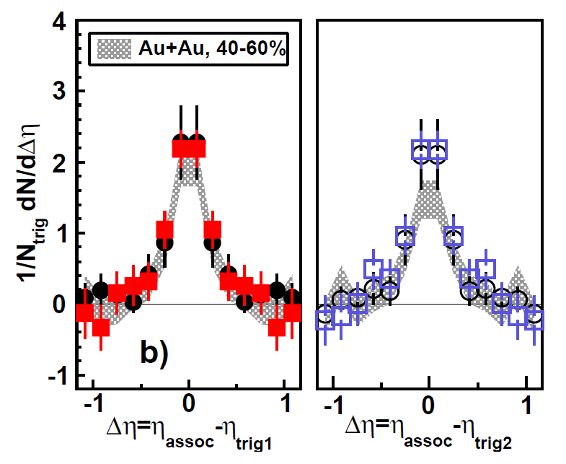

2+1 correlations: di-hadron study
“Pin” the jet axis by selecting back-to-back triggers.
Investigate distributions of associated hadrons
with respect to both trigger hadrons.
secondary trigger
T2
primary trigger
T1
associated hadrons
symmetric triggers (p_{T1}~p_{T2})
5 < p_{T1} < 10 GeV/c, 4 GeV/c < p_{T2} < p_{T1}
1.5 GeV/c < p_{T}^{assoc} < p_{T1}
STAR, PRC 83 (2011) 061901
Central Au+Au ~ d+Au collisions:
- no away-side suppression
- no significant shape/yield modifications
- no apparent ridge present
Sampling of surface-biased/unmodified di-jets?
Di-jets where both jets lose similar
amounts of energy?
Look at p_{T} asymmetric di-jets
using EM calorimeter for T1
Notes:
Looking at the summed “Jet” energy diffference between the near and awat sids ives values of
The difference between the summed energy on the near and away sides give values of ~1.6 Gev, commensurate with expectations from “kt” effects.

Slide 11
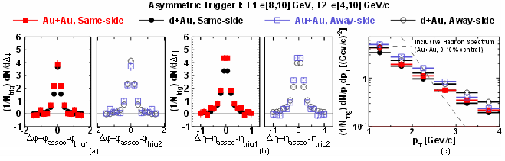
2+1 correlations: di-jet energy imbalance
Phys. Rev. C 87 (2013) 44903
Extends previous 2+1 study using higher statistics and extends trigger particle P_{t} reach using Electromagnetic Calorimeter trigger.
secondary trigger
T2
Extended Trigger range and asymmetry
8 < p_{T1} < 10 GeV/c or 10 < p_{T1} < 15 GeV/c
4 < p_{T2} < 10 GeV/c
1.5 < p_{T}^{assoc} < 10 GeV/c
primary trigger
T1
associated hadrons
Near and away side peaks similar for Au+Au and d+Au (surface bias).
By varying the asymmetry between P_{T1} and P_{T2} one may control the degree of surface bias, and thus in-medium path length traversed by parton.
Notes:
Qualitatively one reaches same conclusion, no sign of away side modification relative to d-Au.

Slide 12
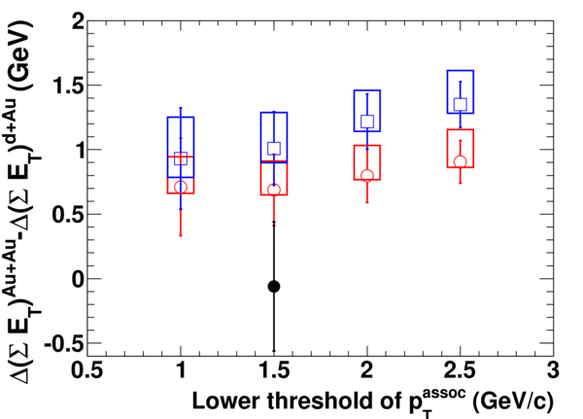
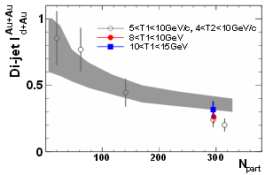

2+1 correlations: di-jet energy imbalance
Energy imbalance:
Jet energy ~ Σp_{T} within the 0.5x0.5 (Δη x Δφ)
◊ investigate relative energy imbalance:
Δ(ΣE_{T}) ^{Au+Au} - Δ(ΣE_{T}) ^{d+Au}
Δ(ΣE_{T}) = (E_{T}^{T1} + Σp_{T}^{assoc,near}) - (p_{T}^{T2} + Σp_{T}^{assoc,away})
◊ investigate relative Di-Jet survival probability (core – corona model):
STAR, Phys. Rev. C 87 (2013) 44903
Phys. Rev. C 83, 061901(R)(2011)
p_{T}^{T1} ∈ [4,10] GeV/c
p_{T}^{T1} ∈ [8,10] GeV/c
p_{T}^{T1} ∈ [10,15] GeV/c
non-zero relative energy imbalance for asymmetric triggers observed
the imbalance increases with trigger asymmetry
Indication of softening of fragmentation function for selected di-jets
qualitatively consistent with longer path-lengths traversed and higher energy loss
Notes:
I = conditional di-jet survival probability. Increase in di jet survival with trigger asym. Consistent with idea of probing deeper into the medium.

Slide 13
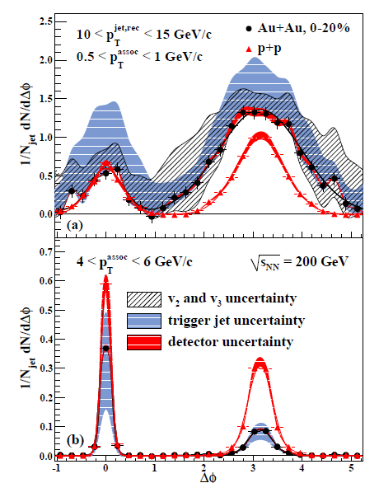
Jet-hadron correlations
reconstructed
trigger jet
Larger kinematic reach compared
to di-hadron correlations
associated
particles
Jet reconstruction allows more direct access (relative to dihadron) to the parton energy.
jet reconstruction: anti-k_{T} algorithm (R = 0.4)
with a trigger tower in BEMC with E_{T} > 6 GeV
and constituent tracks/towers with p_{T}/E_{T} >2 GeV
to reduce background fluctuations
(NOTE: “a highly biased jet population”)
recoil (away-side) jet fragmentation is unbiased

Slide 14
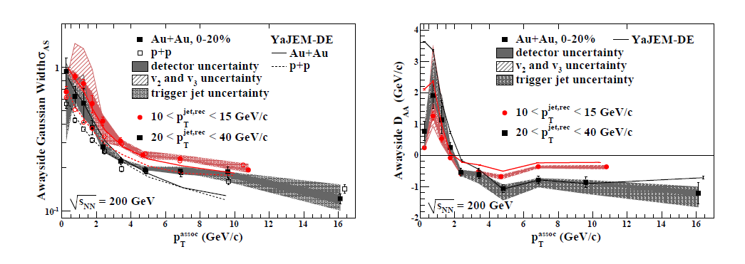

Quantifying properties of jet-hadron correlations
STAR, arXiv: 1302.6184 ; YaJEM-DE, T. Renk, PRC 87 (2013) 2, 024905
Away-side Gaussian width:
suggestive of medium induced broadening
BUT!
highly depends on fitting of flow backgrounds
Away-side P_{t} difference (Au+Au vs d+Au):
Suppression of high-p_{T} associated hadron yield ~ balanced by enhancement of yield at low-p_{T}.
The redistribution of energy quantitatively consistent with YaJEM-DE model
of in-medium shower modification.

Slide 15
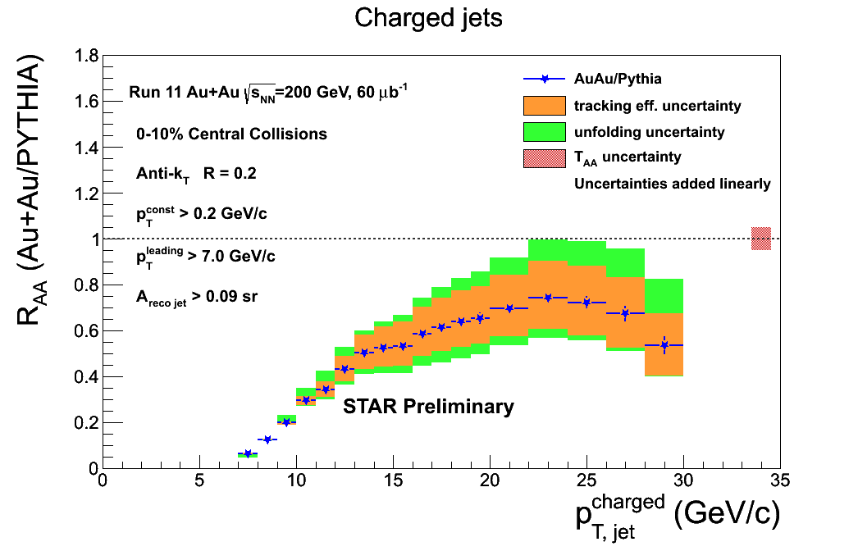
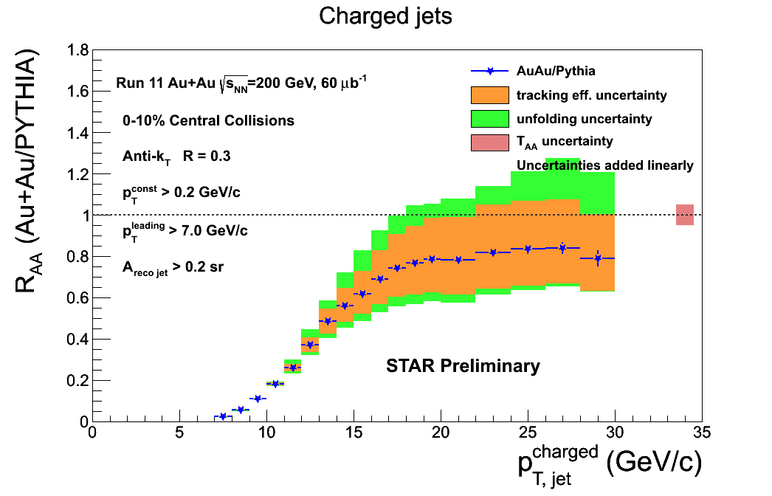
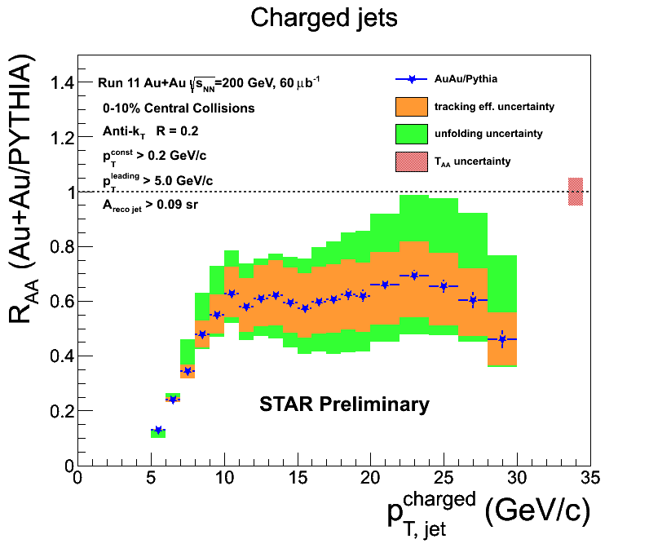
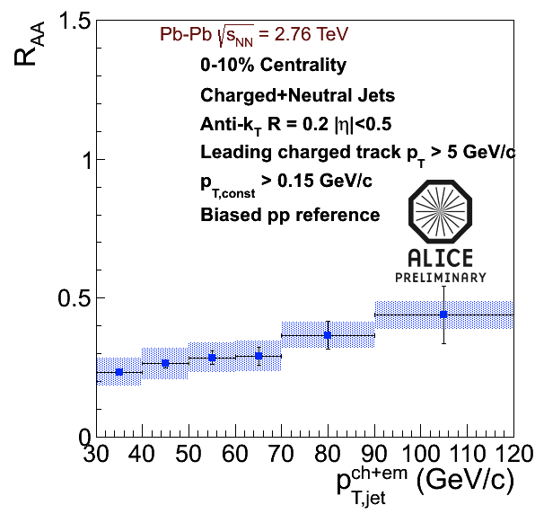
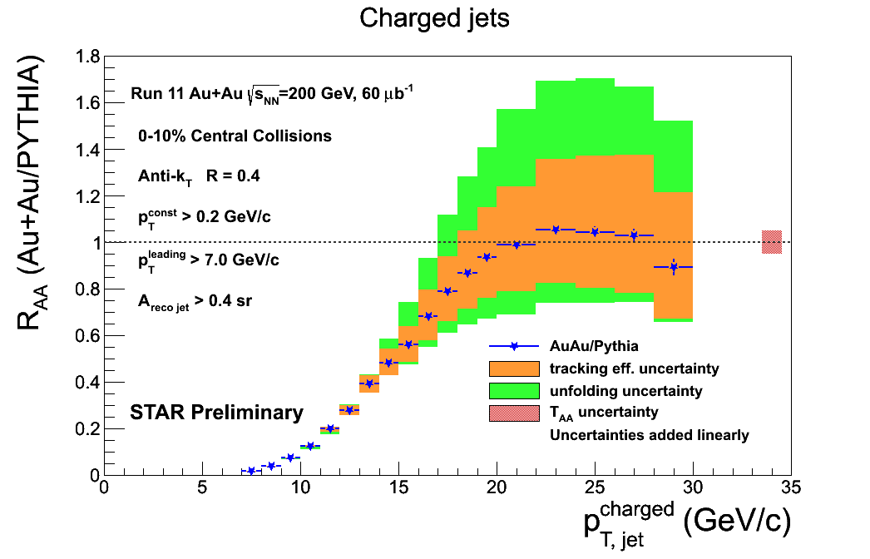
Inclusive Charged Jet R_{AA}
Jet reconstruction method similar to ALICE
  dominant uncertainty: tracking efficiency
R_{AA} > 0.5 for Au+Au at 200GeV
R_{AA}(RHIC) > R_{AA}(LHC)
  at same jet p_{T}
Central R_{AA} value increase with size of jet R ?
  uncertainties large
  careful assessment of correlated/uncorrelated errors
R=0.2
R=0.3
HQ’12 arxiv:1304.5945
R=0.4

Slide 16
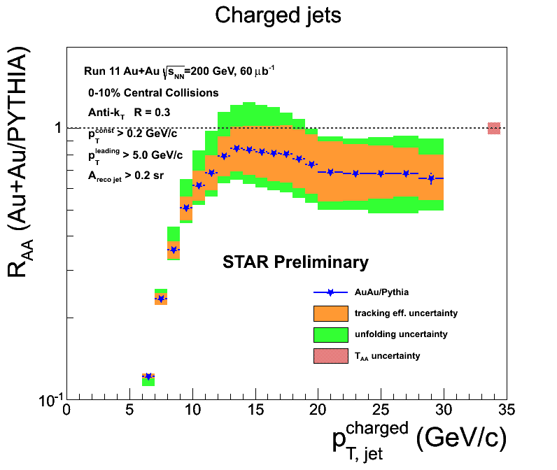
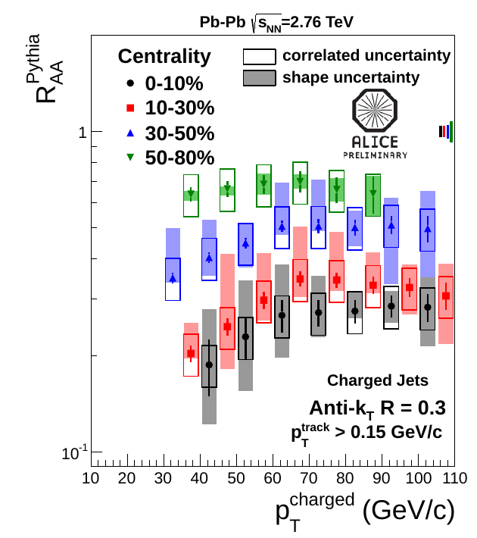
Comparison with ALICE results
Strongly biased
By P_{T}^{leading}
Charged jet RAA:
  R_{AA} >~ 0.5
  R_{AA} appears to be larger at RHIC (25-30GeV/c) than at the LHC (30 - 40GeV/c)
  Growth in central value with increasing R?
  (need to assess correlated and uncorrelated uncert. for definitive statement)
M. Verweij (ALICE)
NPA 904-905 (2013) 1015c
Next Steps:
  Cross check with other unfolding methods (Singular Value Decomposition)
  Full jets – incorporating BEMC, use triggered data

Slide 17
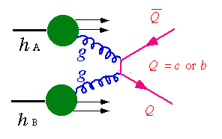
Heavy-Flavor Measurements
Heavy Flavor primarily from initial hard scattering
  important probe for studying properties of the QGP
  sensitive to the initial gluon distribution & density
  parton energy loss in the medium
Hadronic decay
  small branching ratio
  fully reconstructed
    direct access to heavy quark kinematics
  large combinatorial background (if no secondary vertex)
Semi-leptonic decay
  large branching ratio
  single e±: indirect access to kinematics
  background from conversion and light hadron decay
e⁻/μ⁻
e⁺/μ⁺
heavy quarkonia
K⁺
e⁻/μ⁻
ν_{l}
K⁻
D⁰
π
open heavy flavor

Slide 18
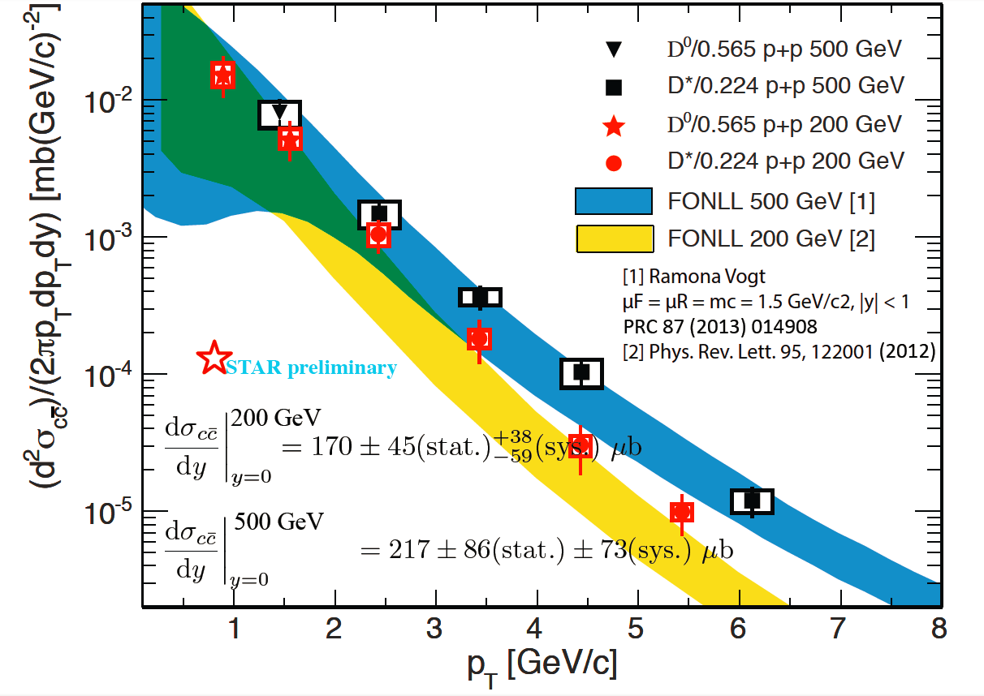
Open charm production in p+p
FONLL: Fixed Order plus Next-to-Leading Logarithm calculation, μF = μR = mc, |y| < 1,
R. Nelson, R. Vogt, A. D. Frawley, arXiv: 1210.4610
Measurements in p+p provide constraints for the pQCD calculations.
D⁰ and D* cross section consistent with FONLL upper limit at 200 and 500 GeV.

Slide 19
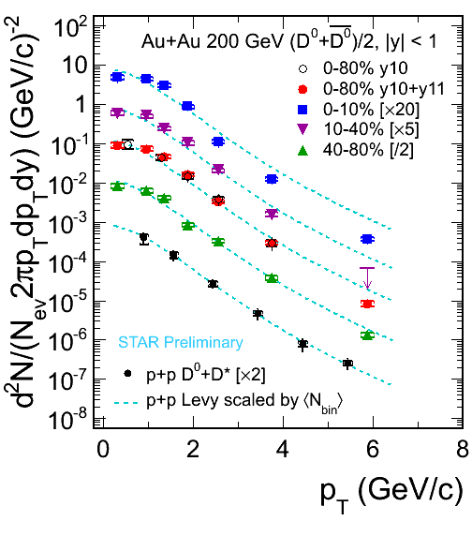
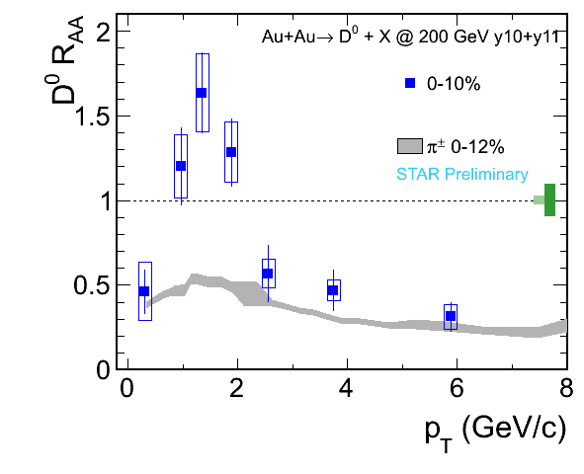
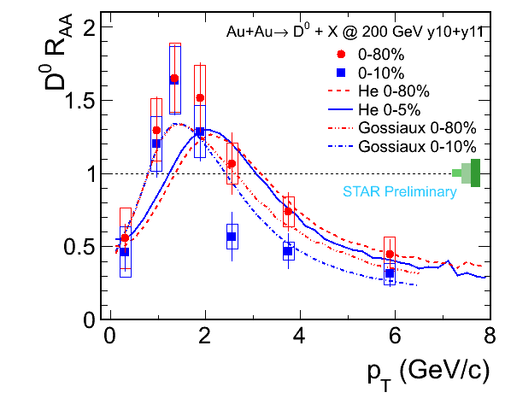
Open charm production in Au+Au (Had. channel)
Models: He, Fries, Rapp: PRL 110 (2013) 112301 Gossiaux, Aichelin, Bluhm, Gousset, Vogel, Werner arxiv:1207.5445
production of D mesons in Au+Au collisions:
high-p_{T}: suppression in (semi)central collisions
consistent with light hadrons
intermediate-p_{T} : enhancement
recombination, radial flow, … ?

Slide 20
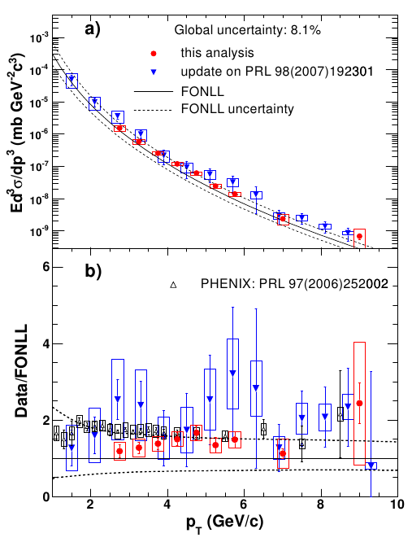
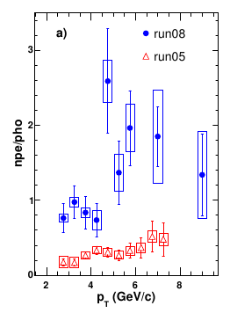
Non Photonic Electrons in p+p collisions at $\sqrt{S}$ = 200 GeV
STAR Phys. Rev. D 83 (2011) 052006
Combined 2005 and 2008 data:
Different material thickness, more ɣ conversion background in 2005 data.
Despite sensitivity of analyses to the different NPE/PE ratios of the two data sets, the results agree.
Results from 2005 and 2008 combined.
Results of combined analysis are consistent with PHENIX results, as well as with FONLL calculations.

Slide 21
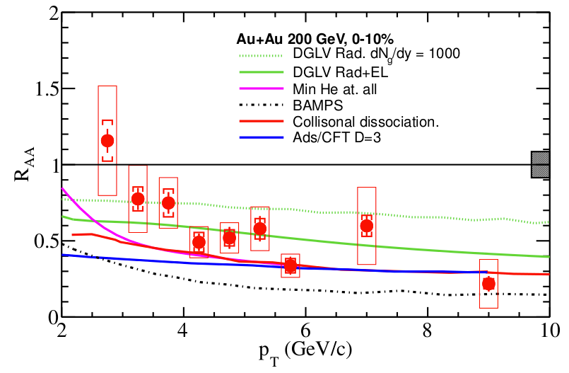

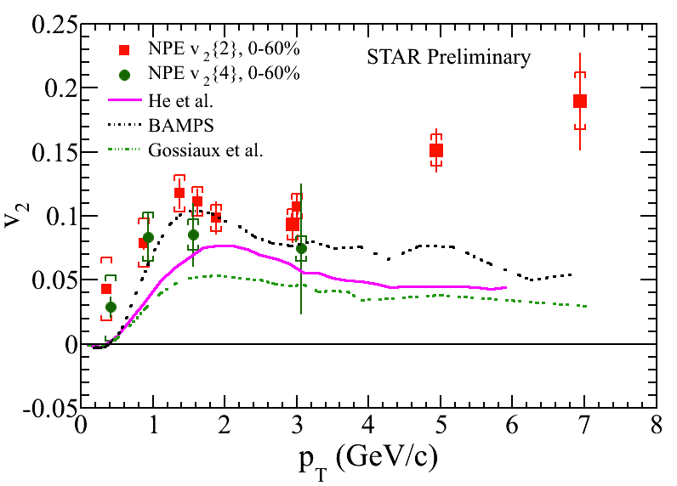
Non-Photonic Electrons
Au+Au at √s_{NN}=200 GeV
Strong suppression for NPE
  Data disfavors radiative energy-loss-only models
  need improvement in p+p precision
  no indication of suppression at 62GeV
  when comparing to FONLL ref.
Significant v₂ for NPE
  coalescence with light quarks or charm quark flow?
  HFT upgrade will try to answer
Olga Rusnakova – Monday 18:40 – 17:05 A2

Slide 22
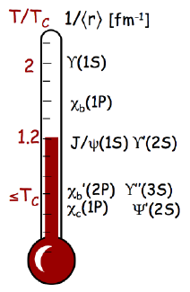
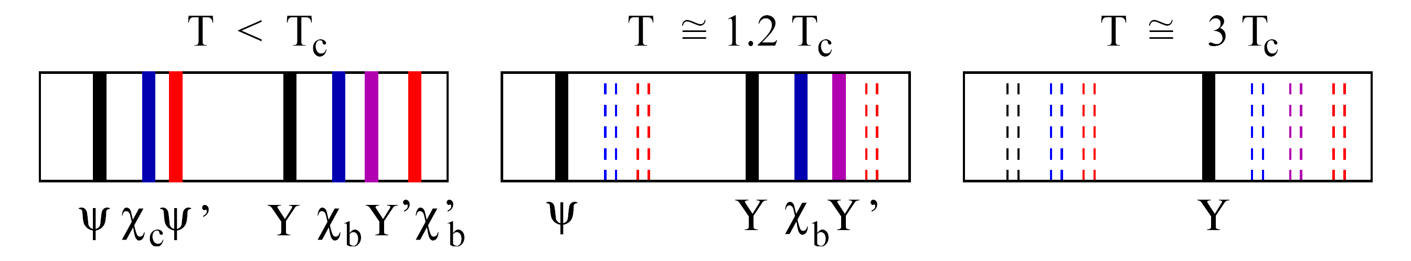

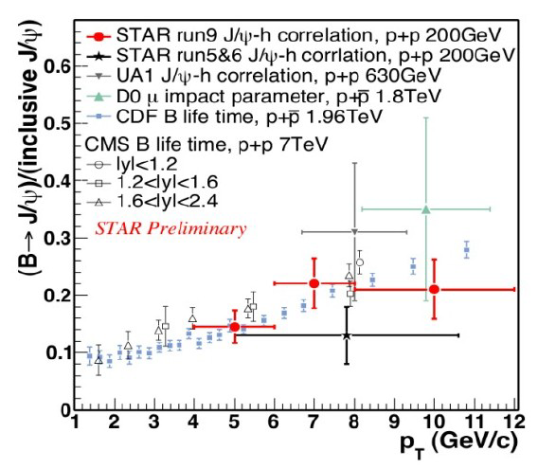
Quarkonia
Sensitive to color screening of quark potential: dissociation in QGP
Suppression of different states determined by medium temperature and their binding energy
  QGP thermometer
Production mechanism not completely understood
  p+p: Color-Singlet or Color-Octet?
But, …
Measured J/Ψ yields include significant feed down contributions
  B mesons carry 10-25% of charmonium yield
Contributions from Cold Nuclear Medium effects
  suppression mechanisms, e.g. nuclear absorption, gluon shadowing, initial state energy loss
  enhancement mechanisms, Cronin effect
Contributions from hot & dense medium effects
  recombination from uncorrelated charm pairs
H. Satz, Nucl. Phys. A (783):249-260(2007)

Slide 23
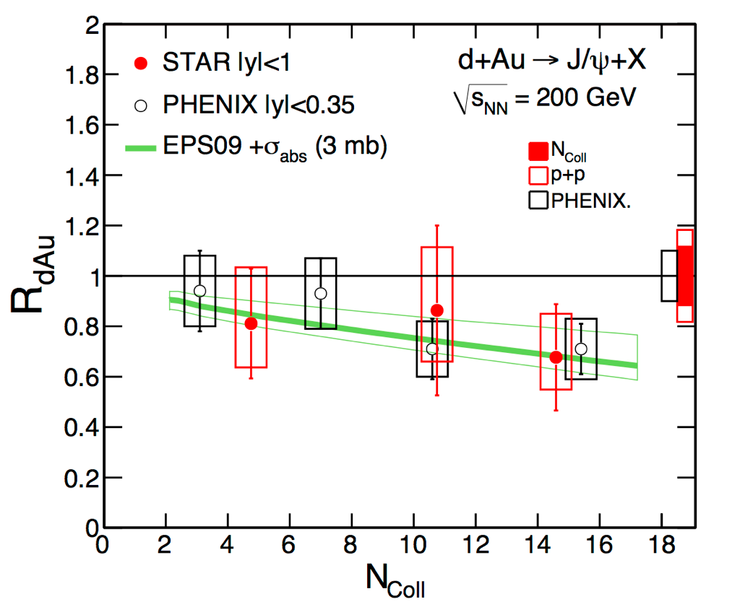
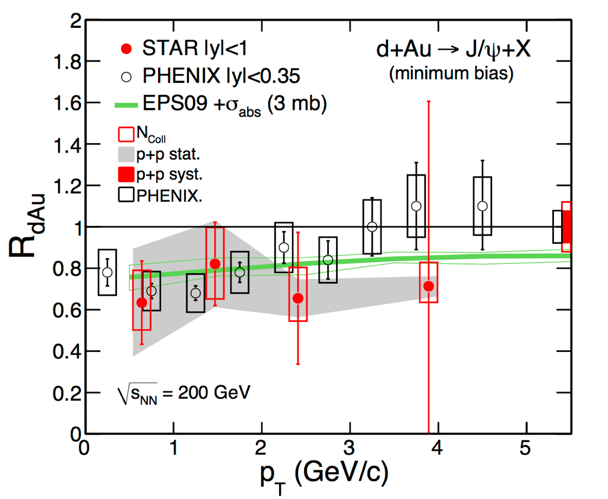
J/Ψ in p+p and d+Au
p_{T} range in p+p extended to 14 GeV/c
  prompt NLO CS+CO describes data
  prompt CEM describes data at high p_{T}
R_{dAU} consistent with model calculations
  shadowing from EPS09 nPDF
  nuclear absorption: σ_{abs}^{J/Ψ}=3mb
PLB 722 (2013) 55
STAR Preliminary
STAR Preliminary

Slide 24
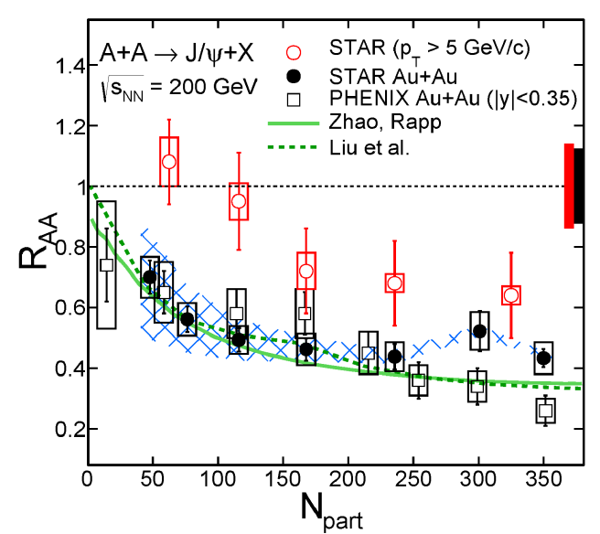
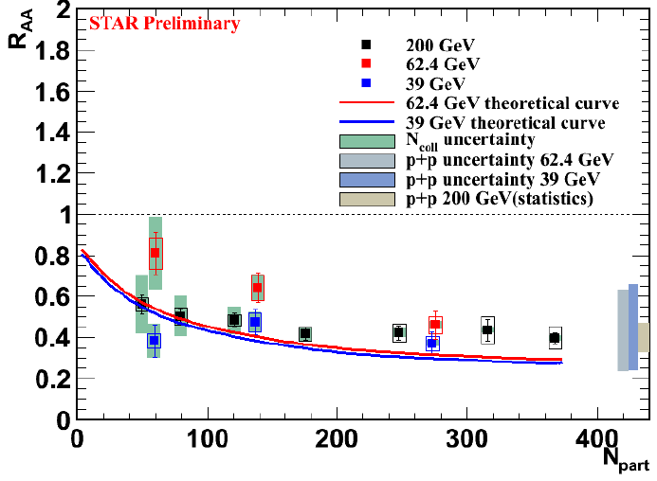
J/Ψ in Au+Au
Au+Au at 200 GeV: suppression observed
  increase with centrality
  decrease with p_{T}
Au+Au at 39 and 62.4 GeV
  similar centrality and p_{T} dependence
Au+Au v₂: consistent with no flow
  disfavors production by coalescence of thermalized charm (for p_{T}>2 GeV/c)
Phys. Lett. B 722 (2013) 55
v₂
Au+Au 200 GeV 0-80%
PRL 111 52301 (2013)
Barbara Trezeciak – Thursday 15:25 – 15:50 C1
Notes:
PRL 111 [30] 52301 (2013) –
29 – Yan, Zhuang, N. Xu PLB655 126 (2007)
- Greco, Ko, Rapp PLB 595 202 (2004)
32 – x.zhao & rapp ariv:0806.1239
33 – y.li, nu xu, p.zhuang NPA 834, 317c
34 Heinz, Shen priv. comm

Slide 25
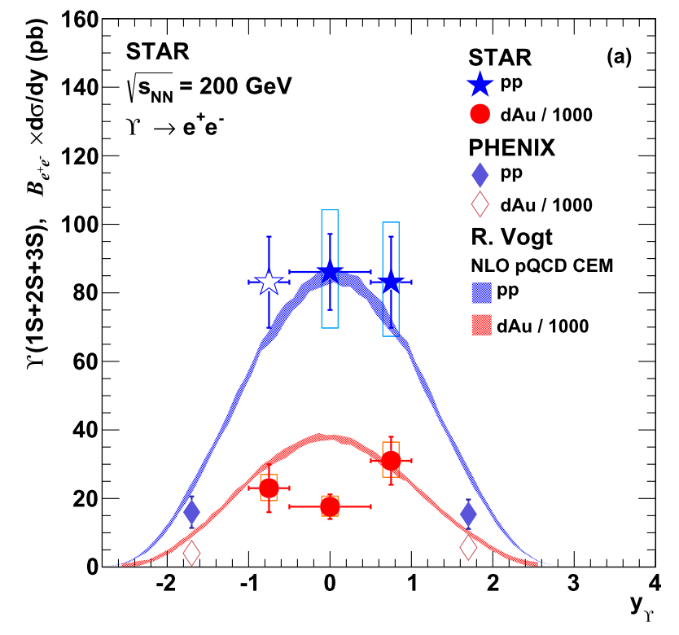
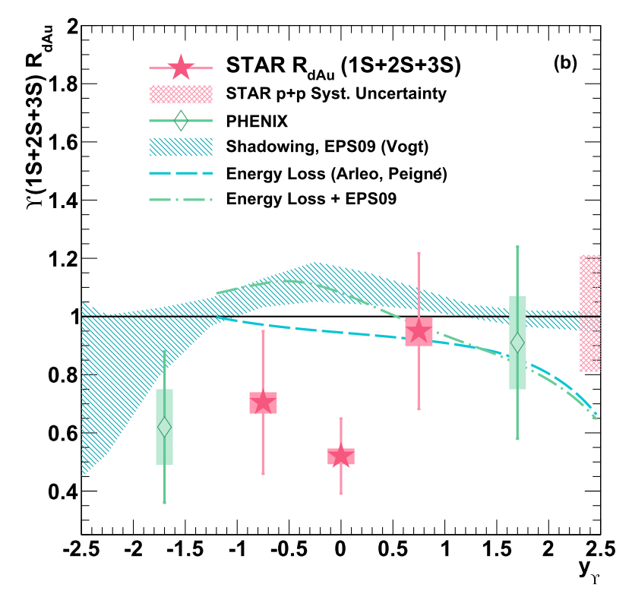
Upsilon measurements at 200 GeV
arXiv:1312.3675
ϒ-cleaner probe compared to J/ψ
Co-mover absorption → negligible
  ϒ(1S): tightly bound, larger kinematic threshold.
  Expect σ~ 0.2 mb, 5-10 times smaller than for J/ψ
Recombination → negligible
  at RHIC: σ_{cc} ~800μb >> σ_{bb} ~(1-2)μb
Expect sequential suppression of ϒ(1s), ϒ(2s), ϒ(2s) states
Challenge: low rate, rare probe
  STAR upgrades
New, high-statistics p+p baseline for R_{AA}
  Consistent with pQCD Color Evaporation Model
Cold matter effects from d+Au
  Important for interpreting Au+Au results
  Additional suppression from CNM needed for d+Au at mid-rapidity to fully reproduce ϒ production
d
Au
Notes:
Sem mozna obrazek z PDG

Slide 26
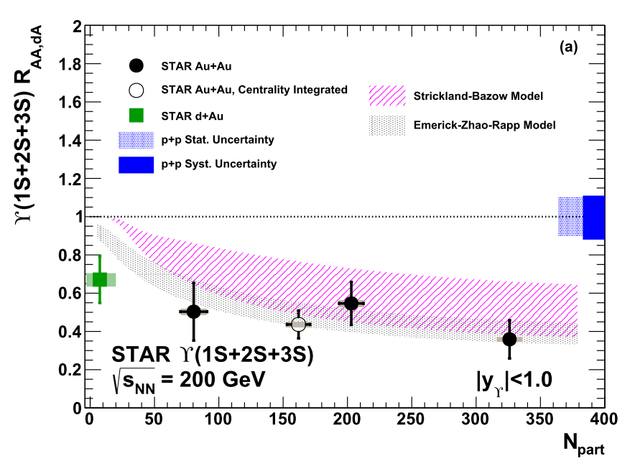
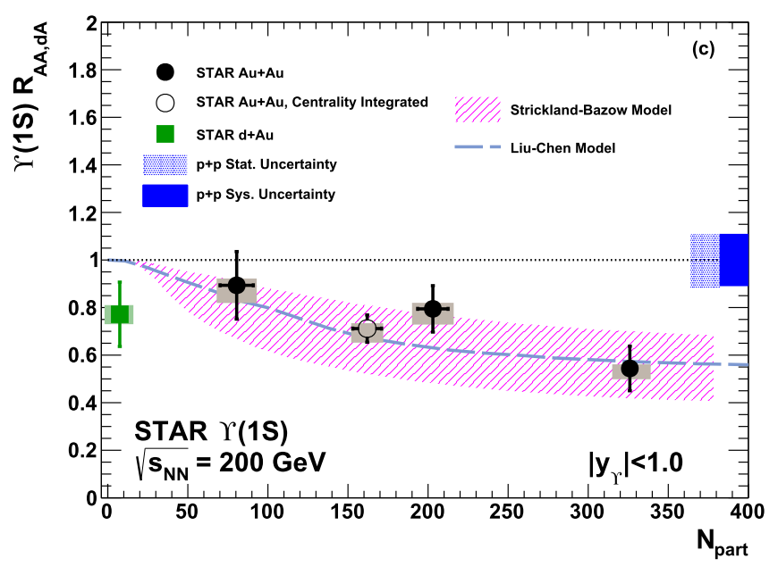
Upsilon R_{AA} in Au+Au 200 GeV
Separate yield extraction for ϒ(1S) and ϒ(1S+2S+3S) states at mid-rapidity
Suppression of ϒ production in Au+Au observed
  R_{AA} decreases with centrality.
  Data consistent with models that contain bottomium melting in deconfined matter
Increased Au+Au statistics from run 11 will further decrease R_{AA} uncertainties
Muon telescope detector upgrades
  Significant improvement of ϒ measurements via di-muon channel
Petr Chaloupka – Thursday 15:50 – 16:15
Notes:
Celkovou luminositu
Crosssection
Centrality bins
odkazy

Slide 27
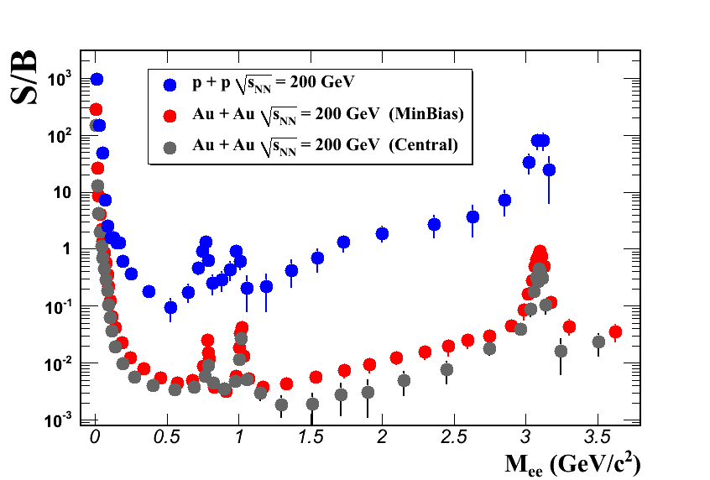
Dielectron Measurements
Intermediate Mass Range
  QGP thermal radiation
  heavy-flavor modification
Low Mass Range
  in-medium modification of vector mesons
  possible link to chiral symmetry restoration
Advantage:
  very low cross section with QCD medium
  created throughout evolution of the system
Disadvantage
  (very) low signal/background
  requires low material budget
Axel Drees

Slide 28
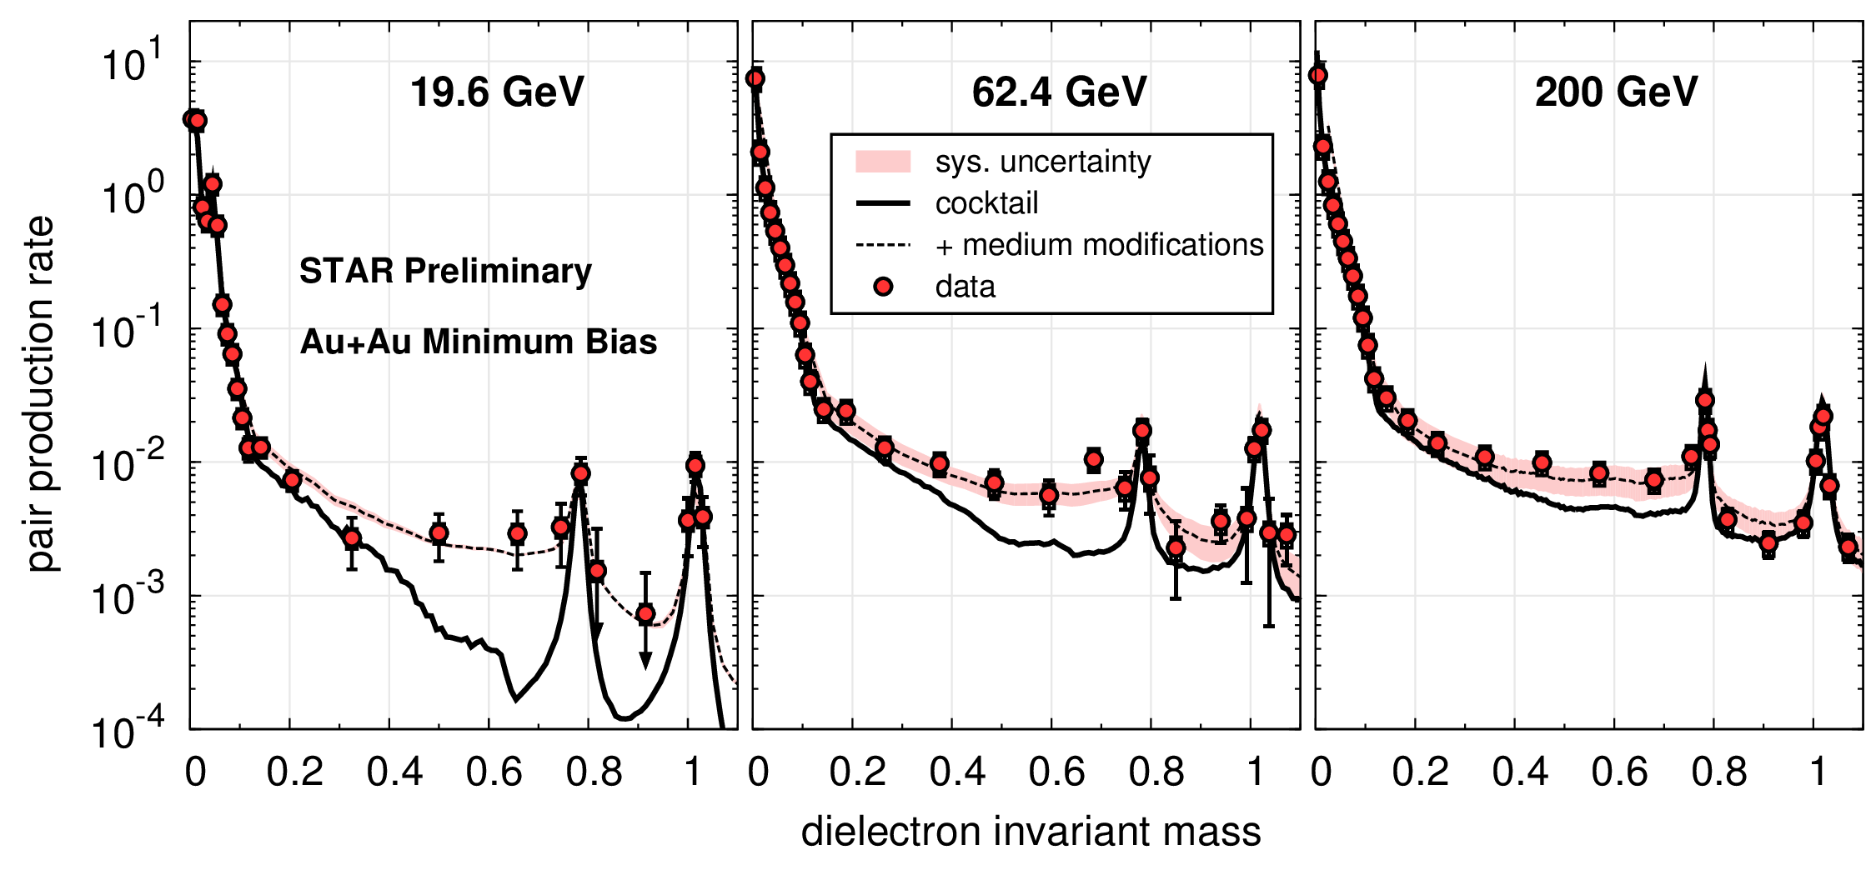
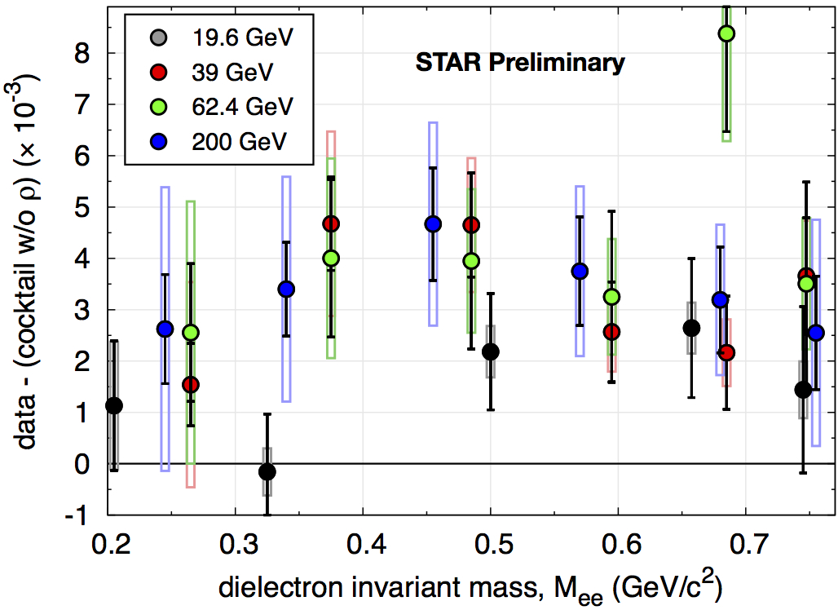
Beam Energy Scan: Dielectrons
Rapp, priv.comm.
LMR excess observed for all energies
systematic measurement of excess
Model calculations appear to provide robust description from RHIC down to SPS energies
Measurements consistent with in-medium ρ broadening
  expected to depend on total baryon density

Slide 29
STAR Upgrades: HFT +MTD
Heavy Flavor Tracker + Muon Telescope Detector on track for RHIC Run 14
  major focus: heavy-flavor & di lepton measurements
  revisit Au+Au, p+p, and p+Au at √s_{NN}=200 GeV
Separate charm and bottom, study open heavy flavor (HFT), quarkonia (MTD), thermal dileptons (MTD)
  combine HFT+MTD: separate secondary J/Ψ from prompt
  combine MTD+BEMC: trigger on e-μ pairs to disentangle charm contributions to the dilepton IMR
Muon Telescope Detector
Heavy Flavor Tracker

Slide 30



Concept of design of the STAR-MTD
Multi-gap Resistive Plate Chamber (MRPC):
gas detector, avalanche mode
A detector with long-MRPCs covers the
whole iron bars and leaves the gaps in-
between uncovered. Acceptance: 45% at
|η|<0.5
118 modules, 1416 readout strips, 2832 readout
channels
Long-MRPC detector technology, electronics
same as used in STAR-TOF
MTD

Slide 31


Quarkonium from MTD
J/ψ: S/B=6 in d+Au and S/B=2 in central Au+Au collisions
Excellent mass resolution: separate different upsilon states
With HFT, study B→J/ψ X; J/ψ→μμ using displaced vertices
Heavy flavor collectivity and color
screening, quarkonia production
mechanisms:
J/ψ R_{AA} and v₂; upsilon R_{AA} …
Z. Xu, BNL LDRD 07-007; L. Ruan et al., Journal of Physics G: Nucl. Part. Phys. 36 (2009) 095001

Slide 32

Heavy Flavor Tracker (HFT)
Inner Field Cage
Magnet
Return Iron
Outer Field Cage
FGT
TPC Volume
Solenoid
EAST
WEST

Slide 33
Heavy Flavor Tracker (HFT)
HFT
Detector | Radius (cm) | Hit Resolution R/ϕ - Z (μm - μm) | Radiation length
SSD | 22 | 20 / 740 | 1% X₀
IST | 14 | 170 / 1800 | <1.5 %X₀
PIXEL | 8 | 12/ 12 | ~0.4 %X₀
 | 2.7 | 12 / 12 | ~0.4% X₀
SSD
IST
PXL
PIXEL
two layers
18.4x18.4 μm pixel pitch
10 sectors, delivering ultimate Pointing resolution that allows for direct topological identification of charm.
New monolithic active pixel sensors (MAPS) technology
SSD
Existing single layer detector, double side strips (electronic upgrade)
IST One layer of silicon strips along the beam direction (r-φ) , guiding tracks from the SSD to PIXEL detector. - proven technology

Slide 34


Physics – Run-14,15 projections
R_{CP}=a*N10%/N(60-80)%
Assuming D⁰ R_{cp} distribution as charged hadron.
500M Au+Au m.b. events at 200 GeV.
Charm R_{AA} 
Energy loss mechanism!
Color charge effect!
Interaction with QCD matter!
Assuming D⁰ v₂ distribution from quark coalescence.
500M Au+Au m.b. events at 200 GeV.
- Charm v₂ 
Medium thermalization degree
Drag coefficients!
34

Slide 35
STAR Contributions at Conference
Monday
  Olga Rusnakova - Non-photonic electrons measurements in STAR
  16:40 – 17:05 Room A2
Thursday
  Barbara Trezeciak - J/Ψ production in the STAR experiment
  15:25 – 15:50 Room
  Petr Chaloupka – Upsilon production at the STAR experiment
  15:50 – 16:15 Salon de Honor
Thursday (RHIC presentation)
STAR Spin results will be included in the presentation by Elke Aschenauer on RHIC spin,
“The Quest for the Spin of the proton – Results from RHIC”
12:15 – 12:50 Salon de Honor

