Slide 1
ρ⁰ Vector- Meson Production and Elliptic Flow (v₂)
in STAR at RHIC
Prabhat Pujahari for the STAR Collaboration
Indian Institute of Technology Bombay
DAE - NP, Pilani 20 – 25 Dec.10
π⁺
Mass : 775.5 +- 0.4 MeV
Width: 149.4+- 1.0 MeV
B. R. ~ 99.8 %
cτ ~ 1.3 fm
π⁻
ρ⁰

Slide 2
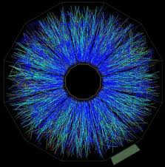
Outline
Motivation
Data Analysis & Results
Cu + Cu @200 GeV
a) Invariant mass distributions.
b) ρ⁰ transverse momentum spectra.
c) <p_{T}> distributions.
e) Particle ratios.
Au + Au @200 GeV
a) Elliptic Flow
Summary and Outlook
ρ⁰
π ⁻
π ⁺

Slide 3
Motivation - I
Leptonic decay products are measured directly as they do not interact, but hadronic decay products are sensitive to the medium.
If ρ⁰ decays before kinetic freeze-out ⇒ not reconstructed due to rescattering of daughters
Chemical freeze-out ⇒ elastic interactions π⁺π⁻ → ρ⁰→ π⁺π⁻ regenerate ρ⁰ until kinetic freeze-out
Is the regeneration and rescattering driven by the hadron cross-sections?
π⁻
ρ⁰
π⁻
π⁺
ρ⁰
ρ⁰ measured
π⁻
ρ⁰ lost
ρ⁰
π⁺
π⁻
π⁺
ρ⁰
ρ⁰ regeneration ⇒ σ(ππ)
ρ⁰ daughter rescattering ⇒ σ(pπ) and σ(Kπ)
σ(ππ) > σ(Kπ)
σ(pπ) > σ(ππ)
π⁺
π⁺
π⁻
ρ⁰ measured
Chemical freeze-out
Kinetic freeze-out
time

Slide 4
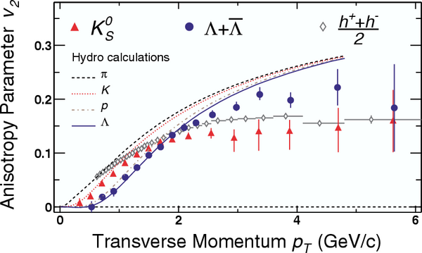
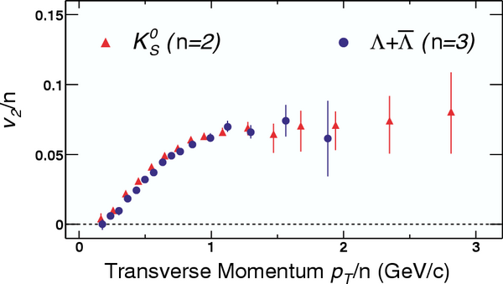
Motivation - II
Physics is different in different transverse
momentum ( p_{T}) regions.
0 < p_{T} ≤ 1.5 GeV/c ➔
Hydrodynamics applies
1.5 < p_{T} ≤ 5 GeV/c ➔
Coalescence/recombination
model works
p_{T} ≥ 5 GeV/c ➔
Contribution from jets fragmentation
Number of Constituent Quark(NCQ)
scaling at intermediate p_{T}(2=mesons,
3=baryons) Indication of
partonic degrees of freedom.
ρ⁰ production mechanism.
⇒ scale NCQ ⇒ v₂/n
π⁺π⁻ → ρ⁰ ⇒ n = 4
qq → ρ⁰ ⇒ n = 2
Phys. Rev. Lett. 92 (2004) 52302

Slide 5
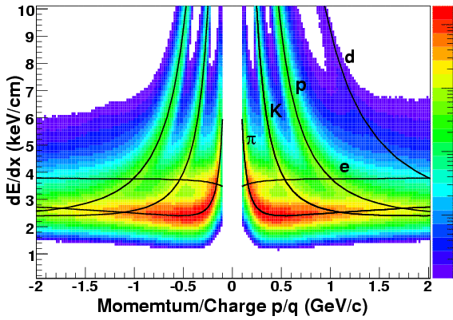
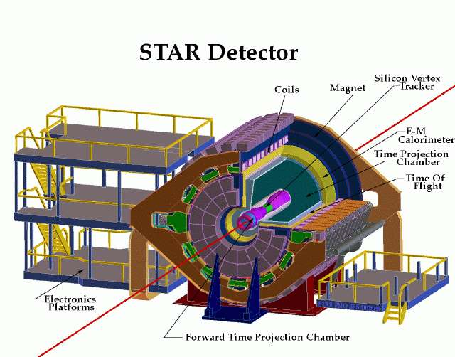
STAR Experiment
We used the Cu+Cu and high statistics Au+Au 200 GeV data to measure the ρ⁰ observables for this study.
STAR TPC is used to identify pion via
dE/dx in TPC gas.

Slide 6
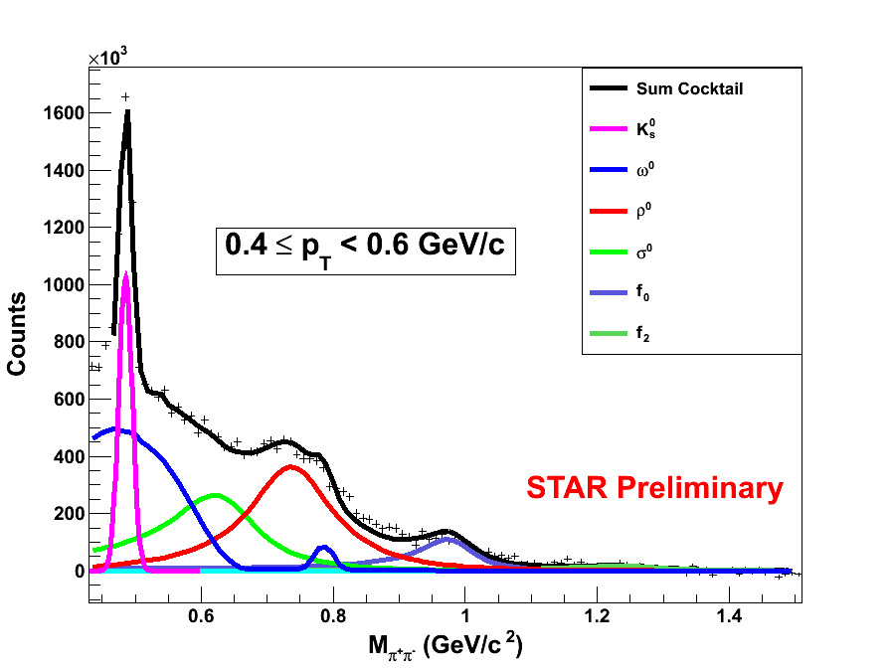
The Measurement
Final background subtracted M_{π+π-} invariant mass distribution fitted with a cocktail
function to extract the ρ⁰ yield.
Hadronic cocktail
K_{s}⁰ is fitted to a gaussian function.
ω⁰ and K* shapes obtained from
HIJING event generator.
ρ⁰,σ⁰, f₀ and f₂ are fitted with
relativistic Breit-Weigner times
the Boltzmann factor which takes the
phase space in account.
( p-wave BW for ρ⁰ and s-wave BW
for the scalar mesons)
The masses of K_{s}⁰ and ρ⁰ are free parameter in the above fit.
The ω⁰, f₀ and f₂ masses are fixed according to PDG values .
The ρ⁰, f₀ and f₂ widths are fixed in the cocktail fit.
The mass and width of σ⁰ is fixed at 630 MeV/c² and 160 MeV/c² respectively.

Slide 7
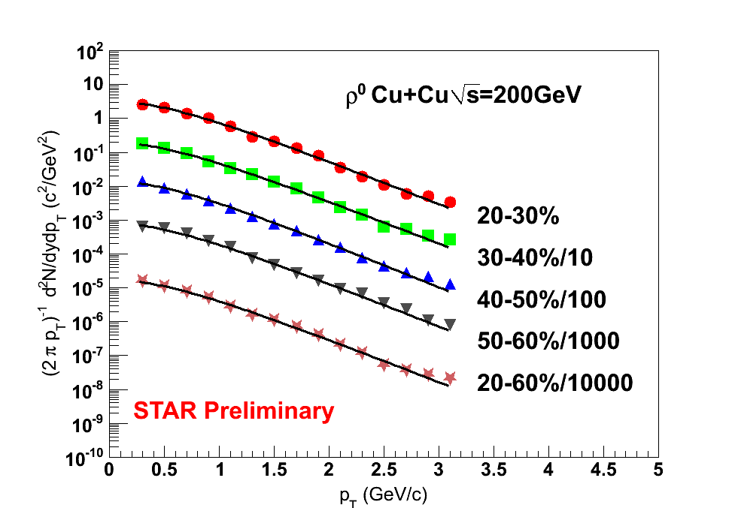
Transverse Momentum(p_{T}) Spectra
Fit with exponential function
extract the Yield and slope parameter
Small error bars shown here is only statistical.
Small signal to background ratio prevents the measurement in central collisions (~1/1000).
Solid lines ⇒ exponential fits.

Slide 8
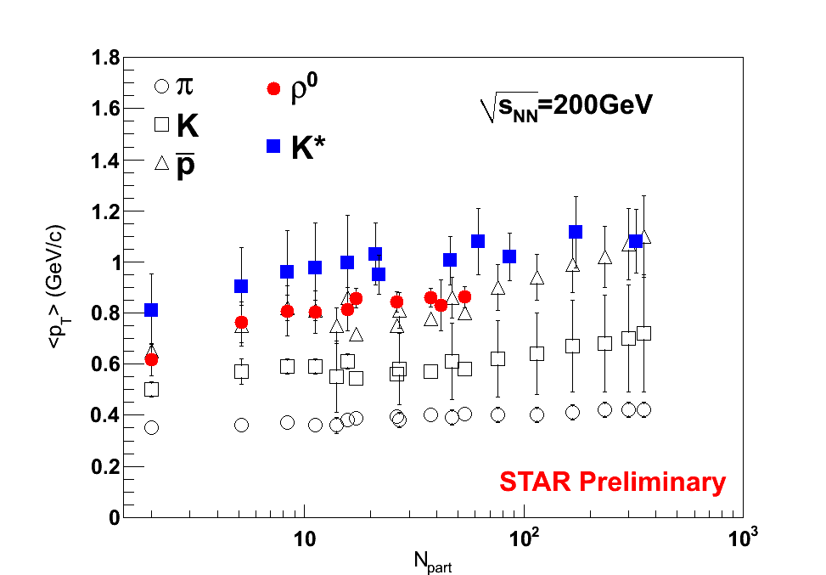
Mean p_{T} Distributions
The
of
π, K, and K*
is taken from STAR published
results.
ρ⁰ in p+p, Au+Au 200 GeV: Phys. Rev. Lett. 92 (2004) 92301
ρ⁰ in d+Au 200 GeV:
Phys. Rev. C 78 (2008) 44906
For ρ⁰ in Cu+Cu only statistical error.
ρ⁰ mean p_{T} slightly increases with N_{part}.
ρ⁰ mean p_{T} comparable with proton mean p_{T}.

Slide 9
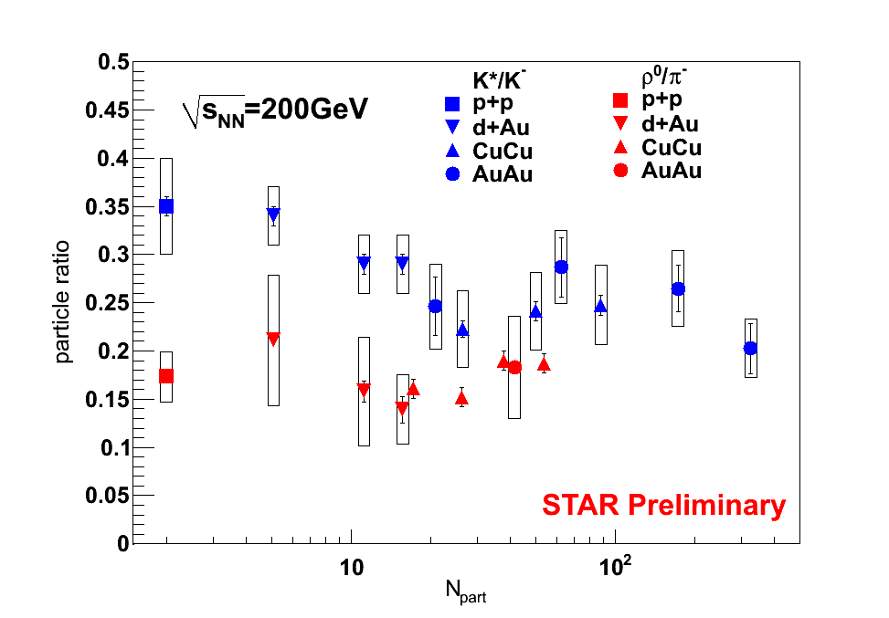
Particle Ratios
K*/K⁻ ratio is obtained
From STAR published results.
Cross-section ⇒ regeneration or rescattering.
K*/K⁻ ⇒ rescattering of the daughters.
ρ⁰/π⁻ ⇒ regeneration compensating rescattering of the daughters.

Slide 10
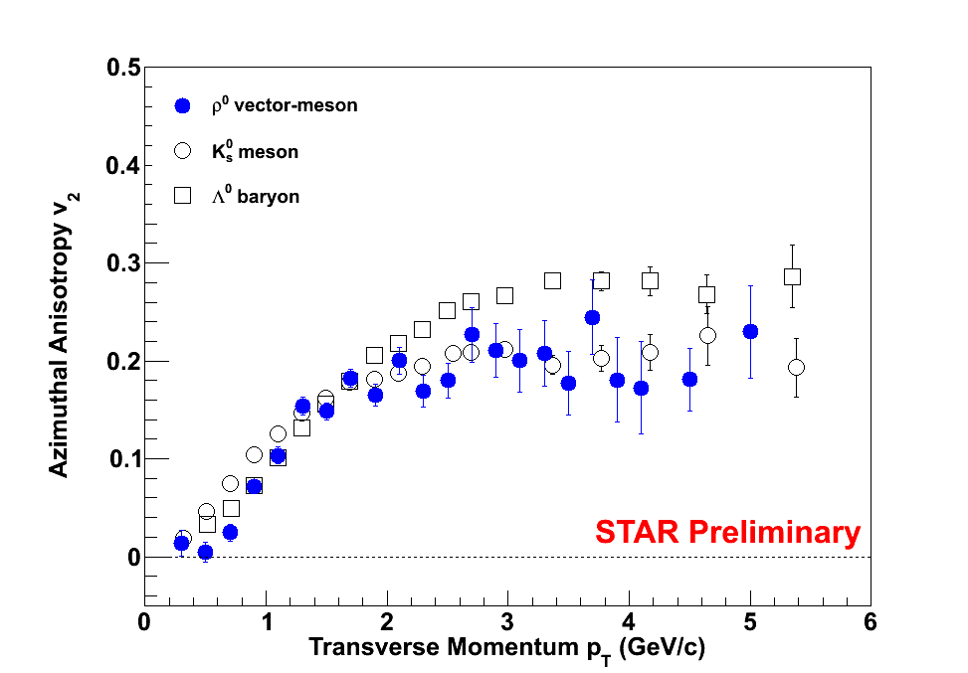
v₂ as a function of p_{T}
40% - 80% peripheral Au+Au collisions
Only statistical error
For p_{T} > 1.5 GeV/c, v₂ of ρ⁰ is more
consistent with v₂ of K_{s}⁰ then v₂ of Λ⁰ .
K_{s}⁰ and Λ⁰ v₂ results are obtained from Phys. Rev. C 77 (2008) 54901

Slide 11
Summary
ρ⁰ production ( from π⁺π⁻ invariant mass reconstruction) is studied in
Cu+Cu collisions at √s_{NN} = 200 GeV .
ρ⁰/π⁻ and K*/K⁻ ratios were compared in different collision systems and different
collision centralities.
Regeneration and/or re-scattering is driven by hadronic cross-sections.
K* ⇒ Re-scattering of daughters.
ρ⁰ ⇒ Regeneration compensating Re-scattering of the daughters.
First time we have discussed the preliminary ρ⁰ elliptic flow
results obtained in higher statistics Au+Au 200 GeV collisions.

Slide 12
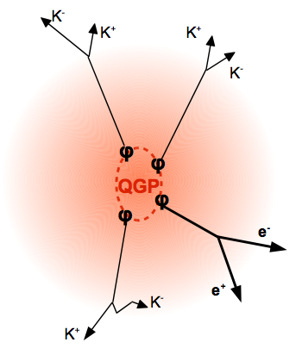
The Future …
Further interesting predictions can be investigated using ρ⁰
vector-meson observables
ρ⁰ di-lepton decay channel is a very clean
probe from the early stage (e⁺⁻ do not interact
strongly)
ρ⁰
e⁺ e⁻
Good channel to search for modifications of
hadrons properties due to the hot medium.
Will be a challenge: (B.R ~ 10⁻⁵)
ρ⁰
e⁺ e⁻
STAR Full barrel Time of Flight (TOF) detector
(installed 2009) will be a huge asset in making
this measurement.

