Slide 1
Measurement of D-meson azimuthal anisotropy
in Au+Au 200GeV collisions at RHIC
Michael R. Lomnitz
Kent State University
Lawrence Berkeley National Laboratory
for the STAR Collaboration

Slide 2
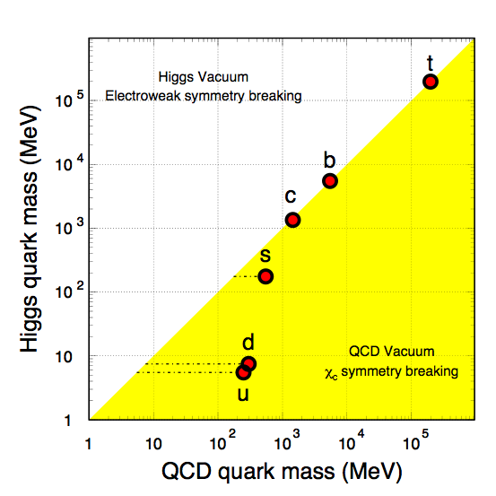
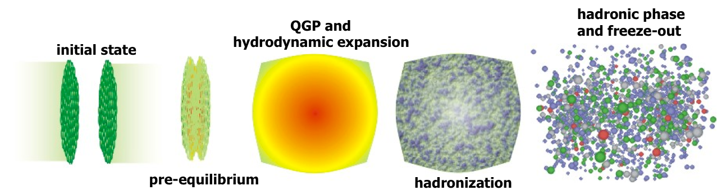
Motivation
Charm quarks:
Produced early in heavy ion collisions at RHIC, through hard scattering
Experience the whole evolution of the system -> good probe for medium properties
Physics interest:
High p_{T}: test different energy loss mechanisms: radiative vs collisional
At low p_{T}: extract medium properties from
motion of heavy quarks in medium
(Brownian motion), e.g.
diffusion coefficient
X. Zhu, et al, Phys. Lett. B647, 366(2007).

Slide 3
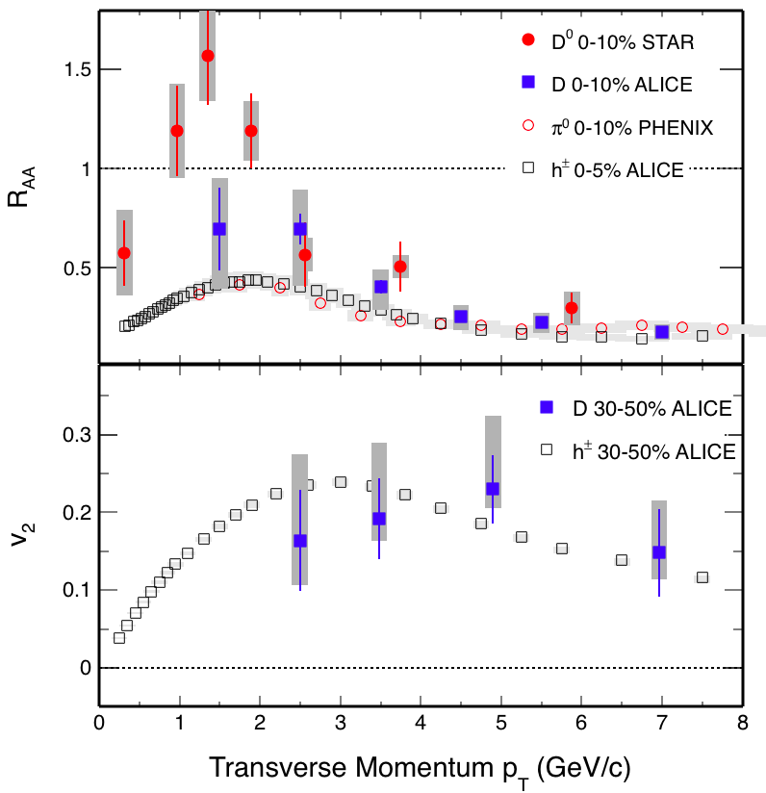
Recent developments and understanding
RHIC and LHC: D-meson R_{AA} suppression at high p_{T} : strong charm-medium interactions
D⁰ v₂ LHC results are compatible with light flavor v₂, charm thermalized?
v₂ and R_{AA} can be used simultaneously to constrain models
What is occurring at low p_{T} at RHIC?
Low p_{T} v₂ is especially sensitive to the partonic medium: scattering strength, transport properties
For R_{AA} talk see G. Xie (Monday 15:10)
STAR:PRL 113 (2014) 142301
PHENIX:PRL 101 (2008) 232301
ALICE: PRL 111 (2013) 102301
arXiv:1509.06888 (2015)
Notes:
First one is too general, give detailed information v2
Before 2nd bullet, high pt suppresion is strong charm-medium interactions,
Third poit also consistence , also siggests charm is thermalized
Enhancement at low pt consistent with models with coalescence + finite flow
Move reference to Guannan’s talk to bottom or corner somewhere Shorten last point, get rid of the details
Fix references

Slide 4
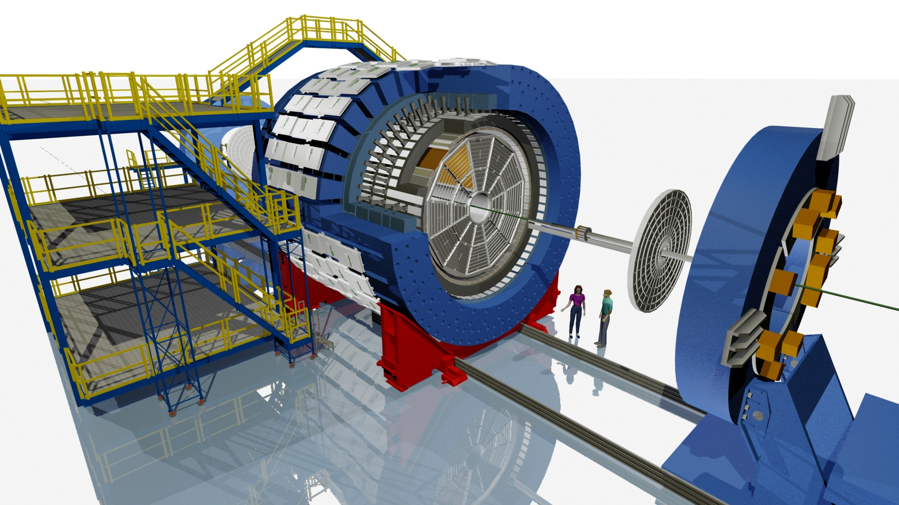
STAR experiment
TPC:
Tracking,
PID (dE/dx)
TOF:
PID (1/β)
-1<η<1, 0≤ϕ<2π
VPD:
Min-Bias trigger
Heavy Flavor Tracker:
Silicon Strip Detector
Intermediate Silicon Tracker
PiXeL
Notes:
Change the 30 microns to number at 1 GeV
V

Slide 5
STAR experiment
TPC:
Tracking,
PID (dE/dx)
TOF:
PID (1/β)
-1<η<1, 0≤ϕ<2π
VPD:
Min-Bias trigger
Heavy Flavor Tracker:
<50 μm pointing resolution for kaons @ 750MeV/c
Thinned Monolithic Active Pixel Sensor technology
Low material budget (0.4% X₀ for inner most layer)
See talk by G. Contin (Tuesday 15:00)
Notes:
Change the 30 microns to number at 1 GeV
V

Slide 6
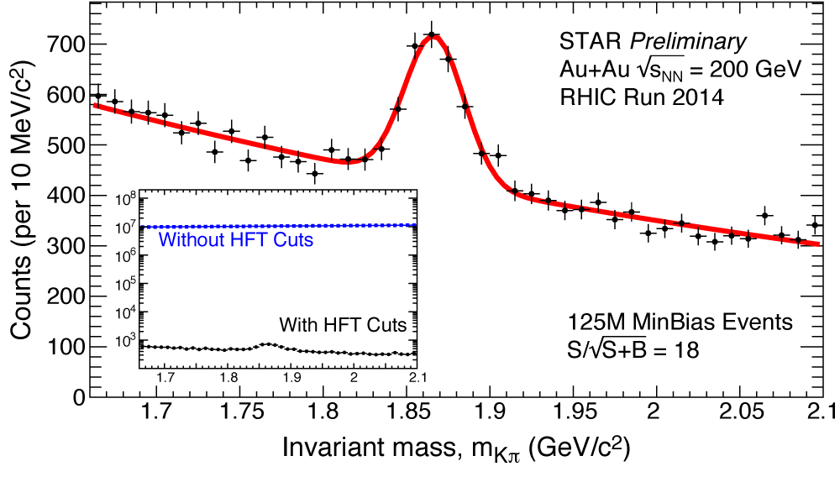
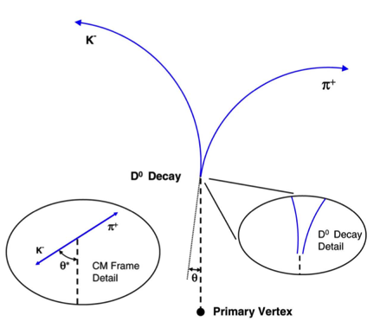
D⁰ reconstruction
Direct topological reconstruction through channel:
Greatly reduced combinatorial background (4 orders of magnitude)
Topological cuts optimized using TMVA (Toolkit for Multivariate Analysis)
Notes:
Update BR ratio to 3.89

Slide 7
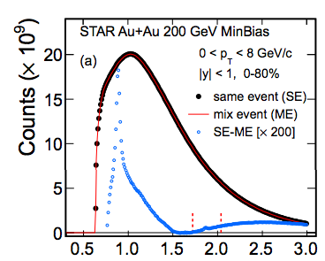

D⁰ reconstruction using HFT
Significance greatly enhanced compared to STAR previous, 2010+2011 results.
 | w/o HFT | w HFT
 | 2010 + 2011 | 2014
# events(MB) analyzed | 1.1 B | 780 M
sig per billion events | 13 | 51
STAR Preliminary
STAR Preliminary
STAR 2010/11
STAR: PRL 113 (2014) 142301
Notes:
Change the number of events to actual number
Make comparison between significance’s as a function of no. events

Slide 8
v₂: Event plane method
Event plane reconstructed using charged hadrons within STAR TPC acceptance (|η|<1)
Corrected for detector acceptance
Yields in φ−Ψ bins corrected for event plane resolution
Δη gap of ~0.15 used in event plane reconstruction
Non-flow estimated from measured D-h correlations in p+p 200GeV
STAR Preliminary
p+p
Au+Au
  A.M. Poskanzer, et al. PRC 58 (1998) 1671
  STAR: PRL 93 (2004) 252301
Notes:
Too technical, fix this

Slide 9
v₂: Two particle correlation
Event by event v₂ for foreground and background
h₁ in η < 0, h₂ in η>0
Statistically subtract background from foreground to obtain D⁰ v₂
Corrected for detector acceptance
STAR Preliminary
  A.M. Poskanzer, et al. PRC 58 (1998) 1671
For details see poster by L. He (Exhibition space 4)
Notes:
Phi flattening plot is too technical, slide needs to be simplified.
Have plot of v2 vs invariant mass, and signal extraction and v2’s

Slide 10
D^{+/-} reconstruction
Direct topological reconstruction through channel:
Yield in plane and out of plane obtained following event plane method
STAR Preliminary
STAR Preliminary
D^{+/-} yield in and out of plane
Notes:
Missing plot, show in and out of plane signal’s themselves
Focus big on signal plot!

Slide 11
D Meson v₂
STAR Preliminary
D⁰ azimuthal anisotropy significantly different from zero for p_{T} > 2 GeV/c
( χ²/n.d.f. = 17.5/4 )
B->D feed down is negligible at RHIC energies (<5% relative contribution)
Notes:
This slide should include only data results, left slide remove theory and do chi test against hadrons

Slide 12
D Meson v₂
STAR Preliminary
Good agreement between EP and 2 PC methods within systematics
Notes:
This slide should include only data results, left slide remove theory and do chi test against hadrons

Slide 13
D Meson v₂
STAR Preliminary
D^{+/-} v₂ compatible with D⁰ albeit within large error bars
Notes:
This slide should include only data results, left slide remove theory and do chi test against hadrons

Slide 14
Comparison to experiment
STAR Preliminary
D⁰ v₂ is below light hadrons for 1 < p_{T} < 4 GeV/c
  ( χ²/n.d.f. = 9.6/3 )
STAR:PRC 77 (2008) 54901
Notes:
This slide should include only data results, left slide remove theory and do chi test against hadrons

Slide 15
Model comparison: TAMU
Full T-matrix treatment, non-perturbative model with internal energy potential
Diffusion coefficient extracted from calculation 2πT x D = 2-7
Good agreement with D⁰ meson v₂ at low p_{T}, data favors model including c quark diffusion in the medium
  ( w/ c diff. χ²/n.d.f. = 1.8/5 )
  ( w/o c diff. χ²/n.d.f. = 7.4/5 )
- χ² tests done to v₂
STAR Preliminary
  Theory: arXiv:1506.03981 (2015) & private comm.
  STAR: PRL 113 (2014) 142301
STAR Preliminary
Notes:
Don’t wait for plots to improve themselves

Slide 16
Model comparison: SUBATECH
pQCD+HTL calculation with latest EPOS3 initial conditions
Diffusion coefficient extracted from calculations 2πT x D ~ 2-4
Good agreement between model and experiment for both v₂ and R_{AA} in entire p_{T} range
  ( χ²/n.d.f. = 2.8/5 )
  - χ² tests done to v₂
STAR Preliminary
  Theory: arXiv:1506.03981 (2015) & private comm.
  STAR: PRL 113 (2014) 142301
STAR Preliminary
Notes:
Don’t wait for plots to improve themselves

Slide 17
Model comparison: Duke
Diffusion coefficient is a free parameter, fixed by fitting to R_{AA} at high p_{T}
Input value for diffusion coefficient 2πT x D = 7 fixed to fit LHC results
Model with 2πT x D = 7 doesn’t describe the magnitude of v₂ in experimental data
STAR Preliminary
  Theory: arXiv:1505.01413 & private comm.
  STAR: PRL 113 (2014) 142301
STAR Preliminary
Notes:
Don’t wait for plots to improve themselves

Slide 18
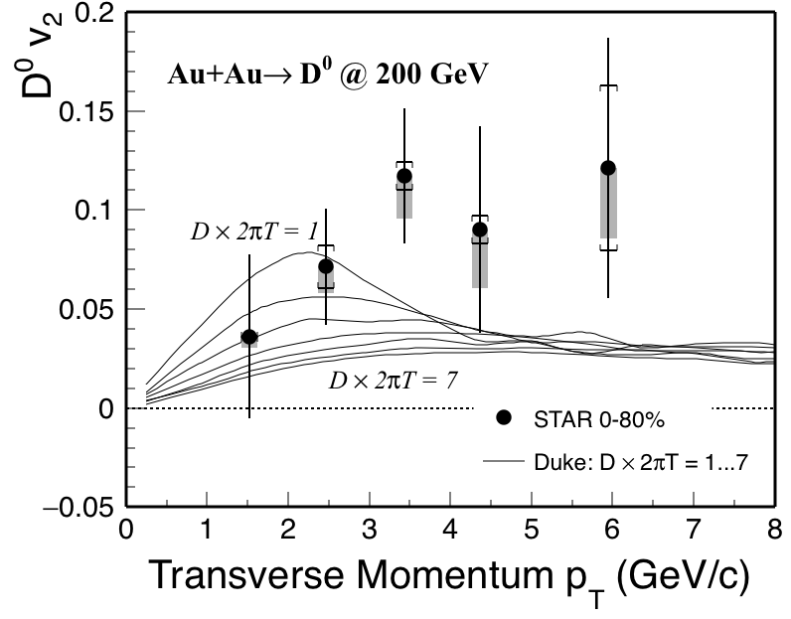
Charm diffusion coefficient
STAR Preliminary
Scan different values of the diffusion coefficient to find best agreement to data
Best agreement for diffusion coefficient 2πT x D = ~1 – 3
This model seems to underestimate the data for p_{T} > 3 GeV/c
  Theory: arXiv:1505.01413 & private comm.
Notes:
Model systematically lower than data at high pt

Slide 19
Diffusion coefficient
Compatible with models predicting a value of diff. coefficient between 2 to ~10
Lattice calculations, although with large uncertainties, are consistent with values inferred from data
Notes:
This 2 plts need to merge and include STAR data point, discussions

Slide 20
Outlook
Run 14:
  Full statistics available soon
Run 15:
    Full aluminum cables for inner layer of PXL
  p+p and p+A data sets with HFT
Run 16:
  Full aluminum cables for inner layer of PXL
  Factor 2 -3 improvement for D⁰ significance @ 1 GeV -> centrality dependence for v₂
Year | System | Events(MB)
Run 14:
 | Au+Au | 1.2 B
Run 15:
 | p+p | 1 B
 | p+Au | 0.6 B
Future
Run 16:
 | Au+Au | 2 B
Notes:
Run14 will have full statics
Run 15 pp and pA
Run16 full aluminum cables, SSD and 2 billion -> significance improvement 2-3 for 1 GeV D0 -> centrality dependence

Slide 21
Summary
STAR Preliminary
D⁰ v₂ is finite for p_{T} > 2.0 GeV/c
D⁰ v₂ lower than light hadrons for 1< p_{T} < 4.0 GeV/c
Data favor model scenario where charm quarks flow
D⁰ v₂ and R_{AA} can be described simultaneously by models and are consistent with values of 2πTxD between 2 and ~10
Looking forward to improved statistics in year 2016
Notes:
Put plot of D0 v2 vs model caluclations, plot of extracted D vs model calculations

Slide 22
Thank you!

Slide 23
Back ups

Slide 24
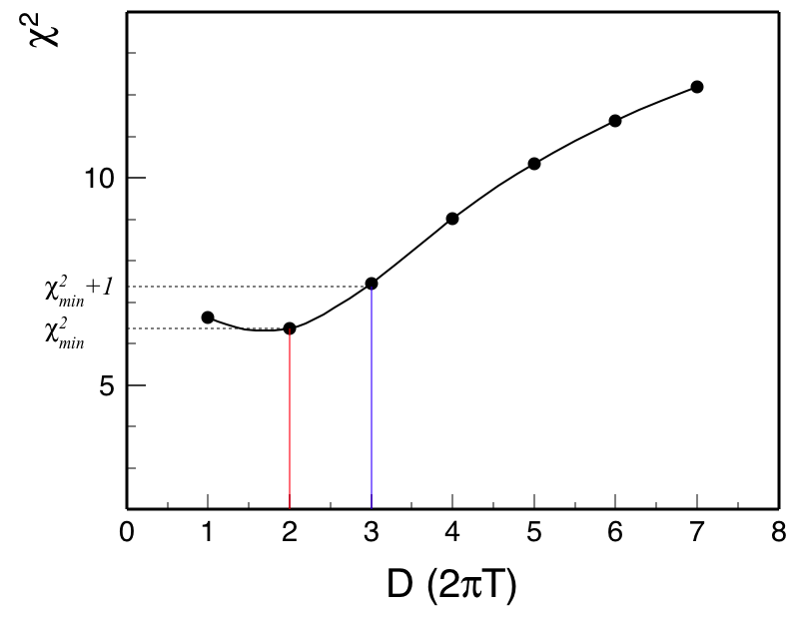
Diffusion Coefficient from DUKE
STAR Preliminary

Slide 25
Comparison to ALICE
STAR Preliminary
STAR Preliminary
STAR Preliminary
Notes:
This slide should include only data results, left slide remove theory and do chi test against hadrons

Slide 26
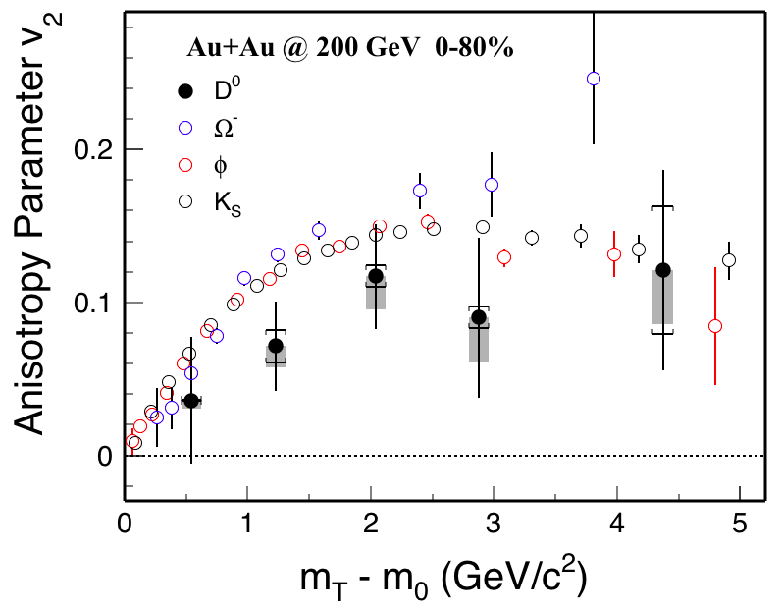
Mass Effect
STAR Preliminary
Notes:
This slide should include only data results, left slide remove theory and do chi test against hadrons

