Slide 1
STAR Forward Calorimeter System Assembly at BNL
10/17/19
Andrew Edwards
Valparaiso University
For the STAR Collaboration

Slide 2
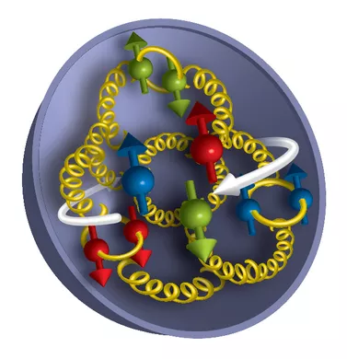
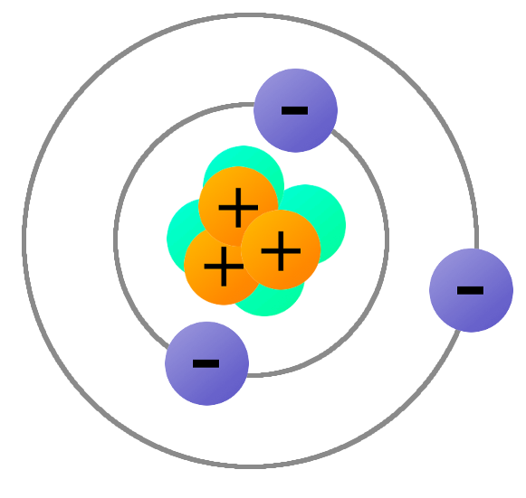
Proton Structure and Spin
Gluon
Sea quark pair
Proton
Valence quark
Proton at high energy
Atom
Notes:
Label proton, gluon

Slide 3
Motivation: Proton Spin
The proton has an intrinsic spin of ½ ħ
• Each of the proton’s internal components (quarks and gluons) contribute to the overall spin.
• Quarks only contribute a small fraction < 30%
• What are the gluons contributing? The remaining 70%?
• What is the contribution from the orbital angular momentum of quarks and gluons?

Slide 4
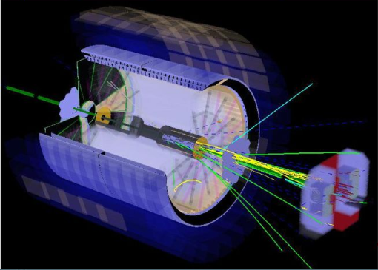
Motivation: STAR
The Relativistic Heavy Ion Collider (RHIC) facility at Brookhaven National Laboratory is the only polarized proton beam collider in the world.
Collisions happen in the Solenoidal Tracker at RHIC (STAR), a detector 3 stories high.
STAR is in the process of installing an upgrade with several new sub-detectors in the forward region.

Slide 5
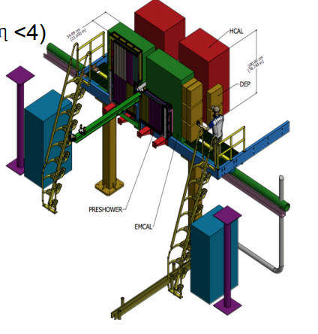
The STAR Forward Upgrade
Includes a new Tracking and Calorimeter System
Forward Calorimeter System (FCS):
STAR’s first hadronic calorimeter (HCal) and a forward electromagnetic calorimeter (ECal)
Planned for completion by 2021

Slide 6
Overview of Contributions
Prepared 1500 ECal towers from PHENIX detector for use in STAR FCS
Processed 600 scintillator tiles for HCAL

Slide 7
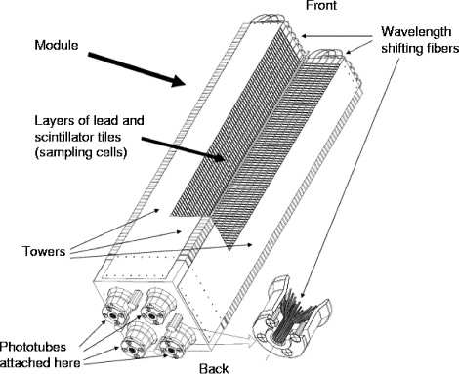
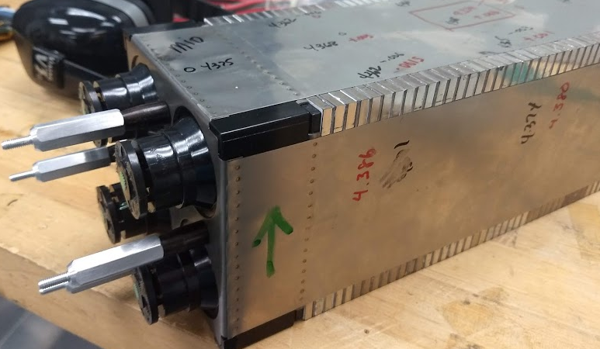
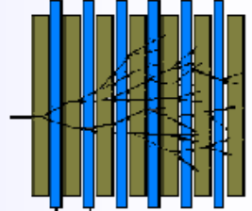
Calorimeter Structure
SiPMs/FEE card mounted here
Photons trigger a shower in the sampling cell.
Notes:
Some particle like a photon or an electron is headed toward the calorimeter, and "hits" it, I guess (you may not need the word "hit"). It showers in the calorimeter. The lead layers develop the shower. Charged particles in the shower deposit energy in the plastic scintillators, where it's turned into light. There are wavelength shifting fibers that run the length of the tower (looping through it), collect light from the scintillator, shift it to a wavelength more compatible with the SiPM and route it to your light guide and SiPM.
So, I guess you could say that the fibers collect photons. But, often when we say "photon" in a collider context we're referring to high energy photons, like from the decay of a pi0. The fibers are collecting more pedestrian, lower energy light emitted by the plastic scintillator layers. Usually we'd just say they collect "light" from the scintillator. The light guides then mix light from multiple fibers into one channel of electronics. Optical fibers are different from wires (which typically carry electricity, not light)

Slide 8
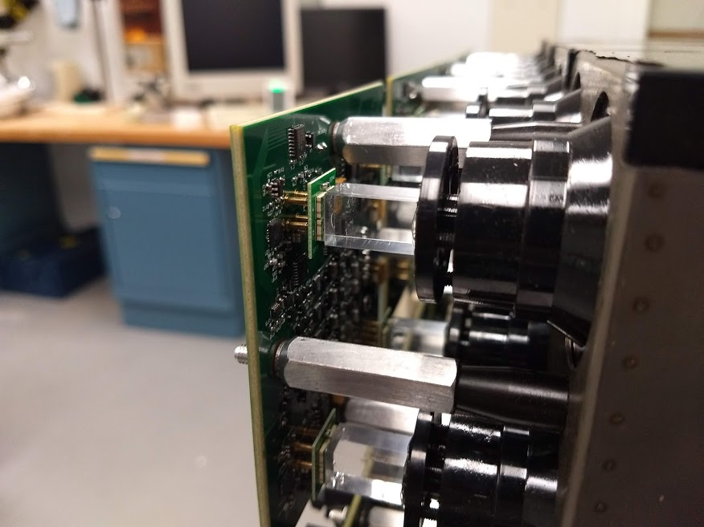
Gluing ECal Light Guides
Several supermodules originally used in the PHENIX detector have been repurposed for the STAR forward upgrade.
Light guides/mixers were installed in order to optimize the connection to the new silicon photomultiplier (SiPM) readout.
Front-End Electronics (FEE) card (digital readout)
SiPM board
(converts to electric signal)
Light guide (combines signals from multiple fibers into readout)
Fiber bundle (collects light from shower)
Notes:
These are the pieces of the detector, explain that this is a new version applies same principles

Slide 9
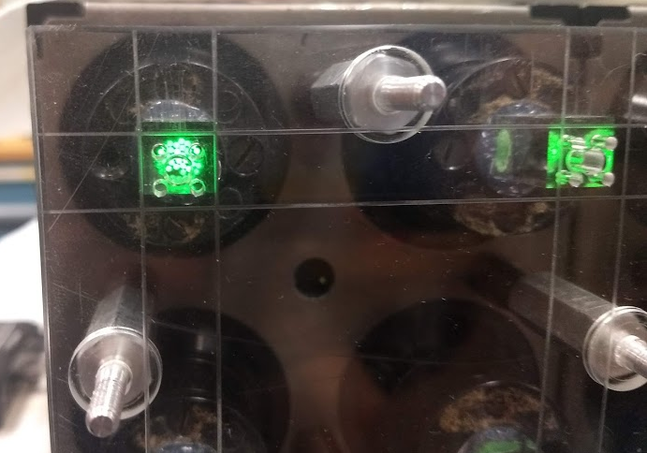
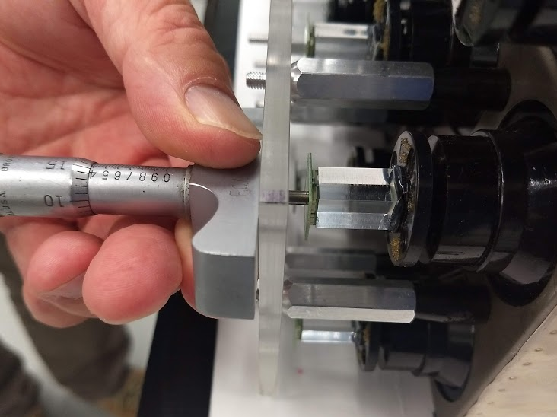
Quality Assurance Measurements
We needed to check the alignment of the modules, FEE cards, and light guides
The average variation in all three coordinate dimensions was within tolerances for this coupling.

Slide 10
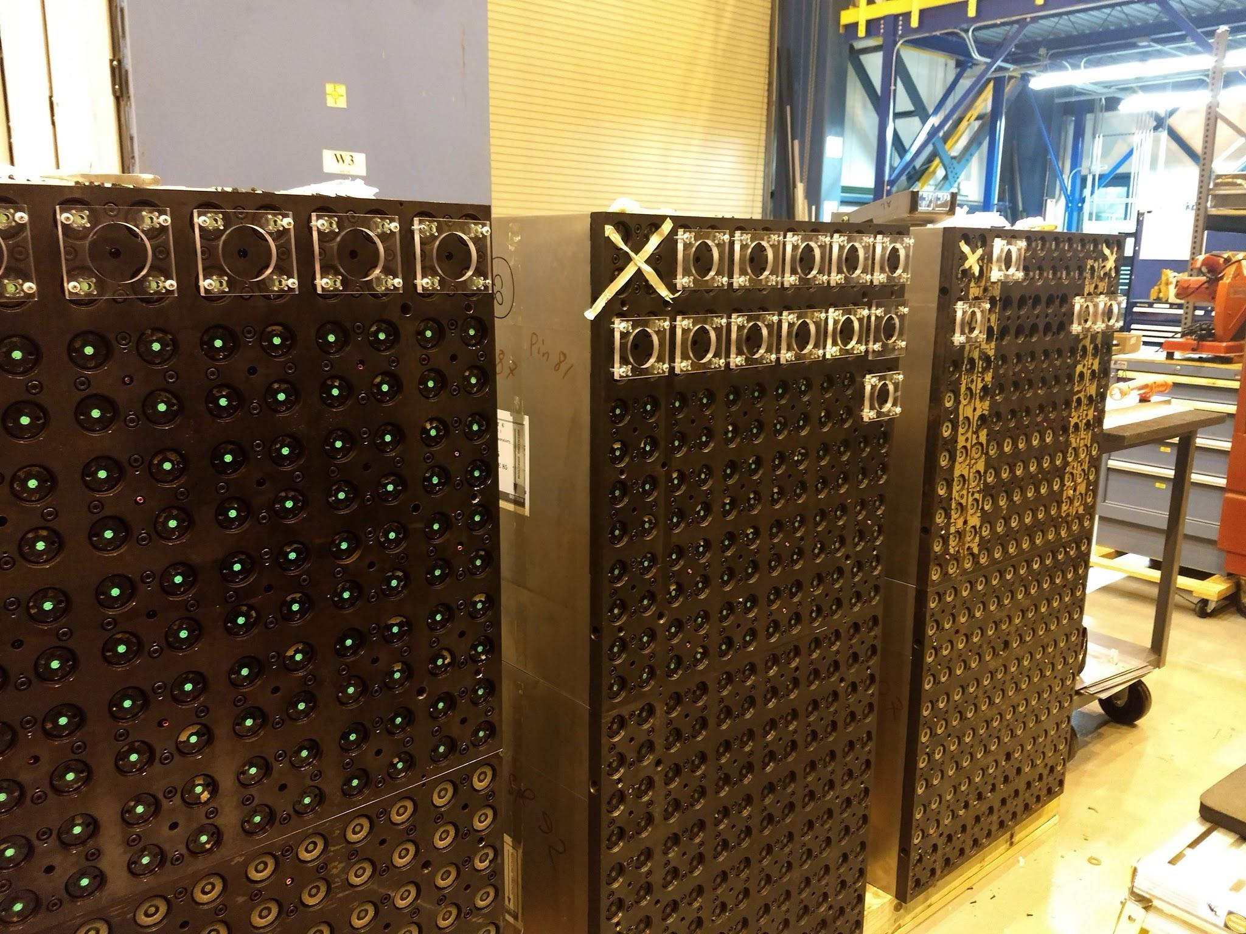
ECal Summary
We glued 1500 light guides to all 1500 channels, a process which took ~4 weeks.
We checked a sample of 31 modules and found that all were within tolerances for the connection to the SiPMs.
All ECal modules are ready for installation.

Slide 11
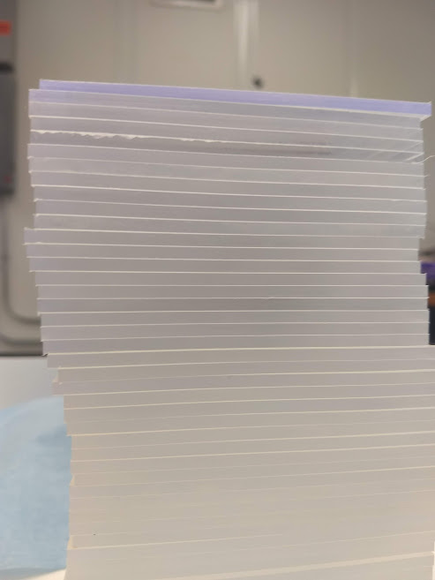
Scintillators for the HCal
The new hadronic calorimeter will require 18,720 scintillating tiles. The machining, polishing, and painting of these tiles will be accomplished over the next months at contributing universities.
We polished and painted the first batch of 600 tiles, machined at UCLA.
The tiles are 95x97 mm; the longer sides are polished while the shorter sides are painted.

Slide 12
Polishing Procedure
Tiles are marked to easily distinguish 95 vs 97 mm sides.
The polish is placed on the rotating table, which is set to spin at a moderate speed. Tiles are held vertically so that the polish flows beneath them. Changing the location of the tile on the rotating surface and twisting back and forth helps ensure even polishing.
Finally, the surface and edges are wiped and the tile is visually inspected to ensure that polishing is complete.

Slide 13
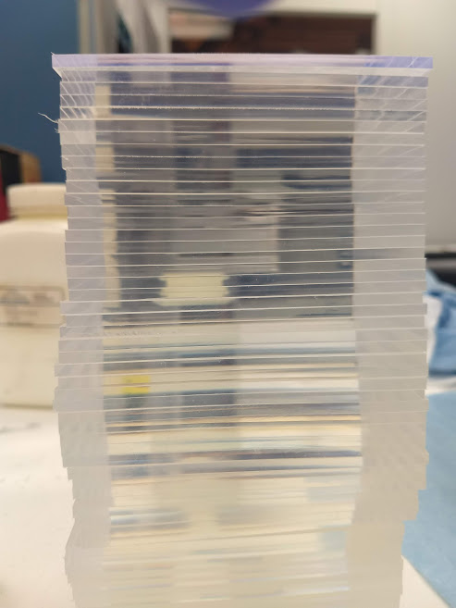
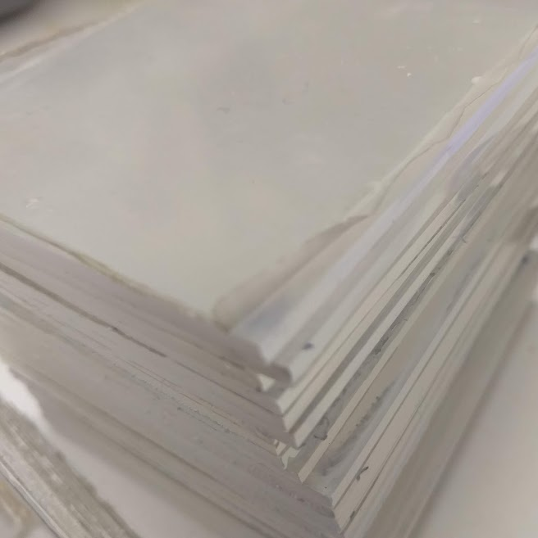
Polishing Results
Visual inspection: easier to check a stack than individual tiles

Slide 14
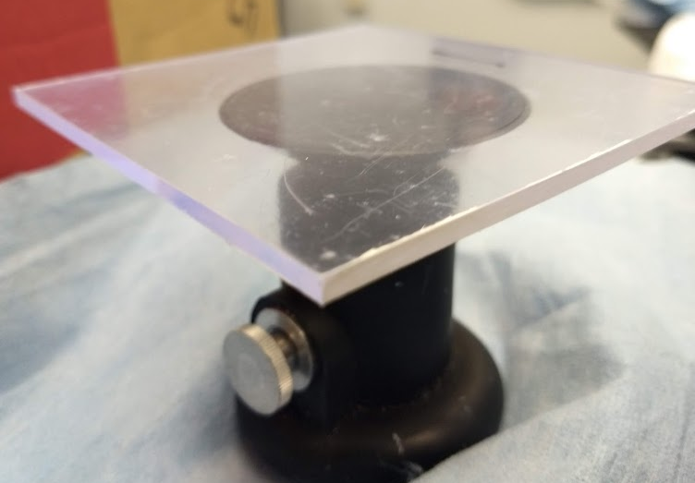
Painting and Packaging
Tiles are held with suction cups while painting and stacked with O-ring spacers to dry.
Two coats of reflective paint are used.
After painting, the protective film is removed and the tiles are individually packaged.

Slide 15
Conclusion/Ongoing work
ECal: 1500 towers ready for installation.
HCal: First batch of scintillators processed, 100% acceptance rate, procedures established.
Installation of ECal will take place over the course of October. The platform which will support both calorimeters is nearly complete as of the end of September.
Approximately 10% of the aforementioned 18,720 tiles have been manufactured and their preparation is ongoing.

Slide 16
Acknowledgements
Oleg Tsai, UCLA
Valparaiso University
STAR Collaboration
Brookhaven National Laboratory
Department of Energy Office of Science

