Slide 1
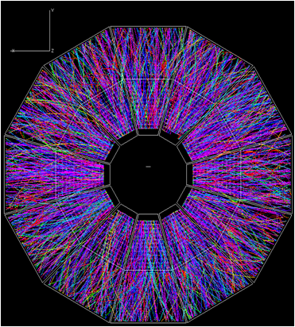
Asymmetric dihadron azimuthal correlations in Au+Au collisions at 200 GeV
Joshua Konzer
Purdue University
STAR Collaboration

Slide 2
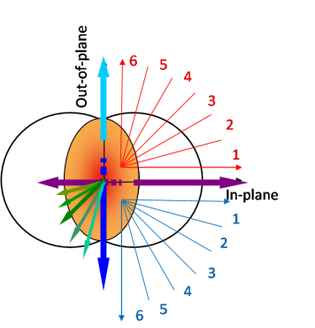
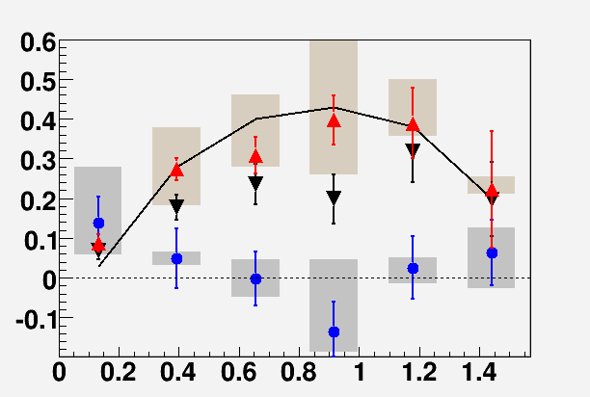
QM 2009 Results
AuAu √s_{NN} = 200GeV; 20-60% Centrality
Dihadron Correlations separated into 12 different groups/slices depending on φ_{s} = φ_{Trig} – ψ_{EP}
STAR Preliminary
trigger pt=3-4 GeV/c
CEM model
Ridge
Jet is symmetric and remains constant as φ_{s}→90º.
Ridge is Asymmetric and decreases as φ_{s}→90º!
Ridge may be due to
jet-flow alignment.
Ridge: assoc pt=1-1.5 GeV/c
Ridge: assoc pt=1.5-2 GeV/c
Jet: assoc pt=1.5-2 GeV/c
Jet
2
in-plane
|φ_{s}|= φ_{trig} – ψ_{RP}
Out-plane

Slide 3
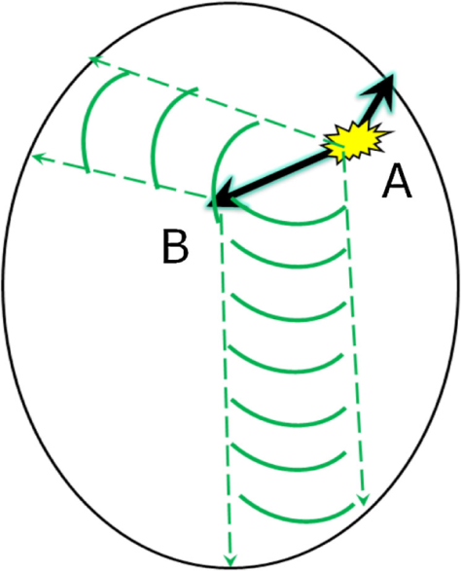
4-Gaussian Fit
Flow subtracted signal includes jet, ridge, away-side ridge?, and away-side double peak
Need to remove jet to get to ridge; Δη > 0.7
Away-side asymmetry
Away 1
RP
Ridge
Jet
Trig.
Away 2
Jia et al, PRL 103 (2009) 022301
Fit with 4 Gauss to analyze features
Away-side pathlength sensitivity
3

Slide 4
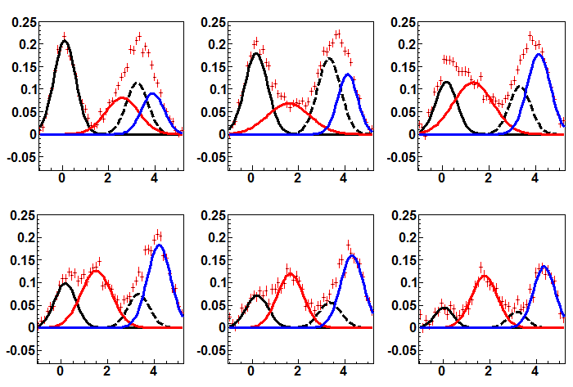
4-Gaussian Fits
φ_{s} – in-plane
STAR Preliminary
Data points
1/N_{trig}dNdΔφ
∆φ (radians)
∆φ (radians)
∆φ (radians)
Near-side “ridge”
Away-side “ridge” (dashed)
Away-side peak 1
Away-side peak 2
∆φ (radians)
∆φ (radians)
∆φ (radians)
φ_{s} – out-of-plane
4 Gaussian is a good fit to data ; χ² ≈ 1.0
Possible away-side ridge
4

Slide 5
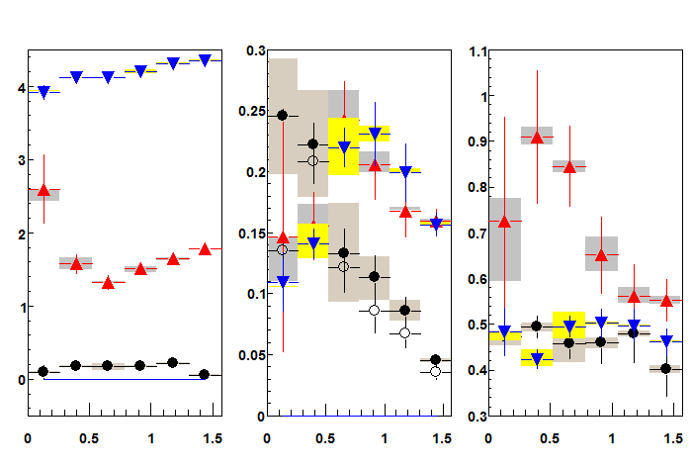
4-Gaussian Data
Peak Location
Gaussian Areas
Gaussian Sigmas
φ
STAR Preliminary
φ_{s}
φ_{s}
φ_{s}
Near-side Ridge Away-side Ridge Away-side 1 Away-side 2
Peak locations reflect Event Plane influence
Away-side peak areas similarity; inconsistent with absorption
Peak width differences may be result of medium interaction showing sensitivity to medium pathlength
5

Slide 6
v₃ Estimation
STAR Preliminary
1/N_{trig}dNdΔφ
φ
φ
φ
φ
φ
φ
Raw Dihadron Correlation v₂ & v₄ background v₃ background
All inclusive Background
v₃ inclusion has very little effect on Background
v₂ & v₄ from calculation
Theorized that away side peak and dip at 1 radian could change ZYAM and create away-side double peak
Signal w/ v3 Signal w/o
STAR Preliminary
v₃ estimates from
AMPT – Phys. Rev. C 81, 054905 (2010)
UrQMD - arXiv:1008.0625
STAR data- arXiv:0806.0513
1/N_{trig}dNdΔφ
φ
φ
φ
φ
φ
φ
v₃ has very little effect on final Dihadron Correlation
6

Slide 7
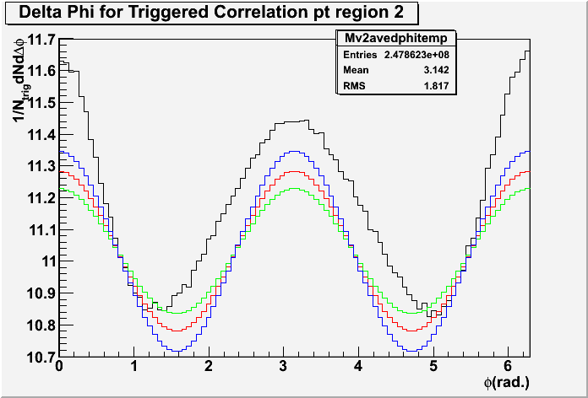
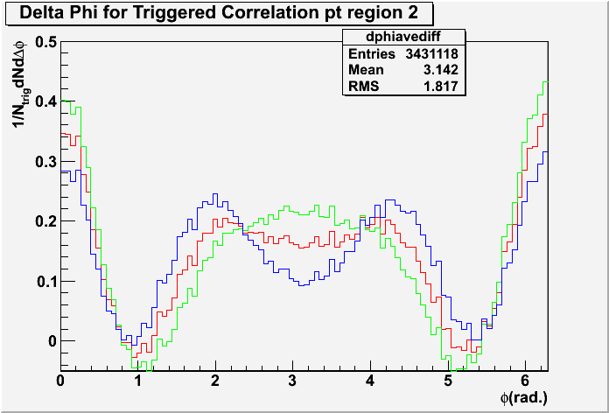
Minbias ZYAM Estimation
STAR Preliminary
STAR Preliminary
Raw Correlation Background v₂ average
Background v₂ maximum Background v₂ minimum
Minbias data is used to give most unbiased estimation of ZYAM
Background is obtained from mixed events with v₂ added on top
ZYAM values align very well with raw correlation at ≈ 1 radian
7

Slide 8
Conclusions
4 Gauss fit seems to suggest back-to-back ridge
Away-side peaks seem to be effected by medium but not absorbed
Ridge decreases as φ_{s} progresses from in-plane to out-of-plane
ZYAM is an assumption. Minimum bias data study indicates ZYAM appears reasonable.
Present study suggests that v₃ has very little affect on final dihadron correlations.
8

Slide 9
Backup Slides

Slide 10
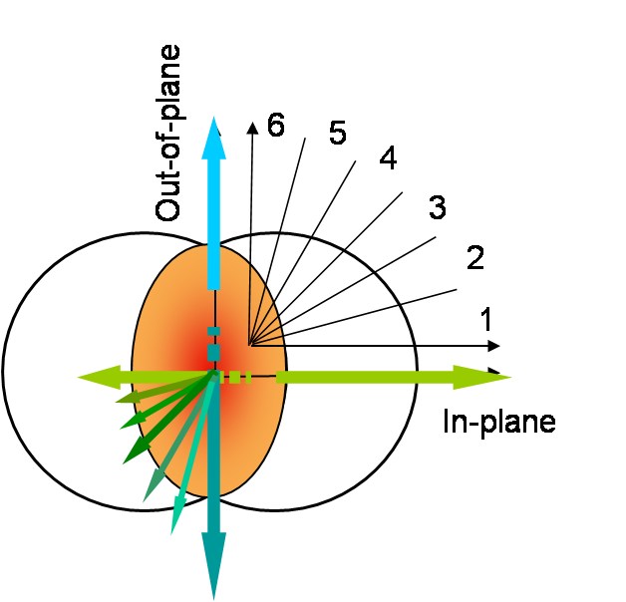
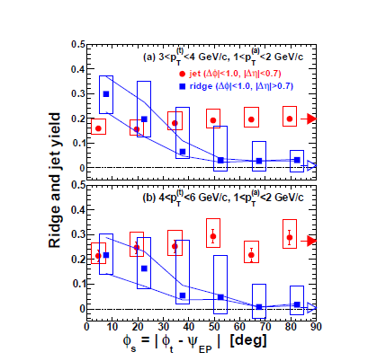
Previous Studies
Previous research involved Dihadron correlation with Reaction Plane orientation;
MAGNITUDE ONLY
arXiv:1010.0690
Ridge decreased as φ_{Trig} progressed from in-plane to out-of-plane
Jet Remains constant
10

Slide 11
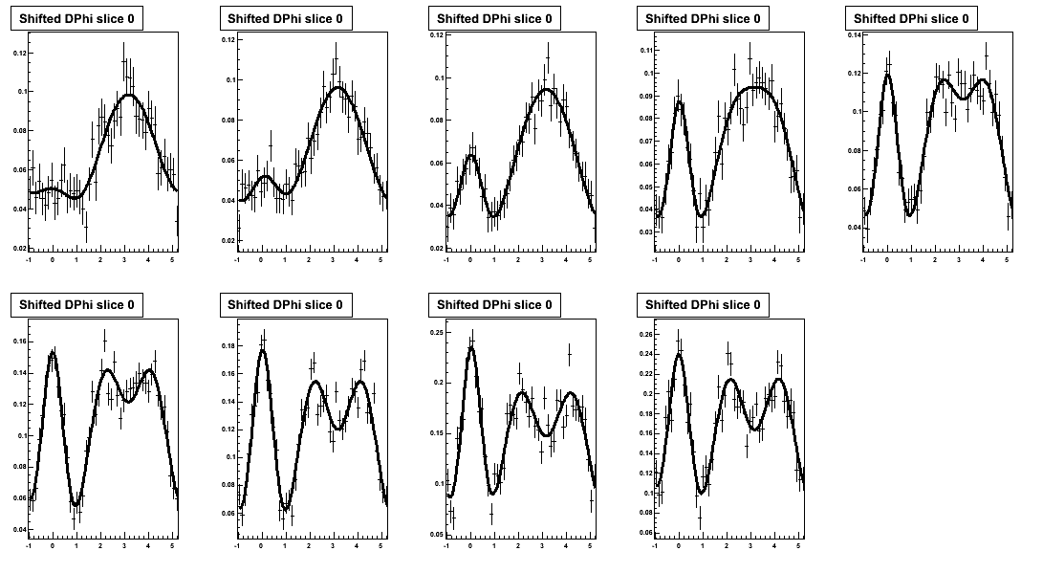
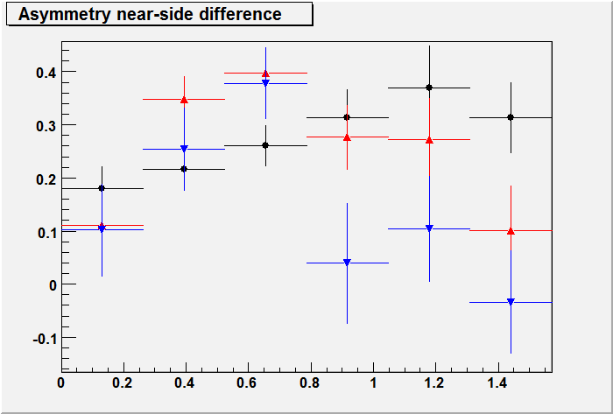
Centrality Dependence
Peripheral
Progression toward more central shows the development of ridge peak and impact of medium interaction.
Most Central
Centrality 9
Asymmetry appears to peak at different φ_{s}
Sigma does not appear to change at different φ_{s}
Centrality 5
A_{s}
Centrality 3
φ_{s}
11

Slide 12
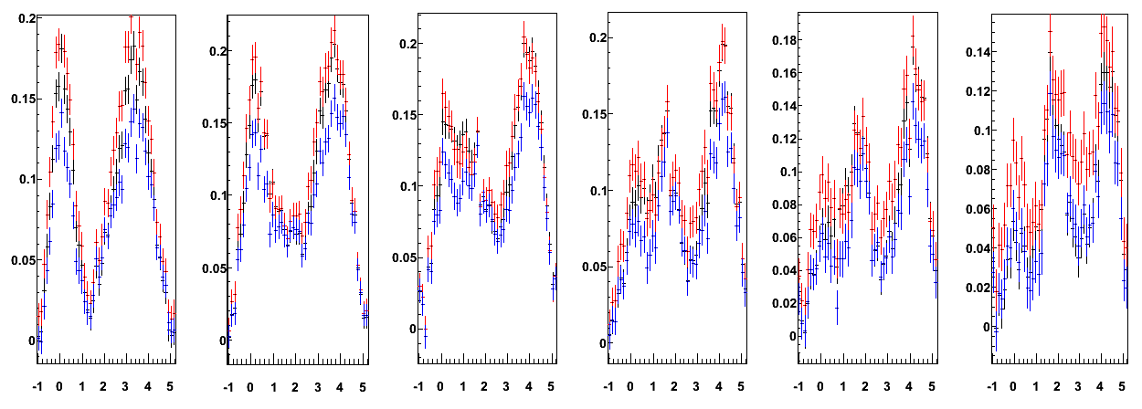
ZYAM Estimation
1/N_{trig}dNdΔφ
STAR Preliminary
φ
φ
φ
φ
φ
φ
Method 1 : v2 and ZYAM are calculated from this large centrality and applied respectively.
Method 2 : v2 and ZYAM are calculated and applied for each of the centralities individually. The background-subtracted signals are the added together, with proper trigger weighting, to form the larger centrality chunk.
Method 3 : v2 is calculated and recorded for each centrality. Raw signals for each centrality are combined as are the representative v2 background functions, with proper trigger weighting. The ZYAM is then calculated from the conglomerate Raw and v2 background functions.
12

Slide 13
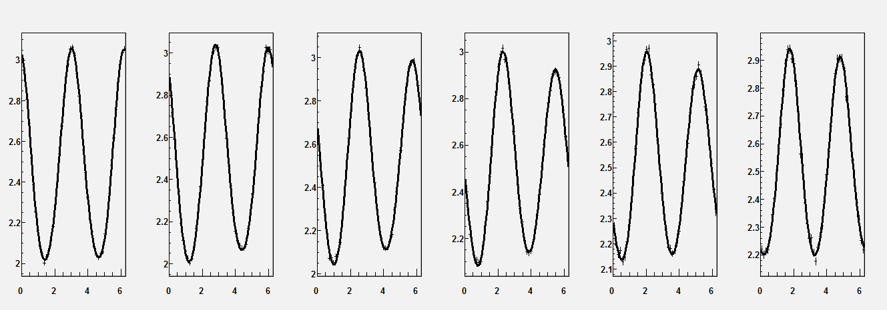
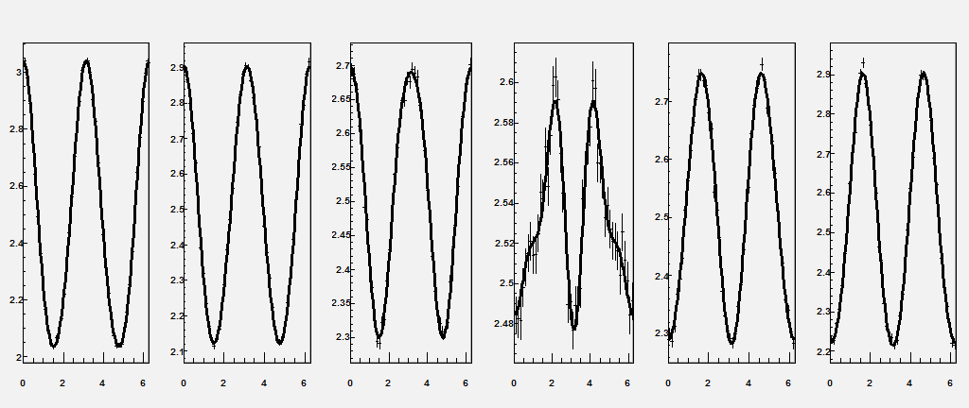
Fourier Fit
χ²/ndf =
31.05/39
χ²/ndf =
46.84/39
χ²/ndf =
57.28/39
χ²/ndf =
27.1/39
χ²/ndf =
45.9/39
χ²/ndf =
51.89/39
χ²/ndf =
46.94/43
χ²/ndf =
46.47/43
χ²/ndf =
57.44/43
χ²/ndf =
41.13/43
χ²/ndf =
60.62/43
χ²/ndf =
64.26/43
13

Slide 14
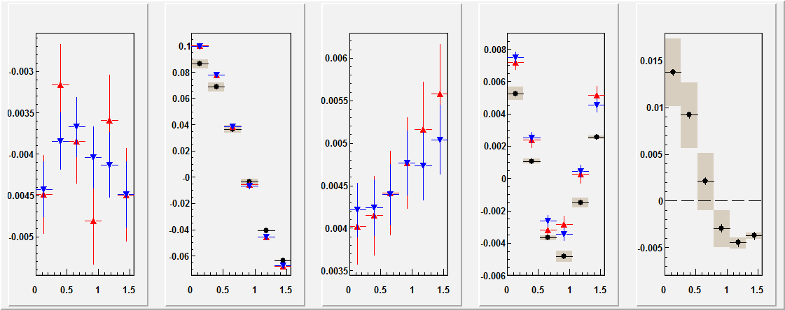
Fourier Fits to Data
V₁
V₂
V₃
V₄
V₂(fit) – V₂(meas)
RP-dep. w/o direction Dependence RP-dep. w/ direction Dependence Calculated values: RP-dep. w/o direction dep. v₂(assoc.)*v₂(trig)=0.02305
Fit values don’t necessarily agree with calculated values from data
14

Slide 15
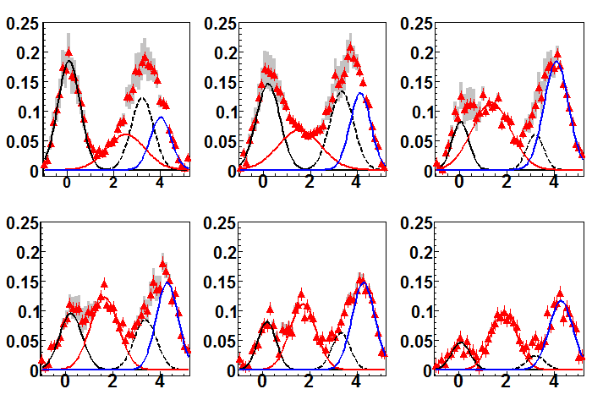
Jet Correlation Effect on EP
φ_{s} – in-plane
STAR Preliminary
Data points
1/N_{trig}dNdΔφ
∆φ (radians)
∆φ (radians)
∆φ (radians)
Near-side “ridge”
Away-side “ridge” (dashed)
Away-side peak 1
Away-side peak 2
∆φ (radians)
∆φ (radians)
∆φ (radians)
φ_{s} – out-of-plane
No Leading particle (|Δη|>0.5) cut when constructing Event Plane
At trigger p_{T} of 3-4 GeV (shown), jet impact on the Event Plane calculation has little effect on final signal
15

