Slide 1
Manufacturing Scintillator Tiles for the STAR Forward Hadronic Calorimeter
Lilian McIntosh

Slide 2
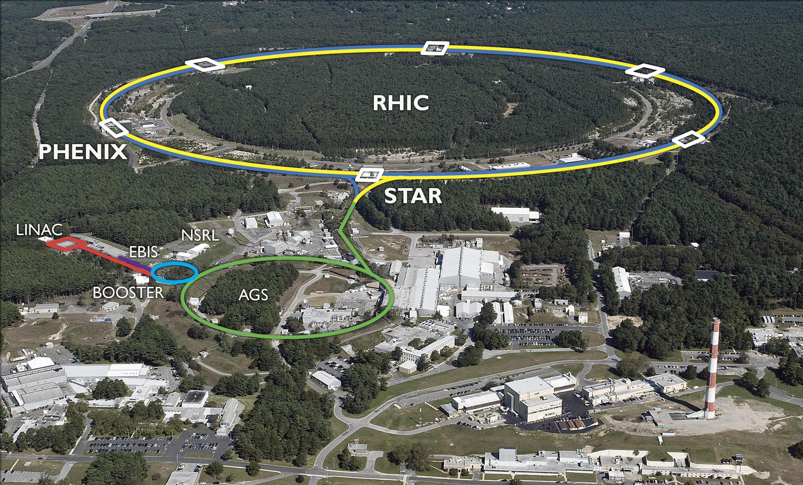
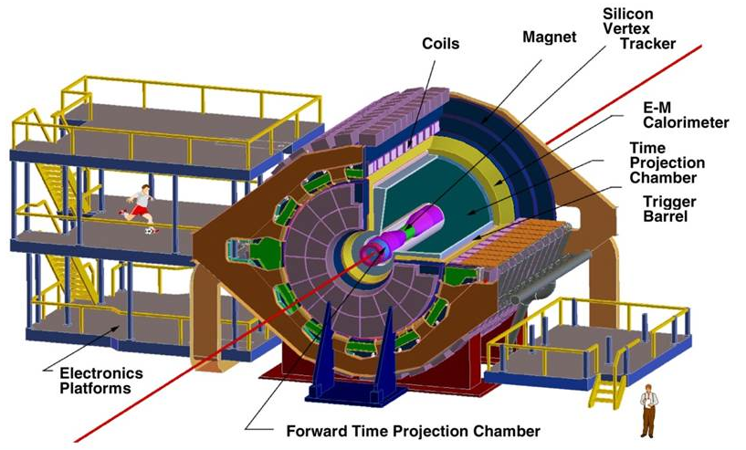
The STAR Experiment
STAR is located at Brookhaven National Lab (BNL)
The Solenoidal Tracker at RHIC (STAR)
STAR studies the proton structure and the interactions of quarks and gluons that make up the proton
STAR consists of multiple different detectors including:
Electromagnetic Calorimeter
Time-Of-Flight Detector
Time Projection Chamber

Slide 3
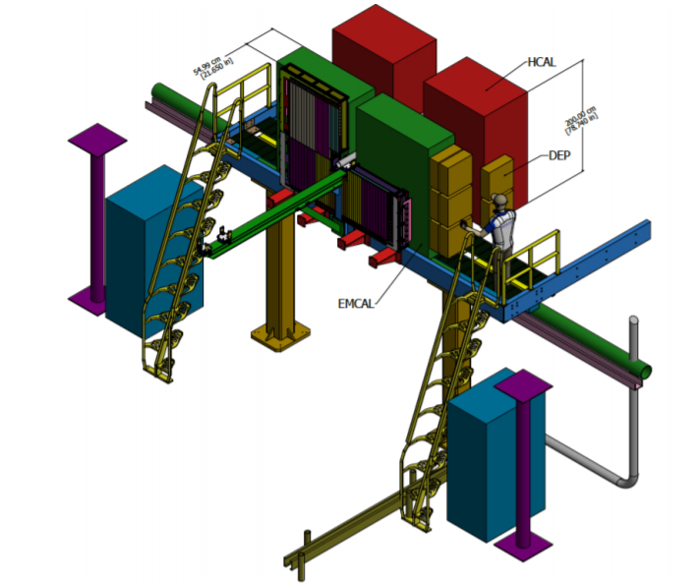
Overview and Motivation
The STAR Forward Upgrade will be implemented to measure data in the forward region.
This upgrade will enhance STAR’s capabilities by creating new low-angle subsystems
Pair of left/right symmetric modules assembled on either side of the beam
ACU has contributed to the manufacturing of scintillator tiles for HCal
‹#›
Notes:
Hole around the beam line in the low angle region (2.5<η<4).
Upgrade includes EMCal, Forward Tracker, HCal
Dimensions of towers: 1.3 meters wide and 2 meters tall
Does not enclose the beam line
Located next to the EMCAL

Slide 4
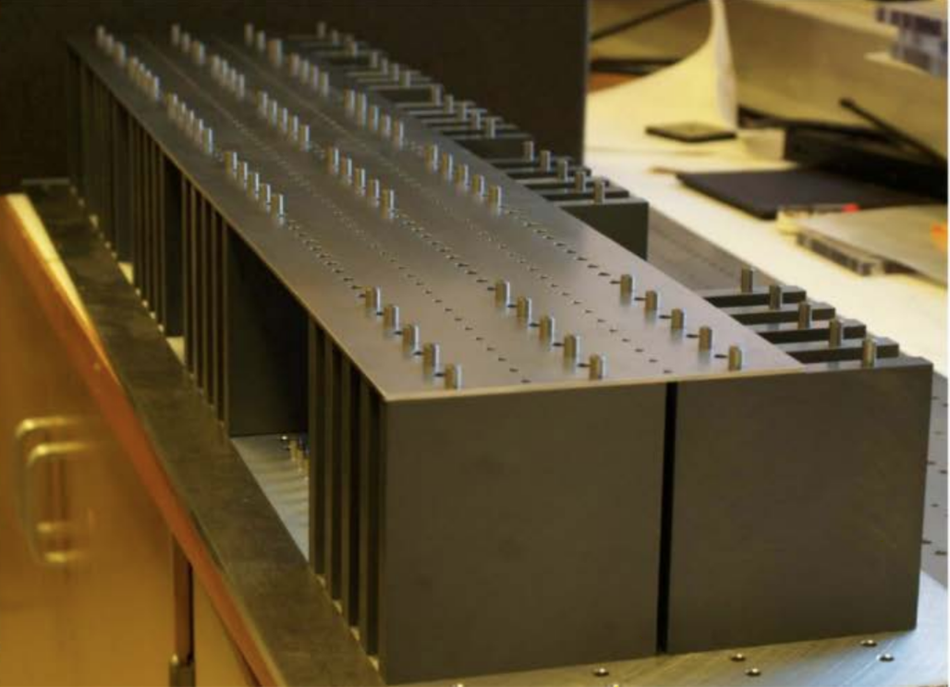
HCal Design
Two partial stacks shown on the left
The stack will consist of layers of 20mm of iron following a 3.1mm gap for a scintillator tile
Each stack is layered with a perforated iron sheet
Then pegs will be placed into the holes slotting into each iron plate
This process is repeated until the towers are 1.3 meters wide and 2 meters tall.
‹#›

Slide 5
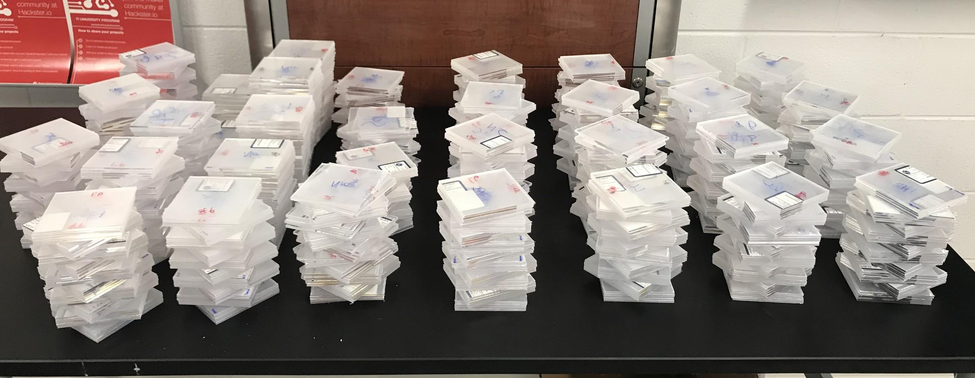
ACU’s Contribution to the STAR Forward Upgrade
ACU has manufactured approximately 6,700 new HCal scintillator tiles.
Manufacturing at ACU includes:
Cutting
Milling
Polishing
Painting

Slide 6
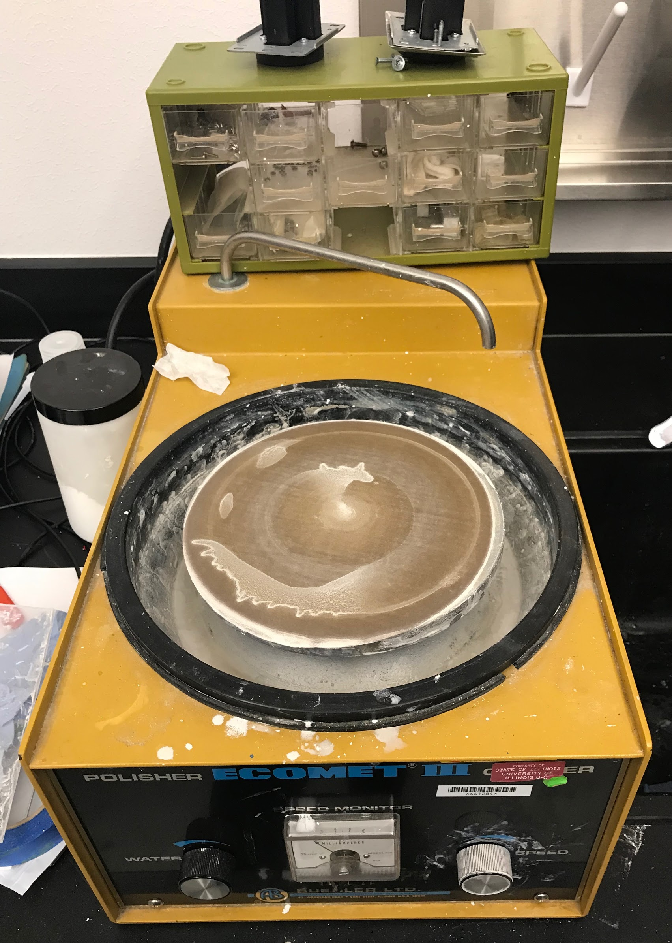
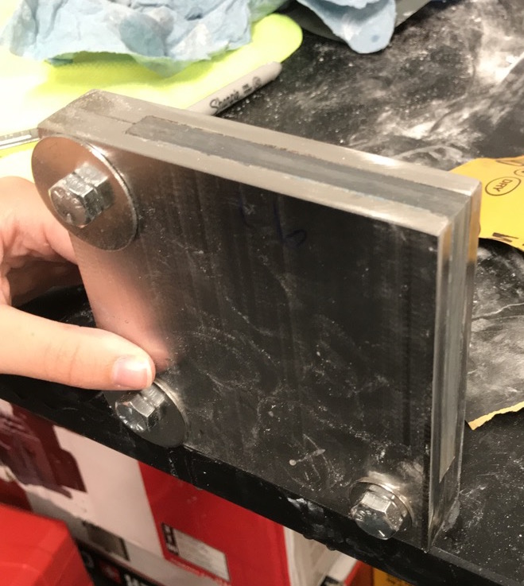
Creating the Manufacturing Process
Summer 2019
Cutting Techniques
Table Saw
Chop Saw
CNC Router
Band Saw
Sanding and Polishing Techniques
Hand Sanding
Sanding with a jig
Polishing wheel
Updated process now includes milling!

Slide 7
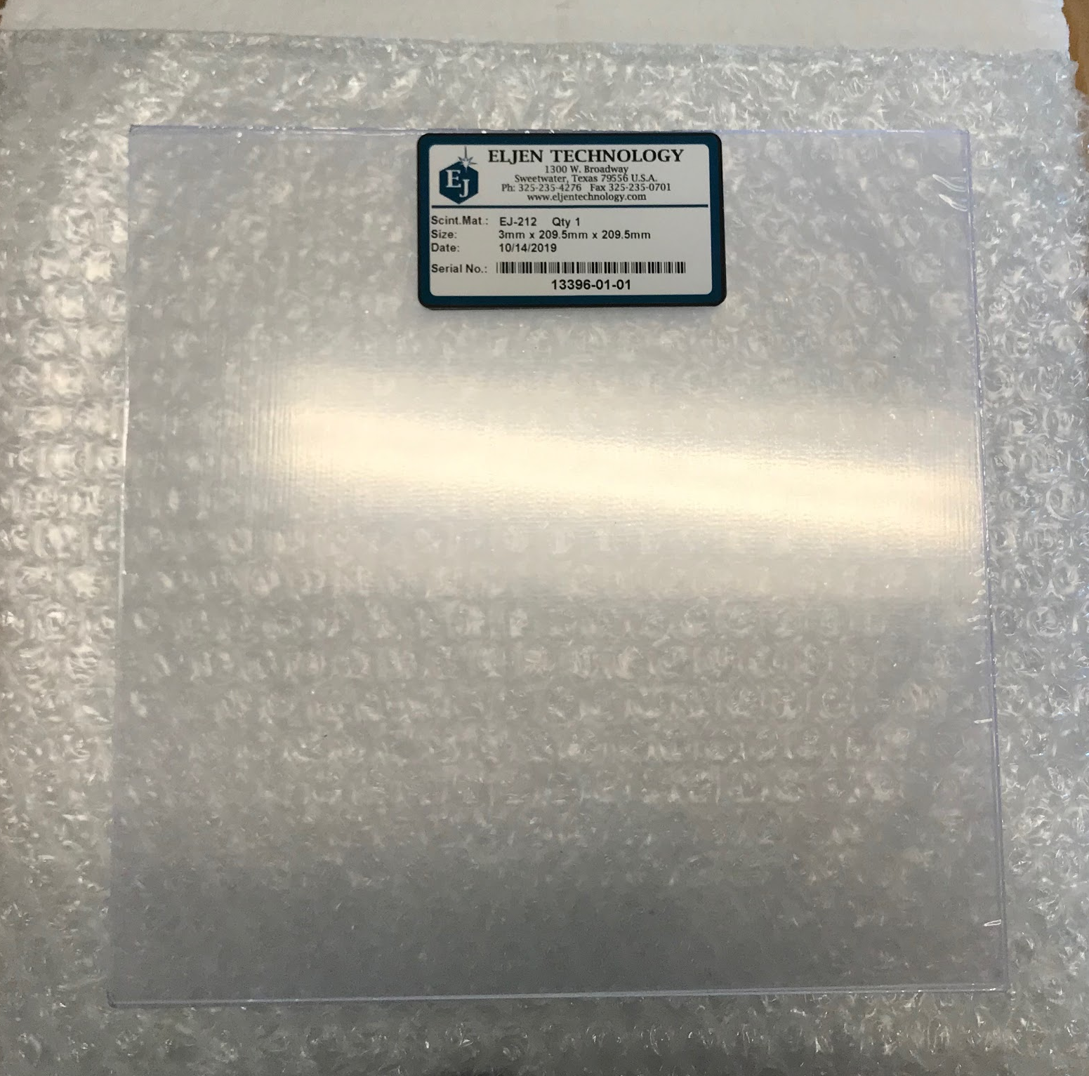
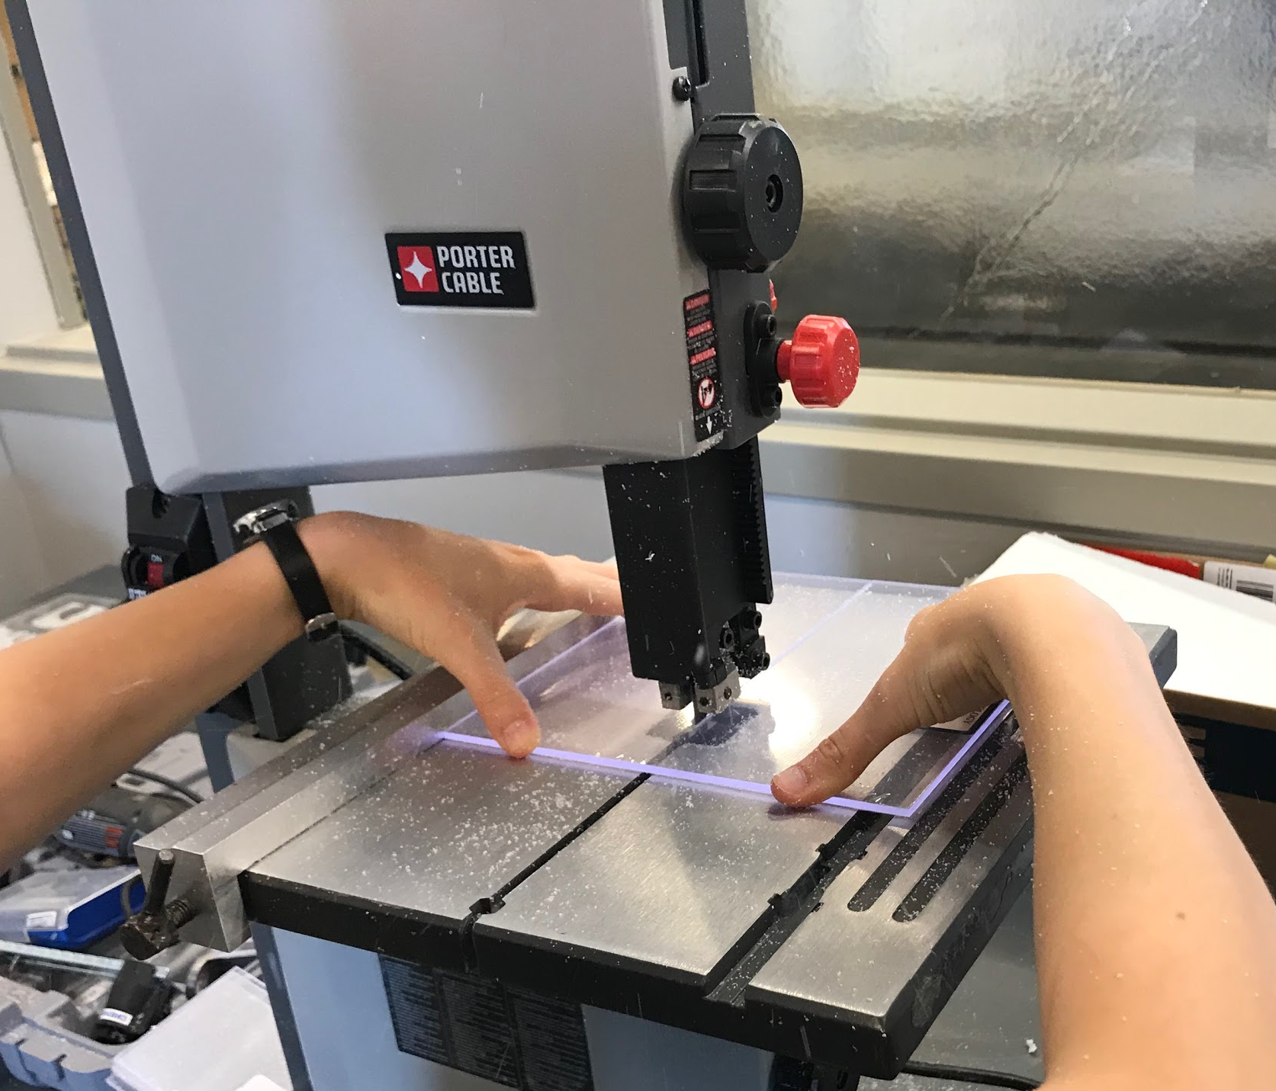
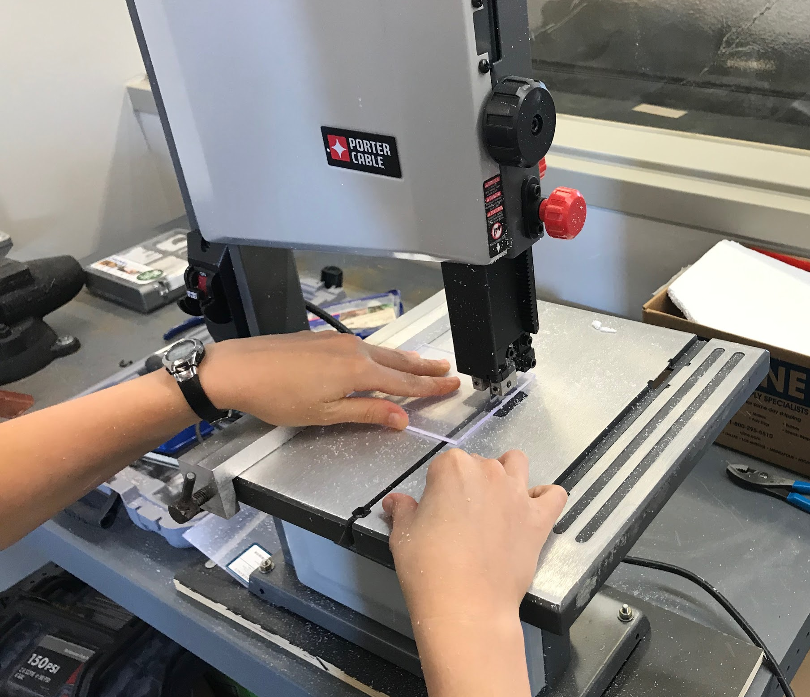
ACU’s Current Manufacturing Process
Square scintillator tiles (EJ-212) arrive to ACU
Square tiles are cut into 4 smaller rectangles on a bandsaw

Slide 8
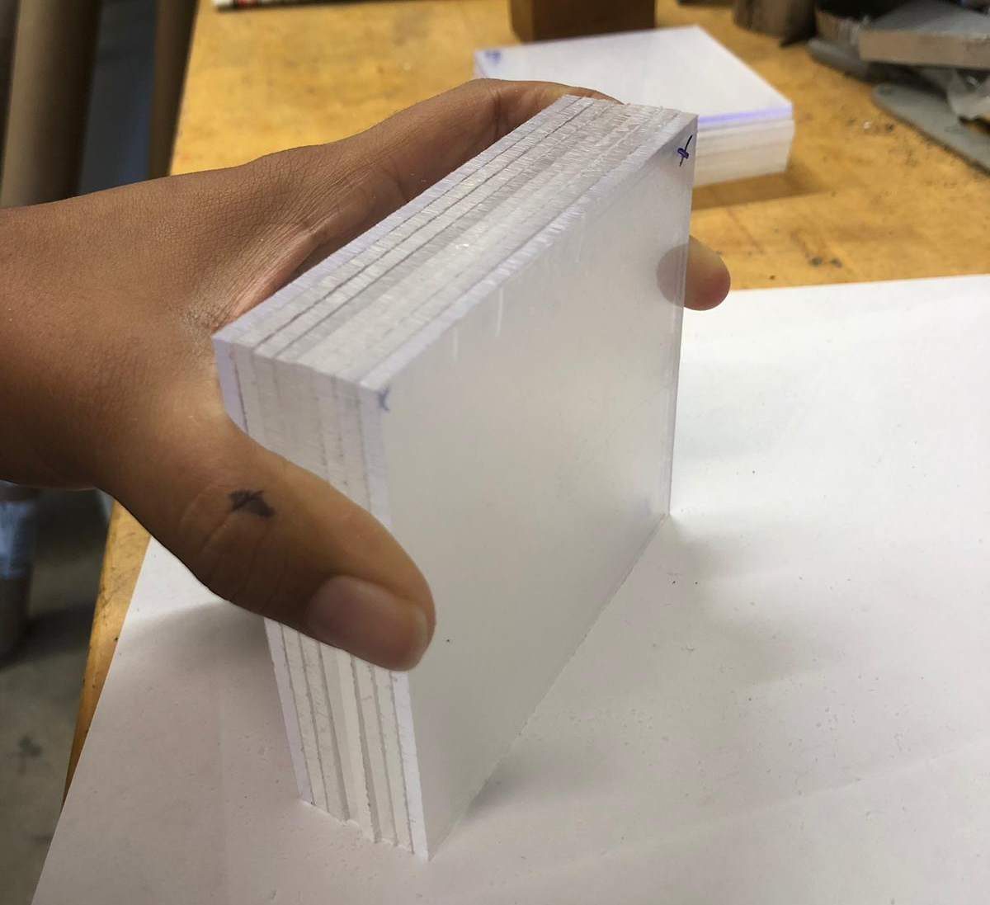
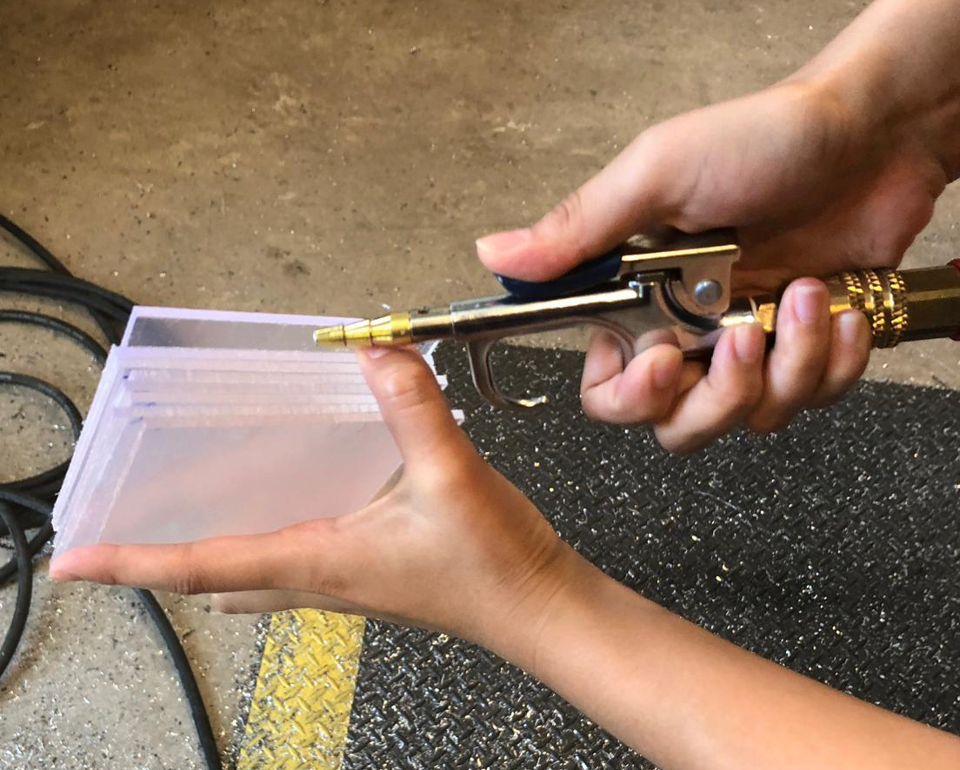
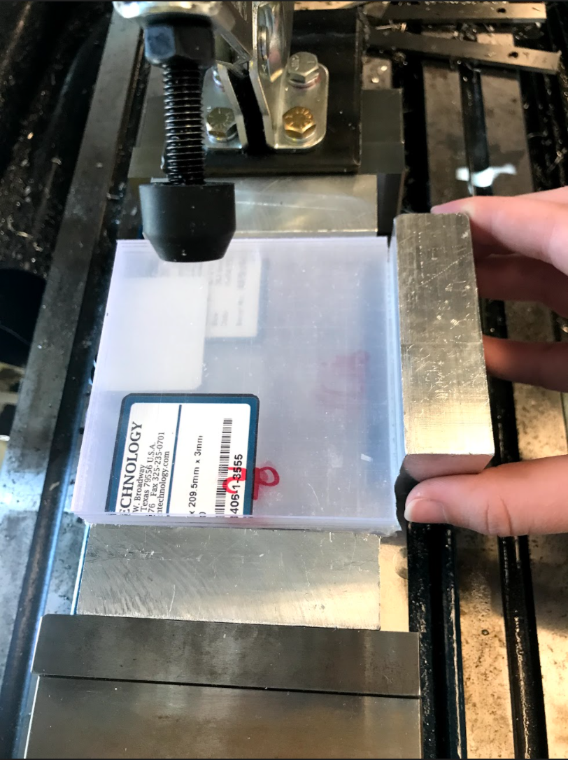
ACU’s Current Manufacturing Process
Mill the scintillator tiles in stacks of 8
Align the most alike scintillators to avoid shifting
2. Use air to spray between the tiles to remove excess scintillator dusts. This prevents shifting.
3. Align the stack of 8 into the jig, making sure the edges are flush.

Slide 9
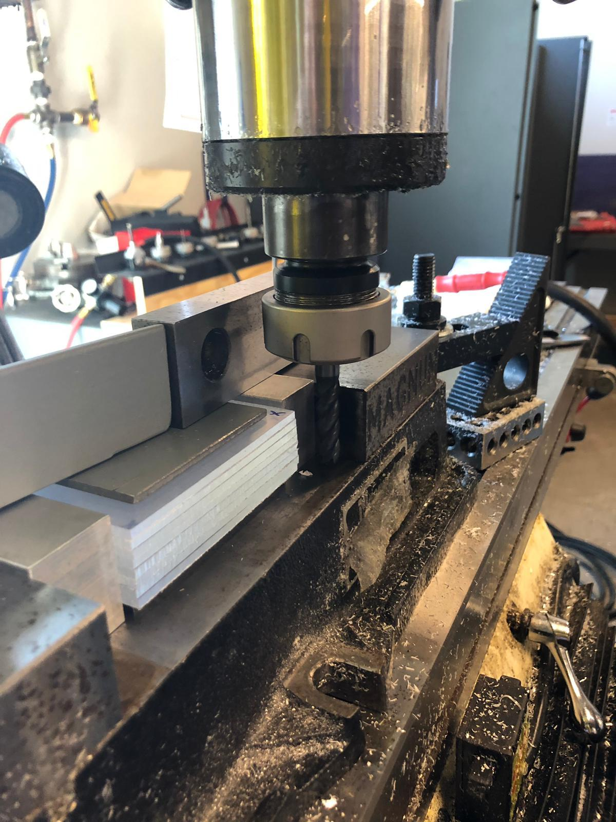
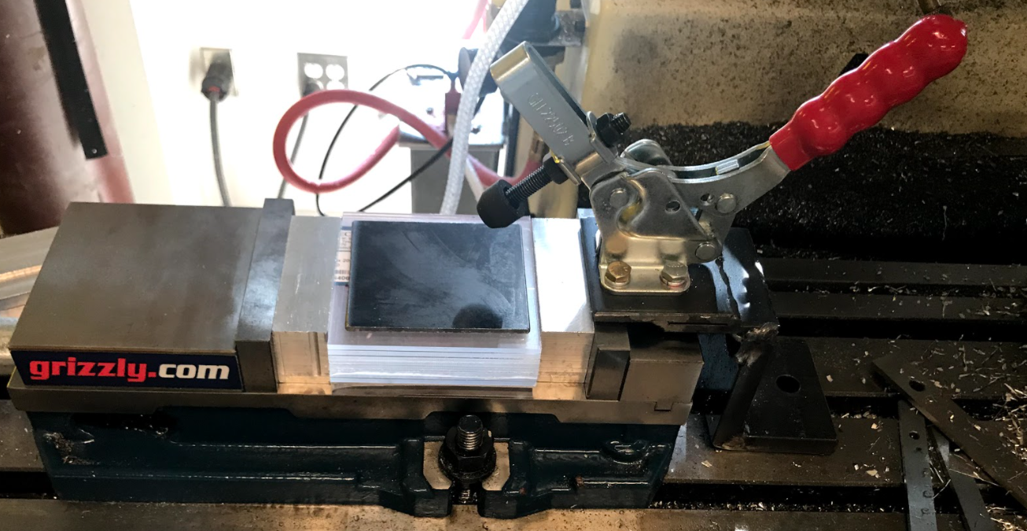
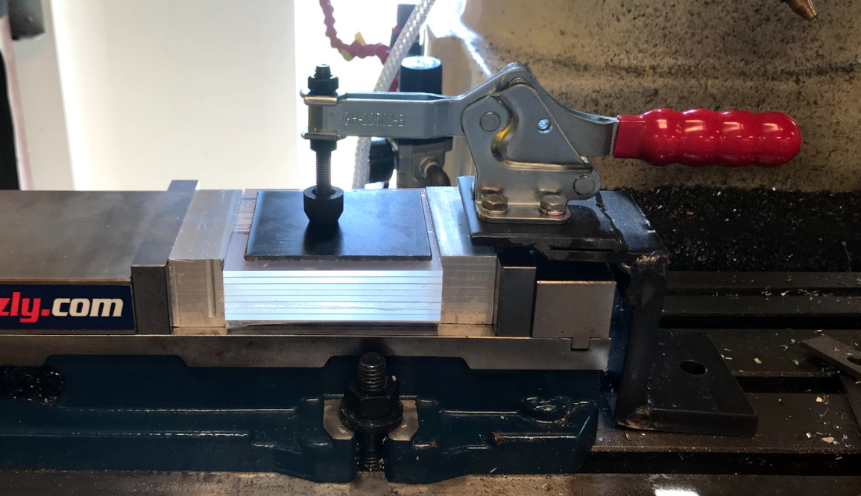
ACU’s Current Manufacturing Process
Mill the scintillator tiles in stacks of 8
4. Close the horizontal clamps to hold the tiles in place. Make sure the tightness is the correct amount to make sure they do not bow or crack.
5. Tighten the top clamp over a metal plate to spread out the surface area of the impact. This will help the tiles stay in place while milling and not to bow or crack.
6. Align the drill bit. Mill off 1mm of material at a time until you reach the desired dimension.

Slide 10
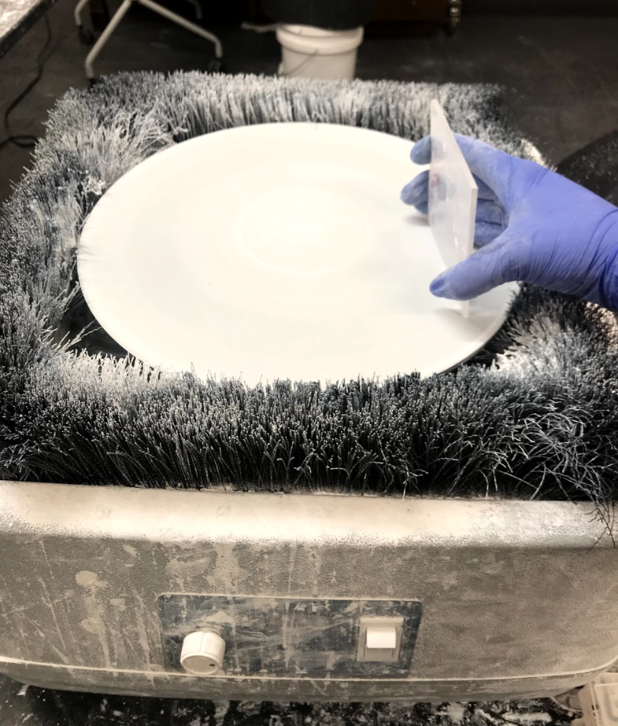
Current Manufacturing Process
After Milling we sand, polish, paint, and package the tiles.
One micron Alumina Powder, this is used as the polishing compound.
97mm side polished using alumina powder and polishing wheel.

Slide 11
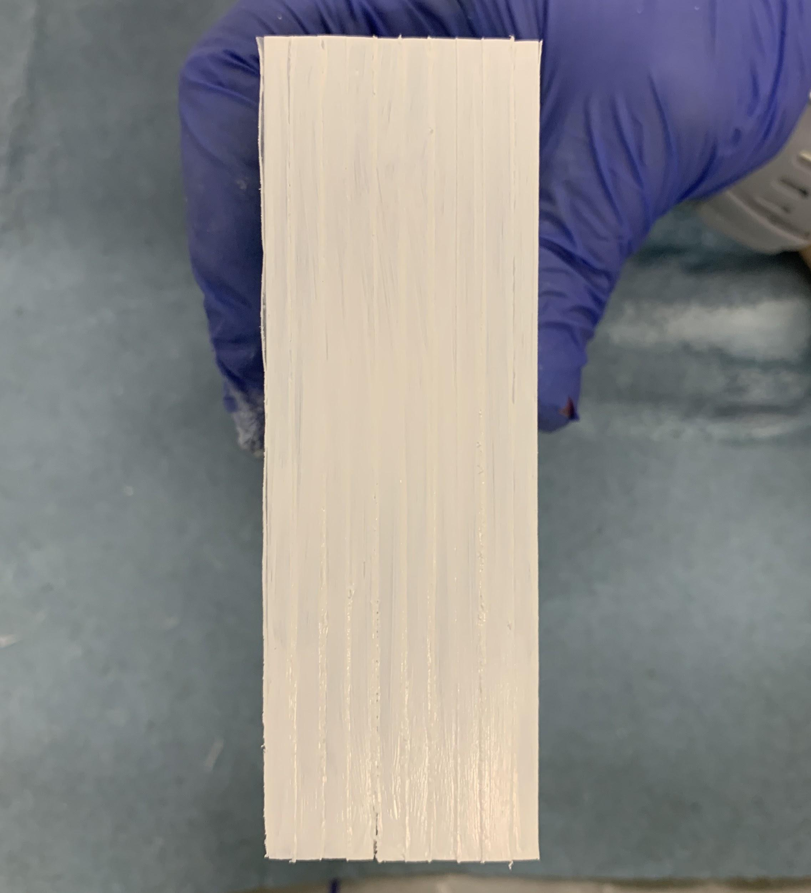
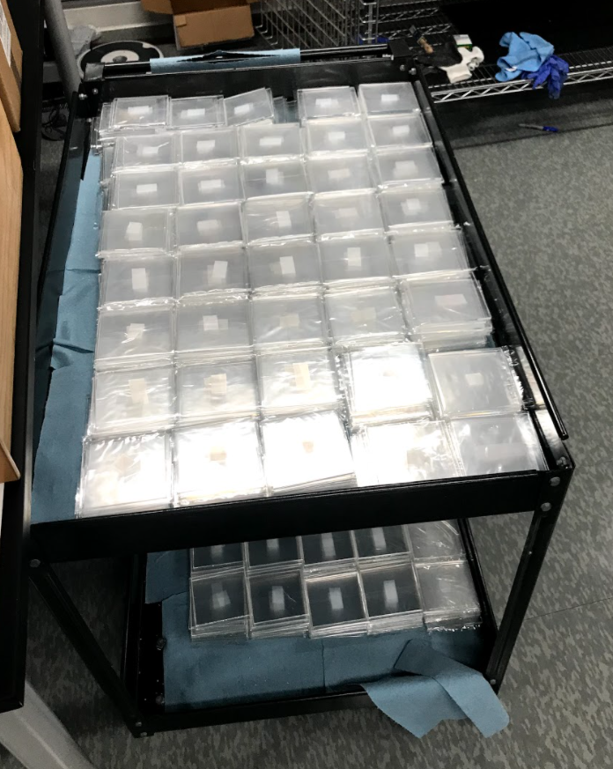
Current Manufacturing Process
After polishing, we paint and package the tiles.
EJ-510 Reflective Paint
After polishing, the 95mm side is painted with a reflective coat of paint.
Packaged tiles on cart. Awaiting on shipment.

Slide 12
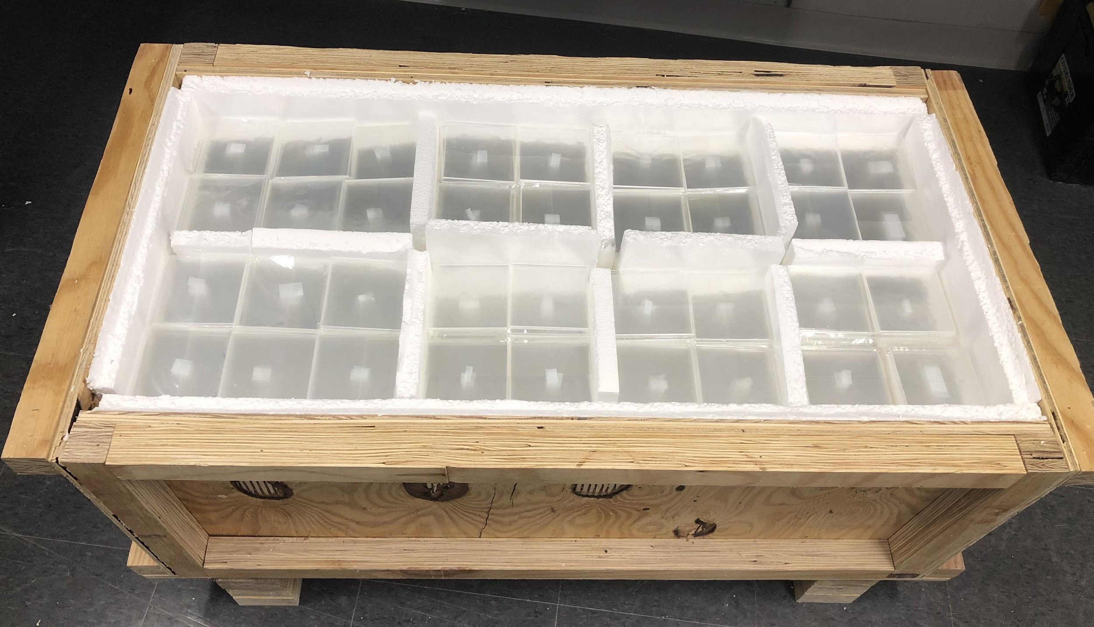
Conclusions and Thanks
ACU cut and milled over 4,200 tiles in the summer of 2020. This makes over 6,700 in total.
Tile stacking at BNL began on October 16, 2020.
Special thanks to:
Dr. Jim Drachenberg
Dr. Donald Isenhower
The ACU Nuclear Physics Research Group
This research was supported by NSF MRI Grant #1920077

