Slide 1
Investigating Transversity and Fragmentation Functions with Hadrons in Jets at STAR
Jim Drachenberg for the STAR Collaboration
2021 Fall Meeting of the APS Division of Nuclear Physics
October 13, 2021
OUTLINE
Transversity and TSSAs
STAR
Hadrons-in-jets at STAR
Looking forward
Supported in part by

Slide 2
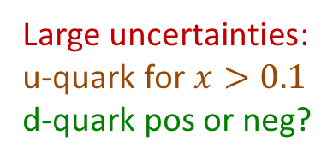
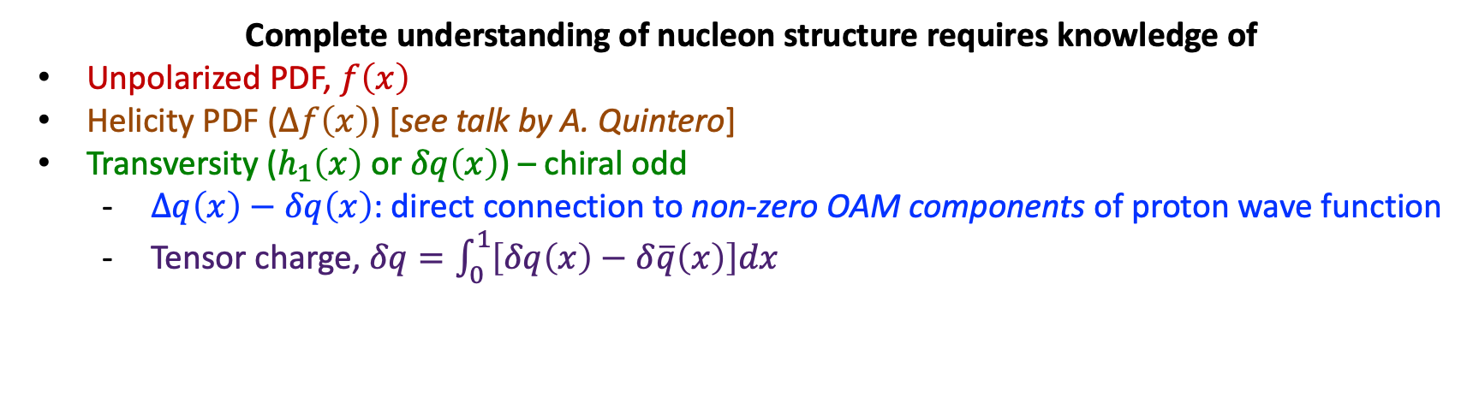
Transversity
Complete understanding of nucleon structure requires knowledge of
Unpolarized PDF, $f\left(x\right)$
Helicity PDF ($Δf\left(x\right)$) [see talk by A. Quintero]
Transversity ($h_{1}\left(x\right)$ or $δq\left(x\right)$) – chiral odd
  $Δq\left(x\right)−δq\left(x\right)$: direct connection to non-zero OAM components of proton wave function
  Tensor charge, $δq=\int_{0}^{1}{\left[δq\left(x\right)−δ\overline{q}\left(x\right)\right]dx}$
→ requires another chiral-odd distribution
PRD 93, 014009 (2016)
Large uncertainties:
u-quark for $x>0.1$
d-quark pos or neg?
Kang et al: PRD 93, 014009 (2016)
Anselmino et al: PRD 87, 094019 (2013)
Radici et al: JHEP 05, 123 (2015)
Accessed through global analyses in SIDIS + $e^{+}e^{−}$, e.g. via “Collins” or IFF asymmetries
Currently limited reach in $\left(x,Q^{2}\right)$
[see talks by B. Pokhrel, N. Ghimire]

Slide 3
Polarized Hadrons Within Jets
Anselmino et al, PRD 73, 014020 (2006)
F. Yuan, PRL 100, 032003 (2008)
D’Alesio et al., PRD 83, 034021 (2011)
Collins mechanism
J. Collins, NP B396, 161 (1993)
Transversely polarized quarks inside transversely polarized proton
Polarization transfer during hard scattering
Distribution of hadrons correlated to quark polarization
Azimuthal asymmetry in distribution of hadrons within the jet
  Requires non-zero quark transversity
  Requires spin-dependent TMD FF
(analogous effect for gluon linear polarization)

Slide 4
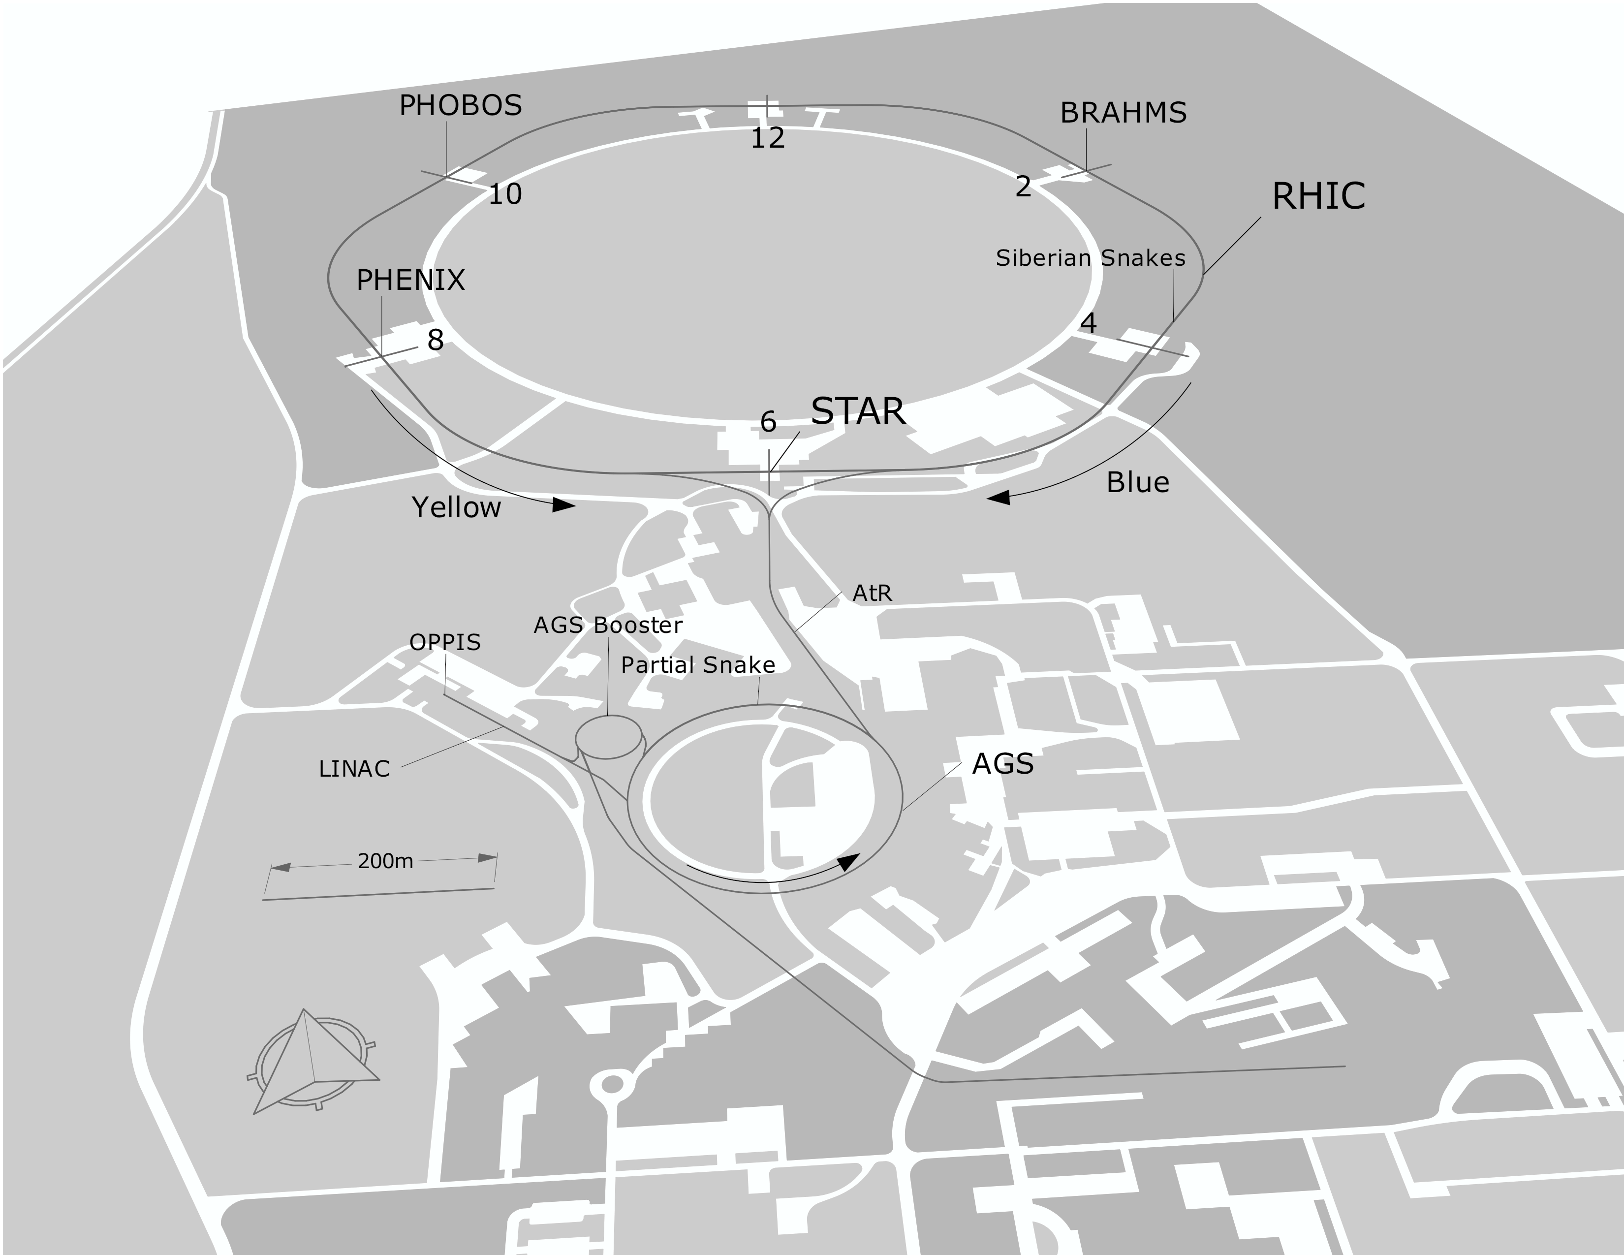
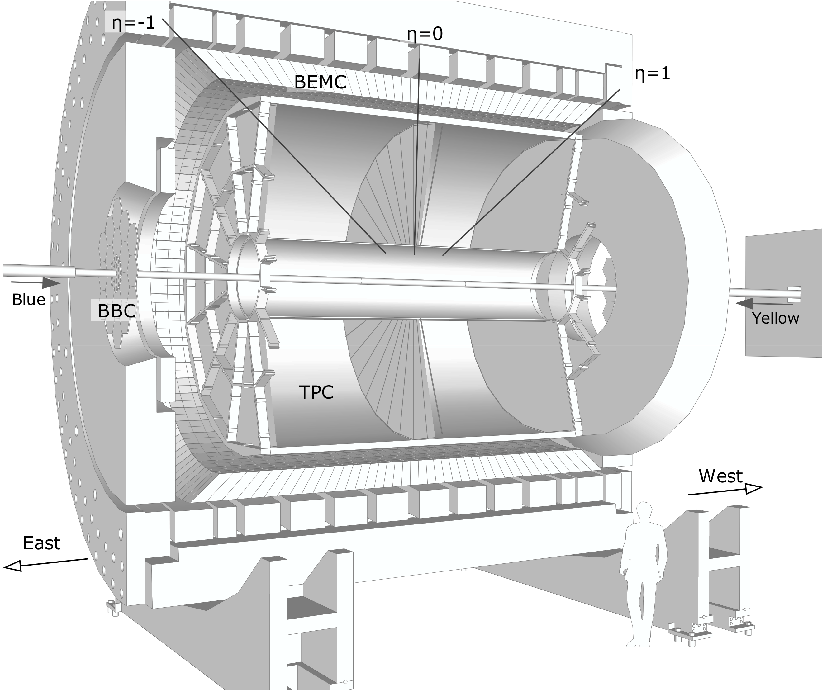
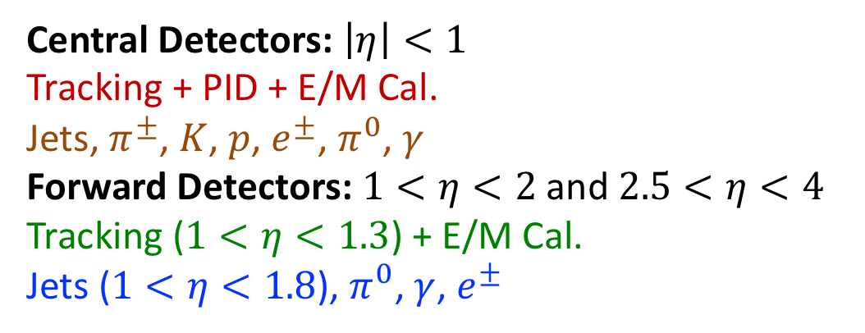
The Solenoidal Tracker at RHIC
RHIC as Polarized-proton Collider
“Siberian Snakes” → mitigate depolarization resonances
Choice of spin orientation → independent of experiment
Spin direction varies bucket-to-bucket (9.4 MHz)
Spin pattern varies fill-to-fill
Central Detectors: $\left|η\right|<1$
Tracking + PID + E/M Cal.
Jets, $π^{±}$, $K$, $p$, $e^{±}$, $π^{0}$, $γ$
Forward Detectors: $1<η<2$ and $2.5<η<4$
Tracking ($1<η<1.3$) + E/M Cal.
Jets ($1<η<1.8$), $π^{0}$, $γ$, $e^{±}$

Slide 5
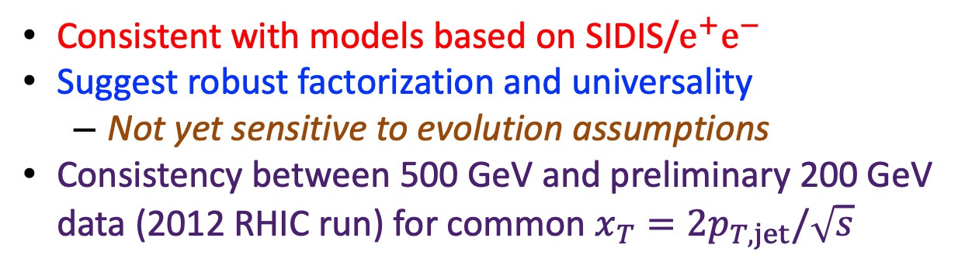

Collins Effect at STAR
Consistent with models based on SIDIS/$e^{+}e^{−}$
Suggest robust factorization and universality
  Not yet sensitive to evolution assumptions
Consistency between 500 GeV and preliminary 200 GeV data (2012 RHIC run) for common $x_{T}=2p_{T,jet}/\sqrt{s}$
2012
Peak appears to shift to higher $j_{T}$ for increasing $z$
STAR Collaboration, PRD 97, 032004 (2018)
D’Alesio, Murgia, Pisano: PLB 773, 300 (2017)
Kang, Prokudin, Ringer, Yuan: PLB 774, 635 (2017)

Slide 6
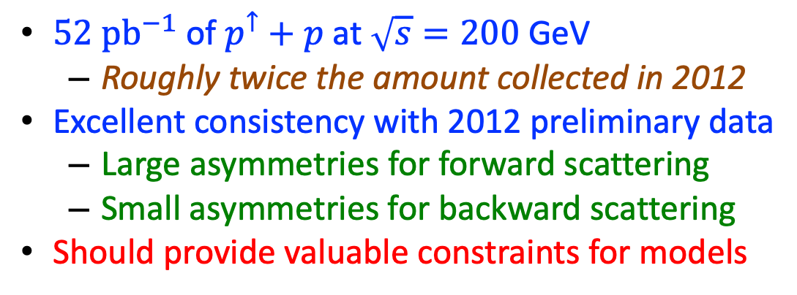


STAR 2015 Data: Higher Statistics at 200 GeV
$$x_{F}>0$$
$52 {pb}^{−1}$ of $p^{↑}+p$ at $\sqrt{s}=200$ GeV
  Roughly twice the amount collected in 2012
Excellent consistency with 2012 preliminary data
  Large asymmetries for forward scattering
  Small asymmetries for backward scattering
Should provide valuable constraints for models
$$x_{F}<0$$

Slide 7
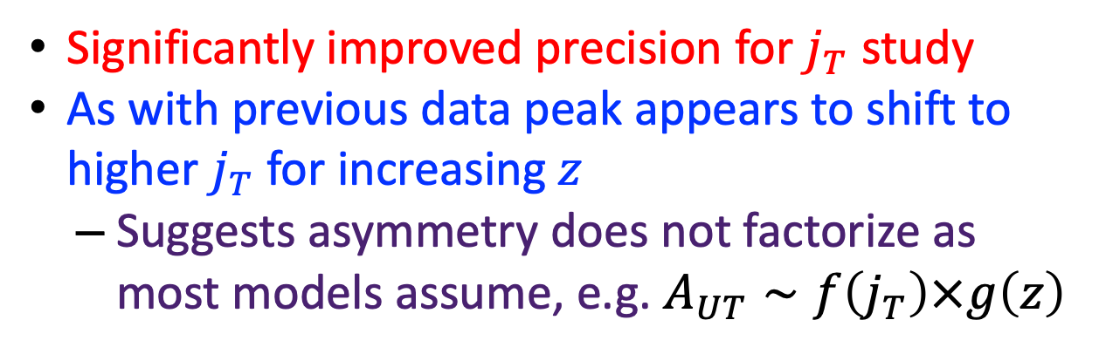
STAR 2015 Data: Higher Statistics at 200 GeV
Significantly improved precision for $j_{T}$ study
As with previous data peak appears to shift to higher $j_{T}$ for increasing $z$
  Suggests asymmetry does not factorize as most models assume, e.g. $A_{UT}∼f\left(j_{T}\right)×g\left(z\right)$
Anselmino et al, PRD 73, 014020 (2006)
F. Yuan, PRL 100, 032003 (2008)
D’Alesio et al., PRD 83, 034021 (2011)

Slide 8
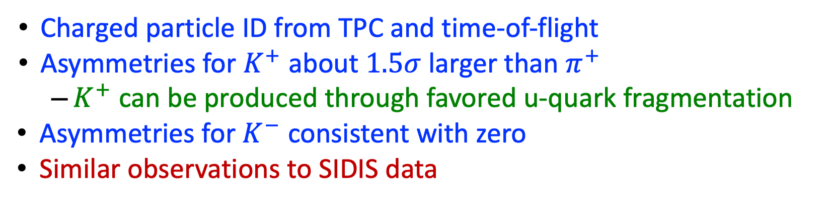
Kaon Asymmetries at 200 GeV
Charged Particle Identification
Charged particle ID from TPC and time-of-flight
Asymmetries for $K^{+}$ about $1.5σ$ larger than $π^{+}$
  $K^{+}$ can be produced through favored u-quark fragmentation
Asymmetries for $K^{−}$ consistent with zero
Similar observations to SIDIS data

Slide 9
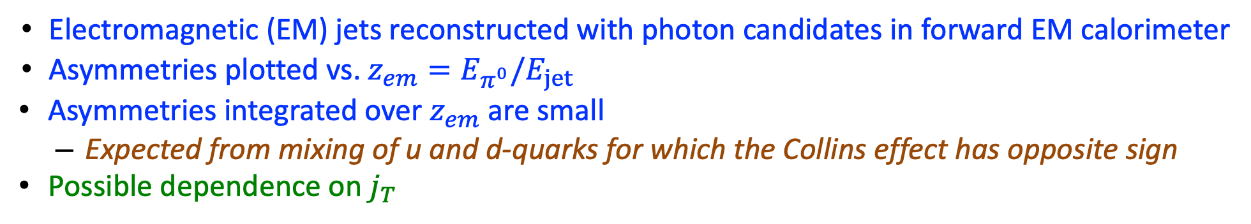
Neutral Pion in Electromagnetic Jet Asymmetries
STAR Collaboration, PRD 103, 092009 (2021)
Electromagnetic (EM) jets reconstructed with photon candidates in forward EM calorimeter
Asymmetries plotted vs. $z_{em}=E_{π^{0}}/E_{jet}$
Asymmetries integrated over $z_{em}$ are small
  Expected from mixing of u and d-quarks for which the Collins effect has opposite sign
Possible dependence on $j_{T}$
Theory: Kang, Prokudin, Ringer, Yuan, PLB 774, 635 (2017)

Slide 10
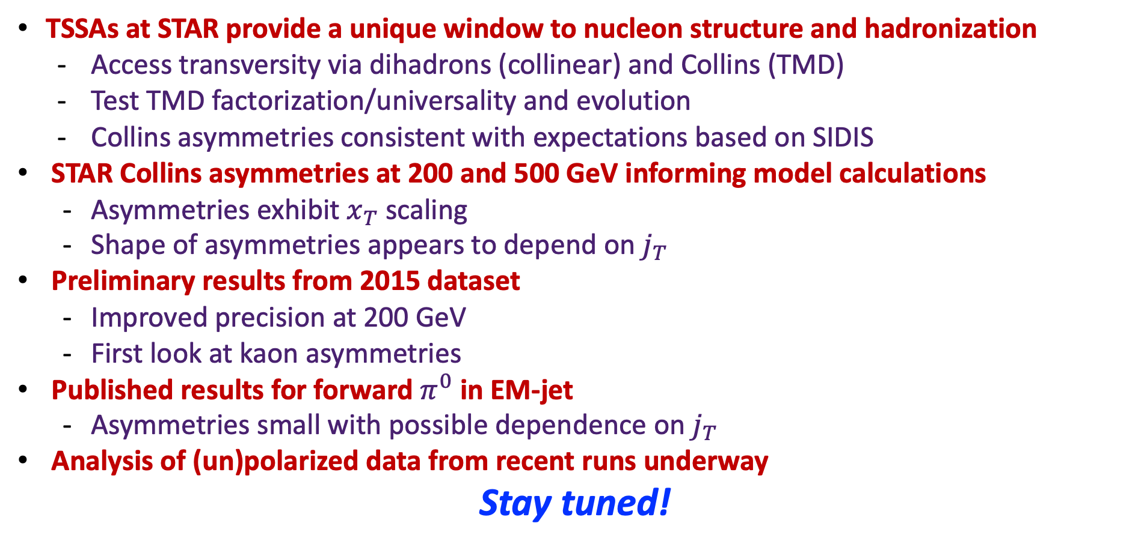
Summary
TSSAs at STAR provide a unique window to nucleon structure and hadronization
  Access transversity via dihadrons (collinear) and Collins (TMD)
  Test TMD factorization/universality and evolution
  Collins asymmetries consistent with expectations based on SIDIS
STAR Collins asymmetries at 200 and 500 GeV informing model calculations
  Asymmetries exhibit $x_{T}$ scaling
  Shape of asymmetries appears to depend on $j_{T}$
Preliminary results from 2015 dataset
  Improved precision at 200 GeV
  First look at kaon asymmetries
Published results for forward $π^{0}$ in EM-jet
  Asymmetries small with possible dependence on $j_{T}$
Analysis of (un)polarized data from recent runs underway
Stay tuned!

Slide 11
Back-up Slides

Slide 12
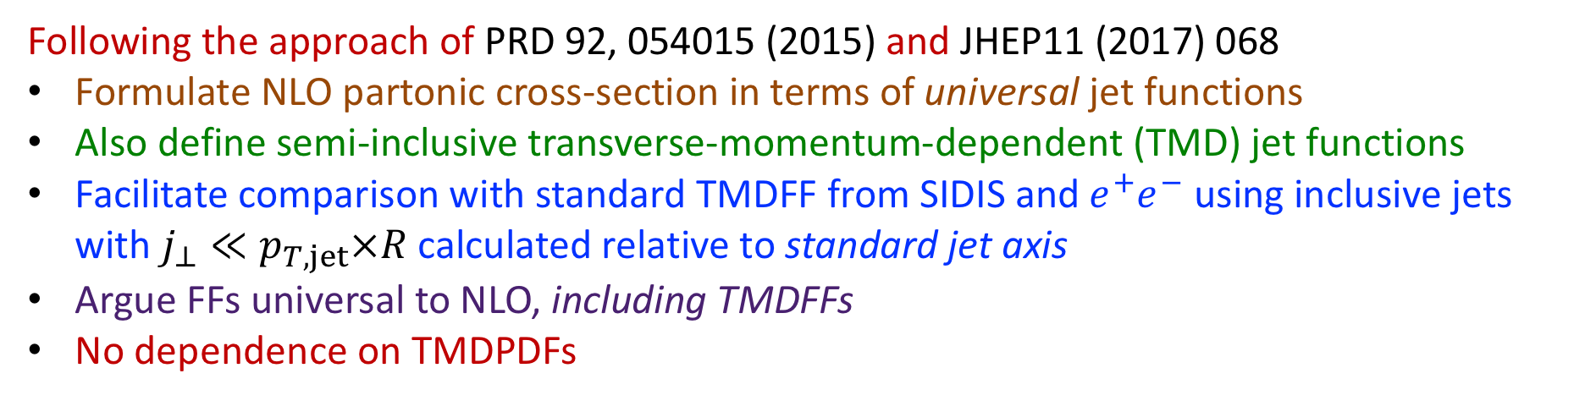
Unpolarized Hadrons Within Jets
Following the approach of PRD 92, 054015 (2015) and JHEP11 (2017) 068
Formulate NLO partonic cross-section in terms of universal jet functions
Also define semi-inclusive transverse-momentum-dependent (TMD) jet functions
Facilitate comparison with standard TMDFF from SIDIS and $e^{+}e^{−}$ using inclusive jets with $j_{⊥}≪p_{T,jet}×R$ calculated relative to standard jet axis
Argue FFs universal to NLO, including TMDFFs
No dependence on TMDPDFs

Slide 13
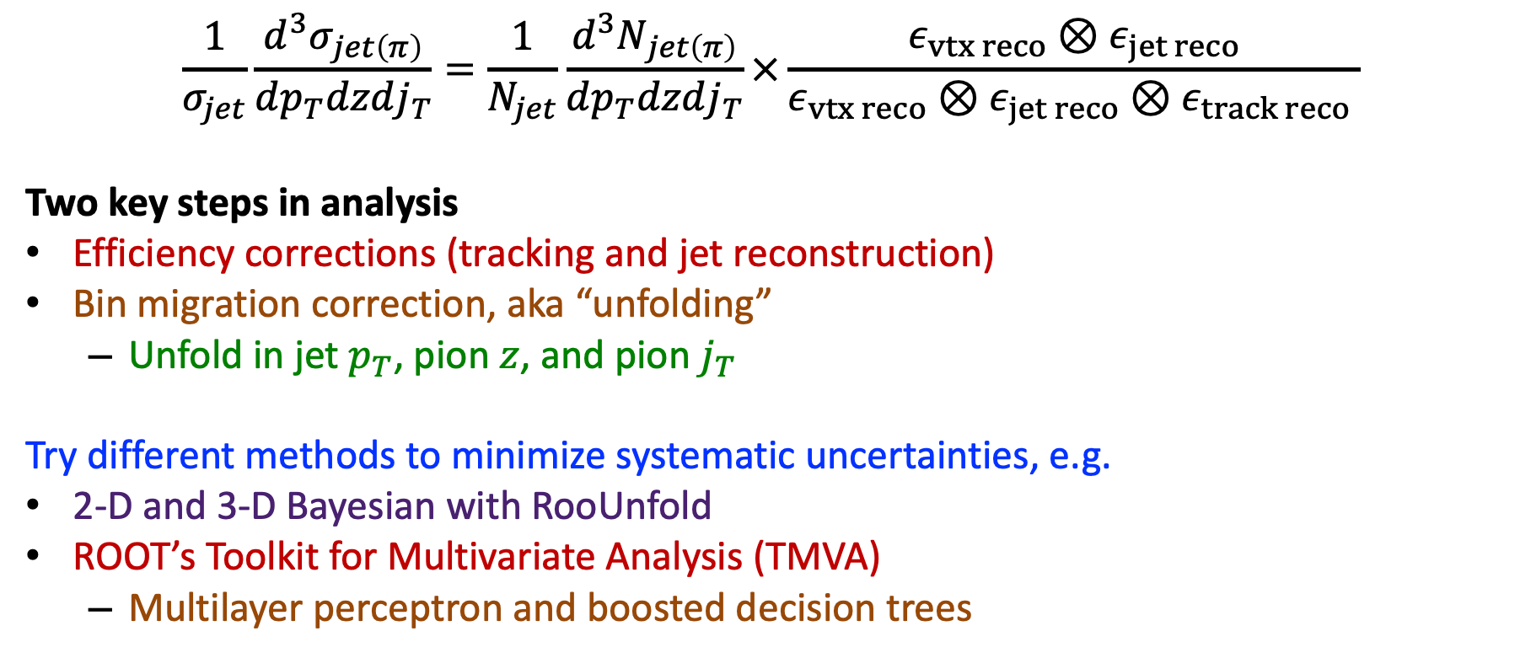
Status of In-jet FF Analysis
$$\frac{1}{σ_{jet}}\frac{d^{3}σ_{jet\left(π\right)}}{dp_{T}dzdj_{T}}=\frac{1}{N_{jet}}\frac{d^{3}N_{jet\left(π\right)}}{dp_{T}dzdj_{T}}×\frac{ε_{vtx reco}⊗ε_{jet reco}}{ε_{vtx reco}⊗ε_{jet reco}⊗ε_{track reco} }$$
Two key steps in analysis
Efficiency corrections (tracking and jet reconstruction)
Bin migration correction, aka “unfolding”
  Unfold in jet $p_{T}$, pion $z$, and pion $j_{T}$
Try different methods to minimize systematic uncertainties, e.g.
2-D and 3-D Bayesian with RooUnfold
ROOT’s Toolkit for Multivariate Analysis (TMVA)
  Multilayer perceptron and boosted decision trees
Embedded Monte Carlo Studies

Slide 14
Collins-like Effect at RHIC
Collins-like effect
Sensitive to linearly polarized gluons in a transversely polarized proton
Asymmetries consistent at zero in 500 GeV (shown) and also preliminary 200 GeV
STAR data provide first-ever constraints
STAR Collaboration, PRD 97, 032004 (2018)

