Slide 1
Investigating Transversity with Hadrons in Jets at STAR
Jim Drachenberg for the STAR Collaboration
2022 Fall Meeting of the APS Division of Nuclear Physics
October 28, 2022
OUTLINE
Transversity and TSSAs
STAR
First results at 500 GeV
High statistics at 200 GeV
First look at kaons/protons
Summary
Supported in part by

Slide 2
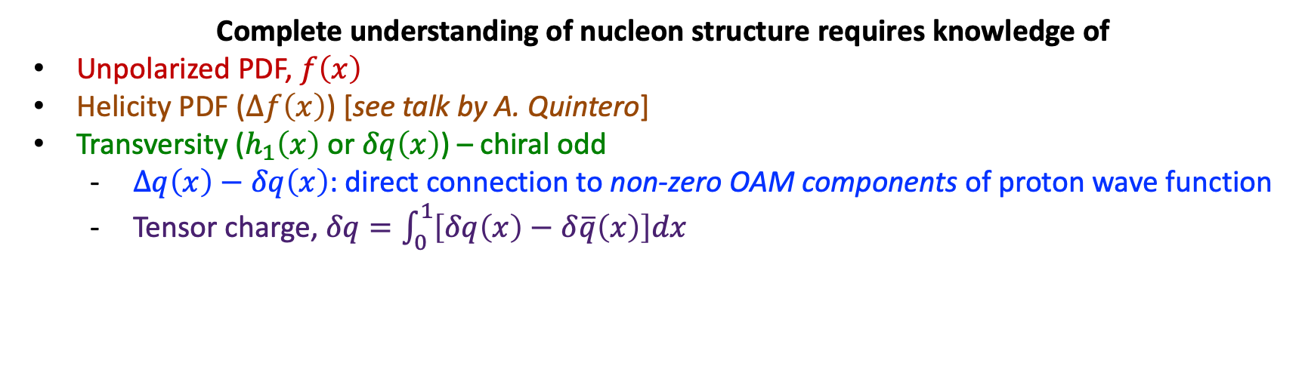
Transversity
Complete understanding of nucleon structure requires knowledge of
Unpolarized PDF, $f\left(x\right)$
Helicity PDF ($Δf\left(x\right)$) [see talk by A. Quintero]
Transversity ($h_{1}\left(x\right)$ or $δq\left(x\right)$) – chiral odd
  $Δq\left(x\right)−δq\left(x\right)$: direct connection to non-zero OAM components of proton wave function
  Tensor charge, $δq=\int_{0}^{1}{\left[δq\left(x\right)−δ\overline{q}\left(x\right)\right]dx}$
→ requires another chiral-odd distribution
JAM: PRD 106, 034014 (2022)
Lots of on-going work and questions
d-quark, Soffer bound, consistency with Lattice QCD, etc.
D’Alesio et al: PLB 803, 135347 (2020)
Radici, Bacchetta: PRL 120, 192001 (2018)
Kang et al: PRD 93, 014009 (2016)
One way to access: SIDIS + $e^{+}e^{−}$ via “Collins” or IFF asymmetries
Currently limited reach in $\left(x,Q^{2}\right)$

Slide 3
Polarized Hadrons Within Jets
Anselmino et al, PRD 73, 014020 (2006)
F. Yuan, PRL 100, 032003 (2008)
D’Alesio et al., PRD 83, 034021 (2011)
Collins mechanism
J. Collins, NP B396, 161 (1993)
Transversely polarized quarks inside transversely polarized proton
Polarization transfer during hard scattering
Distribution of hadrons correlated to quark polarization
Azimuthal asymmetry in distribution of hadrons within the jet
  Requires non-zero quark transversity
  Requires spin-dependent TMD FF
(analogous effect for gluon linear polarization)

Slide 4
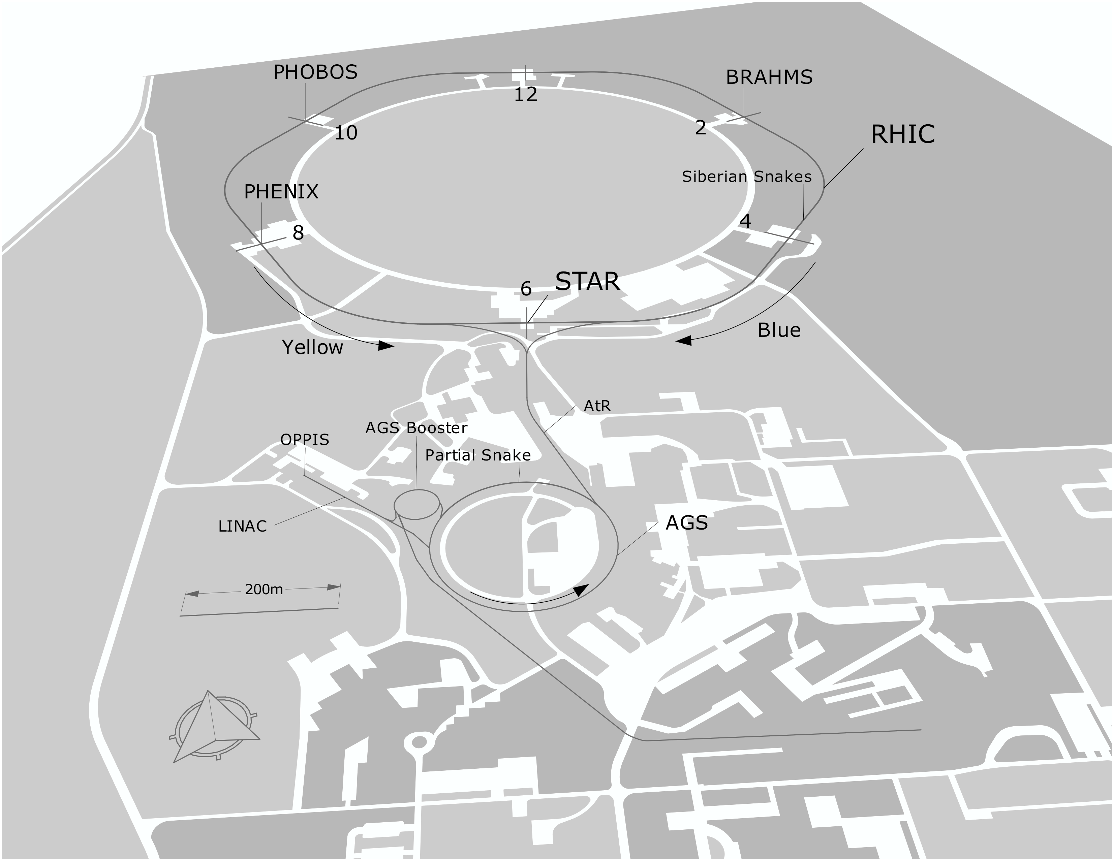
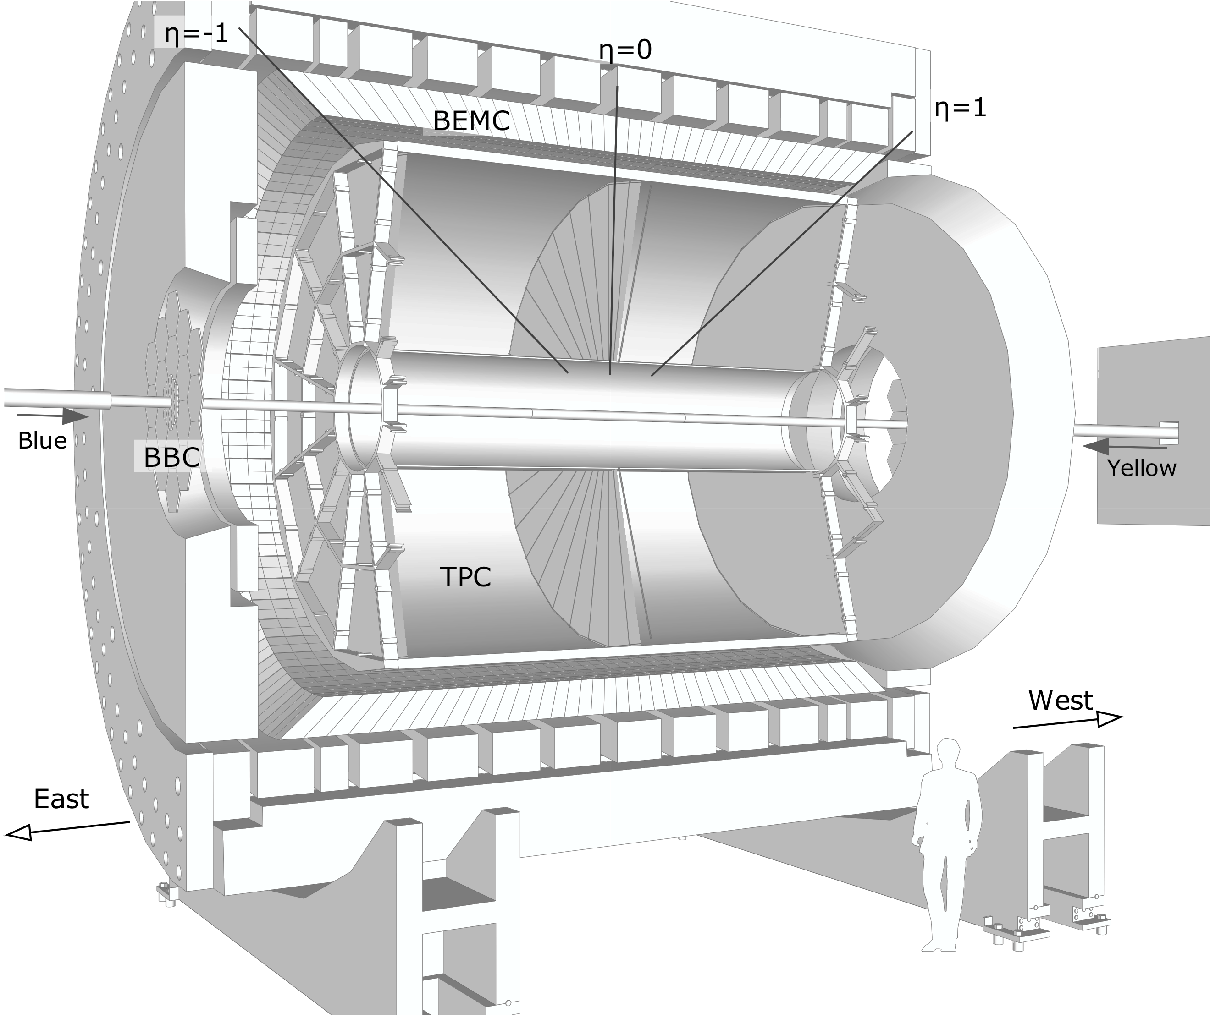
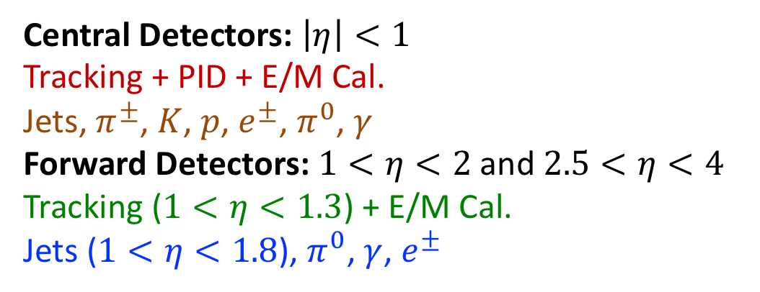
The Solenoidal Tracker at RHIC
RHIC as Polarized-proton Collider
“Siberian Snakes” → mitigate depolarization resonances
Choice of spin orientation → independent of experiment
Spin direction varies bucket-to-bucket (9.4 MHz)
Spin pattern varies fill-to-fill
Central Detectors: $\left|η\right|<1$
Tracking + PID + E/M Cal.
Jets, $π^{±}$, $K$, $p$, $e^{±}$, $π^{0}$, $γ$
Forward Detectors: $1<η<2$ and $2.5<η<4$
Tracking ($1<η<1.3$) + E/M Cal.
Jets ($1<η<1.8$), $π^{0}$, $γ$, $e^{±}$
STAR in 2015

Slide 5
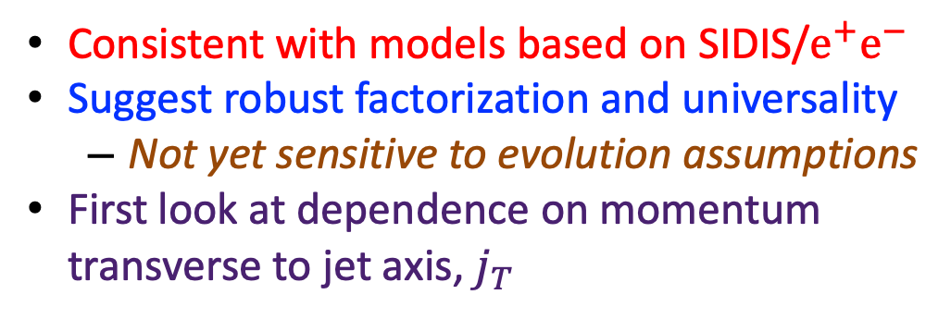
STAR Collins Results at 500 GeV
STAR Collaboration, PRD 97, 032004 (2018)
D’Alesio, Murgia, Pisano: PLB 773, 300 (2017)
Kang, Prokudin, Ringer, Yuan: PLB 774, 635 (2017)
Consistent with models based on SIDIS/$e^{+}e^{−}$
Suggest robust factorization and universality
  Not yet sensitive to evolution assumptions
First look at dependence on momentum transverse to jet axis, $j_{T}$

Slide 6
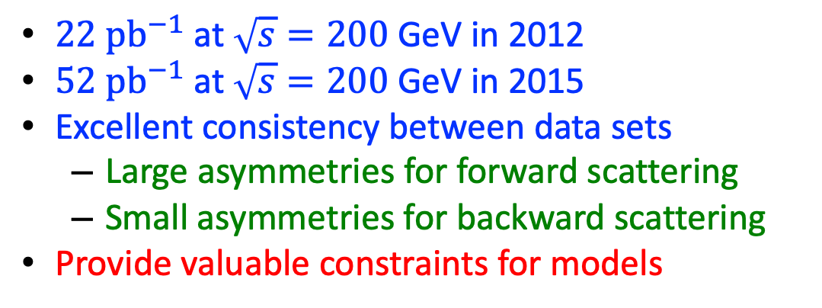


STAR 2012-2015: High Statistics at 200 GeV
$$x_{F}>0$$
$22 {pb}^{−1}$ at $\sqrt{s}=200$ GeV in 2012
$52 {pb}^{−1}$ at $\sqrt{s}=200$ GeV in 2015
Excellent consistency between data sets
  Large asymmetries for forward scattering
  Small asymmetries for backward scattering
Provide valuable constraints for models
$$x_{F}<0$$
STAR Collaboration, arXiv:2205.11800 (accepted by PRD)
Theory: D’Alesio, Murgia, Pisano: PLB 773, 300 (2017)

Slide 7
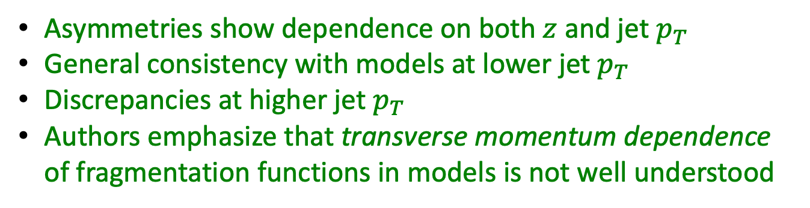
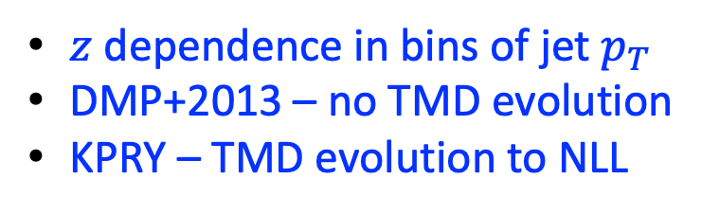
STAR 2012-2015: High Statistics at 200 GeV
$z$ dependence in bins of jet $p_{T}$
DMP+2013 – no TMD evolution
KPRY – TMD evolution to NLL
STAR Collaboration, arXiv:2205.11800 (accepted by PRD)
Theory: D’Alesio, Murgia, Pisano: PLB 773, 300 (2017)
Theory: Kang, Prokudin, Ringer, Yuan: PLB 774, 635 (2017)
Asymmetries show dependence on both $z$ and jet $p_{T}$
General consistency with models at lower jet $p_{T}$
Discrepancies at higher jet $p_{T}$
Authors emphasize that transverse momentum dependence of fragmentation functions in models is not well understood

Slide 8
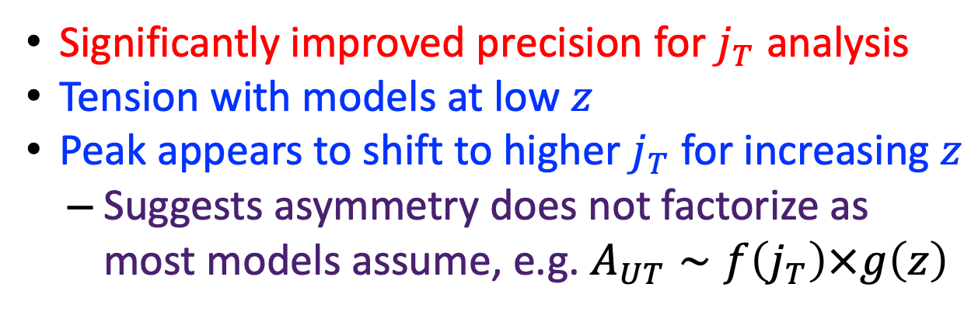
STAR 2012-2015: High Statistics at 200 GeV
Significantly improved precision for $j_{T}$ analysis
Tension with models at low $z$
Peak appears to shift to higher $j_{T}$ for increasing $z$
  Suggests asymmetry does not factorize as most models assume, e.g. $A_{UT}∼f\left(j_{T}\right)×g\left(z\right)$
STAR Collaboration, arXiv:2205.11800 (accepted by PRD)
Theory: D’Alesio, Murgia, Pisano: PLB 773, 300 (2017)
Theory: Kang, Prokudin, Ringer, Yuan: PLB 774, 635 (2017)
Anselmino et al, PRD 73, 014020 (2006)
F. Yuan, PRL 100, 032003 (2008)
D’Alesio et al., PRD 83, 034021 (2011)

Slide 9
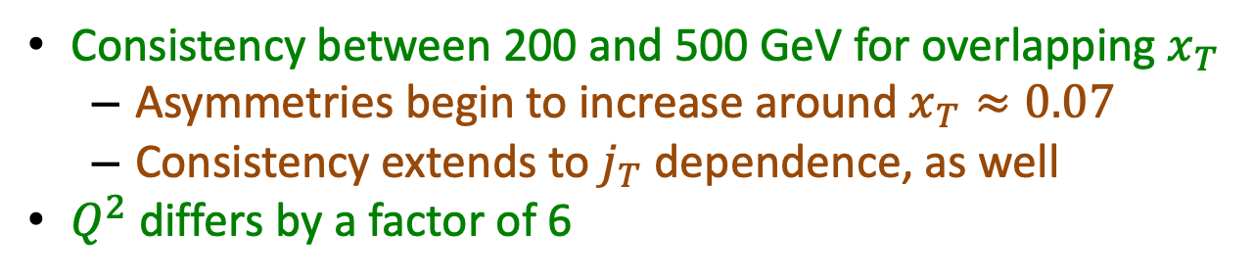
Comparing 200 GeV to 500 GeV
STAR Collaboration, arXiv:2205.11800 (accepted by PRD)
Consistency between 200 and 500 GeV for overlapping $x_{T}$
  Asymmetries begin to increase around $x_{T}≈0.07$
  Consistency extends to $j_{T}$ dependence, as well
$Q^{2}$ differs by a factor of 6

Slide 10
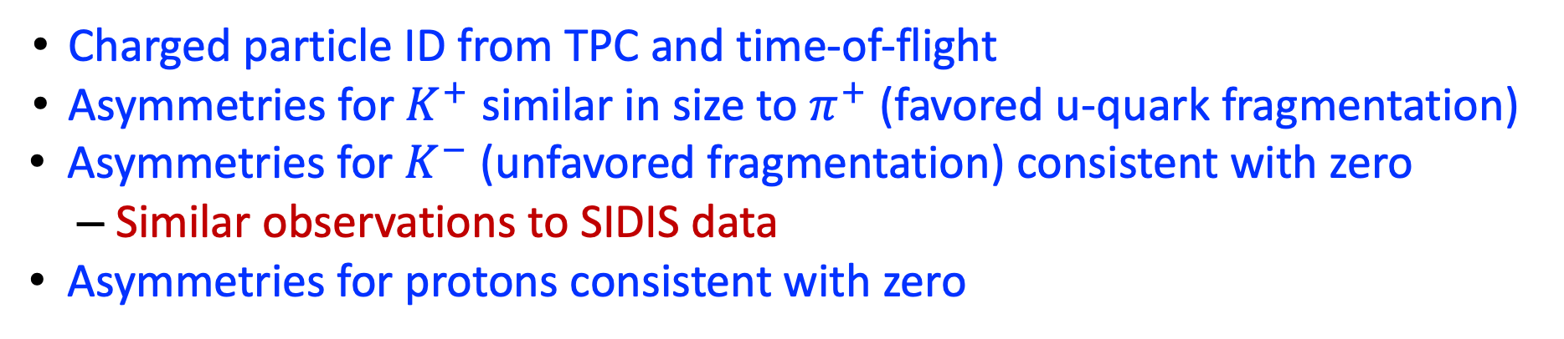
Kaon and Proton Asymmetries at 200 GeV
Charged Particle Identification
STAR Collaboration, arXiv:2205.11800 (accepted by PRD)
Charged particle ID from TPC and time-of-flight
Asymmetries for $K^{+}$ similar in size to $π^{+}$ (favored u-quark fragmentation)
Asymmetries for $K^{−}$ (unfavored fragmentation) consistent with zero
  Similar observations to SIDIS data
Asymmetries for protons consistent with zero

Slide 11
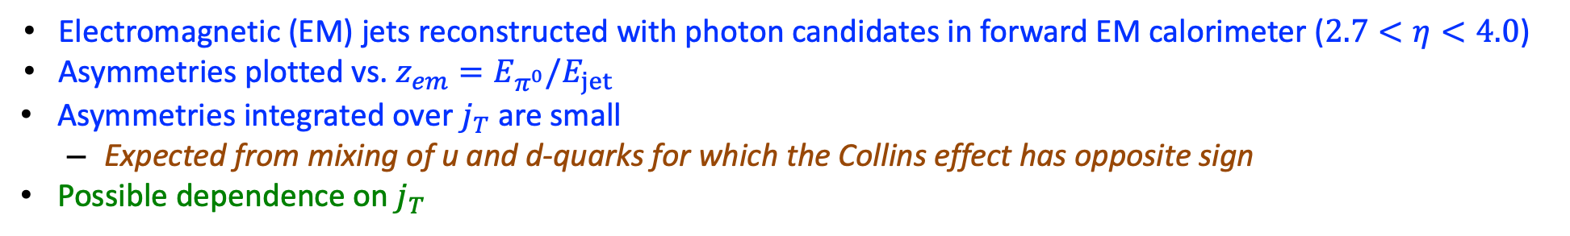

Asymmetries of Neutral Pions in Electromagnetic Jets
$\sqrt{s}=200$ GeV
STAR Collaboration, PRD 103, 092009 (2021)
Theory: Kang, Prokudin, Ringer, Yuan, PLB 774, 635 (2017)
Electromagnetic (EM) jets reconstructed with photon candidates in forward EM calorimeter ($2.7<η<4.0$)
Asymmetries plotted vs. $z_{em}=E_{π^{0}}/E_{jet}$
Asymmetries integrated over $j_{T}$ are small
  Expected from mixing of u and d-quarks for which the Collins effect has opposite sign
Possible dependence on $j_{T}$

Slide 12
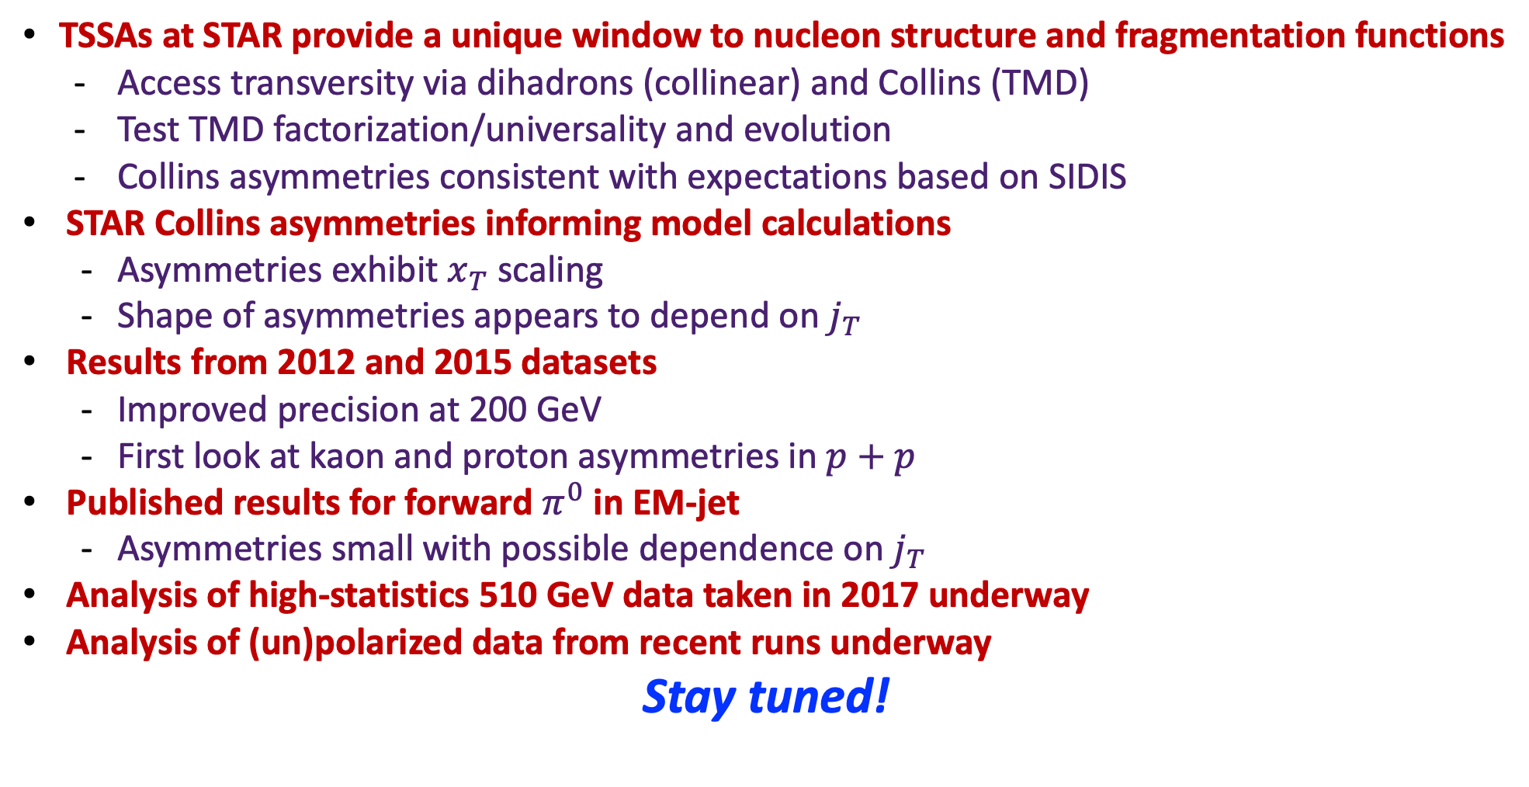
Summary
TSSAs at STAR provide a unique window to nucleon structure and fragmentation functions
  Access transversity via dihadrons (collinear) and Collins (TMD)
  Test TMD factorization/universality and evolution
  Collins asymmetries consistent with expectations based on SIDIS
STAR Collins asymmetries informing model calculations
  Asymmetries exhibit $x_{T}$ scaling
  Shape of asymmetries appears to depend on $j_{T}$
Results from 2012 and 2015 datasets
  Improved precision at 200 GeV
  First look at kaon and proton asymmetries in $p+p$
Published results for forward $π^{0}$ in EM-jet
  Asymmetries small with possible dependence on $j_{T}$
Analysis of high-statistics 510 GeV data taken in 2017 underway
Analysis of (un)polarized data from recent runs underway
Stay tuned!

Slide 13
Back-up Slides

Slide 14
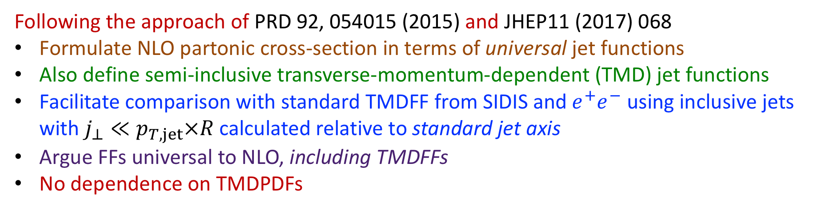
Unpolarized Hadrons Within Jets
Following the approach of PRD 92, 054015 (2015) and JHEP11 (2017) 068
Formulate NLO partonic cross-section in terms of universal jet functions
Also define semi-inclusive transverse-momentum-dependent (TMD) jet functions
Facilitate comparison with standard TMDFF from SIDIS and $e^{+}e^{−}$ using inclusive jets with $j_{⊥}≪p_{T,jet}×R$ calculated relative to standard jet axis
Argue FFs universal to NLO, including TMDFFs
No dependence on TMDPDFs

Slide 15
Collins-like Effect at RHIC
Collins-like effect: Sensitive to linearly polarized gluons in a transversely polarized proton
STAR Collaboration, PRD 97, 032004 (2018)
STAR Collaboration, arXiv:2205.11800

Slide 16

Collins Effect at RHIC
$j_{T}$ dependence in bins of jet $p_{T}$
STAR Collaboration, arXiv:2205.11800

