Slide 1
Measurement of Charge Asymmetry Correlations in Heavy Ion Collisions
Quan Wang, Purdue
For STAR Collaboration

Slide 2
Outline
Motivation : Chiral Magnetic Effect
Charge Asymmetry Observables
Results
Summary

Slide 3
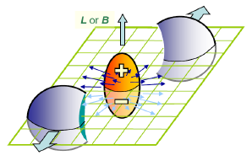
Motivation
Chiral Magnetic Effect:
LPV + large magnetic field
charge separation along the system angular momentum.
Kharzeev et al. NPA 803 (2008) 227

Slide 4
Chiral Magnetic Effect (CME)
+2/3
+2/3
L
R
u
u
R
Color Field
-1/3
-1/3
L
R
d
d
R
Charge Separation
B Field

Slide 5
Charge Asymmetry Observables
UP
LPV effects in UD. LR is null-reference.
LPV expectations:
A_{+UD} and A_{-UD} are anti-correlated
‹A₊A₋›_{UD} < ‹A₊A₋›_{LR}
Additional dynamical fluctuation broadens A_{±UD} distributions
‹A±²›_{UD} > ‹A±²›_{LR}
LEFT
RIGHT
EP
DOWN

Slide 6
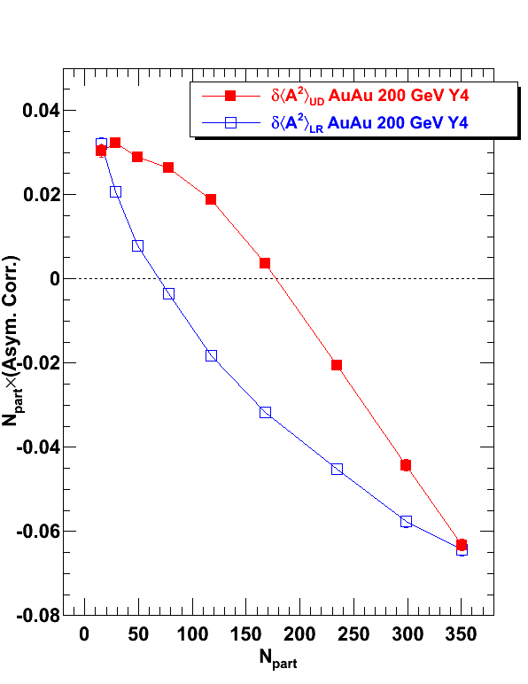
δ‹A²›
In peripheral, both δ‹A²›_{UD} and δ‹A²›_{LR} are positive.
Like-sign pairs more likely in same direction. (small-angle correlation)
In central, both negative.
Like-sign pair more likely back-to-back.
Small-angle same-sign correlation is stronger in UD than LR.
STAR preliminary

Slide 7
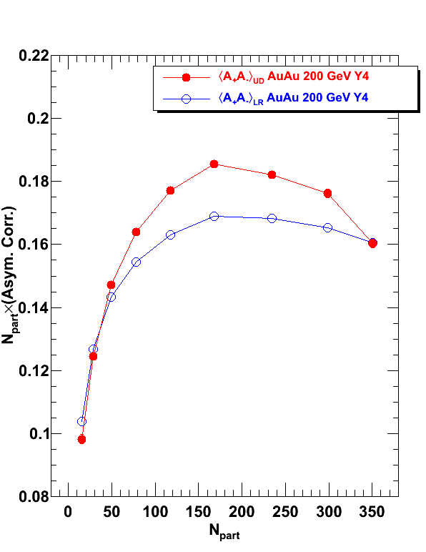
‹A₊A₋›
Both ‹A₊A₋›_{UD} and ‹A₊A₋›_{LR} are large and positive.
Positive and negative charge particles are strongly correlated.
Small-angle opposite-sign correlation is stronger in UD than LR.
STAR preliminary

Slide 8
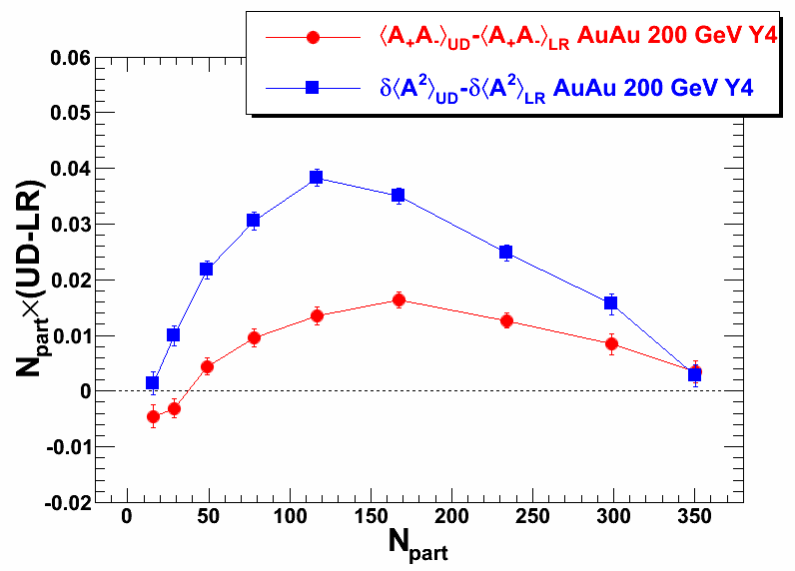
UD-LR
δ‹A²›_{UD} > δ‹A²›_{LR}
Same-sign broadening in UD is larger than LR, consistent with LPV expectation.
However, same-sign are preferentially back-to-back.
STAR preliminary
‹A₊A₋›_{UD} > ‹A₊A₋›_{LR} > 0
Opposite-sign are more strongly emitted in the same direction in UD than LR, which is inconsistent with LPV expectation
Similar centrality dep.

Slide 9
Summary
Dynamical charge asymmetry correlations are presented.
Same-sign (δ‹A²›):
more small-angle correlation in peripheral.
more back-to-back in mid-central to central.
broadening more strongly in UD than LR.
Opposite-sign (‹A₊A₋›):
always in the same direction.
More strongly in UD than LR.
Same-sign measurements COULD BE consistent with LPV expectation, while the opposite-sign measurements are inconsistent with LPV expectation. More experimental as well as theoretical works are needed to further investigate the underlying physics.

Slide 10
Analysis Details
Data set:
AuAu 2004 MinBias 200GeV (20M events)
Standard STAR event and track cuts
To avoid self-correlation effect:
EP: η<0; Asym η>0
EP: η>0; Asym η<0
η<0
η>0

Slide 11
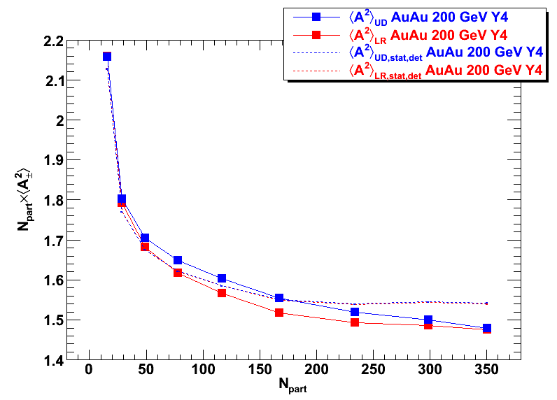
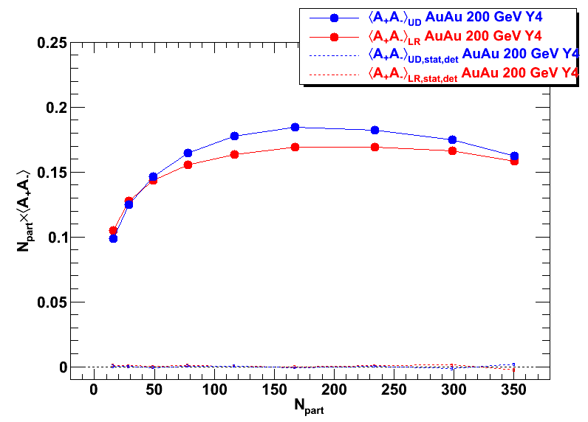
‹A²›, ‹A₊A₋› and Stat. Fluc.
STAR preliminary
STAR preliminary
φ
Random Flip
Statistic fluctuation and detector effect, Dashed line.
Stat. Fluc. Shows only in ‹A²›, and is larger then ‹A²›
TPC
φ+π

Slide 12
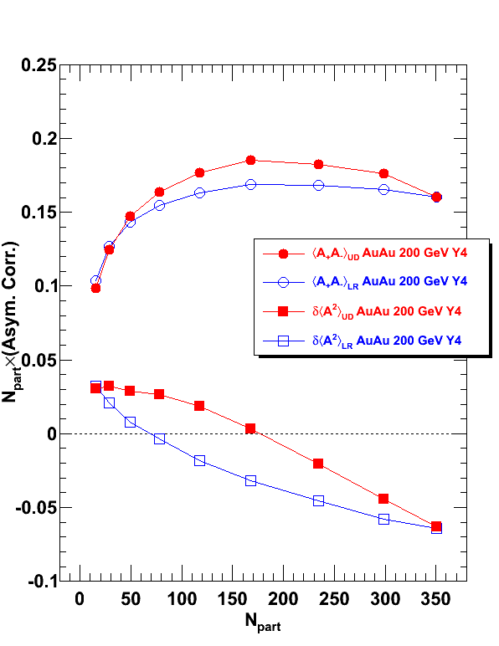
Summary of δ‹A²› and ‹A₊A₋›
STAR preliminary
In peripheral, particles are preferentially in same direction, regardless same-sign or opposite-sign charges.
In mid-central to central, opposite-sign prefer in the same direction, but same-sign prefer back-to-back.

Slide 13
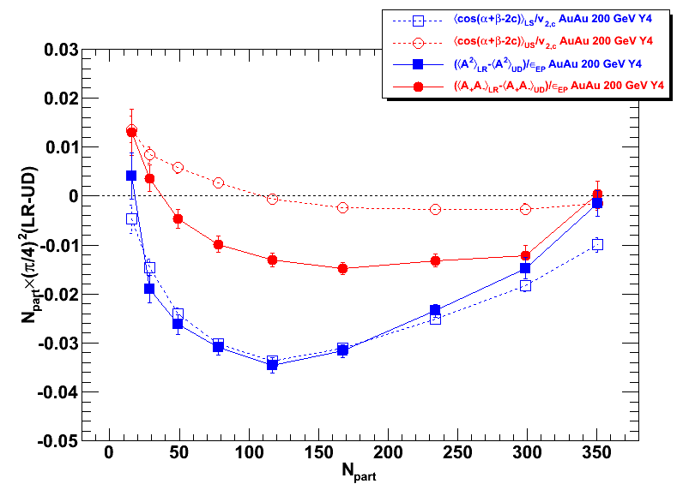
LR-UD Compared to 3-point Correlator
UD-LR: infinite number of harmonic terms.
Δ‹A²›: Higher-order terms may be small.
Δ‹A₊A₋›: Higher-order terms are important.
STAR preliminary

