Slide 1
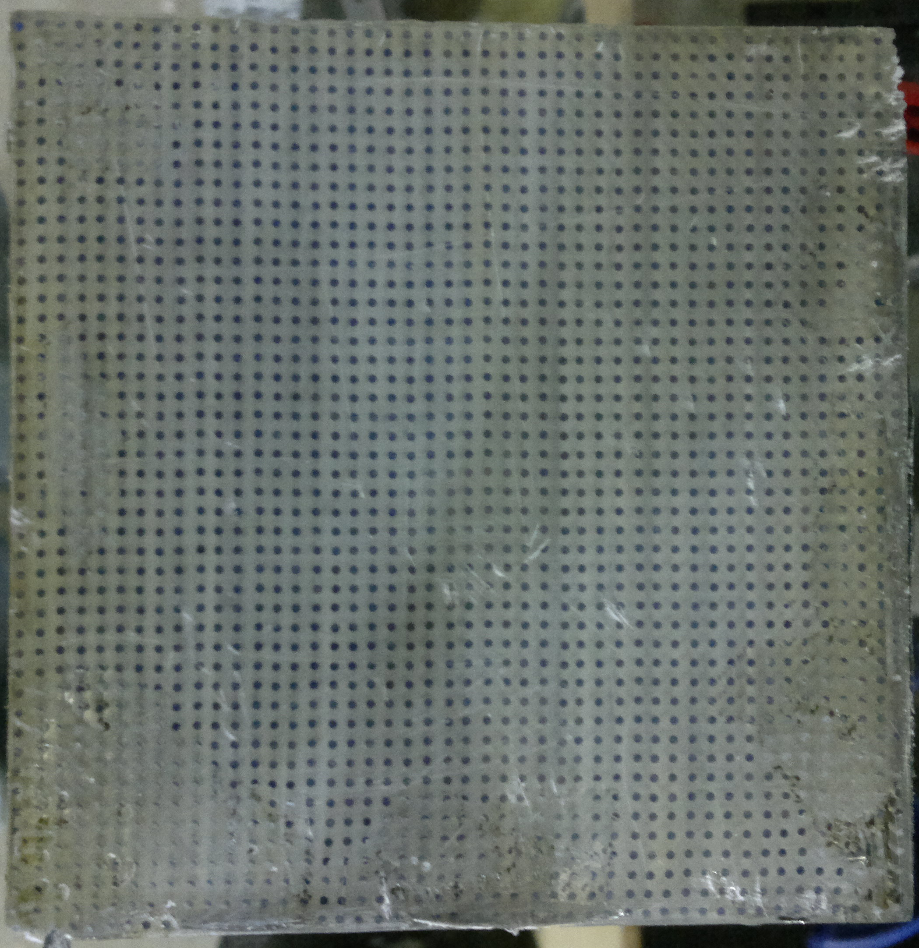





R&D Studies of a Lead-Scintillating Fiber Calorimeter as a STAR Forward Detector
Prashanth Shanmuganathan
(for FCal group at STAR)
Outline
Physics and R&D goals
Pixelizing the existing cells to improve resolution
Results from Fermilab Test Beam Facility-T1064
Prototype at STAR in Run-14
Conclusions
Outlook: Proposed annular geometry at STAR
10 cm
10 cm

Slide 2
Physics Motivations
Improve limited forward instrumentation
Δy~2
D0
IP6
D0
φ
DX
DX
D0
D0
L : insertion length
-y_{Beam}
y
+y_{Beam}
RHIC has large insertion lengths
Measurement of large X_{F} particle production is feasible
Sufficient pT
2

Slide 3
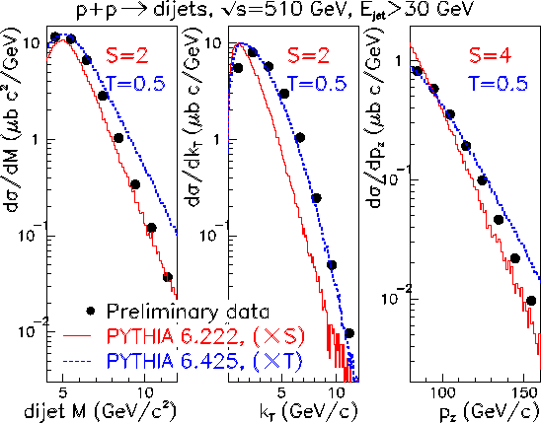
Physics Motivations
Improve limited forward instrumentation
Proton structure
  Drell Yan
  Dijets
A_{n}DY :Perpendicularly polarized p+p
STAR : Spin rotators
=> +/- Helicity proton beam
=> Gluon polarization
=> Low-X measurements
Dijet cross sections as functions of dijet mass (M)
Dijet momentum imbalance (kT)
Dijet longitudinal momentum (pz)
arXiv:1308.4705
2

Slide 4
Physics Motivations
Improve limited forward instrumentation
Proton structure
  Drell Yan
  Dijets
Heavy-ion collision
  Event plane detector for all energies
    Strong flow at large η ➔ Better event plane resolution
    Large η gap ➔ Smaller non flow contribution to flow analysis
2

Slide 5
Physics Motivations
Improve limited forward instrumentation
Proton structure
  Drell Yan
  Dijets
Heavy-ion collision
  Event plane detector for all energies
  Centrality selection
  Long range near side rapidity correlation
  Forward jets in asymmetric HI collisions
  Induced Λ polarization
P_{Λ}
pT
p
p
P_{Λ}
x_{F} ⬆
2

Slide 6
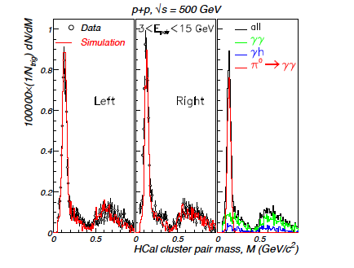
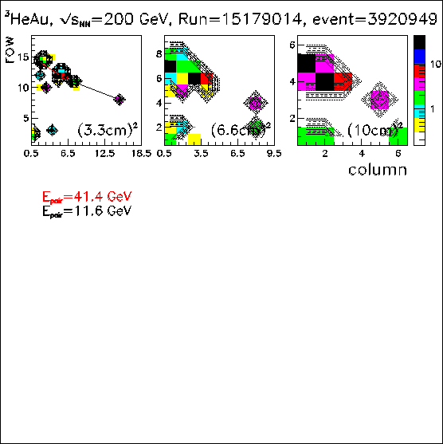
Goals of R&D project
A_{n}DY – (10 cm)²
3 < E_{pair}< 15 GeV
Does increasing transverse resolution allow reconstruction of neutral pions at higher energies?
  Reconstructing pions -> Tool to calibrate FCal
Can we discriminate incident hadrons (e.g. π, K,..) from electromagnetic particle (e.g. ϒ, e⁺,e⁻,…) showers?
100000×(1/N_{trg})dN/dM
Cluster pair mass(GeV/c²)
3 < E_{pair}< 50 GeV
Cell row
arXiv:1304.1454
Cell column
3

Slide 7
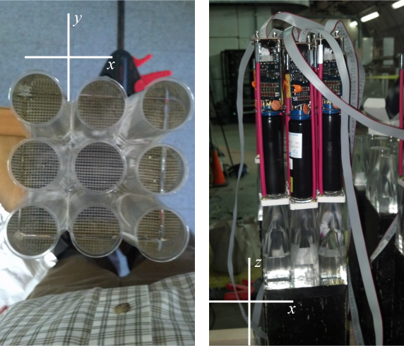
Pixelizing AGS-E864 cells
Transverse resolution is increased by pixelizing
  (10 cm)² cells ➔ 3×3 array of (3.3 cm)² cells
  Specially designed totally internal reflective optically isolated light guides
  xp2972 photomultiplier tubes
Existing FMS detector electronics with STAR triggers for data collection
4

Slide 8
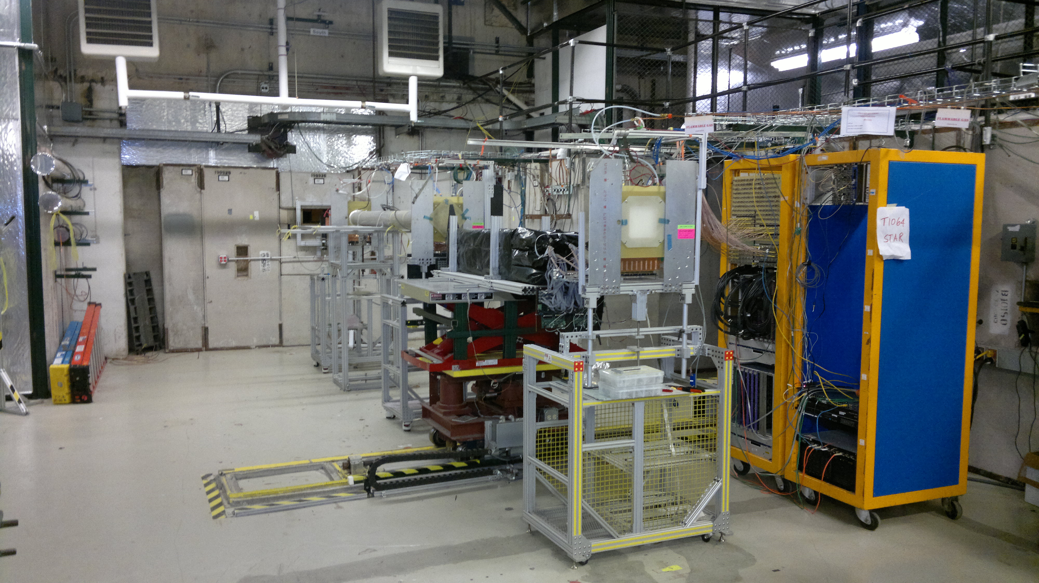
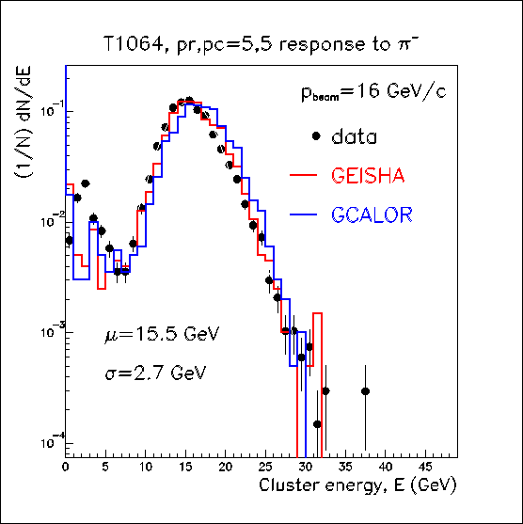
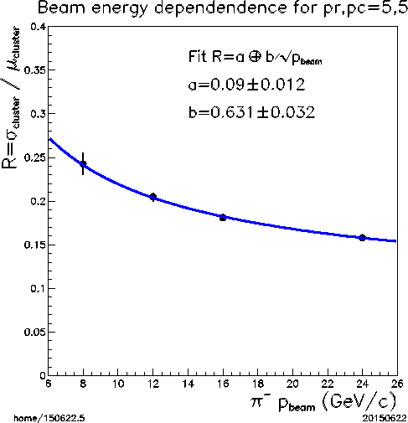
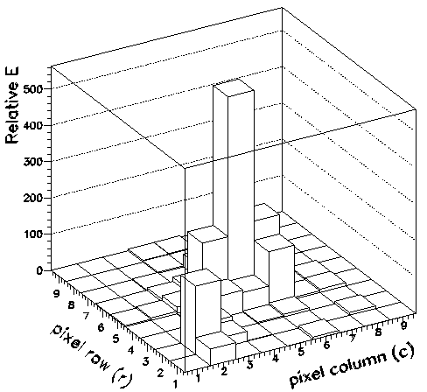
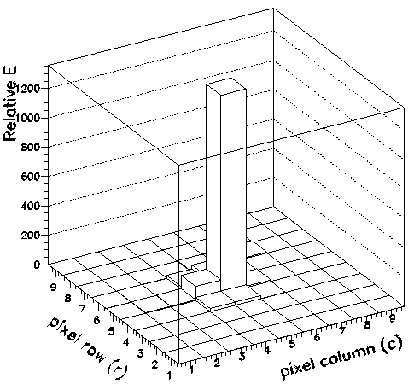
Results from Fermilab Test Beam Facility-T1064
Cluster energy distribution of center pixel for π⁻ beam
Cluster energy resolution for π⁻ on central pixel
FHC cells
MWPC
1 GeV (π,K,p) to 120 GeV p (resolution <3% )
Cerenkov Detector (Particle Identification)
MWPC Tracking System (Beam profile, trigger)
3×3 Cells (9×9 pixel) were used
Studied shower shapes of e⁻ & π⁻ at beam momenta : 8, 12, 16, 24 GeV/c
Simulations shows good agreement with data
Shows clean separation between e⁻ & π⁻ shower shapes
High Tower
π⁻ 16 GeV/c
e⁻ 16 GeV/c
http://ppd.fnal.gov/ftbf/
5

Slide 9
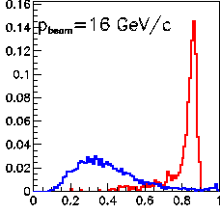
Results from Fermilab Test Beam Facility-T1064
Cluster energy distribution of center pixel for π⁻ beam
Cluster energy resolution for π⁻ on central pixel
FHC cells
MWPC
1 GeV (π,K,p) to 120 GeV p (resolution <3% )
Cerenkov Detector (Particle Identification)
MWPC Tracking System (Beam profile, trigger)
3×3 Cells (9×9 pixel) were used
Studied shower shapes of e⁻ & π⁻ at beam momenta : 8, 12, 16, 24 GeV/c
simulations shows Good agreement with data
Shows clean separation between e⁻ & π⁻ shower shapes
π⁻
e⁻
dN/dR (Normalized)
R=E_{HighTower}/E_{Cluster}
http://ppd.fnal.gov/ftbf/
5

Slide 10
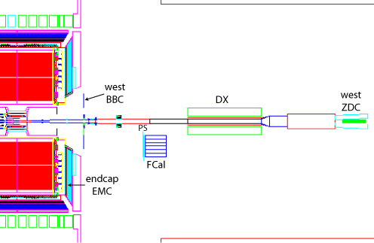
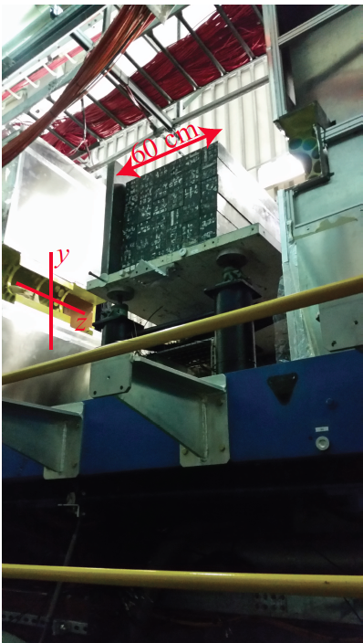
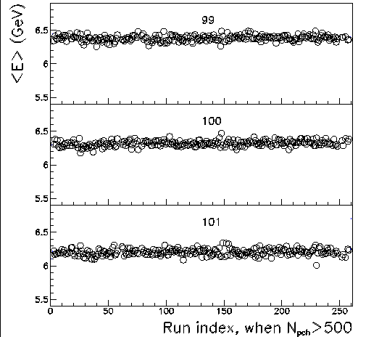
2014 Prototype at STAR
6×6 array of cells (18×18 pixel) were mounted on the North-West side of STAR
Best transverse resolution in forward direction
  Granularity
  Hadronic response
  Large rapidity window
√s_{NN} = 200 GeV Au+Au collisions for commissioning
√s_{NN} = 200 GeV ³He+Au collisions for calibration and analysis
Average energy deposition per run shows stable response throughout the operation
³He
Au
  (x,y,z) = (-41.4,3.3, 718.9) cm
4 < E < 18 GeV
Luminosity of ³He+Au ≈ 25 pb⁻¹ of p+p
6

Slide 11
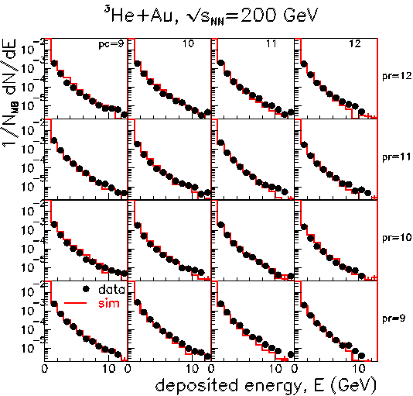
Calibration – Relative calibration of pixel
Relative gain correction factors for each pixel are corrected in two steps
1st approximation
  Relative calibration of pixel by comparing the slope from dN/dE distributions from data and simulation
7

Slide 12
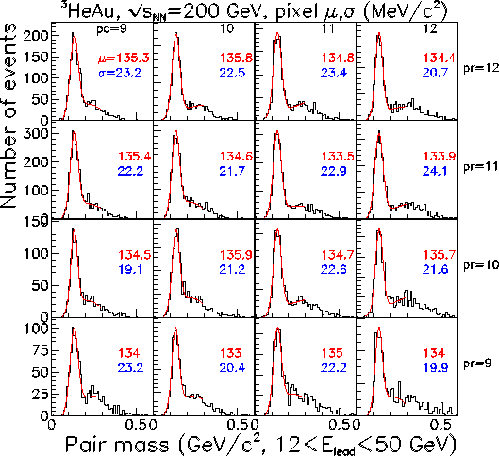
Calibration – Relative calibration of pixel
Relative gain correction factors for each pixel are corrected in two steps
1st approximation
  Relative calibration of pixel by comparing the slope from dN/dE distributions from data and simulation
2nd approximation - relative energy scale of pixels
  Invariant mass of reconstructed cluster pair; high tower is associated to the pixel
  Iterate until cluster pair mass converge to π⁰ mass
Fitted Gaussian centroid (μ) in red
Fitted Gaussian sigma (σ) in blue
Further, energy dependent correction is also applied for pair mass
7

Slide 13
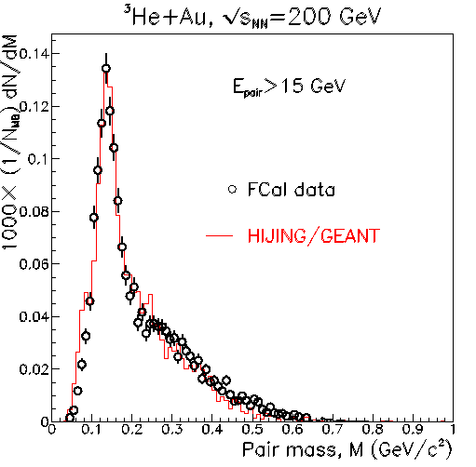
Data vs. Simulation
Invariant mass of good cluster pairs from data vs. Simulation
  Assumed clusters are from π⁰ decay daughters
  But, clusters may arise from non photons
Vertical axis scaled by minimum-bias events
=> Data and Simulation are in good agreement
8

Slide 14
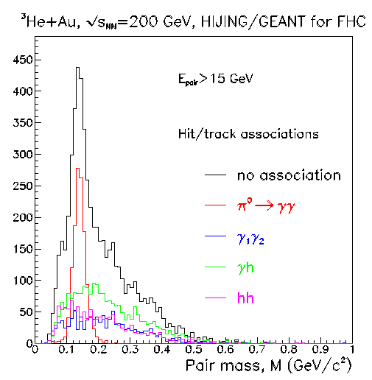
Data vs. Simulation
Hits/Clusters were identified using associated particles in simulation
Dominant background is when one cluster is a photon and the other is a hadron
  Can be effectively reduced by good pre-shower detector and additional e/h discrimination from FCal
8

Slide 15
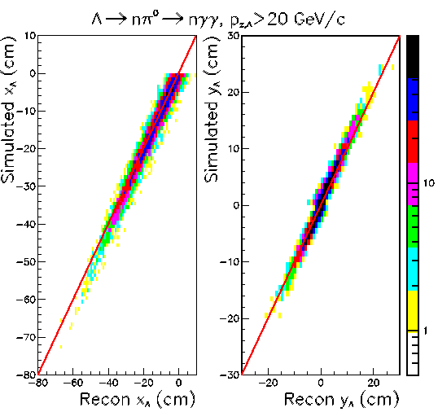
Lambda reconstruction - Ongoing
PYTHIA events
<x,y> are Λ impact point, from energy weighted average of n, ϒ, ϒ measured positions
Y-axis : PYTHIA decay vertex
X-axis : PYTHIA decay vertex is reconstructed including FCal acceptance and efficiencies
Require two photons and neutron to make distinct clusters
=> The Λ decay vertex can be reconstructed from n, ϒ, ϒ measurements in FCal
Λ
Decay length
n
Z_{π}
ϒ
<x,y>
ϒ
FCal
9

Slide 16
Conclusions
Pixelizing E864 cells allows reconstruction of neutral pions to higher energy up to ≈50 GeV
3 < E_{pair}< 50 GeV
row
column
10

Slide 17
Conclusions
Pixelizing E864 cells allows reconstruction of neutral pions to higher energy up to ~50 GeV
3 < E_{pair}< 50 GeV
row
column
10

Slide 18
Conclusions
Pixelizing E864 cells allows reconstruction of neutral pions to higher energy up to ~50 GeV
3 < E_{pair}< 50 GeV
Epair = 41.4 GeV
Epair = 11.6 GeV
row
column
10

Slide 19
Conclusions
Pixelizing E864 cells allows reconstruction of neutral pions to higher energy up to ~50 GeV
Hadronic shower shapes can be distinguished from EM showers with greater than 90% confidence
FCal was stable through ³He+Au collision
Radiation Hardness - no energy re-calibration required over duration of ³He+Au running
Material in-between interaction point and FCal is sufficiently modeled by Geant
10

Slide 20
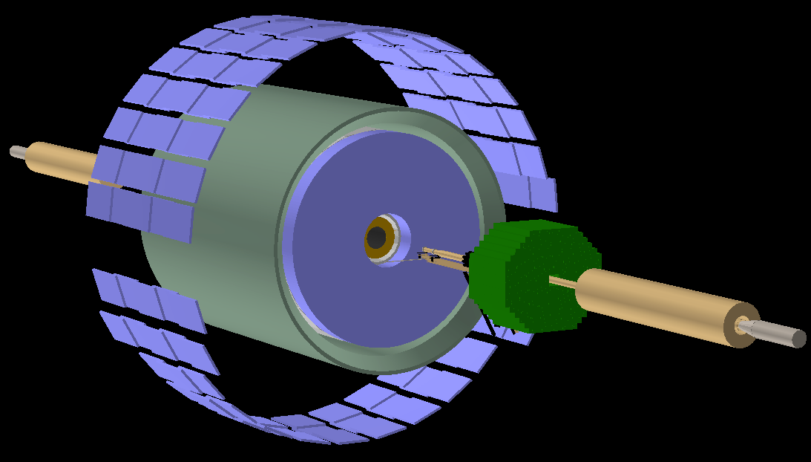
Outlook :Proposed Annular Geometry at STAR
Up (+Y)
18×18 by array (316 cells,2844 pixel)
0 ≤ φ ≤ 2π azimuth coverage
2.7 ≤ η ≤ 4.5 rapidity coverage
=>Best resolution in forward direction
South (+X)
West (+Z)
Enables di-jets for low-x measurements
Enables event plane for pA and AA collisions & Centrality selection
Enables long range correlations over -1.1 > η > 4.5
Combined with tracking detectors (e.g. FGT,FPS) physics goals can be extended with unique beam energy range provided by RHIC
  (Drell-Yan, Baryon Stopping, Flow measurements,…)
Significantly improve forward (X_{F} > 0.1) instrumentation at STAR
11

Slide 21
Backup

Slide 22
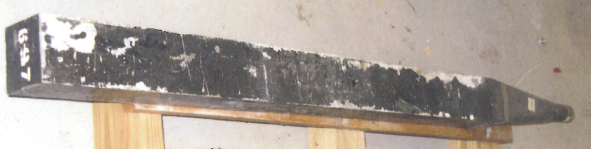
The AGS-E864 lead-scintillating ﬁber hadronic calorimeter
Independent measurement of masses of produced particles
Cell size :(10 cm)² × 117 cm
Showering material is lead
Energy deposition is measured by 47×47 array of scintillating plastic fibers(Spaghetti-type)
1st repurpose – Phenix & Phobos
2nd repurpose - A_{n}DY
3rd repurposing at STAR
117 cm
10 cm
10 cm
Hadronic resolution : 34/√E %
T.A. Armstrong, et al. NIM 406 (1998) 227

Slide 23
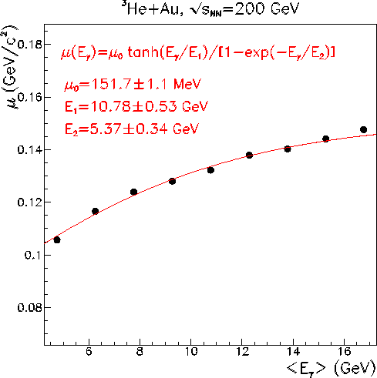
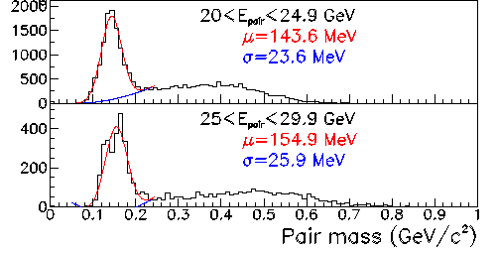
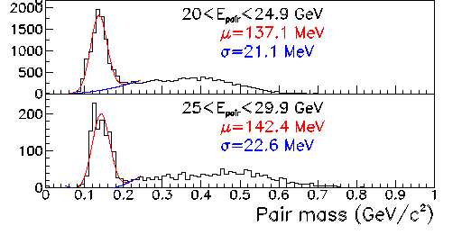
Calibration – Energy Dependence
Energy dependence (non-linearity) between cluster and the incident particle that created the cluster
Dominated by thresholds (e.g.: ADC, cluster finder)
π⁰ mass as a function of leading photon energy
Cluster energy
Pair mass before E correction
Pair mass after E correction

Slide 24
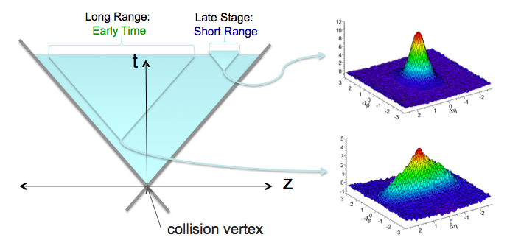
    Long range near side rapidity correlation

Slide 25
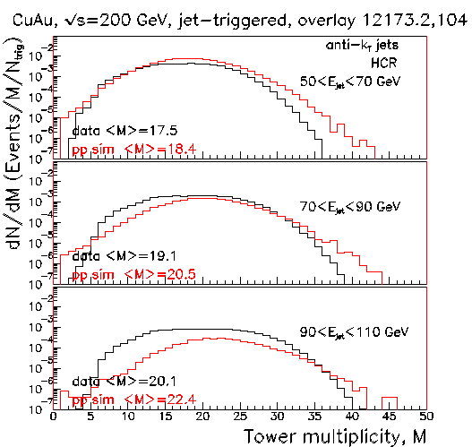
    Forward jets in asymmetric HI collisions
A_{n}DY preliminary

