Slide 1

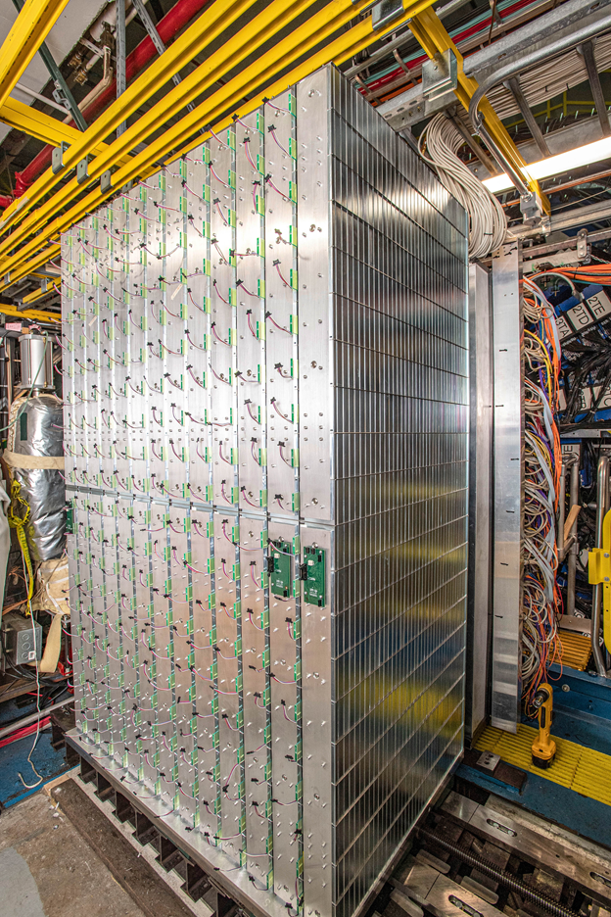
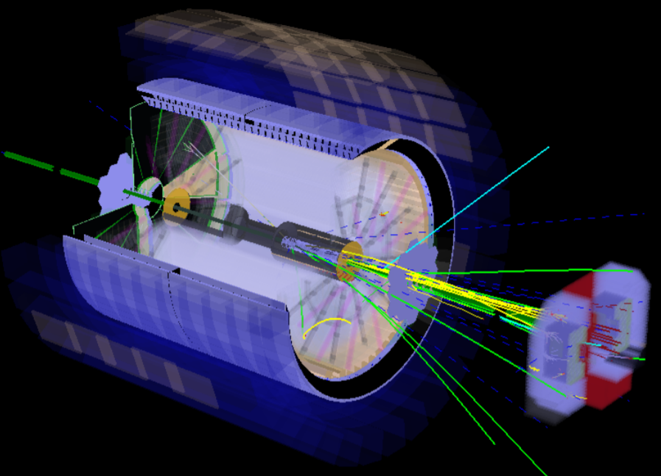
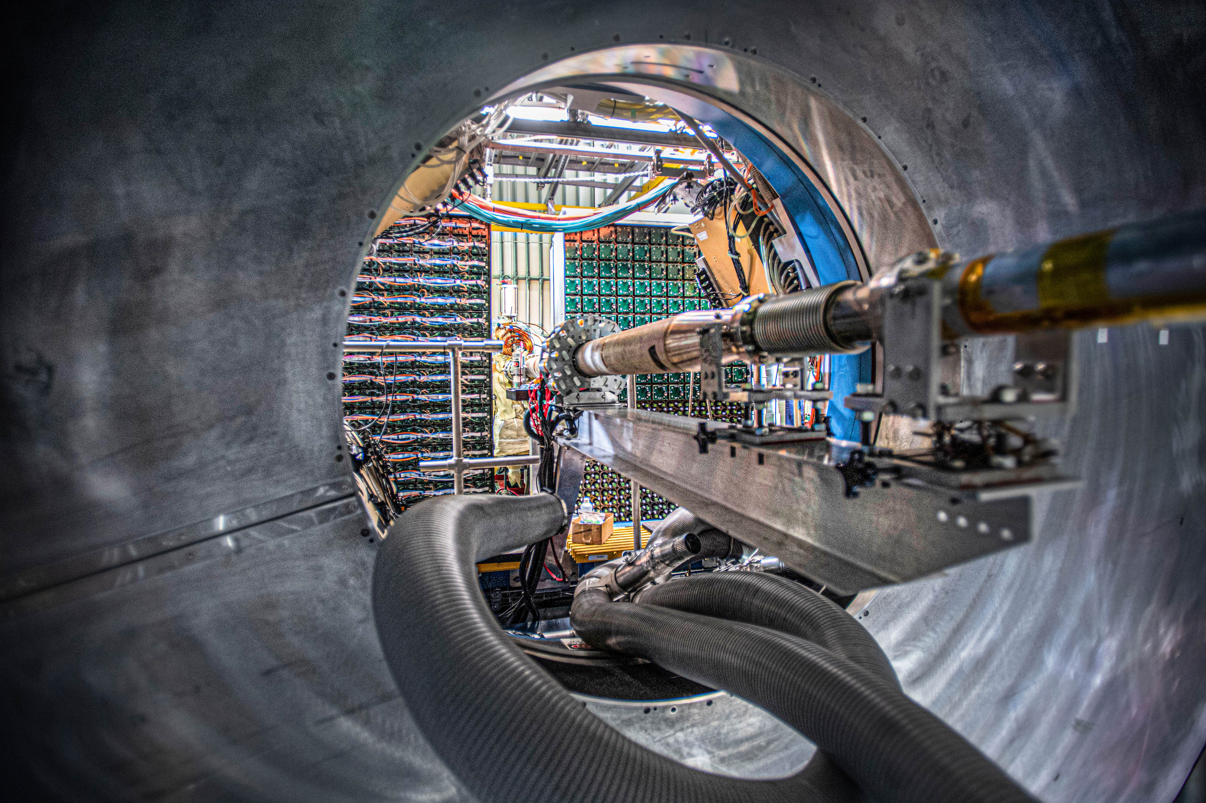
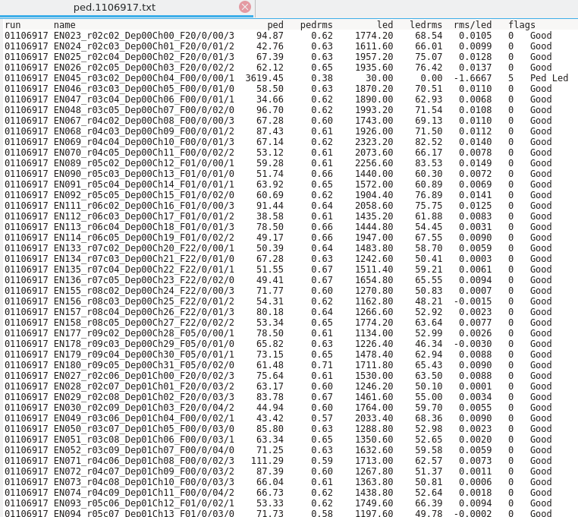
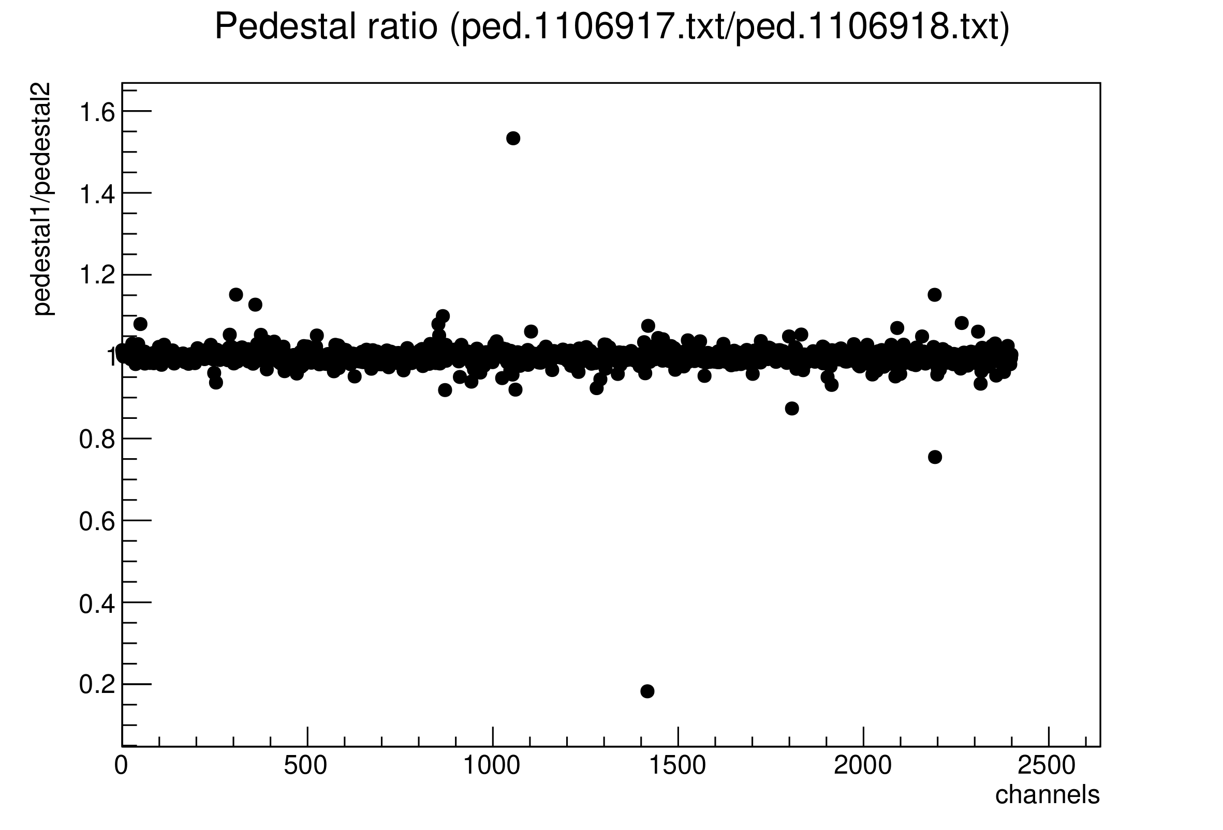
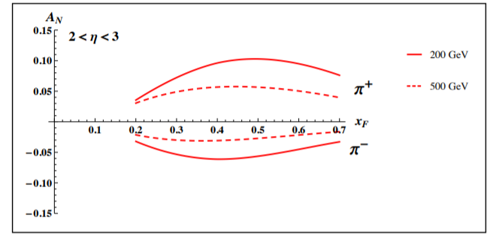
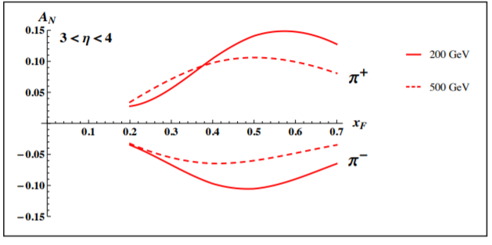

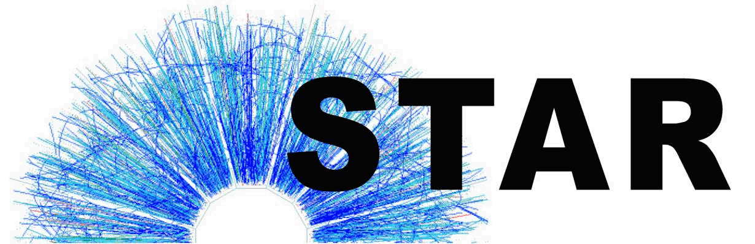

Assessing the Performance of the STAR Forward Calorimeter System
Noah Mitchell of Abilene Christian University for the STAR Collaboration
www.acu.edu
The STAR Experiment
HCAL and ECAL
Analysis Code
Next Steps
The STAR Experiment at RHIC focusses on studying nuclear matter and nuclear structure through the collisions of heavy ions and spin-polarized protons. One region of interest are effects due the transverse momentum structure of partons in the proton and their rapidity / x dependence on, specifically how the Collins effect changes for different kinematic regions. This is accomplished by the large rapidity coverage of the STAR detector. But the forward rapidity region has been not well covered until recently.
The two primary subsystems of the Forward Upgrade are the hadronic (left) and electromagnetic (right) calorimeters. Both can be pictured below, providing us with a more complete picture of the energies of particles in the forward region. To ensure we get high quality data for polarized pp run in 2022, we have been testing both very extensively over run-2021, examples are pedestals and the readout with the LED.
For this analysis, we used a C++ ROOT analysis code. The method of implementation was to read in the files into a vector, and then iterate over that vector to produce graphs. The opening of all the files was done in TGraph. Since Tgraph has some built in parsing capabilities, we took our files and directly defined what each column of data would be (string, float, etc.) Since TGraph is capable of parsing data, this is perfectly fine for slow controls information, like the current.
One of our next steps at STAR is to take this program and having the graphs be posted to the FCS monitor to have them regularly available, instead to have them existing locally, or only at the online cluster. Another plan moving forward is to make the program more efficient in how it organizes the data being taken and representing them, possibly by using a tree or tuple system instead of graphing directly through the TGraph. This would also probably be a more efficient for opening the data files. Below is an example of the files created
STAR Forward Upgrade
ROOT Analysis
The purpose of the STAR forward upgrade is to cover a rapidity region on 2.8 to 4. to access high and low-x partons. Below we show the latest prediction for the transvers single spin asymmetries for π+ and π- at forward rapidities and different √s. Measuring these asymmetries could finally explain the underlying science of the large SSA A_{N} for π⁰s at forward rapitities.
To analyze the efficiency of the HCAL and ECAL systems, LED and Pedestal data were taken with the instruments during runs. This was done to ensure that the noise was staple across different runs, so that the measurements will be of high quality come the 2022 run of STAR. Here is a comparison between two runs, which is just a sample from the 157 graphs that were made. This run indicates that there was minimal differences between the pedestal across two runs. We can extrapolate from this information that there was not any noticeable damage due to radiation done to the new components in the Forward Calorimeter System during our 2021 run.
Conclusion
The calorimeter systems appears to not show any time dependence for the ratios for pedestal and LED data for different data, with a few outliers. This means that we should get excellent data come next year’s run in 2022.
Acknowledgements
DEPARTMENT OF ENGINEERING AND PHYSICS

