Slide 1
Measurement of Transverse Single-Spin Asymmetries for Forward π⁰ and Electromagnetic Jets in Correlation with Midrapidity Jet-like Events at STAR in p+p Collisions at
√s = 500 GeV
Mriganka Mouli Mondal (for STAR experiment)
Texas A&M University
Outline :
Transverse Single Spin Asymmetries (TSSA)
Forward Meson Spectrometer in the STAR experiment
EM-Jets in forward and central rapidity
A_{N} measurements from the 2011 RHIC Run at √s = 500 GeV

Slide 2
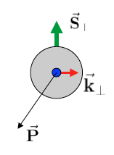
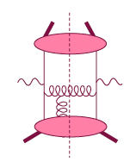
TSSA – in the initial state
Spin-dependent transverse momentum
dependent (TMD) function S_{T}.(Pxk_{T})
Brodsky, Hwang, Schmidt, 02
Collins, 02, Ji, Belitsky, Yuan, 02
Twist-3 quark-gluon correlations
Efremov & Teryaev: 1982 & 1984
Qiu & Sterman: 1991 & 1999
Intermediate Q_{T}
Q>>Q_{T}/p_{T}>>Λ_{QCD}
Transverse
momentum
dependent
Q>>Q_{T}>=Λ_{QCD}
Q>>p_{T}
Collinear/
twist-3
Q,Q_{T}>>Λ_{QCD}
p_{T}~Q
Efremov, Teryaev;
Qiu, Sterman
Sivers fct.
Q_{T}/P_{T}
Λ_{QCD}
<<
Q_{T}/P_{T}
<<
Q
In additions TSSA can arise from final state effects.
Need 2 scales
Q² and p_{t}
Remember pp:
most observables one scale
Some Exceptions:
DY, W/Z-production
Need only 1 scale
Q² or p_{t}
But
should be of reasonable size
should be applicable to
most pp observables
A_{N}(π⁰/γ/jet)
Notes:
Initial state TSSA – in the initial stae
TSSA – can arise final state effects

Slide 3
π⁰ A_{N} Measurements at Forward Rapidity
Inclusive π⁰ production
Transverse Single Spin Asymmetry
x_{F} = 2p_{Z}/√s
Rising A_{N} with X_{F}
A_{N} nearly independent of √s
No evidence of fall in A_{N} with increasing P_{T}

Slide 4
RHIC : the world’s first and only polarized proton collider
For 2011 : Average Blue Beam Polarization = 51.6% (Transverse)
Luminosity =22 pb-1
Hydrogen Jet Polarimeter
Carbon Polarimeters
Siberian Snakes
Beams: √s 62.4 - 500 GeV pp
PHENIX
Spin Flipper
STAR
Spin Rotators
Siberian Snakes
Tune Jump Quads
Polarized Source
Helical Partial Snake
LINAC
AGS
200 MeV Polarimeter
BOOSTER
Strong Snake
AGS Internal Polarimeter
RF Dipole
AGS pC Polarimeter

Slide 5
Forward ECAL in STAR
FMS Pb Glass EM Calorimeter
pseudo-rapidity 2.7<<4.0
Small cells: Outer cells(towers)
3.81x3.81 cm 5.81 x 5.81 cm
x_{F} > 0
Forward Meson Spectrometer (FMS) :
-- Pb glass EM calorimeter covering 2.5< η <4.0
-- Detect 𝜋⁰,η, direct photons and jet-like events in the kinematic region where transverse spin asymmetries are known to be large.

Slide 6
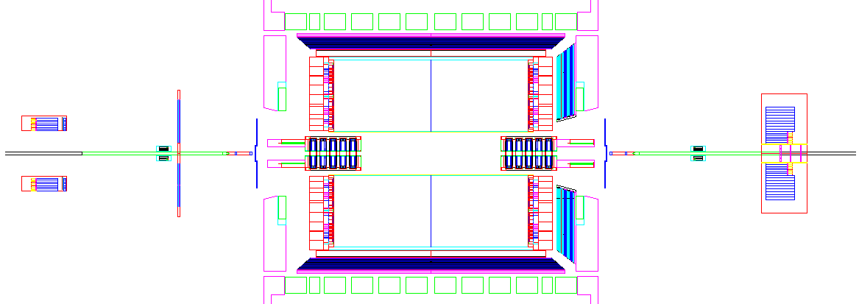
STAR detector cross view
BEMC
EEMC
FMS
FPD
TPC
VPD
VPD
ZDC
BBC
ZDC
BEMC+EEMC towers : to find central electromagnetic jets
FMS photons : to find forward electromagnetic jets
FMS photon reconstruction :
towers clusters photons
shower shape fitting

Slide 7
The 2011 RHIC Run for pp @ √s=500 GeV
Forward Electromagnetic Jets (EM-Jets)
Jet algorithm : anti-kt
R-parameter : 0.7
p_{T}^{EM-Jet} > 2.0 GeV/c
Leading EM-Jets : defined as EM-Jets with highest energy.
2.8<η^{EM-Jet}<4.0
40 GeV < Energy^{EM-Jet} < 100 GeV
(0.16 < x_{F} < 0.4)
# Jets
Structure in EM-Jet p_{T} :
-- Acceptance non uniformity in small and large tower
boundary inside FMS
-- Different trigger threshold influence different p_{T} region

Slide 8
Forward EM-Jet characteristics
EM-Jet Energy 60-80 GeV
# Jets
dE/d(ΔR) (arbitrary scale)
No. of photons in leading EM-Jets
EM-Jet Energy 60-80 GeV
Z _{ϒϒ}<0.8, no. photons =2
# Jets
dE/d(ΔR) distribution of EM-Jets
2-photon jets are mostly π⁰
Events with more than 2 photons show
jet-like energy flow
m_{γγ} (GeV/c²)
γγ invariant mass 2-photon EM-jets

Slide 9
A_{N} vs. EM-Jet Energy
π⁰-Jets –
2γ-EM-Jets with
m_{γγ} <0.3 GeV/c²
Z_{γγ} <0.8
EM-Jets –
with no. photons >2
Isolated π⁰’s have large asymmetries consistent with previous observation (CIPANP-2012 Steven Heppelmann)
https://indico.triumf.ca/contributionDisplay.pycontribId=349&sessionId=44&confId=1383
Asymmetries for jettier events are much smaller

Slide 10
A_{N} for different # photons in EM-Jets
1-photon events, which include a large π⁰ contribution in this analysis, are similar to 2-photon events
Three-photon jet-like events have a clear non-zero asymmetry, but substantially smaller than that for isolated π⁰’s
A_{N} decreases as the event complexity increases (i.e., the "jettiness”
A_{N} for #photons >5 is similar to that for #photons = 5
Jettier events

Slide 11
A_{N} with midrapidity activities
BEMC
EEMC
FMS
η = 2.6-4.2
η = -1.0,1.0
η = 1.09,2.0
central EMJets
forward EMJets
Midrapidity EM Jets
Jet algorithm : anti-kt, R = 0.7
p_{T}^{EM-Jet} > 2.0 GeV/c, -1.0<η^{EM-Jet}<2.0
Inputs for central EMJets : towers from BEMC and EEMC
Leading central EM-Jets : Jet with highest p_{T}
Case-I : having no central jet
Case-II : having a central jet

Slide 12
Δφ correlation between forward and central EMJets
Number of photons for forward EMJets :
1,2 3 and more
Correlation is stronger for more N_photon Jets
For higher EMJets energy, correlation grows stronger

Slide 13
A_{N} for correlated central jets and no central jet cases
Asymmetries for the forward isolated π⁰ are low when there is a correlated away-side jet.

Slide 14
Conclusion
EM-jets are reconstructed from photons detected in the FMS at STAR.
Jets with isolated π⁰ have large asymmetry.
Three-photon jet-like events have a clear non-zero asymmetry, but substantially smaller than that for isolated π⁰’s.
A_{N} decreases as the event complexity increases(i.e., the "jettiness”)
Isolated π⁰ asymmetries are smaller when there is a correlated EM-jet at mid-rapidity.
These dependencies raise serious question how much of the large forward π⁰ A_{N} comes from 2 → 2 parton scattering.

Slide 15
Characteristics of Coincident Central EM-Jets (case-II)
BACKUP SLIDES
For Central
EMJets
p_{T} distribution
Energy flow within central EMJets
Forward-central
correlations
p_{T} balance (di-jet like)
energy sharing (asymmetric scatterings)
central/forward
central/forward

Slide 16
A_{N} for with and without a central EM-Jet
0.06
An EM-jet in the central rapidity region reduces the asymmetries for the forward isolated π⁰

