Slide 1
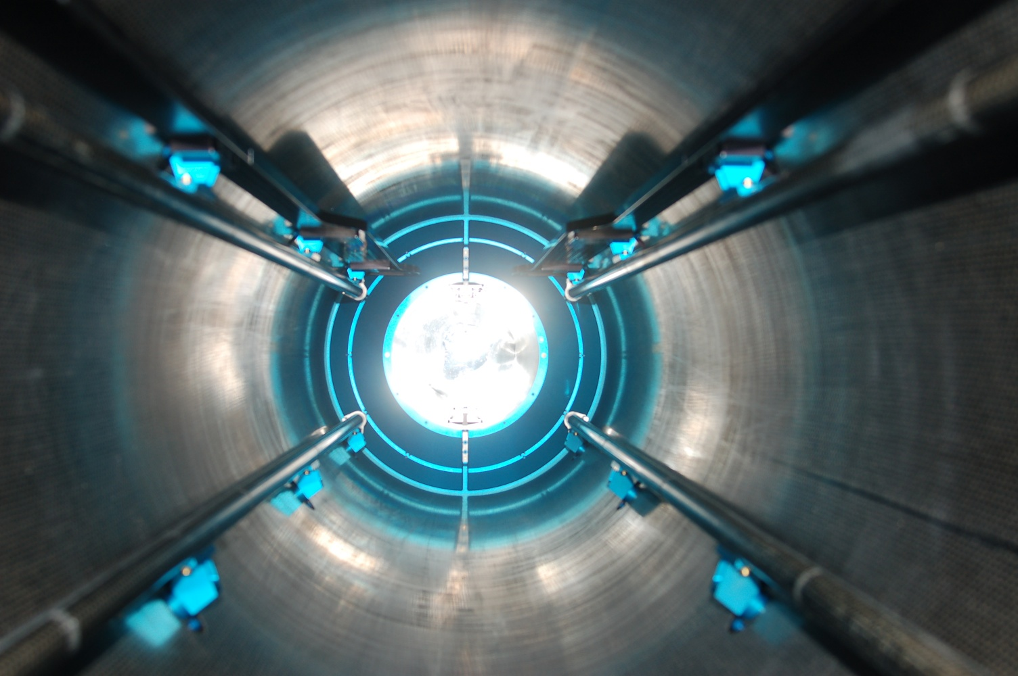


The STAR Heavy Flavor Tracker
Flemming Videbæk
For the STAR collaboration
Brookhaven National Lab
Notes:
Add logo’s

Slide 2
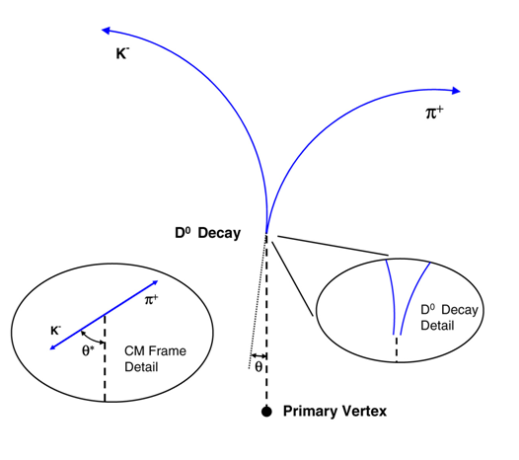
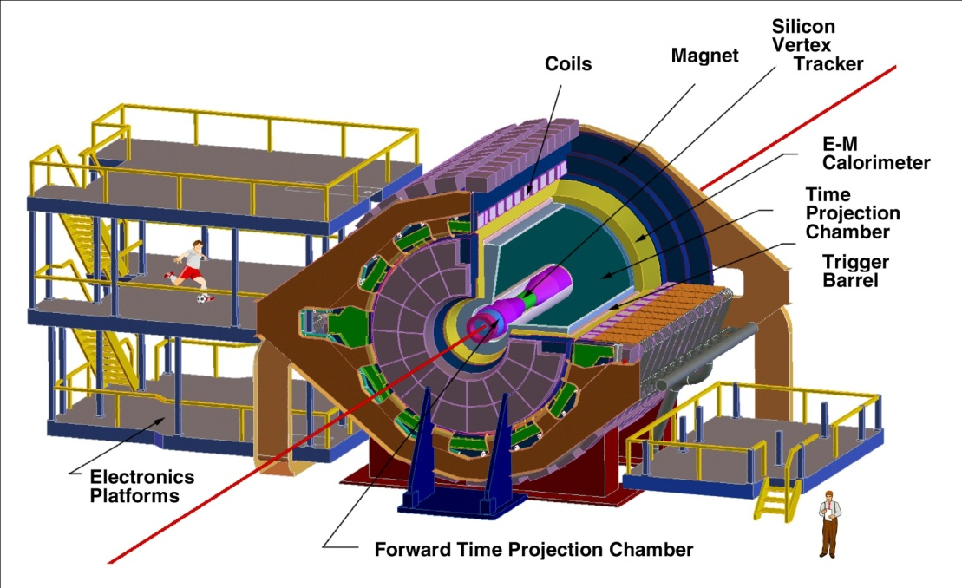
STAR HFT Upgrade Motivation
Direct topological reconstruction of Charm in STAR events
Detect charm decays with small cτ, including D⁰ → K π
Separation of Charm and Bottom
Method: Resolve displaced vertices (123 μm)
200 GeV Au-Au , p+p collisions @ RHIC
Notes:
Highlight detecting short lived particles –
you have heard about the physics in previous talks

Slide 3
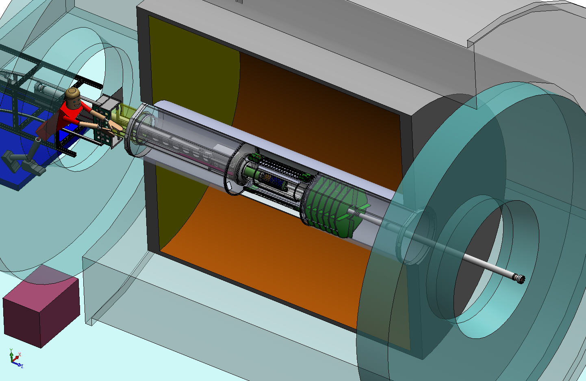
Heavy Flavor Tracker (HFT)
Magnet
Return Iron
TPC Volume
FGT
Solenoid
EAST
WEST

Slide 4

Heavy Flavor Tracker (HFT)
Detector | Radius (cm) | Hit Resolution R/ϕ - Z (μm - μm) | Radiation length
SSD | 22 | 20 / 740 | 1% X₀
IST | 14 | 170 / 1800 | <1.5 %X₀
PIXEL | 8 | 12/ 12 | ~0.5 %X₀
 | 2.7 | 12 / 12 | ~0.5% X₀
HFT
SSD
IST
PXL
PIXEL
two layers
20.7x20.7 μm pixel pitch
10 sector, delivering ultimate pointing resolution that allows for direct topological identification of charm.
~360M pixels
monolithic active pixel sensors (MAPS) technology
SSD
existing single layer detector, double side strips (electronic upgrade)
IST
one layer of silicon strips along beam direction, guiding tracks from the SSD through PIXEL detector.

Slide 5
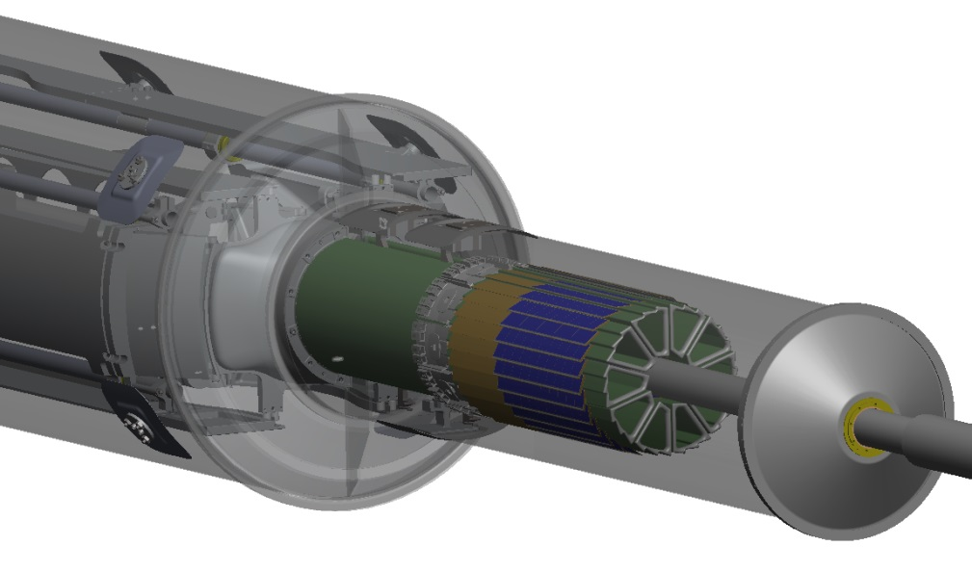
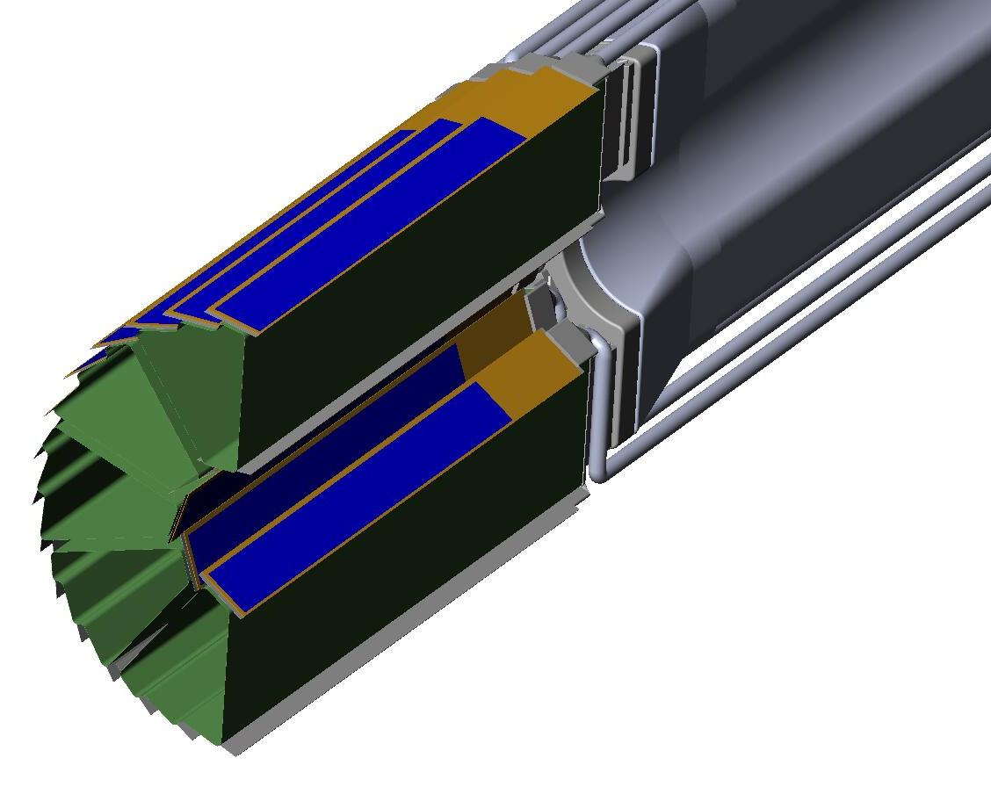
PXL Detector Design
Mechanical support with kinematic mounts (insertion side)
  4 ladders / sector
  5 sectors / half (10 sectors total)
  2 layers
  Insertion from one side
carbon fiber sector tubes (~ 200 µm thick)
Novel rapid insertion mechanism allows effective exchanges and repairs (~12 h)
Precision kinematic mount guarantees reproducibility to < 20 microns
Prototype engineering run in May with 3 sectors. (Talks by J.Bouchet & L.Ma)
Ladder with 10 MAPS sensors (~ 2×2 cm each)
Cu conductor Ladder Flex Cable
20 cm
Notes:
What is the carbon fiber process used?

Slide 6
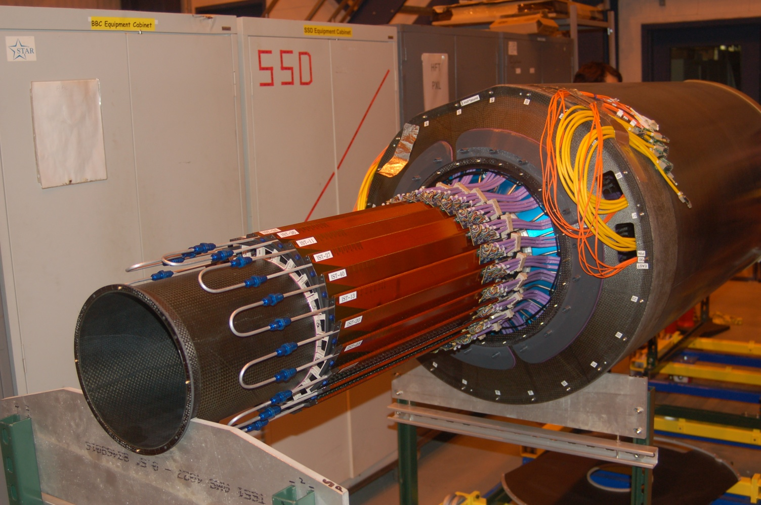
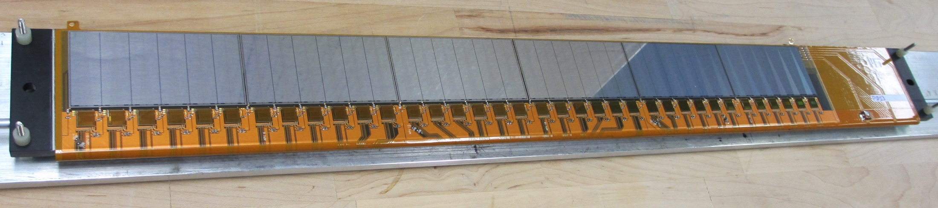
Intermediate Silicon Tracker (IST)
24 ladders 50 cm long
at 14 cm
Si pad detector .6*6 mm pads
36 APV hybrids per ladder for readout
Liquid cooling at 24ºC
<1.5% radiation length
24 ladders, liquid cooling.
Production Ladder
S:N > 20:1
>99.5% live and functioning channels

Slide 7
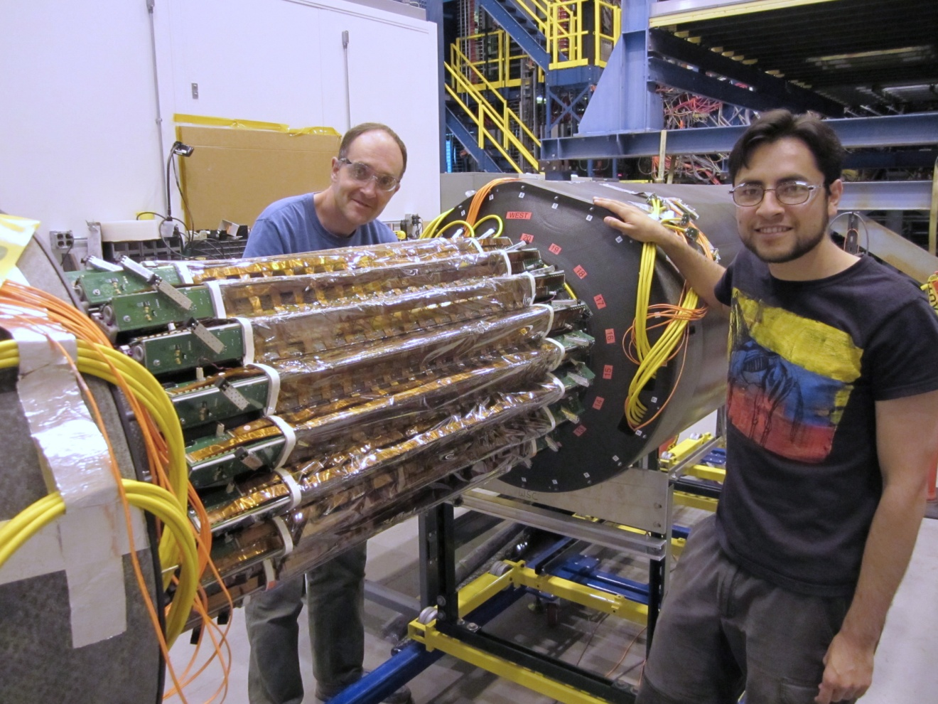
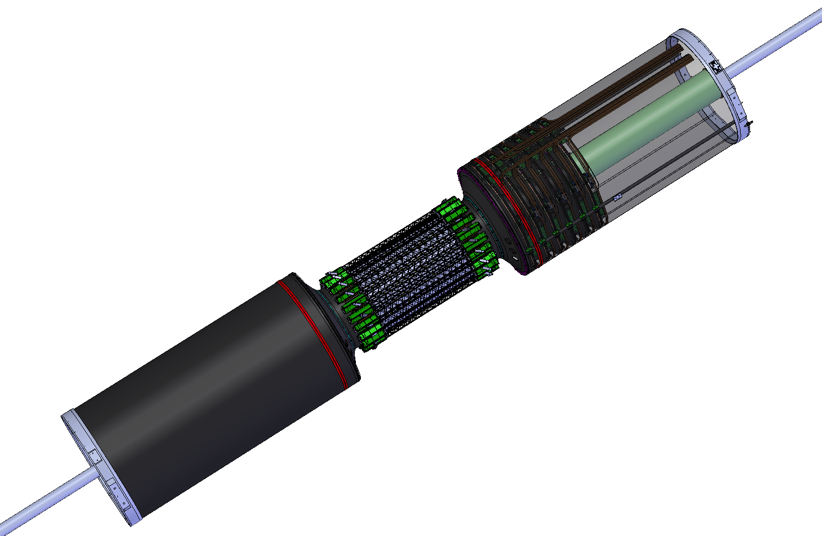
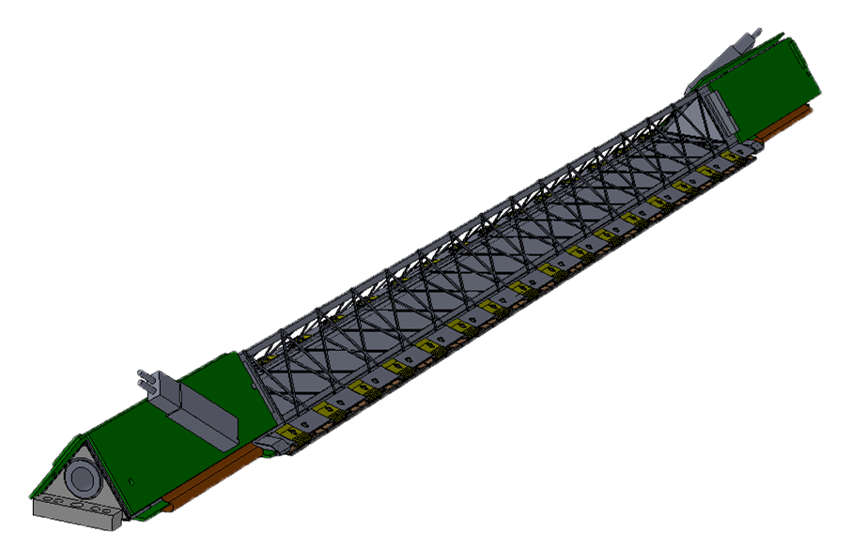
Silicon Strip Detector (SSD)
Existing detector
20 ladders at 22 cm
Double sided Si with total ~400k strips
New, faster readout ~15% deadtime at 1 KHz limited by original detector hybrids
~ 1 Meter
Ladder Cards

Slide 8
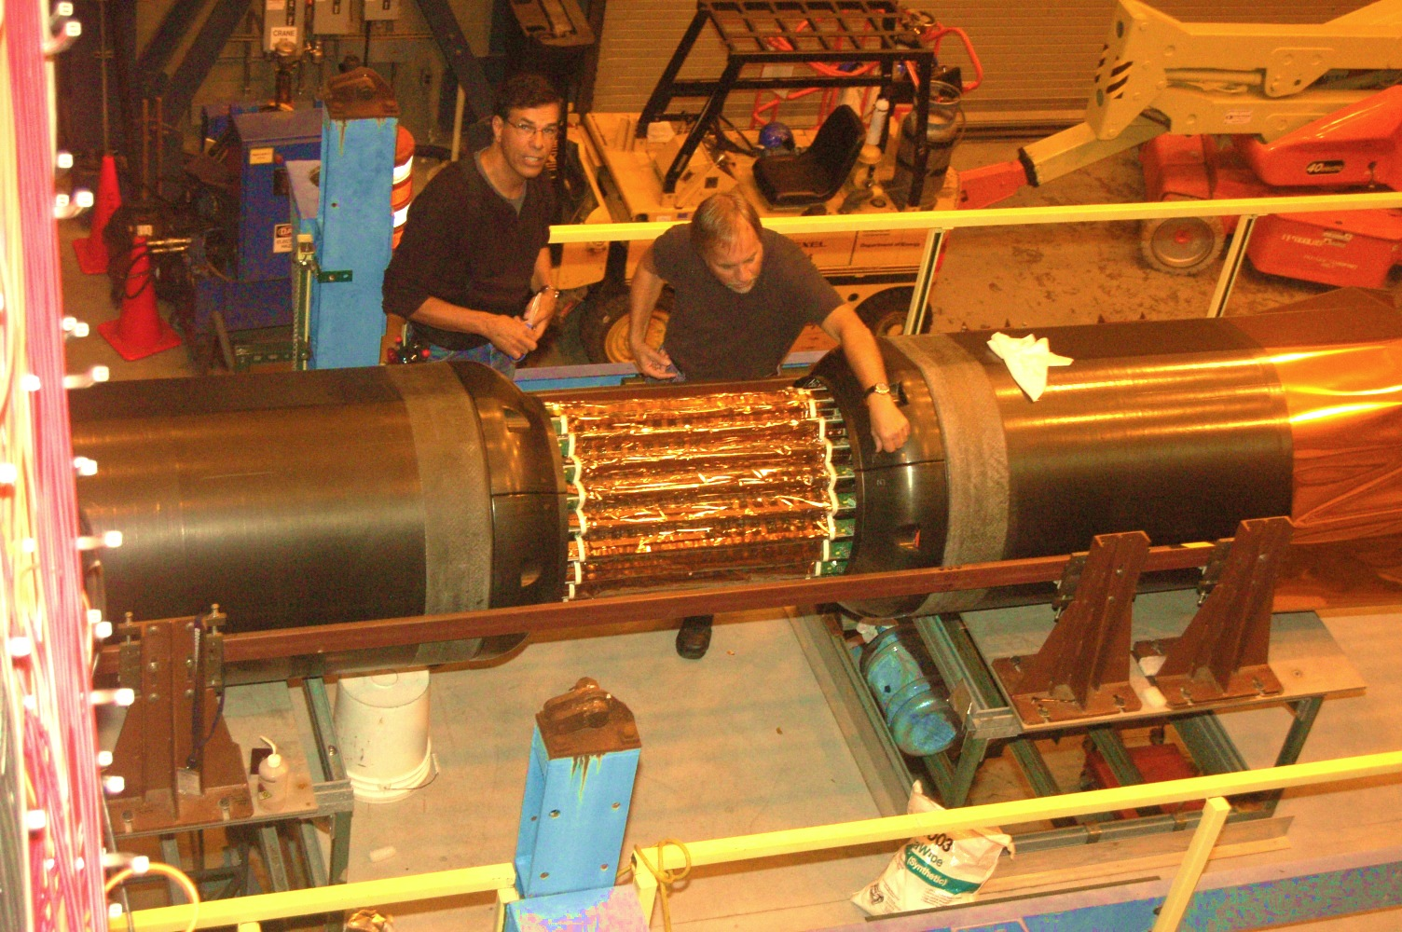
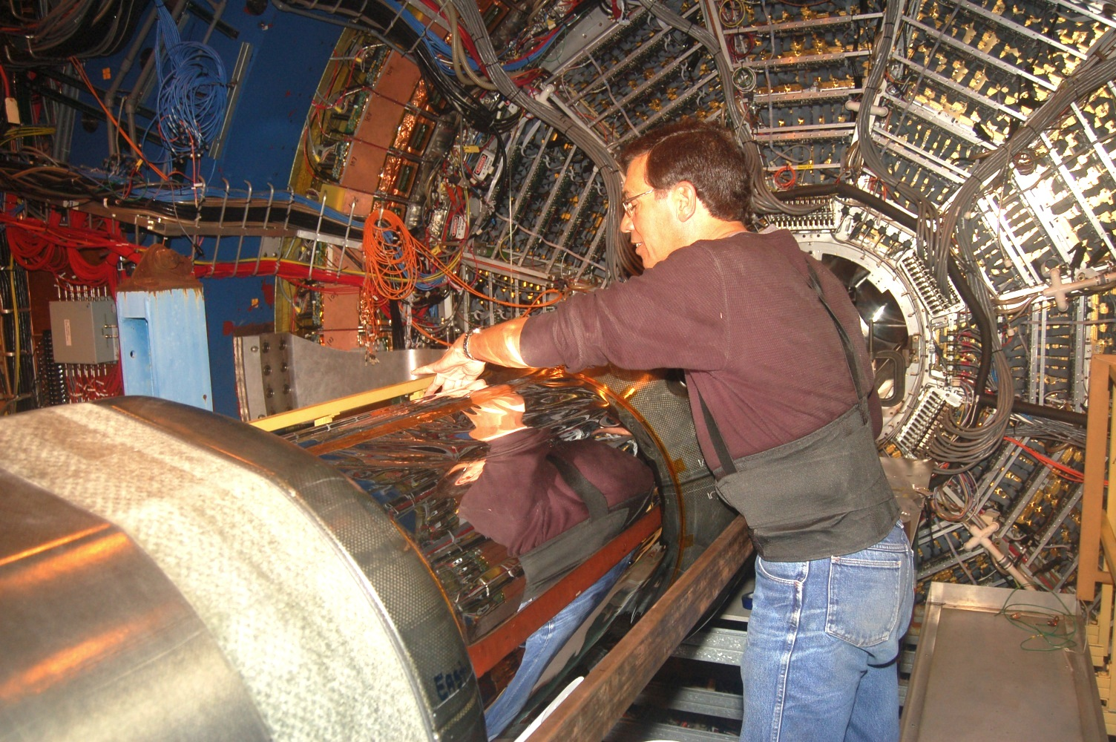
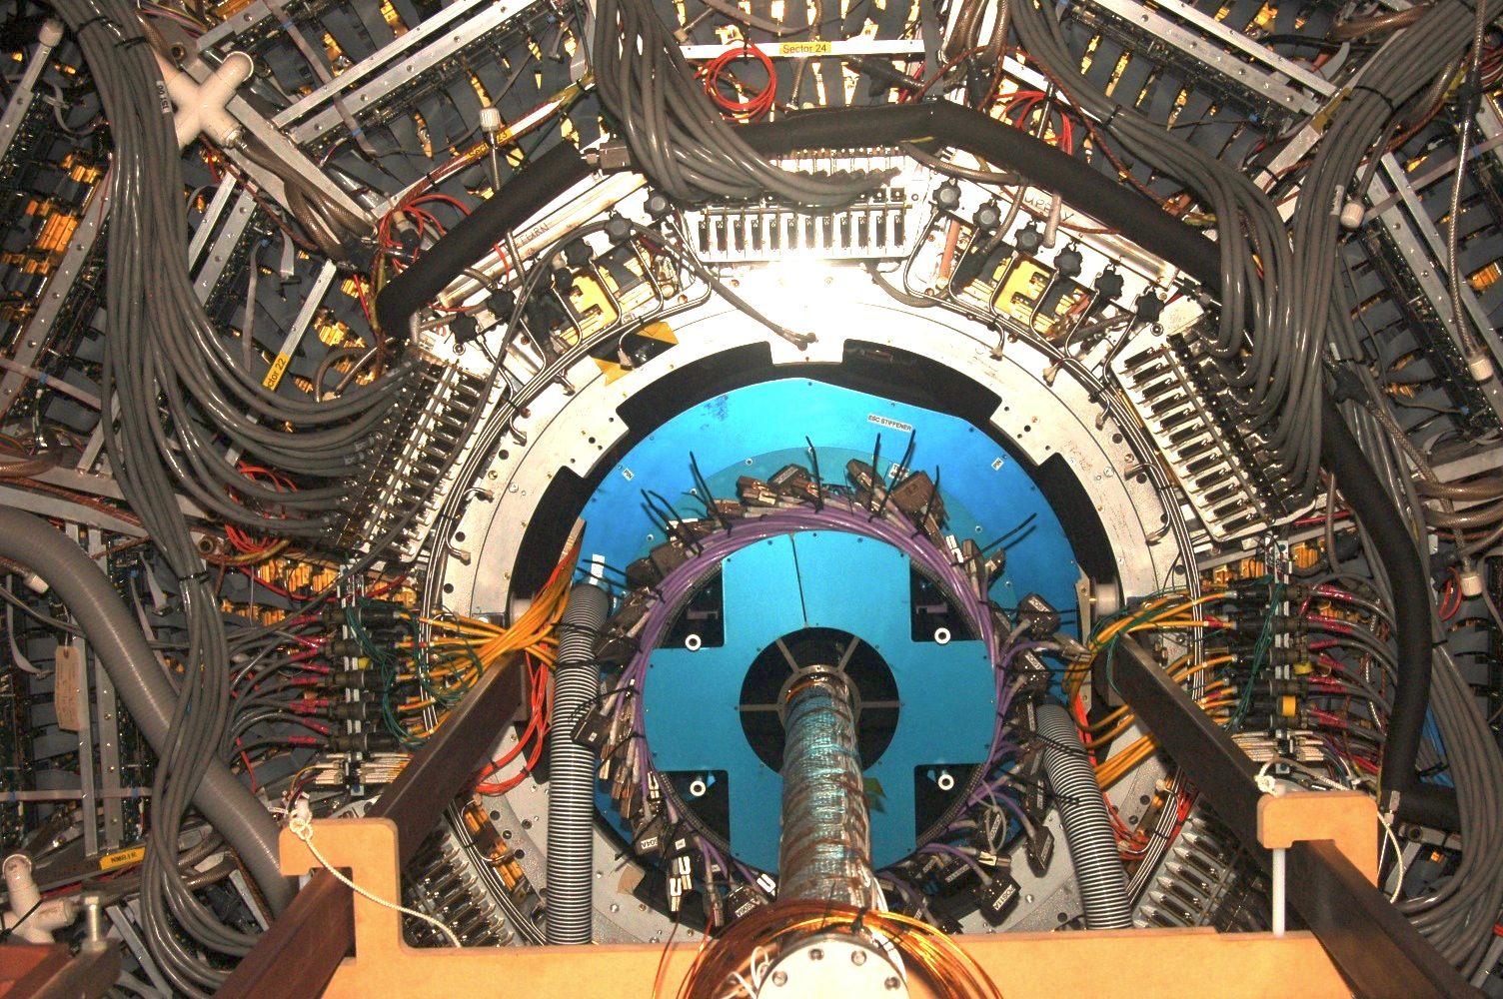
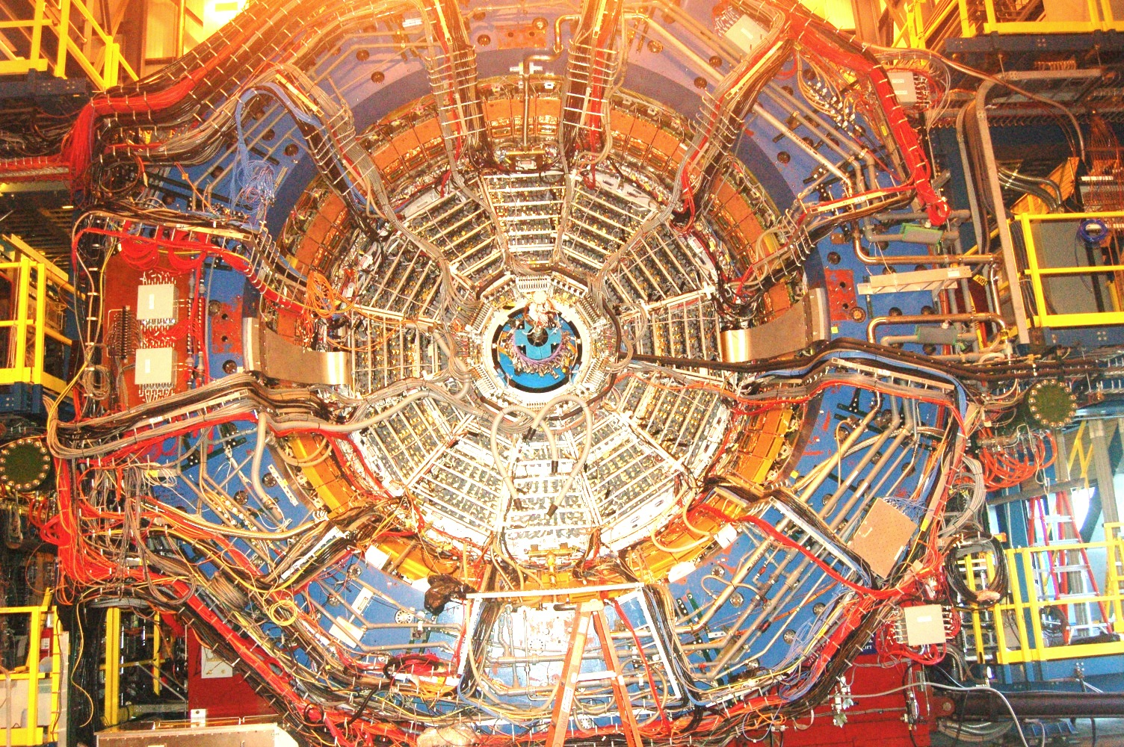
Support Structures
Notes:
Insert picture of assemble structures/ look at pictures that Bill showed at collaboration meeting

Slide 9
Physics of the Heavy Flavor Tracker at STAR
Direct HF hadron measurements (p+p and Au+Au)
  (1) Heavy-quark cross sections: D^{0±}*, D_{S}, Λ_{C} , B, …
  (2) Both spectra (R_{AA}, R_{CP}) and v₂ in a wide p_{T} region: 0.5 - 10 GeV/c
  (3) Charm hadron correlation functions, heavy flavor jets
  (4) Full spectrum of the heavy quark hadron decay electrons
Physics
  (1) Measure heavy-quark hadron v₂, heavy-quark collectivity, to study the medium properties e.g. light-quark thermalization
  (2) Measure heavy-quark energy loss to study pQCD in hot/dense medium e.g. energy loss mechanism
  (3) Hadro-chemistry including heavy flavors
Notes:
Need to go through formatting

Slide 10
DCA resolution performance r-ϕ and z
0.4% X0
GEANT: Realistic detector geometry + Standard STAR tracking
including the pixel pileup hits at RHIC-II luminosity
Goal with Al-based cable (Cu cable -> 55 micron for 750 MeV/c K)
10

Slide 11
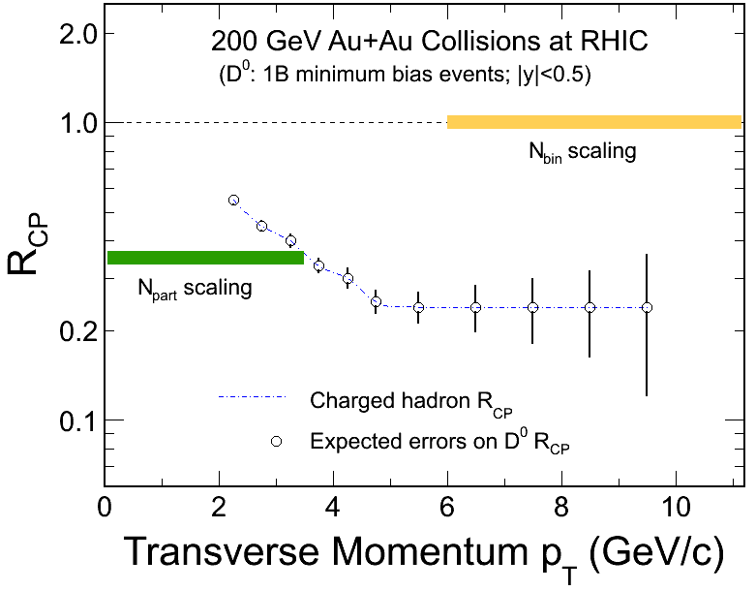
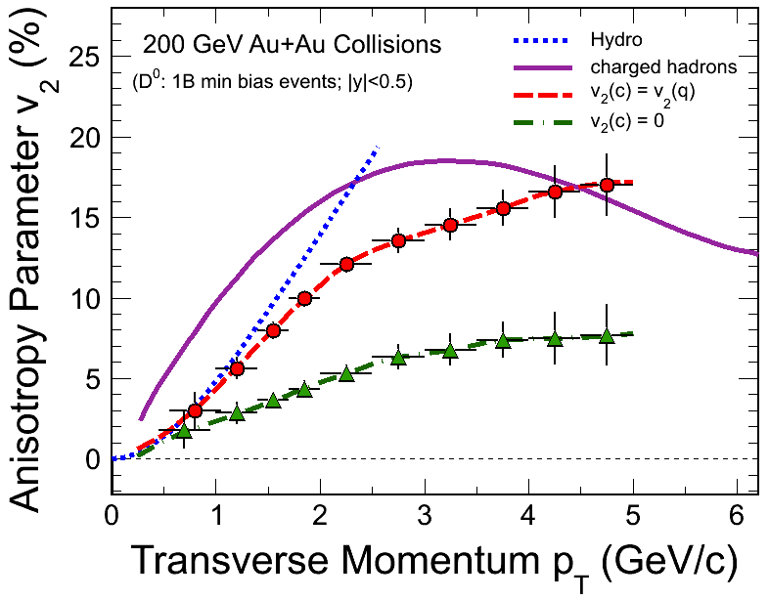
Physics – Run-14,15 projections
R_{CP}=a*N10%/N(60-80)%
Assuming D⁰ R_{cp} distribution as charged hadron.
1B Au+Au m.b. events at 200 GeV.
Charm R_{AA} 
Energy loss mechanism!
Color charge effect!
Interaction with QCD matter!
Assuming D⁰ v₂ distribution from quark coalescence.
1 B Au+Au m.b. events at 200 GeV.
- Charm v₂ 
Medium thermalization degree
Drag coefficients!
Notes:
Possible add in the RAA for D0 in AA (as shown before – to illustarte how it can be done)

Slide 12
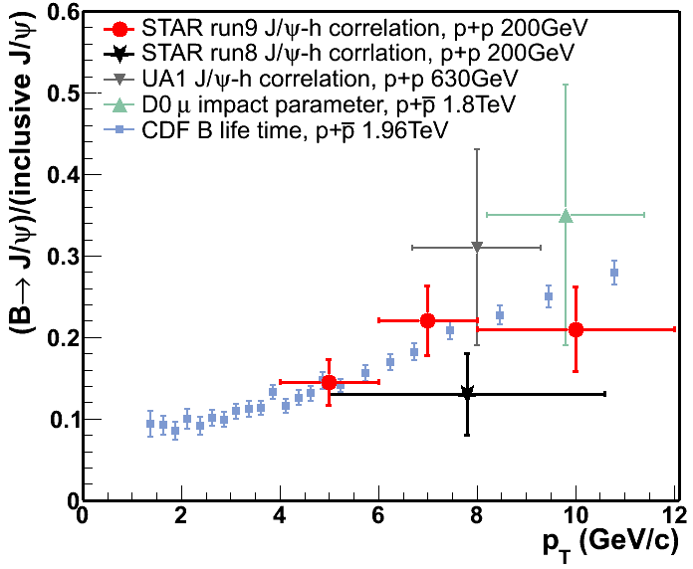
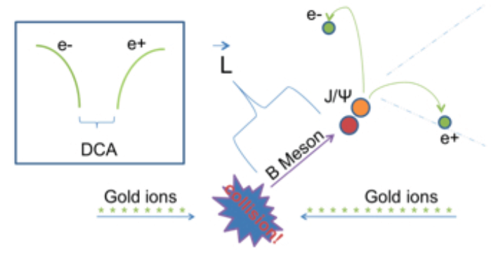
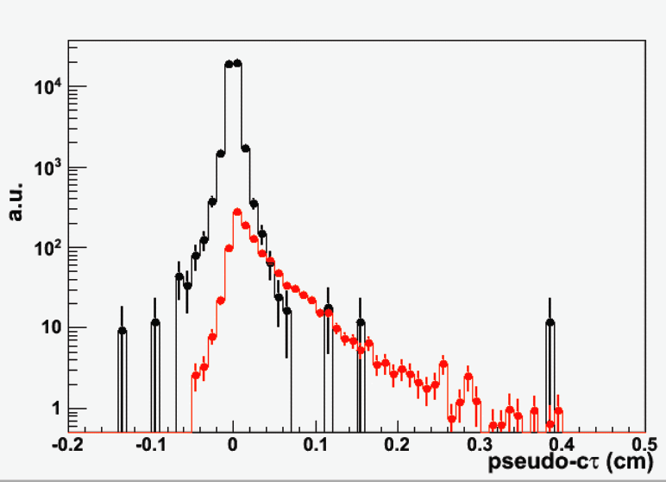
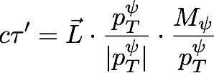
B tagged J/ψ
STAR Phys. Lett. B 722 (2013) 55..
Prompt
Current measurement via J/ψ-hadron correlation have large uncertainties.
Combine HFT+MTD in di-muon channel
  Separate secondary J/ψ from promptJ/ψ
  Constrain the bottom production at RHIC
J/ψ from B

Slide 13
HFT Project Status
HFT upgrade is nearing completion after a 3 year construction period
All detector components have passed the initial testing, integration and commissioning has begun
The full assembly including PXL, IST and SSD will be available for RHIC Run-14, which is planned to be a long Au-Au run

