Slide 1
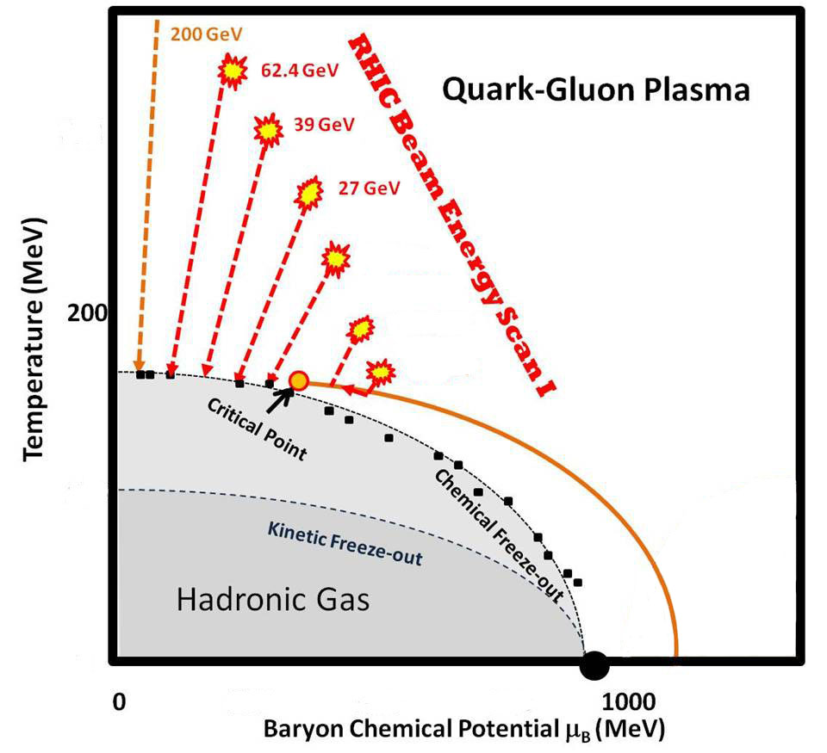
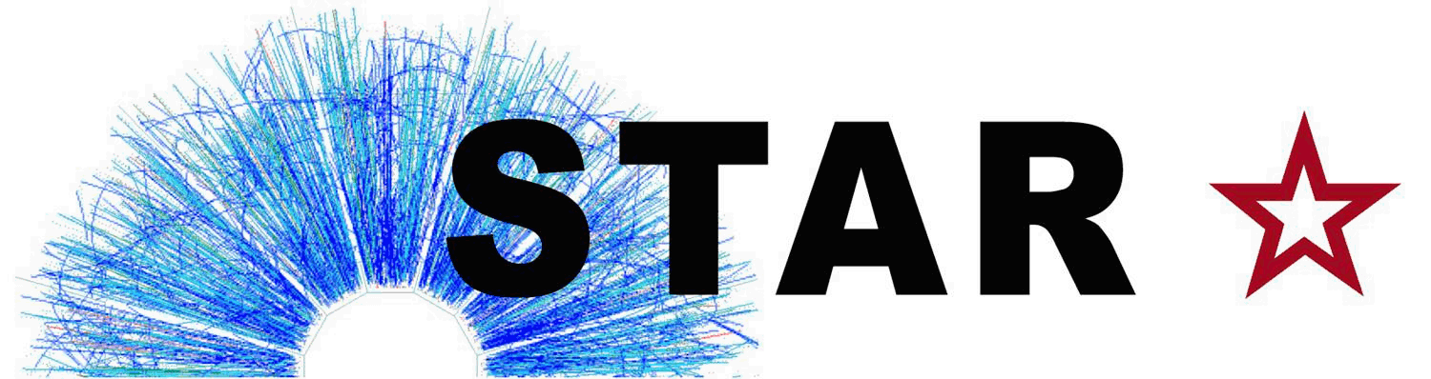


Search for 1st-Order QCD Phase Transition
Beam Energy Scan topics:
Are there signs of EOS softening (possible 1st-order Phase Transition)?
Do we observe a turn-off of QGP signatures?
…or Critical Point? [Zhangbu]
…or Chiral Effect? [Zhangbu]
What are the BES-II plans & schedules? [mostly Zhangbu]
Declan Keane

Slide 2
Search for 1st-Order QCD Phase Transition
Beam Energy Scan topics:
Early universe
Are there signs of EOS softening (possible 1st-order Phase Transition)?
Do we observe a turn-off of QGP signatures?
…or Critical Point? [Zhangbu]
…or Chiral Effect? [Zhangbu]
What are the BES-II plans & schedules? [mostly Zhangbu]
1st-order PT
2007: STAR Beam Energy Scan (BES) Focus Group formed
2008: Test run at √s_{NN} = 9.2 GeV [PRC 81, 024911 (2010)]
2009: Proposal for BES Phase-I [STAR Note SN0493 & arXiv:1007.2613]
2010: BES-I data-taking began (39, 11.5 & 7.7 GeV)
2011: Two further energies (27 & 19.6 GeV)
2012: Test at 5 GeV
2014: Final BES-I energy (14.5 GeV) & BES-II proposal
RHIC BES History &
Timeline

Slide 3
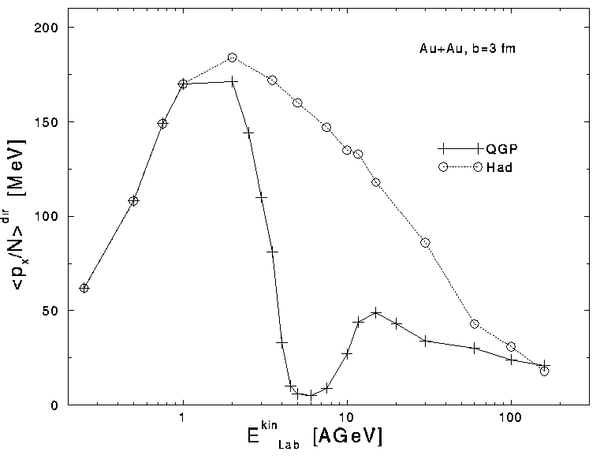
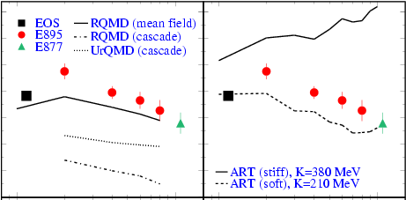
AGS Beam Energy Scan (E895)
D. H. Rischke et al., Heavy Ion Phys. 1, 309 (1995).
0.3
F (GeV/c)
0.2
0.1
0
1
10
1
10
E_{lab} (A GeV)
H. Liu et al. (E895), PRL 84, 5488 (2000)
Horst Stoecker calls this the “collapse of directed flow”
No sign of predicted collapse of directed flow

Slide 4
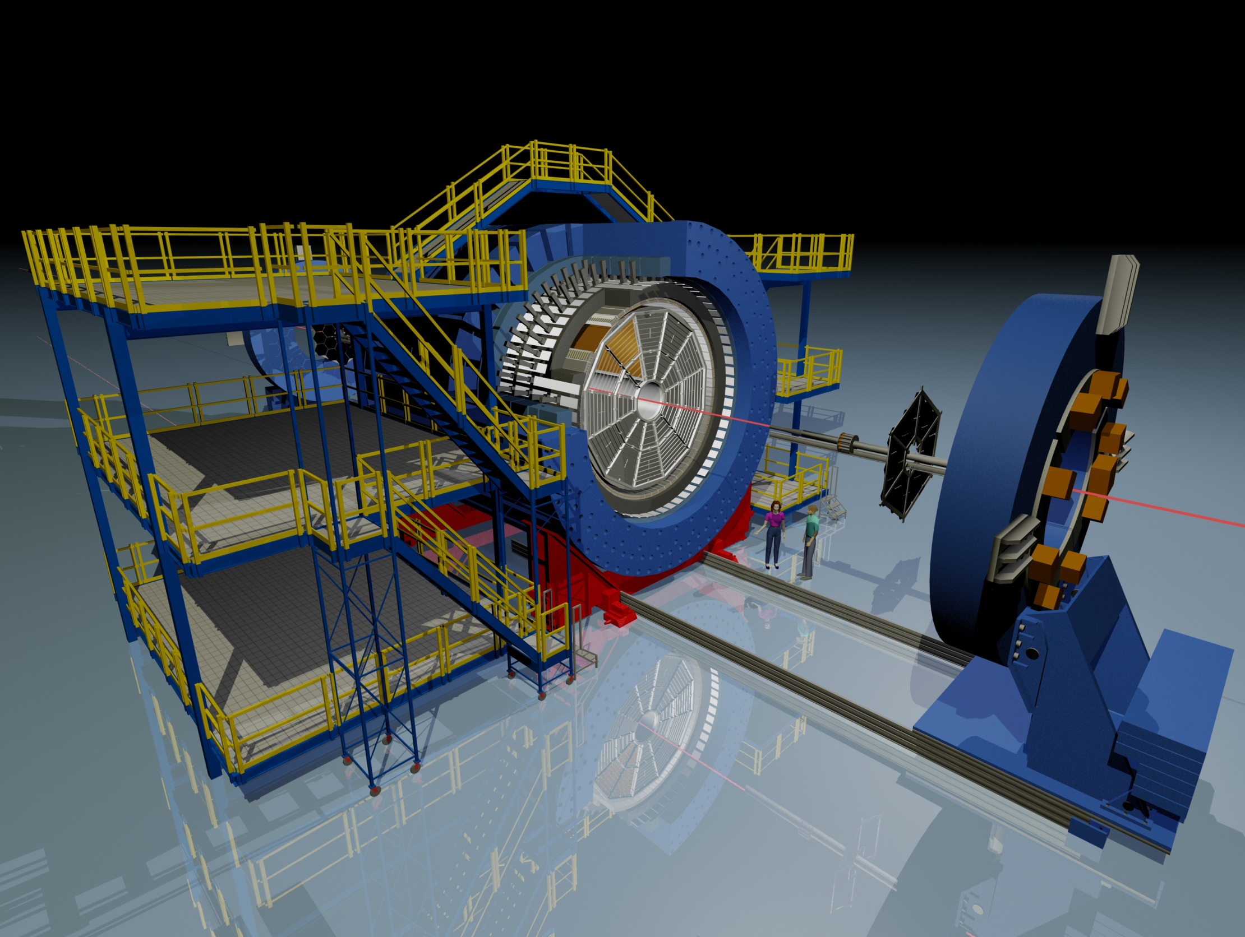
The Solenoid Tracker At RHIC (STAR)
BEMC
Magnet
TOF
TPC
BBC
upVPD
-1 < η < 1 & 2π in azimuth
Uniform acceptance vs √s_{NN}
Excellent particle ID

Slide 5
STAR ZDC SMD
Measures 1st-order Event Plane direction at 62 GeV & up;
resolution not so good as TPC, but still good enough.
Minimal, if any, non-flow effects
SMD is 8 horizontal slats & 7 vertical slats located at 1/3 of the depth of the ZDC
ZDC side view
Scintillator slats of Shower Max Detector
Transverse plane of ZDC

Slide 6
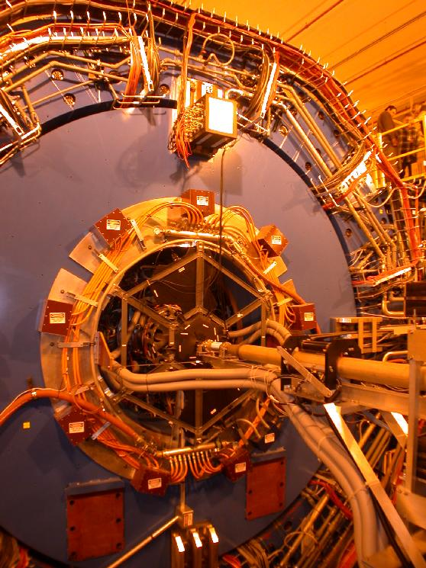
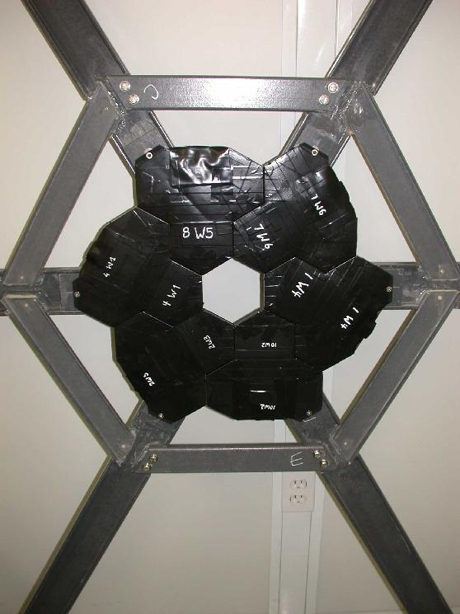
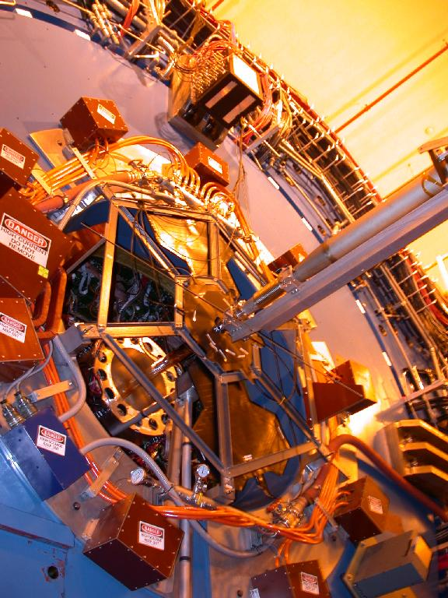
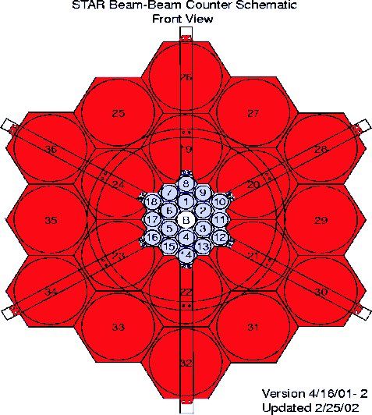
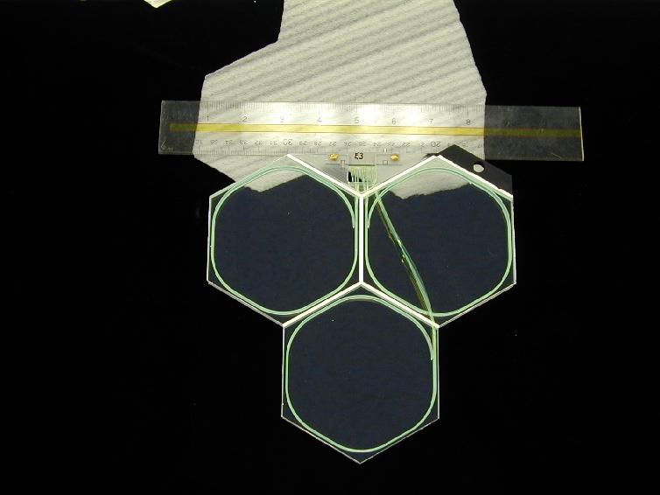
STAR BBC Detectors

Slide 7
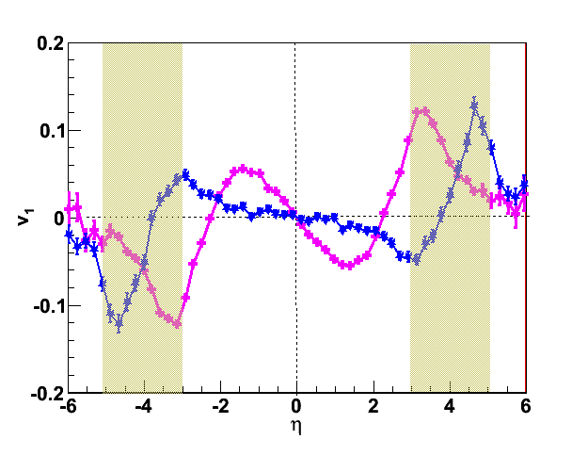
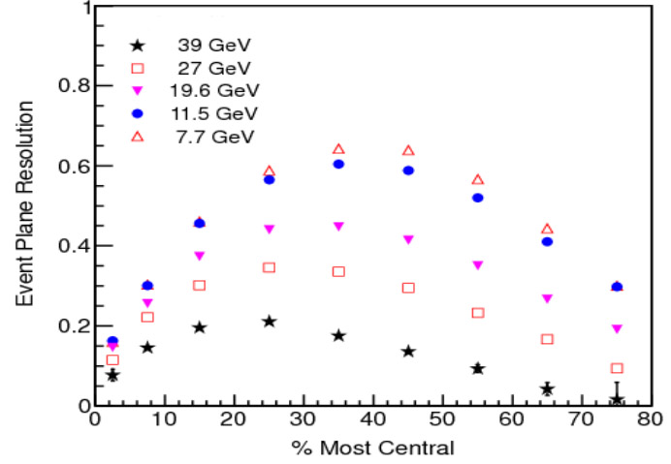
BBC Event Plane Resolution
BBC inner
v₁ for all charged particles (UrQMD)
red = 7.7 GeV &
blue = 39 GeV
Upper plot illustrates why BBC’s 1st-harmonic EP resolution (shown on left) becomes poor at 39 GeV and is unusable at 62.4 & 200 GeV

Slide 8
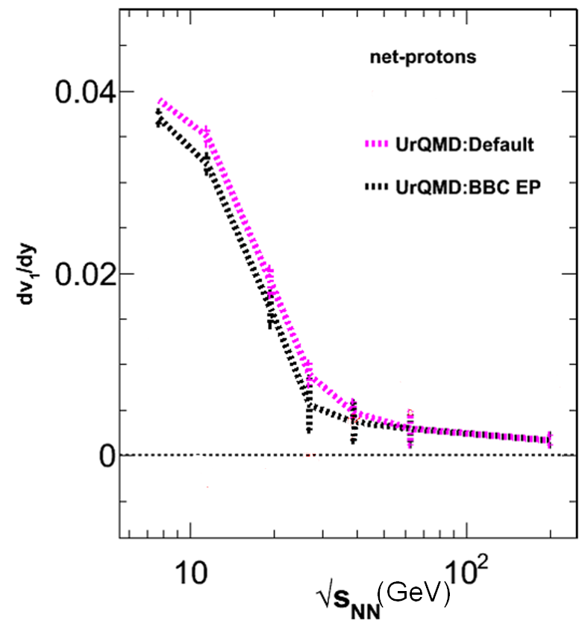
BBC Event Plane Systematics
UrQMD-based simulation of 1st-order Event Plane from STAR BBC ➔ systematic uncertainties arising from EP method appear to be small.

Slide 9
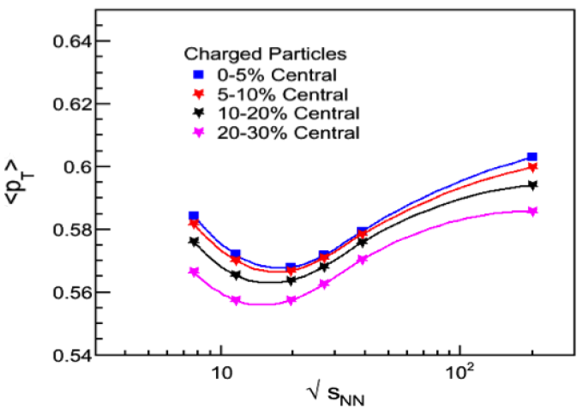
Hadronic Physics –> Non-Monotonic?
STAR Preliminary
<p_{T}> (GeV/c)
√s_{NN} (GeV)
Dip in mean p_{T} for all charged particles explained by
switch-over from proton dominance to pion dominance?

Slide 10
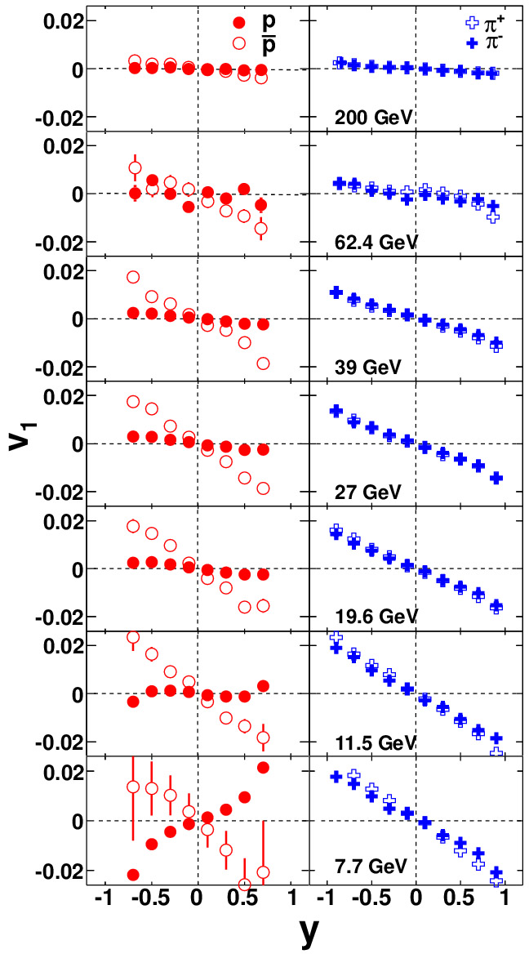
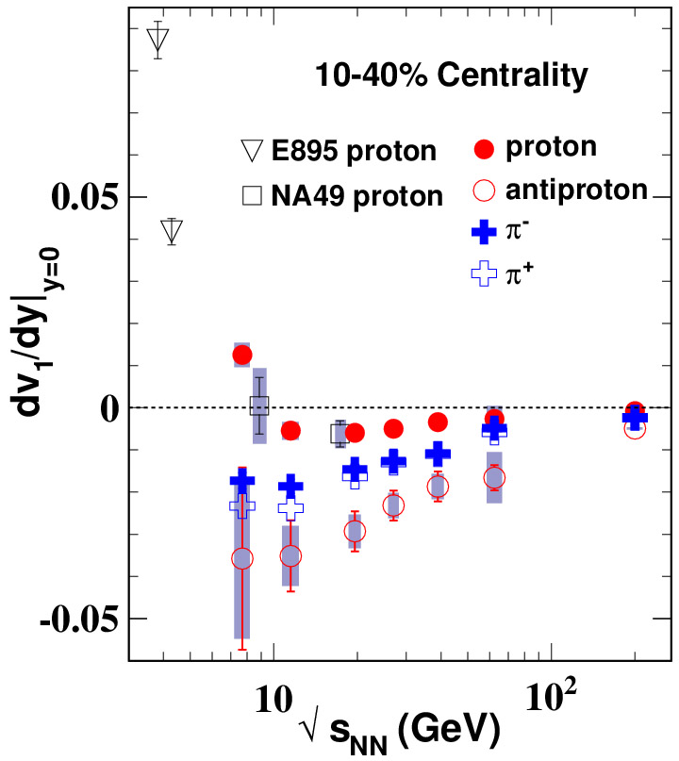
Directed Flow at BES Energies
STAR, PRL 112, 162301 (2014)
arXiv:1401.3043

Slide 11
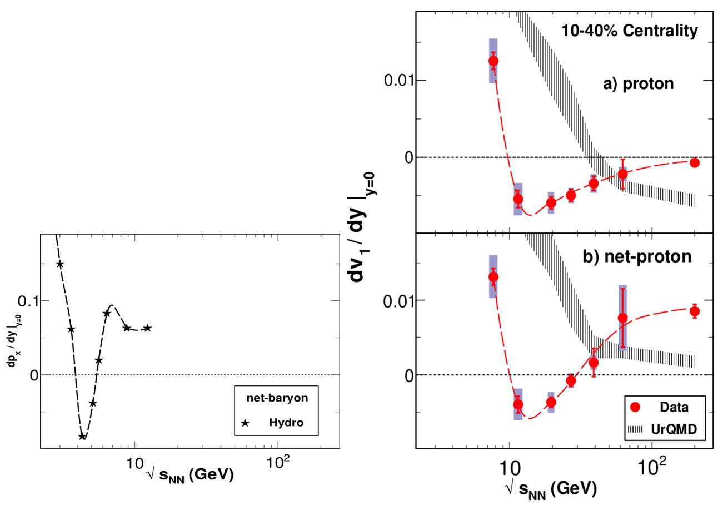
Directed Flow at BES Energies
STAR, PRL 112, 162301 (2014); arXiv:1401.3043
F_{p} = r F_{anti-p} + (1 – r) F_{net-p} , where F is v₁ slope & r(y) =observed anti-p over p.
v₁ for both p & net-p qualitatively resembles collapse signature & is very different from UrQMD.
H. Stoecker,
Nucl. Phys. A 750, 121 (2005).
(GeV/c)
In net-p v₁ model comparison, p-bar/p from model was used; switching to experimental ratios makes only a minor difference.

Slide 12
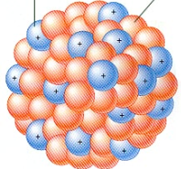

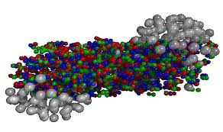
Mike Lisa’s Directed Flow Cartoon
PUSH!

Slide 13
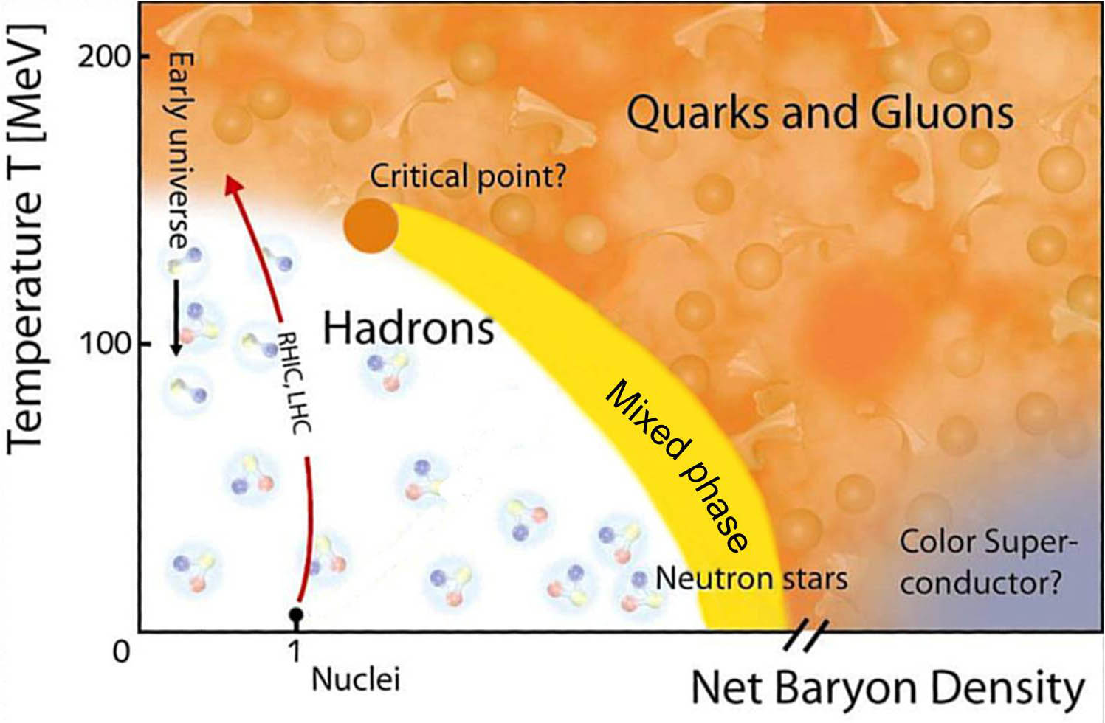
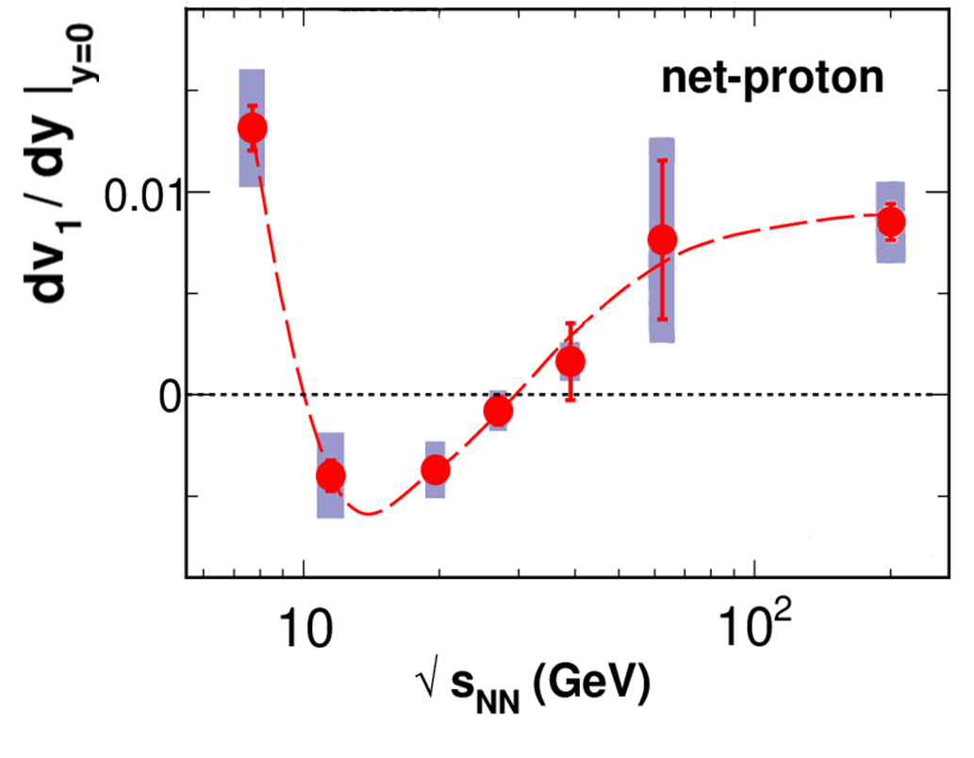
net (“valence”) proton
PUSH!

Slide 14
SOFT...
PUSH!

Slide 15
PUSH!!
SOFT...
PUSH!

Slide 16
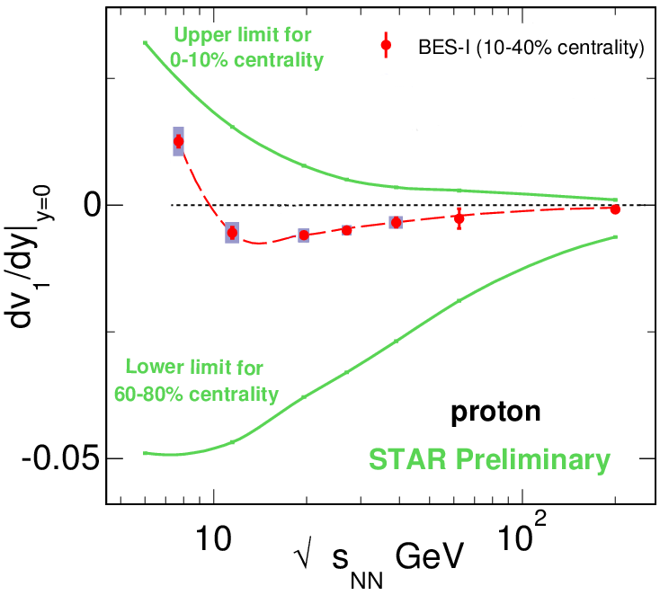
Directed Flow vs. Centrality
STAR BES-II White Paper; see STAR Note 0598 or 2014 link at
http://www.bnl.gov/npp/pac.asp
Proton directed flow shows strong centrality dependence, with an exceptional increase between 10-40% and 60-80% centrality.

Slide 17
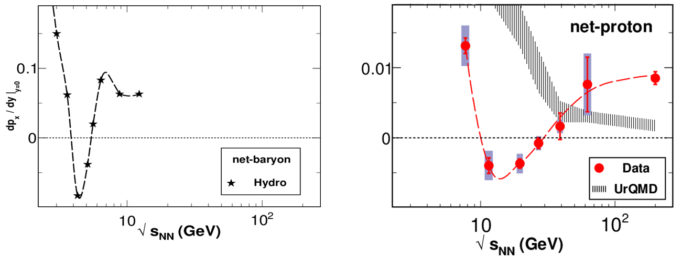

AMPT Model
AMPT
AMPT default & string melting give almost the same net-proton v₁

Slide 18
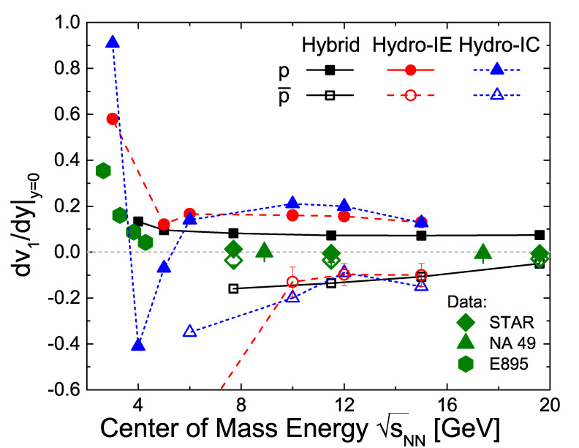
Frankfurt Hybrid Model
IC =Isochronous freeze-out (sim. to 2005 hydro).
IE =Iso-ρ_{E} freeze-out (ρ_{E} is energy density)
J. Steinheimer,
J. Auvinen, H. Petersen, M. Bleicher, H. Stoecker, arXiv:1402.7236
PRC 89 (2014) 054913.

Slide 19
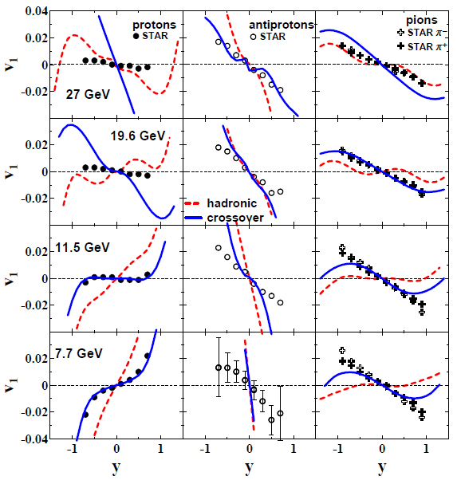
Parton-Hadron-String Dynamics (PHSD/PSD)
“Is the directed flow in heavy-ion collisions a puzzle?” Konchakovski, Cassing, Ivanov, Toneev, arXiv:1404.2765
Phys. Rev. C 90, 014903 (2014).
Model shows no minimum in proton v₁
Paper’s conclusion:
“…semi-qualitative agreement supports a crossover type of quark-hadron transition… but shows no indication of a first-order phase transition.”
EOS with 1st-order PT is mentioned, but isn’t shown in the paper.

Slide 20
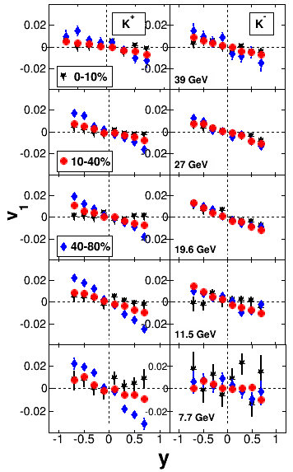
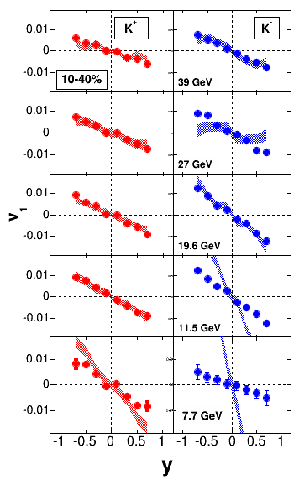
Directed Flow for Charged Kaons
STAR Preliminary
STAR Preliminary
Red & blue shaded bands = UrQMD
y

Slide 21
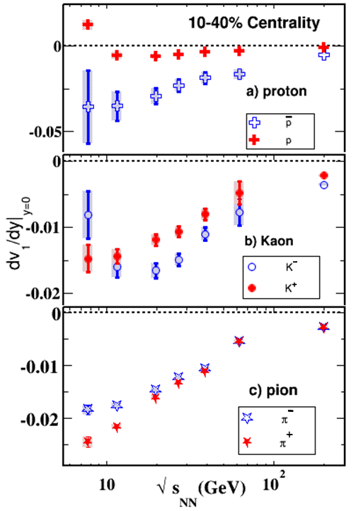
Directed Flow for Charged Kaons
Low kaon statistics fwd-bwd reflection in y + linear slope fit
K ⁰ statistics are poorer & their v₁ is consistent with both K ⁺ & K –.
At higher BES energies, both K ⁺ & K – have similar neg. dv₁ / dy as π ⁺ & π –.
At low BES energies, K ⁺ & K – dv₁ / dy diverge (at all p_{T}), unlike π ⁺ & π –. K – shows a hint of a minimum.
Note the different scale for first panel.
Λ measurement from BES-I with reasonable statistics also in pipeline.
Theory comparisons & interpretation (all particle species) sorely needed (also urged by 2014 RHIC PAC).
STAR Preliminary
This also explains why theorists at this WS get the “panda” treatment…

Slide 22
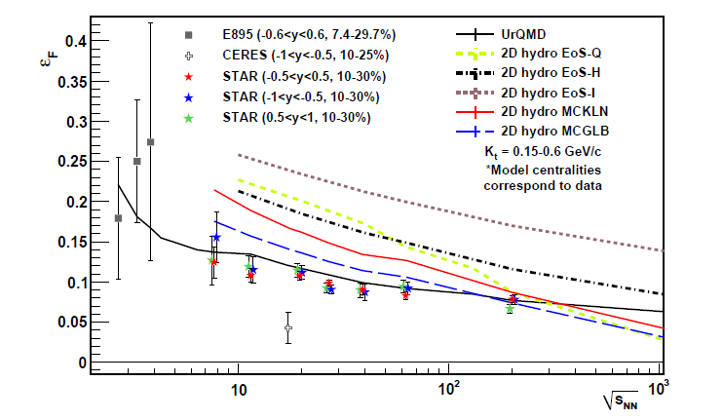
Azimuthally Sensitive HBT
STAR, arXiv:1403.4972 (to appear in Phys. Rev. C)
STAR conclusion from BES HBT data:
Spatial eccentricity ε_{F} at kin. F.O. has sensitivity to EOS, but change is smooth over BES range.
STAR does not confirm CERES result.

Slide 23
Another Way To Plot HBT Data
Talks by Roy Lacey, Ron Soltz at QM ’14
Non-monotonicity magnified with (R_{out})² – (R_{side})²
R_{side}/R_{long} indicative of expansion/lifetime

Slide 24
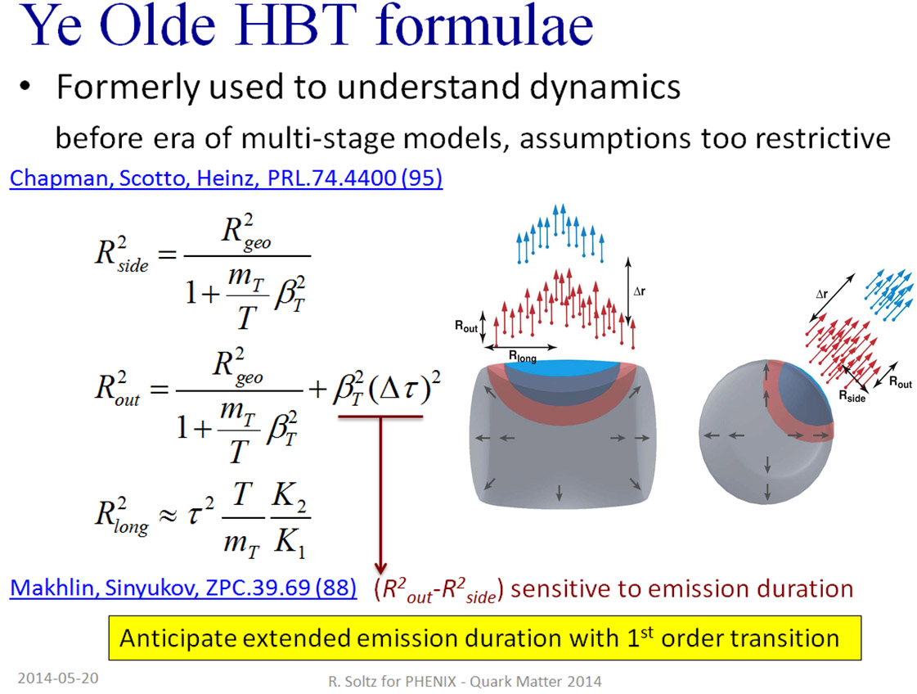
Ron Soltz Explanation from QM 14

Slide 25
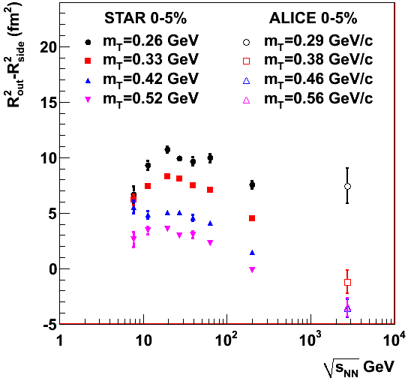
Another Way To Plot HBT Data
Re-plot of data in STAR publication arXiv:1403.4972
Extrapolations not needed!
Interpretation still needs model comparisons, but it’s a promising PT signature

Slide 26
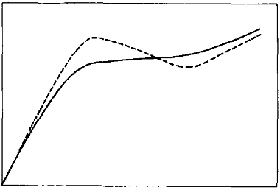
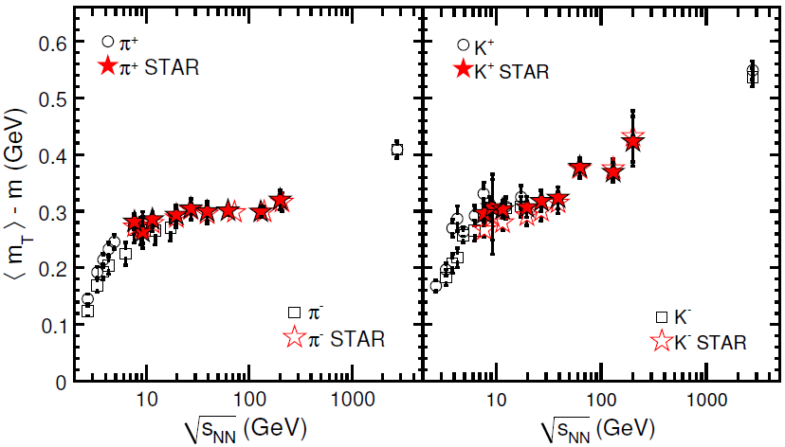
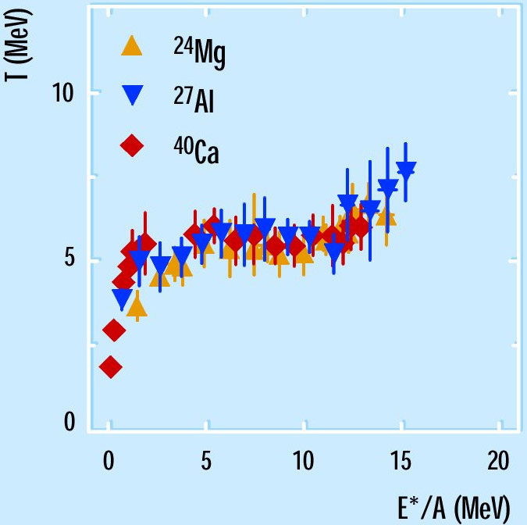
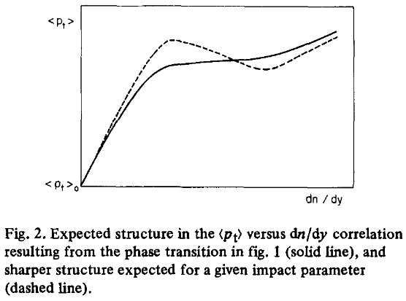
Van Hove’s Proposed Signature
<p_{T}>
L. Van Hove, PLB 118, 138 (1982).
STAR Preliminary
dN/dy
Another corroborating suggestion
of a 1st-Order Phase Transition
H. Feldmeier & J. Schnack,
Rev. Mod. Phys. 72, 655 (2000).
“Caloric curve” – evidence for nuclear liquid-vapor PT

Slide 27
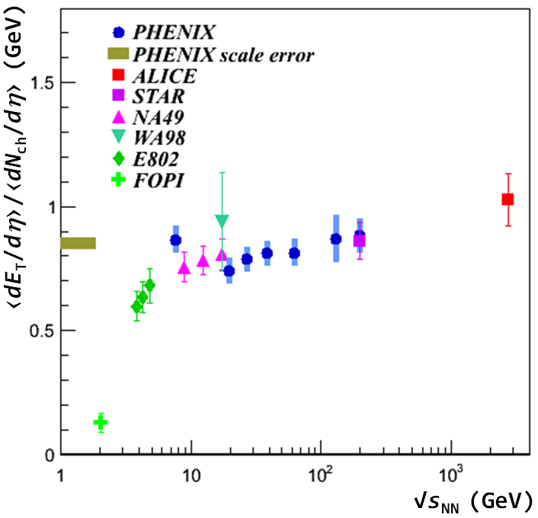
Van Hove’s Proposed Signature
STAR Preliminary
E. O’Brien, Nucl. Phys. A 904-905, 264c (2013).
Another corroborating suggestion
of a 1st-Order Phase Transition

Slide 28
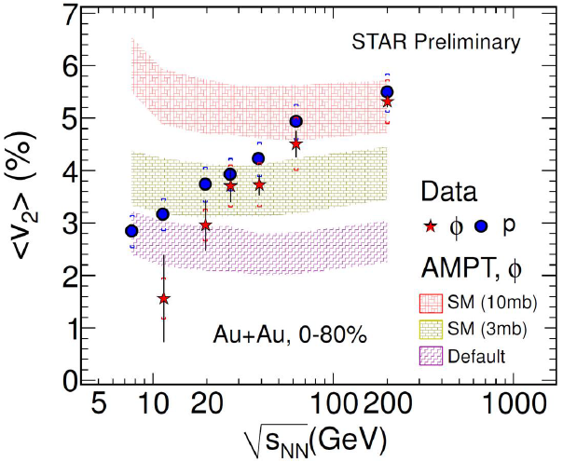
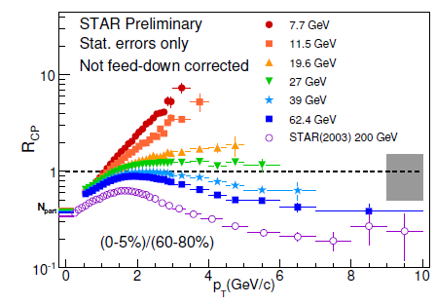
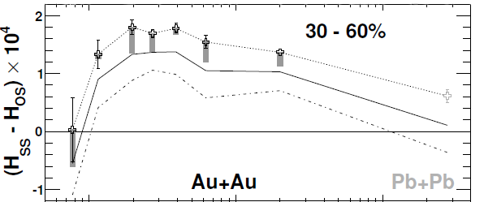
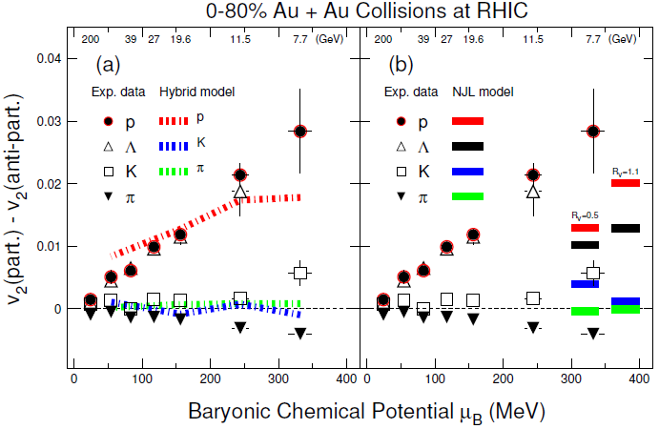


Turn-off of QGP Signatures
All plots from STAR BES-II White Paper; see STAR Note 0598 or 2014 link at www.bnl.gov/npp/pac.asp

Slide 29
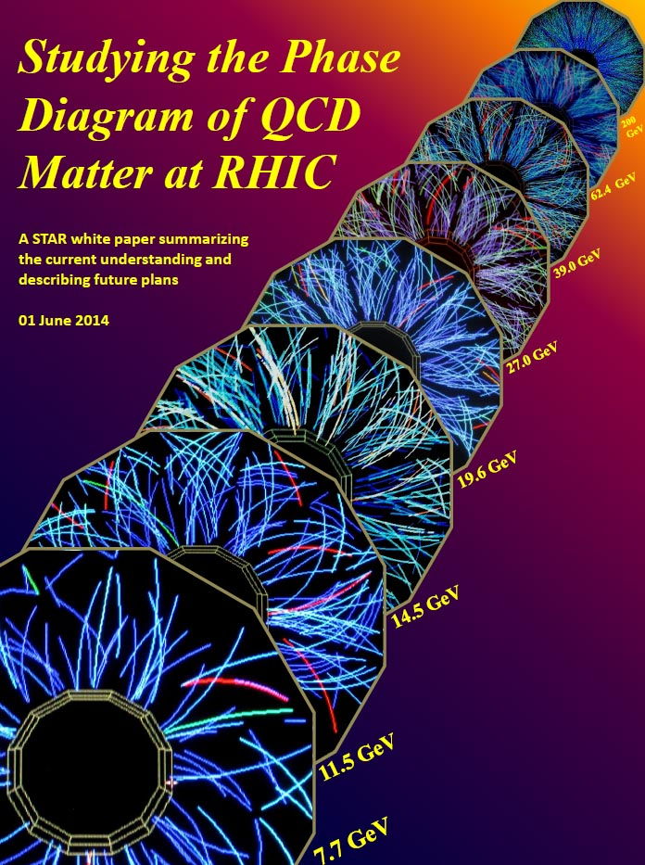
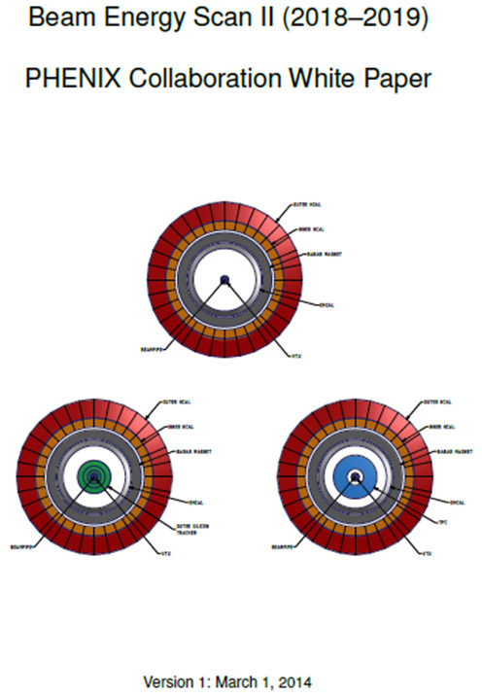
Plans for Beam Energy Scan II

Slide 30
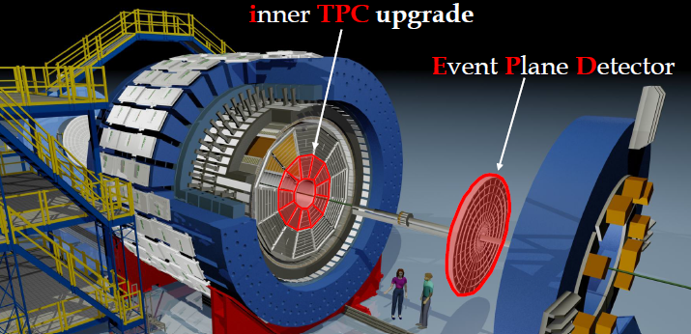
Plans for Beam Energy Scan II
iTPC upgrade:
Replace ageing wires;
Sparse pads cover full area;
better dE/dx;
-1 < η < 1 -1.7 < η < 1.7;
p_{T} >125 MeV/c p_{T} > 60 MeV/c.
EPD upgrade:
Other:
Replaces ageing BBC, which wasn’t designed for BES phys.
Hcal
Endcap TOF
Greatly improved Event Plane info (esp. 1st-order EP);
Better trigger & b/g reduction.

Slide 31
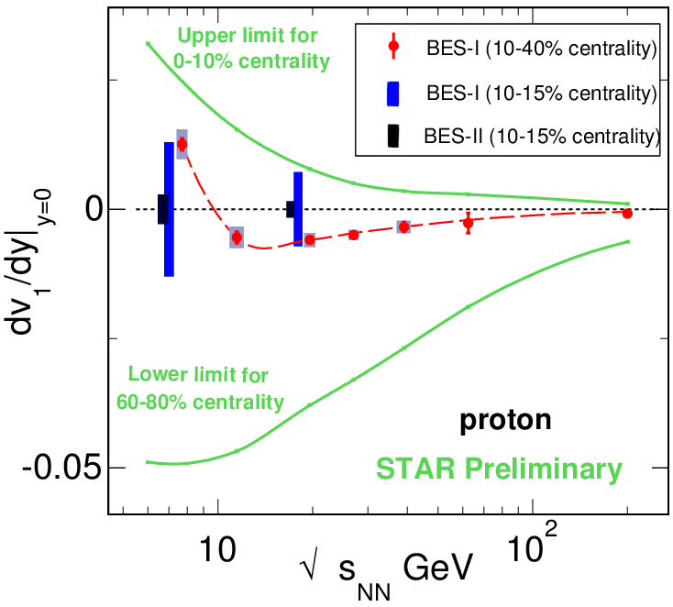
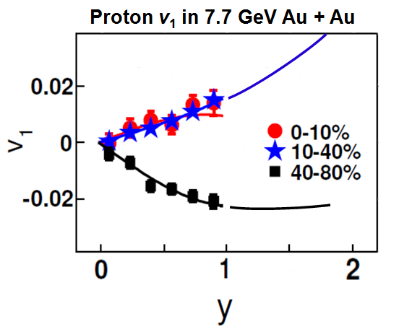
Improved v₁ in Beam Energy Scan II
Statistical errors ~ five times smaller (see opposite); will allow surprisingly strong centrality dependence of proton v₁ to be mapped-out.
Similarly enhanced statistics for less abundant particles, especially Λ & K.
iTPC brings broader acceptance in p_{T} & y => explore beyond v₁ slope near y = 0.
STAR BES-II White Paper; see STAR Note 0598 or 2014 link at
http://www.bnl.gov/npp/pac.asp

Slide 32
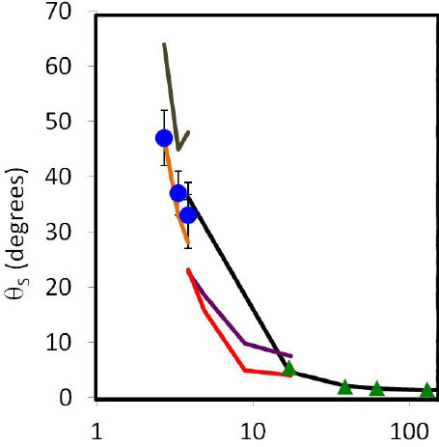
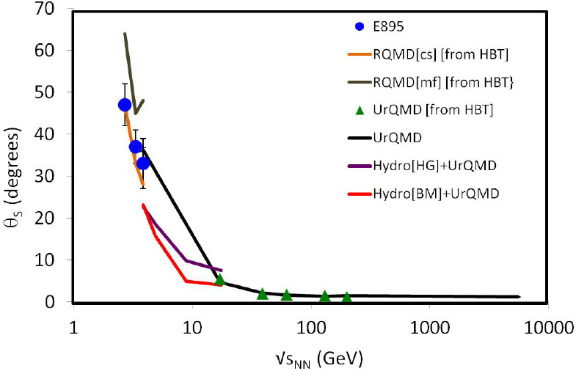
asHBT in Beam Energy Scan II
STAR BES-II White Paper; see STAR Note 0598 or 2014 link at
http://www.bnl.gov/npp/pac.asp

Slide 33
Summary & Conclusions: I
This talk focused on a subset of Beam Energy Scan topics.
Proton & net-proton dv₁/dy both show a prominent minimum that is not explained even qualitatively by hadronic transport models. The net protons show a double sign-change.
Three-fluid hydro with 1st-order PT (2005 & earlier) resembles data qualitatively, but predicted minimum is at a lower energy.
Latest Frankfurt Hydro model calculations corroborate earlier double sign-change, but more realistic Hybrid model options don’t show it. Latest predictions all yield much bigger v₁ than data.
PHSD/PSD model shows no minimum in proton v₁(√s_{NN}). Authors argue that STAR v₁(√s_{NN}) favors crossover PT.
K⁺ and K – v₁(√s_{NN}) measurements from STAR BES-I have reasonable statistics & are close to being ready, and will be followed by Λ v₁(√s_{NN}).

Slide 34
Summary & Conclusions: II
STAR asHBT measurements inconsistent with CERES dip in ε_{F} but R_{o}² – R_{s}² and R_{o}/R_{s} show a peak near 20 GeV that, if not reproduced by hadronic models, would imply extra duration of pion emission at energies near the peak.
Preliminary study suggests strong centrality dependence of proton and net-proton v₁(√s_{NN}), but BES-II statistics and iTPC + EPD upgrades are needed.
BES-II statistics and upgrades are also vital for detailed studies of flow and other signatures for several less-abundant particle species.
Theory comparisons and interpretation badly needed for both published and forthcoming BES measurements.

