Slide 1
Di-lepton production in p+p collisions at 200 GeV at STAR
Bingchu Huang (for STAR Collaboration)
University of Science and Technology of China (USTC)
Brookhaven National Laboratory (BNL)
STAR

Slide 2
Outline
Motivation
Di-electron production in 200GeV p+p collisions
Invariant mass distribution of e⁺e⁻ pairs
Particle cocktail simulation
Light meson and heavy flavor components
Comparison with data
Summary

Slide 3
Di-lepton program at STAR
The initial temperature of sQGP; the mass origin of hadrons;
color screening features of heavy quarkonia …
Measurements | Physics
low mass di-leptons | thermal radiation of QGP; in-medium modifications of vector meson (ρ ω φ), chiral symmetry restoration
intermediate mass di-leptons | thermal radiation of QGP; heavy flavor modification; resonances in sQGP
large mass: heavy quarkonia | T of QGP, color screening, quarkonium production mechanism

Slide 4
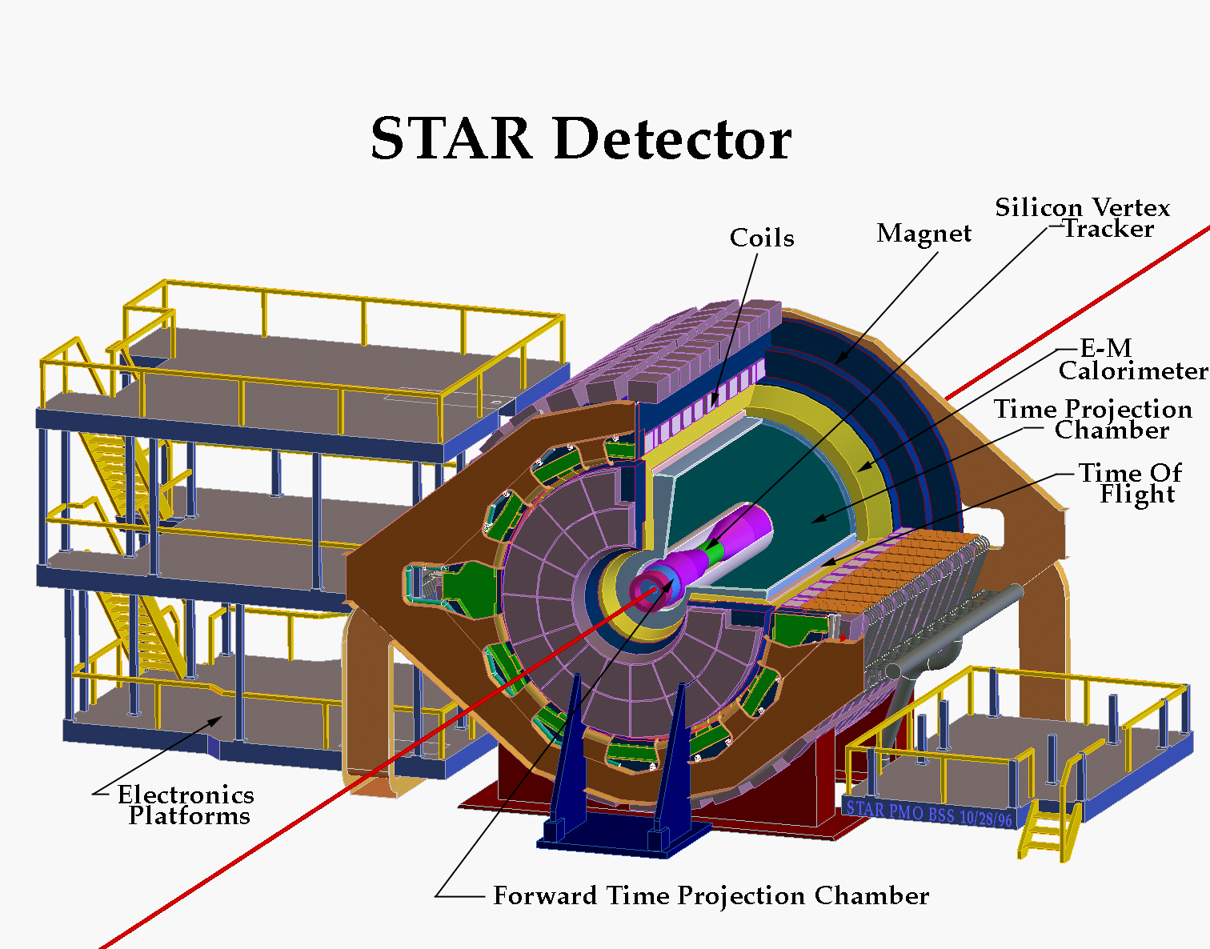
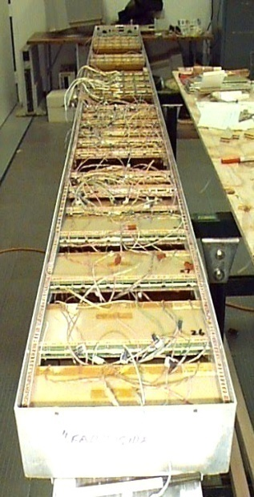
STAR Detector
Time Projection Chamber
1. Tracking
2. Ionization energy loss (dE/dx):
(π, K) < 0.7 or > 3 GeV/c , proton < 1 or > 3 GeV/c
3. Coverage -1<η<1
Time Of Flight ----
1. Timing resolution (<100ps)
2. Coverage: -0.9<η<0.9
3. Install (4% y2008,
72% y2009, 100% y2010)

Slide 5
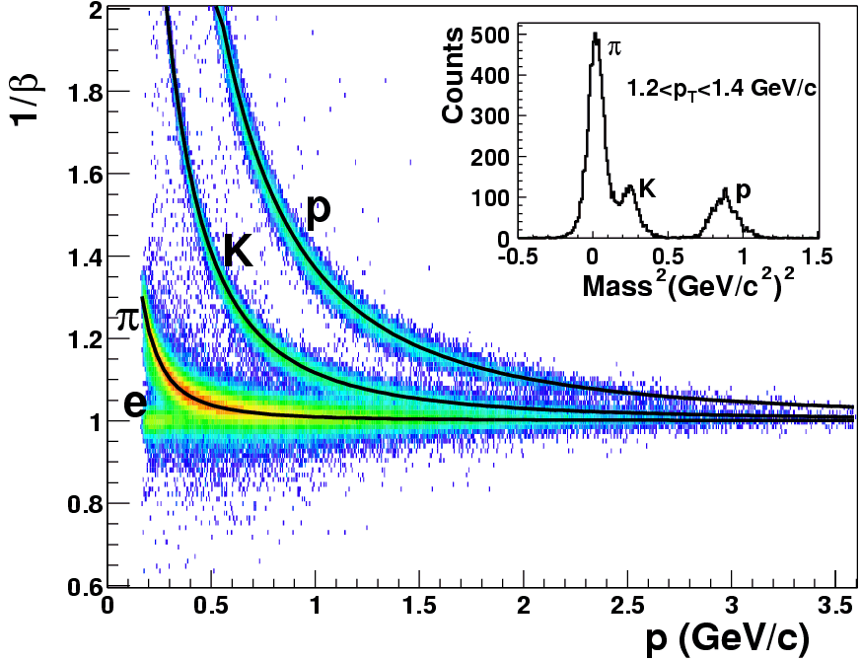
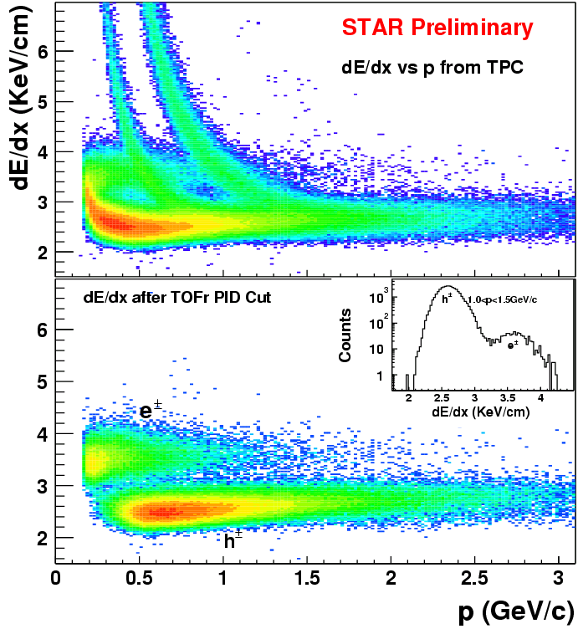
STAR Time of Flight detector performance
200 GeV d+Au collisions
200 GeV d+Au collisions
STAR Collaboration, nucl-ex/0309012
|1/β-1|<0.03
TOF PID: (π, K) ~ 1.6, proton ~ 3 GeV/c
STAR Collaboration, PLB616(2005)8
TOF enables clean electron PID up to P_{T} < 3 GeV/c. (STAR Collaboration, PRL94(2005)062301)
M. Shao et al., NIMA 558(2006)419
STAR Collaboration, nucl-ex/0407006

Slide 6
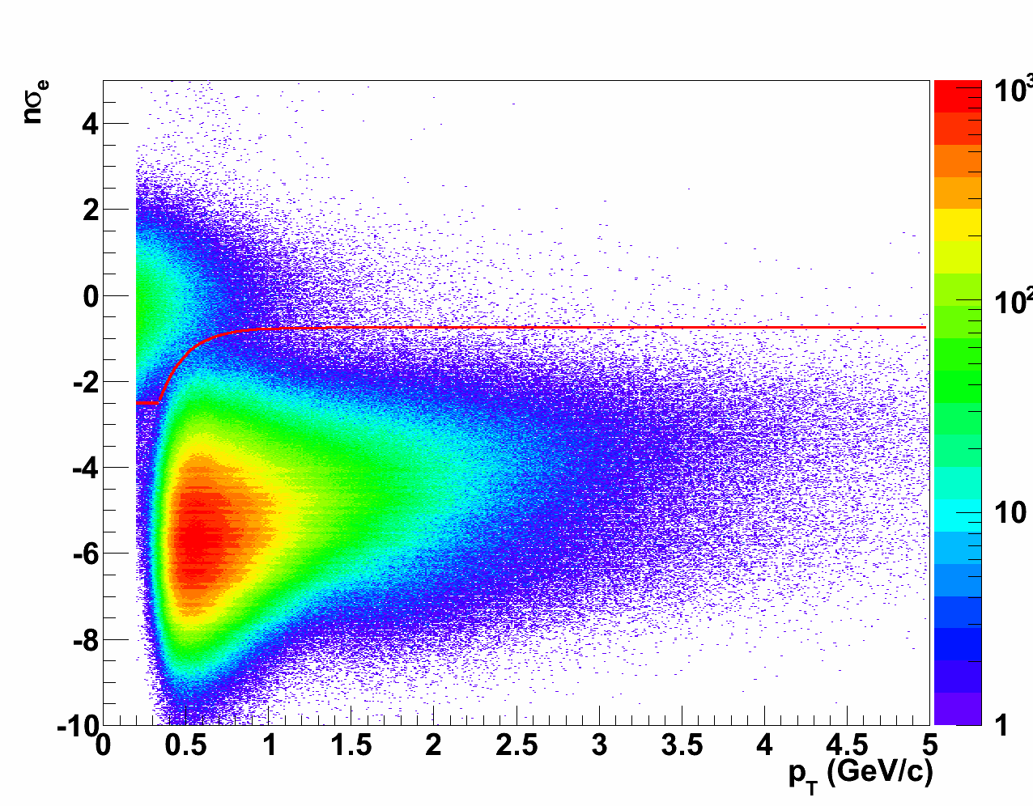
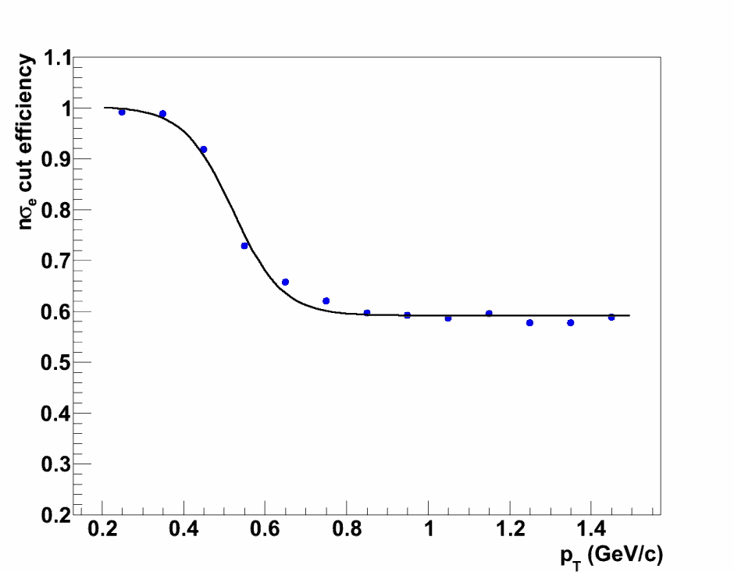
Electron ID
STAR Preliminary
STAR Preliminary
f(pT)
The dE/dx cut efficiency on e
High electron purity: 99% (f(pT)<nσ_{e}<2)
Efficiency: greater than the 60% for the dE/dx cut

Slide 7
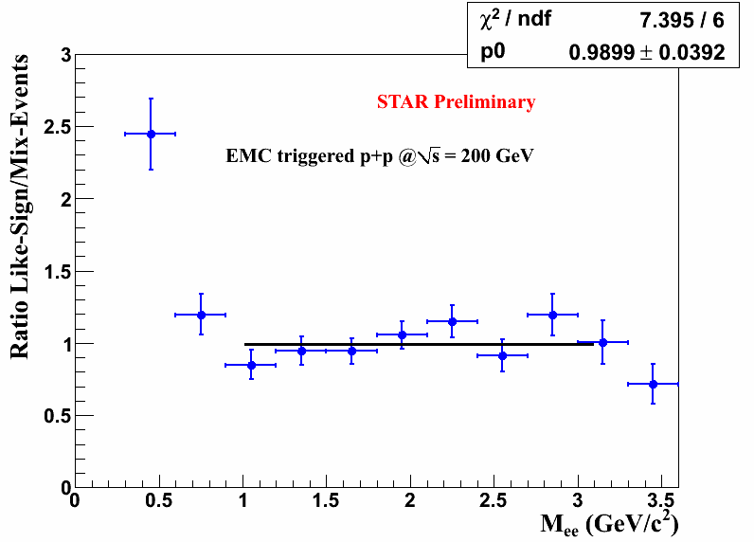
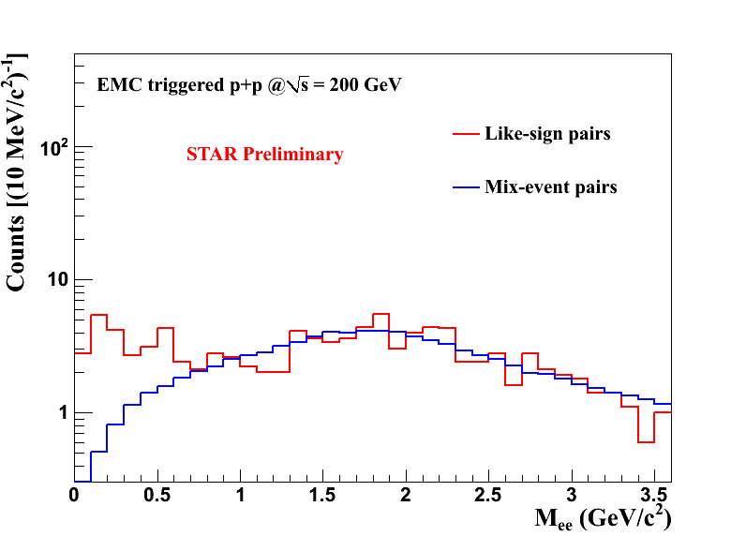
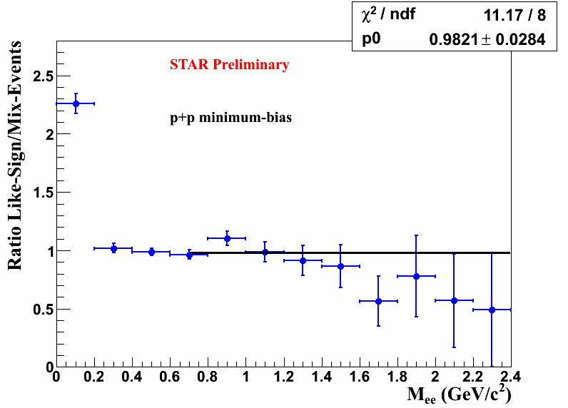
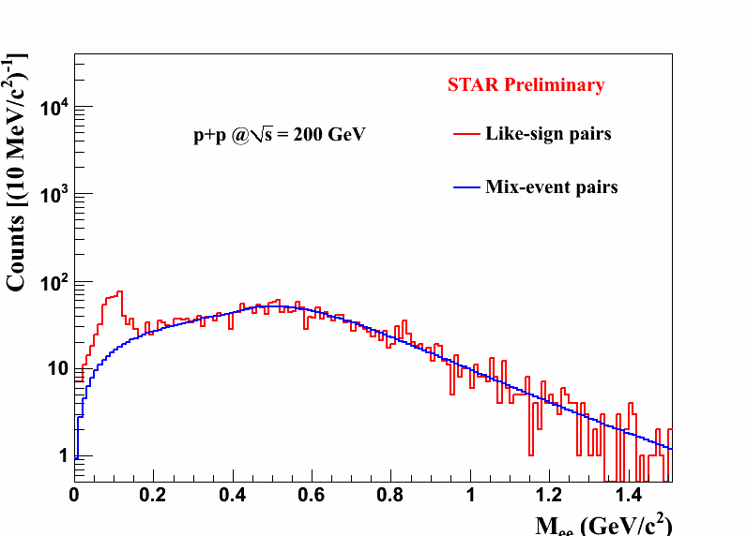
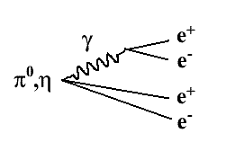
Di-lepton background
Mix-event normalize to like-sign within 0.4 - 1.5 GeV/c²
Mix-event normalize to like-sign within 1-3 GeV/c²
Cross-pair bg. can only be described by like-sign method.
For minimum bias events, we subtracted like-sign bg at M_{ee}<0.7 GeV/c², mix-event bg subtraction was applied at 0.7<M_{ee}<3.5 GeV/c².

Slide 8
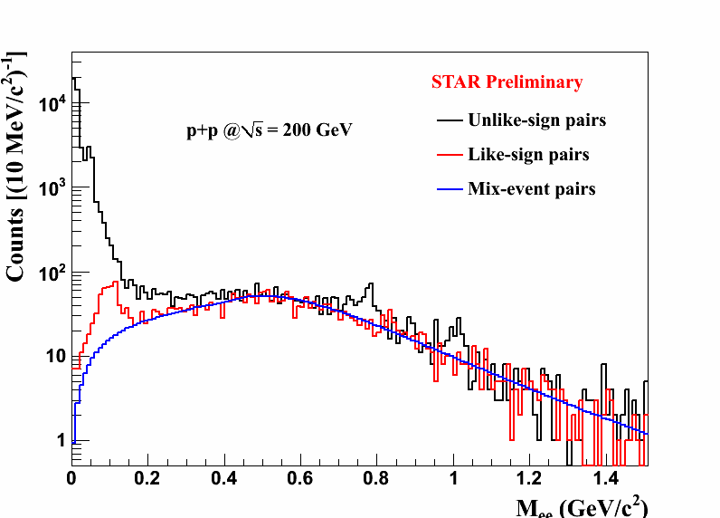
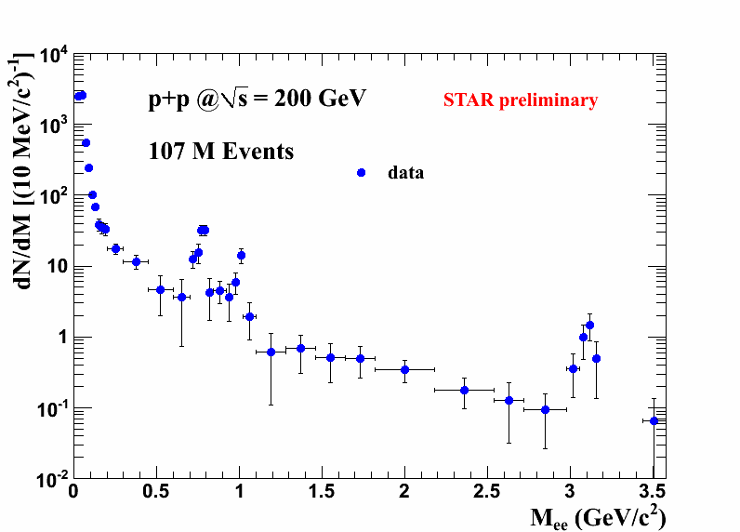
Di-lepton invariant mass spectrum in p+p collisions
Di-lepton at run9 p+p collisions: signal excess above background
ω: S/B~0.7, significance: 5 σ
φ: S/B~1, significance: 4 σ

Slide 9
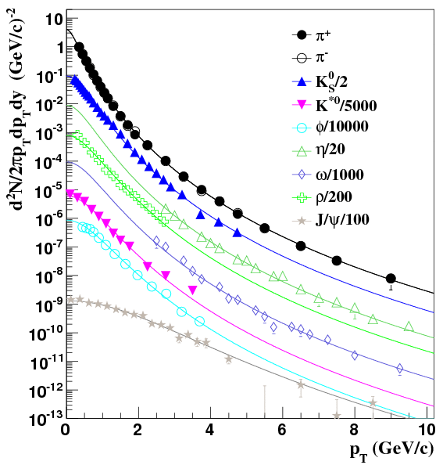
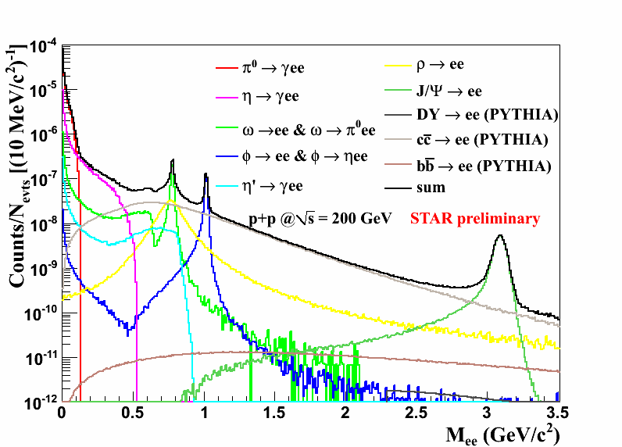
Particle cocktail simulation
STAR: π±, K_{S}, K*, φ, ρ
PHENIX: η, ω, J/ψ
ccbar: STAR measured cross section as input;
STAR Collaboration, PRL94(2005)062301
bbar/ccbar ratio from PYTHIA
Z. Tang et al., PRC 79,051901(R)(2009); M. Shao et al.,
J. Phys. G: Nucl. Part. Phys. 37 (2010) 085104
In GEANT simulation: input the particle Tsallis fit function; output the e+e- invariant mass cocktail.
Same cuts were applied in simulation as in data.

Slide 10
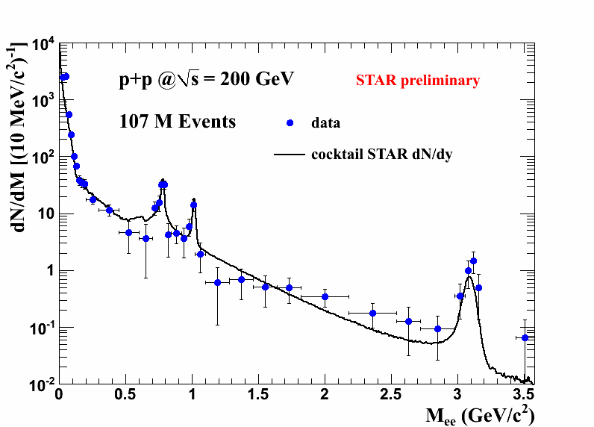
Cocktail comparison with data
The cocktail simulation can describe p+p data.
Baseline for Au+Au
Chi2/NDF=36/30
Systematic uncertainties on data and cocktail are under study.

Slide 11
Summary
STAR’s di-lepton measurement enabled by TOF detector.
Di-electron continuum measured in 200 GeV p+p collisions.
Cocktail simulation is consistent with data.
In future we can study in Au+Au:
low mass continuum, vector meson in-medium modifications, virtual photons, intermediate mass thermal radiation, ccbar modification, quarkonia, rare decay and exotics …

