Slide 1
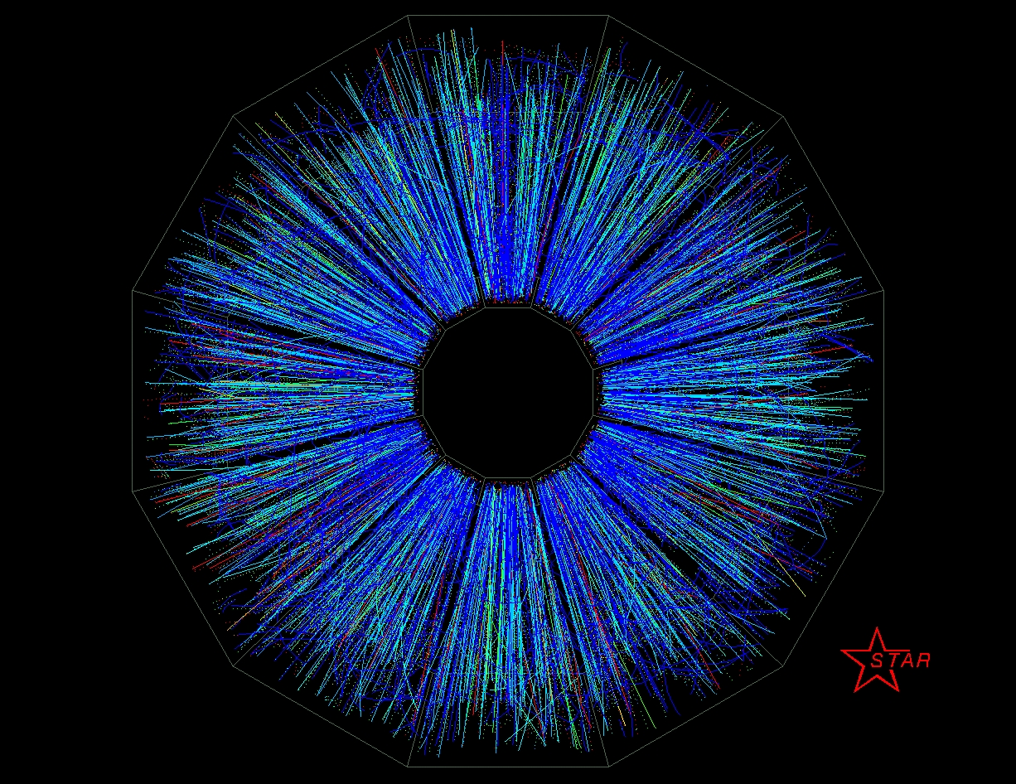

The next half-decade of physics with STAR
1st Collision
June 12, 2000
James Dunlop for the STAR Collaboration

Slide 2
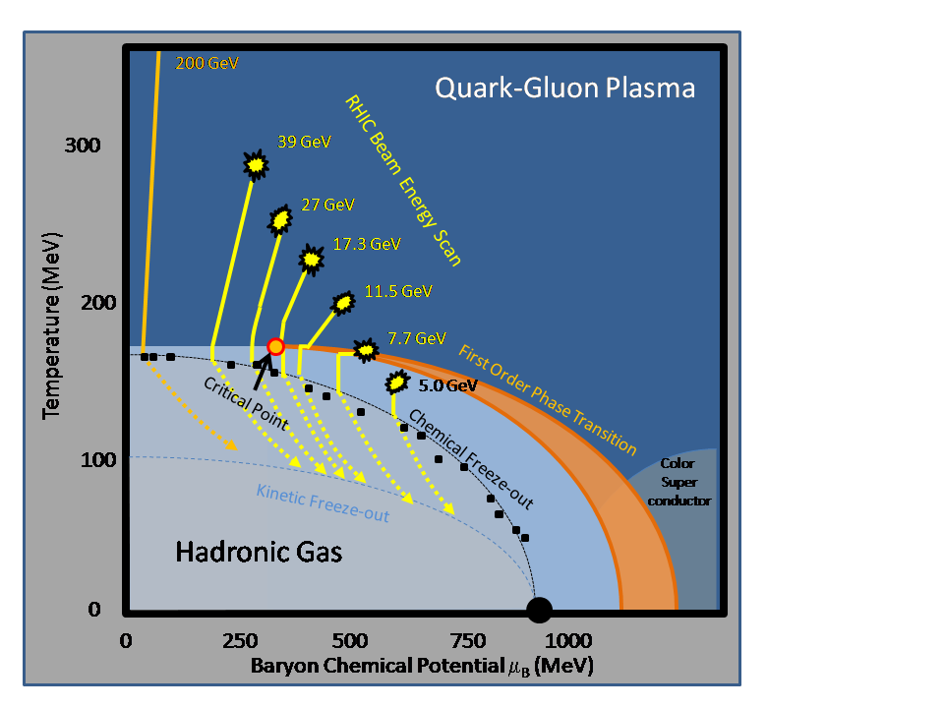
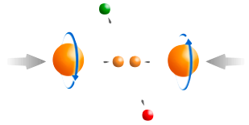
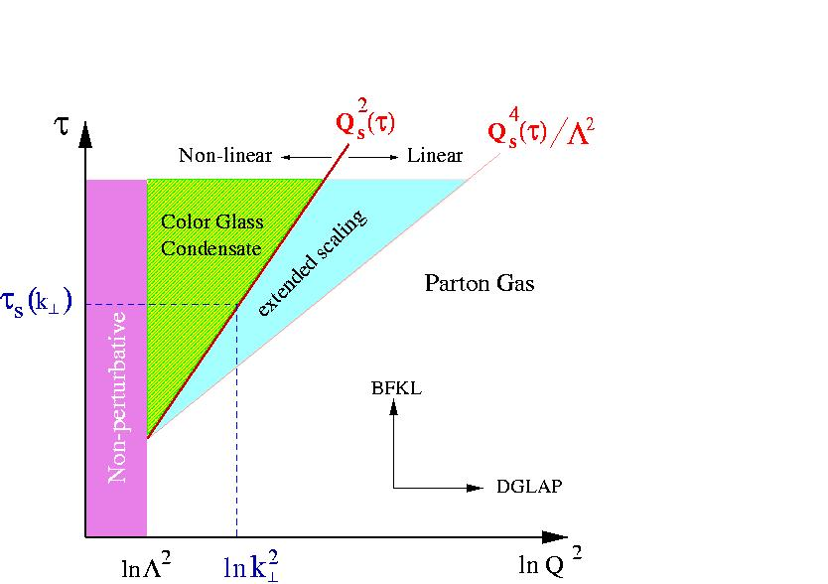
RHIC: Key Unanswered Questions
Hot QCD Matter
Partonic structure
Spin structure of the nucleon
How to go beyond leading twist and
colinear factorization?
Properties of the sQGP in detail
Mechanism of Energy Loss:
weak or strong coupling?
Is there a critical point, and if so, where?
Novel symmetry properties
Exotic particles
What are the properties of
cold nuclear matter?

Slide 3
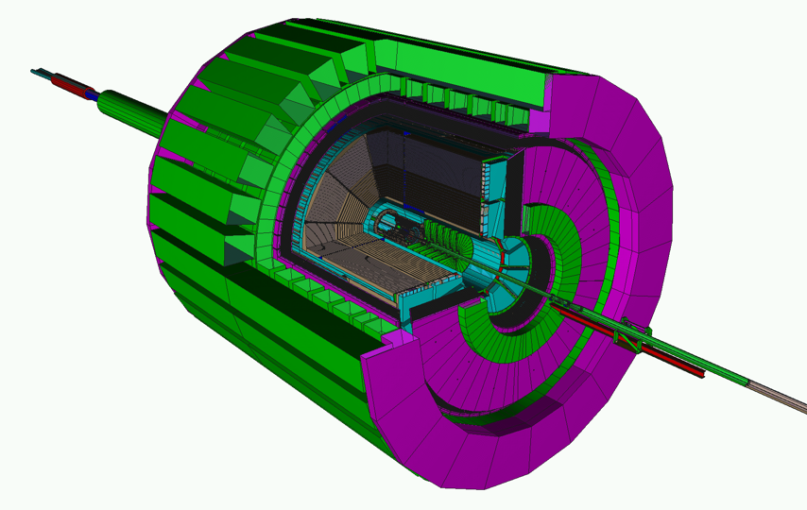
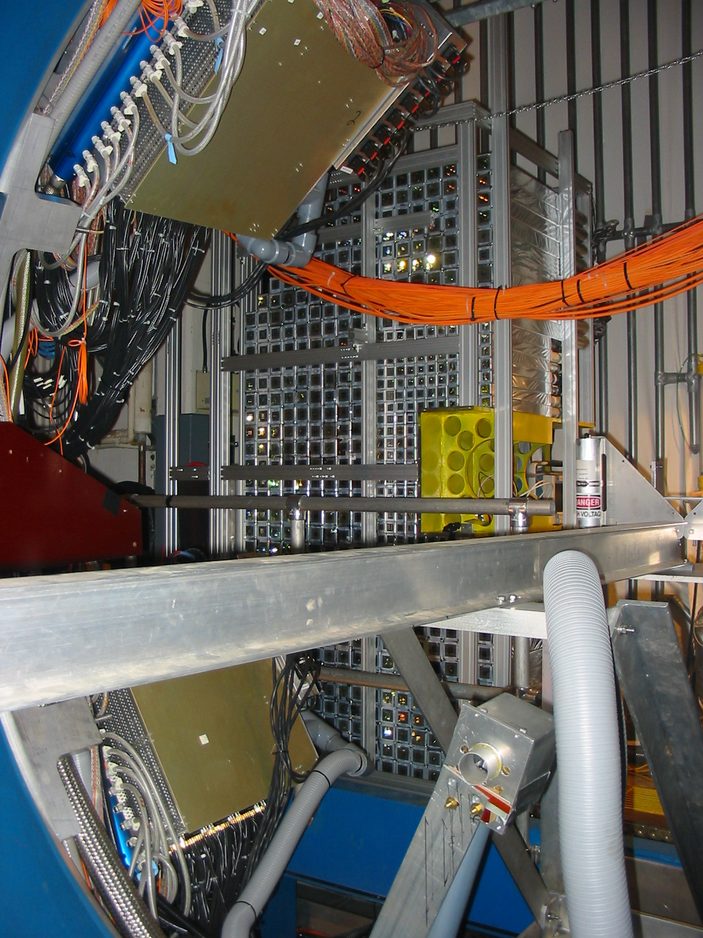

STAR: A Correlation Machine
Tracking: TPC
Particle ID: TOF
Electromagnetic Calorimetry:
BEMC+EEMC+FMS
(-1 ≤ η ≤ 4)
Muon Telescope Detector (2014)
Upgrades:
Trigger and DAQ
Roman Pots Phase 2
Forward Upgrade
Heavy Flavor Tracker (2014)
Full azimuthal particle identification
over a broad range in pseudorapidity
Forward Gem Tracker
(2011)

Slide 4
How to answer these questions
Next 5 years
Hot QCD matter: high luminosity RHIC II (fb⁻¹ equivalent)
  Heavy Flavor Tracker: precision charm and beauty
  Muon Telescope Detector: e+μ and μ+μ at mid-rapidity
  Trigger and DAQ upgrades to make full use of luminosity
  Tools: jets combined with precision particle identification
  Full use of the flexibility of RHIC with U+U, other systems
Phase structure of QCD matter: energy scan
  Analysis of Phase 1, completed in Runs 10 and 11, followed by targeted fine-scale scan of certain energies
Partonic spin structure of the proton
  Gluon polarization: A_{LL} at 200 and 500 GeV with dijets
  Sea quark polarization: W A_{L} at forward and mid-rapidity
  Transverse spin phenomena

Slide 5
Hot QCD Matter

Slide 6
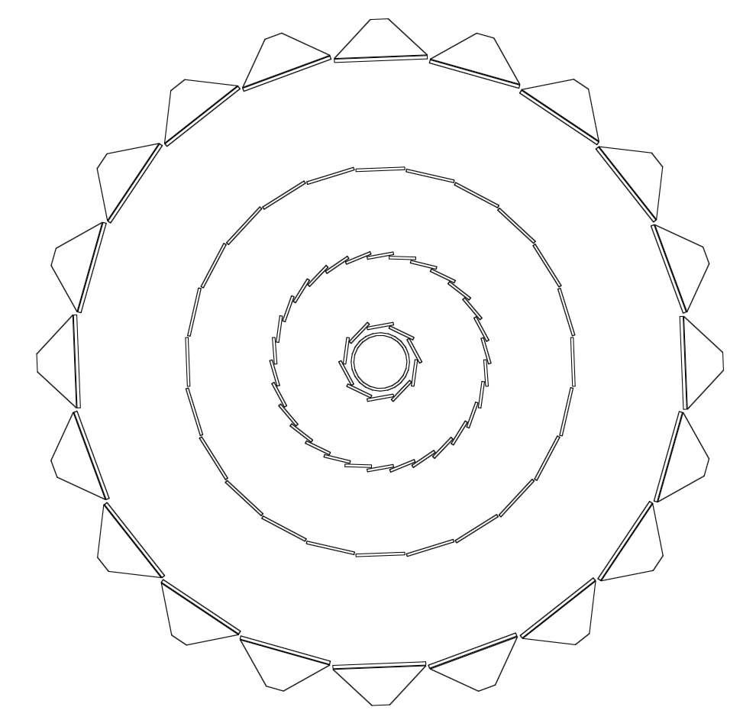
Heavy Flavor Tracker (HFT)
The HFT puts 4 layers of Silicon around the vertex
Provides ~20 μm space point resolution on tracks
Uniquely thin pixels
  < 0.6% X₀/layer, targeting 0.32% X₀
  Topological reconstruction of open charm at low p_{T}
DAQ1000-level rate capabilities
  (~ 800 Hz – 1KHz)
Will be ready for the 2014 run
30
SSD
IST
Beampipe
Pixel Detector
20
10
-10
-20
-30

Slide 7
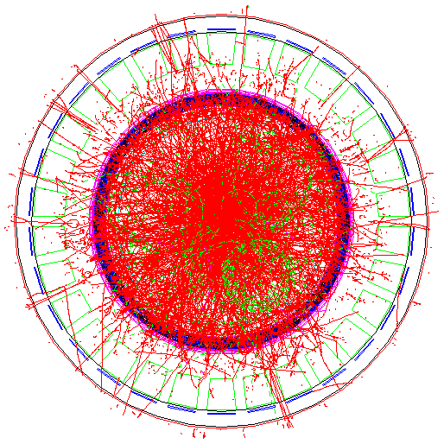
Muon Telescope Detector (MTD)
Muon Tagger: use the magnet steel as absorber, TPC for tracking
  Acceptance: 45% for |η|<0.5
118 modules, 1416 readout strips, 2832 readout
channels
Long-MRPC detector technology, HPTDC
electronics (same as STAR-TOF)
Unique capability to identify muons at mid-rapidity at RHIC

Slide 8
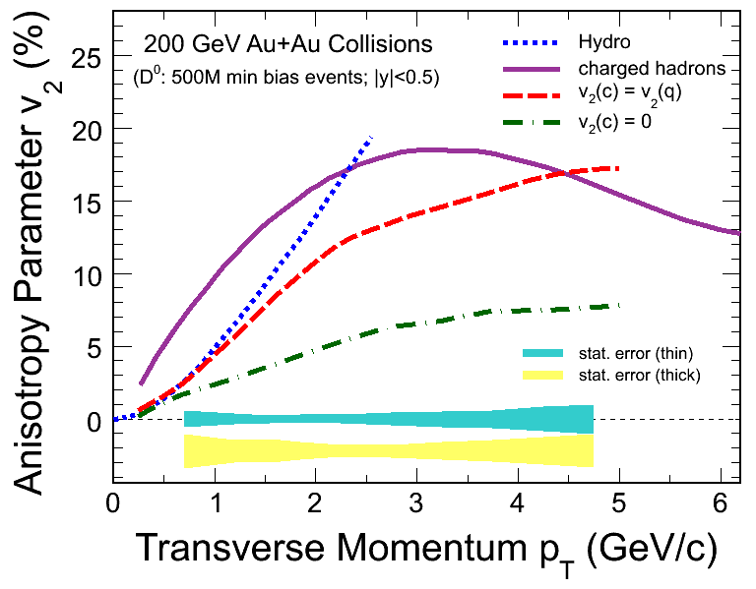
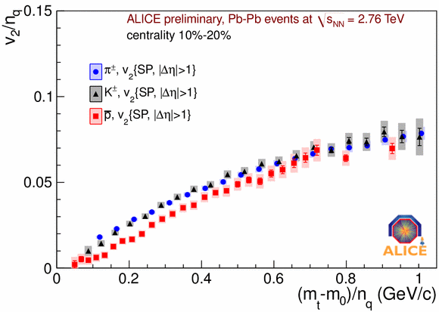
Properties of sQGP: charm flow
Does charm flow hydrodynamically?
  Low p_{T} is the hydro domain
Heavy Flavor Tracker: unique access to low-p_{T} fully reconstructed charm

Slide 9
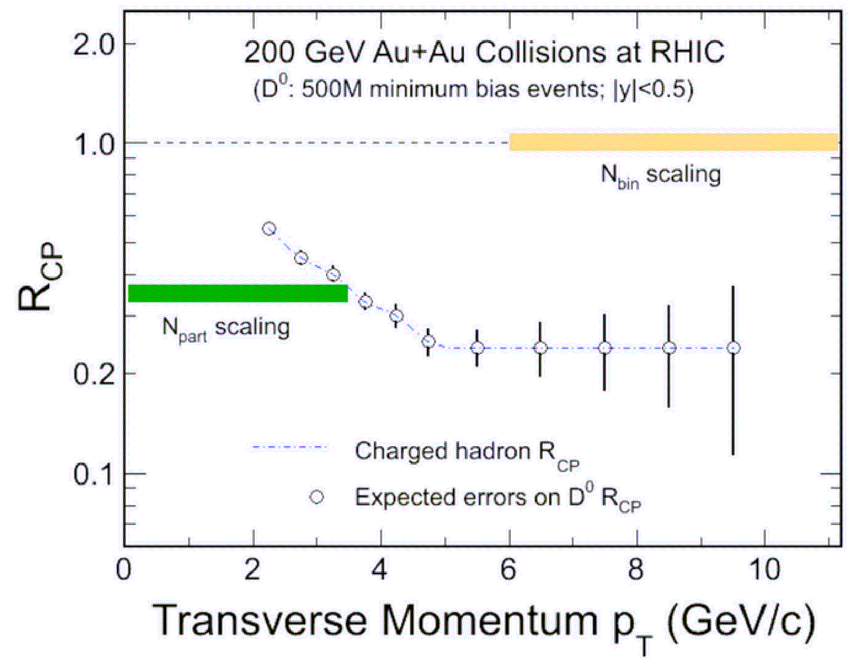
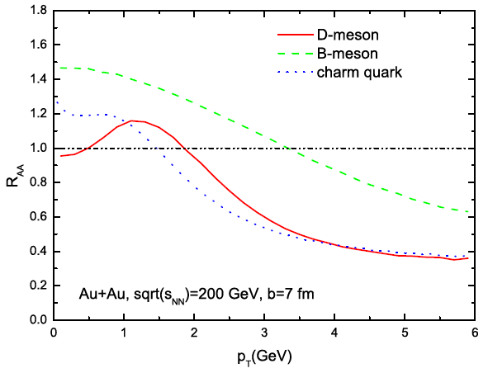
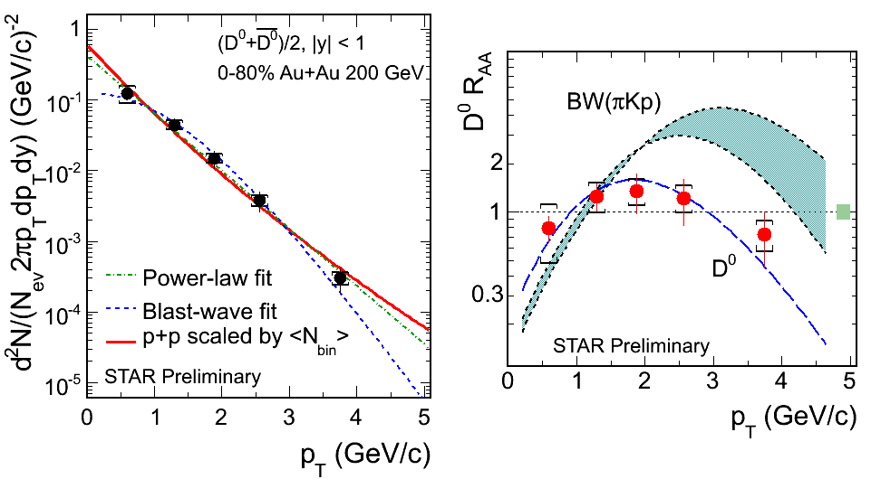
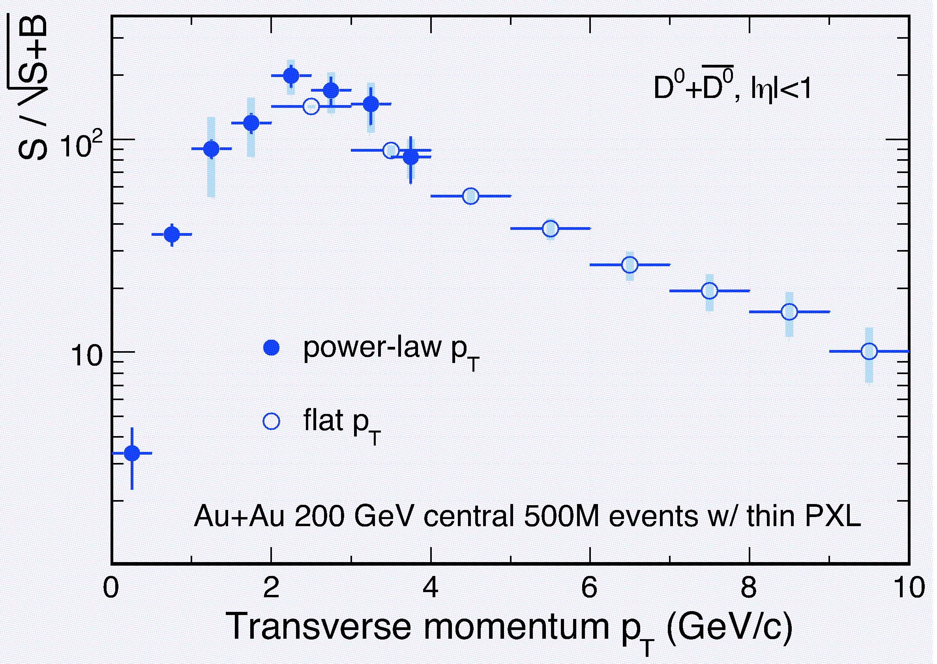
Charm diffusion: low p_{T} matters
R. Fries, QM2011
Critical region for testing diffusion and hydrodynamic flow: p_{T} ~ 1 – 3 GeV/c
STAR is just starting the exploration of this region
STAR HFT is optimized for this

Slide 10
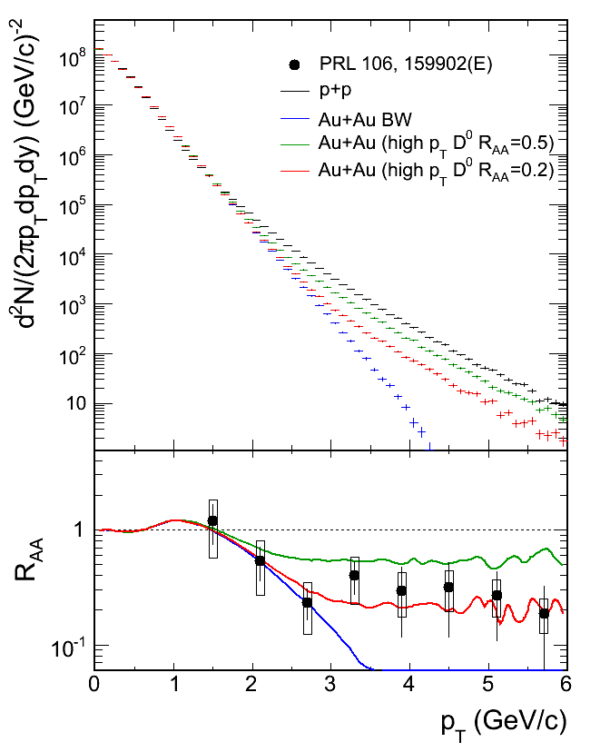
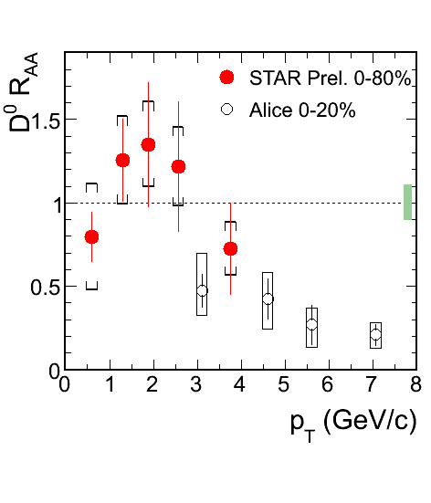
Low p_{T} is unique to the STAR HFT
Low p_{T} D⁰ has little constraint on high p_{T} electrons, and vice versa
Other detectors (ALICE, PHENIX) optimized for higher p_{T}
though ALICE is looking at an upgrade using HFT technology (~2017?)
Y. Zhang, QM2011

Slide 11
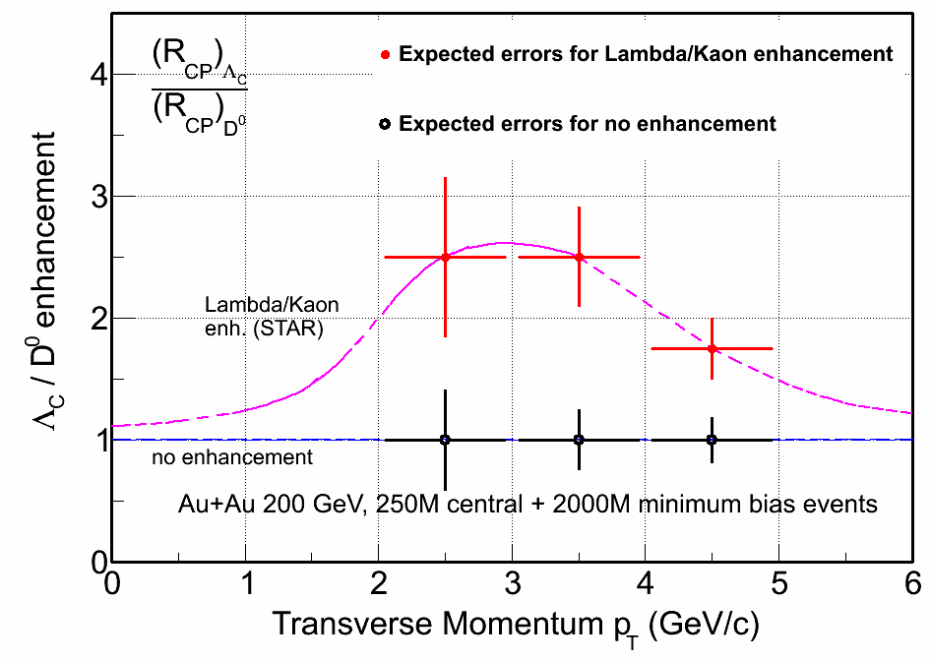
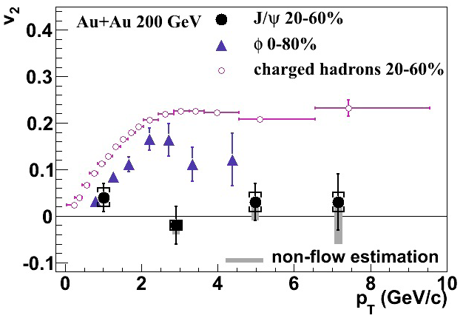
More to charm than just D’s
STAR Preliminary
Are charmed hadrons produced via coalescence?
  Heavy Flavor Tracker: unique access to charm baryons
  Would force a quantitative reinterpretation of non-photonic electron R_{AA}
Muon Telescope Detector: precision measurements of J/ψ flow

Slide 12
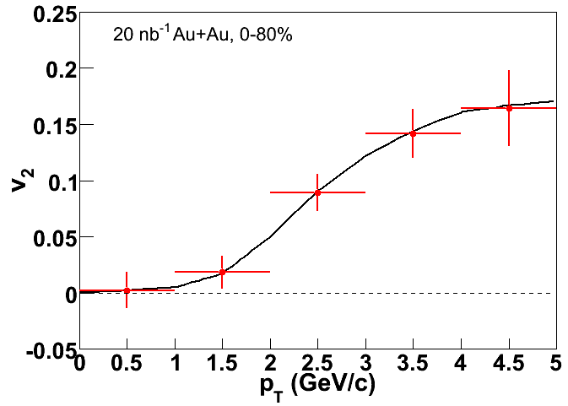
J/Psi Flow: MTD projection
J/Psi v₂ small
Either charm does not flow, or coalescence is not a dominant contributor to J/Psi production
Or charm flows strongly for p_{T} where coalescence small, and vice versa
[X. Zhao and R. Rapp, Phys. Rev. C 82:064905 (2010)]
More subtle measurements needed
Dramatic improvement with RHIC II and MTD

Slide 13
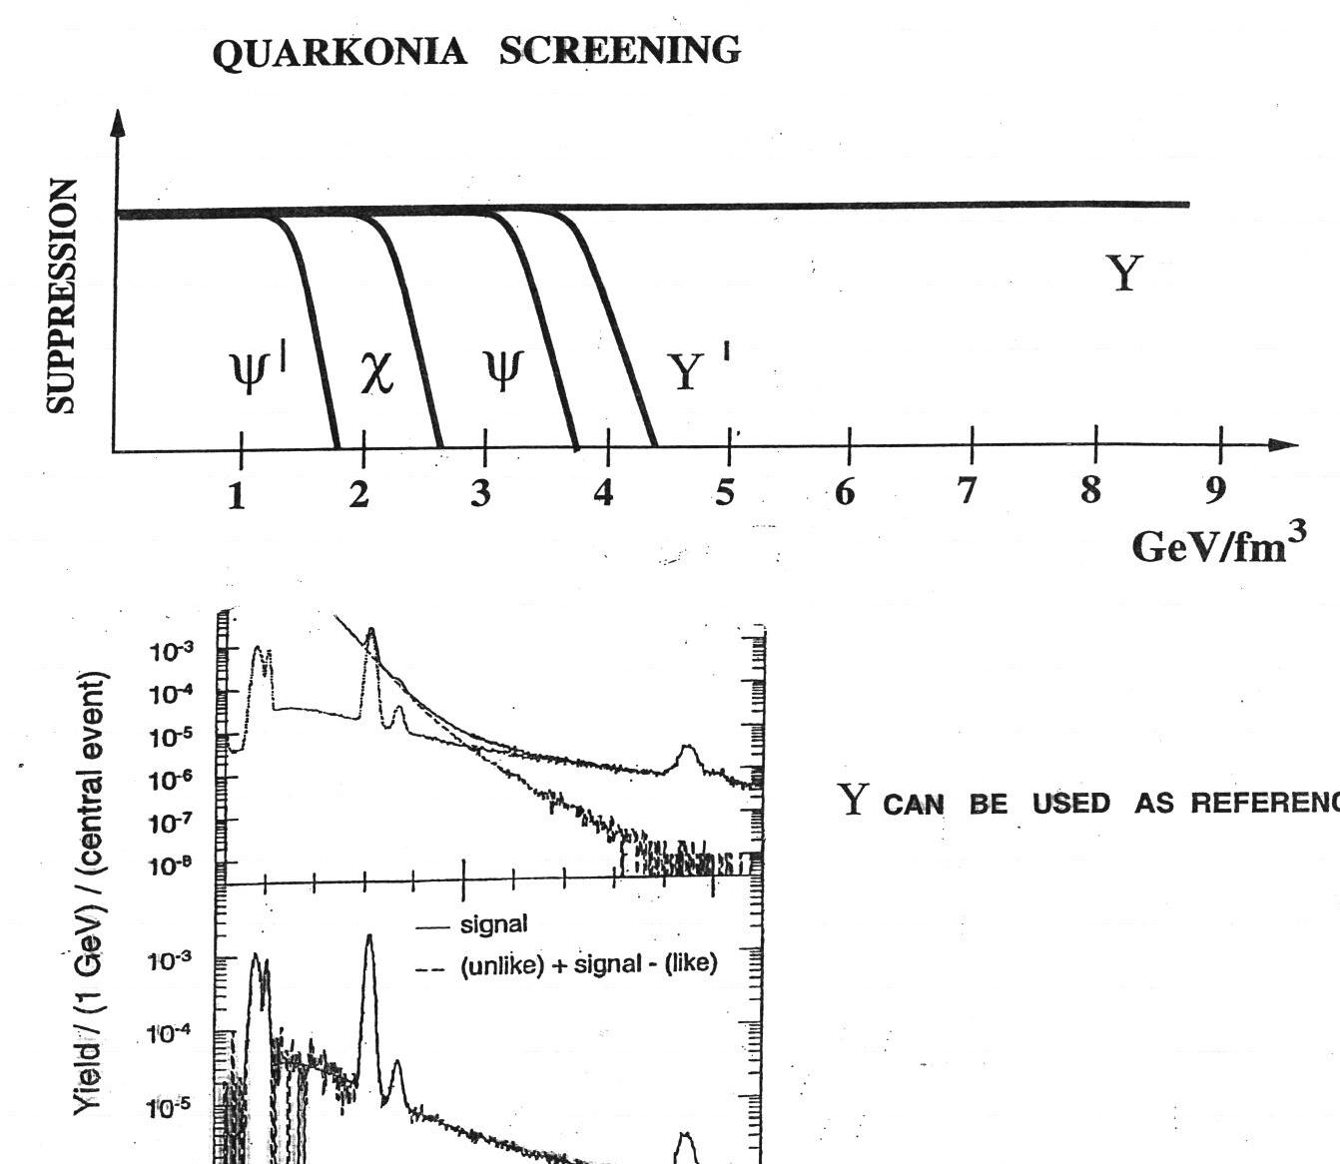
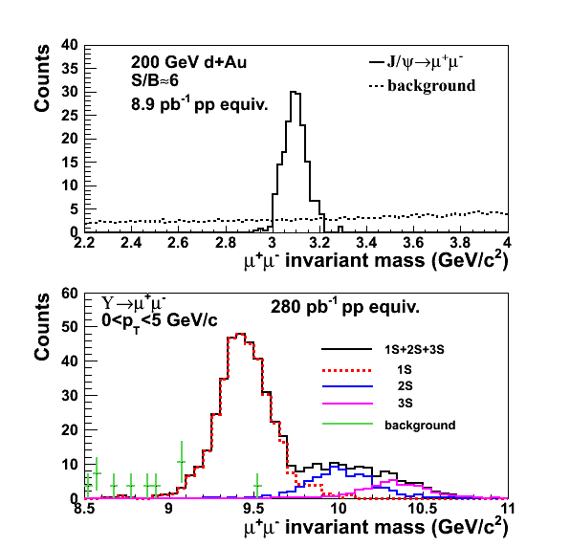
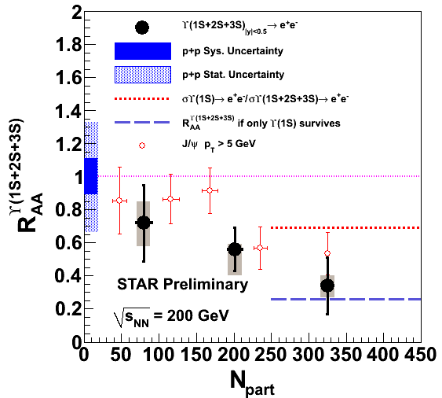
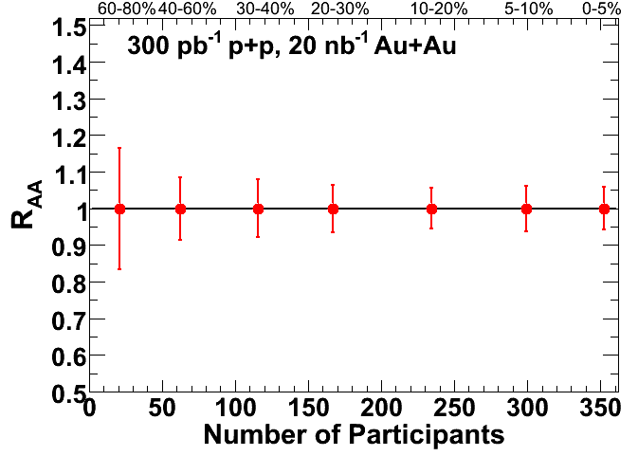
Properties of sQGP: Upsilon
RHIC
What quarkonia states dissociate
at RHIC energy densities?
What is the energy density?
Υ
Muon Telescope Detector: dissociation of Υ, separated by state
  At RHIC: small contribution from coalescence, so interpretation clean
  No contribution of Bremsstrahlung tails, unlike electron channel

Slide 14
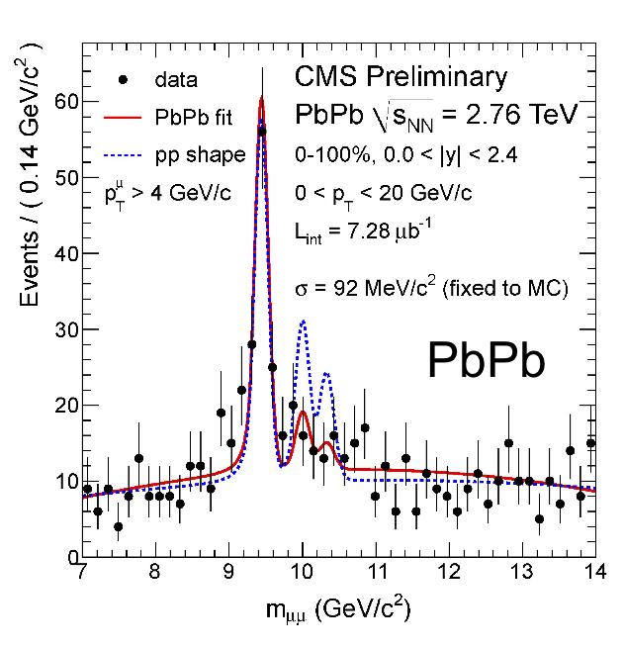
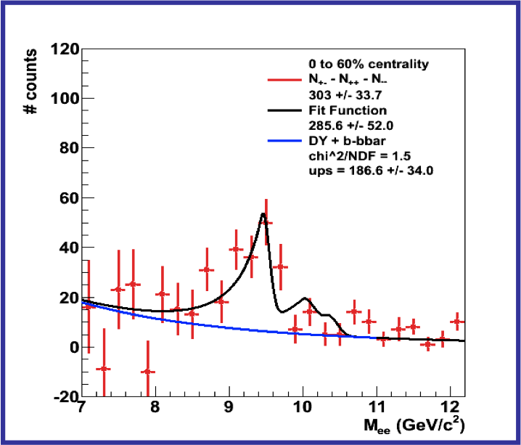
Upsilon: Complementary to LHC
STAR Preliminary
Au+Au √s_{NN}= 200 GeV
0-60%
LHC?
RHIC?
Similar counts per year between LHC and RHIC:
σ (LHC>RHIC) * L (LHC<RHIC)
Complementarity:
T_{LHC} ≠ T_{RHIC}
Possible coalescence contribution at the LHC

Slide 15
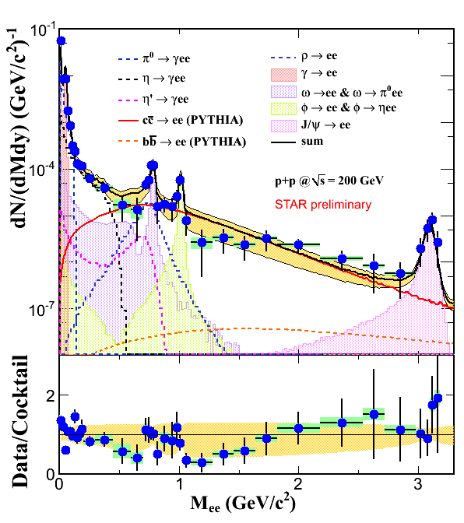
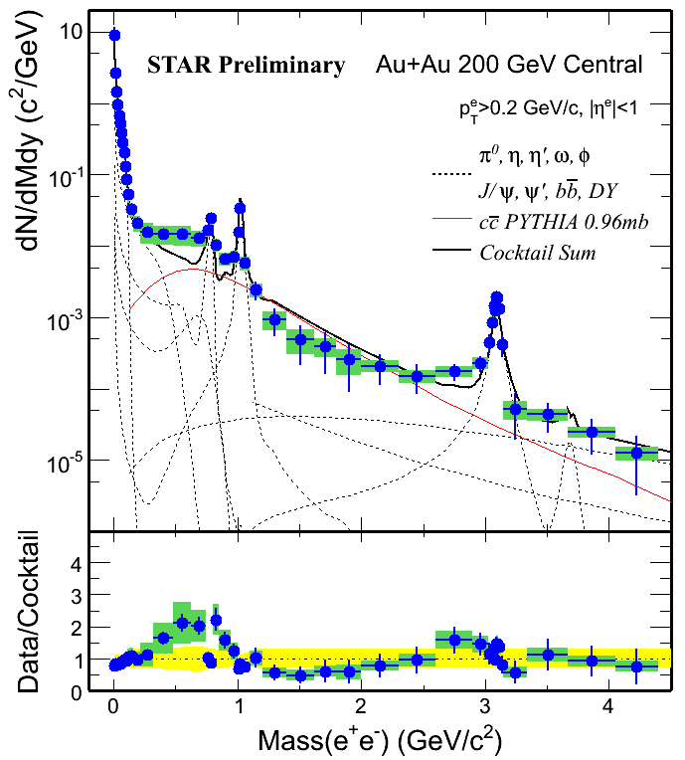
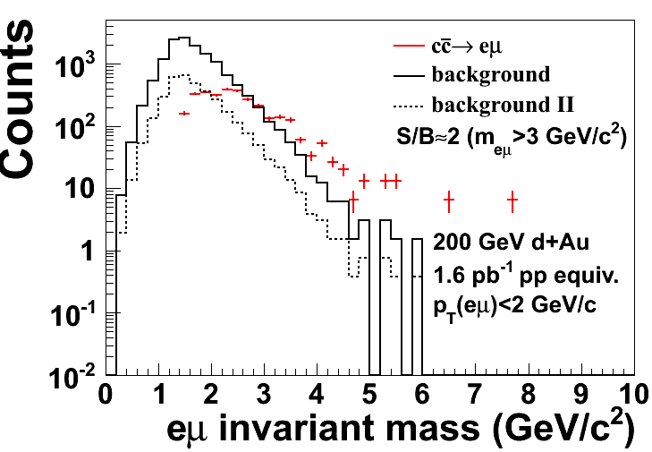
Properties of sQGP: dileptons
p+p
Au+Au Central
Penetrating probe of the bulk medium
Correlated charm dominates 1-3 GeV mass region
  Large uncertainties in pp
  Different in A+A?
Address with:
  HFT: D⁰, displacement
  MTD: e-μ correlations

Slide 16
Mechanism of partonic energy loss
Is the mechanism predominantly collisional or radiational?
  Detailed, fully kinematically constrained measurements via gamma-hadron and full jet reconstruction
  Pathlength dependence, especially with U+U and other systems (Cu+Au)
Does the mechanism depend on the parton type?
  Gluons: particle identification, especially baryons
  Light quarks: gamma-hadron
  Heavy quarks: Heavy Flavor Tracker and Muon Telescope Detector
Does the energy loss depend on the parton energy and/or velocity?
  High precision jet measurements up to 50 GeV
  Vary velocity by comparing light quarks, charm, and beauty

Slide 17
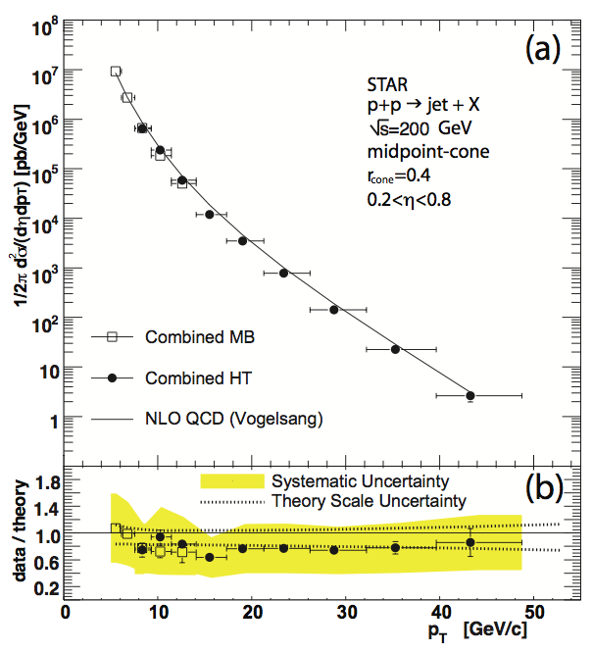
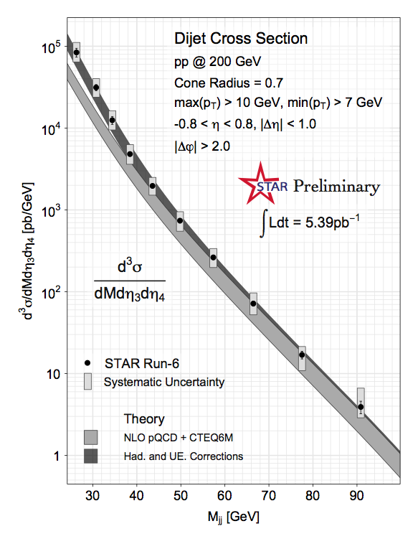
Jets: Proven Capabilities in p+p
B.I. Abelev et al. (STAR Coll.), Phys.Rev.Lett. 97, 252001, 2006
SPIN-2010: Matt Walker/Tai Sakuma, for the collaboration
Jets well understood in STAR, experimentally and theoretically

Slide 18
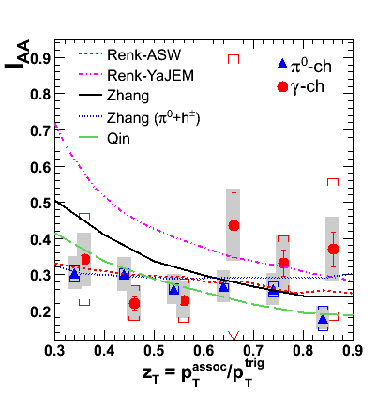
To date: Jets and γ-hadron in A+A
Phys. Rev. C 82, 034909
Triggered: ~0.3 nb⁻¹
Untriggered: ~0.01 nb⁻¹
Beginning results indicative, but not final word
Huge increase in significance with trigger upgrades+luminosity
Complementary to LHC:
RHIC: quarks LHC: gluons

Slide 19
Jet Capabilities in A+A
Sufficient statistical reach out to ~50 GeV for precision measurements
  Large unbiased datasets
  Trigger upgrades to lessen bias with walking jet patches
Smearing of high momentum charged hadrons under control
  Corrections: need to calibrate level of smearing
  Hard cutoff in hadrons: small loss of jets that fragment hard
Dominant uncertainty: fluctuations in the underlying event
Notes:
Backup

Slide 20
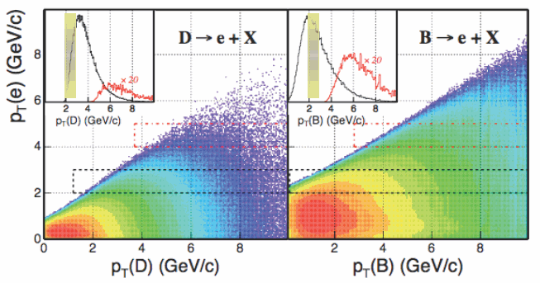
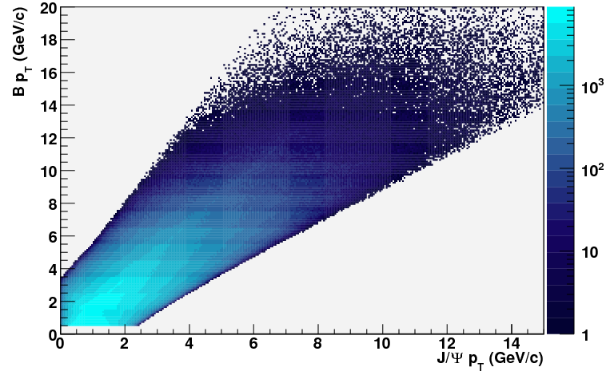
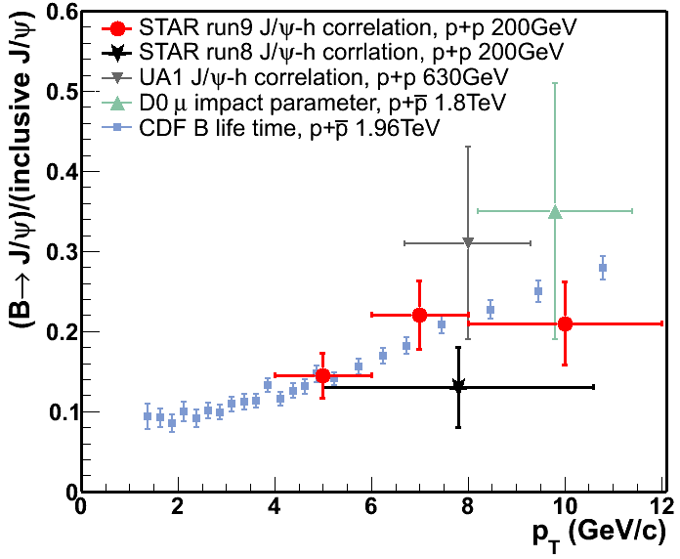
Velocity dependence via Heavy Quarks
What is the velocity dependence of energy loss?
  Key tools: heavy quarks with precise kinematic reconstruction
  Key technology: Heavy Flavor Tracker and Muon Telescope Detector
STAR
Preliminary

Slide 21
Flexibility of RHIC:
System Scans

Slide 22
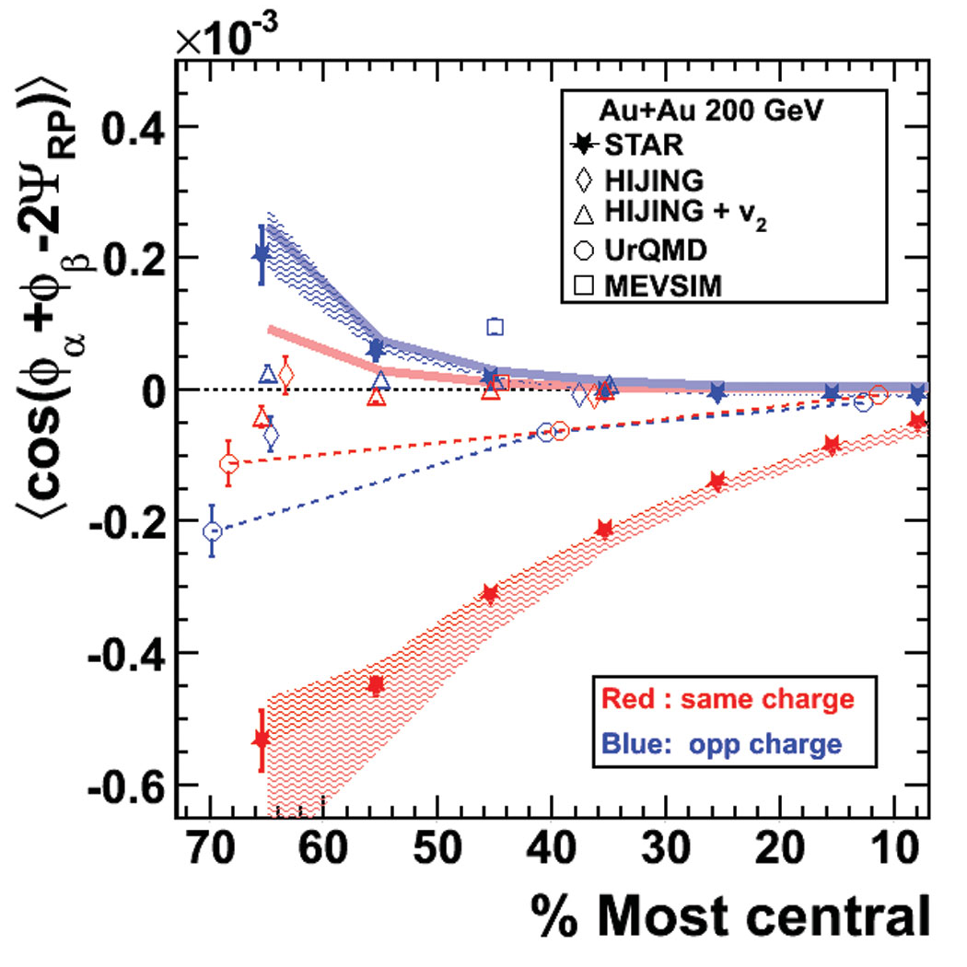
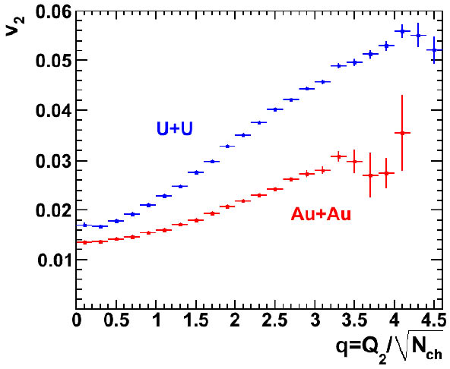
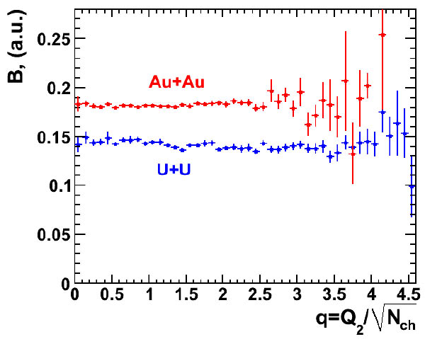
Novel symmetries: local strong parity violation
STAR, PRL 103, 251601
Transitions between domains with different topological charge may induce parity violation in the dense matter
  Similar transitions (at much higher energies) might have produced the matter-antimatter asymmetry in the early universe
Magnetic field in A+A plays a key role: chiral magnetic effect
Crucial to verify if parity violation is the correct explanation
  U+U collisions: collisions with more v₂ and less B field than Au+Au
  Energy scan: Behavior from 7.7 GeV-2.8 TeV as B field and v₂ change

Slide 23
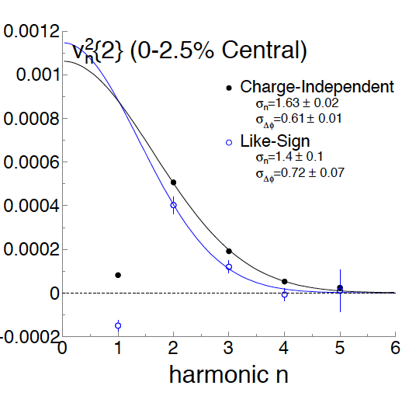
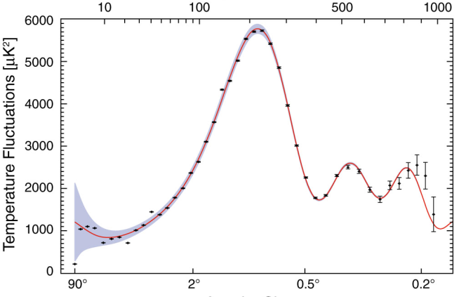
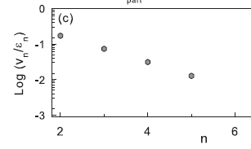
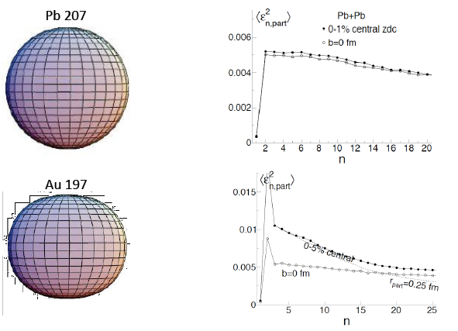
v_{n} fluctuations: varying initial conditions
WMAP
RHIC
Pb 208
Damping of higher harmonics: viscosity
Check interpretation by varying initial conditions: damping unchanged?
Run 12: U+U
Run 13 and beyond: Pb+Pb, Cu+Au, …
Au 197
Paul Sorensen

Slide 24
Phases of QCD

Slide 25
Where is the QCD critical point?
Phase 1
Finished in
Runs 10-11
A landmark on the QCD phase diagram

Slide 26
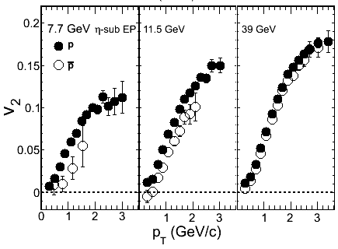
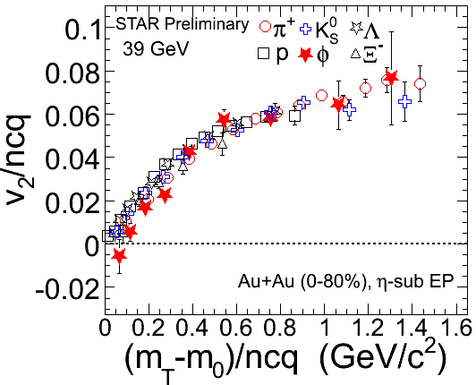
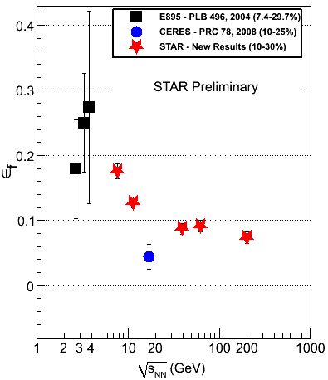
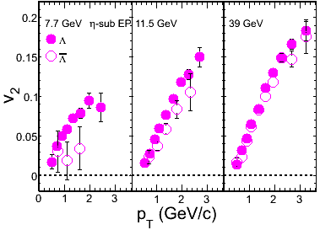
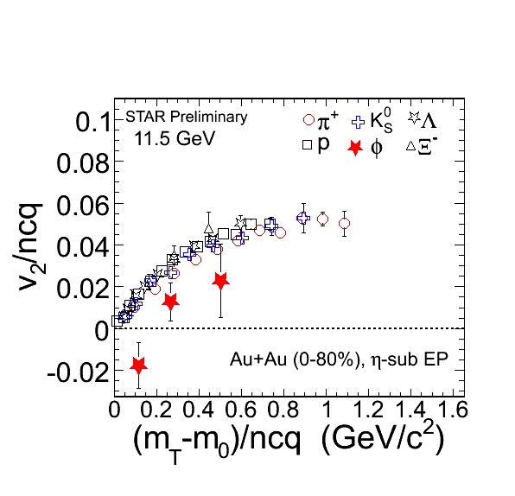
Narrowing down the region of interest
STAR Preliminary
STAR Preliminary
39, 62, and 200 GeV collisions are qualitatively similar
Even extends to LHC energies
But many changes appear at lower energies
Narrowing down the region of interest with Phase 1
Future: need detailed study of the key region
  Finer energy steps with higher statistics

Slide 27
Spin

Slide 28
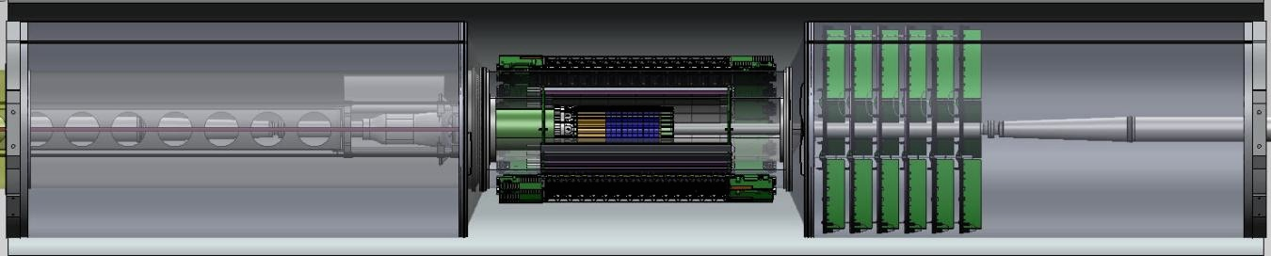
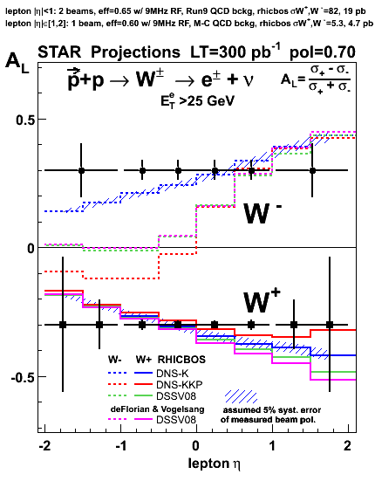
Forward GEM Tracker
HFT
FGT
FGT: RHIC Capital Equipment project
Six light-weight triple-GEM disks
New mechanical support structure
Planned installation: Summer 2011
  Full charge-sign discrimination at high-pT
  Design polarization performance of 70% or better to collect at least 300pb⁻¹
  Ready* for Run 12!
  * minimal configuration

Slide 29
Quark Flavor Measurements: W±
STAR first results* consistent with models: Universality of the helicity distribution functions
Precision measurements require large luminosity and high polarization at RHIC
* STAR: PRL 106, 62002(2010).

Slide 30
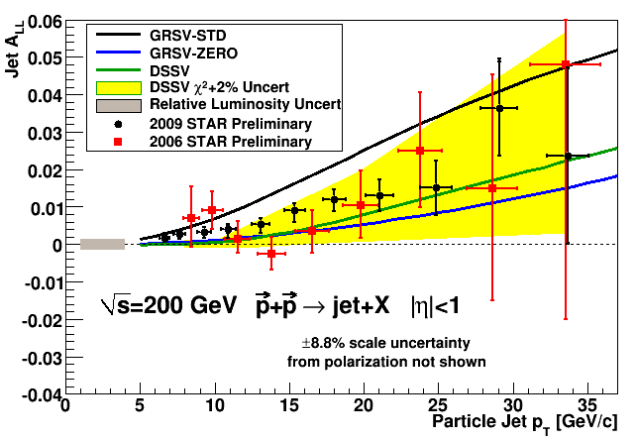
STAR A_{LL} from 2006 to 2009
2009 STAR A_{LL} measurements:
Results fall between predictions from DSSV and GRSV-STD
Precision sufficient to merit finer binning in pseudorapidity

Slide 31
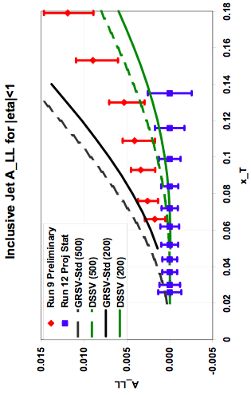
Expected inclusive jet A_{LL} precision
Run 12 (500 GeV) useful complement to Run 9 (200 GeV)
200 GeV: Run 13 uncertainties, as compared to Run 9:
  A factor of ~2 for jet E_{T} >~ 12 GeV
  A factor of ~sqrt(2) for jet E_{T} <~ 12 GeV

Slide 32

Di-jet A_{LL}(2009)
For fixed M, different kinematic regions sample different x ranges
  East-east and west-west sample higher x₁, lower x₂, and smaller |cos(θ*)|
  East-west samples lower x₁, higher x₂, and larger |cos(θ*)|
A_{LL} falls between DSSV and GRSV-STD

Slide 33

Expected di-jet A_{LL} sensitivity at 500 GeV
Assumes 600 pb⁻¹ delivered @ P = 50%
Higher energy accesses lower x_{g}
Expect smaller A_{LL}
Projections include information on trigger rates, etc.
Uncertainties shown are purely statistical
May add EEMC-EEMC di-jets to reach lowest x values once FGT is installed

Slide 34


Transverse: A_{N} for direct photons
Expected STAR precision
Recent model predictions
Z-B. Kang et al, PRD 83, 094001
✓
✓
Very significant measurement of direct photon A_{N} at forward y
Wide range of additional measurements at both 200 and 500 GeV:
Forward-y: π⁰, η A_{N} with extended p_{T} reach; neutral jet-like clusters
Mid-y: W A_{N}; Interference FF and Collins from jets; Sivers dijets

Slide 35
Mid-rapidity Collins asymmetry in jets
200 GeV pp collisions
π⁺ uncertainties (π⁻ similar)
Current uncerts (stat+syst) in Run 6 analysis
Projected uncerts (stat+syst) for 20 pb⁻¹ with 60% pol
Reconstruct full jet in 0 < η < 1
Measure azimuthal asymmetry of charged pions about jet thrust axis
Expect asymmetries of a few percent; opposite signs for π⁺ vs π⁻

Slide 36
Summary: significant progress in next 5 years✓
Hot QCD Matter
Partonic structure
✓ Spin structure of the nucleon
✓ How to go beyond leading twist and
colinear factorization?
Properties of the sQGP in detail ✓
Mechanism of Energy Loss:
weak or strong coupling? ✓
Is there a critical point, and if so, where? ✓
Novel symmetry properties ✓
Exotic particles ✓
❍ What are the properties of
cold nuclear matter?

Slide 37
Backup

Slide 38

STAR Experiment as of 2014
MRPC ToF Barrel
MTD
EMC Barrel
EMC End Cap
FMS
BBC
FPD
TPC
Roman Pots
Phase 2
computing
DAQ1000
COMPLETE
Trigger and DAQ
Upgrades
FGT
HFT
Ongoing
R&D

