Slide 1

Search for the QCD Critical Point
Gary D. Westfall
Michigan State University
For the STAR Collaboration

Slide 2
Search for Possible QCD Critical Point
Trajectories at low μ_{B}
Theories suggest a cross-over transition
Trajectories at high μ_{B}
Theories suggest a first-order transition
Finding the CP theoretically is difficult
Search for the CP experimentally
arXiv:1007.2613

Slide 3
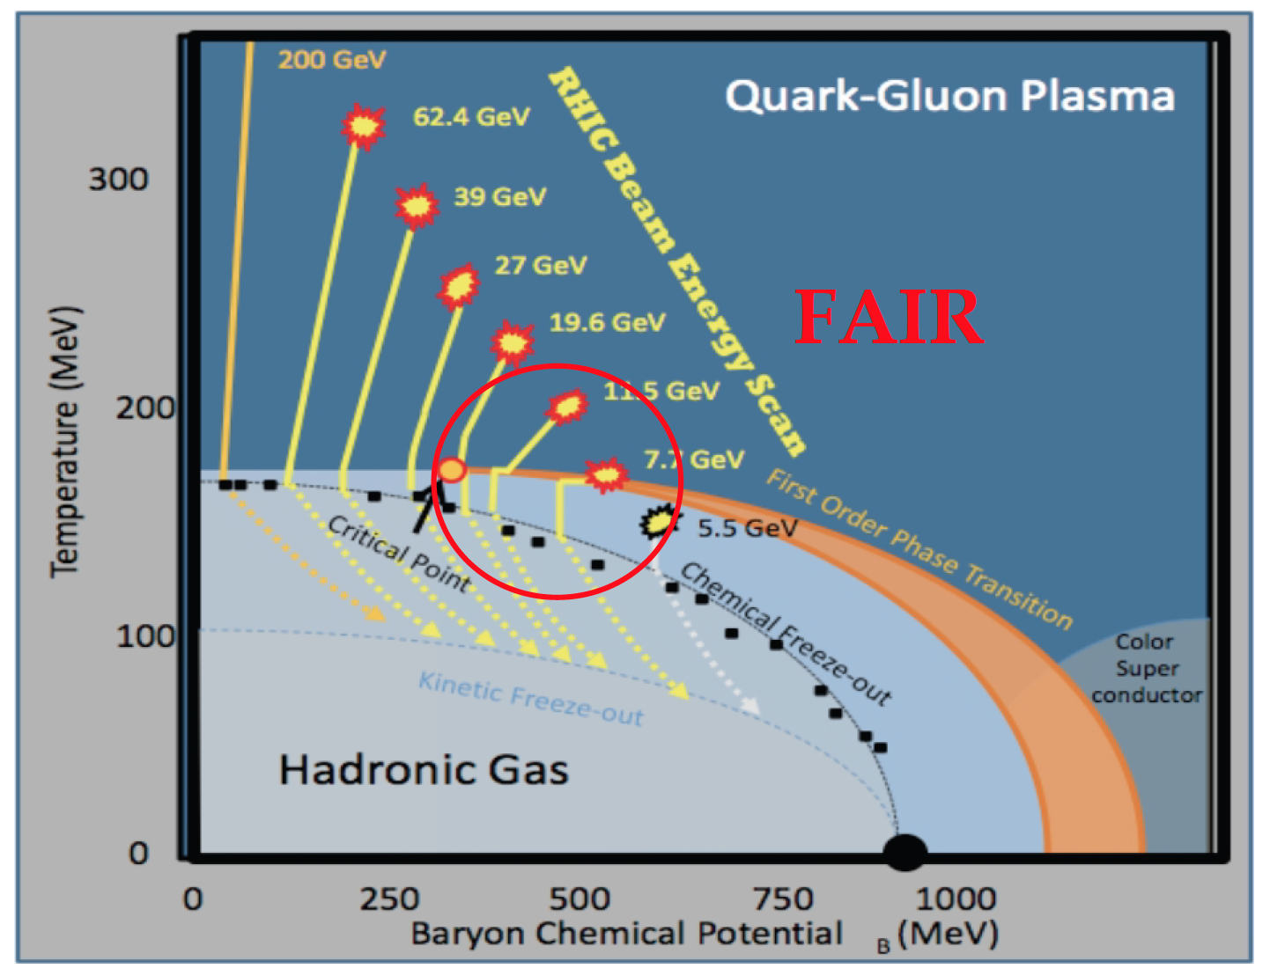
The RHIC Beam Energy Scan
Goals:
    Search for signatures of a possible phase transition from hadronic matter to quark gluon matter
    Search for signatures of a possible QCD critical point
  Strategy
    Vary incident energy to span range in
    T-μ_{B}
    Look for non-monotonic behavior of observables
√s_{NN} (GeV) | Min. Bias Events (10⁶)
7.7 | 4.3
11.5 | 11.7
19.6 | 35.8
27 | 70.4
39 | 130.4
62.4 | 67.3
200 | 500

Slide 4
Observables
Particle ratio fluctuations
  K/π
    Strangeness fluctuations
  p/π
    Baryon fluctuations
  K/p
    Strangeness/baryon correlations
Net particle higher moments
  Net charge
    Net charge fluctuations
  Net kaons
    Net strangeness fluctuations
  Net protons
    Net baryon fluctuations

Slide 5
Observable - Fluctuations
Our observable is ν_{dyn,Kπ}, which measures how correlated the event-by-event distributions are
  ν_{dyn,Kπ}, is zero for uncorrelated emission (Poisson)
NA49 uses σ_{dyn}
With enough statistics and large denominator

Slide 6
Observable – Net Particle Moments
Fluctuations of conserved quantities such as net charge, net strangeness, and net baryon number may be related to the chiral phase transition or critical phenomena
  Net charge
  Net strangeness
  Net baryon number
Higher moments of the net particle distributions are predicted to be sensitive to high powers of the susceptibility

Slide 7
Cumulants
To describe the higher moments of net particle distributions, we employ cumulants
Cumulants can be expressed in terms of the central moments
The central moments are defined by

Slide 8
Cumulants
The first four cumulants are
We can then define
Near the critical point, the cumulants will diverge with large powers of the correlation length (ξ)
Higher moments scale with higher powers of the correlation length

Slide 9
Cumulants
The susceptibilities χ and correlation lengths ξ scale as
Various theories predict large enhancements in C₄/C₂ for net charge, net strangeness, and net baryon number
  Karsch et al., PLB 695, 136 (2011). arXiv: 1203.0784
  Cheng et al., PRD 79, 074505 (2009)
  Hatta et al., PRL 91, 102003 (2003), Hatta et al. PRD 67, 014028 (2003)
  Gavai, Gupta. PLB, 696, 459 (2011)
  Stephanov PRL 102, 032301 (2009)

Slide 10
Expectations for Net Particle Moments
We can define two expectations for net particle moments
  Poisson distribution
    We assume that the positive particle multiplicity and the negative particle multiplicity distributions are described by Poisson distributions characterized by μ⁺ and μ⁻
  Negative binomial/binomial distribution
    We assume that the positive particle multiplicity and the negative particle multiplicity distributions are described by negative binomial/binomial distributions characterized by (μ⁺,σ²⁺) and (μ⁻,σ²⁻)

Slide 11
Difference of Two Negative Binomials/Binomials
The positive particle and negative particle multiplicity distributions are negative binomials or binomial distributions, depending on μ/σ²
The positive and negative multiplicity distributions can be characterized by their cimmulants:
The cumulants of the differences of the two cumulants are
The products of the moments are then
Ole E. Barndorff-Nielsen, David G. Pollard and Neil Shephard
DISCRETE-VALUED LEVY PROCESSES AND LOW
LATENCY FINANCIAL ECONOMETRICS
Oxford, ISSN 1471-0498

Slide 12
Difference of Two Poisson Distributions
μ₊ = mean of the positive particle distribution
μ₋ = mean of the negative particle distribution
The cumulants of a Poisson distribution are given by
So the cumulants of the difference are
The moment ratios are
Same result as Skellam distribution

Slide 13
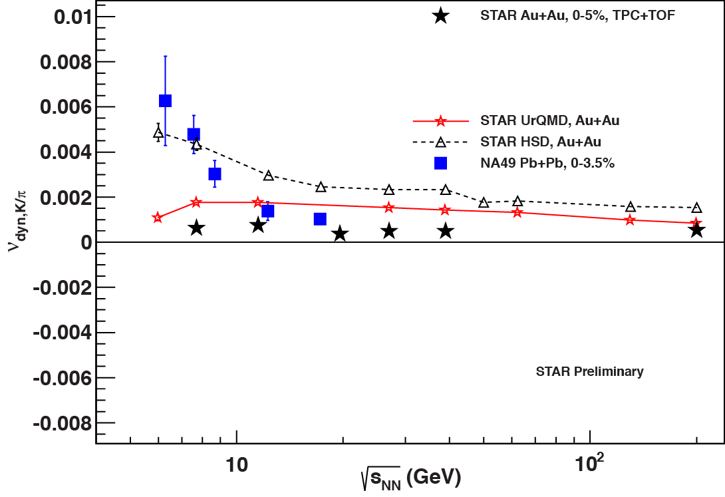
K/π Fluctuations – Summed Signs
(K⁺+K⁻)/(π⁺+π ⁻)
Central events
(0 - 5%)
STAR data show no significant energy dependence
There appears to be a disagreement between STAR and NA49 results below 19.6 GeV
The UrQMD model shows little energy dependence and over-predicts the fluctuations
STAR: Prithwish Tribedy, QM 2012
NA49: C. Alt et al. Phys. Rev. C 79, 044910 (2009)

Slide 14
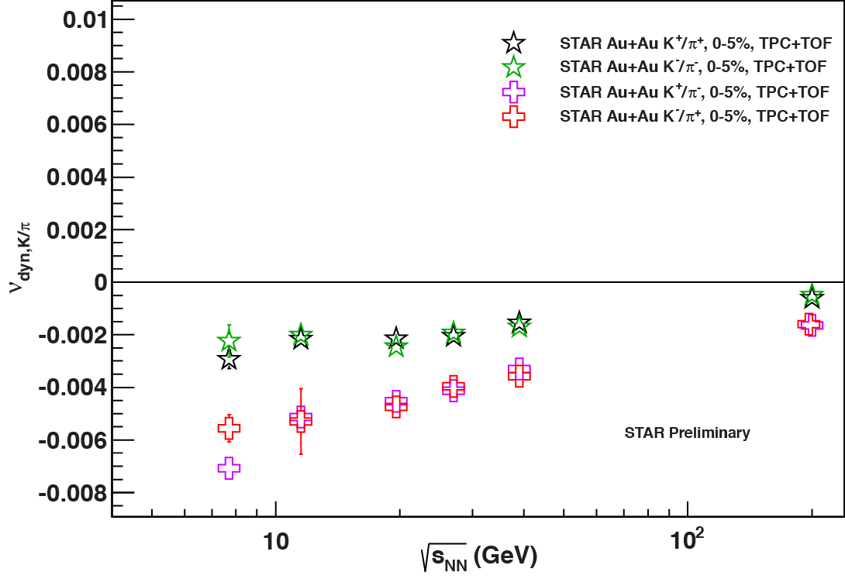
K/π Fluctuations – Separated Signs
K⁺/π ⁻ is strongly negative due to decays, possible candidate is
K⁺/π⁺ is also negative, needs further study to investigate the origin
STAR: Prithwish Tribedy, QM 2012

Slide 15
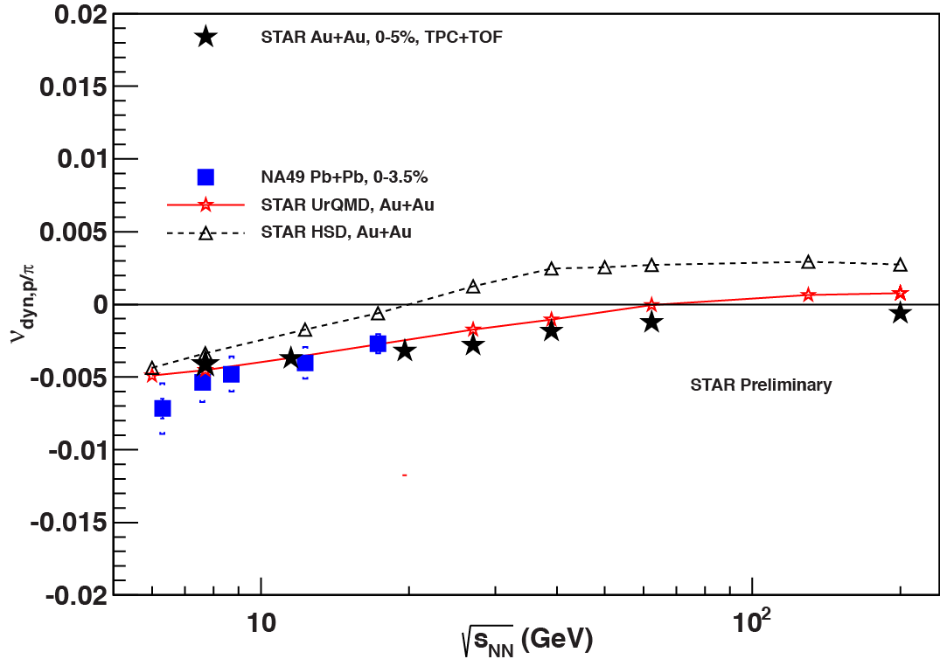
p/π Fluctuations – Summed Signs
(p+ )/(π⁺+π ⁻)
Central events
(0 – 5%)
STAR results show a smooth decrease with decreasing incident energy
There is good agreement between STAR and NA49 results
The UrQMD model agrees with the data at low energy, but changes sign at high energy
STAR: Prithwish Tribedy, QM 2012
NA49: C. Alt et al. Phys. Rev. C 79, 044910 (2009)

Slide 16
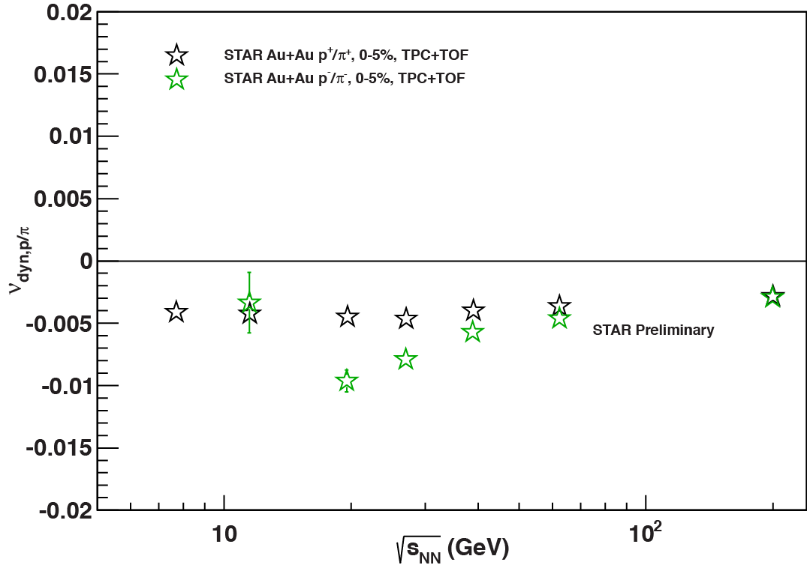
p/π Fluctuations – Same Signs
p⁺/π⁺
p⁻/π ⁻
Central events
(0 – 5%)
Little energy dependence for positive signs
Very few antiprotons at the lowest energy
STAR: Prithwish Tribedy, QM 2012

Slide 17
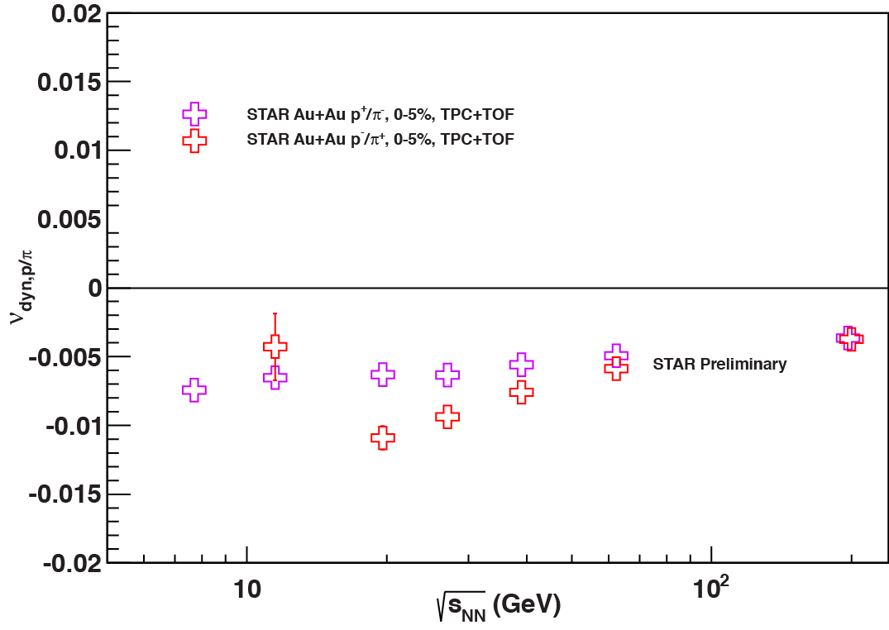
p/π Fluctuations – Opposite Signs
p⁺/π ⁻
p⁻/π⁺
Central events
(0 – 5%)
Little energy dependence for
p⁺/π ⁻
Very few antiprotons at the lowest energy
STAR: Prithwish Tribedy, QM 2012

Slide 18
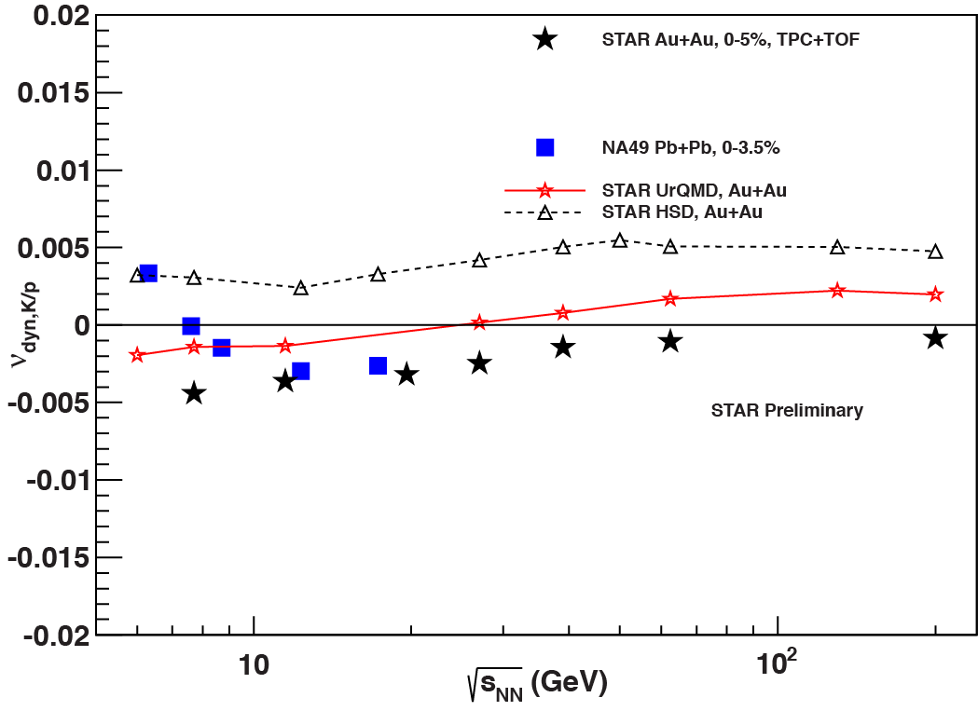
K/p Fluctuations – Summed Signs
(p+ )/(K⁺+K⁻)
Central events (0 - 5%)
STAR results decrease smoothly with decreasing incident energy
The seems to be disagreement between STAR and NA49 results at 7.7 GeV
The UrQMD model over-predicts the fluctuations and changes sign at high energy
STAR: Prithwish Tribedy, QM 2012
NA49: T. Anticic et al., PRC 83, 061902(R) (2011)

Slide 19
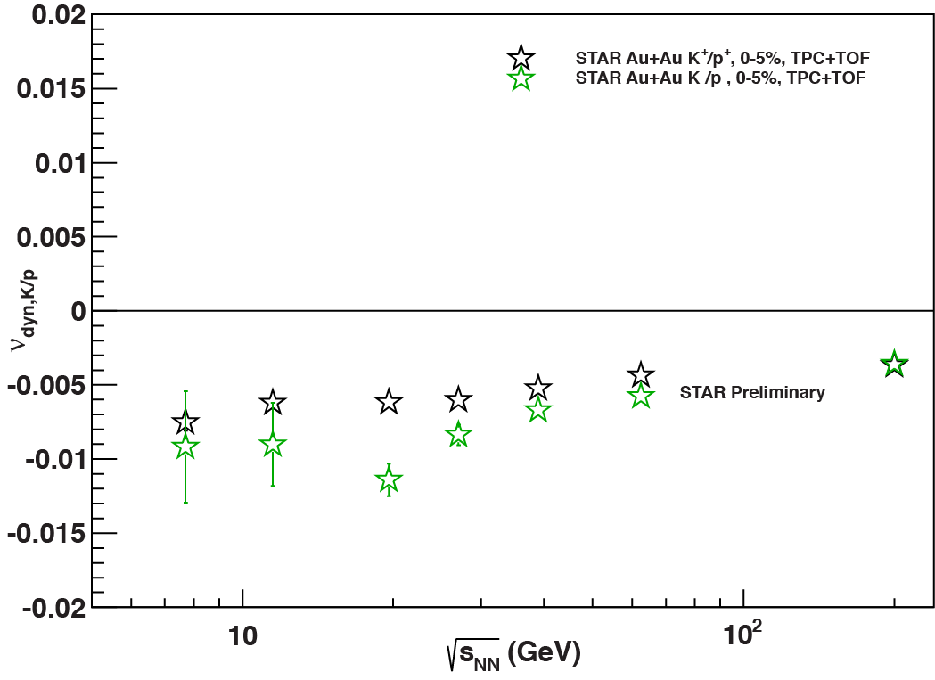
K/p Fluctuations – Same Sign
K⁺/p⁺
K⁻/p ⁻
Central events
(0 – 5%)
Little energy dependence
STAR: Prithwish Tribedy, QM 2012

Slide 20
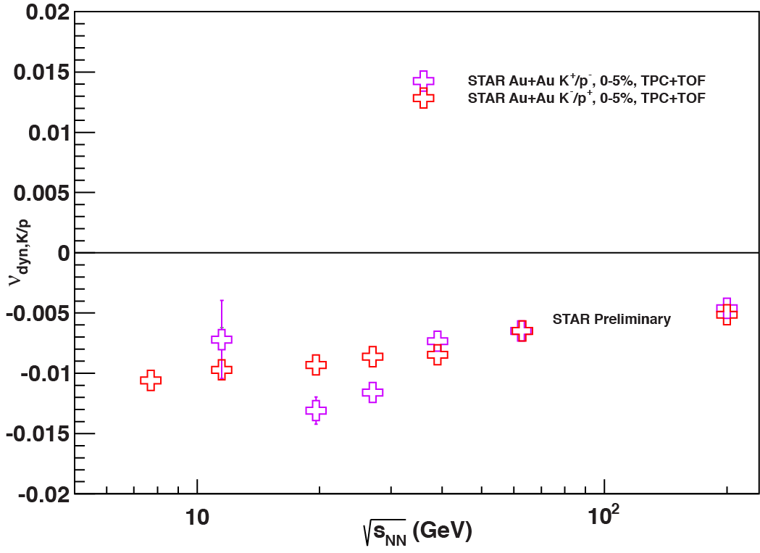
K/p Fluctuations – Opposite Sign
K⁺/p–
K⁻/p⁺
Central events
(0 – 5%)
Little energy dependence
Very few antiprotons at the lowest energy
STAR: Prithwish Tribedy, QM 2012

Slide 21
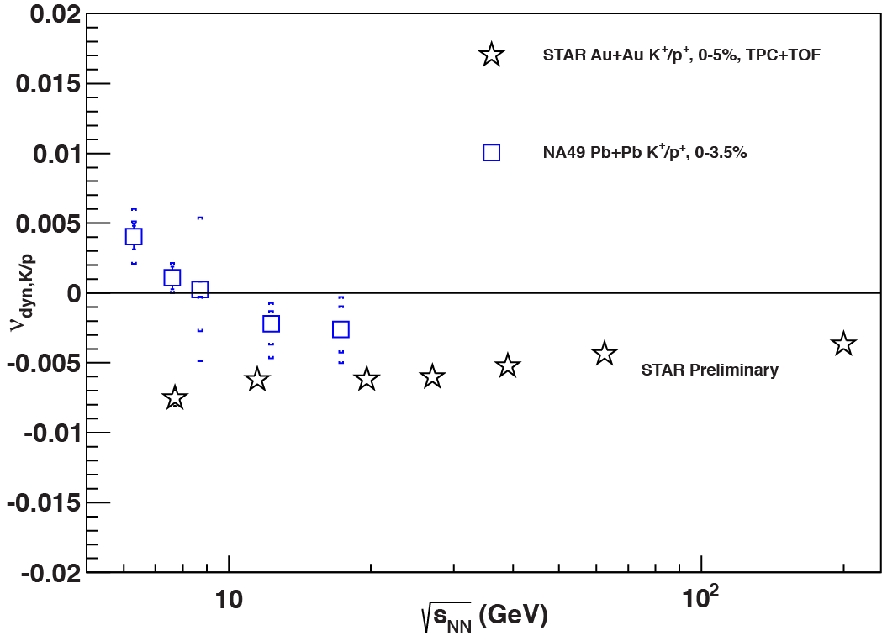
K⁺/p⁺ Fluctuations – Compare NA49
K⁺/p⁺
Central events
Disagreement between STAR and NA49 at lowest energies
STAR: Prithwish Tribedy, QM 2012
NA49: T. Anticic et al., PRC 83, 061902(R) (2011)

Slide 22
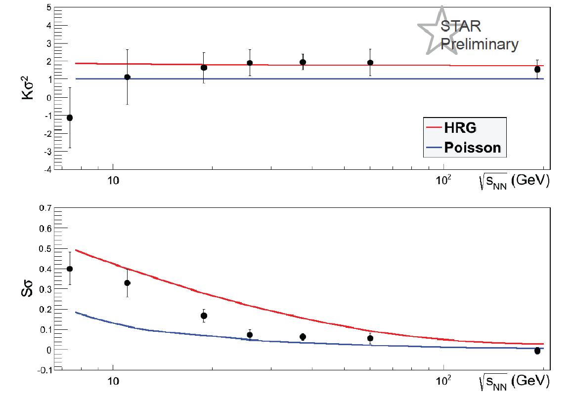
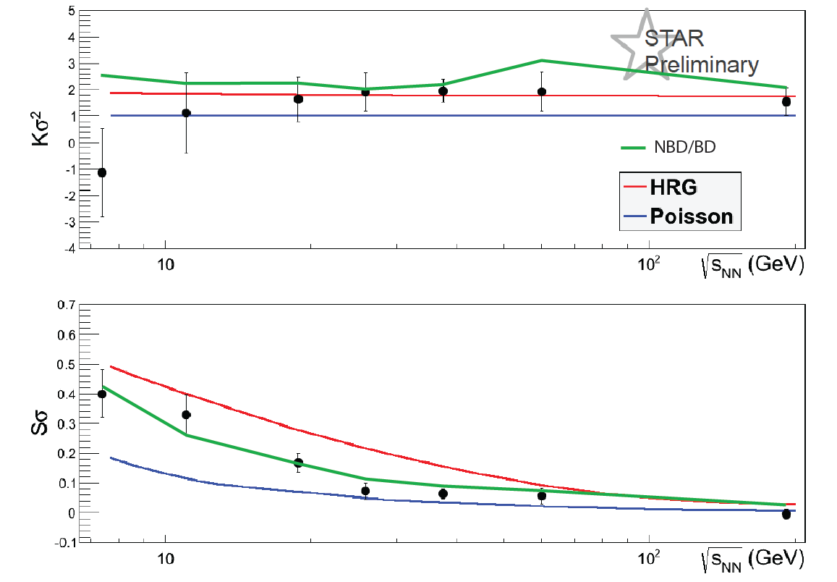
Net Charge Moments
Energy Dependence
Karsch, Redlich, PLB 695, 136 (2011)
STAR: Daniel McDonald, QM 2012
Au+Au 0-5%

Slide 23
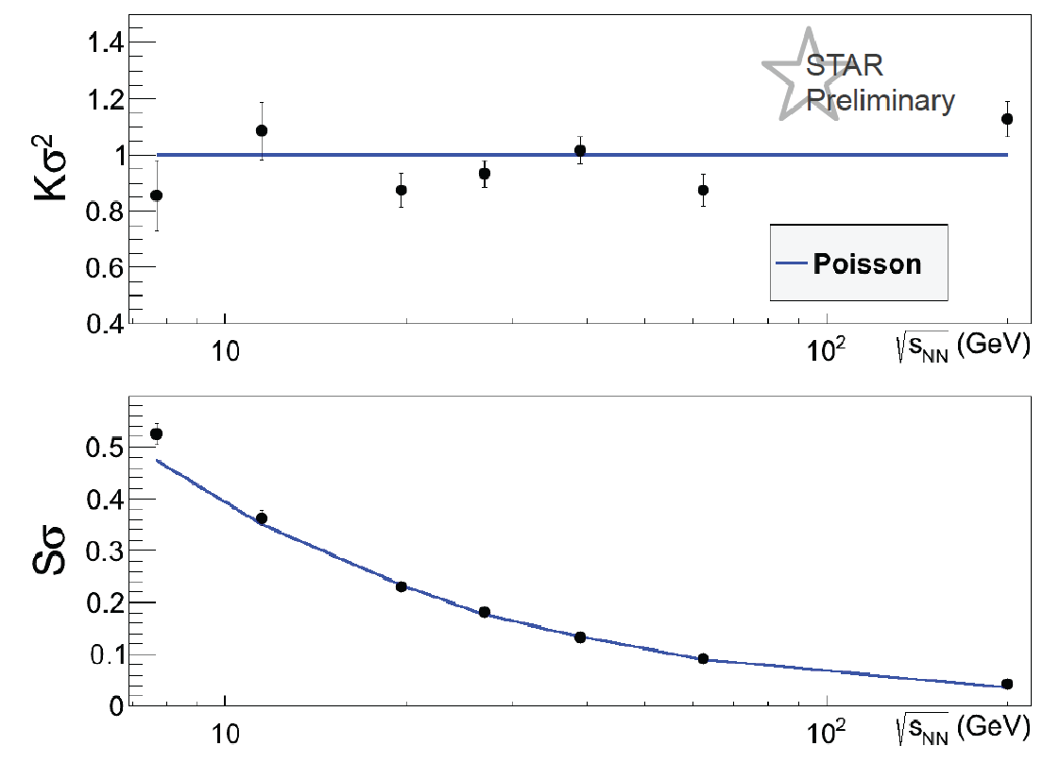
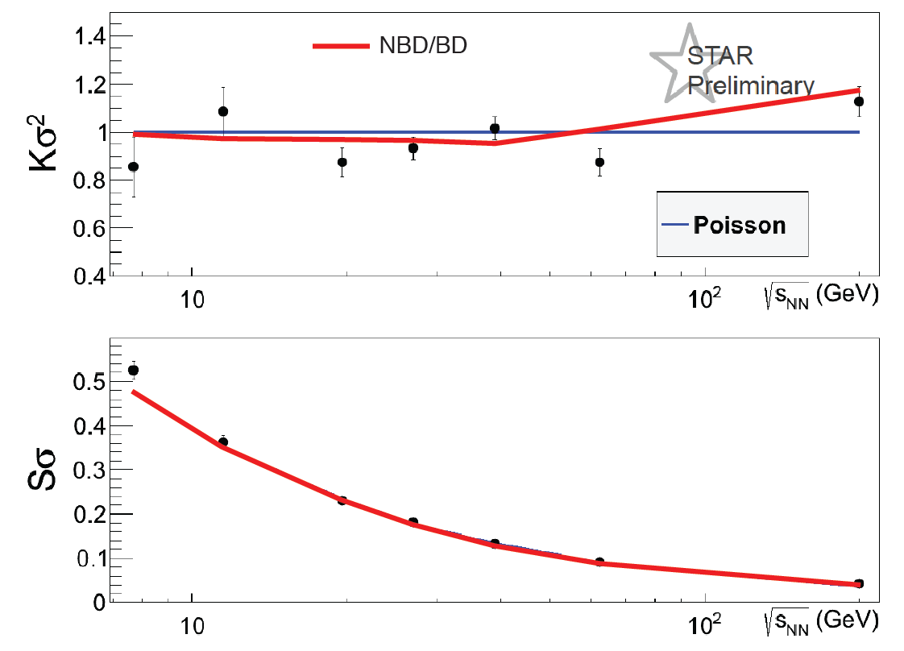
Net Kaon Moments
Energy Dependence
STAR: Daniel McDonald, QM 2012
Au+Au 0-5%

Slide 24
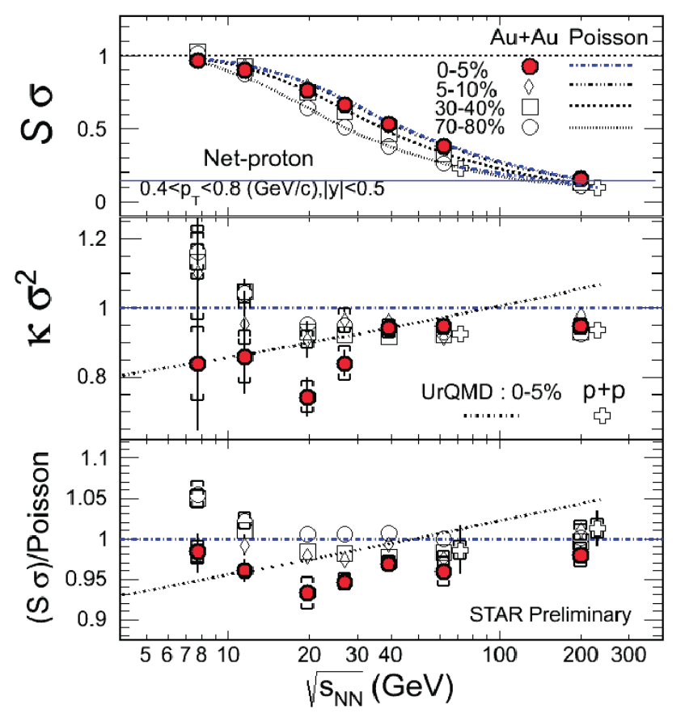
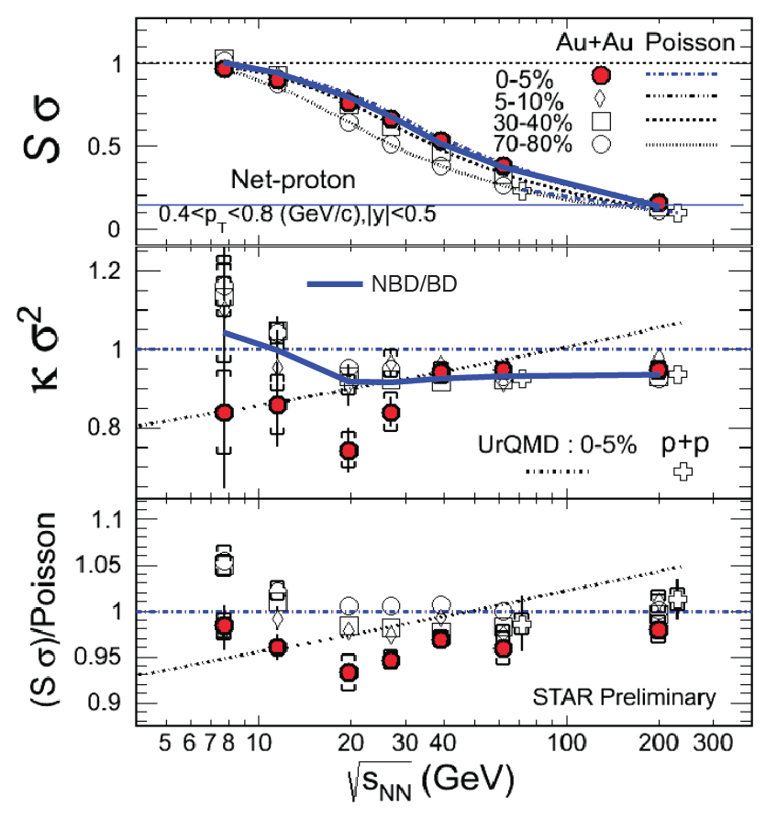
Net Proton Moments
Energy Dependence
STAR: Xiaofeng Luo, QM 2012

Slide 25
Conclusions – Particle Ratio Fluctuations
Particle ratio fluctuations in central collisions
  K/π
    Summed sign fluctuations are positive
    Separate sign fluctuations are negative
    Disagreement with NA49 at lowest energy
  p/π
    Summed sign fluctuations are negative
    Separate sign fluctuations are negative
    Agreement with NA49
  K/p
    Summed sign fluctuations are negative
    Separate sign fluctuations are negative
    Disagreement with NA49 at lowest energy
  No non-monotonic behavior observed with incident energy

Slide 26
Conclusions – Net Particle Higher Moments
Net particle higher moments in central collisions
  Net charge
    Sσ = C₃/C₂ consistent with negative binomial/binomial expectation, above Poisson expectation, and below HRG
    κσ² = C₄/C₂ between Poisson and negative binomial/binomial expectations and consistent with HRG
  Net kaons
    Sσ = C₃/C₂ consistent with both the Poisson and negative binomial/binomial expectations
    κσ² = C₄/C₂ consistent with both Poisson and negative binomial/binomial expectations
  Net protons
    Sσ = C₃/C₂ consistent with both the Poisson and negative binomial/binomial expectations
    κσ² = C₄/C₂ below Poisson expectation but more consistent with the negative binomial/binomial expectation
  No non-monotonic behavior observed with incident energy

