Slide 1
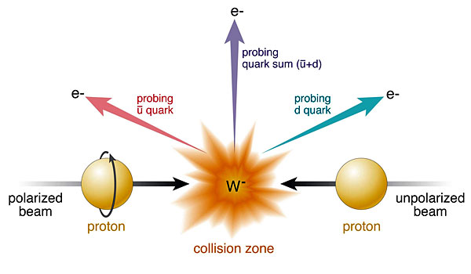



Measurement of transverse single-spin asymmetry and cross-section ratios of
kinematically fully reconstructed weak bosons in
p+p collisions at √s = 500−510 GeV at RHIC
Salvatore Fazio (Brookhaven National Lab)
for the STAR Collaboration
DIS 2015 – April 27- May 1, 2015

Slide 2
Plan of the talk
Physics motivations
The W± selection and A_{N} measurement
The Z⁰ selection and A_{N} measurement
Future plans for A_{N} measurement
Unpolarized xsec charge ratios (New results!)
Conclusions
Other STAR talks on weak boson production:
Matt Posik’s → cross section charge ratio vs electron decay kinematics
Devika S. Guanarathne → Longitudinal transverse spin asymmetry vs electron decay kinematics

Slide 3
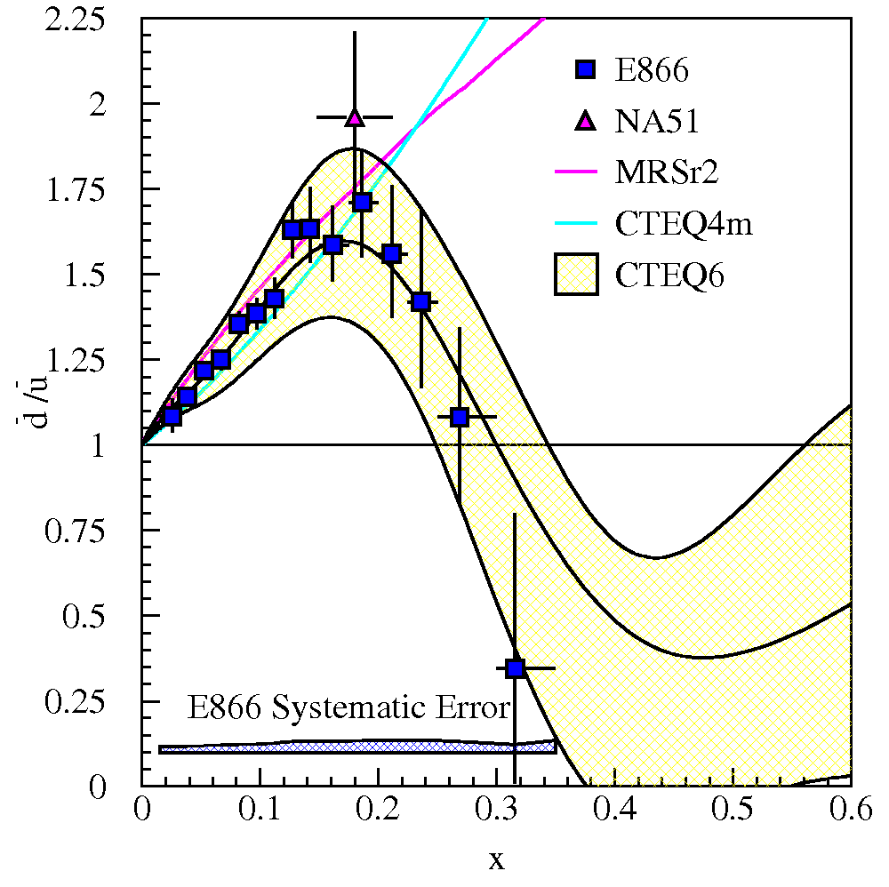
Motivations - unpolarized W+/W- ratios
What will we learn?
  d-bar/u-bar in PDFs
LHC coverage: ~10⁻³ < x < 10⁻¹
RHIC coverage: x > ~10⁻¹
LO:
Current data: E866/NuSea (Drell-Yan)
  included in NLO global PDF fits CTEQ6
Unpolarized asymmetries: Quantitative calculation of Pauli blocking does not explain ratio
→ Non-pQCD effects are large for sea quarks

Slide 4
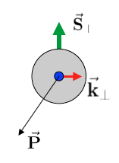
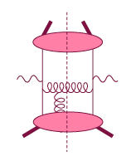
Motivations – Transverse Single Spin Asymmetry (A_{N})
Transverse
momentum
dependent
Q>>Q_{T}>=Λ_{QCD}
Q>>p_{T}
Collinear/
twist-3
Q,Q_{T}>>Λ_{QCD}
p_{T}~Q
Intermediate Q_{T}
Q>>Q_{T}/p_{T}>>Λ_{QCD}
Efremov, Teryaev;
Qiu, Sterman
Sivers fct.
A_{N}
TMDs
need 2 scales
Q² and p_{t}
Remember pp:
most observables one scale
Exception: DY, W/Z, Collins
Twist-3
needs only 1 scale
Q² or p_{t}
But
should be of reas. size.
Applicable to most pp observables A_{N}(π⁰/γ/jet)
Λ_{QCD}
<<
Q_{T}/P_{T}
<<
Q
Q_{T}/P_{T}
related through

Slide 5
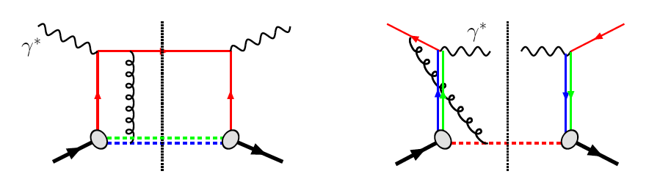
The much discussed sign change of the Sivers’ function
Motivations – Transverse Single Spin Asymmetry (A_{N})
QCD:
DIS: γq scattering
attractive FSI
pp: annihilation
repulsive ISI
Sivers_{DIS} = - Sivers (DY or W or Z)
critical test for our understanding of TMD’s and TMD factorization
Advantages of weak boson production
Very low background
Very high Q²-scale (~ W/Z boson mass)
STAR goal: measure sign change and pin down TMD-evolution by measuring A_{N} for all the processes: γ, W±, Z⁰, DY

Slide 6
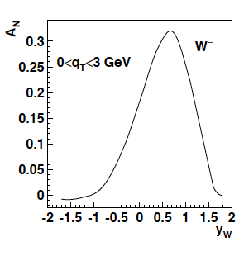
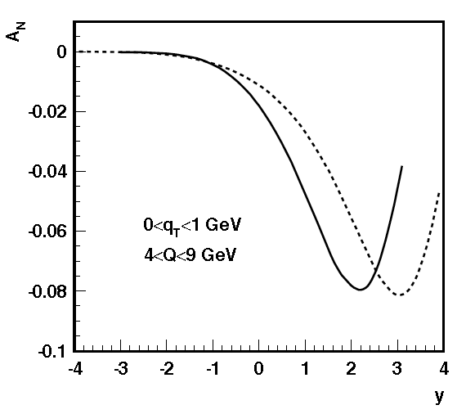
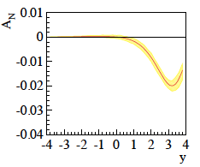
Motivations – The TMD evolution
Z.-B. Kang & J.-W. Qui arXiv:0903.3629
Z. Kang: original paper arXiv:1401.5078
before evolution
after evolution
Very strong
evolution effects
size of the effect still
under discussion
in theory community
For details see
Talk by J. Collins in this session
and
J. Collins, T. Rogers,
Phys.Rev. D91 (2015) 7, 074020
÷ ~10
Z.-B. Kang & J.-W. Qui Phys.Rev.D81:054020,2010
Z. Kang et al. arXiv:1401.5078
before evolution
after evolution
DY
200 GeV
500 GeV
÷ ~4
4 < Q < 9 GeV
0 < q_{T} <1 GeV

Slide 7
Motivations – Transverse Single Spin Asymmetry (A_{N})
What is the sea-quark Sivers fct.?
  Sea quarks are mostly unconstrained from existing SIDIS data... but they can give a relevant contribution!
  W’s ideal → rapidity dependence of A_{N} separates quarks from antiquarks
M. G. Echevarria, A. Idilbi, Z-B Kang, and I. Vitev arXiv:1401.5078
Revised error bands (private communication) use positivity bounds for the sea quarks
0 < p_{T} <3 GeV
W± data can constrain the sea-quark Sivers function
Asymmetry from lepton-decay is small → Full kin. reconstruction of the boson needed
  Z⁰ easy to reconstruct (but small cross-section)
  W kin. can be reconstructed from the hadronic recoil (first time at STAR)

Slide 8
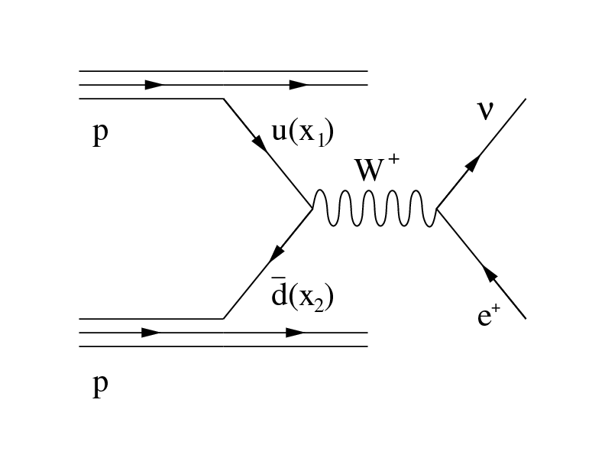
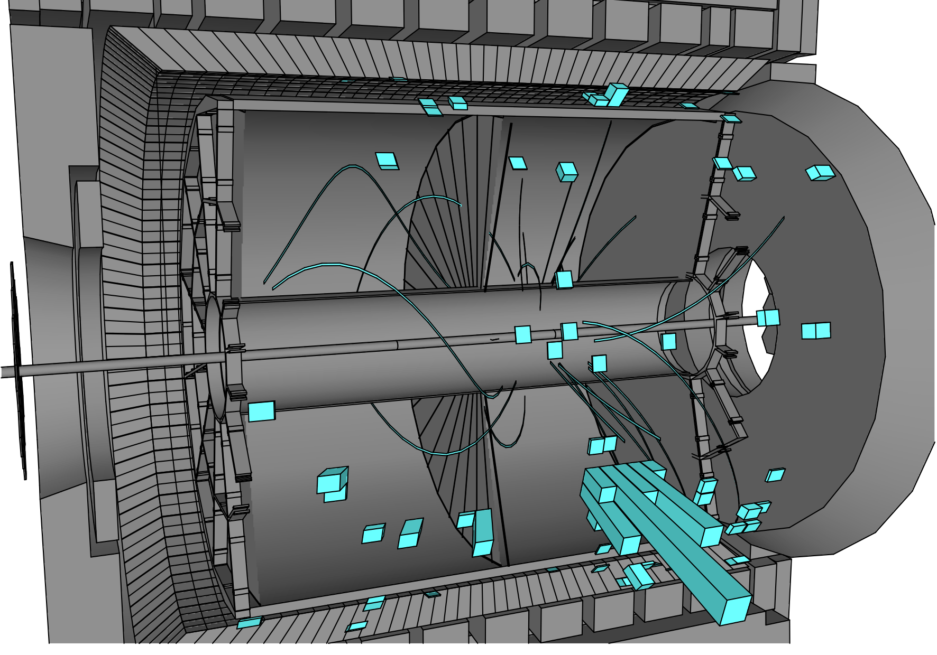
Strategy
Ingredients for the analysis
Isolated electron
neutrino (not measured directly)
Hadronic recoil
W boson momentum reconstruction technique well tested at FermiLab and LHC
[CDF: PRD 70, 032004 (2004); ATLAS: JHEP 1012 (2010) 060]
Select events with the W-signature (STEP 1)
  Isolated high P_{T} electron
Neutrino transverse momentum is reconstructed from missing P_{T} (Step 2)
Neutrino’s longitudinal momentum is reconstructed from the decay kinematics (Step 3)
The STAR detector @ RHIC
TPC (|η| < 1.4)
Barrel EMCAL (|η| < 1)

Slide 9
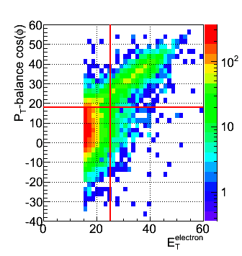
Data & Selection
Monte Carlo
PYTHIA reconstructed through GEANT3 simulated STAR detector
Perugia0 tune
PYTHIA embedded into real zero-bias pp events
Data sample
pp – run11 transverse @ √500 GeV Integrated Luminosity ~25 pb⁻¹
pp – run12 long @ √510 GeV Integrated luminosity: ~ 77 pb⁻¹
Total Int. lumi: 102 pb⁻¹
Selection Criteria – decay electron
Isolation: (P^{track}+E^{cluster}) / Σ[P^{tracks} in R=0.7 cone] > 0.9
Imbalance: no energy in opposite cone (E<20 GeV)
Electron E_{T} > 25 GeV
Electron Track |η| < 1
|Z-vertex|<100 cm
Charge separation (avoids charge misidentification):
0.4 < |Charge (TPC) x E_{T} (EMC) / P_{T} (TPC)| < 1.8
Signed P_{T} balance > 18 GeV (rejects QCD Background)
For boson-PT reconstruction
Track-P_{T} in the recoil > 0.2 GeV
Total recoil-P_{T} > 0.5 GeV
For boson-PL reconstruction
|W-PL| < 50 -> |W-y| < 0.6
SIGNAL
QCD
See M. Posik and D. Guanarathne for more details on W selection

Slide 10
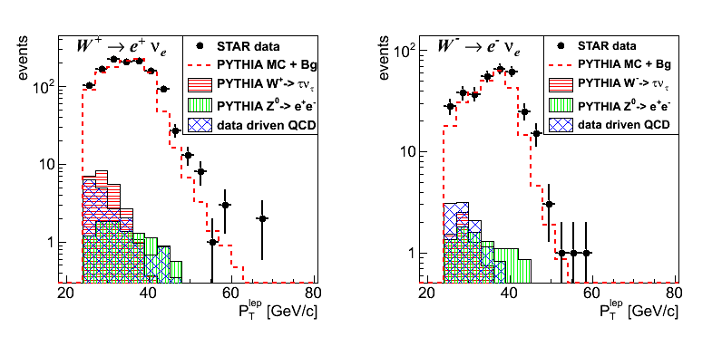
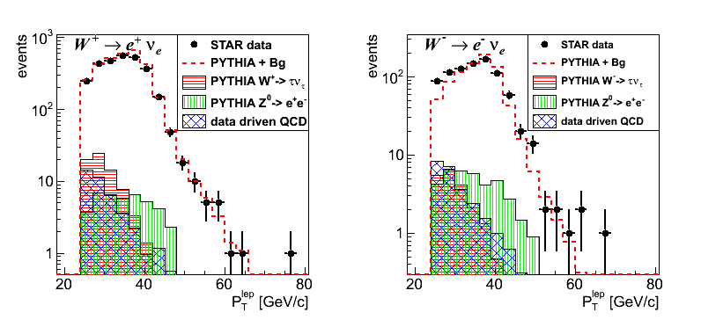
Backgrounds
RUN 11
W -> τv and Z0->ee normalized to the lumi
Data-driven QCD background estimation
  Reverse of P_{T}-balance cut
  QCD sample normalized to the first lepton-P_{T} bin
RUN 12
Backgrounds are a few % of the signal

Slide 11
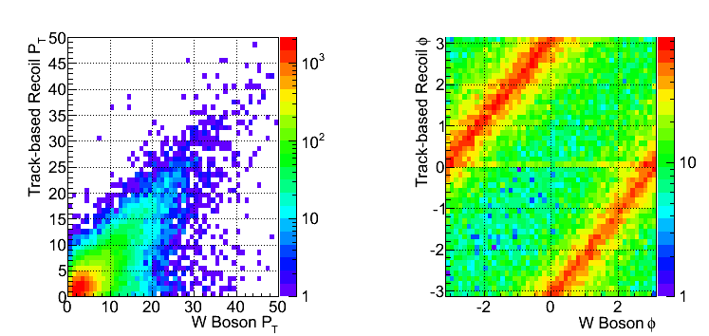
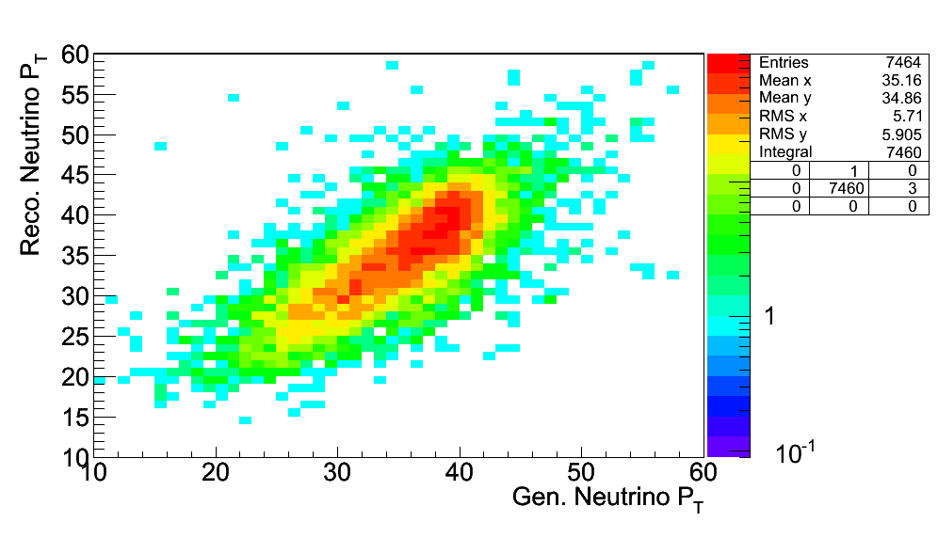
W P_{T} reconstruction
We calculate the recoil summing up all tracks and trackless electromagnetic clusters
Matching track is a track which extends to the BEMC and matches a firing tower (< 7 cm)
Trackless tower is a firing tower in the BEMC with no matching tracks and Energy > 200 MeV
Recoil is calculated summing the momenta of all tracks which do not belong to the electron candidate + all firing trackless towers
In transverse plane:
Recoil reconstructed using tracks and towers:
Part of the recoil not within STAR acceptance → MC correction applied

Slide 12
Monte Carlo correction
The Correction method –
Read recoil P_{T} bin from data
Project correction factor for corresponding P_{T}-bins
Normalize the projection distribution to 1
Pick a correction value sampled from the projection distribution
MC test:
After MC correction
→ very good agreement with RhicBOS (fully re-summed NNL/NLO calculation) and PYTHIA predictions

Slide 13
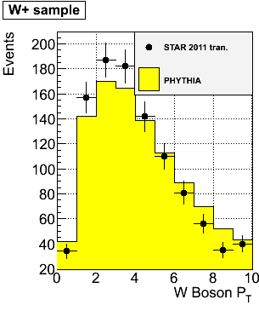
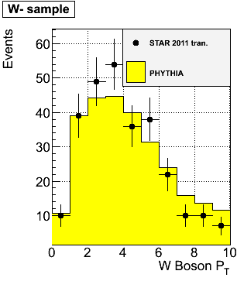
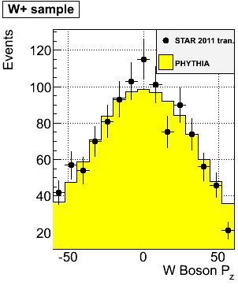
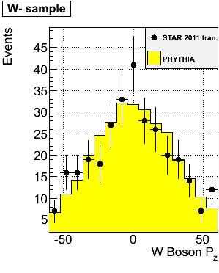
data/MC
Data/MC plots for W+ and W- separately
We add to our selection:
Track-P_{T} in the recoil > 0.2 GeV
Total recoil-P_{T} > 0.5 GeV
Good data/MC agreement for reconstructed P_{T} of W⁺ and W⁻

Slide 14
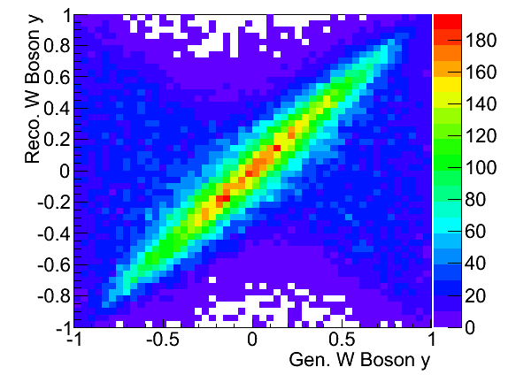
W P_{Z} reconstruction
W longitudinal momentum (along z) can be calculated from the invariant mass. Currently we assume constant M_{W} (for W produced on shell)
Neutrino longitudinal momentum component from quadratic equation
Two solutions!
Smaller |Pz| → first solution
Larger |Pz| → other solution
better Fraction of correctly reconstructed events (Pz is reconstructed within +/- 30 GeV)
We select the first solution →
We cut at
|Pz| < 50 GeV → |W-y| < 0.6 to minimize misreconstructions
NOTE: We only use the first solution. This can be improved at a later stage.

Slide 15
A_{N}
We fit sin(ϕ) modulation with phase = π/2
Average RHIC polarization for 2011 transverse p-p data → P = 53%
Systematics estimated via a Monte Carlo challenge
We use the “left-right” formula to cancel dependencies on geometry and luminosity (in backup slides)

Slide 16
Z⁰ Asymmetry
Clean experimental momentum reconstruction
Negligible background
electrons rapidity peaks within tracker accept. (|η|< 1)
Statistics limited
Z⁰ boson selection criteria
Two tracks each pointing to a cluster (no isolation requirements)
E_{T} > 25 GeV for both candidates
The two candidate tracks have opposite charge
|Zvertex|< 100 cm
Invariant Mass within ± 20% from the nominal M_{Z}
A_{N} measured in a single y, P_{T} bin
2011 pp-tran. ~25 pb⁻¹: 50 events pass selection

Slide 17
...and the future?
STAR plans to collect ~400 pb⁻¹ transverse p-p in 2017
Goal:
Constrain TMD evolution sea-quark Sivers function
Test sign-change if TMD-evolution suppression factor ~5 or less
How?
  Measure A_{N} for γ, W±, Z⁰, DY
  DY and W±, Z⁰ give Q² evolution
  W± give sea-quark Sivers
  All three A_{N} give sign change

Slide 18
The unpolarized W+/W- cross section ratio
We measure the observable
N_{obs} = observed W events
N_{bkg} = background events
ε = efficiency
Same selection as for A_{N}
Background estimated in the same way
W boson kinematics are reconstructed in the same way
  We do not care of the polarization direction in measuring RW
  We added the STAR 2012 longitudinal run at root(s)= 510 GeV (Collected Lumi ~77pb⁻¹)
Data sample
pp – run11 transverse @ √500 GeV Integrated Luminosity ~25 pb⁻¹
pp – run12 long @ √510 GeV Integrated luminosity: ~ 77 pb⁻¹
Total Int. lumi: 102 pb⁻¹

Slide 19
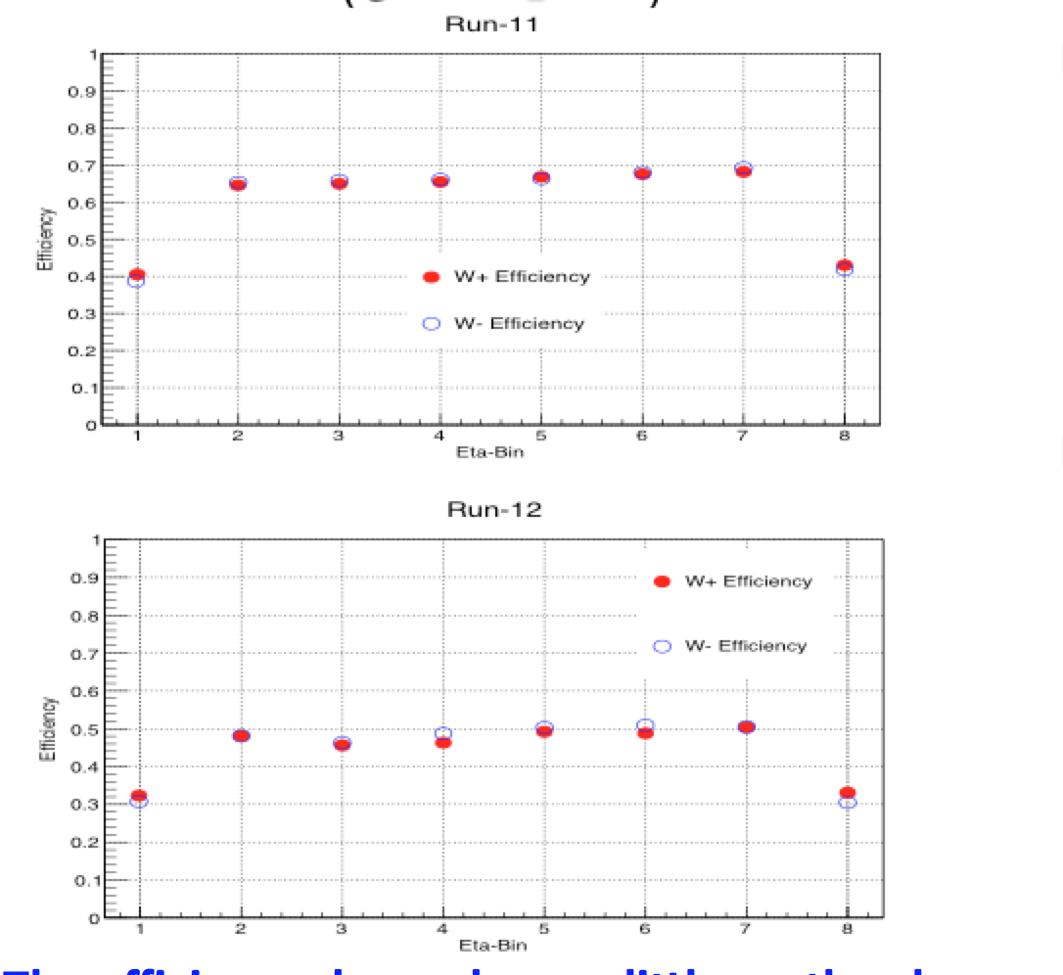
Efficiency study
Uncertainties calculated binomially (not visible)
The efficiency depends on the period
Run 12 less efficient than run 11 because of the lower reconstruction efficiency at higher rates due to pile up effects in the TPC
The efficiency depends very little on the charge
-> it plays negligible role in this measurement

Slide 20

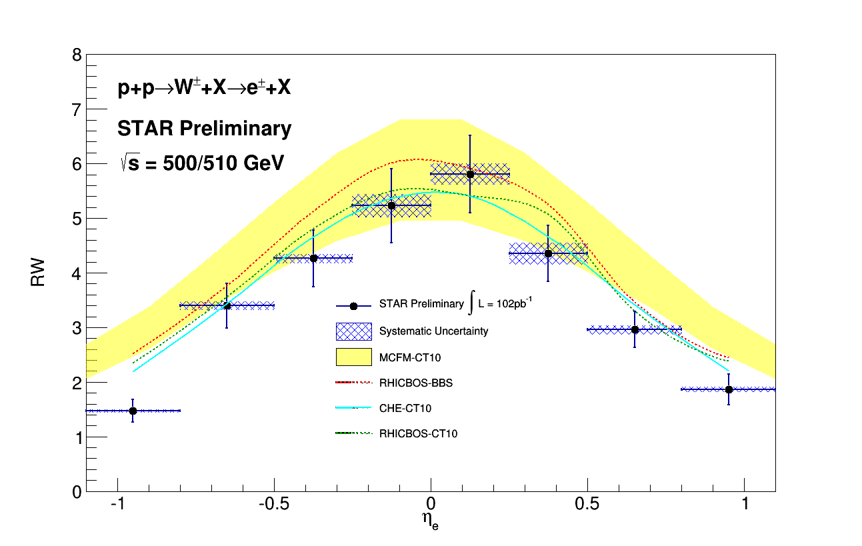
W+/W- versus Electron-Eta
See M. Posik’s talk
for more details
σ(W+) / σ(W-)
Collected Lumi = 102 pb⁻¹
  Systematics are much smaller than statistical uncertainties
Systematics uncertainties (blue shades) come from background subtraction:
QCD background varied the normalization bin to: [15;17] and [15;21]
  Z⁰ -> ee background vary the normalization to STAR lumi +- 13%

Slide 21
W+/W- Vs boson Rapidity
W kinematics reconstructed as for A_{N}
Preliminary
Stat. errors
Blue points -> After subtracting the backgrounds
Subtraction of background has an impact below statistical error
Adding run 12 significantly improves statistical precision
Collected Lumi = 25 pb⁻¹
Preliminary
Stat. errors
Preliminary
Stat. errors
Collected Lumi = 77 pb⁻¹
Collected Lumi = 102 pb⁻¹

Slide 22
MC correction: depends on the charge sign?
Projections
dots -> mean value
Bars -> RMS
RUN 12
RUN 12
Correction Factor
No difference for the correction factor calculated from positive and negative-charge MC samples
No difference in the correction factor due to interaction rates
The Correction factor
is not charge-dependent -> does not impact the W+/W- ratios!
Is not interaction rates dependent -> we can combine different run periods

Slide 23
Systematics on W reconstruction
Systematics on background subtraction (as for the decay lepton)
Systematics on the reconstruction smearing
  Calculate the ratio with generated pure MC
  Calculated the ratio with reconstructed MC after all the analysis
  Assign the difference as systematic uncertainty
Relative Systematics

Slide 24
W+/W- versus Boson-Rapidity
σ(W+) / σ(W-)
Total systematics account for
Syst. from bkd. subtraction
Syst. from W reconstruction

Slide 25
Summary
Rich program on weak bosons at STAR: transverse and longitudinal spin asymmetries, unpolarized cross section ratios
First measurement of A_{N} for W± and Z⁰ production at RHIC by reconstruction of the boson kinematics, using a sample of 25 pb⁻¹ transverse p-p data @ √500 GeV collected by STAR
Preliminary measurement of unpolarized W+/W- cross section ratios versus both the decay lepton and the produced boson kinematics, using a sample of 102 pb⁻¹
The statistical significance will be further improved adding the already collected run 2013 longitudinal data L~300 pb⁻¹
400pb⁻¹ planned to be collected in 2017 and can give statistical significance to test the Sivers sign change and pin down TMD evolution. STAR can have access to A_{N} for γ, W±, Z⁰, DY in a single experiment, simultaneously!

Slide 26
BACKUP

Slide 27
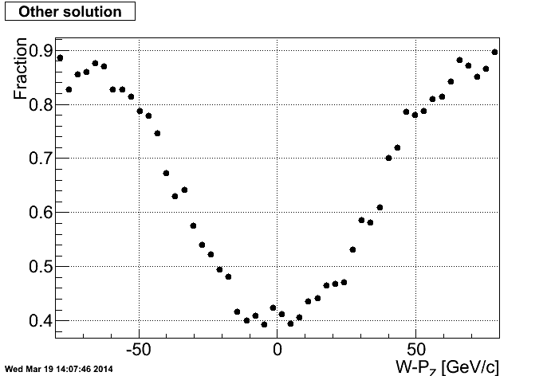
W P_{Z} reconstruction
Determine the fraction for correctly reconstructed events (for both solutions)
FIRST SOLUTION
OTHER SOLUTION

Slide 28
Rapidity binning
Distributions of y-Reco in each bin of y-Gen
Three W-y bins = {-0.6; -0.3; 0.3; 0.6}
bin1 survival probability = 52%
bin2 survival probability = 63%
bin3 survival probability = 54%
~11% of reco. events
migrate more than one y-bin
~2% of reco. events
migrate more than one y-bin
~11% of reco. events
migrate more than one y-bin

Slide 29
A_{N} systematics - MC challenge
Tables (W rapidity-P_{T} bins) for A_{N} prediction with evolution given by Z-B Kang [arXiv:1401.5078]
Use PYTHIA MC prediction for W⁻ (the A_{N} prediction is always positive)
Assign each prediction value from the tables according to the generated values of W-rapidity and P_{T}
After the event is fully reconstructed we look at the P_{T} distributions of A_{N}
Generated
Reconstructed
-0.2 < y < 0.2
-0.2 < y < 0.2
We fit a Gaussian distribution and compare the means
We rely on the fact that the input asymmetry has the same dependence as the data
The same is done for W-P_{T}

Slide 30
W plain asymmetry
W+
W-
W+
W-

Slide 31
Z⁰ plain asymmetry
-6 < η < 6

Slide 32
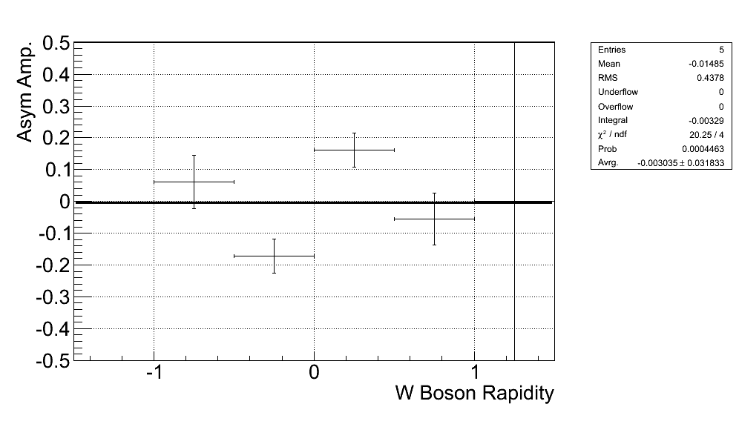
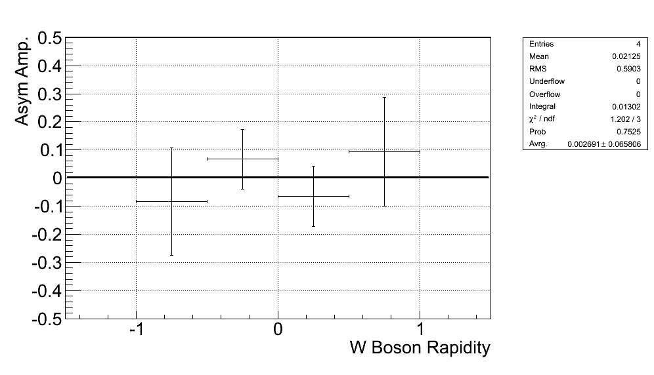
Geometrical Asymmetry
W+
W-
W+
W-

Slide 33
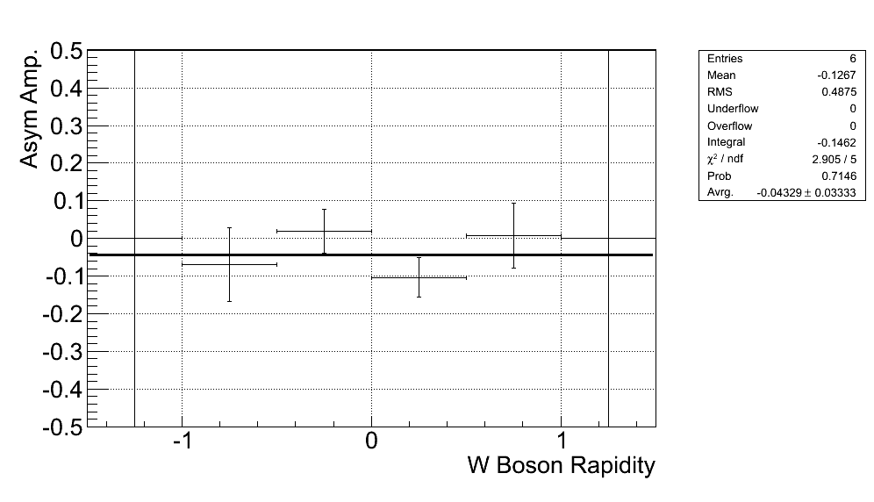
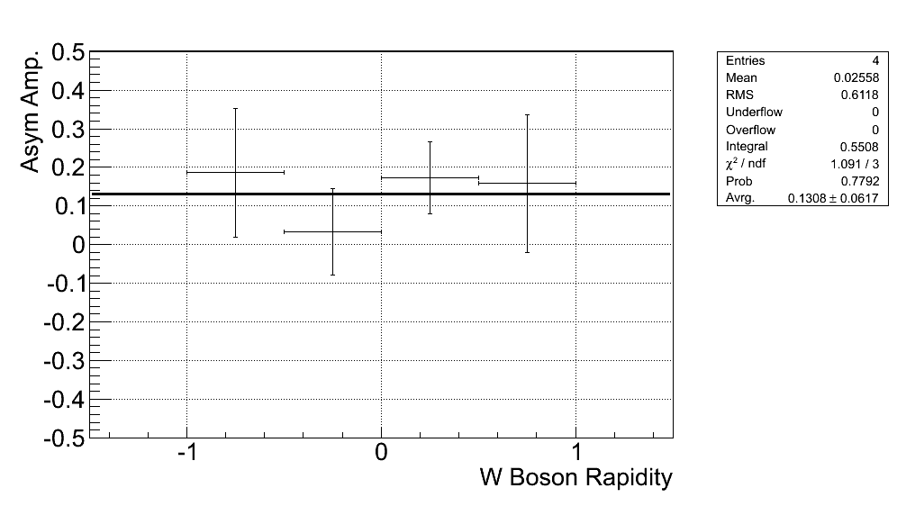
Luminosity Asymmetry
W+
W-
W+
W-

Slide 34
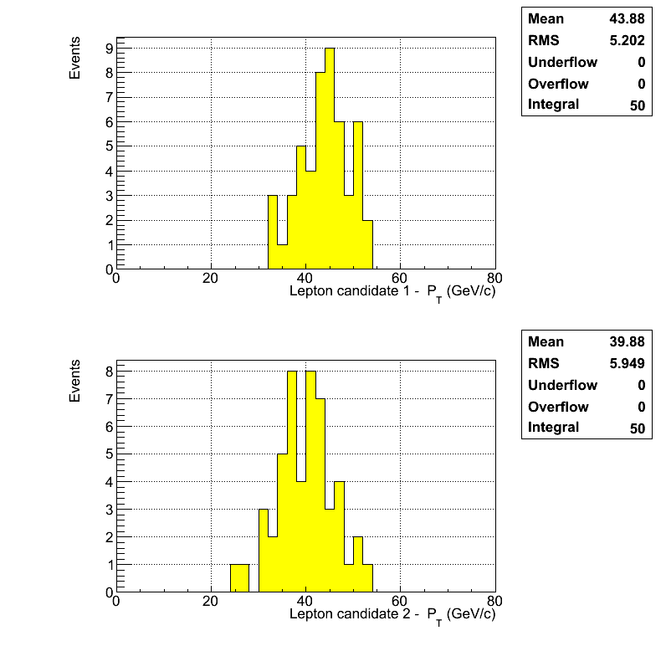
Z⁰ lepton candidates
Lepton candidate go to central rapidity and have large P_{T}

Slide 35
Efficiency study
All W selection applied
Pure MC – no selection
Reco Ele-Eta
Generated Ele-Eta
Generated Ele-Eta
Efficiency = [# evt after the selection] / [# evt generated]
In each generated bin we count how many events survive in that bin after the whole selection, the same as for the data in the code! In doing this we account for:
  Trigger + Vertex + code efficiency (Dependent on the Lumi!)
  Detector geometry + selection cuts acceptance
Then we divide that number for the total # evt simulated in that bin without any cut or trigger required
There is very negligible bin migration (see plot above). Our resolution in reconstructing the decay lepton is superb!
In calculating the efficiency:
Require to pass the whole W boson selection

