Slide 1
Toward a γ+Jet Measurement in STAR
Saskia Mioduszewski, for the STAR Collaboration
Texas A&M University

Slide 2
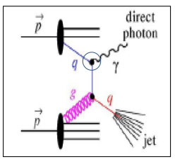
γ-Jet Motivation
Photon does not interact strongly, so
the trigger energy is more directly
connected to the recoil parton energy
Goal:
Measure Recoil Jet Energy vs. Initial Energy of Parton, as approximated by trigger-photon energy
γ (Ε_{initial})
Ideally studied with fully reconstructed jets on the recoil side of trigger photon
More easily studied with azimuthal correlations of charged particles with trigger photon
Modified Jet

Slide 3
Comparison of Photon- to Hadron-Triggered “Jets”
Hadron triggers are surface biased, so recoil parton has (on average) more medium to traverse
Recoil parton of photon triggers mostly quark jets, recoil of high-p_{T} π⁰ are mostly gluon jets (D. de Florian et al., PRD 91, 014035 (2015); T. Kaufmann et al., PRD 92, 054015 (2015))– color factor would result in greater energy loss for π⁰-triggered jets
γ (Ε_{initial})
π⁰
Modified Jet
Modified Jet

Slide 4
γ/π⁰ Discrimination
BEMC:- The energy deposition of EM cluster
BSMD:- The η and ϕ positions of EM cluster

Slide 5
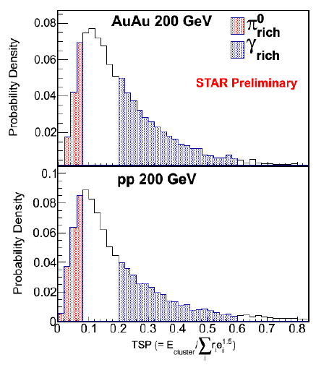
γ/π⁰ Discrimination
From the hits in the BSMD, construct a quantity “Transverse Shower Profile”:
where E_{cluster} is the BEMC cluster energy, e_{i} are the BSMD strip energies , and r_{i} are the strip distances from the center of the cluster
The TSP cuts were tuned to select a nearly pure sample of π⁰ (“π⁰_{rich}”) and a sample with an enhanced fraction of γ_{dir} (“γ_{rich}”)

Slide 6
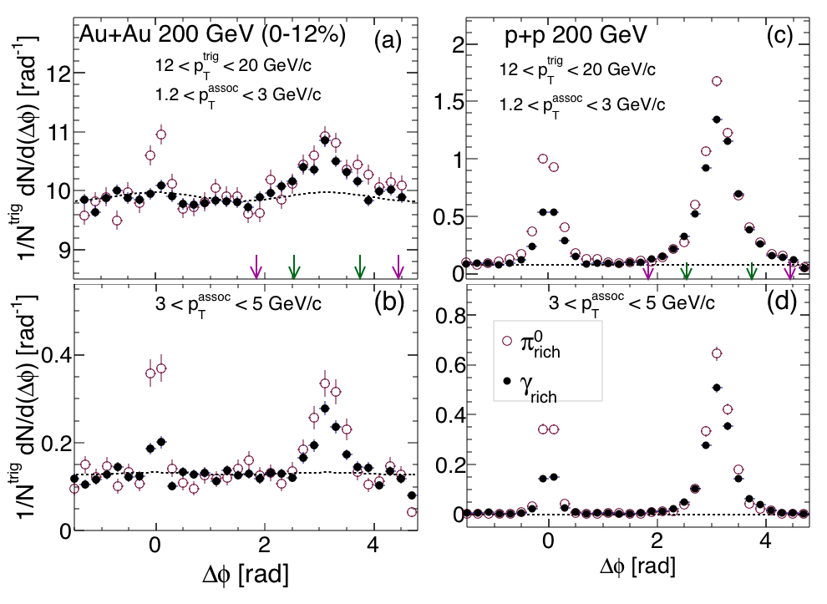
Correlation Functions
Δϕ with respect to trigger particle of charged hadrons with |η| < 1
γ_{rich} sample ~60% background in p+p collisions and ~30% background in central Au+Au
STAR, arXiv:1604.01117

Slide 7
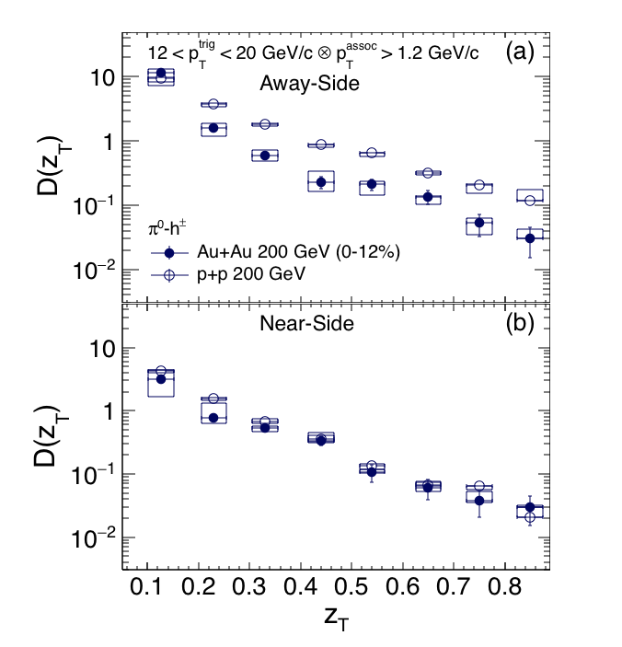
Charged-Particle Yields Associated with π⁰ Triggers
p_{T}^{trig} = 12-20 GeV/c, p_{T}^{assoc} ≥ 1.2 GeV/c
D(z_{T}) represents the per-trigger associated yields
On the away side, yields in central Au+Au suppressed relative to yields in p+p
On the near side, yields in central Au+Au consistent with yields in p+p
STAR, arXiv:1604.01117
z_{T}=p_{T}^{assoc}/p_{T}^{trig}

Slide 8
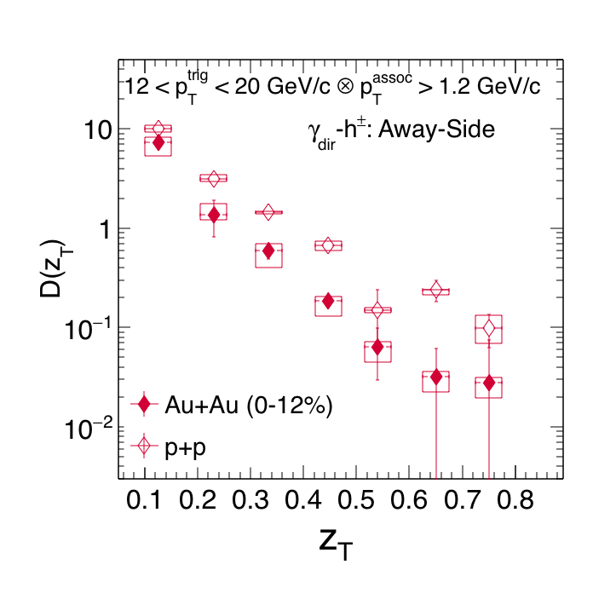
Charged-Particle Yields Associated with γ^{dir} Triggers
where
Yields in central Au+Au suppressed relative to yields in p+p
STAR, arXiv:1604.01117
z_{T}=p_{T}^{assoc}/p_{T}^{trig} ≅
p_{T}^{assoc}/p_{T}^{jet}

Slide 9
Hadron Trigger Energy vs. Jet Energy
We can estimate the fraction of the parton energy carried by the π⁰ trigger by summing the additional energy carried by the associated charged particles on the near side
Integrating z_{T} times a function fit to the near-side D(z_{T}) distribution results in Int=0.17 ± 0.04. This means that 1/(1+Int)=p_{T}^{trig}/(p_{T}^{trig}+Σp_{T}^{assoc})=85±3%
Since the associated particles are charged particles only, we repeat the analysis in PYTHIA, find agreement for charged-particle result, then extend it to include neutral energy: p_{T}^{trig}/p_{T}^{jet}=80±5%
STAR, arXiv:1604.01117

Slide 10
Away-side yields in p+p collisions as a function of “true” z_{T}
Near-side D(z_{T}) measurement for π⁰ triggers supports PYTHIA estimate that π⁰ trigger particle carries 80±5% of jet energy for p_{T}^{trig}=12-20 GeV/c
z_{T}^{corr}=p_{T}^{assoc}/p_{T}^{jet}
Now we can “correct for” p_{T}^{π0}/p_{T}^{jet}=0.8
z_{T}^{corr}=p_{T}^{assoc}/p_{T}^{jet} for π⁰ triggers
and compare away-side yields for π⁰ and direct-γ triggers directly
-- Yields are similar for π⁰ and γ triggers
Differences in quark/gluon fragmentation not seen within uncertainties, within z_{T}=(0.1,0.7)
STAR, arXiv:1604.01117

Slide 11
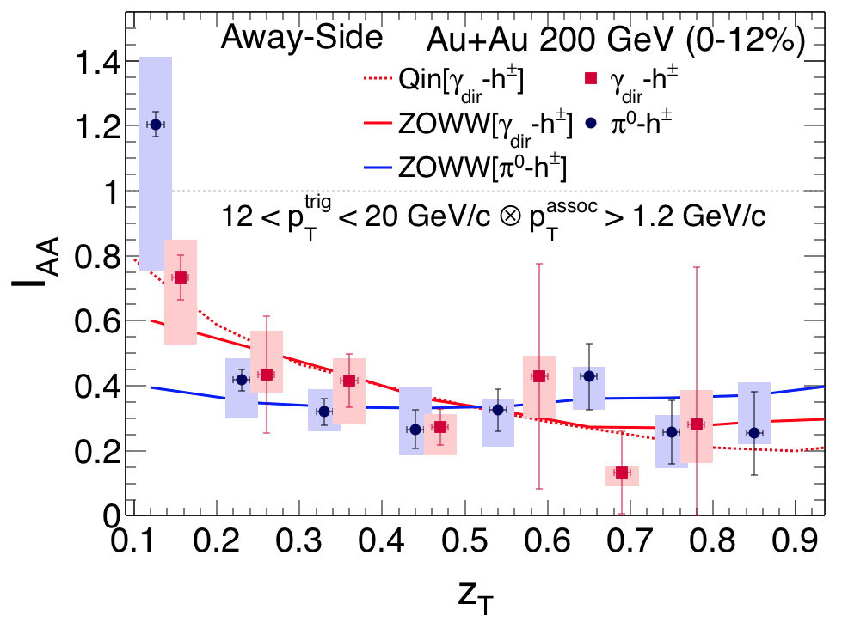
Suppression of jet-like yields on recoil side of π⁰ triggers vs. γ_{dir} triggers
Suppression measured via I_{AA} = ratio of per-trigger yields in central Au+Au to minimum-bias p+p collisions
Suppression consistent for hadron triggers and photon triggers within uncertainties
Suppression appears to be less significant at low z_{T}, low p_{T}^{assoc}
No significant differences seen (within errors) due to naïve expectations from effects:
1) difference in surface vs. volume emission and
2) color factor in energy loss
Model calculations in agreement with data
STAR, arXiv:1604.01117
ZOWW: H. Zhang et al., PRL 103, 032302 (2009), X.-F. Chen et al., PRC 81, 064908 (2010)
Qin: G.-Y. Qin et al., PRC 80, 054909 (2009).

Slide 12
I_{AA} as a function of p_{T}^{assoc}
Suppression appears to be less significant at low p_{T}^{assoc}
STAR, arXiv:1604.01117

Slide 13
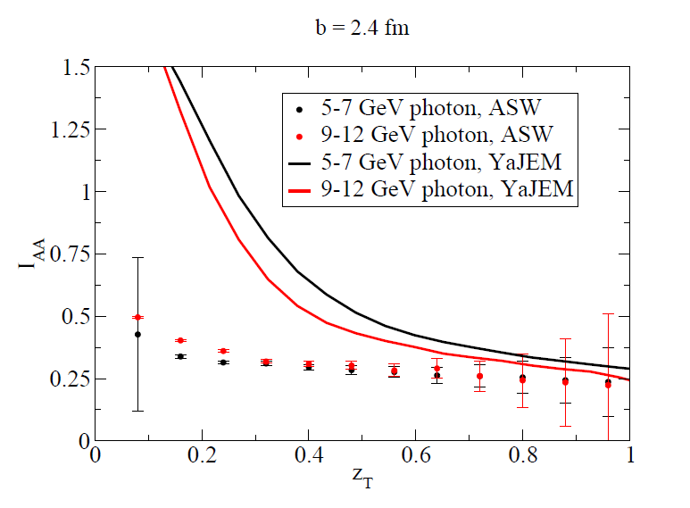
Discussion of Models
Models shown in the comparison (ZOWW and Qin) include energy loss of parton propagating through medium with a hydro-evolution of bulk matter; parton shower evolution taken into account analytically
In contrast to these models, is the so-called “medium-modified shower” Monte Carlo (YaJEM) where lost energy is redistributed to lower p_{T} jet fragments. In this picture, the in-medium shower is modified, and a suppression at high z_{T} results in an enhancement at lower z_{T}
Calculation rises more significantly and at higher z_{T} than our data shows, but here p_{T}^{trig} is lower
-- p_{T}^{assoc} ≈ 2 GeV/c when I_{AA}=1.
T. Renk, Phys. Rev. C80, 014901 (2009).

Slide 14
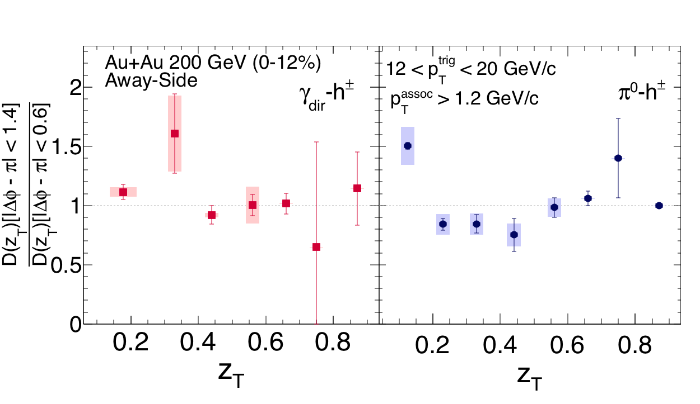
Recovery of Energy at Large Angles?
Compare away-side yields within ±35° vs. ±80°
No significant effect seen, except in lowest z_{T} bin for π⁰ triggers
STAR, arXiv:1604.01117
PHENIX reported effect for z_{T}<0.4, but p_{T}^{trig} = 5-9 GeV/c
→ p_{T}^{assoc} < 2 GeV/c (PHENIX, Phys. Rev. Lett. 111, 032301 (2013))

Slide 15
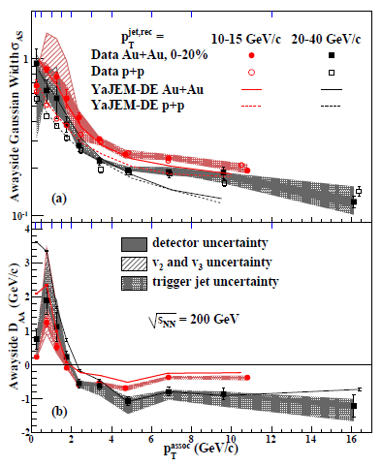
Recovery of Energy at Large Angles?
Previous results from STAR Jet-hadron correlations (for two different ranges of jet energies) also indicate that the lost energy is recovered only for p_{T}^{assoc} < 2 GeV/c
STAR, Phys.Rev.Lett. 112, 122301 (2014)

Slide 16
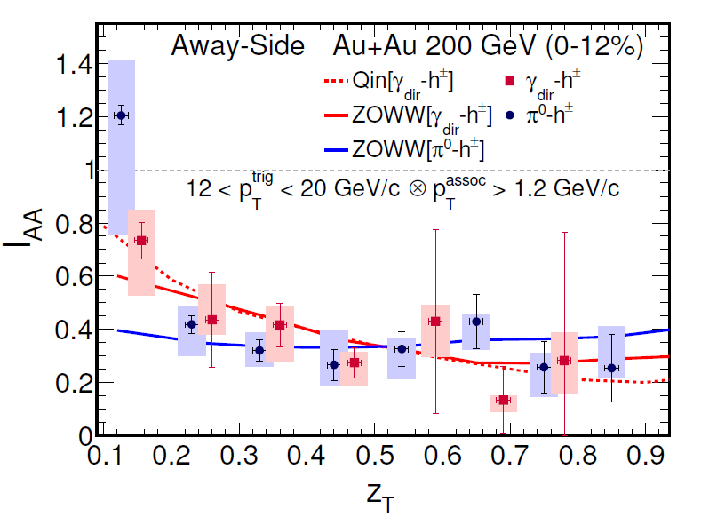
Energy Dependence of Energy Loss
Studied via yields associated with direct photon triggers γ(E_{initial})
STAR, arXiv:1604.01117
No dependence of energy loss on E_{initial} is observed for E_{initial} ≈ 8-20 GeV

Slide 17
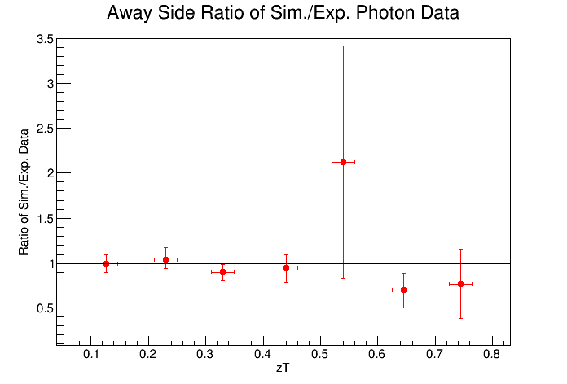
On the Way Toward γ-Triggered Jets
PYTHIA (v8.185) Study:
γ-h± yields comparison to STAR p+p data
Consistency in results is a good cross-check before studying γ-Jet with PYTHIA
The same correlations analysis applied to data also applied to PYTHIA events
The per-trigger away-side yields are compared via the ratio of simulation to data

Slide 18
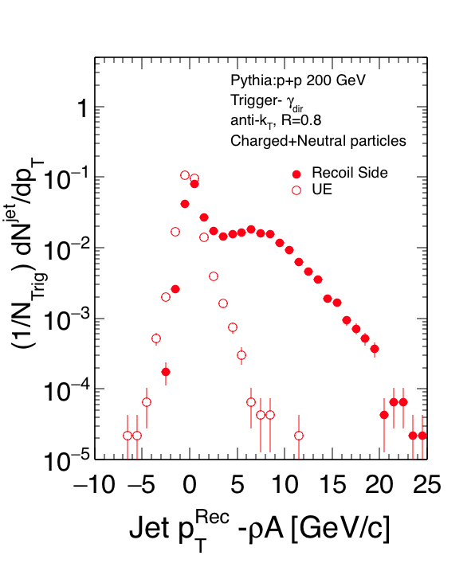
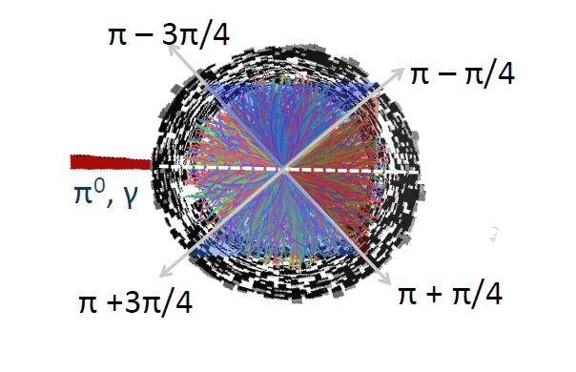
On the Way Toward γ-Triggered Jets
Preliminary PYTHIA (v8.185) Study of γ-Jet events: Using FastJet anti-k_{T} algorithm with R=0.8
Use “Underlying Event” (UE) region to estimate number of uncorrelated jet candidates
UE Region
Trigger
Recoil region
UE Region
Normalization issue – since Recoil side sometimes has an actual correlated jet, there will be fewer R=0.8 uncorrelated jet candidates than in the UE region

Slide 19
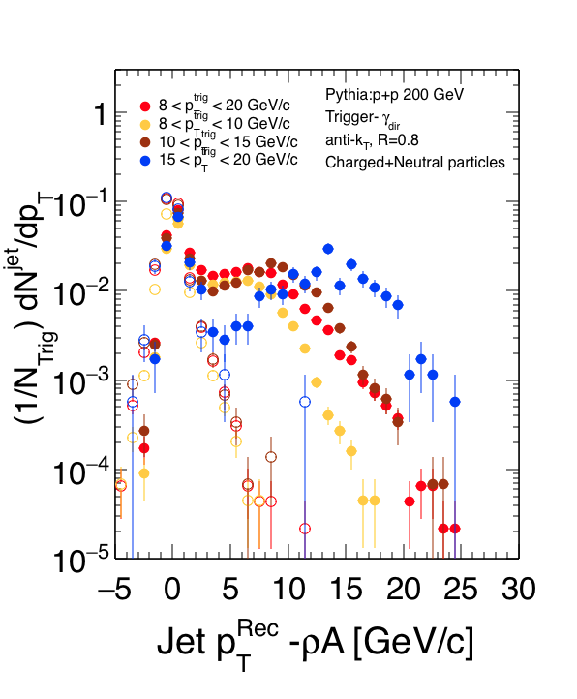
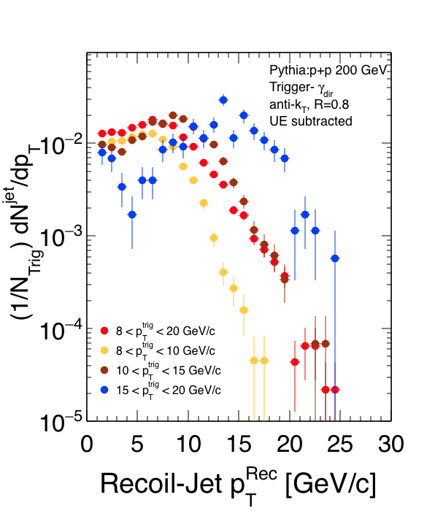
Direct-Photon Triggered Jets
PYTHIA sim. showing FastJet anti-k_{T} algorithm applied to γ-Jet events, R=0.8
Subtracting uncorrelated jet candidates estimated from UE region
UE approximately describes first peak (modulo normalization issue)
Second peak shifts with p_{T} range of direct-photon triggers

Slide 20
Summary
I_{AA} measured via γ-triggered vs. π⁰-triggered charged-hadron correlations show similar level of suppression for p_{T}^{trig}=12-20 GeV/c, p_{T}^{assoc}>1.2 GeV/c.
Suppression is less at low z_{T} (z_{T}<0.2, corresponding to p_{T}^{assoc}<2.4 GeV/c)
Comparison with other measurements suggests that recovered energy appears at p_{T}^{assoc}<2 GeV/c, independent of p_{T}^{trig}.
Expected difference in π⁰ triggered vs. γ-triggered suppression due to surface vs. volume emission and due to the color factor in energy loss is not seen within our uncertainties
γ-triggered Jet Reconstruction in STAR coming soon….

Slide 21
Backup Slides

Slide 22
TSP from Simulation

