Slide 1
Searching for Polarized Glue at
STAR
Brian Page – Indiana University
For the STAR Collaboration
June 17, 2014

Slide 2
Outline
Theoretical Overview
Inclusive Jet Measurements
  Brief Review of 2006
  New 2009 Result
  New Global Analyses
Di-jet Correlation Measures
  Di-jet Cross Section
  Di-jet A_{LL} Statistical and Systematic Errors
Future Measurements

Slide 3
Where’s the Spin?
Polarized DIS tells us that ΔΣ ≈ 0.3
Q² evolution in polarized DIS gives information on gluon polarization but limited kinematic coverage leaves ΔG poorly constrained
A primary goal of RHIC Spin program is to map Δg(x)
Kinematic reach of polarized DIS measurements

Slide 4
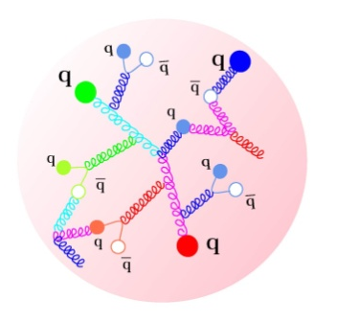



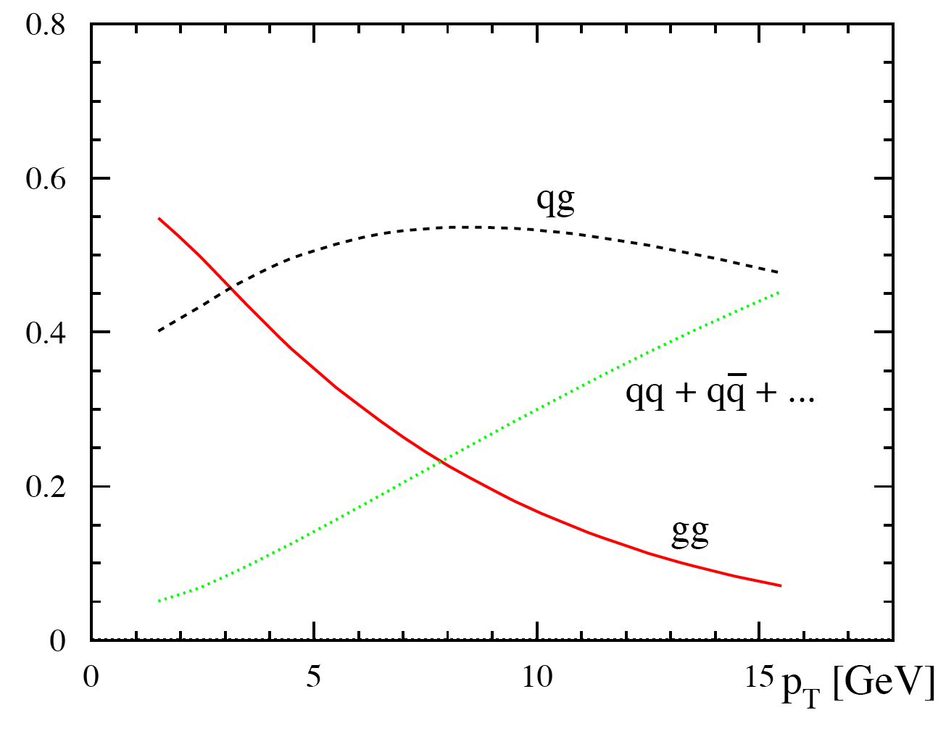
Proton Spin: Polarized pp Collisions
Partonic fractions in jet production at 200 GeV
For most RHIC kinematics, gg and qg dominate, making A_{LL} for jets and hadrons sensitive to gluon polarization.
10
20
30 p_{T}(GeV)

Slide 5
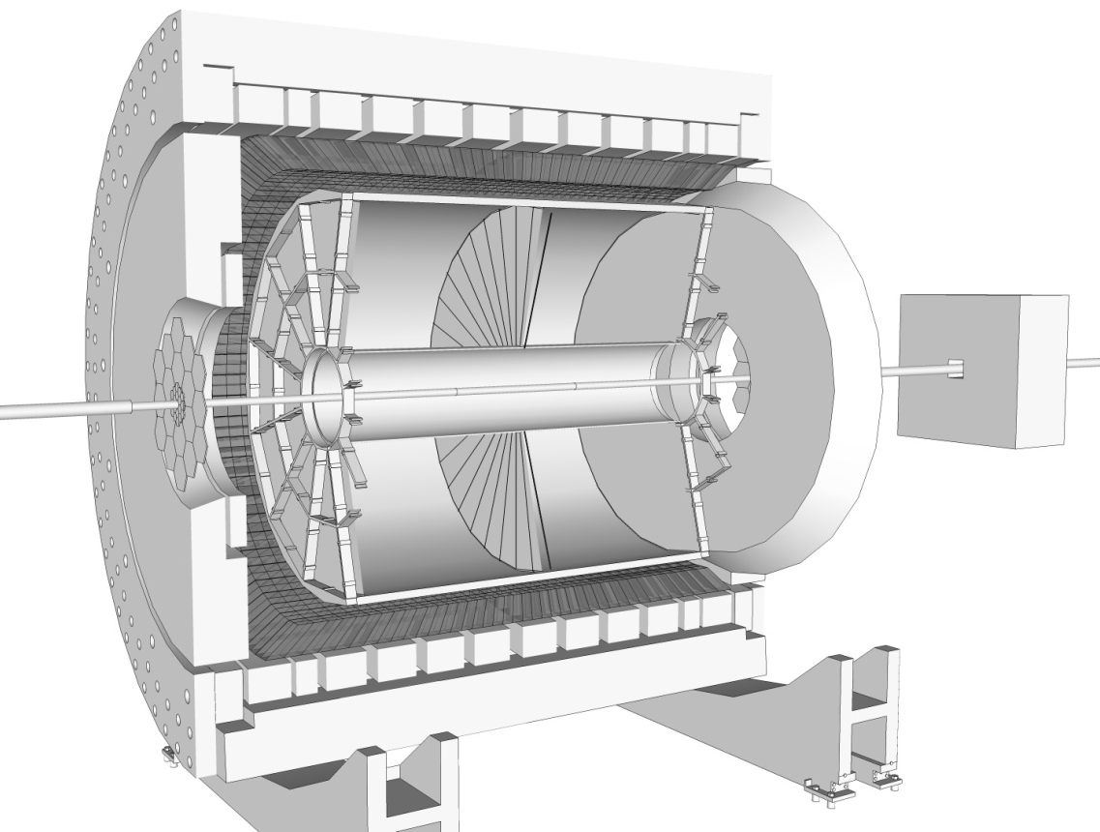
STAR Detector
Time Projection Chamber (TPC)
Charged Particle Tracking |η|<1.3
η = 0
Endcap Electromagnetic Calorimeter:
1<η<2
η = 1
η = - ln(tan(θ/2))
Barrel Electromagnetic Calorimeter (BEMC):
|η|<1

Slide 6
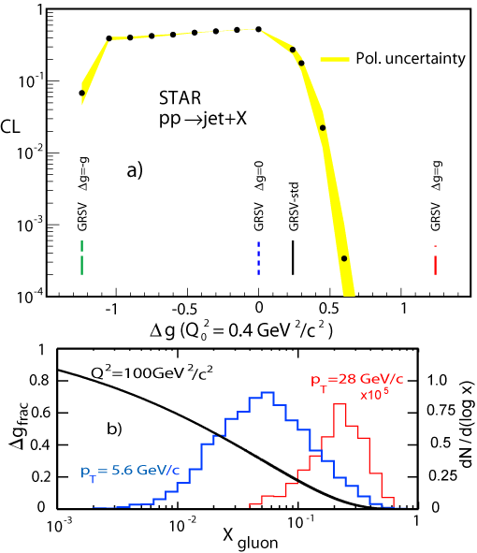
Inclusive Jet Measurements
High statistics
Multiple contributing subprocesses
Wide range of x_{gluon} in each reconstructed bin

Slide 7

Jet Reconstruction
Jet Levels
MC Jets
Anti-K_{T} Algorithm:
Radius = 0.6
Less sensitive to underlying event and pile-up effects
Implemented using FastJet
Used in both data and simulation
Detector
GEANT
Particle
STAR Detector has:
Full azimuthal coverage
Charged particle tracking from TPC for |η| < 1.3
E/BEMC provide electromagnetic energy reconstruction for -1 < η < 2.0
STAR well suited for jet measurements
PYTHIA
Parton

Slide 8
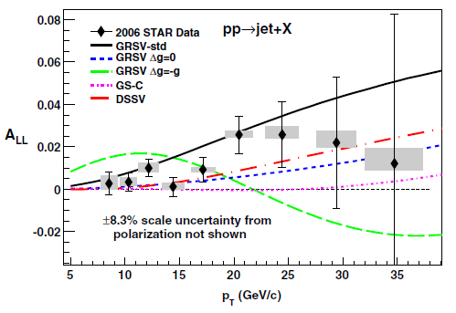
2006 Inclusive Jet A_{LL}
Phys. Rev. D86 032006 (2012)
Run 6 data rules out GRSV-Min and GRSV-Max
Large gluon polarization in the accessible region disfavored

Slide 9
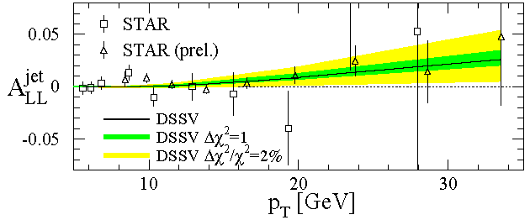
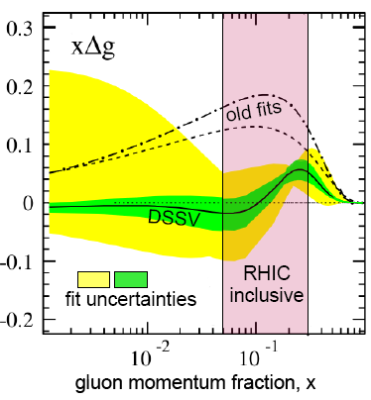
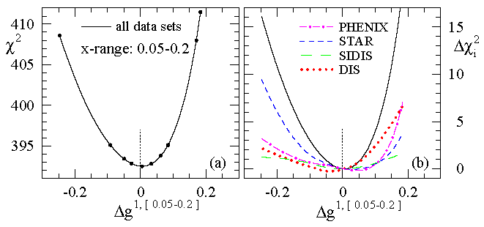
DSSV Global Fit
de Florian et al., PRL 101, 072001 (2008)
STAR
Strong constraint on Δg in the range 0.05 < x < 0.2
Low x range still poorly constrained
First global NLO analysis which includes DIS, SIDIS, and RHIC pp data

Slide 10
2006 to 2009 Improvements
2009 jet patch trigger upgrades
  Overlapping jet patches and lower E_{T} threshold improve efficiency and reduce trigger bias
    Net increase of 37% in jet acceptance
  Remove beam-beam counter trigger requirement:
    Trigger more efficiently at high jet p_{T}
    Measure non-collision background
  Increased trigger rate enabled by DAQ1000
Improvements in jet reconstruction
  Subtract 100% of track momentum from struck tower energy (2009) instead of MIP (2006)
  Overall jet energy resolution improved from 23% to 18%
Sampled 20 pb⁻¹ at 58% average beam polarization

Slide 11
2009 Inclusive Jet A_{LL}
arXiv:1405.5134
2009 results have factor of 3 to 4 better statistical precision than 2006 results
Result divided into two pseudorapidity ranges which emphasize different partonic kinematics
Result lies consistently above the 2008 DSSV fit and is consistent with the LSS10p fit

Slide 12
New DSSV Results
arXiv:1404.4293
2008 DSSV Extraction
DSSV*: Contains the final versions of previous STAR and PHENIX data as well as COMPASS inclusive and semi inclusive DIS data
New DSSV fit containing 2009 RHIC data
Integral of ∆g(x) in range 0.05 < x < 1.0 increases from roughly 0.05 to 0.12 to 0.2
Uncertainty shrinks substantially from DSSV* to new DSSV fit
Uncertainty on integral over low x region is still sizable

Slide 13
NNPDF Fit
arXiv:1405.5134
NNPDF fit 1.0 includes only DIS data
NNPDF group provides a weighting method which allows the effect of new experimental data to be explored without redoing full fit
2006 and 2009 STAR jet data increase the value of ∆g(x) and decrease the uncertainty, especially at larger x

Slide 14
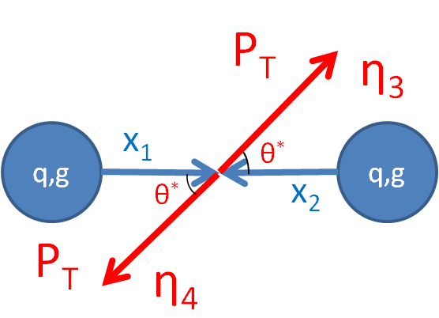
Correlation Measurements
Inclusive measurements have been the workhorse of STAR ΔG program to date
Broad x range sampled in each p_{T} bin
Correlation measurements which reconstruct the full final state are sensitive to initial kinematics at leading order

Slide 15
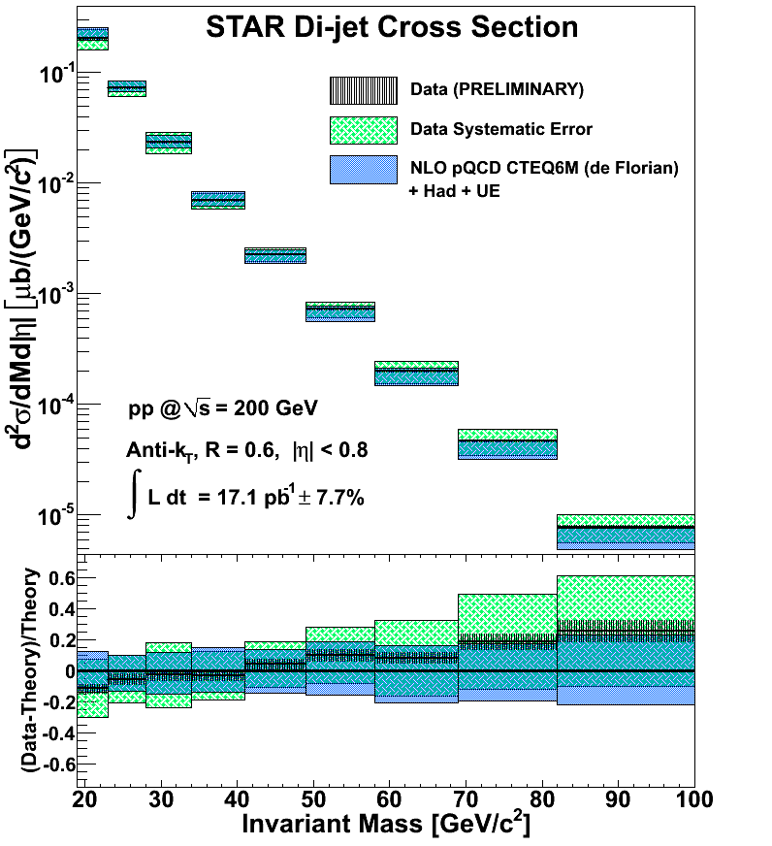
2009 Di-jet Cross Section Result
Thickness of vertical black hashing represents size of statistical error on the measurement
Green hatched box is symmetric about data point and is the quadrature sum of all systematic errors
Thickness of blue box represents error on theory determined by changing factorization and renormalization scales by factor of 0.5 and 2

Slide 16
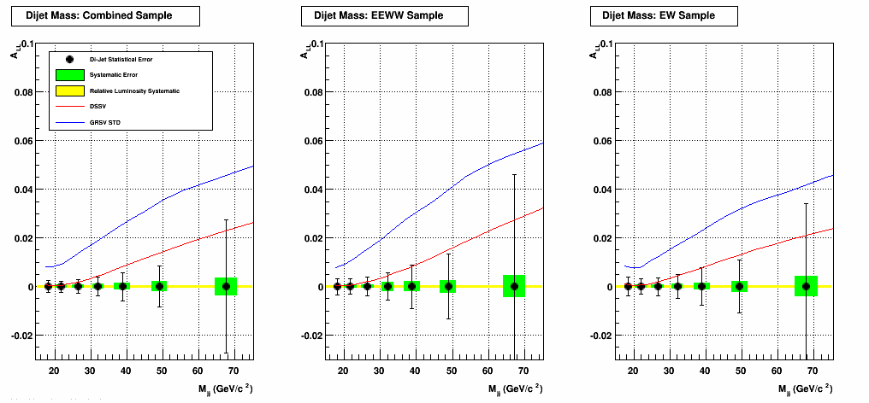
2009 Di-jet A_{LL} Errors
Di-jet statistical and systematic errors shown for two unique topologies and the combination which probe different partonic kinematics
Systematics include contributions from JES, residual transverse polarization, and trigger / reconstruction biases
Red curve shows 2008 DSSV best fit for A_{LL} and blue curve shows GRSV-STD fit

Slide 17
Recent and Upcoming Data Sets
Only longitudinal data sets shown
Run | √s (GeV) | Integrated Luminosity | Average Polarization
2009 | 200 500 | 25 pb⁻¹ 10 pb⁻¹ | 55% 39%
2012 | 510 | 82 pb⁻¹ | 50/53%
2013 | 510 | 300 pb⁻¹ | 50/53%
2015* | 200 | 50 pb⁻¹ | 60%
* Upcoming Data Set

Slide 18
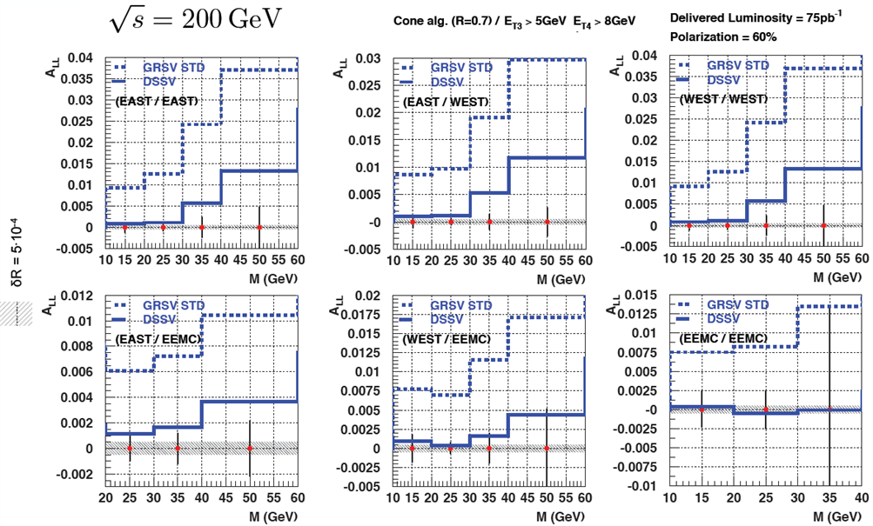
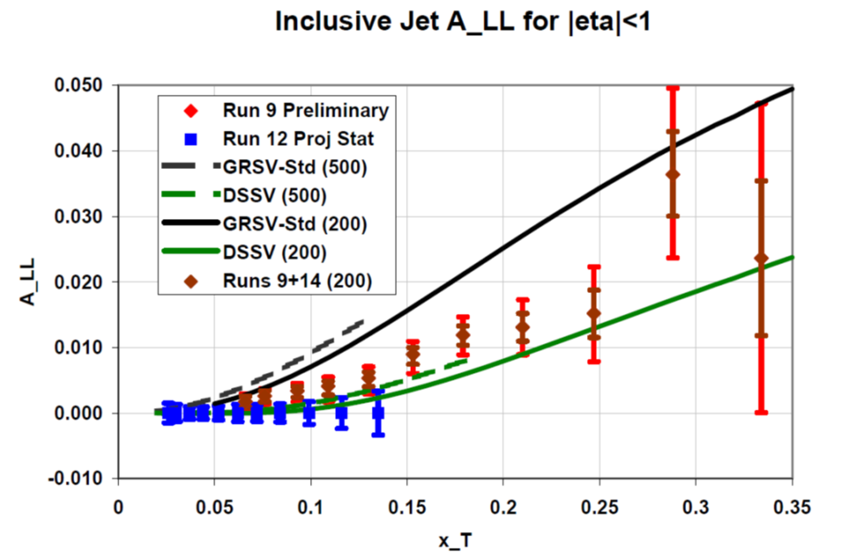
Projected Jet/Dijet Sensitivity
Projected inclusive jet statistical uncertainty vs jet p_{T} scaled by √s
Red = Run 9 Preliminary
Blue = Run 12 (510 GeV)
Brown = Combined Runs 9 and 15
Projected dijet statistical uncertainty at √s = 200 GeV for six topologies
Statistics correspond to Run 9 + Run 15

Slide 19
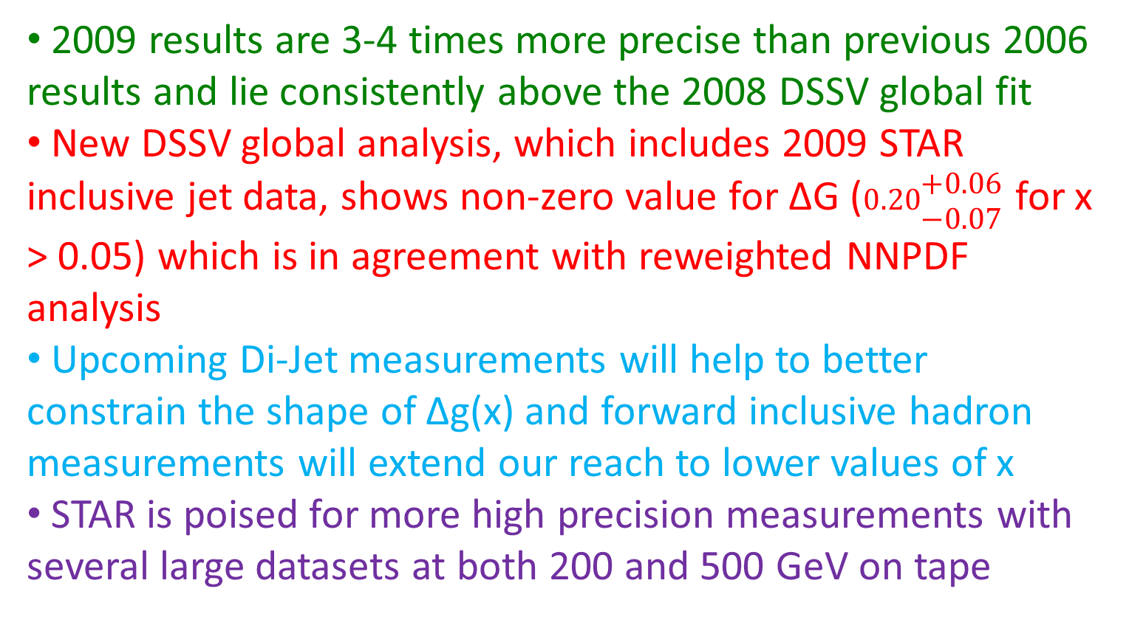
Conclusions
2009 results are 3-4 times more precise than previous 2006 results and lie consistently above the 2008 DSSV global fit
New DSSV global analysis, which includes 2009 STAR inclusive jet data, shows non-zero value for ∆G ($0.20\begin{matrix}+0.06 \\ −0.07\end{matrix}$for x > 0.05) which is in agreement with reweighted NNPDF analysis
Upcoming Di-Jet measurements will help to better constrain the shape of ∆g(x) and forward inclusive hadron measurements will extend our reach to lower values of x
STAR is poised for more high precision measurements with several large datasets at both 200 and 500 GeV on tape

Slide 20
Backup Slides

Slide 21
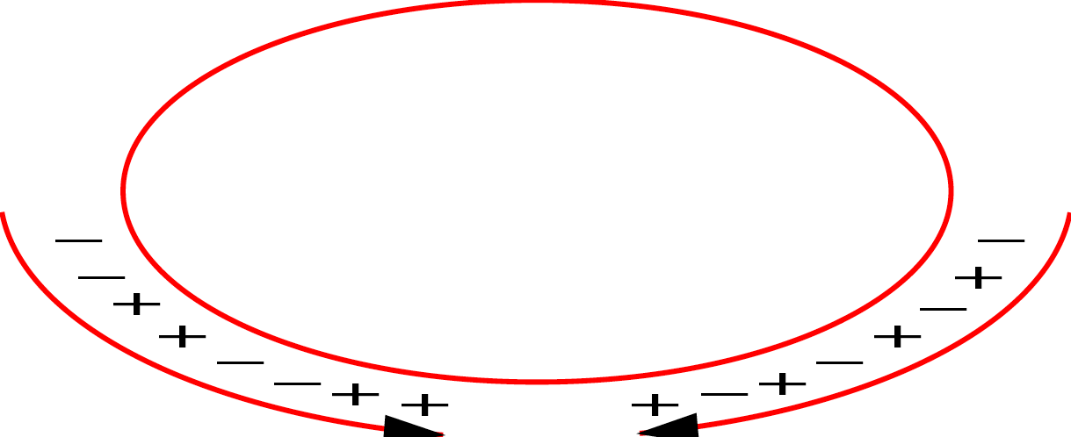
RHIC
Absolute Polarimeter (H↑ jet)
RHIC pC Polarimeters
PHOBOS
BRAHMS
Siberian Snakes
Siberian Snakes
PHENIX
STAR
Spin Rotators
(longitudinal polarization)
Spin flipper
Spin Rotators
(longitudinal polarization)
Pol. H⁻ Source
Solenoid Partial Siberian Snake
LINAC
BOOSTER
Helical Partial Siberian Snake
AGS Internal Polarimeter
200 MeV Polarimeter
AGS
AGS pC Polarimeters
Rf Dipole
Strong Helical AGS Snake

Slide 22
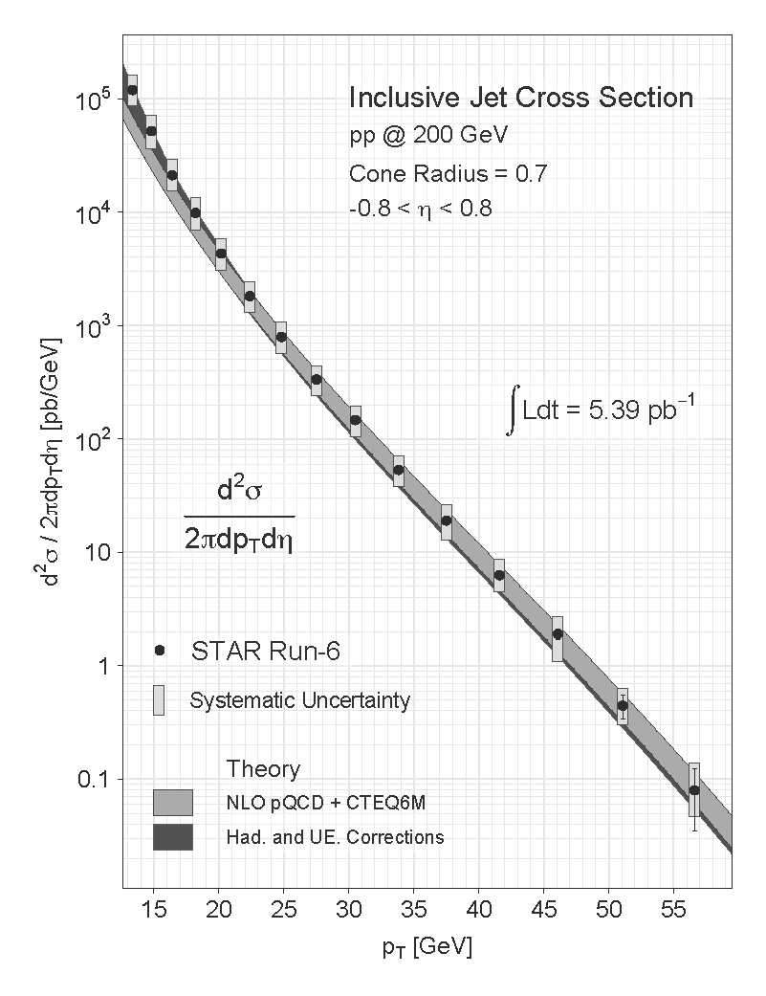
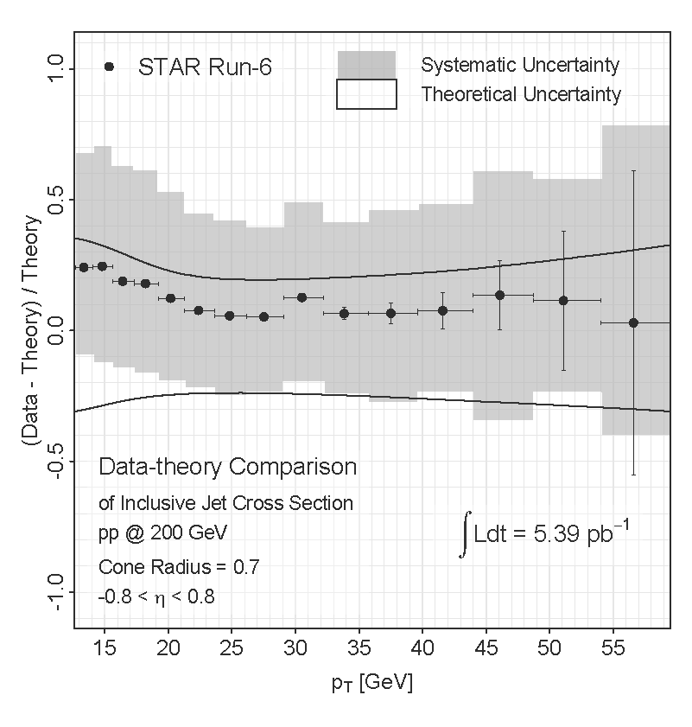

2006 Inclusive Jet Cross Section
p_{T} [GeV/c]
p_{T} [GeV/c]
Data in good agreement with NLO pQCD when including hadronization and underlying event corrections
Hadronization and UE corrections more significant at low p_{T}

Slide 23
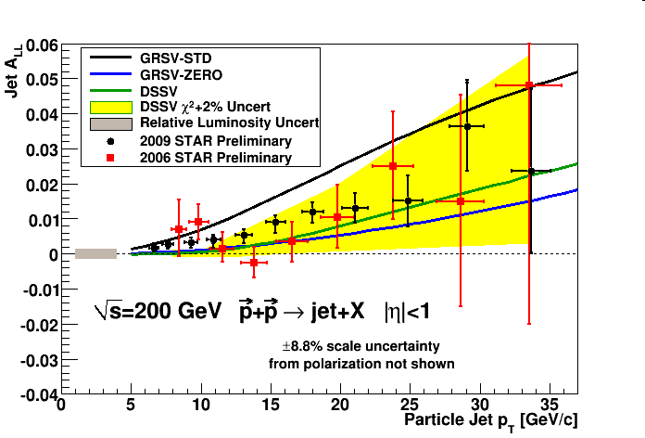
2006 vs 2009 Inclusive Jet A_{LL}
Run 9 results are a factor of 3 or greater more precise than Run 6 results
Data falls between DSSV and GRSV-STD

Slide 24
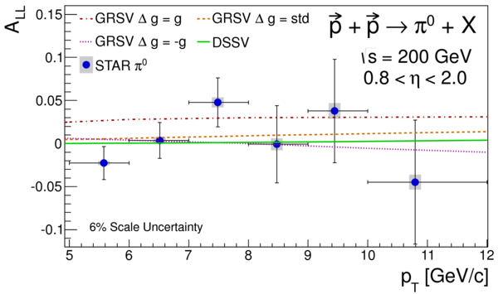
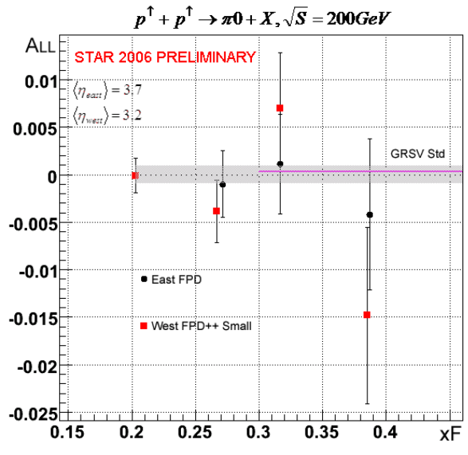
Inclusive Results: π⁰ A_{LL}
PRD 80, 111108(R) (2009)
PRD 89, 012001 (2014)
p_{T} [GeV/c]
|η| < 0.95
1.0 < η < 2.0
η = 3.2, 3.7
STAR has measured π⁰ A_{LL} in three different pseudorapidity ranges
Mid rapidity results excludes maximal Δg model, consistent with EEMC result
qg scattering dominates at high η with large x quarks and small x gluons

Slide 25
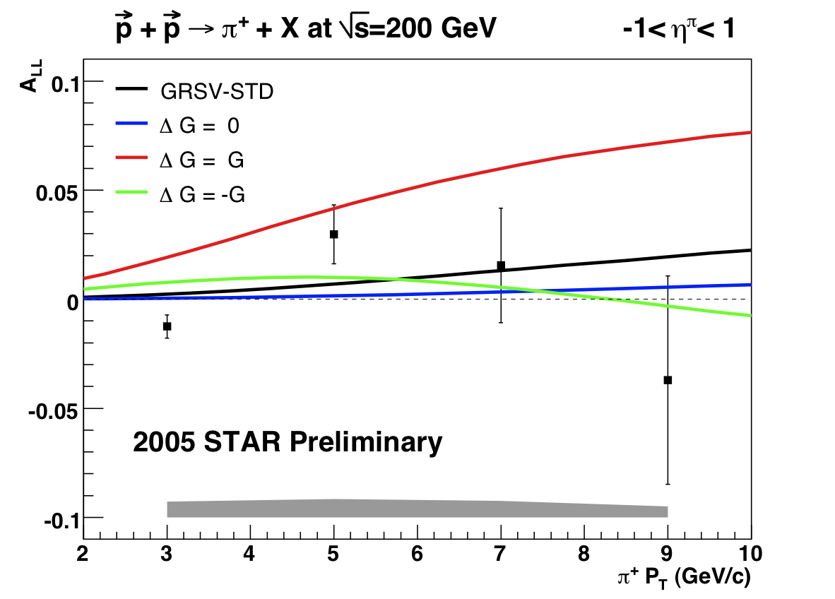
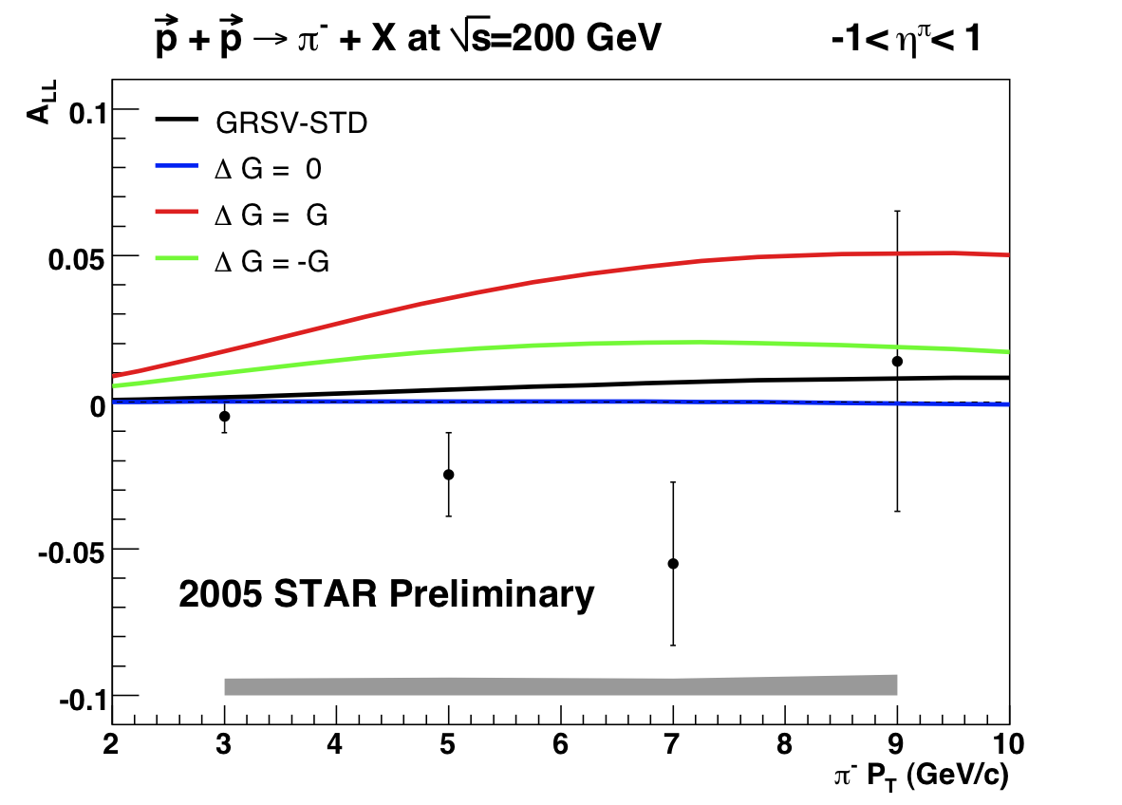
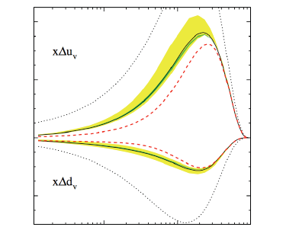
Inclusive Results: π⁺ π⁻ A_{LL}
In Run 5, STAR measured A_{LL} for inclusive charged pions
A_{LL}(π+) - A_{LL}(π-) is sensitive to the sign of ΔG
Trigger using neutral jet patch -> Introduces significant trigger bias (charged pions often subleading particles in jets)

Slide 26
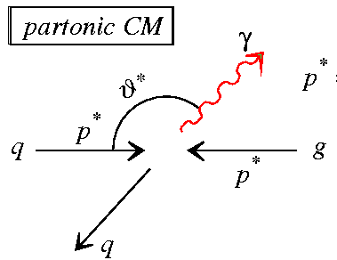
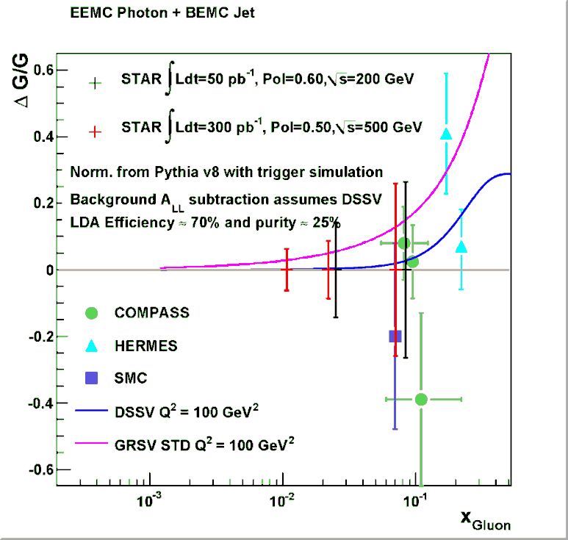
Gamma + Jet: A Long-Term STAR Goal
Gamma + Jet production dominated by quark-gluon Compton scattering
Large spin (→ 1) correlation when partons backscatter
Events with a gamma in the EEMC and a mid rapidity jet come from the most asymmetric collisions → high x quark (with high polarization) interacting with low x gluon
Gamma + Jet yield very small compared to QCD background → background suppression very challenging

