Slide 1
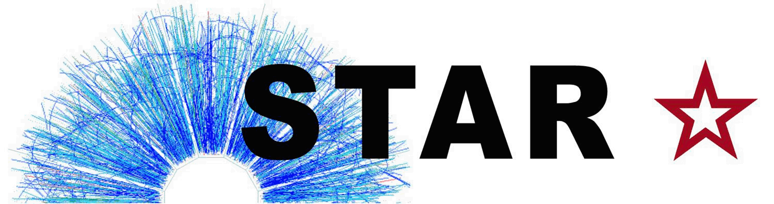



Nuclear Modification Factor of D⁰ Mesons
in Au+Au Collisions at √s_{NN} = 200 GeV
Guannan Xie (for the STAR Collaboration)
Lawrence Berkeley National Laboratory
University of Science and Technology of China
2015 Fall Meeting of the APS Division of Nuclear Physics
Guannan Xie
October 28-31, 2015, Santa Fe, NM
Notes:
Outline, new HFT result

Slide 2
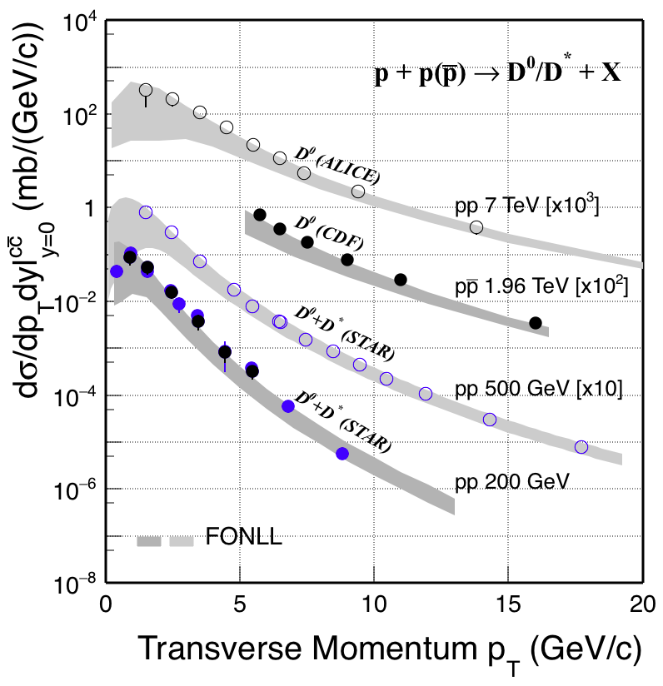
Motivation
Charm quarks: m_{c} >> Λ_{QCD}, T_{QGP(RHIC/LHC)}
Produced early in collision at RHIC through hard scattering
Experience the whole evolution of the system -> good probe for medium properties
Perturbative QCD calculations (FONLL) are consistent with experimental data.
STAR Preliminary
STAR: PRD 86 (2012) 072013,
NPA 931 (2014) 520
CDF: PRL 91 (2003) 241804
ALICE: JHEP01 (2012) 128
FONLL: PRL 95 (2005) 122001
STAR Preliminary
Guannan Xie
October 28-31, 2015, Santa Fe, NM
Notes:
Change the order of slide 3 and 4

Slide 3
Motivation
Charm quarks: m_{c} >> Λ_{QCD}, T_{QGP(RHIC/LHC)}
Produced early in collision at RHIC through hard scattering
Experience the whole evolution of the system -> good probe for medium properties
Perturbative QCD calculations (FONLL) are consistent with experimental data.
Charm cross section follows number of binary collisions scaling =>
At RHIC, charm quarks are produced via initial hard scatterings.
STAR Preliminary
STAR: PRL 94 (2005) 62301,
PRD 86 (2012) 072013,
PRL 113 (2014) 142301
FONLL: PRL 95 (2005) 122001
NLO: Eur.Phys.J.ST 155 (2008) 213
Guannan Xie
October 28-31, 2015, Santa Fe, NM

Slide 4

Results Before the Heavy Flavor Tracker
STAR: PRL 113 (2014) 142301
High p_{T}: large suppression due to energy loss, strong charm-medium interaction.
Enhancement at p_{T} ~0.7-2 GeV/c, described by models with coalescence of charm and light quarks.
Precision measurement is needed to further constrain models and to quantify medium properties.
New 2014 Au+Au results with HFT will be presented
-- p+p and p+Au data with HFT are recorded (run 2015)
Guannan Xie
October 28-31, 2015, Santa Fe, NM
Notes:
NO need to describe the model， also no need to say the

Slide 5
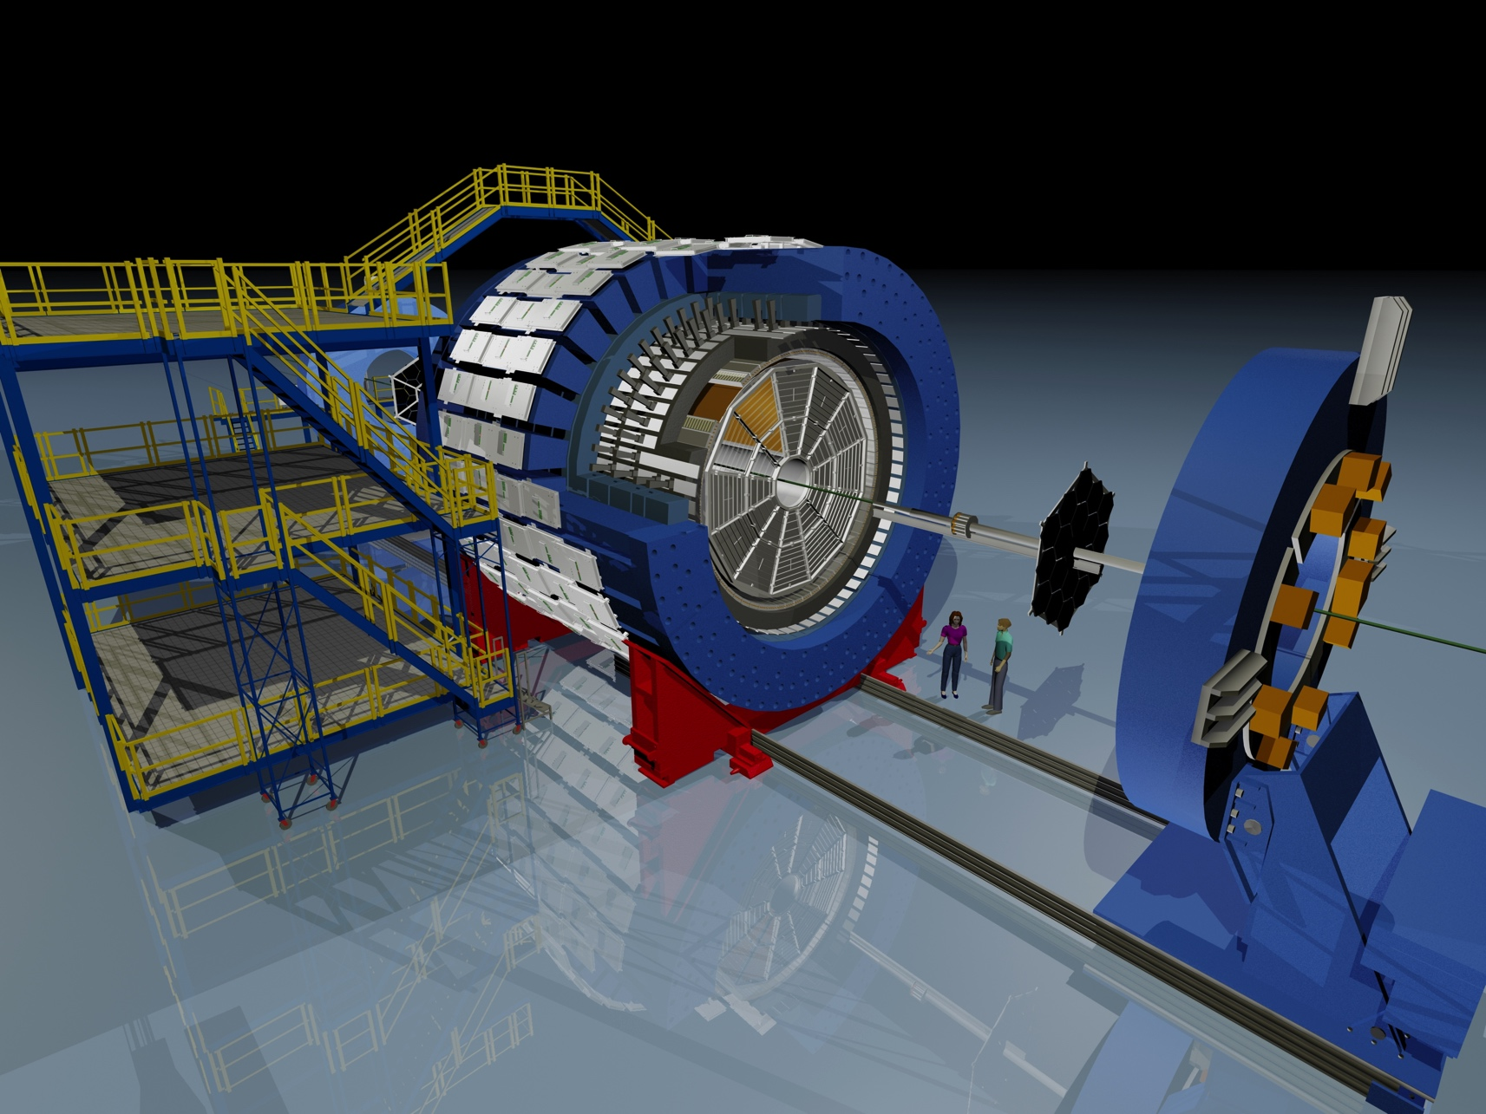
STAR Detector
Time Projection Chamber:
Tracking, PID (dE/dx)
Time Of Flight detector:
PID (1/β)
Heavy Flavor Tracker
HFT:
Silicon Strip Detector: r ~22 cm
Intermediate Silicon Tracker: r ~14 cm
PIXEL detector: r ~2.8 & 8 cm,
MAPS, 20x20 μm², 0.4%X₀, air-cooled
Guannan Xie
October 28-31, 2015, Santa Fe, NM
Notes:
Need to emphasize the thickness of PXL and new technology of MAPS, also traditional SSD and IST technology,
There lays, strip, strip, pxl with new technique

Slide 6
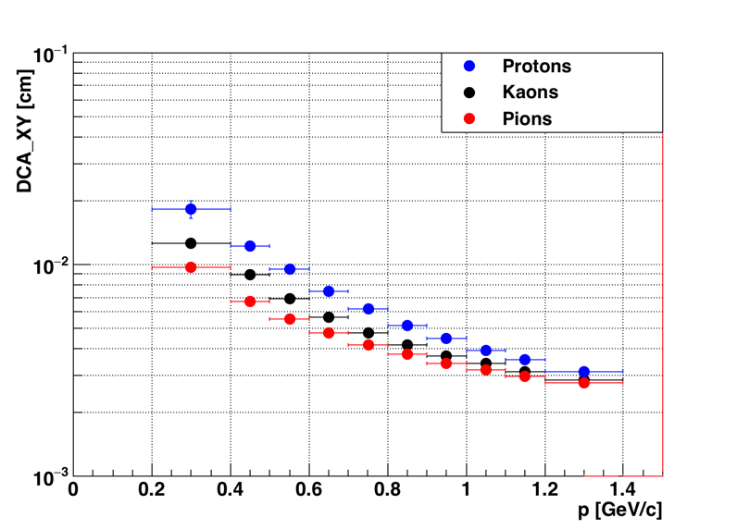
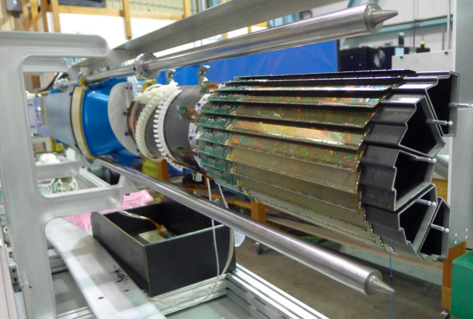
HFT Performance
Au+Au at √s_{NN} = 200 GeV, with Heavy Flavor Tracker
~780M minimum bias events analyzed (out of total 1.2B recorded in 2014)
PIXEL detector
DCA Resolution
Run14 Au+Au @ 200 GeV
750 MeV/c
DCA (Distance of Closest Approach) resolution
~ 30 μm at high p_{T}
Kaon with p = 750 MeV/c, DCA resolution <50 μm
Guannan Xie
October 28-31, 2015, Santa Fe, NM
Notes:
Remove 60um text, and just say it’s better than our design project

Slide 7
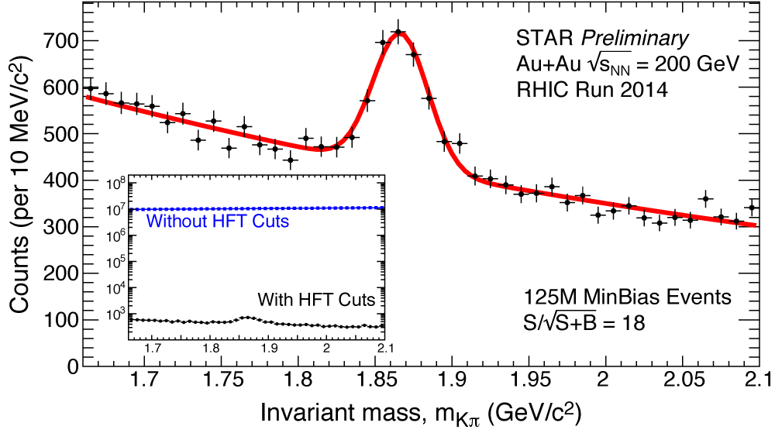
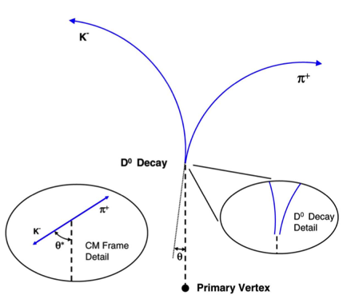
D⁰ Meson Reconstruction
Direct topological reconstruction through hadronic channel:
With HFT:
Greatly reduced combinatorial background
Topological cuts optimized by TMVA
(Toolkit for Multi Variate Analysis)
D⁰ | w/o HFT | with HFT
Year | 2010 + 2011 | 2014
Significance per billion events | 13 | 51
Guannan Xie
October 28-31, 2015, Santa Fe, NM
Notes:
Still need a cartoon to describe the topology cut

Slide 8
D⁰ Meson Signal
STAR Preliminary
STAR Preliminary
With the HFT, significantly enhanced D⁰ signal-to-background ratios in a broad range of transverse momentum
Guannan Xie
October 28-31, 2015, Santa Fe, NM
Notes:
Good signals, mixed Events to subtract background

Slide 9
Invariant yield
PRL 113 (2014) 142301
STAR Preliminary
[High p_{T}] Consistent with published result, with improved statistical precision
- Finalizing systematic uncertainties for p_{T}< 2 GeV/c
Guannan Xie
October 28-31, 2015, Santa Fe, NM

Slide 10
Nuclear Modification Factor
High p_{T}: significant suppression in central Au+Au collisions
New Au+Au results have improved statistical and systematic precision
p+p precision to be improved using 2015 data with HFT
PRL 113 (2014) 142301
AuAu N_{coll} uncertainty [left]
pp normalization uncertainty [right]
STAR Preliminary
Guannan Xie
October 28-31, 2015, Santa Fe, NM
Notes:
Draw theory lines one by one and have some conclusion

Slide 11
R_{AA} : D⁰ vs. π
R_{AA}(D) ~ R_{AA}(π) at p_{T}>4 GeV/c
STAR Preliminary
STAR D⁰: PRL 113 (2014) 142301
STAR π : PLB 655 (2007) 104
Guannan Xie
October 28-31, 2015, Santa Fe, NM
Notes:
Draw theory lines one by one and have some conclusion,
Light quark hadron and heavy quark hadron show a similar suppression at the high p_{T} region 4-8 GeV/c

Slide 12
R_{AA} : RHIC vs. LHC
R_{AA}@ RHIC ~ R_{AA}@LHC
STAR Preliminary
STAR D⁰: PRL 113 (2014) 142301
ALICE D: arXiv: 1509.06888
Guannan Xie
October 28-31, 2015, Santa Fe, NM
Notes:
Draw theory lines one by one and have some conclusion
Strong charm-medium interaction at RHIC and LHC, Charm hadron R_{AA} show strong and similar suppression at the high p_{T} region 4-8 GeV/c

Slide 13
R_{AA} : Comparison to Models
DUKE: Langevin simulation, input parameter （2πT）D = 7 (tuned to the LHC data)
TAMU: non-perturb., Full T-matrix treatment, (2πT)D = 2-10
SUBATECH: perturb. +HTL +resummation, (2πT)D = 2-4
Data compatible with models which predict the value of diffusion coefficient in the range 2 < (2πT)D < 10, same models can also reproduce the measured D⁰ v₂ ^{[QM15,talk ID:493]}
STAR Preliminary
STAR: PRL 113 (2014) 142301
DUKE: PRC 92 (2015) 024907
Theory: arXiv:1506.03981(2015)
Theory curves: latest calculations from private communications
Guannan Xie
October 28-31, 2015, Santa Fe, NM
Notes:
Draw theory lines one by one and have some conclusion, inter- energy potential hard thermol loop
Diffusion coefficient, TAMU Full T-matrix treatment, non-perturbative model with internal energy potential
SUBATECH pQCD+HTL calculation with latest EPOS3 initial conditions，ingredient

Slide 14
Summary & Outlook
STAR Preliminary
First measurement of D⁰ R_{AA} using STAR HFT.
  Significant suppression at high p_{T} in central Au+Au collisions
  Improved data precision, will further constrain models
  Extracted diffusion coefficient 2 < (2πT)D < 10 for central Au+Au collisions at RHIC, consistent with what we learned from the charm hadron v₂ measurements
Near future outlook with HFT
  Year 2014 full D⁰ spectra and R_{AA} is coming soon
  Year 2015 p+p and p+Au data is on the way
  Year 2016 Au+Au 2 Billion minimum bias events, high statistics data will help to reduce the uncertainty of the medium property (2πT)D
Guannan Xie
October 28-31, 2015, Santa Fe, NM
Notes:
2015 pp p+Au, improve baseline and to address CNM effects

Slide 15

Thank You

Slide 16
Efficiency Correction
D⁰ efficiency = TPC tracking eff HFT tracking eff topological cuts
Data-driven simulation (5-15% p_{T}-dependent systematics)
HFT matching and resolution smearing using distributions extracted from data:
  HFT eff. × geometrical acceptance: (HFT matched tracks) / TPC tracks.
  Spatial resolution: DCA distributions of HFT matched tracks (XY-Z dependence).
Luminosity, centrality, azimuth and pseudo-rapidity dependence have been considered.
  Embedding (~3% systematic uncertainty)
  Full STAR GEANT simulation
  + MC embedded in real raw data + data reconstruction chain
Guannan Xie
October 28-31, 2015, Santa Fe, NM
Notes:
----- 会议笔记(9/3/15 15:37) -----
add some sentence

Slide 17
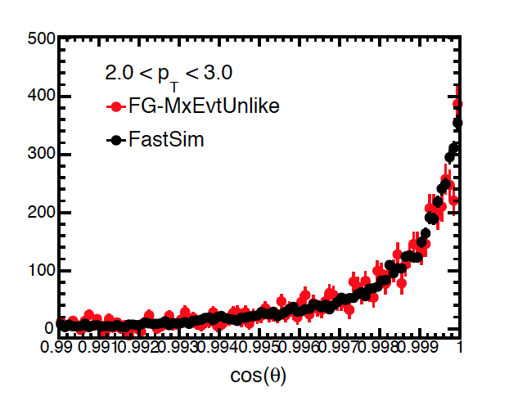
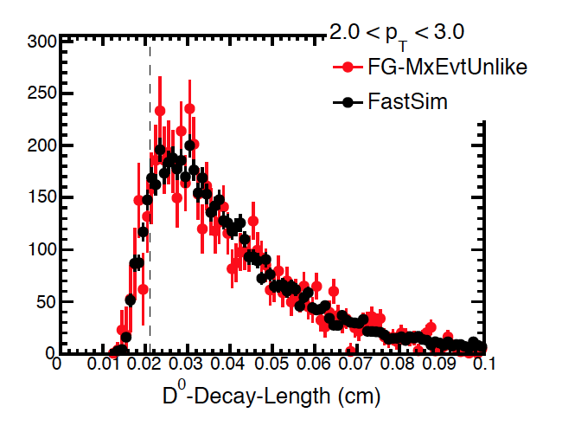
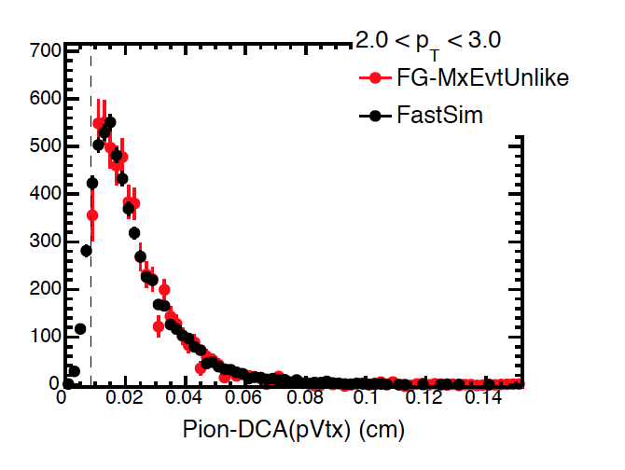
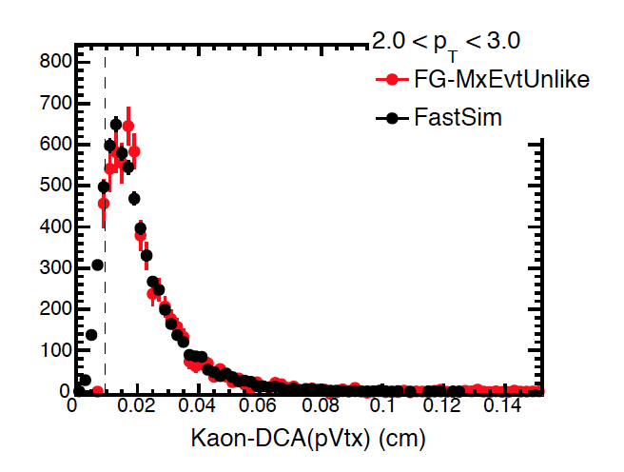
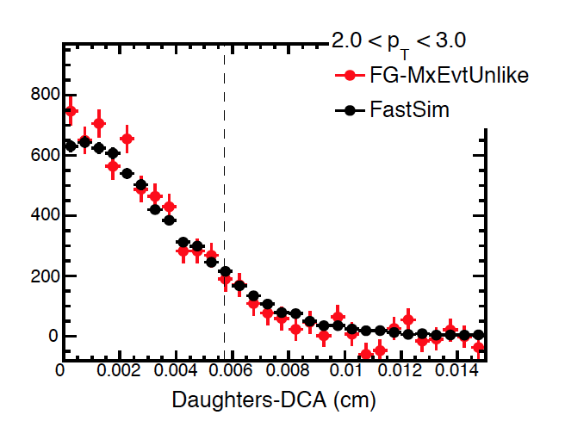
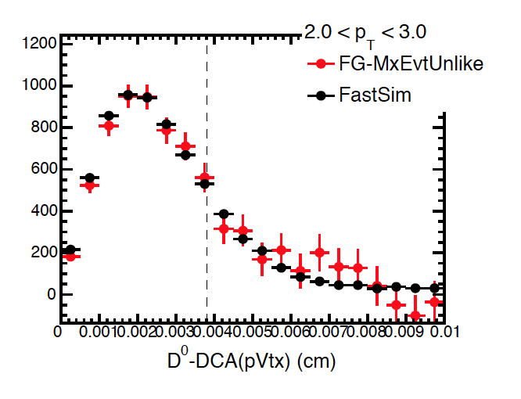
Topology distribution comparison
Guannan Xie
October 28-31, 2015, Santa Fe, NM
Notes:
Run14 will have full statics
Run 15 pp and pA
Run16 full aluminum cables, SSD and 2 billion -> significance improvement 2-3 for 1 GeV D0 -> centrality dependence

Slide 18
V₂ : Comparison to Models
Also good agreement between models and experiment for v₂
Compatible with models predicting a value of diff. coefficient between 2 to ~10
STAR Preliminary
Theory curves: latest calculations from private communications
Guannan Xie
October 28-31, 2015, Santa Fe, NM
Notes:
Draw theory lines one by one and have some conclusion, inter- energy potential hard thermol loop
Diffusion coefficient, TAMU Full T-matrix treatment, non-perturbative model with internal energy potential
SUBATECH pQCD+HTL calculation with latest EPOS3 initial conditions，ingredient

