Slide 1


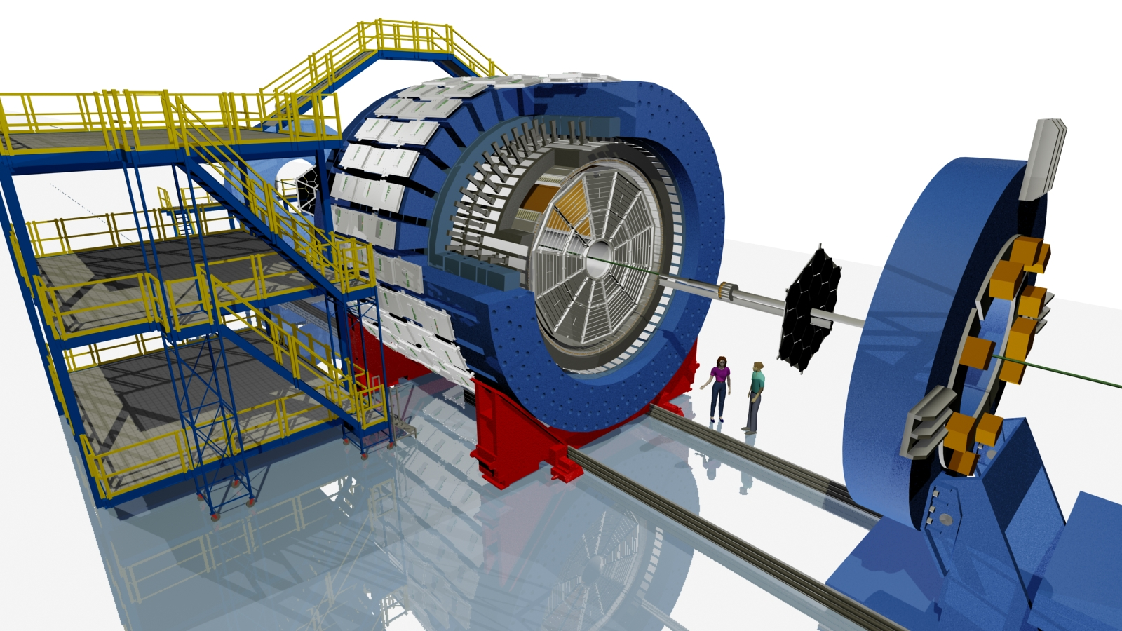
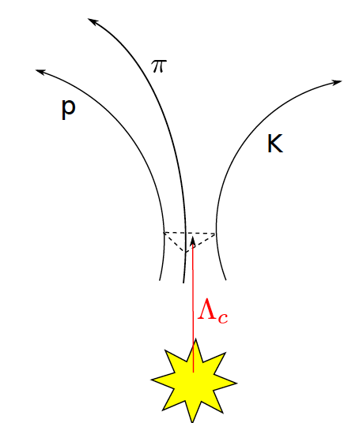



Λ_{c} Production in Au+Au Collisions at √s_{NN} = 200 GeV
at the STAR experiment
Guannan Xie, for the STAR Collaboration
Lawrence Berkeley National Laboratory & University of Science and Technology of China
ABSTRACT: Charm quarks, predominantly produced in the early stage of heavy-ion collisions, are believed to provide unique information on the hot and dense medium created in such collisions. At RHIC, an enhancement in baryon-to-meson ratios for light hadrons and hadrons containing strange quarks has been observed in central heavy-ion collisions compared to p+p and peripheral heavy-ion collisions in the intermediate p_{T} range (2 < p_{T} < 6 GeV/c). This was explained by the hadronization mechanism involving multi-parton coalescence. Λ_{c} is the lightest charmed baryon with the mass close to D⁰ meson, and has an extremely short life time (cτ ~ 60 μm). Different models predict different levels of enhancement in the Λ_{c}/D⁰ ratio depending on the degree of charm quark thermalization in the medium and how the coalescence mechanism is implemented.
In this poster, we will report the first measurement of Λ_{c} production in heavy-ion collisions using the recently installed Heavy Flavor Tracker at STAR. The Λ_{c} baryon is reconstructed through the hadronic decay channel (Λ_{c} → pKπ) using topological cuts optimized by the Toolkit for Multivariate Data Analysis (TMVA). The invariant yield of Λ_{c} for 3 < p_{T} < 6 GeV/c is measured in 10-60% central Au+Au collisions at √s_{NN} = 200 GeV. The measured Λ_{c}/D⁰ ratio will be compared with different model calculations, and the physics implications will be discussed.
Motivation
STAR and HFT Performance
Significant enhancement in baryon-to-meson ratio has been observed in central heavy-ion collisions compared to p+p and peripheral heavy-ion collisions in the intermediate transverse momentum (p_{T}) range for light hadron and hadrons containing strange quarks, suggesting hadronization through collective multi-parton coalescence.
Charm baryon-to-meson ratio in heavy-ion collisions is sensitive to the charm quark hadronization mechanism, charm quark thermalization. Different models have quite different predictions for this enhancement and to charm quark thermalization.
Time Projection Chamber
Time Of Flight detector
Distance of Closest Approach resolution achieved in Run 2014 using Al cables.
Heavy Flavor Tracker
[1] S. Ghosh et al.,PRD 90 054018 (2014). [2] Y. Oh et al.,PRC 79 044905 (2009). [3] S. Lee et al.,PRL 100 222301 (2008).
HFT:
Silicon Strip Detector: r ~22 cm.
Intermediate Silicon Tracker: r ~14 cm.
PiXeL detector: r ~2.8 & 8 cm,
MAPS, 20.7x20.7 μm², 50 μm thick, air-cooled,~0.5%X₀ for the innermost layer.
Λ_{c} Reconstruction
Λ_{c}⁺ (udc), mass ~ 2286 MeV/c², cτ ~ 60 μm
D⁰ (cu), mass ~ 1864 MeV/c², cτ ~ 123 μm
D⁺ (cd), mass ~ 1869 MeV/c², cτ ~ 311 μm
Direct topological reconstruction:
Λ_{c}⁺ → p⁺K⁻π⁺ BR ~ 6.35%
pK∗ 1.98% ∗ 66.7% = 1.32%
Δ⁺⁺Κ⁻ 1.09% ∗ 100% = 1.09%
Λ(1520) π⁺ 2.2% ∗ 22.5% = 0.495%
Non-resonant 3.5%
Λ_{c} signals from different centralities
+
Efficiency : Data-Driven Fast Simulation
[4] C. Patrignani et al. Chin. Phys. C 40 100001 (2016)
dca₁₂
⁻
Ingredients:
Extract centrality-dependent vertex z distributions from data.
Extract ratio of HFT matched tracks to TPC tracks from data.
Extract DCA_{XY} - DCA_{Z} distributions from data.
Extract TPC efficiency and momentum resolution from embedding.
Validated with full GEANT simulation !
dca₃₁
dca₂₃
V₀
STAR Preliminary
Comparison of fast simulation and full GEANT simulation
Λ_{c} reconstruction efficiency
STAR Preliminary
STAR Preliminary
STAR Preliminary
Results
The invariant yield of Λ_{c} for 3 < p_{T} < 6 GeV/c is measured in 10-60% central Au+Au collisions.
The ratio of Λ_{c} over D⁰ ratio in 10-60% Au+Au collisions is significantly enhanced than PYTHIA prediction in proton-proton collisions.
(Rectangular) Topological Cut Optimization using TMVA
Background was constructed from real data using wrong-sign method.
Signal was simulated with data-driven fast simulation.
The figures below show the comparison between signal and background for p_{T} > 3 GeV/c.
Summary and Outlook
First measurement of Λ_{c} in heavy-ion collisions by STAR.
A significant enhancement in the ratio of Λ_{c} over D⁰ has been observed in Au+Au collisions (10-60%) at √s_{NN} = 200 GeV.
  OUTLOOK: In run 2016, STAR recorded 2 billion Au+Au events with all inner ladders replaced with Al cables and better operation with more active sensors. More precise measurements of Λ_{c} production, especially its R_{cp}, will be possible.
The STAR Collaboration
drupal.star.bnl.gov/STAR/presentations

