Slide 1
ρ⁰ vector meson elliptic flow (v₂) in Au + Au collisions at √s_{NN} = 200 GeV in STAR at RHIC
Prabhat R. Pujahari
for
The STAR Collaboration
Indian Institute of Technology Bombay, Mumbai
DAE-BRNS HEP Symposium Jaipur, 13– 18th Dec. 2010
B. R. ~ 99.8 %
cτ ~ 1.3 fm
π⁻
Mass : 775.5 +- 0.4 MeV
Width: 149.4 +- 1.0 MeV
ρ⁰
π⁺

Slide 2
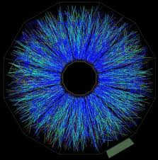
Outline
Introduction: elliptic flow (v₂)
Motivation: ρ⁰ resonance v₂
STAR Experiment
Data Analysis Methods
ρ⁰
π ⁻
(φ – Ψ₂) binning method
v₂ vs. Invariant mass method
π ⁺
Analysis Results
Summary and Outlook

Slide 3
Elliptic Flow and its Origin
Flow is a phenomenon seen in nucleus-nucleus collisions, which correlates
the momentum distributions of the produced particles with the
spatial eccentricity of the overlap region.
azimuthal dependence of the
pressure gradient.
y
p_{y}
x
p_{x}
y
z
x
Reaction plane: z-x plane
Elliptic flow is the second coefficient of the Fourier expansion of the azimuthal particle distribution:

Slide 4
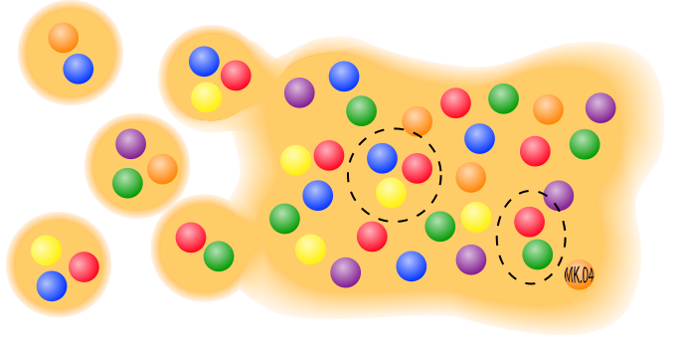
Motivation - I
Why Elliptic Flow (v₂) ?
Quark-Gluon Plasma (QGP) definition: A (locally) thermally equilibrated state
of matter in which quarks and gluons are de-confined from hadrons, so that color
degrees of freedom become manifest over nuclear, rather than merely nucleonic
volume. (Nucl. Phys. A 757 (2005) 102)
Elliptic flow provides early time information on the collectivity of particles from heavy
ion collisions.
Signal is self - quenching with time – EARLY TIME OBSERVABLE !
v₂ is a measure of the degree of thermalization of the matter produced early in
the collisions.
Hydrodynamics calculation of v₂ involves the equation of state (EoS) of QGP.
According to coalescence model, number of
constituent quark (NCQ) scaling of v₂ suggests
the creation of QGP with v₂^{q} characterizing the
properties of the QGP.

Slide 5
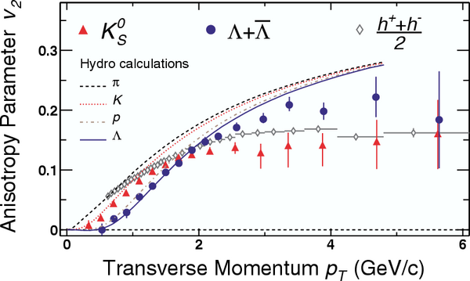
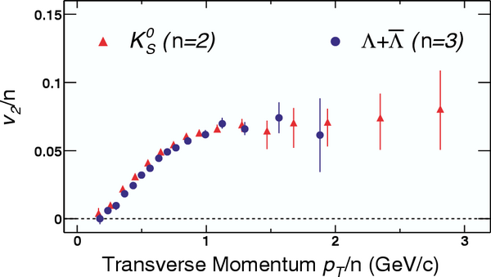
Motivation - II
Why ρ⁰ Elliptic Flow ?
Physics is different in different transverse momentum ( p_{T}) regions.
Low p_{T} (0 < p_{T} ≤ 1.5 GeV/c) ➔
Hydrodynamics applies
Intermediate p_{T}(1.5 < p_{T} ≤ 5 GeV/c)➔
Coalescence/recombination
model works
High p_{T} (p_{T} ≥ 5 GeV/c)
➔
Contribution from jets fragmentation
Number of Constituent Quark (NCQ),
(2 = mesons, 3 = baryons) scaling at
intermediate p_{T} Indication of
partonic degrees of freedom.
ρ⁰ production mechanism.
⇒ scale NCQ ⇒ v₂/n
π⁺π⁻ → ρ⁰ ⇒ n = 4
qq → ρ⁰ ⇒ n = 2
Phys. Rev. Lett. 92 (2004) 52302

Slide 6
Motivation - III
Why ρ⁰ Elliptic Flow ?
Leptonic decay products are measured directly as they do not interact, but hadronic decay products are sensitive to the medium.
Study of v₂ from ρ⁰ π⁺ π⁻ channel may provide information of the dynamical evolution during chemical - kinetic freeze-out.
π⁻
Regeneration is a key phenomenon
in resonance study.
v₂ can help to understand the
hadronic daughters regeneration
effects in the medium.
ρ⁰
π⁻
π⁺
ρ⁰
ρ⁰ regeneration ⇒ σ(ππ)
ρ⁰ measured
π⁻
ρ⁰ lost
ρ⁰
π⁺
π⁻
π⁺
ρ⁰
π⁺
π⁺
π⁻
ρ⁰ measured
Chemical freeze-out
Kinetic
freeze-out
time

Slide 7
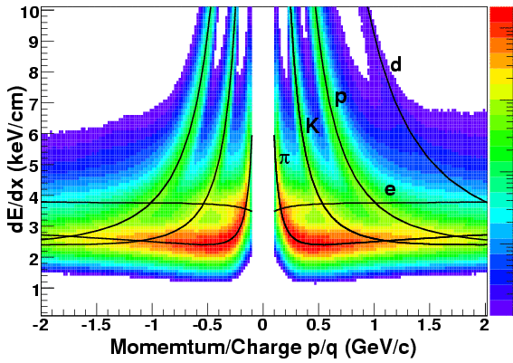
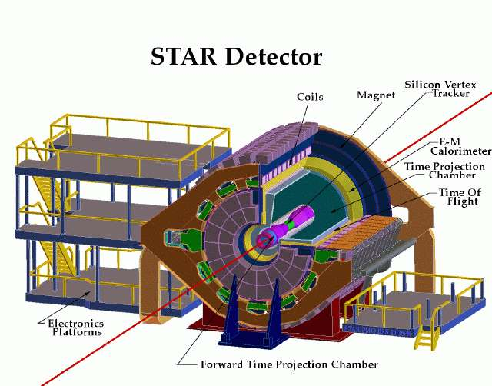
The STAR Experiment
We used the high statistics 200 GeV Au+Au data to measure the ρ⁰observables.
~ 25M events in peripheral (40-80% centrality) collisions.
STAR TPC is used to identify pion via
dE/dx in TPC gas.

Slide 8
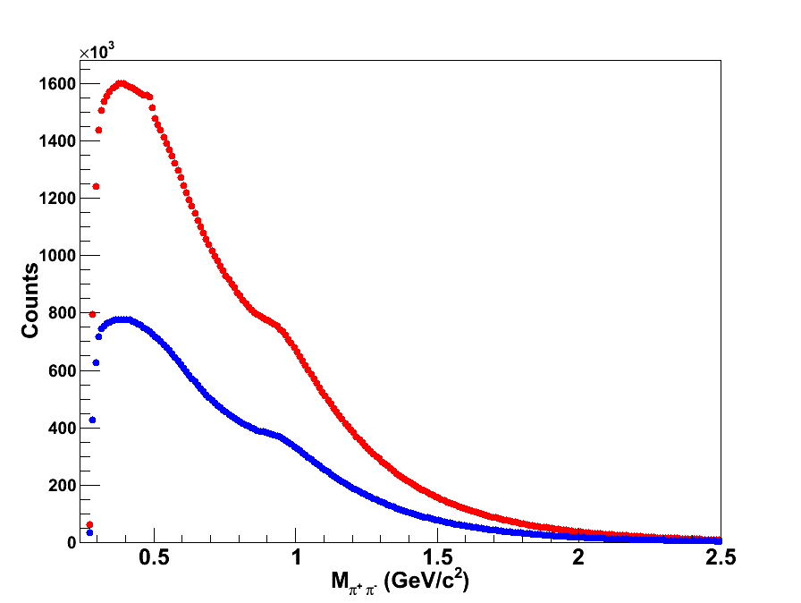
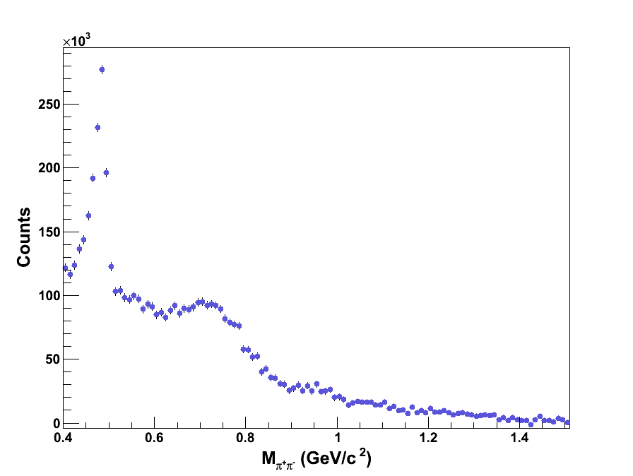
Measurement – ρ⁰ invariant mass reconstruction
real pair
total background
background subtracted
ρ⁰
Real pair:-
Same event like-sign method used to estimate background from
un-correlated π⁺π⁺ and π⁻ π⁻ pairs.
Total background =

Slide 9
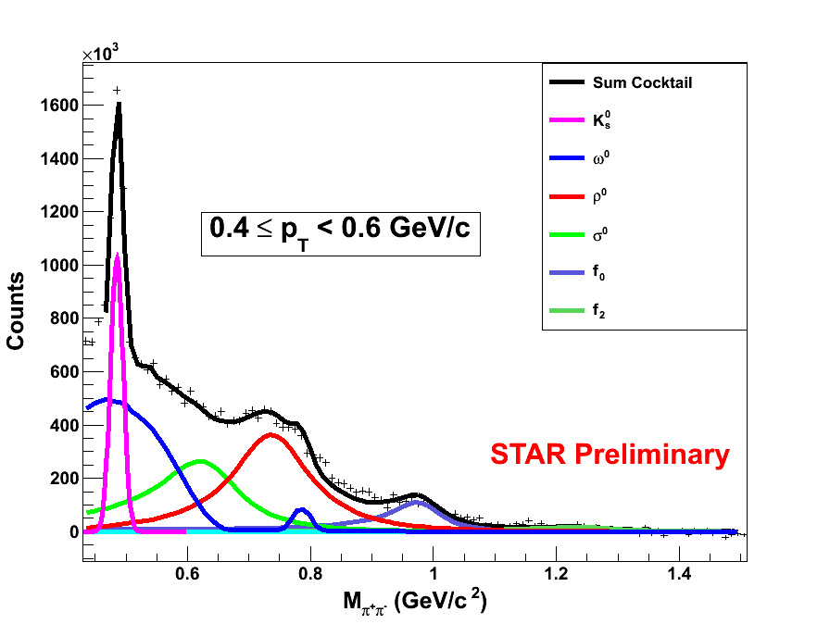
Measurement – Hadronic Cocktail
Final background subtracted M_{π+π-} invariant mass distribution fitted with a cocktail
function to extract the ρ⁰ yield.
Hadronic cocktail
K_{s}⁰ is fitted to a gaussian function.
ω⁰ and K* shapes obtained from
HIJING event generator.
ρ⁰, σ⁰, f₀ and f₂ are fitted with
relativistic Breit-Weigner times
the Boltzmann factor which takes the
phase space in account.
The masses of K_{s}⁰ and ρ⁰ are free parameter in the above fit.
The ω⁰, f₀ and f₂ masses are fixed according to PDG values .
The ρ⁰, f₀ and f₂ widths are fixed in the cocktail fit.
The mass and width of σ⁰ is fixed at 630 MeV/c² and 160 MeV/c² respectively.

Slide 10
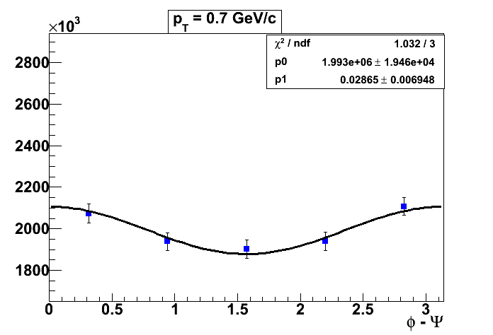
Analysis: (φ-Ψ₂) bin method
Elliptic flow
TPC event plane
The ρ⁰ counts as a function of (φ – ψ₂)
are plotted.
The ρ⁰ counts as a function of (φ – ψ₂)
are fitted to
A [1+2v₂^{obs} cos2(φ – ψ₂ )]
Final v₂ = v₂^{obs} / event plane resolution

Slide 11
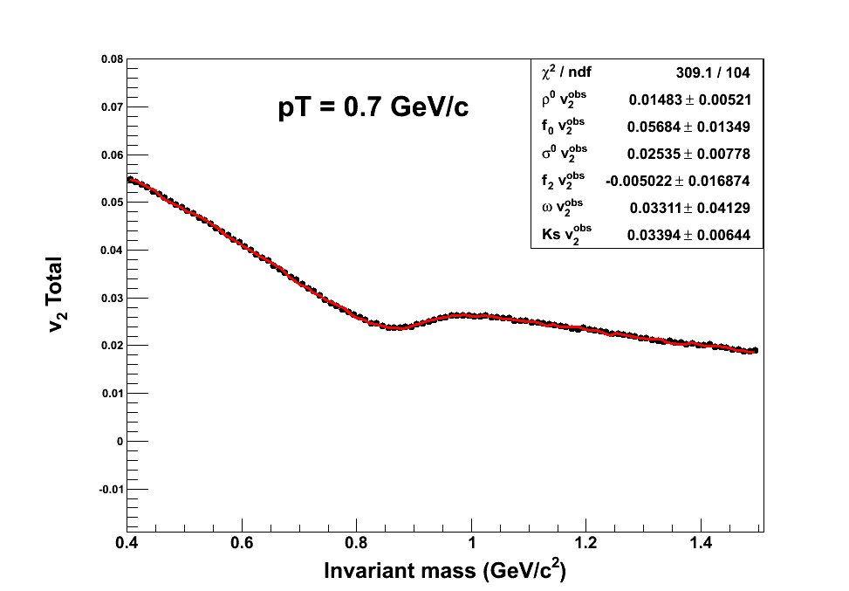
Analysis: v₂ vs M_{inv} method
Multi-parameter fitting function to get v₂ observed values.
is calculated from π⁺ π⁺ and π⁻ π⁻ distributions.
Where,
ρ⁰ final v₂ = v₂^{ρ0} / event plane resolution

Slide 12
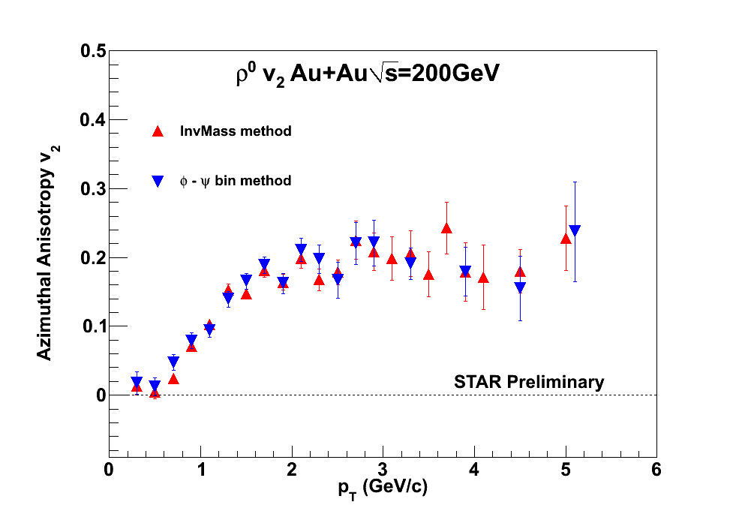
Analysis: Methods Comparison
The ρ⁰ v₂ results from the above two methods consistent with each other within
statistical error bars.
Systematic error calculation is in progress.

Slide 13
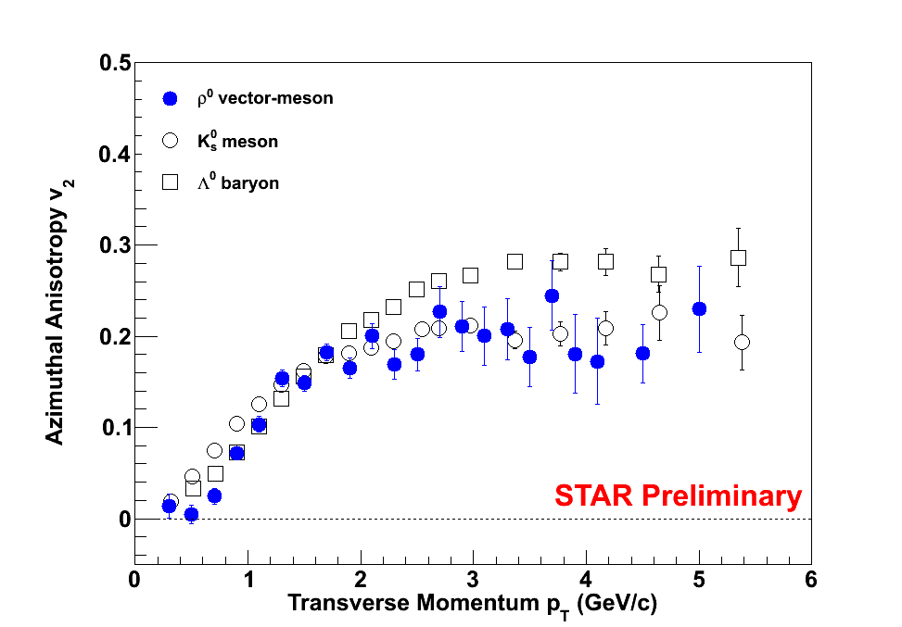
Analysis: Results
v₂ as a function of p_{T}
v₂ vs. M_{inv}
For p_{T} > 1.5 GeV/c, v₂ of ρ⁰ is more
consistent with v₂ of K_{s}⁰ than v₂ of Λ⁰ .
K_{s}⁰ and Λ⁰ v₂ results are obtained from Phys. Rev. C 77 (2008) 54901

Slide 14
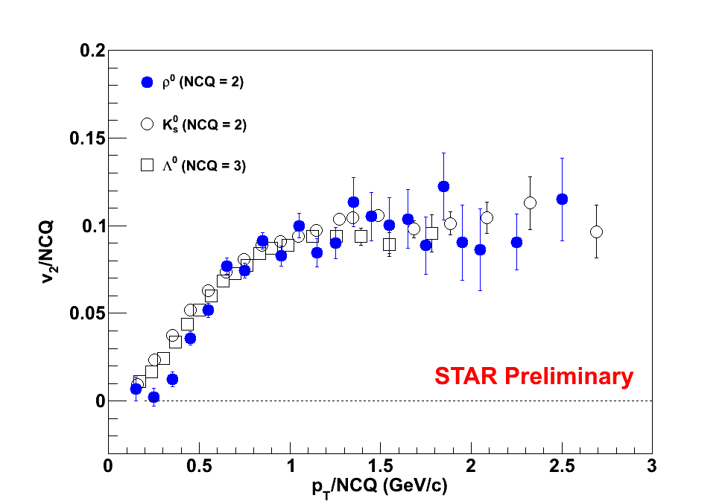
Analysis: Quark Scaling of v₂
NCQ = 2 for ρ⁰
Early Time Information:
The number of constituent quark
scaling of v₂ of ρ⁰ vector-meson in
the intermediate p_{T} follows n =2.
The ρ⁰ production mechanism is
dominated by the early stage quark –
anti-quark coalescence.
π⁺ π⁻ regeneration might be playing
an important role in the low p_{T} region.

Slide 15
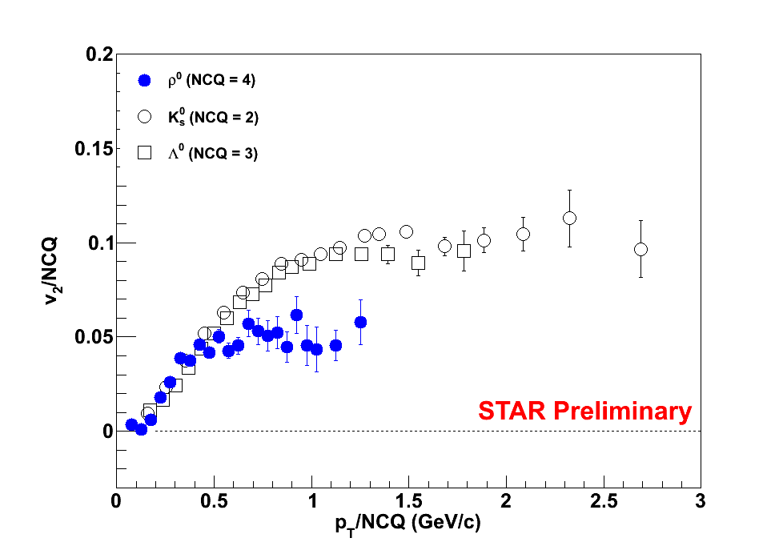
Analysis: n=4 scaling of ρ⁰ v₂
n= 4 scaling of ρ⁰ v₂ does not hold in the
intermediate p_{T}.
Intermediate p_{T} ρ⁰s are not generated from
the late stage π⁺π⁻ interaction rather the ρ⁰s
are produced from the early stage quark
coalescence.

Slide 16
Summary
ρ⁰ v₂ measured in Au+Au 200 GeV collisions in TPC (φ – Ψ₂) bin
method and invariant mass method.
The final results obtained in the above two methods were compared
and they are consistent within the statistical error bars.
In the intermediate transverse momentum ( 1.5 < p_{T} < 5 GeV/c),
the ρ⁰ v₂ scales with n=2 quarks.
In the low p_{T,} we observed the deviation of mass ordering of the ρ⁰ v₂ .
Study is going on to understand the mass ordering effect in the low
p_{T} region.

Slide 17
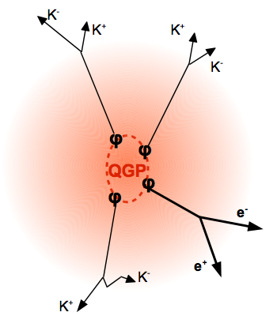
The Future …
Further interesting predictions can be investigated using ρ⁰
vector-meson observables
π ⁺
π ⁻
π ⁺
π⁻
ρ⁰ di-lepton decay channel is a very clean
probe from the early stage (e⁺⁻ do not interact
strongly)
ρ⁰
ρ⁰
e⁺ e⁻
ρ⁰
QGP
ρ⁰
Good channel to search for modifications of
hadrons properties due to the hot medium.
Will be a challenge: (B.R ~ 10⁻⁵)
ρ⁰
ρ⁰
e⁺ e⁻
π⁻
STAR Full barrel Time of Flight (TOF) detector
(installed 2008) will be a huge asset in making
this measurement.
π⁺

Slide 18
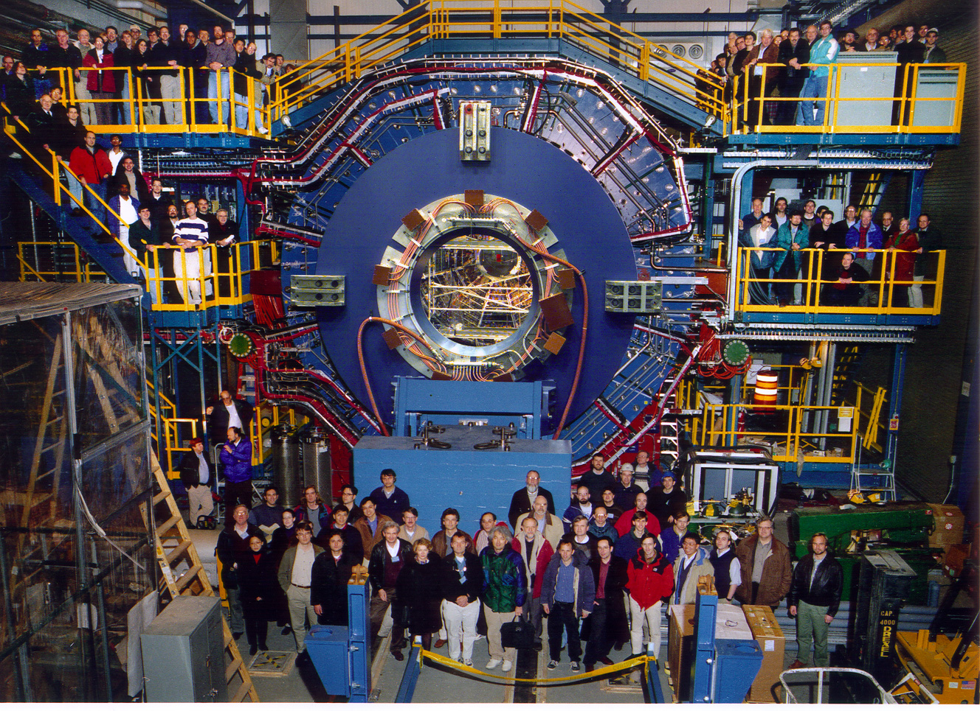
Thank you
STAR Collaborators

Slide 19
Back up slides

Slide 20
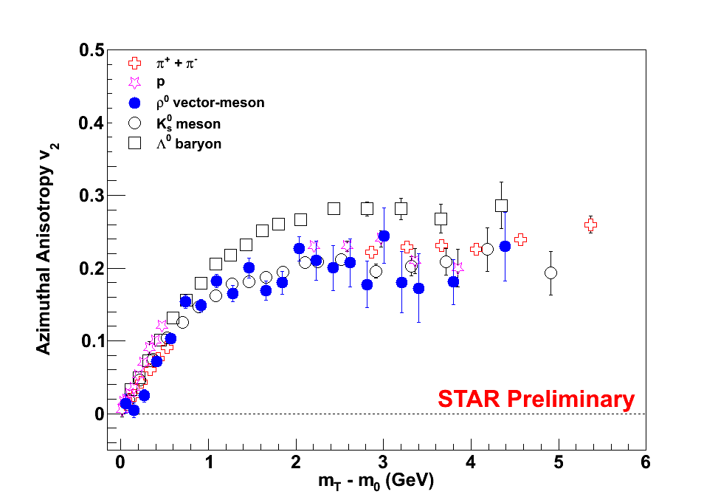
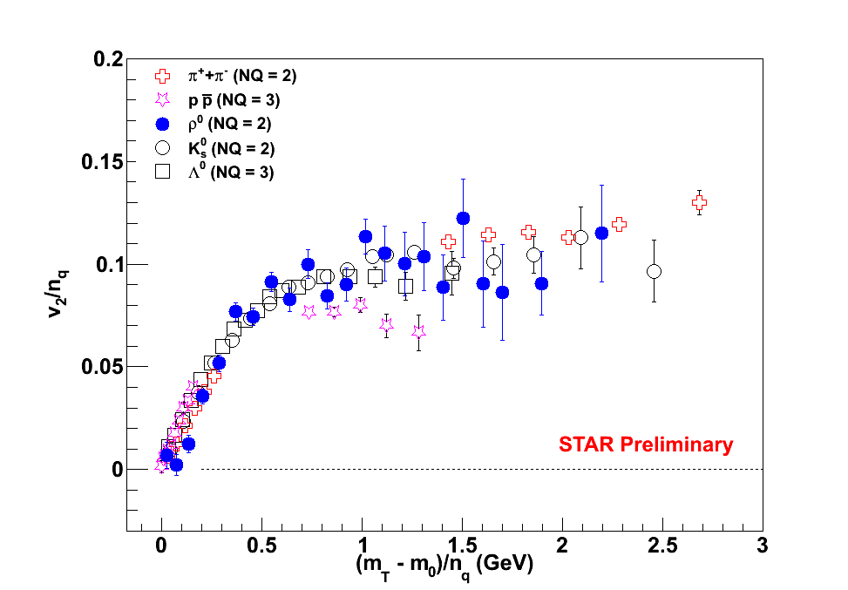
Analysis: v₂ vs. Transverse Kinetic Energy (m_{T} – m₀)
v₂ of ρ⁰ below m_{T} – m₀ = 0.9 GeV/c²
is deviating from the universal curve.
Systematic error is in study …
At m_{T} – m₀ > 0.9 GeV/c²
v₂/n_{q} vs. (m_{T} – m₀)/n_{q}
holds good for ρ⁰ with n_{q} = 2.

Slide 21
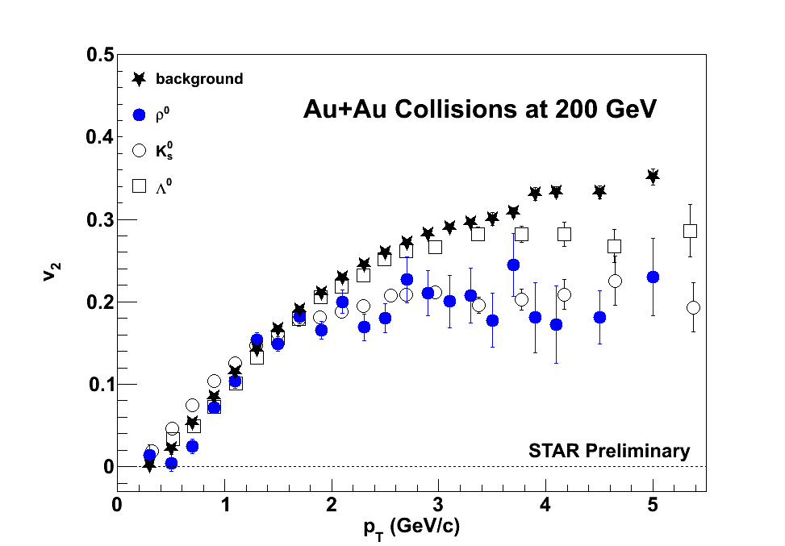
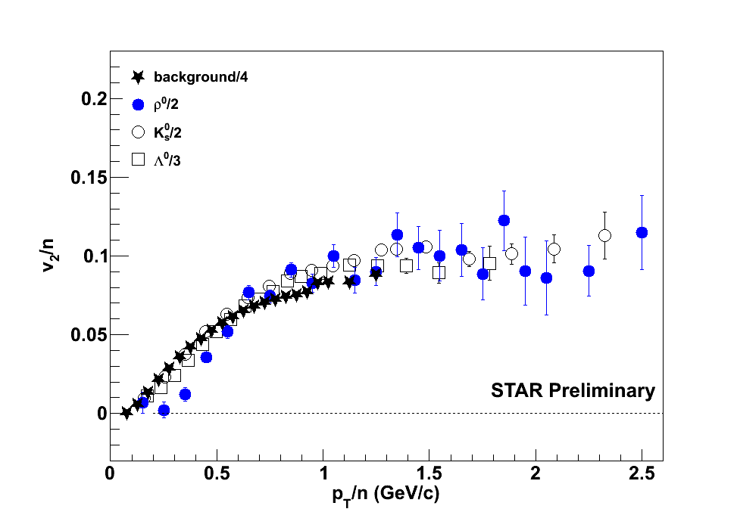
Analysis: v₂ of the uncorrelated pion pairs
It was observed that the real pair v₂ (which is basically background
dominated), follows the n=4 scaling and which is expected.

Slide 22
Phase Space
- √ M² + p_{T}²
M
π⁺
ρ⁰
π⁺
e
T
Phase Space =
√ M² + p_{T}²
π⁻
π⁻
M = Invariant Mass; p_{T} = transverse momentum; T = Temperature
Chemical and kinetic freeze-out ⇒ resonances formed until particles too far apart ⇒ resonances emitted T = 120 MeV
E.V. Shuryak and G.E. Brown, Nucl. Phys. A 717 (2003) 322
3
Γ(M)
M² – 4m_{π}²
2
M_{ρ}
BW(M) =
Γ(M) = Γ_{ρ}
(M² – M_{ρ}²)² + M_{ρ}² Γ(M)²
M_{ρ}² – 4m_{π}²
M
P. Braun-Munzinger et.al., CERES Int. Note, March 2000, unpublished; E.V. Shuryak and G.E. Brown, Nucl. Phys. A 717 (2003) 322; P.K. Kolb and M. Prakash, nucl-th/0301007; H.W. Barz et al., Phys. Lett. B 265, 219 (1991); R. Rapp, hep-ph/0305011.

Slide 23
Methods of Approach for ρ⁰ v₂ measurement
Reaction plane is estimated taking all primary tracks with |η| < 1.0, same particles are used for v₂ calculation
With autocorrelation
y
z
x
Reaction plane is recalculated removing the tracks those are used as pion tracks in calculating the ρ⁰ v₂.
Remove autocorrelation

Slide 24
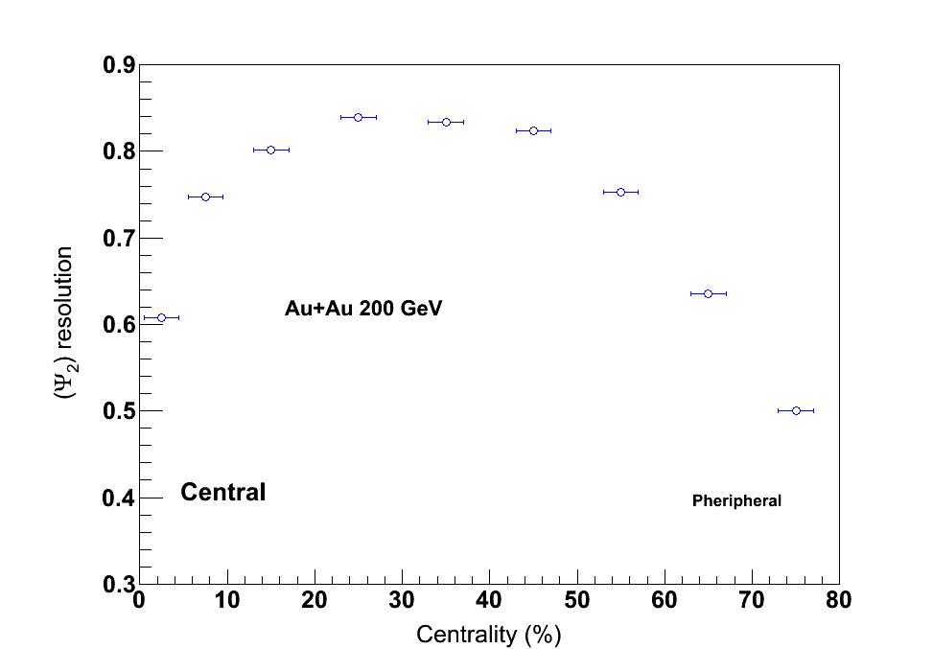
Reaction plane resolution determination
Due to finite number of particles detected there is a limited resolution
in the event plane angle.
A. M. Poskanzer and S. A. Voloshin 1998

