Slide 1
Recent Results from STAR
Rashmi Raniwala for
STAR Collaboration
High Energy Physics Symposium
Dec. 13-18, 2010, Jaipur

Slide 2
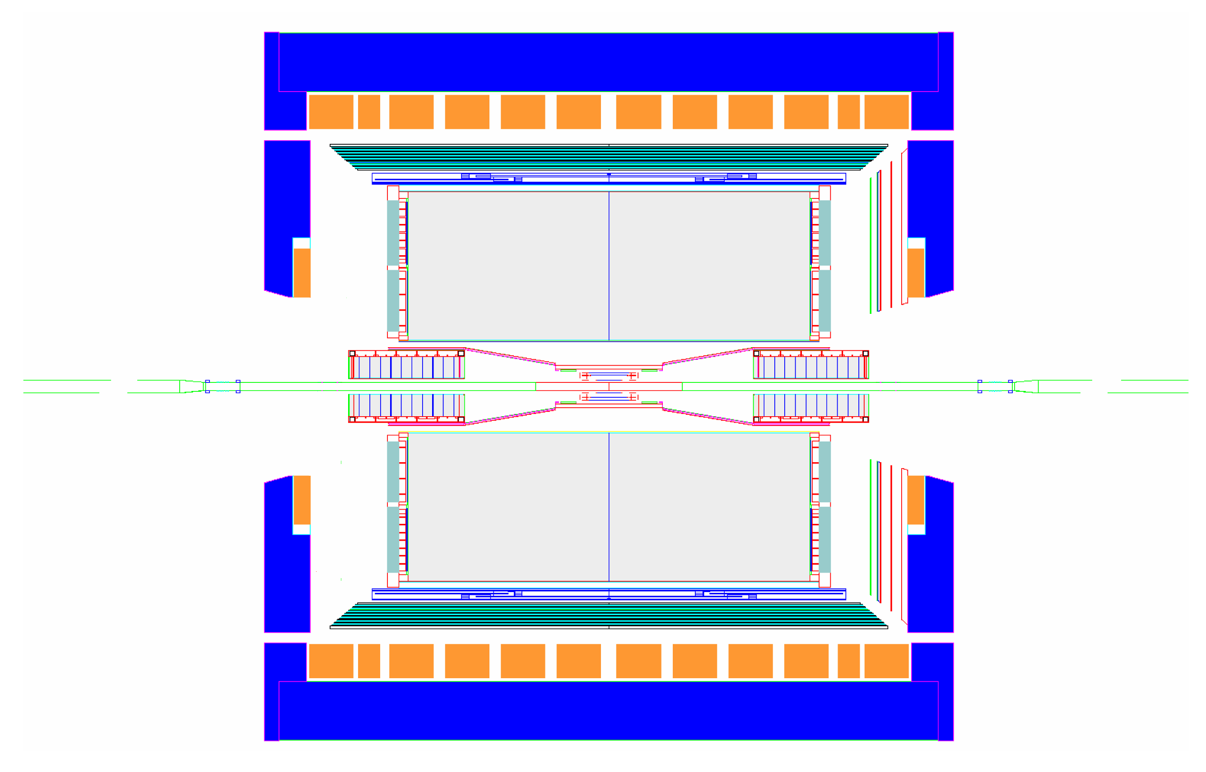
THE STAR DETECTOR
MRPC ToF Barrel
MTD
EMC Barrel
EMC End Cap
FMS
BBC
FPD
TPC
PMD
ZDC
FTPC
trigger
computing
DAQ1000
COMPLETE
HLT
Ongoing
R&D
Notes:
The Solenoidal Tracker is a suite of detectors at Relativistic Heavy Ion Collider.
Most of its detectors can be seen in this schematic diagram.
The main workhorse is the Time Projection Chamber sitting at the heart of STAR
which measures Particle Identity and momentum at mid-rapidity.
A Full Time of Flight Barrel has been added in Run and this has enhanced
STAR’s capabilities for particle identification.
These are surrounded by Barrel and End-Cap Electro-magnetic calorimeters
The Photon Multiplicity Detector can be seen at forward rapidity.
The Forward Time Projection Chambers measure charge particles at forward rapidity overlapping with PMD rapidity range.
Zero Degree Calorimeters aid in measurement of centrality and also determine the event plane for directed flow analysis.
Besides these are a number of trigger detectors Detectors as well as detectors for determining the vertex position.

Slide 3
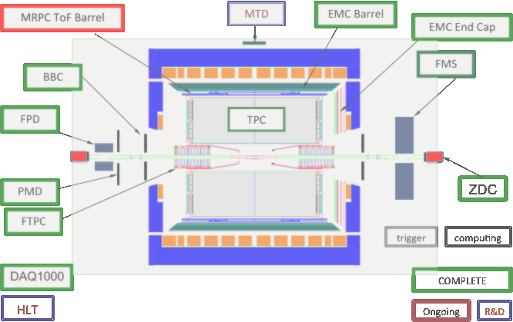
OUTLINE
  First evidence of Anti-Matter-Hyper-Nucleus at STAR
Measurement of photons at forward rapidity using PMD
Flow at STAR
  Elliptic flow and Degree of Thermalization at RHIC energies
  Results on Flow of Multi-Strange particles
  What we learn from elliptic flow of ρ⁰ vector meson
  Charge correlations wrt to reaction plane: Do we see local Parity violation in Strong interactions?
  Locating QCD Critical Point: Data from AuAu √s_{NN} = 9.2 GeV
  Higher Moments of Net protons distribution : Do we see critical behaviour?
Notes:
For this presentation, I have selected a few recent results from studies of heavy-ion collisions
I will begin my talk with the first evidence of Anti-Hyper-Triton at STAR
Then I will present results on measurement of photons at forward rapidity using the Photon Multiplicity Detector
Flow is one of the most sensitive tools in heavy ion collisions.
Elliptic flow results that shed light on the degree of thermalization achieved at RHIC will be presented.
Observation of Number of Constituent Quark Scaling in elliptic flow of Strange particles features next.
Production mechanism of Rho mesons is explored using NCQ scaling.
Flow allows us to determine the reaction plane of each event. We have exploited this information to study
charge correlations wrt reaction plane which has been proposed as a signature of Local Parity Violation in Strong interactions.
Location of QCD Critical point is of major interest.
RHIC took data at lower energies for this purpose during Run as a test case at . GeV
and for a range of energies during Run .
Some results from collisions at . GeV, demonstrating the working capabilities of STAR will be presented.
Results of Higher Moments of Net proton distributions as a tool to look for signals of critical behaviour will be presented.

Slide 4
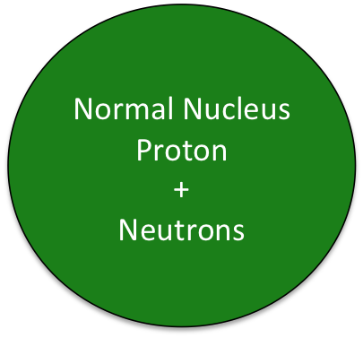
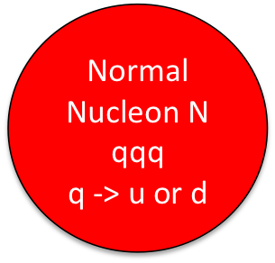
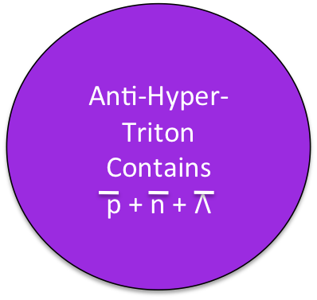
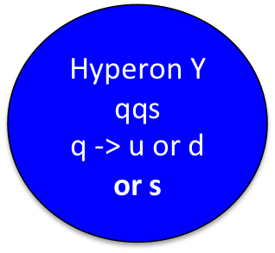
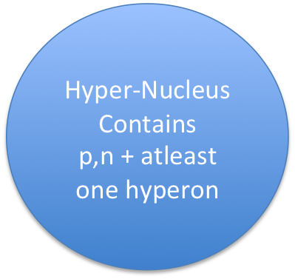
Exotic phenomenon at STAR:
First observation of
ANTI-MATTER HYPER-NUCLEUS
Ref: Science 328 (2010) 58
Notes:
Allow me to begin with the STAR of STAR results : the first ever observation of anti-hyper-nuclei
First a few definitions:
Normal nuclear matter consists of nucleons made of three up or down quarks
A Baryon that contains at least one strange quark is called a hyperon.
Anti-hyperon would then be made of a combination of anti u anti d with at least
one anti strange quark.
A Nucleus containing at least one hyperon is called hypernuclei.
Anti-Hyper Nucleus would contain at least one anti hyperon besides anti nucleons
Like hyperons Hypernuclei are also unstable and have been observed in cosmic
rays as well as in heavy ion collisions.
Anti-hyper-nuclei HAD not been observed, till STAR reported the first observation of
anti-hyper-triton this year.

Slide 5
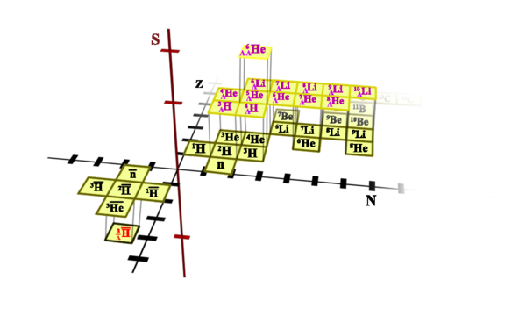
Anti-Matter Hyper-Nucleus at STAR
Hyper-Nuclei discovered in 1952 using Nuclear Emulsion Cosmic Ray Detectors
p,n,Λ
Hyper –Nuclear Matter
p,n
Normal Anti- Nuclear Matter
Normal Nuclear Matter
p,n
Anti-Hyper-Triton composed of antiproton, anti-neutron and anti-lambda-hyperon
Lifetime of
Related to strength of Y-N interaction
-> Interesting in Nuclear Physics, Nuclear Astrophysics……….
p,n
Λ
Notes:
One can mark a normal nucleus on a two dimensional N-Z plane
To mark a Hyper-Nucleus, one needs a third dimension of strangeness on this chart.
Anti-Matter can be plotted on the same by extending the chart to negative axis.
STAR’s observation of Anti-Hyper-Triton has now extended this chart to anti-Strangeness.
Anti-Nuclei heavier than anti-proton have only been observed as products of interactions at particle accelerators.
Measurement of the lifetime, mass of hyper-nuclei allows us to measure the strength of hyperon-nucleus (YN) interaction,
which is of fundamental interest in nuclear physics and nuclear astrophysics.

Slide 6
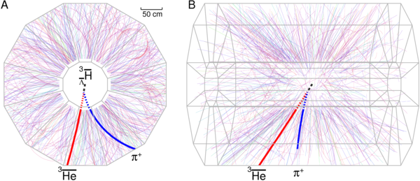
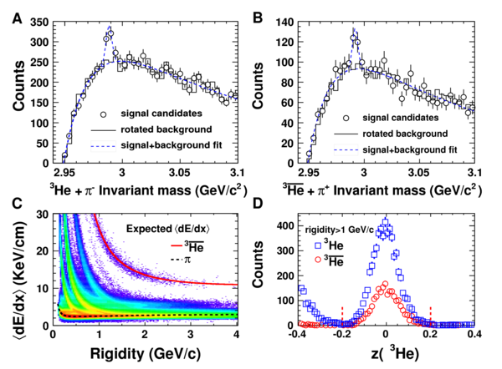
Detecting Anti-Hyper-Triton
Decay Mode used
peak visible in
Invariant Mass Distribution
Background obtained by rotating (Anti)He track & Subtracted to get:
-> 157 ± 30 -> 70 ± 17
Mass of
2.991 ± 0.001 ± 0.002 GeV/c
Lifetime : +
τ = 182 ± 27 pico sec.
-
+18
-27
Notes:
STAR measured the AntiHyperTriton through its decay to anti Helium and a piplus.
The decay products are detected in Time Projection Chamber of STAR through the relation between their Energy Loss by ionization aND CURVATURE of the track in the magnetic field.
One can see in this picture a candidate Anti-Hyper-Triton decaying to
a pion given by blue track and the antiHelium track is given in red.
The anti-Helium are practically detected without any background above pt = GeV.
To obtain the candidates of AntiHyperTriton we construct the invariant mass distribution of AntiHelium and piplus as given in the figure.
The antihypertriton signal is sitting on top of a combinatorial background.
Background is estimated and subtracted to obtain the signal .
The number of candidates of Hyper-Triton were +/- and that of anti-hyper-triton were +/- .
If we assume symmetry between matter and anti-matter the number expected was +/-.
By reconstructing the decay products and extrapolating them backwards to obtain the secondary decay vertex
we can obtain the decay length.
A fit to the decay length distribution of combined data of hypertriton and antihypertriton gives the lifetime
as (+-)+- pico-second. This is consistent with the existing data for hyper triton.

Slide 7
(Anti) Hyper-Nuclei Yield Ratios
Coalescence model : To form a hyper-Nucleus the nucleons & hyperons have to be in close proximity
So Hyper-Nuclei Yield -> Sensitive to phase-space distbn. of p n Λ
P. Braun-Munzinger, J. Stachel, Nature 448(2007)302 , M. Danysz, J. Pniewski, Phil. Mag. 44(1953) 348
e.g.
Particle Type | Measured Ratio
 | 0.49 ± 0.18 ± 0.07
 | 0.45 ± 0.02 ± 0.04
 | 0.89 ± 0.28 ± 0.13
 | 0.82 ± 0.16 ± 0.12
Ratios of Hyperons and Nucleons available from particle spectra.
Measured Ratios of Hyper-Nuclei : consistent with Coalescence Model
Strangeness phase space population is similar to that of light quarks
Notes:
To obtain total yield a theoretical fit to pT spectra in the measured range (pT within to GeV)
Is extended to low pt, to give the total particle yield.
This allows us to calculate the yield ratios for various particle species which can be tested against models.
One of the models for formation of hypernuclei is the coalescence model. According to it,
to form the nucleus, the nucleons, should be in close proximity In coordinate and momentum space.
So the yield of hypernucleus is sensitive to the correlations in phase space distribution of hyperons and nucleons
e.g. the production ratio of anti-hyper-tritons to hyper-tritons Is expected to be given by
number of anti-Lambda by Lambda into number of anti-proton by proton into number of anti-neutron by neutron.
The measured value of particle ratios is consistent with the Anti-hyper-Triton being formed by coalescence.

Slide 8
Particle Production at Forward Rapidity
Collective knowledge by RHIC experiments have shown that
Process of particle production different in different phase space regions.
Ref: PHOBOS Coll: PRL 87(2001)102303; PRL 91(2003) 052303)
Different particle species might show different behaviour of production in the same phase space.
Ref: STAR Coll. J. Adams et al., Phys. Rev. Lett. 95 (2005)062301 ;
HIJING: Total produced particle has contributions from:
Soft processes (N_{part} scaling) + Hard processes (N_{collisions} scaling)
Varying event centrality -> Relative contribution of soft and hard processes. Ref: PHENIX Coll. PRL 86 (2001) 3500
PMD at STAR studies photons production (different species) at forward rapidity -3.7 < η < -2.3 (different phase space) : Compares with charge particle production at RHIC ! Phys. Rev. C 73 (2006) 34906; Phys. Rev. Lett. 95 (2005) 62301
Notes:
The knowledge collect by different experiments at RHIC have shown the following:
Particle production process is different in different phase space regions.
So it is important to study particle production not only at mid-rapidity but also at forward rapidity
Different particles species have different behaviour: charge particles have contributions from both
meson and baryon production while photons are dominated by meson production
Study with HIJING tells us that particle production has contributions from both hard and soft processes.
The soft processes scale with the number of participants and hard processes with number of binary collisions.
Both npart and ncolliision change with event centrality.
Study of particle production with centrality can tell us on the relative contribution from both the processes

Slide 9
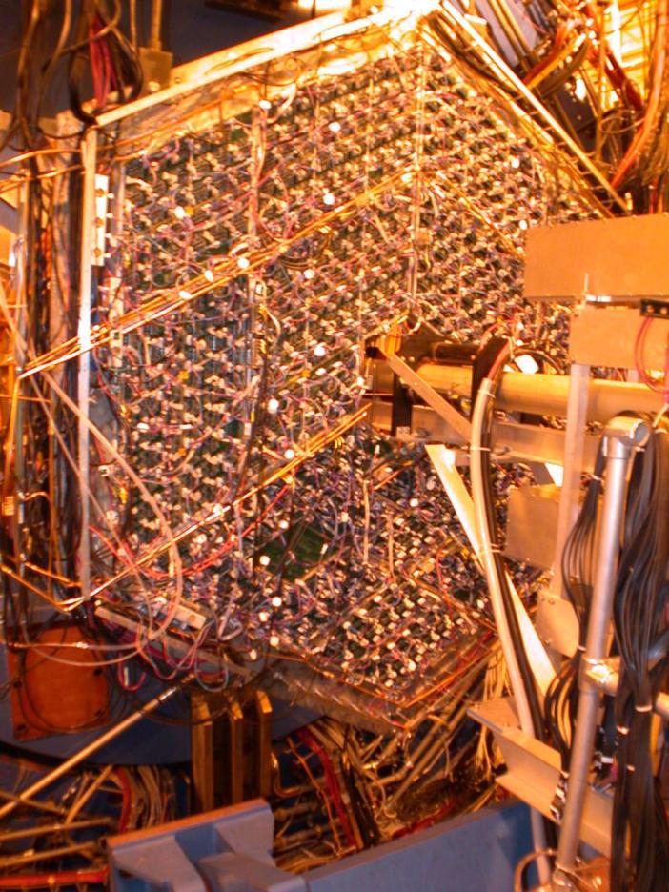
The Photon Multiplicity Detector at STAR
Nucl. Instrum. Meth. A 499 (2003) 751
Photon Multiplicity Detector measures N_{γ} and dN_{γ}/dη at forward rapidity (-3.7 < η < -2.3)
Designed, Fabricated, Installed & Maintained by 3 Indian Univ. & 3 Institutes.
Photon Production studied as a function of:
Event centrality
System size : AuAu and CuCu collisions
Center of mass Energy (√s_{NN}): 200 GeV & 62.4 GeV
Notes:
At STAR we have a photon multiplicity detector which can measure photon multiplicity and pseudo-rapidity density in forward rapidity region.
This detector is designed, fabricated and constructed by an Indian collaboration spanning over institutes and universities.
It consists of an array of tiny proportional counters after a 3 radiation thick later of Pb and Steel.
Photons convert in the Pb plate and their preshower is detected in the sensitive volume.
Here we present results on photon production as a function of event centrality, system size and center of mass energies and
compare them with results of charged particles in the same rapidity window.

Slide 10
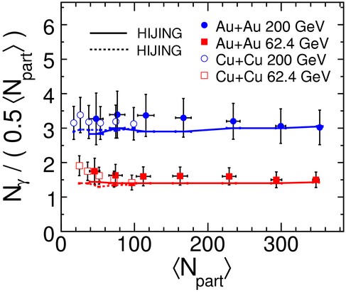
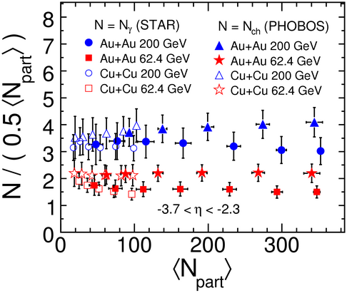
Photon Production: Scaling with N_{part}
Nucl.Phys.A 832: 134-147, 2010
N_{γ} measured in -3.7 ≤ η ≤ -2.3 have been scaled with N_{part}/2
Increasing coll. energy increases N_{γ}
CuCu and AuAu collisions at same N_{part} have same N_{γ}
N_{γ}/0.5*N_{part} constant with N_{part}: Photon production at forward rapidity is due to Soft processes
HIJING results match well with data
N_{ch} also scales with N_{part}
N_{ch}/N_{γ}= 1.4 ± 0.1 for √s_{NN} = 62.4GeV
= 1.2 ± 0.1 for √s_{NN} = 200 GeV
Ref: PHOBOS data : PRL 87 (2001) 102303 ; PRL 91(2001) 052303
Notes:
We now see how photon production scales with event centrality.
The particle multiplicity is measured in eta range -. to -. and is scaled with the number of participant pairs for each centrality.
The number of photons is higher at higher energy as expected.
For same number of participants CuCu collisions and AuAu collisions have same photon multiplicity
If particle multiplicity scales with Number of participants, it would be constant across all centralities.
Within our experimental errors photon multiplicity at both .$ and GeV
shows scaling with number of participants
This indicates that the photon production at forward rapidities is due to soft processes.
Hijing results are also plotted for both collision energies and compare well with the data within errors.
<click> to change the picture.
Now we see the same results for photons along with charged particles measured in the same rapidity range for AuAu and CuCu at GeV and . GeV
Charge particle multiplicity was also seen to scale with Npart showing production due to soft processes.
The number of charge particles is slightly more…could be due to contribution of protons besides charge pions.
Increasing energy increases number of charge particles as well as number of photons.
Nch by ngamma is . for . GeV and . for GeV collisions.
The slightly higher ratio for . might be due to larger contributions from protons since we are closer to beam rapidity.

Slide 11
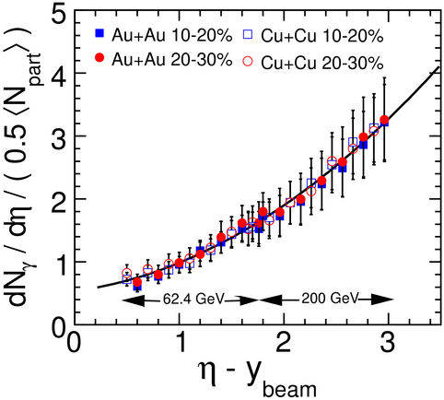
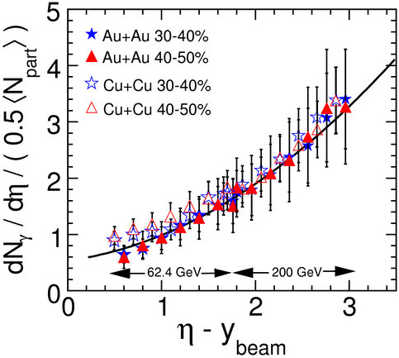
Longitudinal Scaling of Photon Production
dN_{ch}/dη/0.5*N_{part} v/s (η -y_{beam}) : independent of beam energy: Limiting Fragmentation Phys. Rev. 188 ( 1969) 2159
Longitudinal scaling observed for Photons at forward rapidity independent of Beam Energy, Event Centrality
STAR Coll. PRL 95(2005) 062301
Now also seen to be true for different Colliding Systems
Longitudinal scaling in Charge Particles centrality dependent at η – y_{beam} = 0.25 to 1.25
STAR Coll. Phys. Rev. C 73 (2006) 034906.
Notes:
It was observed that Number of charge particle produced per participant pair plotted in the beam frame of reference through eta – ybeam, was independent of the beam energy.
This is known as the limiting fragmentation behaviour.
Photon rapidity density per participant pair also exhibits limit fragmentation behaviour as seen earlier for AuAu collisions at different energy.
Photons exhibited limiting fragmentation behaviour for different event centrality which is not observed for charged particles.
Now we can see that this longitudinal scaling is also true for different colliding systems
.

Slide 12
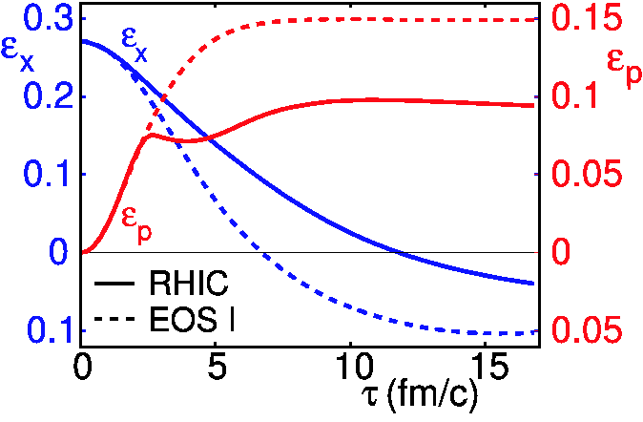
WHY IS ANISOTROPIC FLOW IMPORTANT?
P.F. Kolb & U. Heinz, NP A
715 (2003) 653c
Anisotropic Geometry + strongly interacting medium -> Momentum anisotropy -> More particles emitted in Reaction Plane : FLOW
Reaction zone expansion -> decreases spatial eccentricity : Self Quenching
Flow develops before ε_{X} vanishes -> Sensitive to early stages of evolution.
S,Voloshin & A.Poskanzer Phys. Rev. C 58: 1671-1678, 1998
Notes:
This is a schematic diagram of a heavy ion collision. The beam direction is given by the z axis.
The impact parameter vector lies along the x axis. The XZ plane is called the reaction plane of the collision.
For a non-zero impact parameter, the overlap region is ellipsoidal in shape with its long axis along the Y axis.
So in the XY plane, the azimuthal plane, the system is not symmetrical.
During the expansion stage of the dense matter, the high pressure of the QGP leads to
collective outward motion of formed matter.
If the medium is strongly interacting, the pressure gradients along the reaction plane and out of the plane
are different. The anisotropic pressure gradients transfer the initial coordinate space anisotropy into momentum
space anisotropy
Which causes more number of particles to come out in the direction of higher pressure gradients, the reaction plane:
This is what would show up as anisotropic emission of particles in the azimuthal plane: the flow.
With more particles being driven out in the reaction plane, the initial space anisotropy decreases causing the pressure gradients to equalize and so the momentum anisotropy saturates flow also saturates. This is called the Self Quenching behaviour.
So the flow develops in the initial stages of the collision while the spatial anisotropy is finite in the initial expansion stage
of the produced matter.

Slide 13
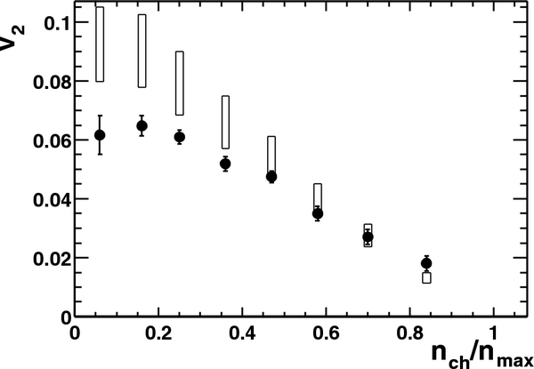
FLOW AT RHIC : Hydrodynamics works!
Initial results of v₂ by STAR : Large values, close to the ideal hydrodynamic model with complete thermalization
v₂ depends on
Equation of state of the system
Initial Spatial Eccentricity ε
v₂/ε : filters out trivial effect of geometry
Calculate ε using models : Glauber And Color Glass Condensate
AuAu Collisions √s_{NN} = 130GeV
STAR Coll. PRL.86:402-407,2001
Notes:
The initial STAR results on v of charged particles were exciting because the values of v
were close the values expected from hydro model which assumes complete thermalization.
With large flow seen in peripheral collisions, the effect of eccentricity is dominant in this picture.
Anisotropic flow depends in the initial space anisotropy and how well the initial eccentricity
Is converted to the final anisotropy depends on the equation of state.
If we want to see the effect of the Equation of state we have to filter out the effects due to initial spatial eccentricity.
This achieved by scaling the anisotropy with the initial eccentricity.
To calculate eccentricity we have to depend on the models and since we are unsure about what is the initial conditions,
we use two models: Glauber and Color Glass Condensates model.
Let us now look at the v/e distributions for charged particles in AuAu collisions as a function of transverse momentum.

Slide 14
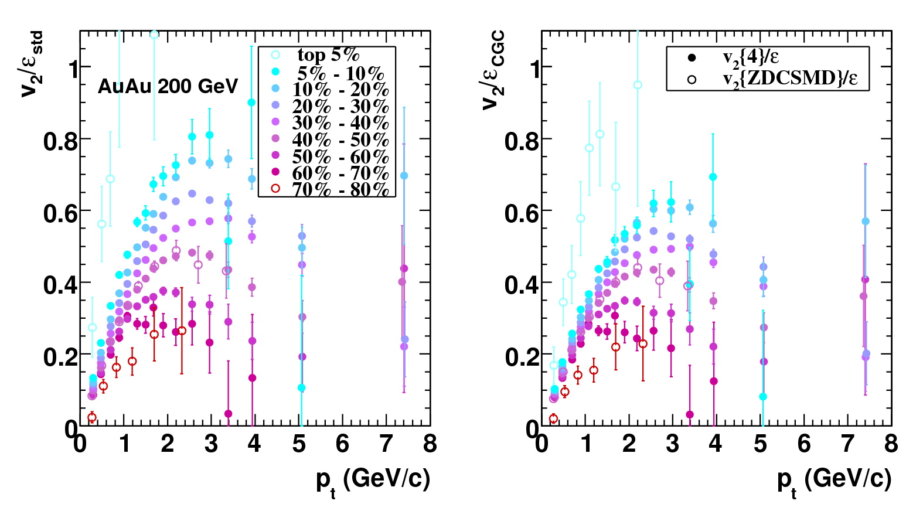
A Closer look at p_{T} dependence of v₂/ε
STAR Preliminary
STAR Preliminary
GLAUBER
CGC
v₂/ε increases with centrality for both Glauber & CGC initial conditions
  Better conversion of initial ε to final v₂
CGC eccentricity is larger and hence gives smaller v₂/ε values
Both models indicate higher thermalization in more central collisions
Notes:
The plots on this slide show v scaled by the initial eccentricity for AuAu GeV collisions in fine centrality bins.
Eccentricity has been determined for each centrality and v values corresponding to that centrality have been scaled with this eccentricity.
The plots on the left use Glauber eccentricity while the plots on the right use CGC eccentricity.
Since CGC predicts higher eccentricity, the v/e values are smaller as compared to Glauber.
Let us look at the plot on the left.
For a given centrality v/ecc increases with pT and then reaches a peak value before dropping off.
The slope at low pT and v/e at peak position increase with increasing centrality.
The position of the peak also shifts to higher pT with increasing centrality.
All these are signatures of higher thermalization in more central events.

Slide 15
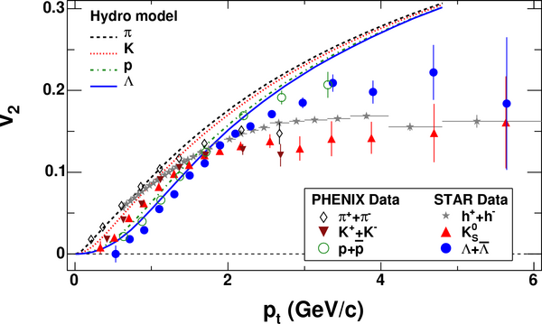
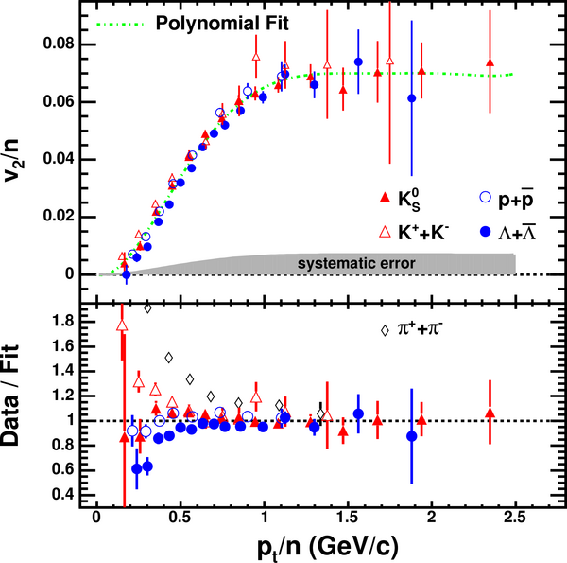
Number of Constituent Quark Scaling
STAR Coll. Phys. Rev. C 72 (2005) 1490
p_{T} / n (Gev/c)
v₂ shows a rise with p_{T} at low p_{T} : matches with Hydrodynamic model
At intermediate p_{T} : v₂ saturates
Saturation value different for Mesons and Baryons->Depends on Number of Quarks?
v₂ Scaled by Number of Constituent Quarks: Mesons and Baryon scale at intermediate p_{T} : NCQ Scaling
Suggests partonic degrees of freedom during early stages of event evolution
Notes:
What are the features of v2 with pT which we have to watch out for?
Here is a look at old STAR results for lighter hadrons for AuAu collisions at GeV.
(i) V2 increases with pT at low pT : This observation is consistent with the expectations from hydro model calculations
(ii) At intermediate pT, v2 saturates, the saturation value is different for mesons and baryons suggesting scaling by number of constituent quarks
V scaled by nq plotted against pT also scaled by nq showed that baryons and mesons scaled: NCQ Scaling
This demonstrated that during the early states of flow when v originates, the degree of freedom are partonic.
When these partons coalesce to form mesons and hadrons, they naturally get,
twice and thrice the parton v as well as the momentum respectively.

Slide 16
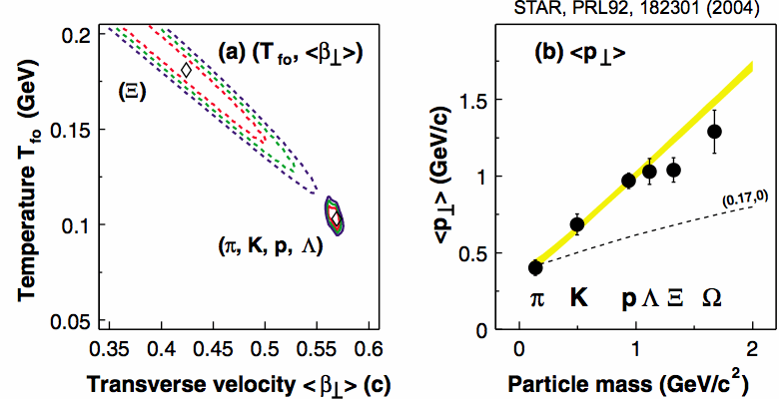
Why v₂ of Multi-strange hadrons?
Why do we want to study flow of multi-strange hadrons?
Smaller <β_{T}> Larger T_{freeze-out} obtained from spectra.
<p_{T}> deviates from expected relation
Freeze out earlier than lighter hadrons
Does Multi-strange hadron v₂ show same features as lighter hadrons?
Notes:
STAR has recently measured flow of multi-strange hadrons.
The study of spectra of these particles shows that the temperature of the system was higher when they decoupled
From the system and the radial flow velocity is smaller.
Mean pT also shows deviations from the relation observed for lighter particles.
The multi-strange particles freeze-out early from the hot formed matter. The question is: do they show the same features
As lighter hadrons?
First what feature are we talking about.
========================
Φ(s sbar)( MeV)
Ω(sss)()
Ξ(ssu,ssd)()
Find out the temperate ans beta T for other phi and omega also. Also get <pT> for phi
Spectra of multi-strange hadrons give us information about the transverse source velocity and
as well as temperature at the time of freeze-out or decoupling of multi-strange particles.
The mean pT of the particles is also observed to be smaller than
This implies that these particles decouple from the strongly interacting
matter earlier than the non-strange and singly strange mesons and baryons.
Why do the multi-strange hadron decouple earlier. What is the cause of the smaller cross-section????
Look up the notes made for hard probe talk TIFR raniwala.ppt
V is seen to increase from central to peripheral and the magnitude is as large as other light hadrons.
NCQ scaling works upto pT/nq or (m-mT)/nq ~ -. GeV/c.
This further underlines the fact that coalescence picture of multi-strange hadrons is valid.

Slide 17
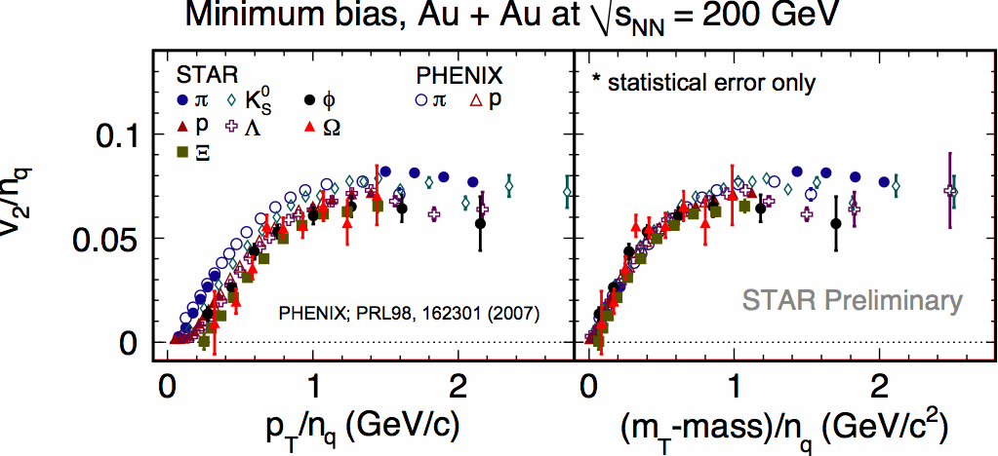
Elliptic Flow of Multi-strange hadrons: Φ, Ξ, Ω
NPA 830 (2009) 187
Min. Bias AuAu √s_{NN} = AGeV
v₂ is of the same order as for lighter hadrons
NCQ scaling works well upto p_{T}/n_{q} ~ 1.5 GeV/c
validates coalescence model -> Partonic degrees of freedom
Notes:
The data for multi-strange hadrons indicates that v for multi-strange hadrons is of the same order as the lighter hadrons.
The Number of Constituent quark scaling works well up to pT/nq or mT-m/nq upto . GeV/c validating
coalescence model of formation of these hadrons.
========================
Φ(s sbar)( MeV)
Ω(sss)()
Ξ(ssu,ssd)()

Slide 18
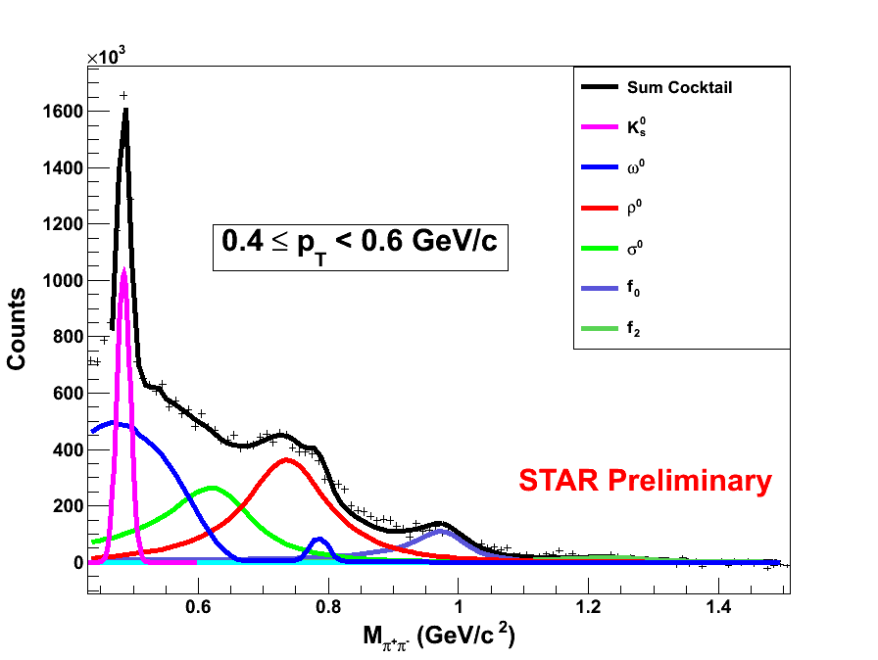
ρ⁰ Meson Production and NCQ Scaling
ρ⁰
Mass : 775.5 ± 0.4 MeV
Width: 149.4 ± 1.0 MeV
Decay Mode ρ⁰ ->π⁺ π⁻
Invariant mass -> Fit to Hadronic cocktail (ω⁰ K* ρ⁰ K_{S}….)
Hadronic decay products sensitive to medium
Production Mechanism probed using NCQ Scaling of v₂
π⁺ π⁻ ->ρ⁰ n_{q}= 4
q q ->ρ⁰ n_{q}= 2
Prabhat Pujahari’s talk in QMRHIC parallel session
Notes:
Recently measurements on elliptic flow of rho mesons in AuAu collisions at AGeV have been reported by STAR
Here the signal of rho is constructed through the invariant mass reconstructions of the decay products and its elliptic flow is
measured wrt to event plane measured by TPC.
Rho is short lived and so is a broad resonance.
Signal is extracted using a cocktail fit to the invariant mass distribution.
Rho is short lived and decays after chemical freeze-out but before the kinetic freeze-out.
The decay is mainly through pi+pi- pair production. Hadronic decay products interact with the medium and might be modified.
There also might be regeneration of rho via pi_pi- →rho ; If dominant then v of rho should show nq = scaling.
If rho is produced during before chemical freezeout-> expect number of quark scaling = to match the data with other mesons and baryons.

Slide 19
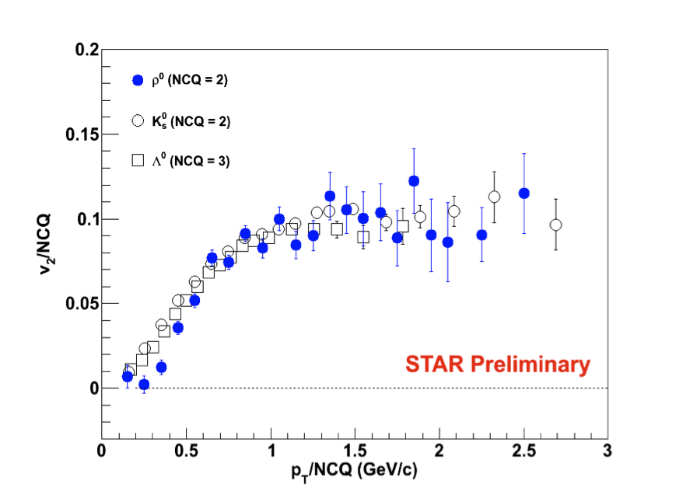
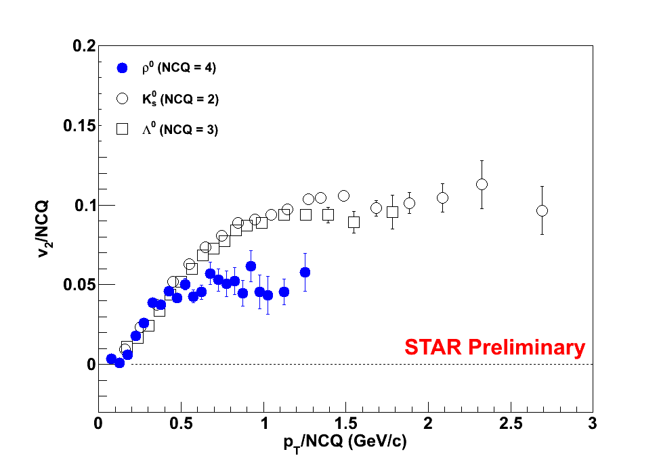
ρ⁰ Production : n=2 or n=4?
qq -> ρ⁰ n_{q}= 2
π⁺ π⁻ ->ρ⁰ n_{q}= 4
ρ⁰ v₂ at intermediate p_{T} (1.5 to 4.0 GeV) shows n_{q} = 2 scaling
Production mode by quark and anti-quark pair dominant!
Notes:
Here v2 and traqnsverse momentum of rho mesons is scaled by 2 and 4 Constituent quarks respectively. Data for Kshort and lambda is also plotted on the same for comparison.
Data confirms nq = 2 scaling above scaled (mt-mo) of 1.0 GeV/c. Rho are dominantly produced at the time of chemical freeze-out.

Slide 20
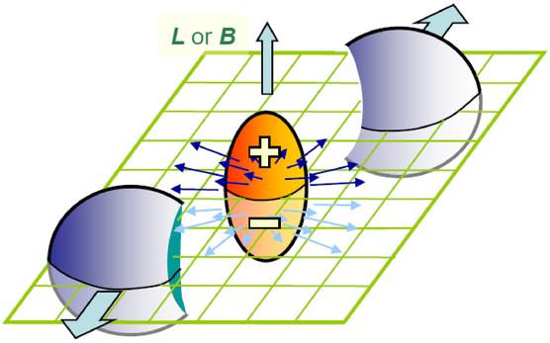
Is Local Parity Violation in Strong Interactions Observable?
L ~ 10⁵
B ~ 10¹⁵ T
P/CP globally invariant in strong interactions as evident from Zero Electric Dipole Moment of Neutrons
BUT
Local meta-stable P-odd domains are not forbidden
Kharzeev, Kraanitz, Venugopalan PL B545 (2002)298 and references therein
Local P-Odd domains result in charge separation along the large Magnetic field of the medium.
T.D.Lee,PRD 8,1226(1973), T.D.Lee & G.C.Wick, PRD 9,2291(1974)
Notes:
Space and charge Parity is conserved in Strong interactions, as is evident by the zero neutron electric dipole moment measurements.
BUT, according to theory, formation of local – meta-stable-P-odd domains are not-forbidden in heavy ion collisions.
The system created in a non-central heavy-ion collision has a large value of angular momentum and so also of magnetic field.
If local Parity Odd domains are formed, they cause charge separation along this magnetic field. The magnetic field is perpendicular to
The reaction plane which can be determined in heavy ions. So experimentally observation of charge separation is possible in an event.
Let us understand why does the charge separation occur in the first place.

Slide 21

Charge Separation in a Heavy Ion Collision
Left Right
Magnetic Field aligns
Spin of +ve charged quarks along itself
Spin of -ve charged quarks opposite to itself
S P
S P
+ve
-ve
B
N_{Left} < N_{Right}
S P
S P
+ve
-ve
B
Kharzeev, PLB 81(1998)512 Kharzeev, Zhitnitsky, NPA 797 (2007)67 , Kharzeev, McLerran, Warringa, NPA 803(2008) 67, Voloshin PRC 62(2000)044901, Liang, Wang, PRL 94(2005)102301
Notes:
The magnetic field aligns the spins of +ve charged quarks along itself and –ve charges quarks opposite to its direction.
Assume magnetic field in direction up.
Momentum of left handed quark is opposite to its spin which means it is pointing downwards for a positively charged
quarks And upwards for a the negatively charged quarks.
Right handed quarks are similarly aligned but have momentum along spin.
If the number of right and left handed quarks is same, the total charge moving up or down is same.
If there exists an excess of either handed quark: this number is unequal and we have a charge separation in a finite volume.
Magnetic field is perpendicular to reaction plane and so we have unequal charged on either side of reaction plane.

Slide 22
Observing Charge separation w.r.t. Reaction Plane
Azimuthally Anisotropic Distribution : was charge independent earlier.
: Now has a charge dependent term
Predicted charged particle asymmetry a± ~ 1% for mid-central collisions
BUT averaged over all events -> <a±>= ☹
If we measure charge particle correlations <a_{α}a_{β}> …. Does not vanish ☺
<a_{α}a_{β}> ~ 10⁻⁴ : Can be measured using correlation with Reaction Plane OR using a three particle correlator
Notes:
Azimuthal anisotropic particle distribution was charge independent earlier, but in case of local parity violation in strong interactions,
it has a charged dependent term.
Since the sign of a varies event-by-event, averaged over a large number of events,
it would vanish since it would be averaged very many different domains all oriented differently.
But if we measure correlations between charged particles, it will not vanish. i.e. by measuring
<a_alpha a_beta> where alpha and beta are charges of the particle taking values either positive or negative.
But we have three more terms here Are they spoiling the picture?
If we measure the correlator in a rapidity window placed symmetrically about mid-rapidity, average v*v vanishes except for fluctuations.
There are also reaction plane independent and reaction plane dependent terms. These are built into the models, analyzed and then compared with data.

Slide 23
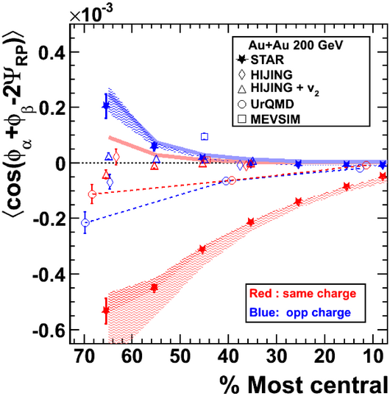
Observation from Data and Simulations
Same Charge signal <a₊a₊>,
<a₋a₋> is strong
Opposite charge signal <a₊a₋> is small : suppression by medium !
Opposite Charge signal dominated by background according to models
Reaction Plane dependent and independent background effects built into various models do not explain Same Charge Signal
Local Strong Parity Violation: A possible explanation of the observed phenomenon
Notes:
We observed that
The same charge signal is strong.
Opposite charge signal is small maybe since one of the charges has to pass through the medium and suffers suppression like in jets.
Reaction plane independent as well as dependent backgrounds were built into various models and the results are also plotted here.
The opposite charge effect observed is dominated by background.
The strength of Same charge effect is not explained by any model. Some models give opposite sign of the effect.
All possible precautions were taken to ensure that the signal is not due to detector effects.
The observed signal remains unexplained;
Local Strong Parity Violation is a possible explanation of the observed phenomenon

Slide 24
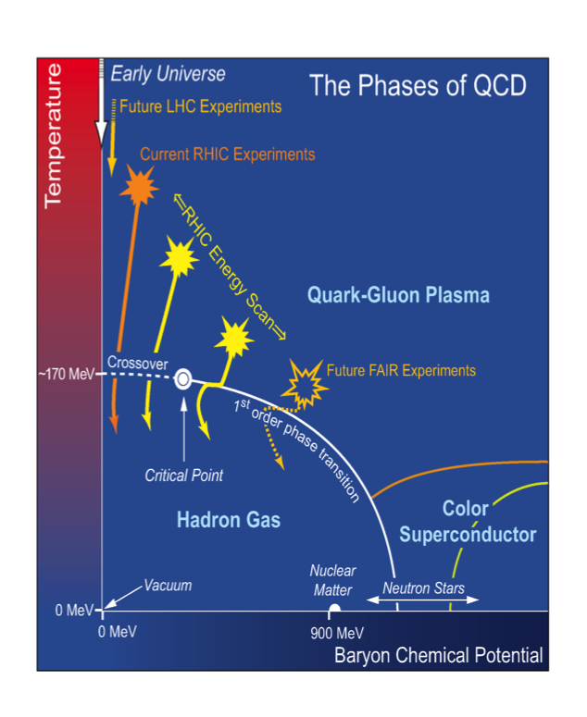
QCD Phase Diagram : Locating Critical Point
Lattice QCD Y. Aoki et al. Nature 443 (2006) 675 , PLB 643 (2006) 46
At μ_{B}=0; phase transition is a cross-over at T ~170 MeV
QCD based Model Calculations: C.Athanasiou, M. Stephanov, K. Rajagopal PRL 102(2009)032301, R. Gavai S.Gupta PRD 78 (2008) 114503
At large μ_{B} : 1st order phase transition
1st order transition ends at CP
QCD Phase space mapped exptly. by varying √s_{NN} in HI Collisions
PR D78(2008) 074597; PR D74(2006)054507 ; PRC 79(2009) 0152202 ; Prog.Th.Phy.Supp 153(2004)139
RHIC Beam Energy Scan √s_{NN} = 5-39 GeV -> μ_{B} = 550 - 100MeV
STAR known to work very well at top RHIC energies !
Check it work as well at low energy : AuAu collisions √s_{NN} = 9.2 GeV
Need tools to detect CP : Higher Moments of Net Proton Multiplicity
Notes:
This is the QCD phase diagram of strongly interacting matter characterized by Baryon Chemical Potential and Temperature.
It shows various phases that can occur under different conditions including the boundary between the hadron gas phase and
the Quark Gluon Plasma phase. At top RHIC energy we are spanning low baryon chemical potential region of this diagram.
According to Lattice QCD at zero baryon chemical potential there is a rapid cross over
from QGP phase to the hadron gas phase. QCD based model calculations show that at large baryon chemical potential there is a first order phase transition.
The point in phase space where the 1st order transition ends is called the QCD critical point.
To locate this point experimentally, we have vary the Baryon chemical potential which can be achieved by varying the CM energy of heavy-ion collisions. This is the motivation for the Recent Beam Energy Scan program of RHIC in 2010 and 2010, where collisions with CM energy GeV to GeV would be studied.
In the process we expect to vary the baryon chemical potential from to MeV.
You will be hearing more about the critical point in Dr Viyogi’s talk tomorrow.
This program raised two questions:
(i) STAR works very well at high energy collisions, Can it work as well for low energy?
(ii) What are the tools to detect critical point?
To study the first question a short run of AuAu collisions was taken at . GeV in .
I will be presenting the results from this data set to establish the capabilities of STAR.
For second question: we will be looking at higher moment analysis of net proton data performed on STAR data at various energies.

Slide 25
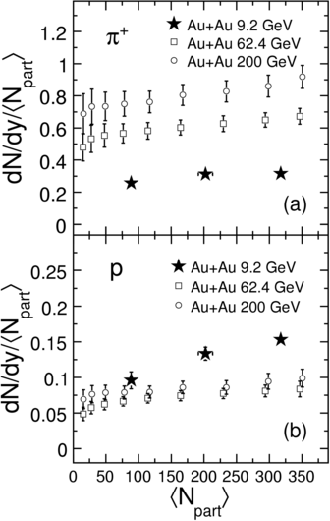
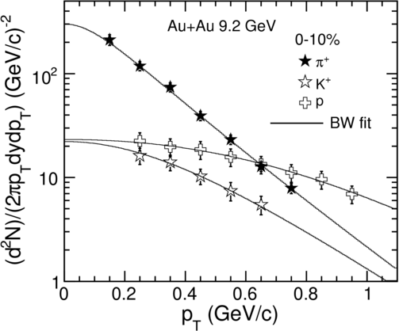
AuAu collisions at √s_{NN}= 9.2 AGeV
Ref: Phys. Rev. C 81(2010) 24911
Spectra of π⁺, π⁻, p, pbar, Κ⁺, Κ⁻ was obtained using TPC ;
Centrality dependence of Multiplicity, <pT> was studied
Notes:
In Run a tiny statistics of AuAu collisions events were taken at .GeV center of mass energy per nucleon,
in a short data-taking period at STAR.
Here I will report the results of various analysis on this small dataset.
Spectra and Centrality dependence of rapidity density of identified particles was studied.
The plots for piplus are given here and And compared with the corresponding values at GeV and . GeV.
Mean pT of the piplus is plotted as a function of number of participants on the right.
The chemical and kinetic freezeout temperatures, baryon chemical potential were extracted from
particle ratios and spectra.

Slide 26
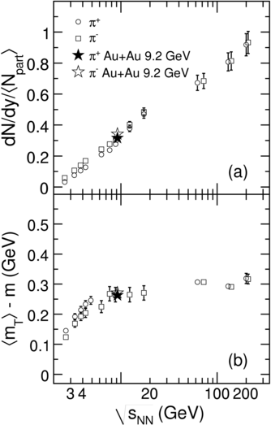
Comparison of 9.2 GeV results with SPS data
STAR AuAu at 9.2 GeV : consistent with SPS results.
List of references for AGS and SPS data are listed in:
STAR Coll. Phys.Rev. C 81 (2010) 24911
STAR Advantages:
Similar Acceptance at all energies
All detectors are tested and known to work very well
Addition of Time of Flight makes Particle ID better
DAQ1000 makes data taking faster
STAR capable of making best use of Beam Energy Scan Runs
Notes:
Here some results of rapidity density and mean kinetic energy of pions are compared with those at SPS energies.
STAR results are consistent with the results from fixed target SPS experiments.
And it has many advantages on its side over SPS.
Being a collider experiment, the acceptance is similar at all energies.
All its detectors are tested and known to work well.
With the full barrel of TOF the particle ID would be much better for data taken in and onwards.
DAQ makes data taking faster so we can build more statistics, in fact run exceeded all its statistics goals.
In short: STAR has taken data in the first phase of BES Run and is ready for more.

Slide 27
How to recognize Critical Behaviour?
Correlation length ξ related to various moments of distributions of conserved quantities like Net Baryon, Net Charge, Net Strangeness number : Higher moments are more sensitive
M. A. Stephanov, Phys. Rev. Lett. 102 (2009)032301 ; M. Asakawa et al., Phys. Rev. Lett. 103 (2009) 262301
According to QCD based model calculations:
At Critical Point : ξ diverges -> Non-Gaussian Fluctuations
-> κσ² and Sσ diverge
Away from CP : according to Central Limit Th. : κσ² =1; Sσ=const.
Models show that fluctuations in Net Proton number reflect the fluctuations in Net Baryon Number Y. Hatta et al. PRL 91(2003) 102003
Study of Higher Moments of Net Proton Multiplicity as a function of centrality and beam energy as a probe for Critical Point
Notes:
Correlation length is related to various moments of distributions of conserved quantities like net-baryon and net-Charge.
IN fact the higher moments like skewness and kurtosis are more sensitive to correlation length .
κσ is related to the ratio of fourth order baryon susceptibility χ_{B}⁽⁾ to second order baryon susceptibility χ_{B}^{().}
According to QCD based model calculations at critical point correlation length diverges, resulting in divergence of susceptibilities; kurtosis times variance is expected to show large deviations.
Away from CP it is expected to be equal to unity.
Inclusive (anti) protons closely reflect the total (anti) baryons production;
net protons can be measured as opposed to net baryons which are not.
We report here higher moments of net-proton multiplicity as a function
of centrality (Npart) and Beam Energy

Slide 28
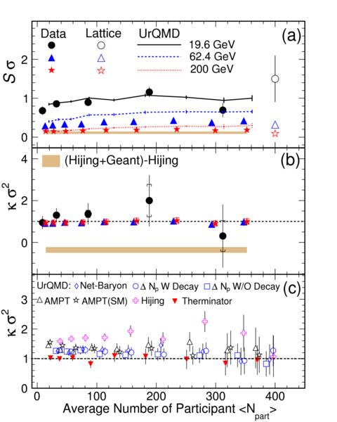
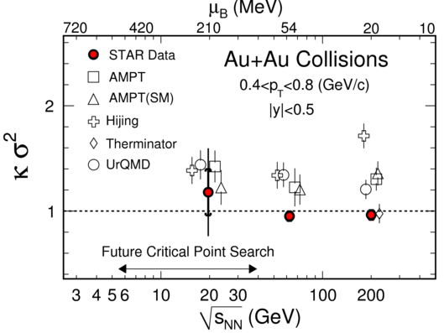
Experimental search for Critical Point
STAR Coll. Phys. Rev. Lett. 105 (2010) 22302
Study of κσ² & Sσ with event centrality and Collision Energy
No-divergences observed till μ_{B}< 200 MeV
No indication of CP yet.
…………………………………..BES data is being analyzed!
New results in Nihar Sahoo’s talk in Parallel Session
Notes:
Experimental detail:
STAR measures the number of protons and antiprotons using TPC for AuAu collisions at ., . and GeV.
In each event net number of protons ( Np – Npbar) was measured and the distribution was obtained for each centrality.
Variance, Skewness and kurtosis of the distribution was obtained and is plotted here.
The results for S sigma and k sigma-square are presented for all three energies. The expectation from models are also plotted. Lattice points plotted are for an equilibrium scenario and would not match the data close to CP.
Ksigma –square is consistent with , the value expected for non-CP scenario. No divergences have been observed till . GeV i.e till baryon chemical potential < .
It is an exciting time with BES energies data being analyzed. Higher moments talk

Slide 29
Summary
First Observation of Anti-Hyper-Triton with a statistical significance of 4.2 σ.
Photon multiplicity and rapidity distribution at forward rapidity is a measured for different centrality, colliding energy and systems. Centrality independent Limiting fragmentation behaviour confirmed.
Matter at RHIC more thermalized in central collisions as compared to peripheral collisions as shown by both CGC and Glauber Model.
NCQ Scaling observed for Multi-strange quarks and ρ⁰ vector meson.
Local Parity Violation in Strong Interactions : Results for same and opposite charge correlation presented : Models rule out detector effects for same charge correlations.
Results from AuAu collision at 9.2 GeV presented -> STAR has taken good data in phase I of BES in 2010. Watch out for interesting results.
Critical behaviour ruled out by Higher Moments upto μ_{B} < 200 MeV.

Slide 30
Thank you from All of us
B. I. Abelev, M. M. Aggarwal, Z. Ahammed, A. V. Alakhverdyants, I. Alekseev, B. D. Anderson, D. Arkhipkin, G. S. Averichev, J. Balewski, L. S. Barnby, S. Baumgart, D. R. Beavis, R. Bellwied, M. J. Betancourt, R. R. Betts, A. Bhasin, A. K. Bhati, H. Bichsel, J. Bielcik, J. Bielcikova, B. Biritz, L. C. Bland, B. E. Bonner, J. Bouchet, E. Braidot, A. V. Brandin, A. Bridgeman, E. Bruna, S. Bueltmann, I. Bunzarov, T. P. Burton, X. Z. Cai, H. Caines, M. Calderon, O. Catu, D. Cebra, R. Cendejas, M. C. Cervantes, Z. Chajecki, P. Chaloupka, S. Chattopadhyay, H. F. Chen, J. H. Chen, J. Y. Chen, J. Cheng, M. Cherney, A. Chikanian, K. E. Choi, W. Christie, P. Chung, R. F. Clarke, M. J. M. Codrington, R. Corliss, J. G. Cramer, H. J. Crawford, D. Das, S. Dash, A. Davila Leyva, L. C. De Silva, R. R. Debbe, T. G. Dedovich, M. DePhillips, A. A. Derevschikov, R. Derradi de Souza, L. Didenko, P. Djawotho, S. M. Dogra, X. Dong, J. L. Drachenberg, J. E. Draper, J. C. Dunlop, M. R. Dutta Mazumdar, L. G. Eﬁmov, E. Elhalhuli, M. Elnimr, J. Engelage, G. Eppley, B. Erazmus, M. Estienne, L. Eun, O. Evdokimov, P. Fachini, R. Fatemi, J. Fedorisin, R. G. Fersch, P. Filip, E. Finch, V. Fine, Y. Fisyak, C. A. Gagliardi, D. R. Gangadharan, M. S. Ganti, E. J. Garcia-Solis, A. Geromitsos, F. Geurts, V. Ghazikhanian, P. Ghosh, Y. N. Gorbunov, A. Gordon, O. Grebenyuk, D. Grosnick, B. Grube, S. M. Guertin, A. Gupta, N. Gupta, W. Guryn, B. Haag, A. Hamed, L-X. Han, J. W. Harris, J.P. Hays-Wehle, M. Heinz, S. Heppelmann, A. Hirsch, E. Hjort, A. M. Hoffman, G. W. Hoffmann, D. J. Hofman, R. S. Hollis, B. Huang, H. Z. Huang, T. J. Humanic, L. Huo, G. Igo, A. Iordanova, P. Jacobs, W. W. Jacobs, P. Jakl, C. Jena, F. Jin, C. L. Jones, P. G. Jones, J. Joseph, E. G. Judd, S. Kabana, K. Kajimoto, K. Kang, J. Kapitan, K. Kauder, D. Keane, A. Kechechyan, D. Kettler, D. P. Kikola, J. Kiryluk, A. Kisiel, S. R. Klein, A. G. Knospe, A. Kocoloski, D. D. Koetke, T. Kollegger, J. Konzer, M. Kopytine, I. Koralt, L. Koroleva, W. Korsch, L. Kotchenda, V. Kouchpil, P. Kravtsov, K. Krueger, M. Krus, L. Kumar, P. Kurnadi, M. A. C. Lamont, J. M. Landgraf, S. LaPointe, J. Lauret, A. Lebedev, R. Lednicky, C-H. Lee, J. H. Lee, W. Leight, M. J. Levine, C. Li, L. Li, N. Li, W. Li, X. Li, Y. Li, Z. Li, G. Lin, S. J. Lindenbaum, M. A. Lisa, F. Liu, H. Liu, J. Liu, T. Ljubicic, W. J. Llope, R. S. Longacre, W. A. Love, Y. Lu, T. Ludlam, X. Luo G. L. Ma, Y. G. Ma, D. P. Mahapatra, R. Majka, O. I. Mal, L. K. Mangotra, R. Manweiler, S. Margetis, C. Markert, H. Masui, H. S. Matis, Yu. A. Matulenko, D. McDonald, T. S. McShane, A. Meschanin, R. Milner, N. G. Minaev, S. Mioduszewski, A. Mischke, M. K. Mitrovski, B. Mohanty, M. M. Mondal, B. Morozov, D. A. Morozov, M. G. Munhoz, B. K. Nandi, C. Nattrass, T. K. Nayak, J. M. Nelson, P. K. Netrakanti, M. J. Ng, L. V. Nogach, S. B. Nurushev, G. Odyniec, A. Ogawa, H. Okada, V. Okorokov, D. Olson, M. Pachr, B. S. Page, S. K. Pal, Y. Pandit, Y. Panebratsev, T. Pawlak, T. Peitzmann, V. Perevoztchikov, C. Perkins, W. Peryt, S. C. Phatak, P. Pile, M. Planinic, M. A. Ploskon, J. Pluta, D. Plyku, N. Poljak, A. M. Poskanzer, B. V. K. S. Potukuchi, C. B. Powell, D. Prindle, C. Pruneau, N. K. Pruthi, P. R. Pujahari, J. Putschke, R. Raniwala, S. Raniwala, R. L. Ray, R. Redwine, R. Reed, H. G. Ritter, J. B. Roberts, O. V. Rogachevskiy, J. L. Romero, A. Rose, C. Roy, L. Ruan, R. Sahoo, S. Sakai, I. Sakrejda, T. Sakuma, S. Salur, J. Sandweiss, E. Sangaline, J. Schambach, R. P. Scharenberg, N. Schmitz, T. R. Schuster, J. Seele, J. Seger, I. Selyuzhenkov, P. Seyboth, E. Shahaliev, M. Shao, M. Sharma, S. S. Shi, E. P. Sichtermann, F. Simon, R. N. Singaraju, M. J. Skoby, N. Smirnov, P. Sorensen, J. Sowinski, H. M. Spinka, B. Srivastava, T. D. S. Stanislaus, D. Staszak, J.R. Stevens, R. Stock, M. Strikhanov, B. Stringfellow, A. A. P. Suaide, M. C. Suarez, N. L. Subba, M. Sumbera, X. M. Sun, Y. Sun, Z. Sun, B. Surrow, D. N. Svirida, T. J. M. Symons, A. Szanto de Toledo, J. Takahashi, A. H. Tang, Z. Tang, L. H. Tarini, T. Tarnowsky, D. Thein, J. H. Thomas, J. Tian, A. R. Timmins, S. Timoshenko, D. Tlusty, M. Tokarev, T. A. Trainor, V. N. Tram, S. Trentalange, R. E. Tribble, O. D. Tsai, J. Ulery, T. Ullrich, D. G. Underwood, G. Van Buren, M. van Leeuwen, G. van Nieuwenhuizen, J. A. Vanfossen, Jr., R. Varma, G. M. S. Vasconcelos, A. N. Vasiliev, F. Videbaek, Y. P. Viyogi, S. Vokal, S. A. Voloshin, M. Wada, M. Walker, F. Wang, G. Wang, H. Wang, J. S. Wang, Q. Wang, X. L. Wang, Y. Wang, G. Webb, J. C. Webb, G. D. Westfall, C. Whitten Jr., H. Wieman, E. Wingﬁeld, S. W. Wissink, R. Witt, Y. Wu, W. Xie, N. Xu, Q. H. Xu, W. Xu, Y. Xu, Z. Xu, L. Xue, Y. Yang, P. Yepes, K. Yip, I-K. Yoo, Q. Yue, M. Zawisza, H. Zbroszczyk, W. Zhan, J. Zhang, S. Zhang, W. M. Zhang, X. P. Zhang, Y. Zhang, Z. P. Zhang, J. Zhao, C. Zhong, J. Zhou, W. Zhou, X. Zhu, Y. H. Zhu, R. Zoulkarneev, Y. Zoulkarneeva,

Slide 31
Back Up Slides

Slide 32
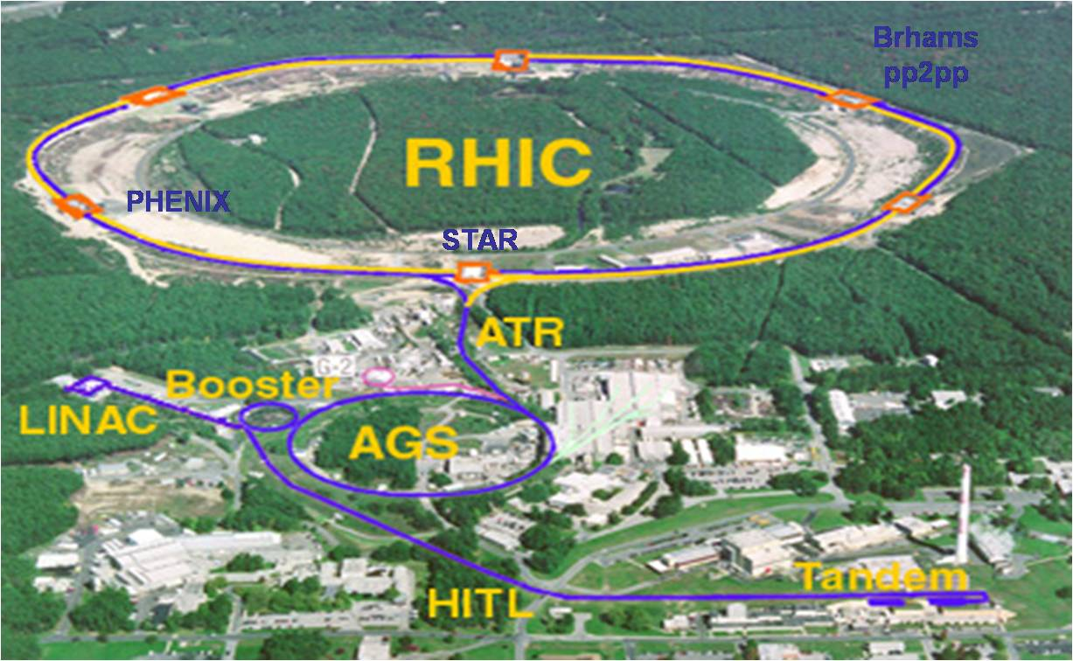
Relativistic Heavy Ion Collider
PHOBOS
Notes:
Relativistic Heavy Ion Collider which has been an extremely useful discovery tool that
has given us vast amounts of data in the last few years.
It has collided heavy ions at energies ranging from to GeV for systems ranging from
AuAu, dAu and CuCu
Here you can see all the RHIC experiments: STAR, PHENIX, Brahms and PHOBOS.
STAR is seen at o’clock position in this ring. Zooming on to STAR now.

Slide 33
EVOLUTION OF A HEAVY ION COLLISION AT RHIC
Time
Initial conditions
Dense Partonic Matter Hydro description
Kinetic freeze-out
Bulk of this produced matter is soft
Initial hard interactions
Hadronization and chemical freeze-out
Anisotropic flow : early expansion stage (v, v, Knudsen fitting to the identified particles)
Particle Spectra : Properties at Chemical & Kinetic Freeze-out
Multiplicity, Rapidity density of various species in various phase space regions and its variation with centrality, beam energy and system size : Particle Production Mechanism
Notes:
Getting back to the every-day physics of heavy-ion collisions
Let us first study evolution of a heavy ion collision at RHIC.
When two heavy ions collide, a dense hot system is formed in the early stages of the collision,
which continuously expands and cools.
Hadrons are formed from the partons and melt again due to high temperature till the system
cools enough at which point the number and ratio of hadron species do not change anymore …
they are fixed: the chemical freeze-out has taken place.
These hadrons continue to exchange energy and momentum until kinetic freeze-out which is
when they stop interaction with each other and free-stream to the waiting detectors.
Various methods, analysis, techniques are used to obtain information about each stage of evolution.
One of the most important measurements is that of azimuthal anisotropy and that is the first topic of my talk
(i)Flow gives information about the expansion stage of the reaction
(ii) Particle ratios and their spectra gives information on the properties of the system at Chemical and Kinetic freeze-out
(iii) Multiplicity measurement gives information tells us about the contribution of hard and soft processes in particle produciton

Slide 34
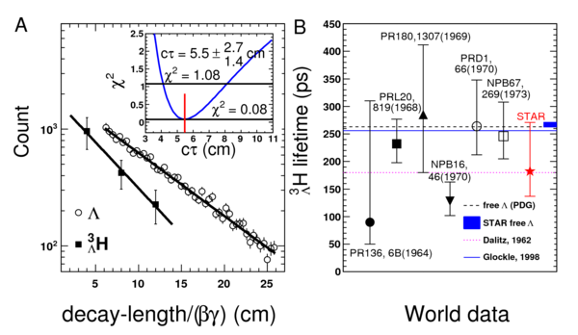
Lifetime of Anti-Hyper-Triton
Lifetime measurement of
Anti-Hyper-Triton + Hyper-Triton
τ = ± pico sec
Consistent with other measurements of Hyper-Triton lifetime
Notes:
Mass of Hypertriton and AntiHyperTriton have been obtained from invariant mass distribution of candidates.
The number of these particles is measured in pt range to GeV/c, and corrected for detection efficiency.
By reconstructing the decay products and extrapolating them backwards to obtain the secondary decay vertex
we can obtain the decay length.
A fit to the decay length distribution of combined data of hypertriton and antihypertriton gives the lifetime
as (+-)+- pico-second.
This is consistent with the existing data for hyper triton.
The same method was also applied to lambda lifetime and the value obtained matches the PDG data for hyper-triton.

Slide 35
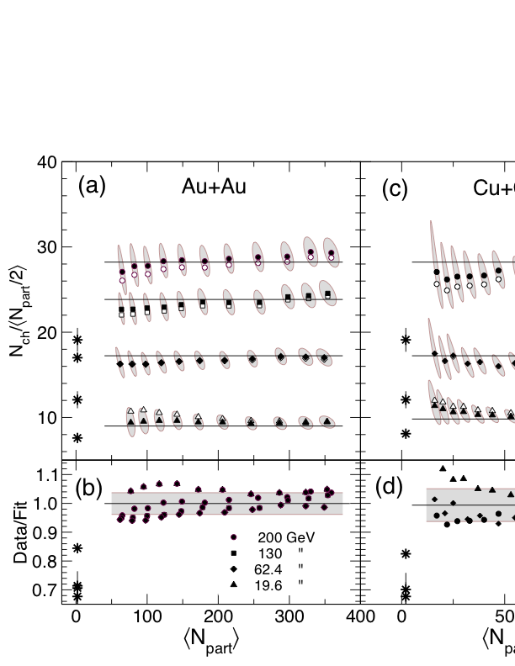
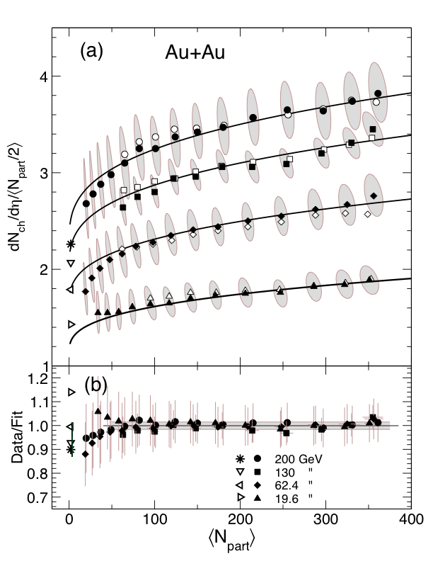
Particle production in Different phase space
Ref: PHOBOS Collaboration
PRL () ; PRL ()
With increasing energy and increasing event centrality the total particle multiplicity increases: due to increase in the num. of participants / binary collisions and increase in the energy per participant / binary coll.
Total N_{charge}/N_{part} increases with N_{part}
(dN/dy)/N_{part} increases with N_{part} at midrapidity; constant at forward η.
N_{part} scaling is different in different phase space regions ->
Important to study it in each pseudo-rapidity region
Notes:
With increasing energy and increasing event centrality the total particle multiplicity is expected to increase:
this is because of increase in the number of participants and increase in the energy per participant.
Total multiplicity and pseudo-rapidity scaled to the number of participant pairs and find that the total multiplicity is constant event though the pseudo-rapidity density at mid-rapidity increases.
This shows that particle production is different in different phase space regimes and it is important to study it in each pseudo-rapidity region

Slide 36

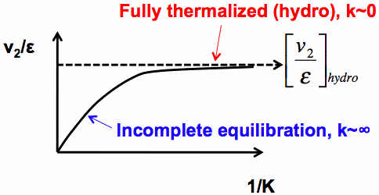
Degree of thermalization: Knudsen No.
Ref: J-Y Ollitrault et. al. , PLB 627 (2005) 49, PRC 76 (2007) 024905
Transport model ->Hydro for small λ interaction length (Ref: above)
K ~ λ/R is ratio of mean free path and system size
Hydrodynamic limit can only be approached asymptotically (K->0)
In low density limit v₂/ε is proportional to system size and hence to 1/K
K = 0.7 from model calculations and
S = 4π √ ( ⟨x²⟩ ⟨y²⟩ ) and ε are calculated using initial conditions: we use Glauber or CGC model initial conditions
Fitting the plot of v₂/ε with 1/S*dN/dy gives σc_{s}
Notes:
To quantify the degree of thermalization we use a transport model which for small interaction length goes to hydro.
In this case dependence of v/e on particle density in the transverse plane can be described by
the equation using Knudsen Number K.
Knudsen number is defined by the mean free path divided by the system size.
In low density limit v/e is proportional to /K so with increasing number of collisions, the initial eccentricity is more and more
effectively translated into final azimuthal anisotropy. If K goes to zero , V/e = (v/e)hydro indicating complete thermalization
Here S the transverse size and eccentricity is calculated from models ( Glauber and CGC) and rapidity density of
particles is obtained from experiment.
Knudsen number under the model assumptions is proportional to the particle density in the transverse plane and so fitting
v/e with the given equation gives us information about the sigma *c_{s} Partonic cross section and velocity of sound in medium.
Since the constants involved are model dependent, the fit estimates are also different for different models.
We plotted v/e as a function of /S dN/dy and fitted it to the above equation. The asymptotic value of v/e was then used to rescale v/e at finite particle density. Let us see the scaled plots from STAR now.
For RR:
Sigma is the partonic cross-section
Cs is the velocity of sound
S is the transverse Area
R is the size of the interacting volume.

Slide 37
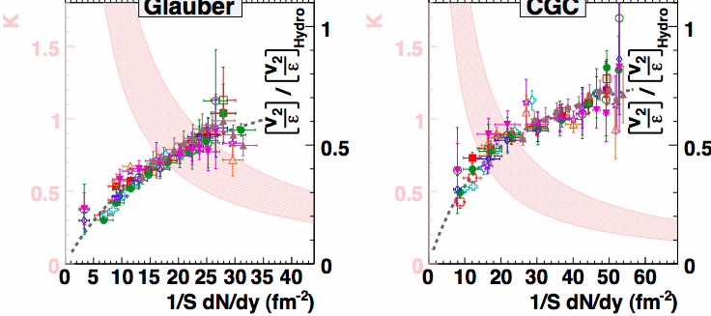
Obtaining Knudsen Number from Data
Glauber
CGC
All p_{T} integrated v₂/ε plotted for Glauber and CGC initial conditions: fits nicely to transport model Relation
CGC gives steeper curve as compared to Glauber : Estimates the system is Closer to hydro limit!
Fit parameters σ*c_{s} related to η/s under model assumptions

Slide 38
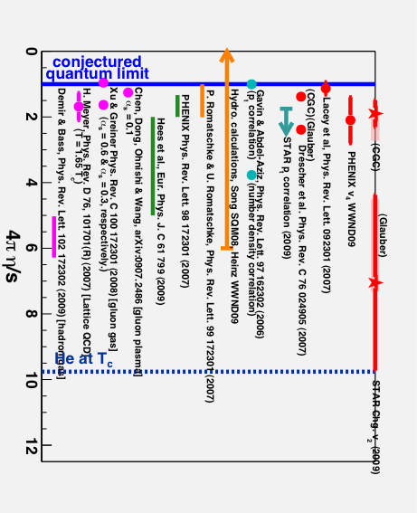
Estimates of η/s (Viscosity/Entropy)
η/s estimated by various Experiments & Models
η/s is small and close to the Conjectured Quantum Limit of 1/4π
Notes:
Hydrodynamic models say that, sigma*cs is related to viscosity by entropy of a system
Using the fit parameters obtained from fitting Knudsen formula, one can estimate
viscosity by entropy as given in the equation above
With initial conditions from Glauber or CGC calculations and sigma time cs
is from the fitting the Knudsen fitting shown in the previous slides.
The temperature T is obtained from STAR pion mT slope.
The estimated values for eta/entropy are plotted as a function of particle density in the transverse plane (/S*dN.dy )
Glauber model gives eta by ess to be .+/- . times the conjectured quantum and
CGC model gives .+/- . times the limit.
This plot on the right shows various estimates of eta/entropy scaled by the quantum limit.
The blue line shows the quantum limit while the dashed blue line on the right shows the
Viscosity of Helium at critical temperature ( what temperature)

Slide 39
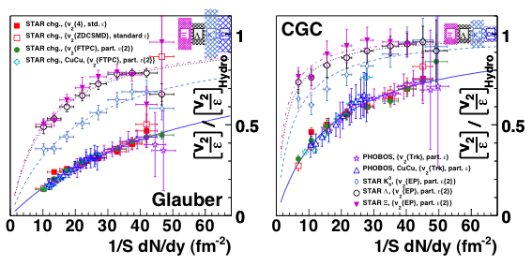
Knudsen Fit to Charge Particle v₂/ε
STAR Preliminary
p_{T} integrated v₂/ε plotted for Glauber and CGC initial conditions: fits nicely to transport model Relation
CGC gives steeper curve as compared to Glauber : Estimates the system is Closer to hydro limit!
Fit parameters σ*c_{s} related to η/s under model assumptions
Notes:
The left panel is for Glauber and the right for CGC initial conditions.
The steeper the curve, closer is it to the fitted hydro limit. A stronger saturation in shape is observed in case of CGC as
compared to Glauber.

