Slide 1
Dihadron azimuthal correlations at large pseudo-rapidity difference in multiplicity-selected d+Au collisions by STAR
Fuqiang Wang
(for STAR Collaboration)
Purdue University

Slide 2
Outline
Physics motivations
Centrality definitions
Results (extensive systematics)
2D correlations
Δφ and Δη correlations with ZYAM
Fourier Coefficients
Concentrate on 1<p_{T}^{trig}, p_{T}^{assoc}<3 GeV/c bin, but have p_{T} dependence
Summary

Slide 3
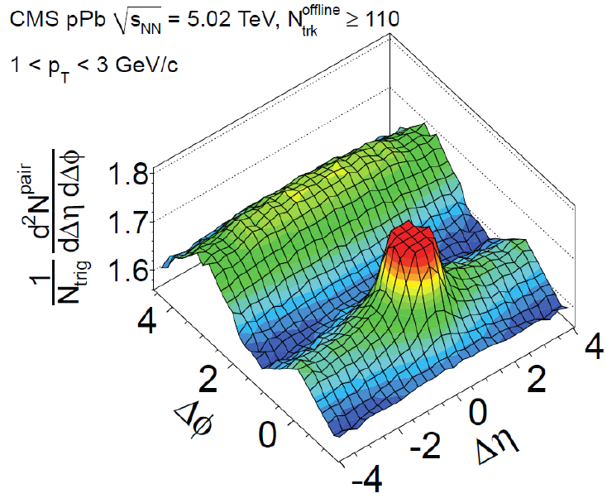
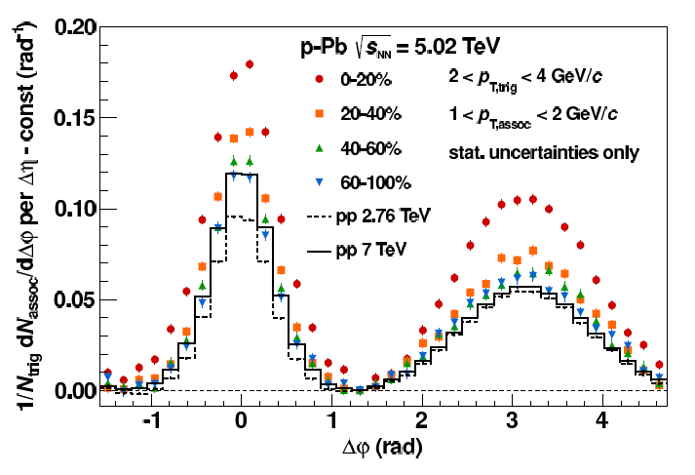
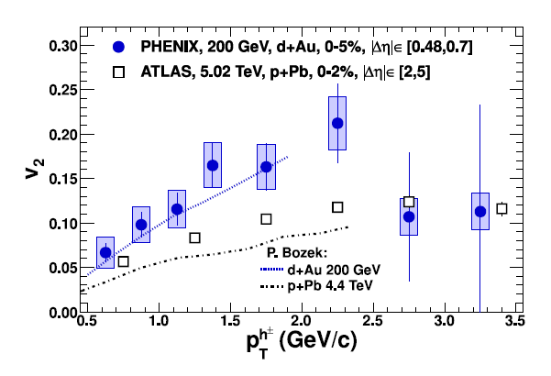
Physics motivations
ALICE, arXiv:1212.2001
CMS:1210.5482
|Δη|<1.8
ATLAS, arXiv:1212.5198
PHENIX, arXiv:1303.1794
Ridge in small systems at LHC.
Double-ridge from central – peripheral technique
Ridge in d+Au at RHIC?
CGC correlated gluon emission?
Hydrodynamics in small systems?

Slide 4
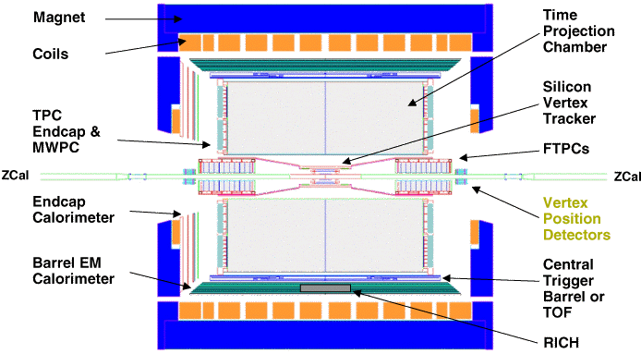
The STAR detector
TPC
d
Au
ZDC
FTPC
FTPC
ZDC

Slide 5
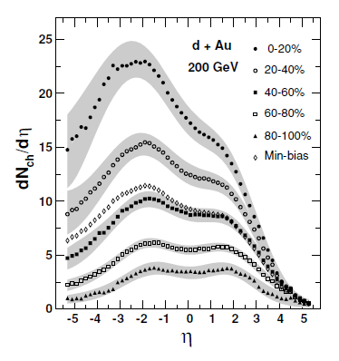
The STAR detector
TPC
d
Au
ZDC
FTPC
FTPC
ZDC
PHOBOS, PRC 72 (2005) 031901(R)

Slide 6
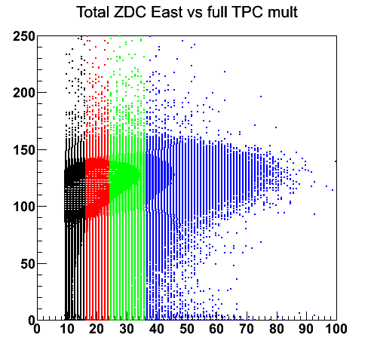
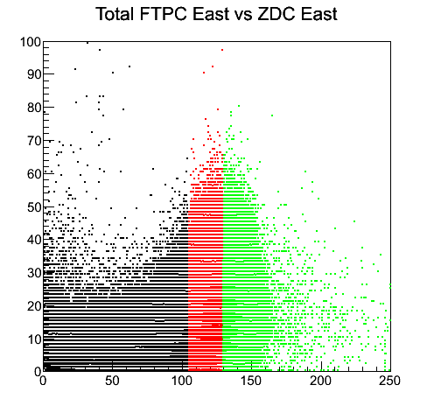
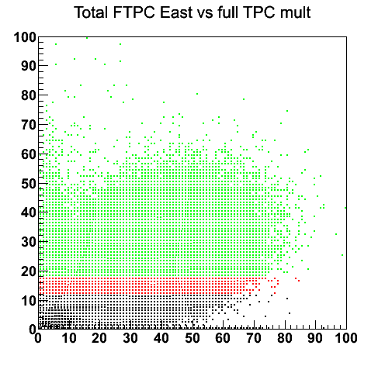
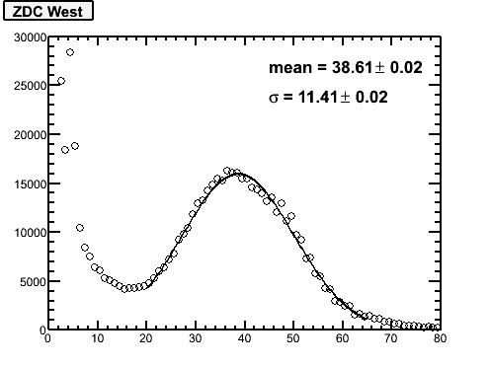
Centrality definitions
STAR PRELIMINARY
STAR PRELIMINARY
STAR PRELIMINARY
ZDC-Au
FTPC-Au
FTPC-Au
Full TPC mult.
ZDC-Au
Full TPC mult.
Three different centrality definitions
Correlations are broad
Single n-tag: p+Au

Slide 7
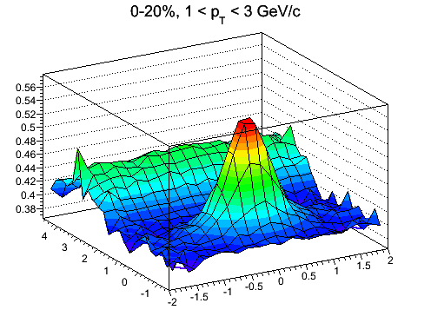
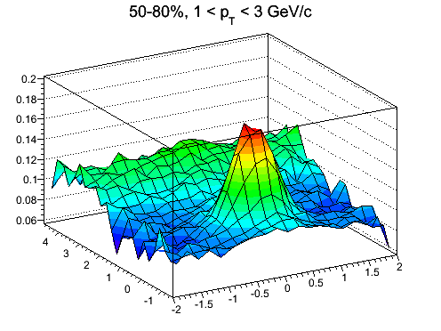
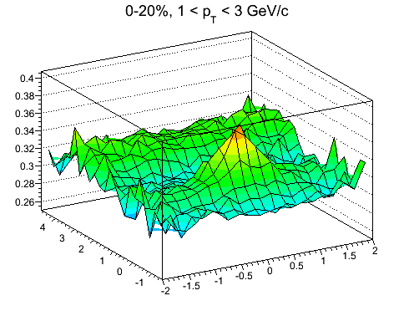
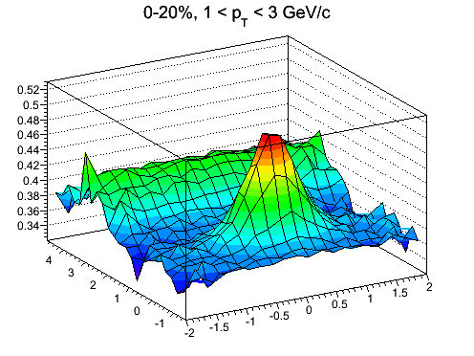
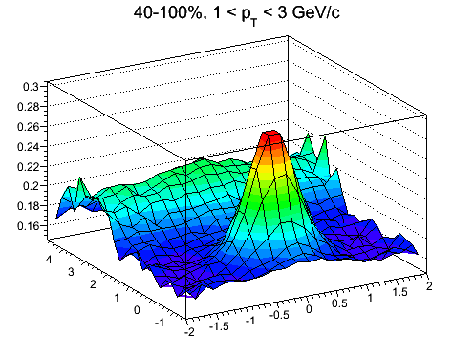
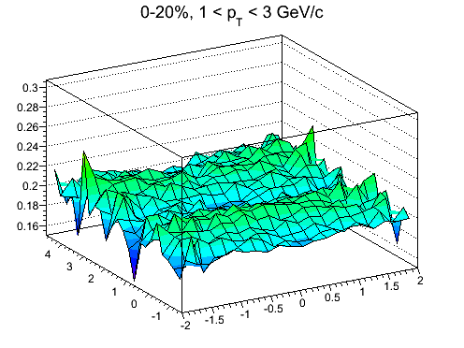
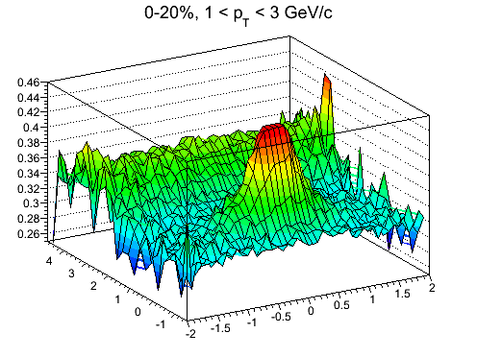
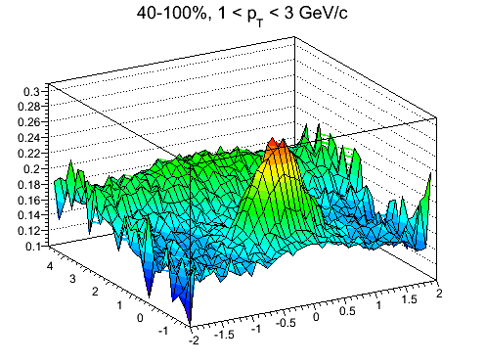
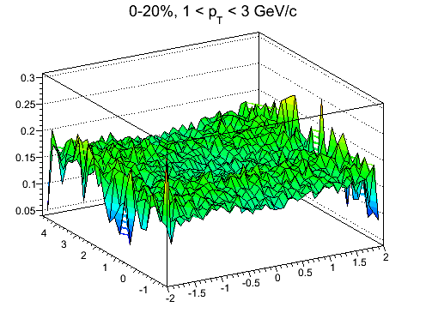
2D TPC-TPC correlation functions
1 < p_{T}^{trig}, p_{T}^{assoc} < 3 GeV/c
Centrality def.
Central
Peripheral
Central – Peripheral
Central – Peripheral
STAR PRELIMINARY
STAR PRELIMINARY
STAR PRELIMINARY
TPC mult.
|η|<1
Δφ
Δη
STAR PRELIMINARY
STAR PRELIMINARY
STAR PRELIMINARY
FTPC-Au
-3.8<η<-2.8
STAR PRELIMINARY
STAR PRELIMINARY
STAR PRELIMINARY
ZDC-Au

Slide 8
ZYAM’ed correlations
ZYAM by Δφ correlation
ZYAM in each Δη bin
Uncertainty by different Δφ ranges for ZYAM
Efficiency corrected: 85±5%

Slide 9
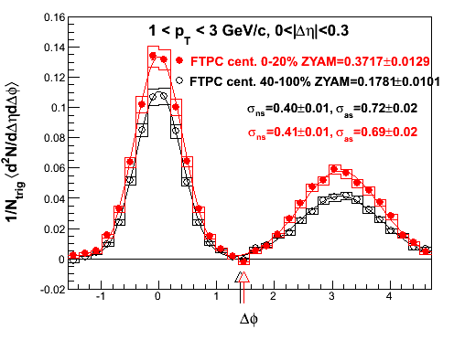
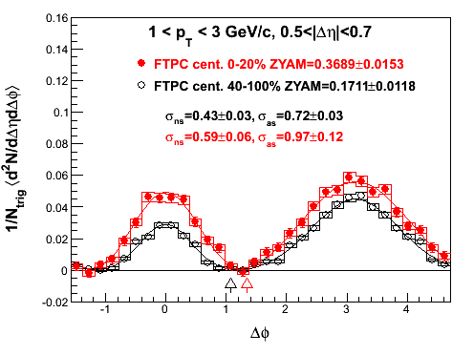
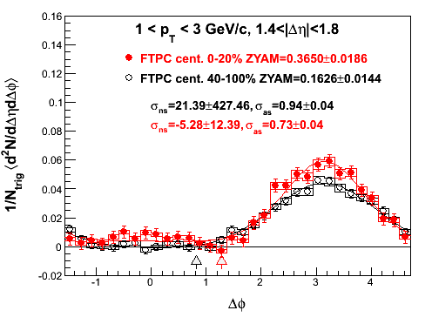
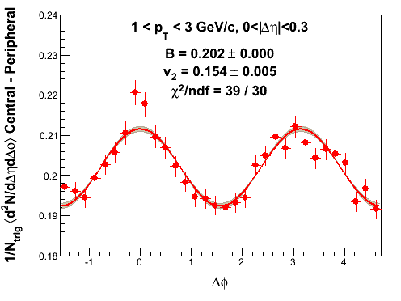
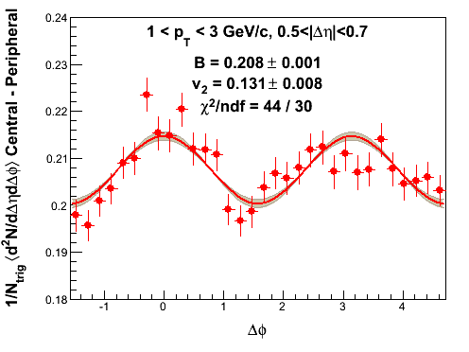
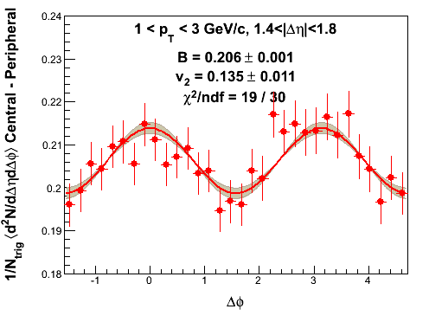
TPC-TPC Δφ correl. (FTPC-Au centrality)
1 < p_{T}^{trig}, p_{T}^{assoc} < 3 GeV/c
ZYAM’ed
STAR PRELIMINARY
STAR PRELIMINARY
STAR PRELIMINARY
Straight difference
No ZYAM involved
STAR PRELIMINARY
STAR PRELIMINARY
STAR PRELIMINARY
Jets in TPC differ btw central and peripheral; bias introduced by FTPC-Au mult.
Remaining back-to-back structure at large Δη; near-side bump from jets?

Slide 10
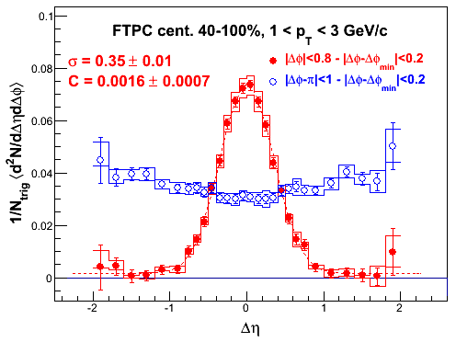
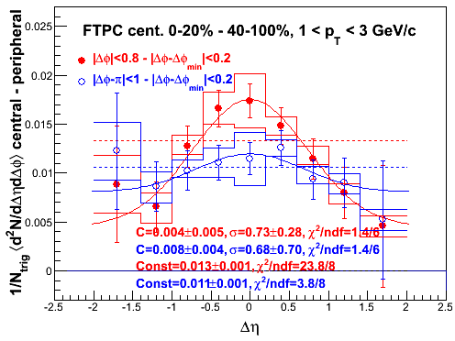
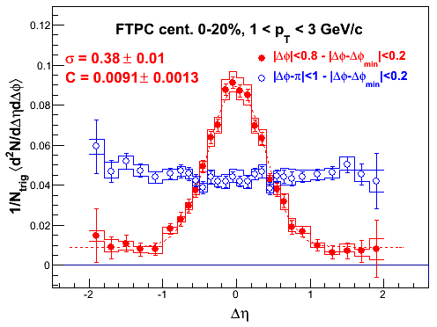
TPC-TPC Δη correl. (FTPC-Au centrality)
1< p_{T}^{trig}, p_{T}^{assoc} < 3 GeV/c
Peripheral
Central – Peripheral
STAR PRELIMINARY
STAR PRELIMINARY
PHENIX acceptance
Central
STAR PRELIMINARY
Central – peripheral resembles jet correlations.
FTPC-Au multiplicity selection biases jets in TPC.
Large Δη excess in central (fit pedestal ≈zero within 1σ) from ridge?

Slide 11
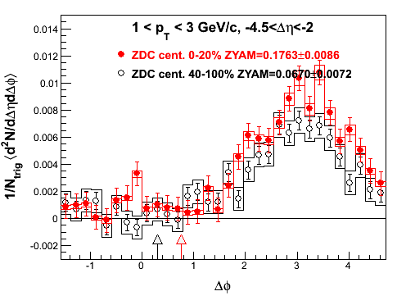
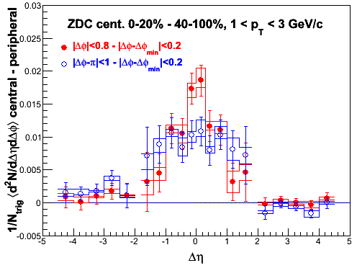
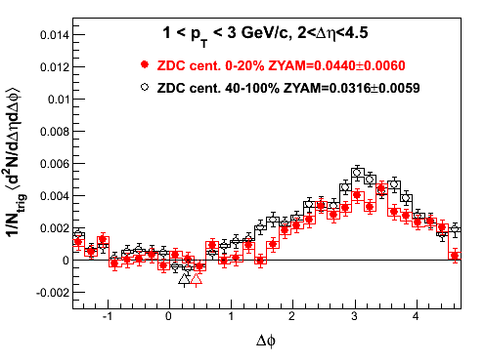
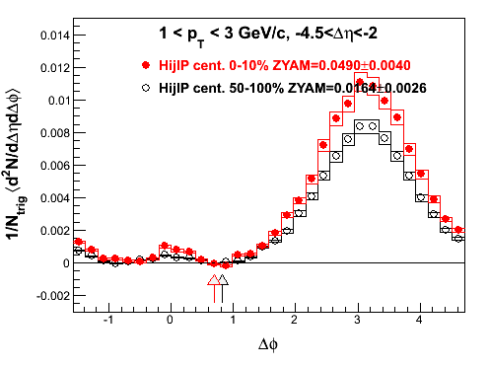
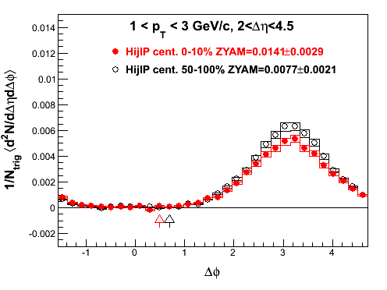
Going to even larger Δη (ZDC-Au centrality)
1 < p_{T}^{trig}, p_{T}^{assoc} < 3 GeV/c
NS jet contr.
Peri.
Cent.
Peri.
Cent.
AS flat
Au-side away-side correl:
central > peripheral
d-side away-side correl:
central < peripheral
HIJING
Peri.
Cent.
Impact parameter centrality
Peri.
Cent.
Effects in Hijing too.

Slide 12
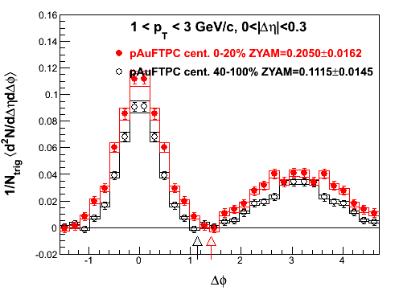
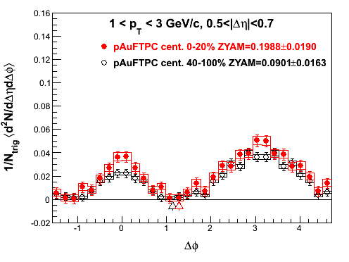
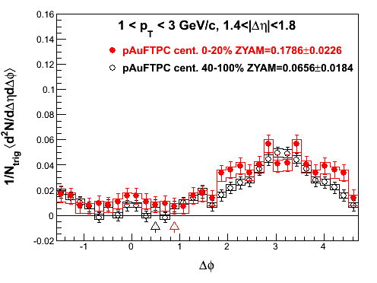
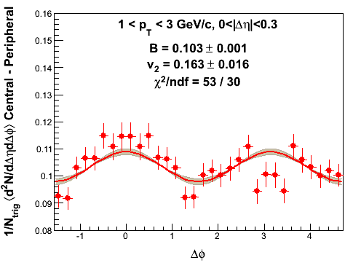
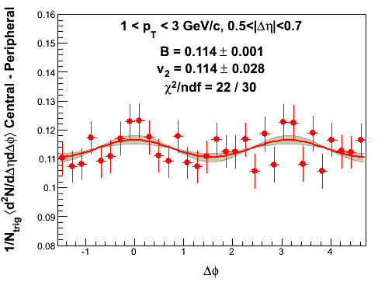
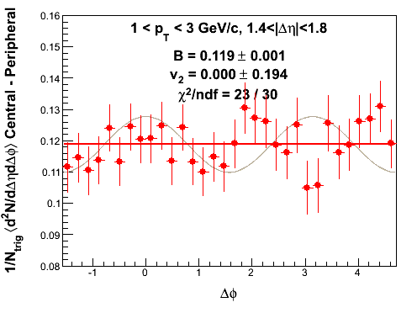
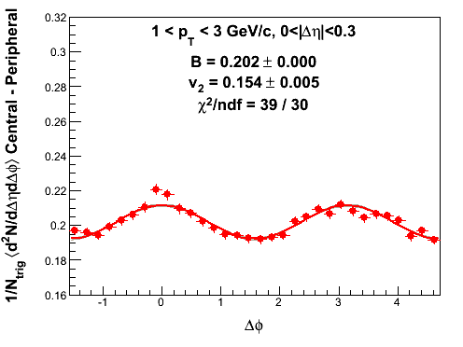
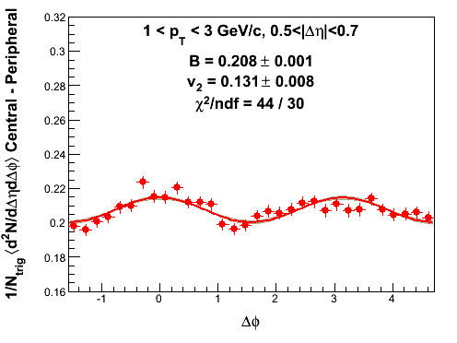
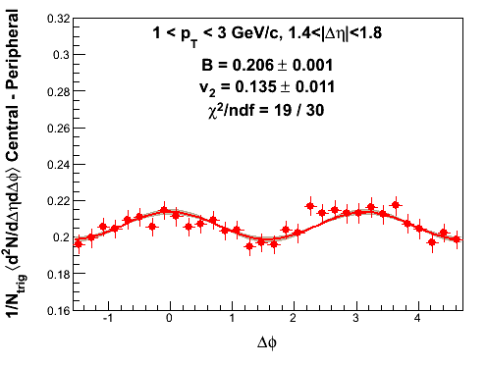
p+Au vs d+Au (FTPC-Au centrality)
1 < p_{T}^{trig}, p_{T}^{assoc} < 3 GeV/c
|Δη|<0.3
0.5<|Δη|<0.7
1.4<|Δη|<1.8
p+Au
p+Au
p+Au
7.4±0.7%
6.2±0.2%
0±12%
p+Au
p+Au
p+Au
8.0±0.3%
7.0±0.4%
7.5±0.6%
d+Au
d+Au
d+Au
STAR PRELIMINARY
STAR PRELIMINARY
STAR PRELIMINARY
Fourier fits to central – peripheral yield similar coefficients.
v₂=v₂^{fit}(1-ZYAM_{peri}/ZYAM_{cent})

Slide 13
Fourier coefficients
Fourier decomposition of correlation functions
No ZYAM
No central – peripheral

Slide 14
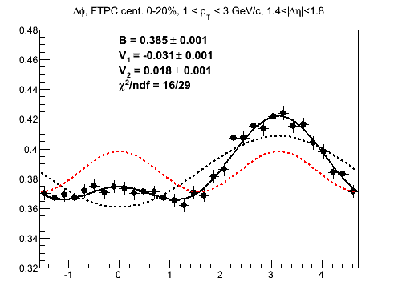
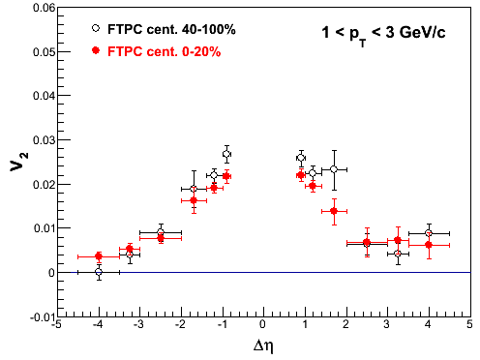
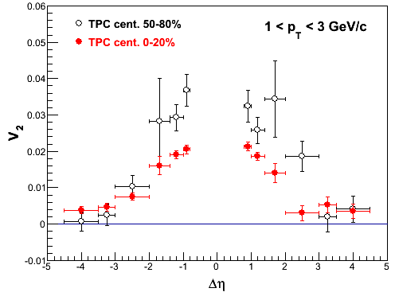
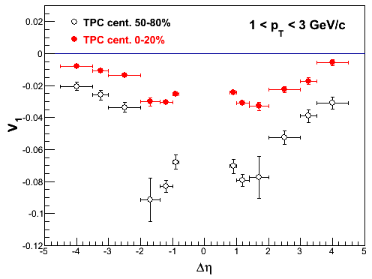
Calculated Fourier coefficents vs Δη
1 < p_{T}^{trig}, p_{T}^{assoc} < 3 GeV/c
STAR PRELIMINARY
V₂
STAR PRELIMINARY
STAR PRELIMINARY
Finite V₂, central ≈ peripheral.
V₁ smaller in central, ~1/N.
V₃ consistent with zero.
V₁
STAR PRELIMINARY

Slide 15
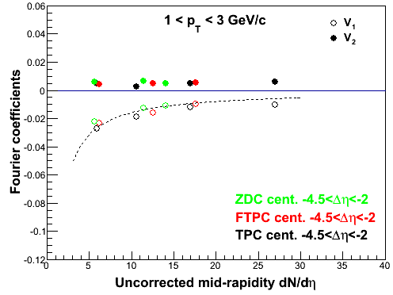
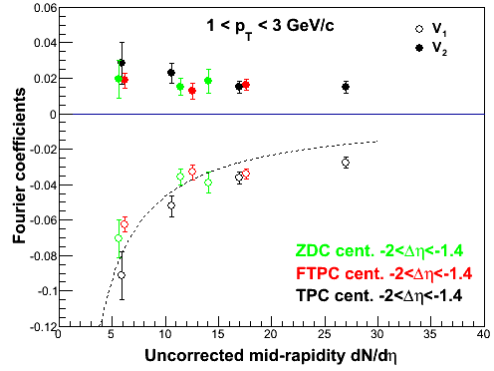
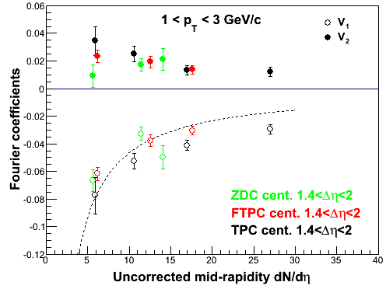
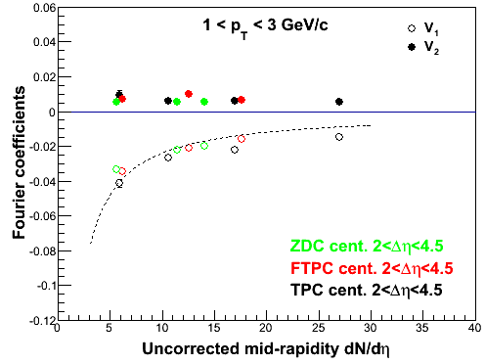
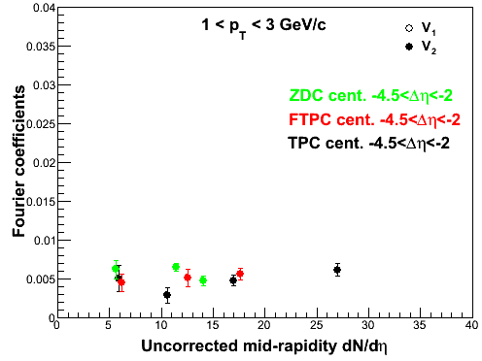
Calc. Fourier coefficients vs multiplicity
1 < p_{T}^{trig}, p_{T}^{assoc} < 3 GeV/c
V₂
V₁
STAR PRELIMINARY
STAR PRELIMINARY
STAR PRELIMINARY
STAR PRELIMINARY
V₂
STAR PRELIMINARY
STAR PRELIMINARY
STAR PRELIMINARY
STAR PRELIMINARY
Au-side
d-side
Correlations have V₁ and V₂ components
V₁ appears ~1/N. V₂ ~constant over multiplicity
Even at very forward d-side, V₂ component is large (maybe even larger than Au-side).

Slide 16
RHIC/LHC v₂ vs multiplicity
1 < p_{T}^{trig}, p_{T}^{assoc} < 3 GeV/c
STAR PRELIMINARY
V₂ = v₂²
v₂=7%
LHC v₂{2} is also relatively insensitive to multiplicity.
LHC v₂{4} is independent of multiplicity except peripheral. Nonflow or flow?
Hydrodynamic flow: In peripheral? No increase with multiplicity?
CGC: No increase with multiplicity?

Slide 17
Simple math
1 < p_{T}^{trig}, p_{T}^{assoc} < 3 GeV/c; 1.4 < |Δη| < 1.8
FTPC peripheral 40-100%
FTPC central 0-20%
central – peripheral
40%
STAR PRELIMINARY
STAR PRELIMNARY
STAR PRELIMINARY
Same v2 on
a deeper dip.
ZYAM may give distorted information.
Central=peripheral jets and anisotropic triggers do not come hand-in-hand naturally.

Slide 18
Summary
Central – peripheral excess resembles near- and away-side jet shapes. Near-side Gaussian peak in Δη; away-side approximately flat.
Central – peripheral has jet contributions (caused by centrality bias: large multiplicity events → larger-energy jets?)
Premature to draw physics conclusions from central – peripheral.
STAR large acceptance allows detailed investigation.
Very forward/backward correlations are suppressed/enhanced on the away side of the more central d+Au collisions. Effect present in Hijing too.
Similar v₂ component in peripheral and central, including d-going forward rapidity.
d+Au data seems consistent with jet phenomenology; p+Au (n-tag) similar to d+Au.

Slide 19
Δη correlations, ZYAM’ed
1< p_{T}^{trig}, p_{T}^{assoc} < 3 GeV/c
Shaded: PHENIX acceptance
ZYAM-ed
Peripheral
Central
Central – Peripheral
STAR PRELIMINARY
STAR PRELIMINARY
STAR PRELIMINARY
STAR PRELIMINARY
STAR PRELIMINARY
STAR PRELIMINARY
ZYAM syst. error from different sizes of Δφ region for ZYAM.
Efficiency corrected: 85 ± 5% .

Slide 20
Central – Peripheral
0.15 < p_{T}^{trig} < 3 GeV/c, 1 < p_{T}^{assoc} < 2 GeV/c
Note diff. p_{T}^{trig}
ZYAM-ed
STAR PRELIMINARY
STAR PRELIMINARY
FTPC 0-20% - 40-100%
TPC 0-20% - 50-80%
STAR PRELIMINARY
STAR PRELIMINARY
TPC 0-20% - 50-80%
TPC 0-20% - 50-80%
ZYAM syst. error from different sizes of Δφ region for ZYAM.
Efficiency corrected: 85 ± 5% .

Slide 21
TPC-FTPC central – periphetal (ZDC-Au centrality)
1 < p_{T}^{trig}, p_{T}^{assoc} < 3 GeV/c
HIJING
Impact parameter
centrality

Slide 22
Hijing TPC-TPC Δφ correl. (FTPC-Au centrality)
0.5 < p_{T}^{trig}, p_{T}^{assoc} < 3 GeV/c
1 < p_{T}^{trig}, p_{T}^{assoc} < 3 GeV/c

Slide 23
p+Au vs d+Au (FTPC-Au centrality)
0.5 < p_{T}^{trig}, p_{T}^{assoc} < 3 GeV/c
|Δη|<0.3
0.5<|Δη|<0.7
1.4<|Δη|<1.8
6.2±0.1%
5.5±0.2%
4.9±0.3%
d+Au
d+Au
d+Au
const. fit χ²/ndf=1317/31
const. fit χ²/ndf=358/31
const. fit χ²/ndf=118/31
6.3±0.2%
5.9±0.4%
3.8±1.1%
p+Au
p+Au
p+Au
const. fit χ²/ndf=374/31
const. fit χ²/ndf=102/31
const. fit χ²/ndf=31/31
Fourier fits to central – peripheral yield similar coefficients.
v₂=v₂^{fit}(1-ZYAM_{peri}/ZYAM_{cent})

Slide 24
ZYAM’ed yield vs multiplicity
1 < p_{T}^{trig}, p_{T}^{assoc} < 3 GeV/c
STAR PRELIMINARY
STAR PRELIMINARY
STAR PRELIMINARY
Jets are biased by multiplicity
Small ridge yield after ZYAM at large Δη; 2-3σ effect

Slide 25
Calc. Fourier coefficients vs p_{T}
One particle p_{T} is fixed 0.5-2 GeV/c
V₂
V₂
STAR PRELIMINARY
V₁
STAR PRELIMINARY
STAR PRELIMINARY
STAR PRELIMINARY
V₂

