Slide 1
Direct Photon Production from measurements of the low-mass e⁺e⁻ excess at STAR
Chi Yang¹
for the STAR Collaboration
University of Science and Technology of China
Hard Probes 2016, Sep. 23-27, 2016, Wuhan, China

Slide 2
Outline
Motivation
STAR detector
Electron identification
e⁺e⁻ production
Direct photon production
Summary and outlook

Slide 3
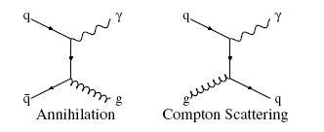
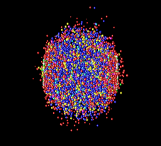
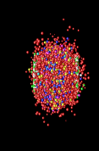
Motivation
Direct photon and e+e- pairs
------ ideal electroweak probes
suffer no strong interaction, traverse the medium with minimum interaction
produced throughout all stages of the evolution of the system
Direct photon:
high p_{T} photons (>5GeV/c) : initial hard scattering
low p_{T} photons (1-5GeV/c) : access QGP production
γ
Jet
γ
e
μ
Time
π
φ
p
K
π
Λ
cc
time
freeze-out
hadronization
formation and
thermalization
of quark-gluon
matter
Similar process for virtual photon production,
which could convert into e⁺e⁻ pair.
hard parton scattering(primordial)
Space
Au
Au
$$γ^{∗}→e^{+}e^{−}$$

Slide 4
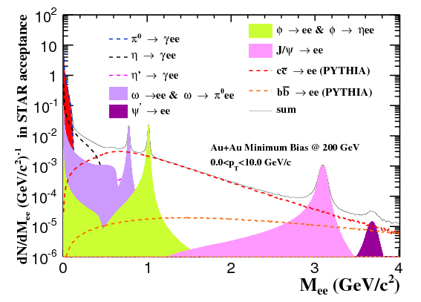
Motivation
e⁺e⁻ pairs:
higher invariant mass => earlier production
Low Mass Region
In-medium modification of vector mesons
Intermediate Mass Region
QGP thermal radiation
Semi-leptonic decay of correlated charm:
charm modification in Au+Au
High Mass Region
Heavy quarkonia
Drell-Yan process
Cocktail simulation in Au+Au 200GeV

Slide 5
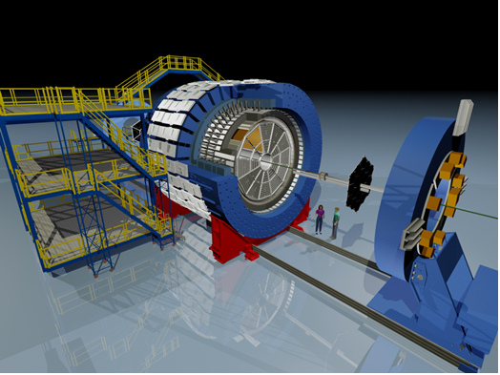
STAR detectors
Key detectors used in the analysis:
Time Projection Chamber:
|η| < 1 0<Φ<2π
Main tracking detector: track, momenta, ionization energy loss (dE/dx)
Time Of Flight:
|η| < 0.9 0<Φ<2π
Intrinsic timing resolution ~ 75 ps
Time-of-flight measurement
Barrel Electro-Magnetic Calorimeter:
|η| < 1 0<Φ<2π
Trigger on and measure high-p_{T} processes
Time Projection Chamber
Beam Beam Counter
Muon Telescope Detector
Time Of Flight
Barrel ElectroMagnetic Calorimeter
Vertex Position Detector
Type | Year | Central | Min.Bias | EMC trigger (energy threshold 4.3GeV)
Au+Au 200GeV | 2010 | 220M | 240M
 | 2011 |  | 490M | 39M
p+p 200GeV | 2012 |  | 375M

Slide 6
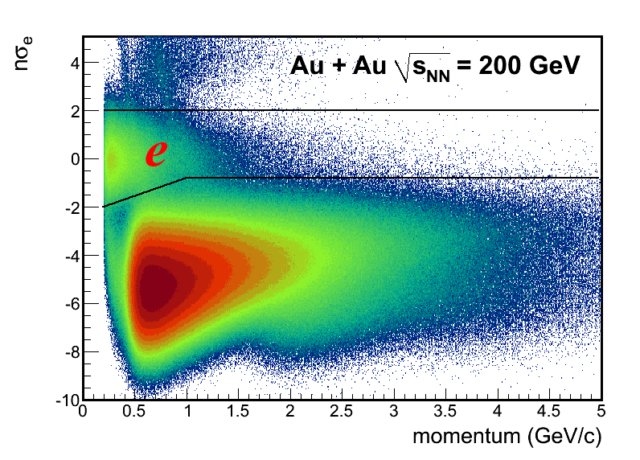
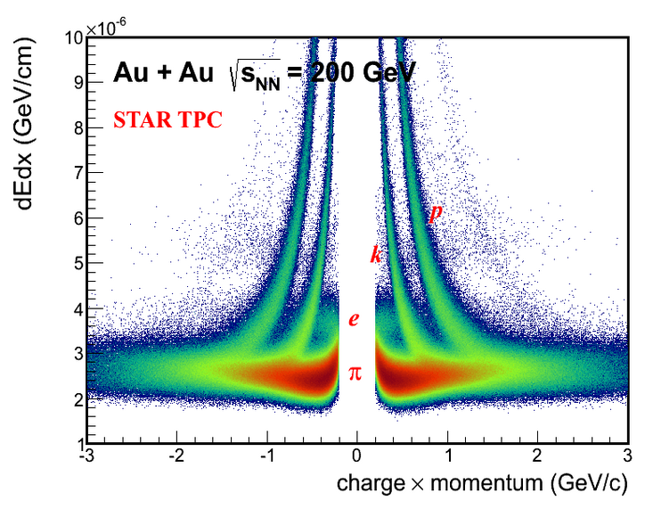
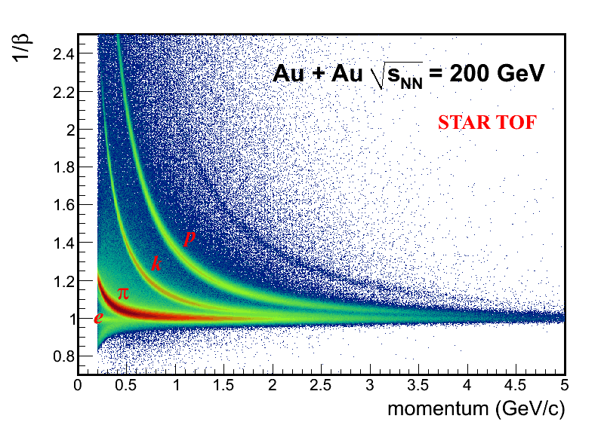
Electron identification
Time-Of-Flight provides clean electron identification from low to intermediate p_{T} which enables the dielectron measurements.
Require $β$ close
to speed of light
Collision system | Trigger | Momentum range | Purity
Au+Au 200GeV | Min.Bias | 0.2 – 2.0 GeV/c | ~95%
 | Central | 0.2 – 2.0 GeV/c | ~93%
 | EMC trigger | 3.5 – 6.0 GeV/c | Up to 80%
p+p 200GeV | Min.Bias | 0.2 – 2.0 GeV/c | ~98%

Slide 7
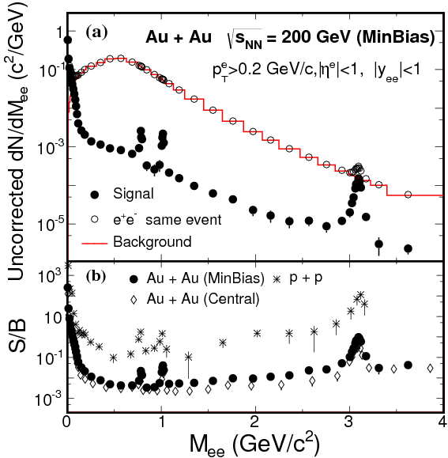
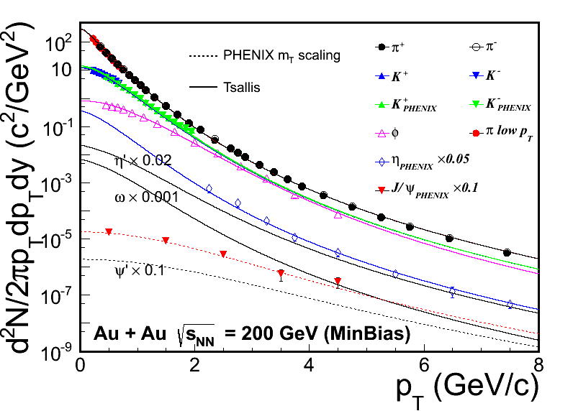
Invariant mass distribution and cocktail input for Au+Au at $\sqrt{s_{NN}}=$ 200GeV
Phys. Rev. Lett. 113 (2014) 22301
Input p_{T} spectra
p + p S/B : STAR Collaboration, Phys.Rev. C 86, 024906 (2012).
PHENIX Collaboration, Phys. Rev. C 81, 034911 (2010)
STAR Collaboration, Phys. Rev. Lett. 92, 112301 (2004)
STAR Collaboration, Phys. Lett. B 612, 181 (2005).
STAR Collaboration, Phys. Rev. Lett. 97, 152301 (2006)
Z. Tang et al. Phys. Rev. C 79, 051901 (2009)
M_{ee} < 1 GeV/c² Like sign background
M_{ee} >= 1 GeV/c² Mixed event background

Slide 8
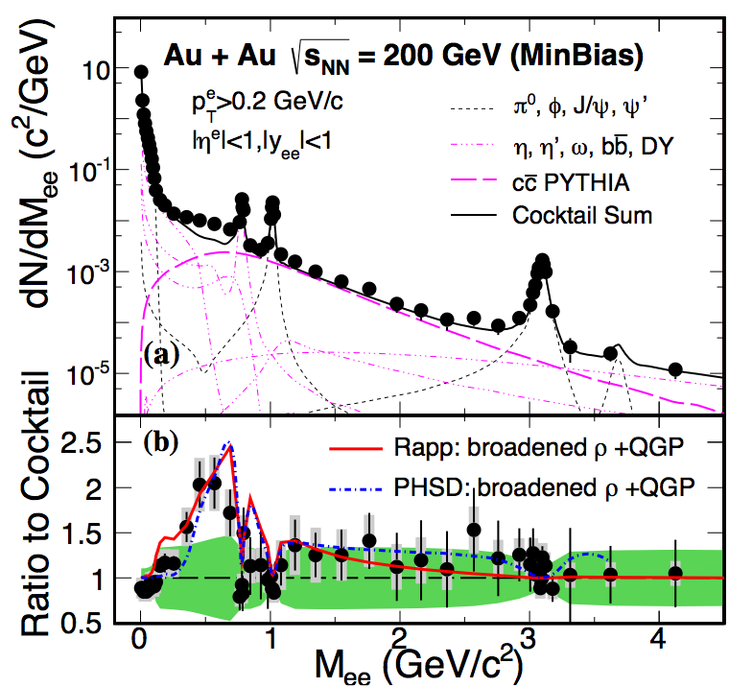
Au+Au at $\sqrt{s_{NN}}=$ 200GeV results
Phys. Rev. Lett. 113 (2014) 22301
The measured enhancement factor
at ρ-like region(0.30-0.76 GeV/c² ) is
1.77 ± 0.11(stat.) ± 0.24 (sys.) ± 0.33 (cocktail)
in Min.Bias
Comparison with models based on a ρ-broadening scenario :
Model I : effective many-body model
[R. Rapp, PoS CPOD2013, 008 (2013)]
2) Model II : Parton-Hadron String Dynamics (PHSD)
[O. Linnyk et al., Phys. Rev. C 85, 024910 (2012)]
Models show good agreement with data within uncertainty.

Slide 9
e⁺e⁻ pairs from internal conversion
Relation between real photon yield and the associated e⁺e⁻ pairs:
$\frac{d^{2}N_{ee}}{dM}=\frac{2α}{3π}\frac{L\left(M\right)}{M}S(M,q)dN_{γ}$
$L\left(M\right)=\sqrt{1−\frac{4m_{e}^{2}}{M^{2}}}(1+\frac{2m_{e}^{2}}{M^{2}})$
$S\left(M,q\right)=\frac{dN_{γ^{∗}}}{dN_{γ}}$
$\left(1−r\right){ f}_{c} + r{ f}_{dir}$ : two-component fit to e⁺e⁻ continuum.
pass STAR acceptance
normalize to 0-30MeV/c²
cocktail normalized
to 0-30MeV/c²
Direct photons can be measured by
the associated e⁺e⁻ production.
S = 1 => direct photon ($p_{T}≫M, M≫m_{e}$)
cocktail component
direct virtual photon component
$$r= \frac{yield of direct photon}{yield of inclusive photon}$$

Slide 10
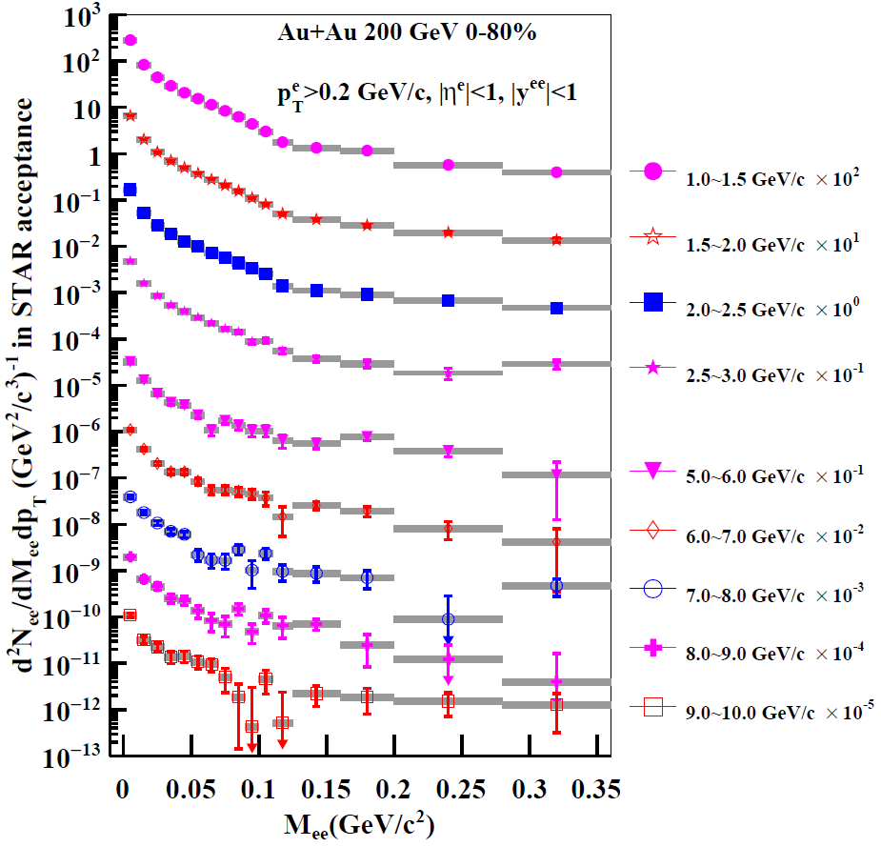
Low mass e⁺e⁻ continuum
1-3 GeV/c
Run10+Run11 MB data
5-10 GeV/c
Run11 EMC triggered data
[arXiv:1607.01447]
The statistical and systematic uncertainties are shown by the bars and bands, respectively.

Slide 11
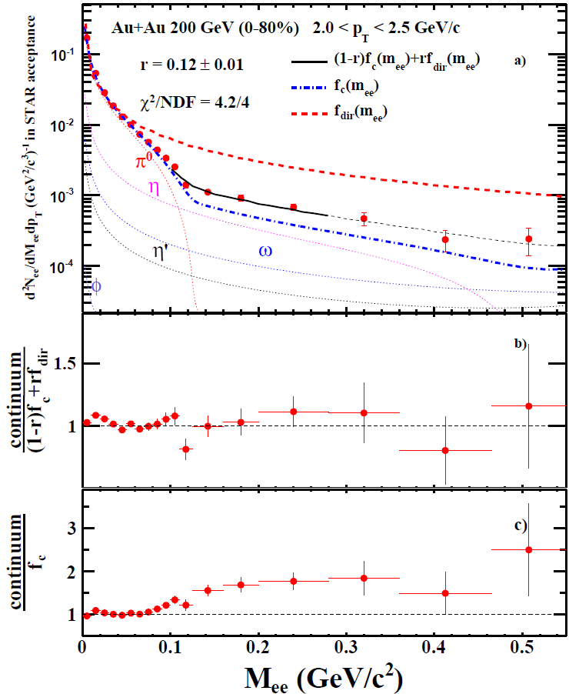
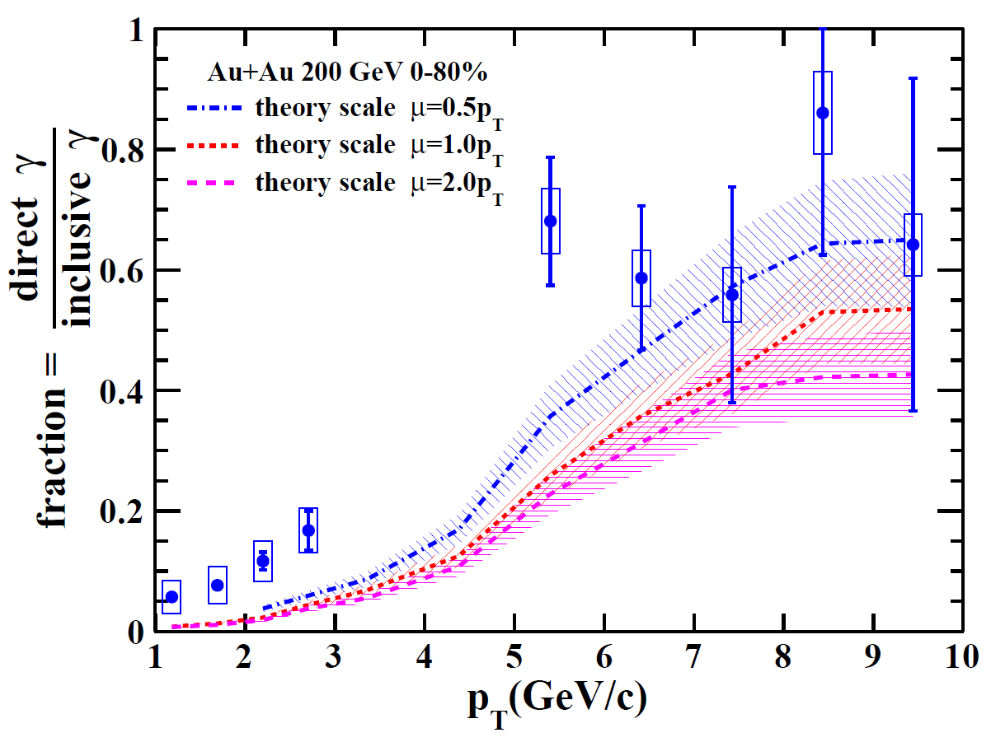
Two component fit and fraction of direct photon
[arXiv:1607.01447]
The curves represent NLO pQCD prediction: $\frac{T_{AA}dσ_{γ}^{NLO}\left(p_{T}\right)}{dN_{γ}^{inclusive}\left(p_{T}\right)}$
L. E. Gordon and W. Vogelsang, Phys. Rev. D 48, 3136 (1993).
PHENIX Collaboration, Phys.Rev.L 98, 012002 (2007).
PHENIX Collaboration, Phys.Rev.L 104,132301(2010).
Compared to p+p reference, an excess is observed in low p_{T}

Slide 12
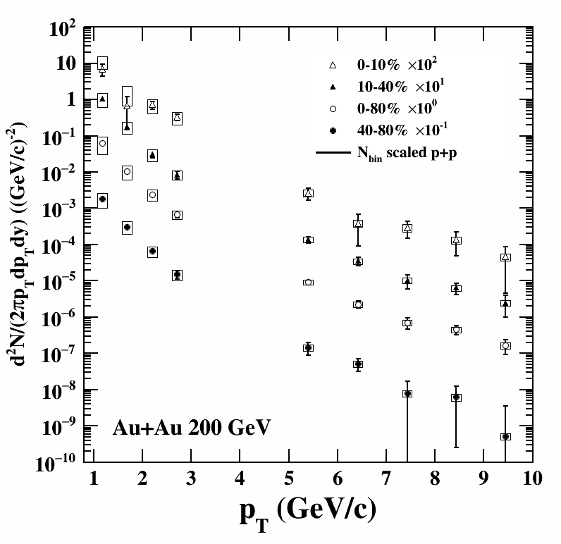
Direct photon invariant yield
[arXiv:1607.01447]

Slide 13
Direct photon invariant yield
No η measurement for cocktail simulation input
Large uncertainty (>100%)
3<p_{T}<5 GeV/c
low purity and statistics
[arXiv:1607.01447]

Slide 14
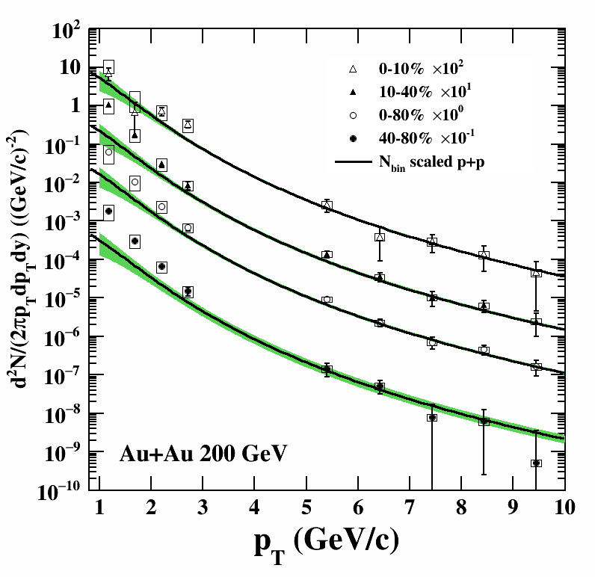
Direct photon invariant yield
In the high p_{T} range above 6 GeV/c
the yield is consistent with a T_{AA} scaled fit function to PHENIX pp data.
[A. Adare et al. Phys.Rev.C.81:034911, (2010)]
[S.S. Adler et al. Phys.Rev.Lett., 98:012002, (2007)]
In the p_{T} range 1~3 GeV/c
Compared to the pp reference,
an excess is observed in 10-40%
and 40-80%.
[arXiv:1607.01447]

Slide 15
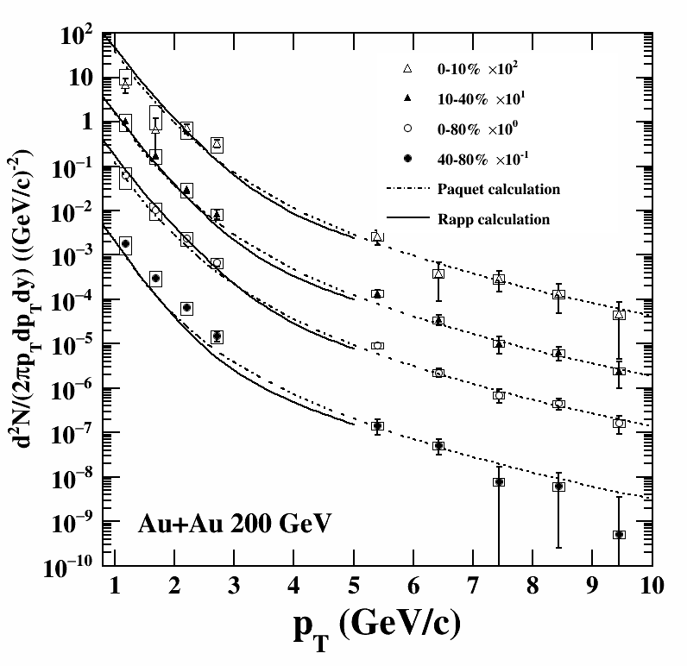
Compared to model prediction
Rapp calculation:
elliptic thermal fireball evolution
(consistent with their (2+1)-D hydrodynamic evolution (beam-direction independent))
Paquet calculation:
(2+1)-D hydrodynamic evolution
both models include:
QGP thermal radiation
in-medium meson
mesonic interactions in the hadronic gas
primordial contributions from the initial hard parton scattering
H. van Hees, C. Gale, and R. Rapp
[Phys. Rev. C 84, 054906 (2011)]
H. van Hees, M. He, and R. Rapp
[Nucl. Phys. A 933, 256 (2015)]
J.-F. Paquet et al.,
[Phys. Rev. C 93, 044906 (2016)]
private communications
[arXiv:1607.01447]

Slide 16
Compared to model prediction
p_{T} 1-3 GeV/c:
thermal radiation dominant
p_{T} > 6 GeV/c:
initial hard-parton scattering dominant
The comparison shows consistency between both
model calculations and measurements within uncertainties for all the other centralities except 40-80% centrality.
40-80% includes peripheral collisions,
where hydrodynamic calculations might not be applicable.
H. van Hees, C. Gale, and R. Rapp
[Phys. Rev. C 84, 054906 (2011)]
H. van Hees, M. He, and R. Rapp
[Nucl. Phys. A 933, 256 (2015)]
J.-F. Paquet et al.,
[Phys. Rev. C 93, 044906 (2016)]
private communications
[arXiv:1607.01447]

Slide 17
Total yield and excess yield
The model calculations are consistent with our measurements within uncertainties in central and semi-central for both excess and total direct photon yield.
H. van Hees, C. Gale, and R. Rapp
[Phys. Rev. C 84, 054906 (2011)]
H. van Hees, M. He, and R. Rapp
[Nucl. Phys. A 933, 256 (2015)]
J.-F. Paquet et al.,
[Phys. Rev. C 93, 044906 (2016)]
private communications
[arXiv:1607.01447]

Slide 18
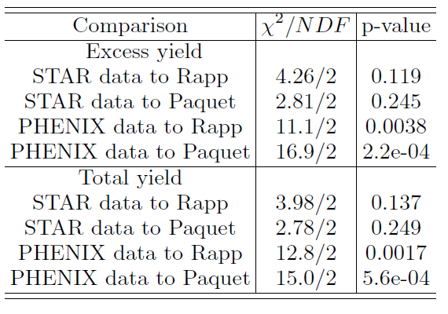
Total yield and excess yield
PHENIX collaboration
[Phys. Rev. C 91, 064904 (2015)]
H. van Hees, C. Gale, and R. Rapp
[Phys. Rev. C 84, 054906 (2011)]
H. van Hees, M. He, and R. Rapp
[Nucl. Phys. A 933, 256 (2015)]
J.-F. Paquet et al.,
[Phys. Rev. C 93, 044906 (2016)]
private communications
[arXiv:1607.01447]

Slide 19
Summary
Presented the direct photon measurement (1-3 and 5-10 GeV/c) from low-mass e⁺e⁻ excess in Au+Au collisions at STAR at $\sqrt{s_{NN}}$=200GeV
An enhancement compared with PHENIX p+p results is observed for 1-3 GeV/c in 10-40% and 40-80%
In the p_{T} range above 6 GeV/c there is no clear enhancement observed for all the centralities
Model predictions including the contributions from thermal radiation and initial hard-processes are consistent with our direct photon yield within uncertainties in central and mid-central collisions
In 40-80% centrality bin, the model calculation results are systematically lower than our data for 1<p_{T} <3 GeV/c
Outlook:
Direct photon in 62 GeV Au+Au collisions to study its behavior close to critical temperature
May have enough statistics from future RHIC run

