Slide 1




Characterizing the away-side jet with robust flow background subtraction via two- and three-particle correlations in Au+Au Collisions at √s_{NN} = 200 GeV in STAR
Kun Jiang
University of Science and Technology of China (USTC)
(for the STAR collaboration)
Kun Jiang
Hard Probes 2016, Wuhan, China
1

Slide 2

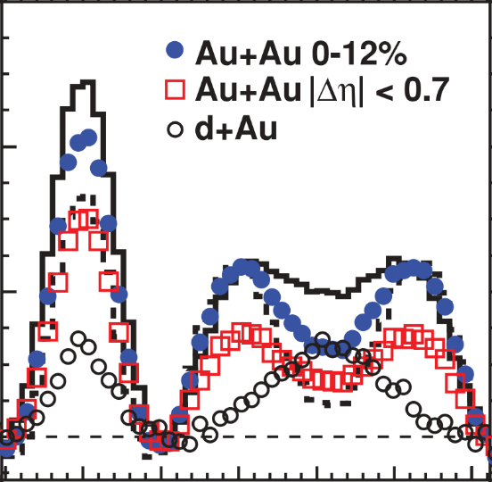
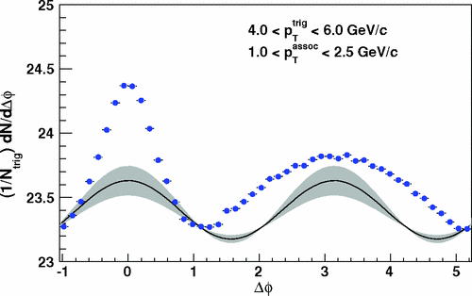

Motivation
Energetic partons lose energy due to interactions in the dense medium
Measurements of medium modifications of jets have so far been obscured by the large anisotropic flow background. Flow background decreases with p_{T}. Flow shape and amplitude are not precisely known.
All orders of v_{n} are possible and need to be subtracted
We devise a method to subtract flow background using data
PRC 82 (2010) 024912
1/N_{trig} dN/dΔφ
Δφ
Kun Jiang
Hard Probes 2016, Wuhan, China
2

Slide 3
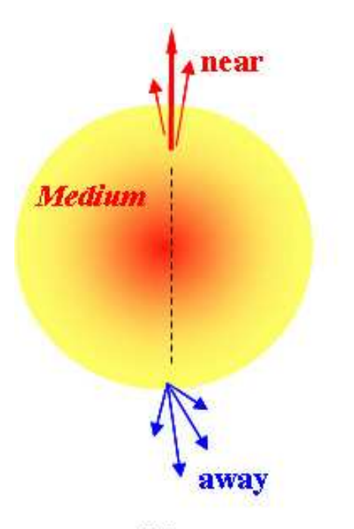
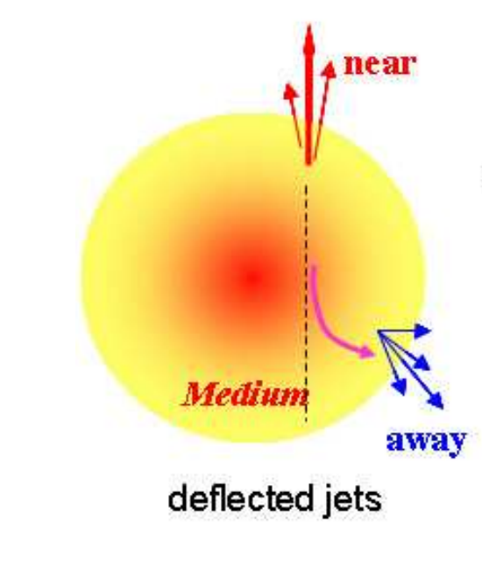
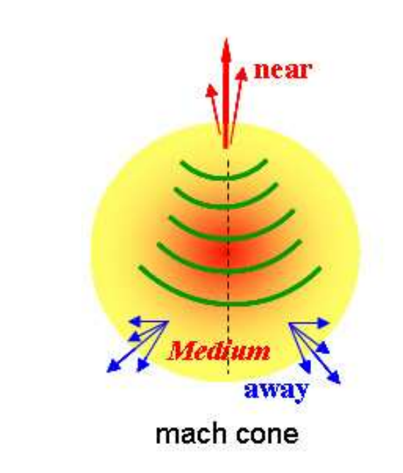
Possible effects of jet-medium interactions
Nuclear k_{T} effect
Event averaging of away-side jets deflected by medium flow
Collective medium excitation by Mach cone shock waves
k_{T}
Kun Jiang
Hard Probes 2016, Wuhan, China
3

Slide 4
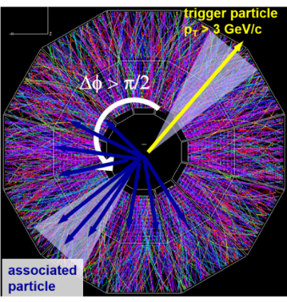
P_{x}: projection of away-side p_{T} onto trigger axis
ε: single-particle acceptance × efficiency
STAR preliminary
For each centrality, cut on the left tail of the distribution (fraction of events) to enhance away-side jet population
Kun Jiang
Kun Jiang
Hard Probes 2016, Wuhan, China
4
4

Slide 5
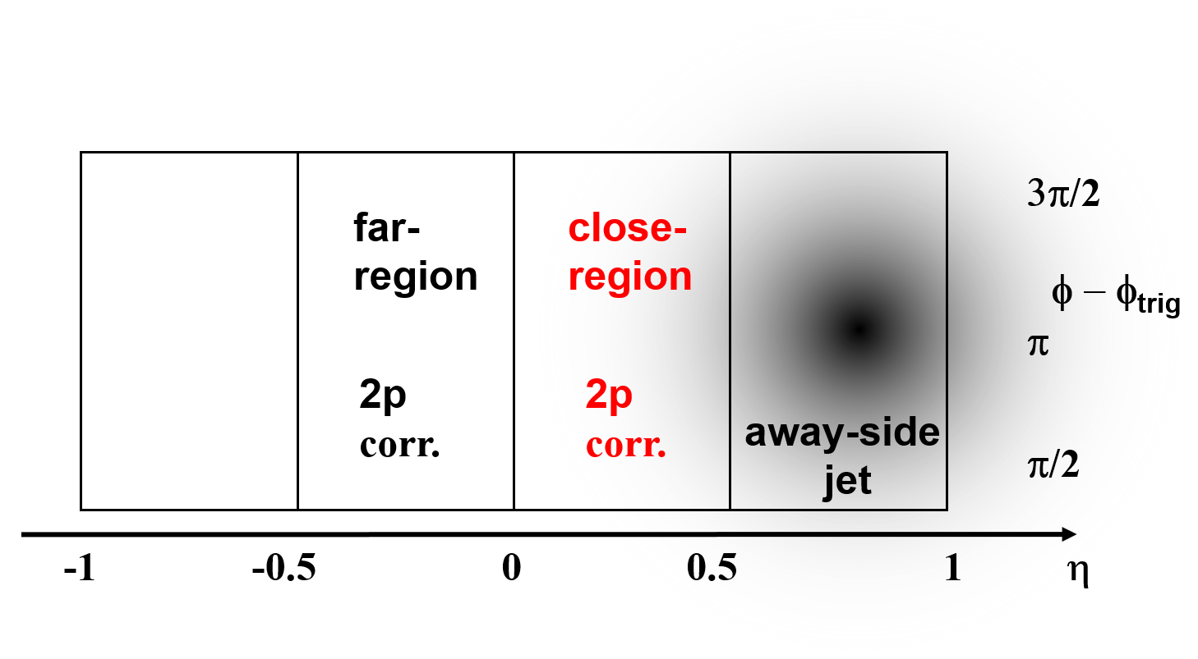
Methodology for two-particle correlations
Trigger particle |η| < 1
Select events with a large recoil momentum (P_{x}) within a given η window (cartoon 0.5<η<1) from a high-p_{T} trigger particle to enhance away-side jet population
Analyze di-hadron correlations in close-region and far-region respectively
Flow contributions to close-region and far-region are equal
close-region 2p corr. = flow + near-side jet + away-side jet ∗ fraction_close
far-region 2p corr. = flow + near-side jet + away-side jet ∗ fraction_far
Kun Jiang
Hard Probes 2016, Wuhan, China
5

Slide 6
STAR Au+Au 200 GeV
STAR TPC
STAR preliminary
far-
region
close-
region
away-side jet
close-region 2p corr. = flow + near-side jet
+ away-side jet ⋅ fraction_close
far-region 2p corr. = flow + near-side jet
+ away-side jet ⋅ fraction_far
preliminary
Near-side almost equal as expected
Flow backgrounds are the same in close-region and far-region, cancelled in their difference
Quantify the shape by Gaussian fit σ
Δφ(rad)
Kun Jiang
Hard Probes 2016, Wuhan, China
6

Slide 7
Away-side jet correlation shape
STAR
preliminary
STAR
preliminary
STAR
preliminary
STAR
preliminary
The correlation shape is consistent with Gaussian.
Kun Jiang
Hard Probes 2016, Wuhan, China
7

Slide 8
Away side jet correlation width
Away-side jets are modified:
Moderate to high p_{T}
associated particles: broaden
with increasing centrality
Shape for all p_{T} more similar in central than in peripheral collisions
STAR preliminary
The horizontal caps indicate the systematic error
Kun Jiang
Hard Probes 2016, Wuhan, China
8

Slide 9
Comparison to pp and dAu
PRD 74 (2006) 072002
PRC 73 (2006) 054903
PLB 743 (2015) 333-339
The leftmost 3 sets of
data are for
PHENIX p+p
PHENIX d+Au
STAR d+Au
Minbias
pp and dAu:
No P_{x} cut is applied.
Momentum cuts in the ref. are slightly different
STAR preliminary
Peripheral data are consistent with pp/dAu
Kun Jiang
Hard Probes 2016, Wuhan, China
9

Slide 10
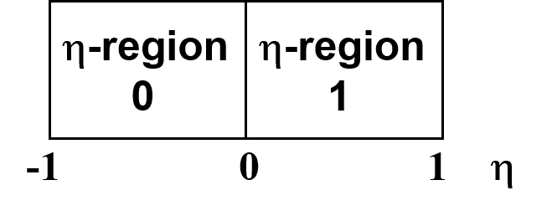
Methodology for three-particle correlations
Suppose an event is composed of: (besides the High-p_{T} trigger particle T)
A: Jets correlated with the trigger (di-jet)
f: flow background
a: jets uncorrelated with the trigger
Two lower p_{T} associated particles
same η-region pairs
= TAA+TAf+TAa+TfA+Tff+Tfa+TaA+Taf+Taa
(signal + combinatorial bkg + bkg jets)
cross η-region pairs
= TAf+TAa+TfA+Tff+Tfa+TaA+Taf
(combinatorial bkg)
same η-region pairs - cross η-region pairs
= TAA + Taa (signal + bkg jets)
No P_{x} cut is applied in 3-p correlations
Kun Jiang
Hard Probes 2016, Wuhan, China
10

Slide 11
Background jets Taa
Background jets in triggered events = jets in min-bias events
(no requirement of a trigger, normalized per event)
Suppose the number of jets is Poisson distributed with an average of λ. the probability to have n jets per event is
The probability of having a trigger particle with (n-1) background jets is
This is identical to the probability to have (n-1) jets per event for minbias events
We can construct the jet background Taa by min-bias events w.r.t. a random “trigger” φ
Kun Jiang
Hard Probes 2016, Wuhan, China
11

Slide 12
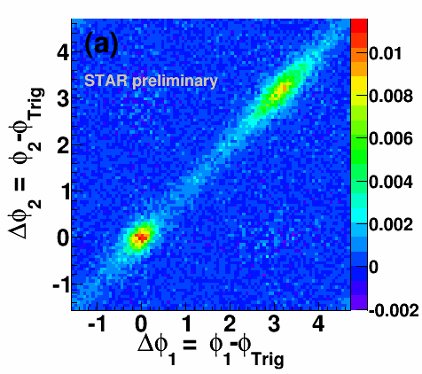
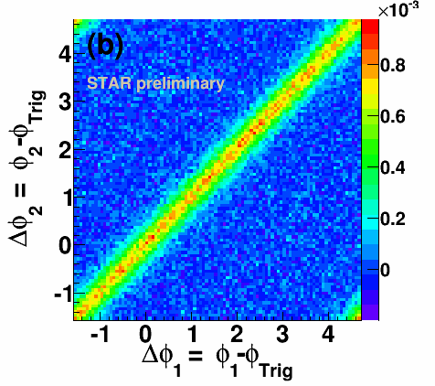
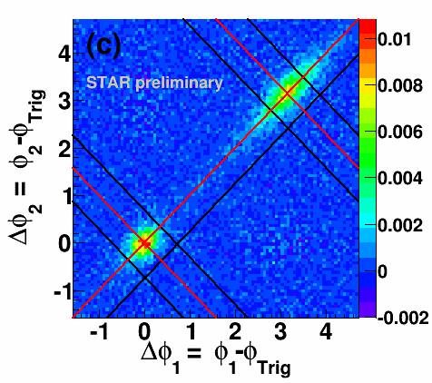
Three-particle azimuthal correlations
3<p_{T}^{trig}<10 GeV/c, 2<p_{T}^{assoc}<3 GeV/c
60-80% Au+Au
TAA + Taa Taa TAA
Same η-region correlations
- cross η-region correlations
Backgroud jet correlations
Background-subtracted three-particle correlations
What’s left in three-particle correlations are the short range correlations on both the near side and away side
Kun Jiang
Hard Probes 2016, Wuhan, China
12

Slide 13
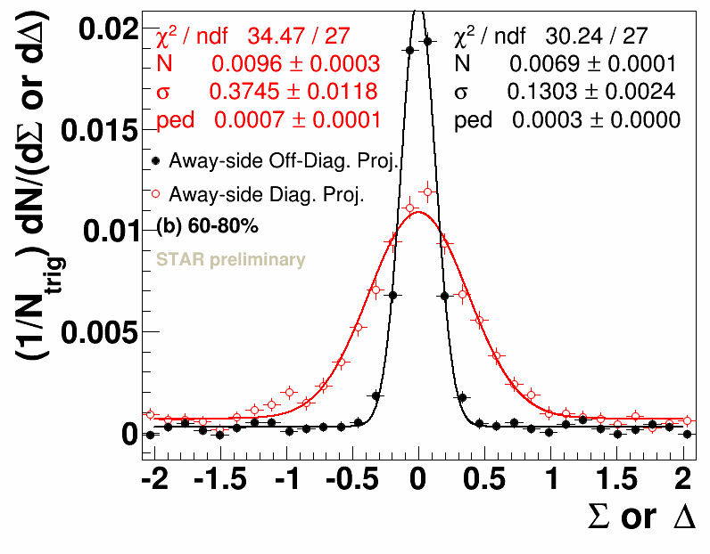
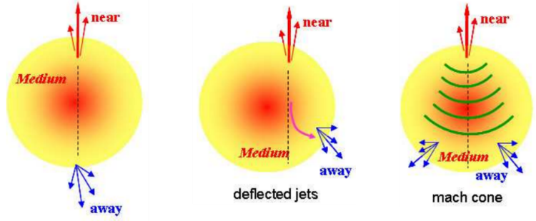
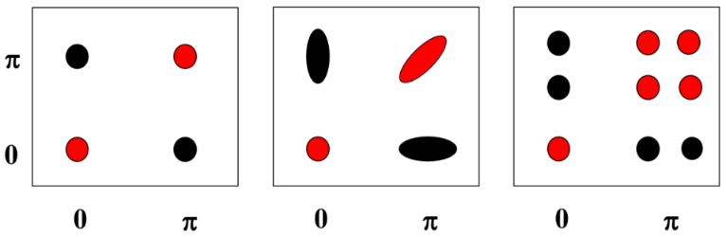
Intra-jet and inter-jet correlation width
Unmodified
Di-jets
Deflected jets
or k_{T} effect
Conical
emission
Σ = (Δφ₁+Δφ₂)/2-π, Δ = (Δφ₁-Δφ₂)/2
Δφ₂=φ₂-φ_{Trig}
Δφ₁=φ₁-φ_{Trig}
Off-diagonal projection: intra-jet correlations (|Σ|<0.35)
Diagonal projection: inter-jet correlations (0<Δ<0.35)
STAR preliminary
Away side: inter-jet correlation >> intra-jet correlation → significant k_{T} and/or flow deflection.
Intra-jet correlation: σ near = away and no centrality dependence → little jet modification?
Requirement of a trigger (p_{T} > 3 GeV/c) and two associated particles (2 < p_{T} < 3 GeV/c) bias towards unmodified jets?
Kun Jiang
Hard Probes 2016, Wuhan, China
13

Slide 14
Conclusions
Novel methods were devised to measure away-side jet correlations with clean, robust flow subtraction using data.
Away-side jets are modified
  Correlation broadens with centrality except low p_{T}
Three-particle azimuthal correlations
  Away-side: inter-jet correlations is significantly broader than intra-jet correlations → significant k_{T} and/or flow deflection.
  Intra-jet correlations: similar between near- and away-side, and no centrality dependence is found. → Little jet-shape modification on the away side?
  p_{T} cuts bias towards unmodified jets?
Kun Jiang
Hard Probes 2016, Wuhan, China
14

Slide 15
Kun Jiang
Hard Probes 2016, Wuhan, China
15
Thank you！

Slide 16
Backup slides
Kun Jiang
Hard Probes 2016, Wuhan, China
16

Slide 17
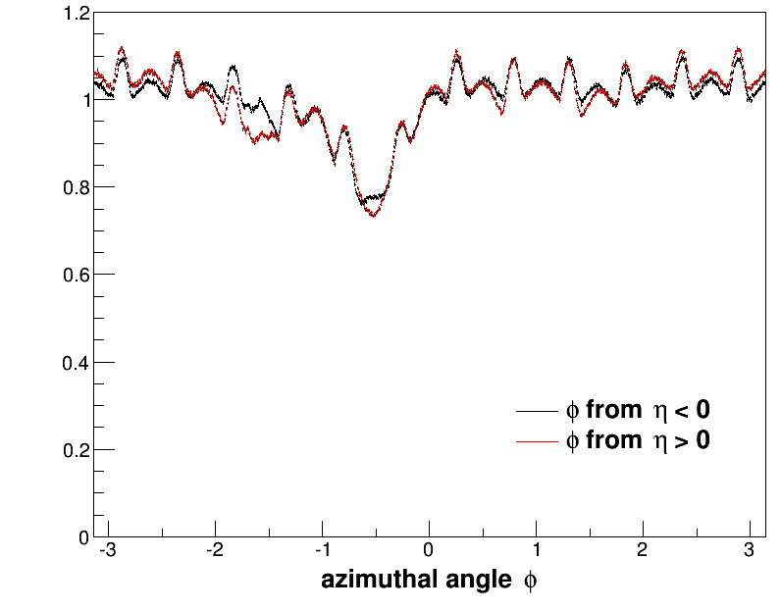
Correct for φ-dependent acceptance × efficiency
Normalize the single particle φ distribution to average unity. The inverse of that will be the φ-dependent efficiency
Done run-by-run (and runs with same efficiency grouped together)
Corrections are done as a function of centralities
Apply φ-dependent efficiency correction for P_{x} calculation and di-hadron correlations
Kun Jiang
Hard Probes 2016, Wuhan, China
17

Slide 18
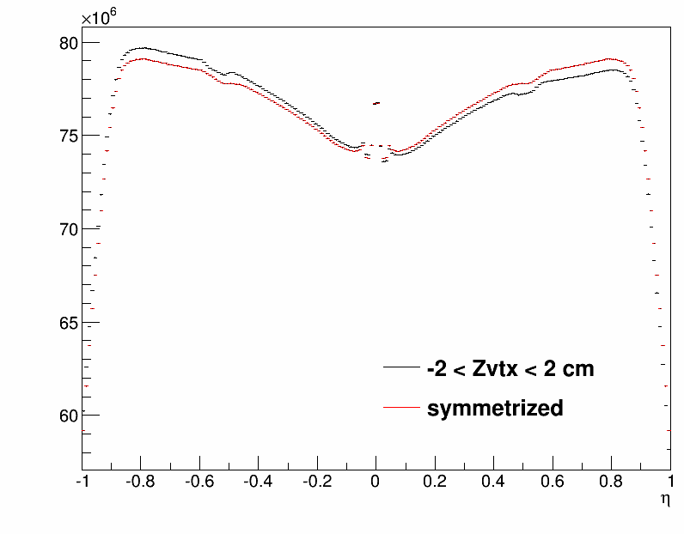
Correct for η-dependent acceptance × efficiency
Treat symmetrized dN/dη distribution in events with |z_{vtx}| < 2 cm as the baseline
Take the inverse of the ratio of the dN/dη distribution from each z_{vtx} bin to this baseline
Apply η-dependent efficiency correction for P_{x} calculation and di-hadron
correlations
Kun Jiang
Hard Probes 2016, Wuhan, China
18

Slide 19
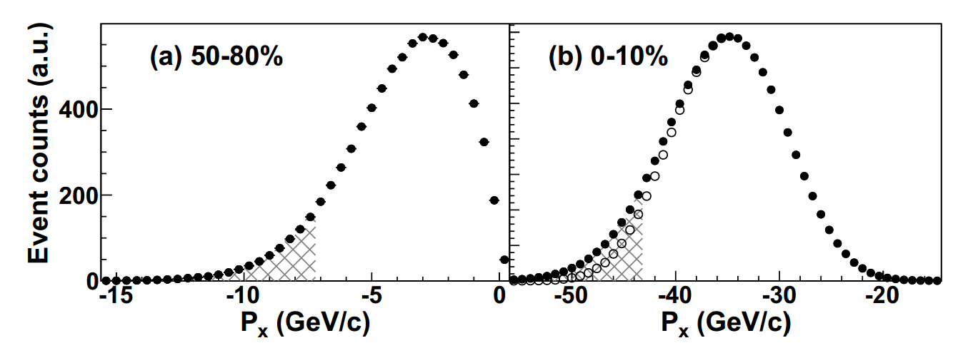
Systematic study
Vary P_{x} cut to vary the relative contributions of jets and background fluctuations to the selected events.
  From allowing 10% of events to 2%, 5%, 15%, 20%, 30%, 50% of events.
  Assign a systematic error of 3.2% from P_{x} cut
Vary track quality cut
  A systematic error of 1.5% form dca (distance of closest approach to the collision vetex)
  A systematic error of 2.0% from nhitsfit (number of TPC hits)
Kun Jiang
Hard Probes 2016, Wuhan, China
19

Slide 20
Systematic study
Vary the close- and far-region η window locations and ranges, vary P_{x} η window location and range
  Effects of flow may be decorrelated over η due to geometry fluctuations
  The largest deviation of σ from the default results is approximately half of the statistical error
  Assign a systematic error of 2.5% as another source of systematic uncertainty
STAR TPC
far-
region
close-
region
away-side jet
0 η
 | Set 0, 1, 2 | Set 0, 1 | Set 0, 2
1. Vary close- and far- | -0.10 +/- 0.17 | 0.44 +/- 0.16 | -0.64 +/- 0.25
2. Vary close- and far- (with η gap) | 0.00 +/- 0.13 | 0.34 +/- 0.17 | -0.34 +/- 0.17
3. Vary P_{x} | -0.21 +/- 0.20 | -0.50 +/- 0.27 | 0.08 +/- 0.26
4. New P_{x}, Vary close- and far- | 0.00 +/- 0.15 | 0.11 +/- 0.21 | -0.11 +/- 0.16
Kun Jiang
Hard Probes 2016, Wuhan, China
20

Slide 21
Systematic study
Summary of systematic errors
Source | Percent
P_{x} | 3.2%
dca | 1.5%
nhitsfit | 2.0%
η windows | 2.5%
Kun Jiang
Hard Probes 2016, Wuhan, China
21

Slide 22
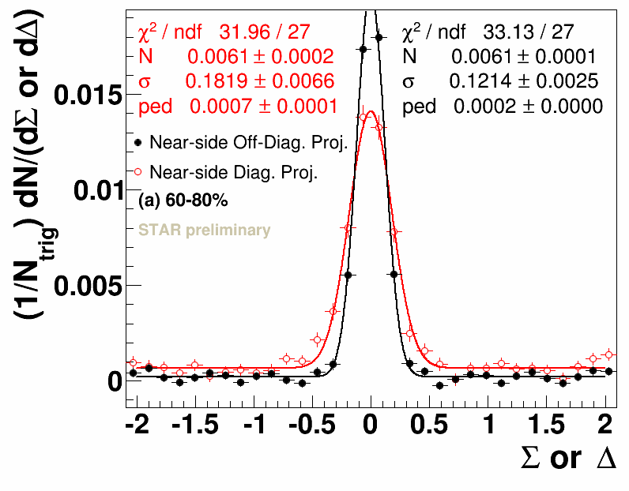
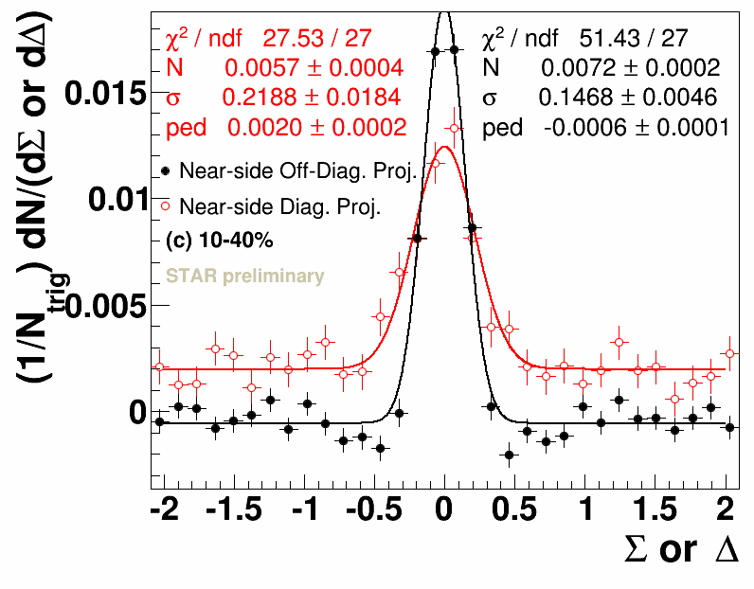
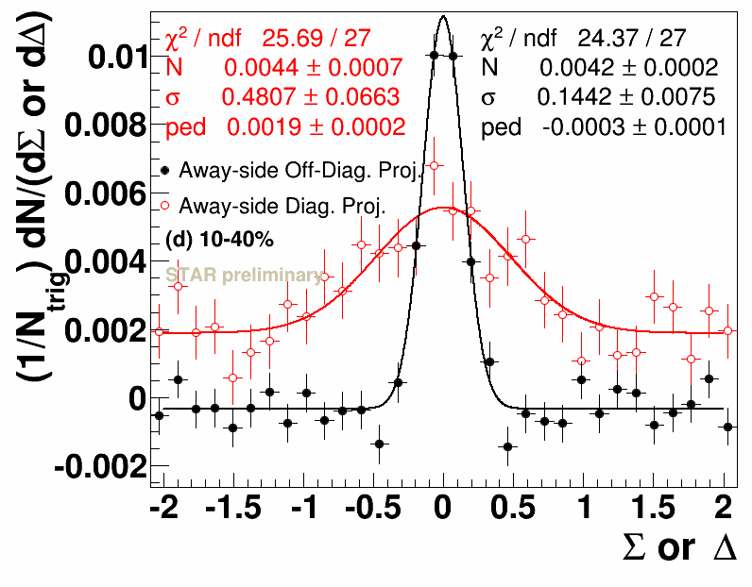
Intra-jet and inter-jet correlations
Off-diagonal projection: intra-jet correlations
Diagonal projection: inter-jet correlations
Σ = (Δφ₁+Δφ₂)/2-π (away-side) or
Σ = (Δφ₁+Δφ₂)/2 (near-side)
Δ = (Δφ₁-Δφ₂)/2
Projections of near-side and away-side three-particle correlations along the diagonal Σ within 0<Δ<0.35 and off-diagonal Δ within |Σ|<0.35.
Kun Jiang
Hard Probes 2016, Wuhan, China
22

Slide 23
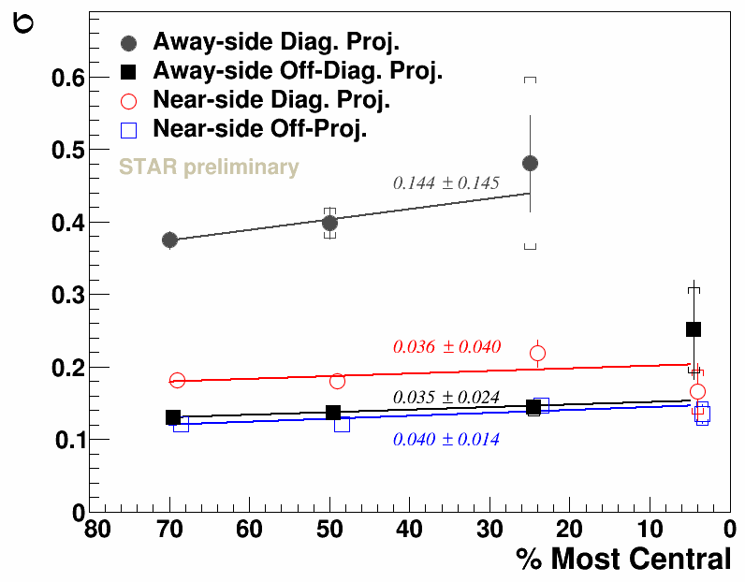
Intra-jet and inter-jet correlation
width: near-side
Systematic errors are estimated by varying track quality cuts
jet axis
jet axis
trigger
trigger
assoc
assoc
assoc
Near-side: σ diag > off-diag. → jet axis swing effect?
(the trigger and the two associated particles are likely on different sides of the jet axis)
Kun Jiang
Hard Probes 2016, Wuhan, China
23

Slide 24
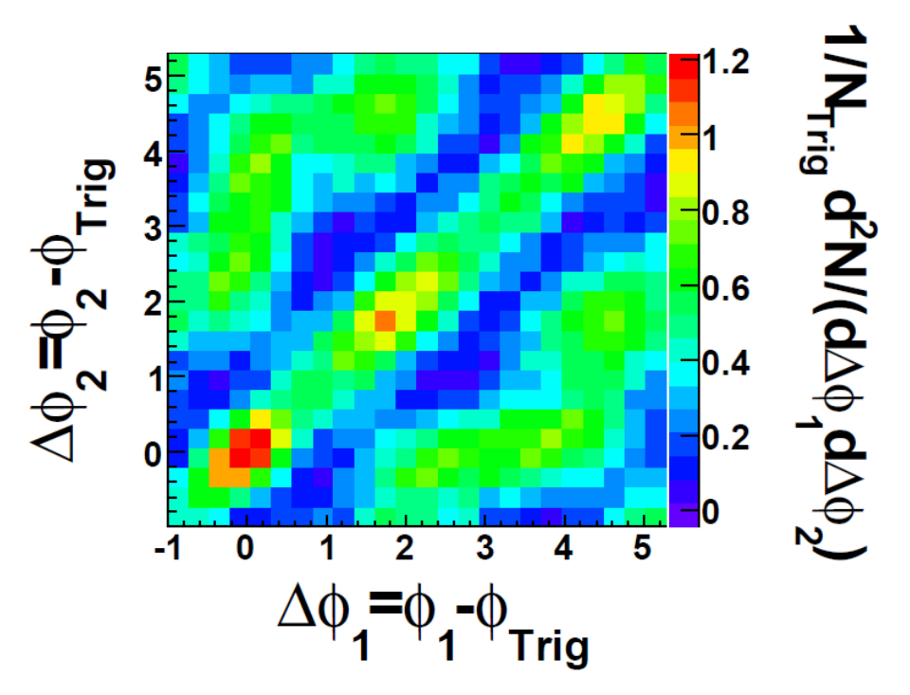
PRL 102 (2009) 052302
The v₂ and v₄ background subtracted three-particle correlations. 12% central Au+Au
Kun Jiang
Hard Probes 2016, Wuhan, China
24

