Slide 1
High-p_{T} Particles and RHIC Paradigm of Jet Quenching
Ahmed M. Hamed
NN2012
The 11th International Conference on
Nucleus-Nucleus Collisions

Slide 2
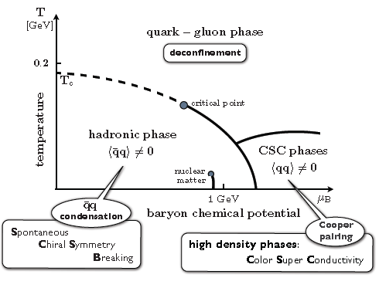
RHIC and QCD Phase Diagram
Condensed Matter (SSB) → Cosmology, Finite Temperature Field Theory
Theory of QCD phase diagram
Bag Model based model
Nambu-Jona-Lasinio- NJL model
Statistical Thermal model
Chiral Perturbation Theory
Lattice QCD
QCD matter (T ≈ 100 MeV) →
Relativistic Heavy Ion Collisions (QGP)?

Slide 3
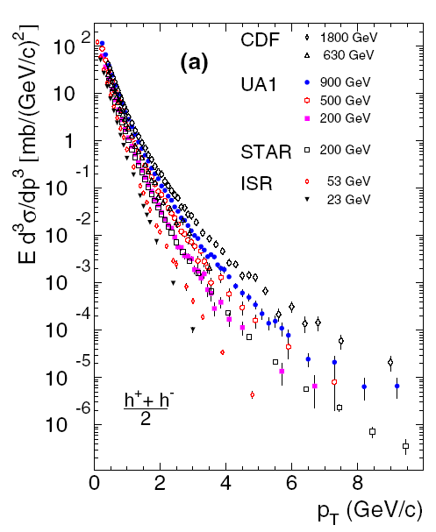
High-pt Particles
fragmentation of partons scattered with large momentum transfer
rates in the framework of pQCD
high-pt , leading,
particle
Jet
p
p
high momentum
transfer (exchange)
Yield = fractional energy carried by initial parton*hard scattering (parton interactions)*fractional energy carried by final particles
early time of the collisions (0.1 fm/c)

Slide 4
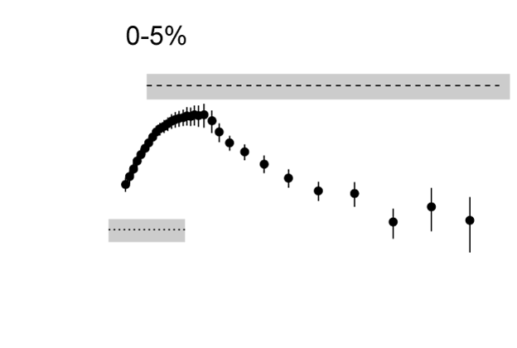
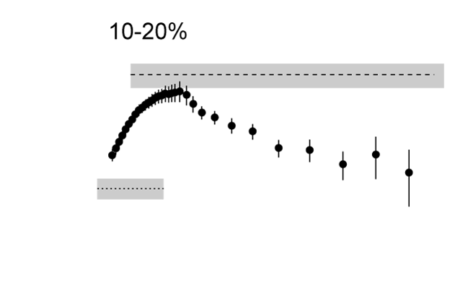
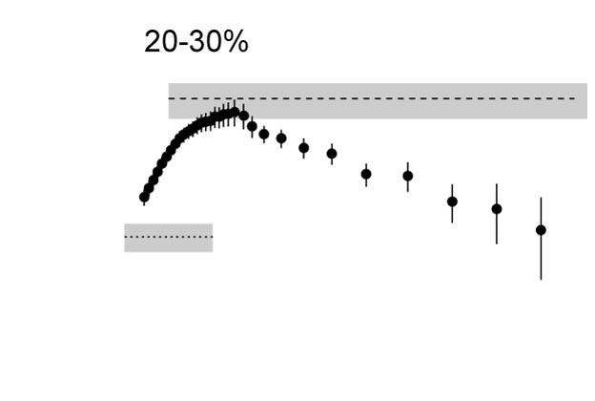
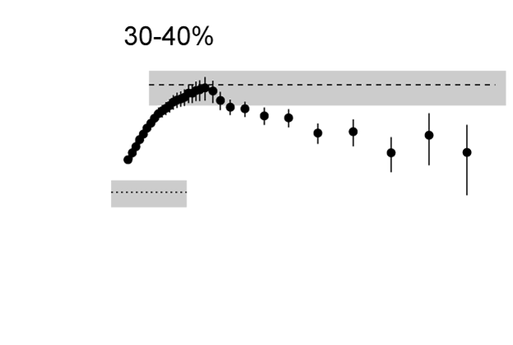
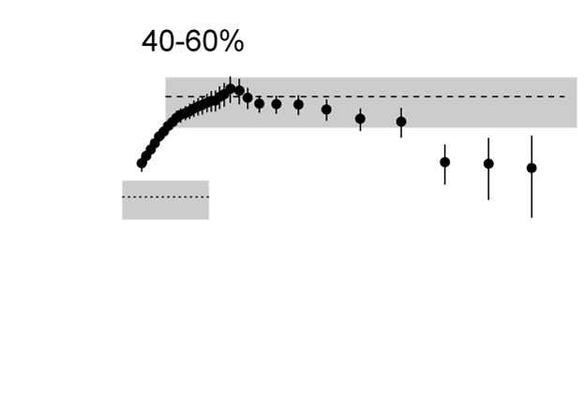
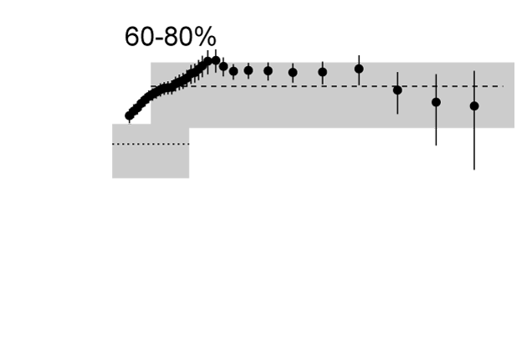
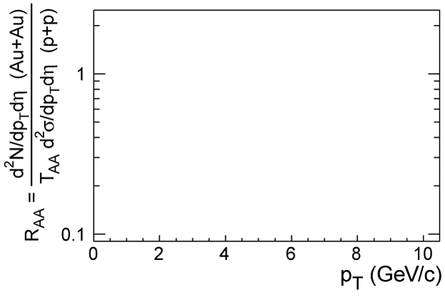
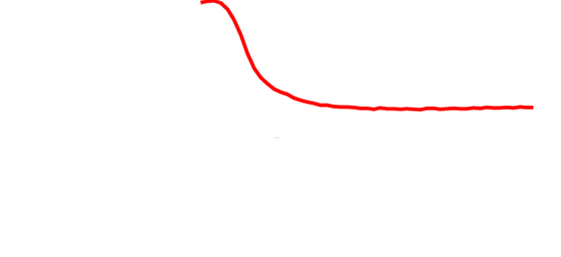
RHIC Paradigm of Jet Quenching-I
Yield_{(AA)}
≠ 1 → not incoherent superposition of pp collisions .
R_{AA} =
<N_{coll}>Yield_{(pp)}
≈ 0.2 → large suppression beyond CNM effect.
energy
loss
STAR, nucl-ex/0305015
Deduced ε ≈ 15 GeV/fm³ ~ 15*ε_{critical} (e.g. X.N. Wang nucl-th/0307036)
SYSTEM NEEDS TO BE PARTONIC

Slide 5
RHIC Paradigm of Jet Quenching-II
PRL 91 (2003) 072304
Jet quenching is final state effect
Surface bias
Recoil jet → quenched inside the medium
?
Surface emissions picture
Au+Au

Slide 6
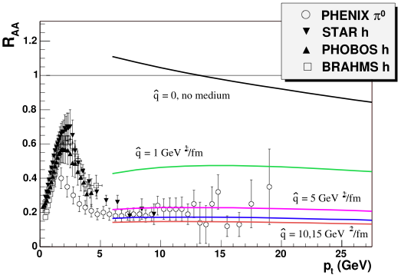
RHIC Paradigm of Jet Quenching-III
pQCD-based models → wide rang of medium parameters.
Hadrons (light quarks) → not calibrated probes

Slide 7
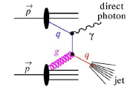
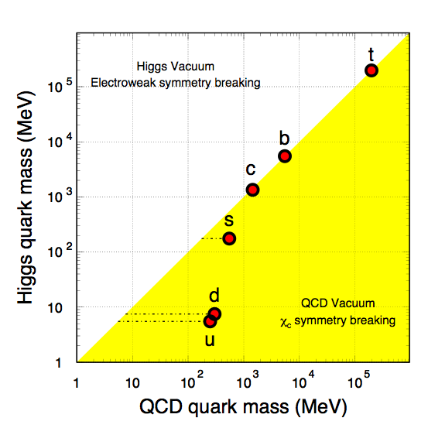
Calibrated Probes
P(Δ E) α f ( E, L, C_{R}, m)‏
1) E: parton initial energy
→ Direct photon
2) L: path length
→ Direct photon/hadrons
3) C_{R}: color factor (q/g)
4) m: quark mass
→ hadrons (Q)/hadrons (q)
γ
Surface bias
h
h±
2), and 3) → recoil jet from h to lose more energy than
that of γ^{dir}
→ Light quarks (q) are expected to lose
more energy than heavy quarks (Q)

Slide 8
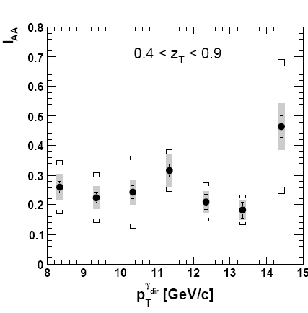
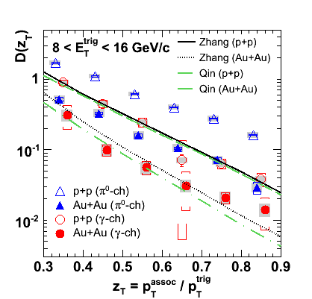
Recoil jet of direct photon-I
D_{AA}
I_{AA}
=
vs.
=
D_{NN}
Phys. Rev. C 82, 034909 (2010)
Phys. Rev. C 82, 034909 (2010)
The yields in p+p and Au+Au are well described by theory
Energy loss is independent of parton initial (negligible k_{T} !)

Slide 9
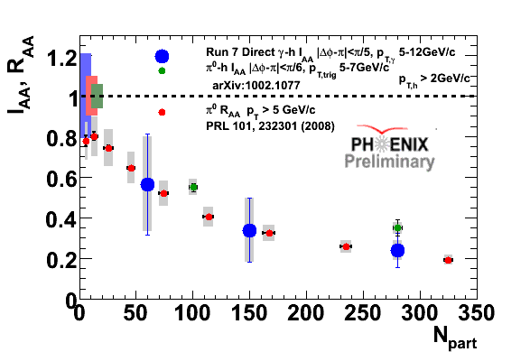
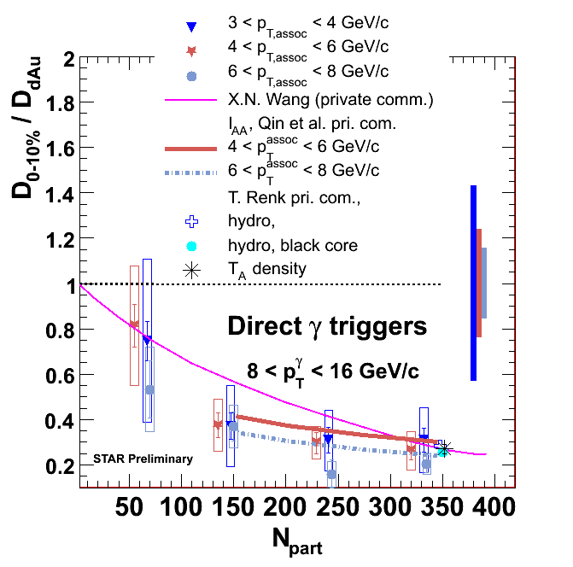
Recoil jet of direct photon-II
Centrality dependence
Conditional yield per π⁰ and direct photon triggers show similar level and pattern of suppression over wide range of centrality as R_{AA} of π⁰ and charged hadrons (light and heavy)

Slide 10
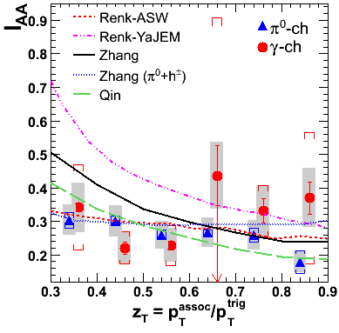
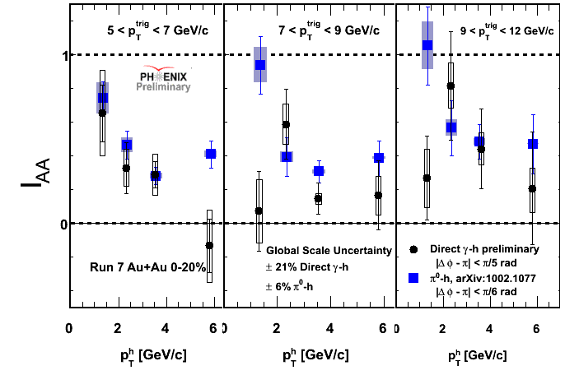
Recoil jet of direct photon-III
Phys. Rev. C 82, 034909 (2010)
Different techniques (STAR/PHENIX) → similar results
Unexpected similar level and pattern of suppression, challenge to theory!
Fragmentation photons? Dominance of fluctuations in energy loss?
Lower z_{T} ?

Slide 11
Conclusions
QCD phase diagram is of very rich structure and exploring these phases is a key theme of modern nuclear physics
The only mean (so far) to study hot nuclear matter is RHIC
High-p_{T} particles are crucial signature for QGP
Single hadron and di-jet analysis at mid η in pp, dAu, and AuAu support the final state effect “jet quenching” in AA
Theory - experiment comparison support the partonic energy
loss (light quarks) over the hadronic absorptions
Associated yields with direct photons show similar medium effect as
those associated with hadrons!
Calibrated probe/particle’s Id measurements have been started at
RHIC; many detector upgrades; and collider machine as well,
stay tuned.
Spanish poet Antonio Machado:
(Traveller, the road is nothing more than your footprints;
Traveller, there is no road, you make it as you go.

