Slide 1
Open charm hadron production via hadronic decays at STAR
STAR
David Tlusty
NPI ASCR, CTU Prague
for the STAR collaboration

Slide 2
Outline
Motivation
Analysis methods, Detector Setup and Particle Identification
D⁰ and D* in p+p 200 GeV collisions
D⁰ in Au+Au 200 GeV collisions
Analysis status on D⁰ and D* in p+p 500 GeV collisions
Summary

Slide 3
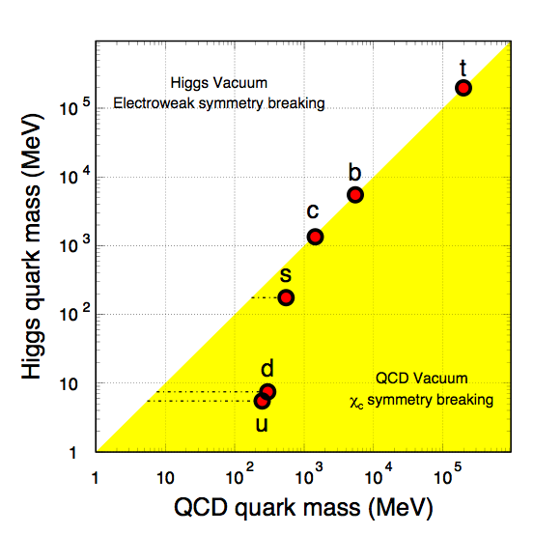
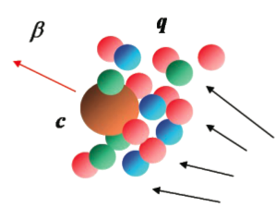
Why to study heavy quarks
X. Zhu, et al, PLB 647, 366(2007)
Produced in initial hard partonic collisions
Sensitive to initial gluon density and gluon distribution. Due to it’s large mass a good pQCD test at RHIC collision energies.
Heavy quark mass is believed to be external to QCD (=> stay heavy even in QGP)
Couple differently with the medium than light quarks. Reveal critical features of the medium
Spectra could be significantly modified but still would retain memory about their interaction history

Slide 4
How to measure charm quarks
Indirect measurements through semi-leptonic decay
can be triggered easily (high p_{T})
higher B.R.
indirect access to the heavy quark kinematics
contribution from both charm and bottom hadron decays
non-photonic electrons in STAR
by Olga HAJKOVA
(parallel room T3: Thursday 14:00 - 14:20)
Direct reconstruction
direct access to heavy quark kinematics
difficult to trigger (high energy trigger only for correlation measurements)
smaller Branching Ratio (B.R.)
large combinatorial background (need handle on decay vertex)

Slide 5
The STAR detector
VPD: minimum bias trigger
TPC: PID, tracking
TOF: PID (β, time resolution = 110 ps in p+p, = 100 ps in Au+Au)
BEMC: remove pile-up tracks, Energy triggers, E/p
Year 2009 72% of full TOF
Year 2010/2011 100% of full TOF

Slide 6
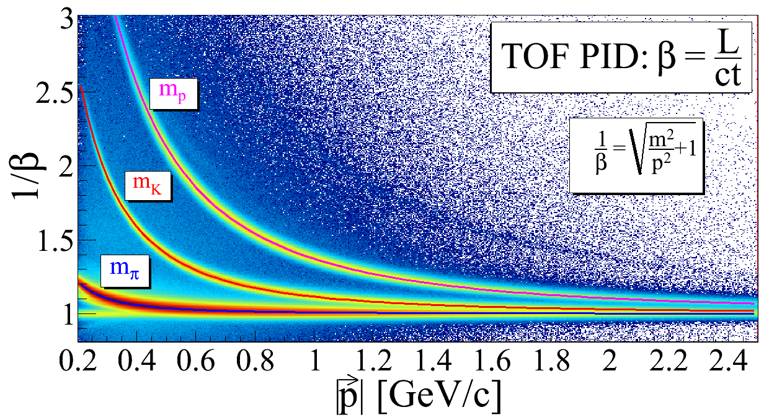
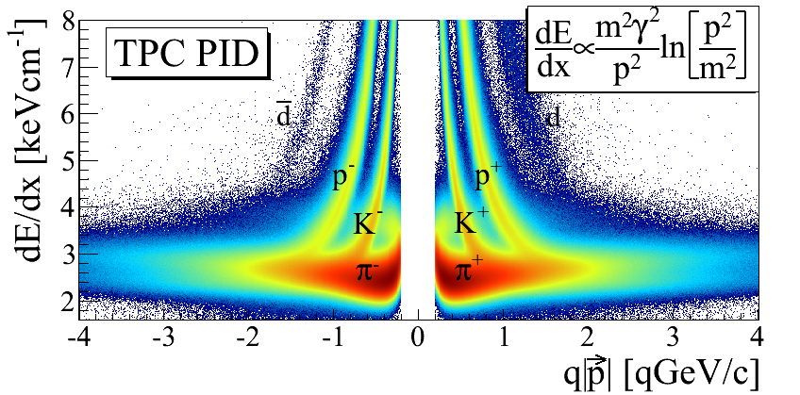
Hadron Identification
STAR preliminary
Kaons: TOF only
Pions: TOF if available, otherwise TPC dE/dx with matching to BEMC required to remove pile-up tracks
STAR preliminary
STAR preliminary

Slide 7
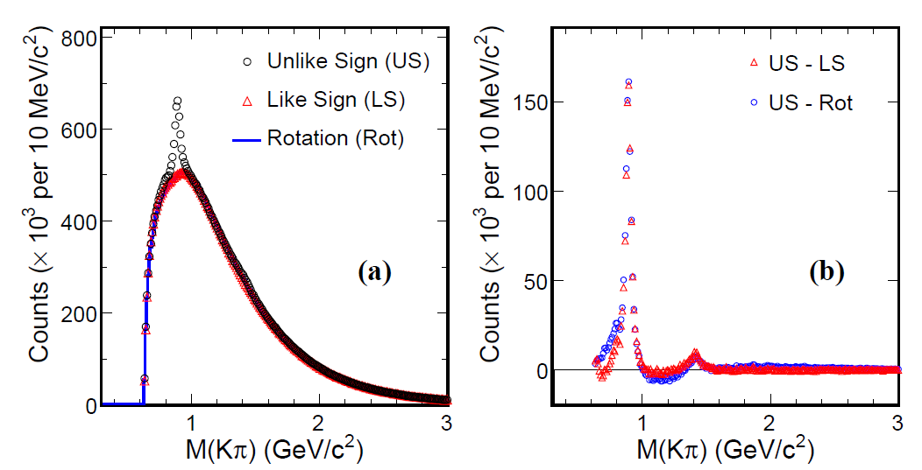
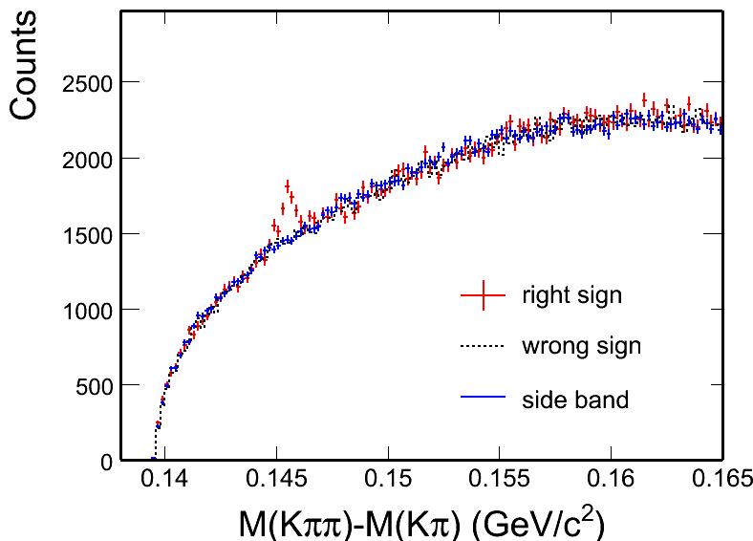
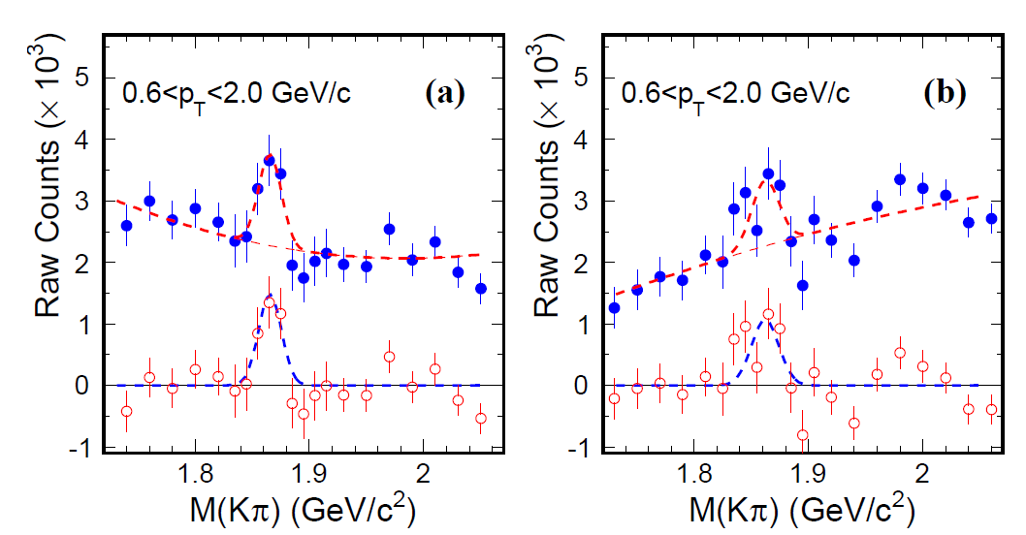
D⁰ and D* signal in p+p 200 GeV
arXiv: 1204.4244
K*⁰
K*⁰
arXiv: 1204.4244
D⁰
K₂*(1430)
D⁰
D⁰ mass window zoom
D⁰ mass window zoom
p+p minimum bias 105 M
Different methods reproduce combinatorial background.
Consistent results from two background methods.
D⁰
D⁰

Slide 8
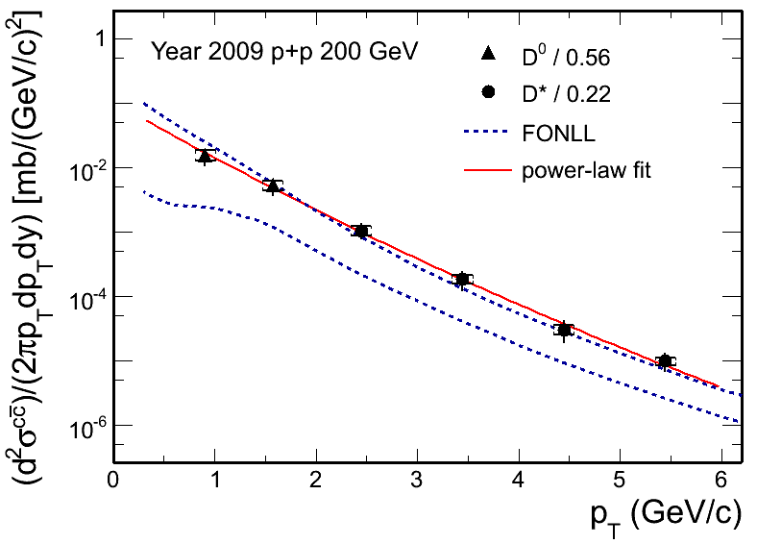
D⁰ and D* p_{T} spectra in p+p 200 GeV
D⁰ scaled by N_{D0}/N_{cc}= 0.56^{[1]}
D* scaled by N_{D*}/N_{cc}= 0.22^{[1]}
Xsec = dN/dy|^{cc}_{y=0} * F * σ_{pp}
F = 4.7 ± 0.7 scale to full rapidity.
σ_{pp}(NSD) = 30 mb
arXiv: 1204.4244
The charm cross section at mid-rapidity is:
The charm total cross section is extracted as:
Consistent with FONLL^{[2]} upper limit.
[1] C. Amsler et al. (Particle Data Group), PLB 667 (2008) 1.
[2] Fixed-Order Next-to-Leading Logarithm: M. Cacciari, PRL 95 (2005) 122001.

Slide 9
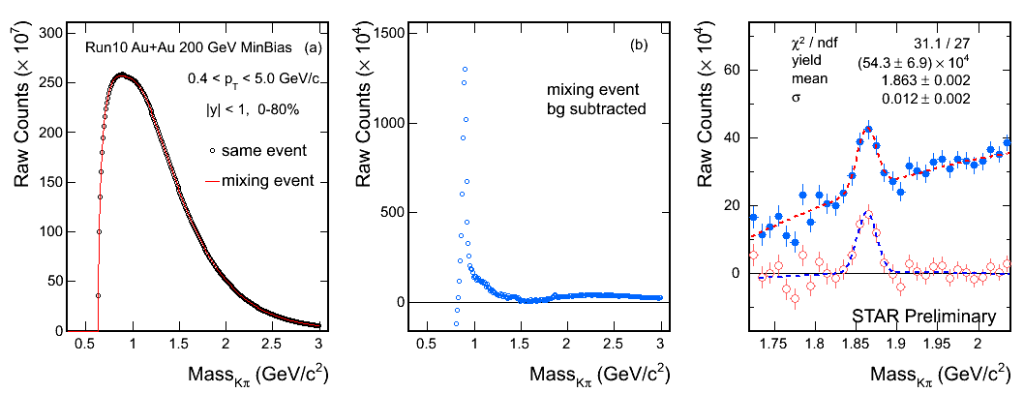
D⁰ signal in Au+Au 200 GeV
STAR, Quark Matter 2011, JPG 38, 124142 (2011)
K*⁰
D⁰
Minimum bias 0-80% 280M Au+Au 200 GeV events.
S/√(S+B) = 8
Mass = 1863 ± 2 MeV (PDG value is 1864.5 ± 0.4 MeV)
Width = 12 ± 2 MeV

Slide 10
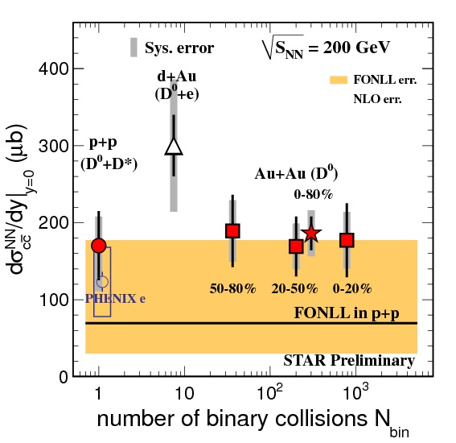
Number-of-binary-collisions scaling
STAR, Quark Matter 2012, JPG 38, 124142 (2011)
arXiv:1204.4244.
Measurements from Year 2009 p+p D⁰+D*
and Year 2010 Au+Au D⁰ are consistent
Charm cross section in Au+Au 200 GeV is estimated from D⁰ cross section, scaled by fragmentation ratio 0.56:
Cross section at mid-rapidity:
186 ± 22 (stat.) ± 30 (sys.) ± 18 (norm.) μb
Total cross section:
876 ± 103 (stat.) ± 211 (sys.) μb
[1] FONLL: M. Cacciari, PRL 95 (2005) 122001.
[2] NLO: R. Vogt, Eur.Phys.J.ST 155 (2008) 213
[3] PHENIX e: A. Adare, et al., PRL 97 (2006) 252002.
[4] STAR d+Au: J. Adams, et al., PRL 94 (2005) 62301
Charm cross section follows number of binary collisions scaling =>
Charm quark produced at early stage of collisions.

Slide 11
D⁰ R_{AA} vs p_{T}
D⁰ Au+Au 0-80% divided by p+p with N_{bin} scaled.
Below 3 GeV/c, R_{AA} consistent with unity. Consistent with D⁰ yield N_{bin} scaling behavior.
ALICE results shows D meson is suppressed at high p_{T}.
At present, The Non-photonic Electrons analysis is the key to study high p_{T} charm and bottom production at RHIC.
Heavy Flavor Tracker, the new STAR subsystem, will make a significant improvement

Slide 12
D⁰ signal in p+p 500 GeV
STAR preliminary
Like-sign background subtracted.
S/√(S+2B) = 4
from 52 M minimum bias events
STAR preliminary
Rotated background subtracted.
S/√(S+2B) = 4.1

Slide 13
D* in p+p 500 GeV
Minimum bias events
High tower triggered events
STAR preliminary
STAR preliminary
2< p_{T} < 20 GeV/c
2< p_{T} < 20 GeV/c

Slide 14
Summary
D⁰ and D* are measured in p+p 200 GeV up to 6 GeV/c the first direct measurement at RHIC
consistent with FONLL upper limit.
Sufficient D⁰ and D* signal from p+p 500 GeV collisions promises first open charm cross section calculation in such energy with p_{T} coverage being 0.4 – 7.0 GeV/c
D⁰ are measured in Au+Au 200 GeV up to 5 GeV/c.
1) Charm cross sections at mid-rapidity follow number of binary collisions scaling
2) R_{AA} is consistent with unity for p_{T} < 3 GeV/c.
=> charm is produced at early stage of the collisions.
Run 2011 Au+Au data with twice more statistics will allow us to extend the R_{AA} p_{T} range up to 7 – 8 GeV/c.

Slide 15
Backup Slides

Slide 16
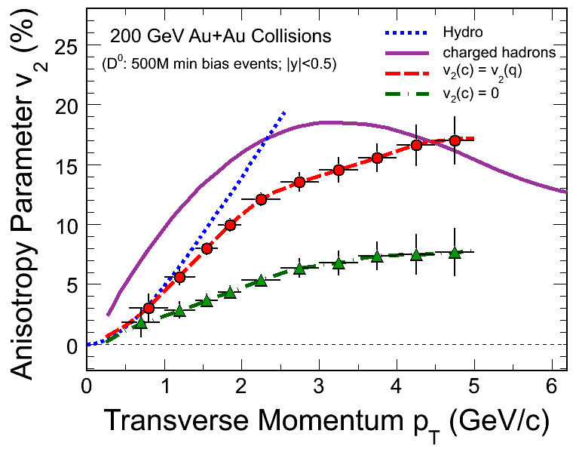
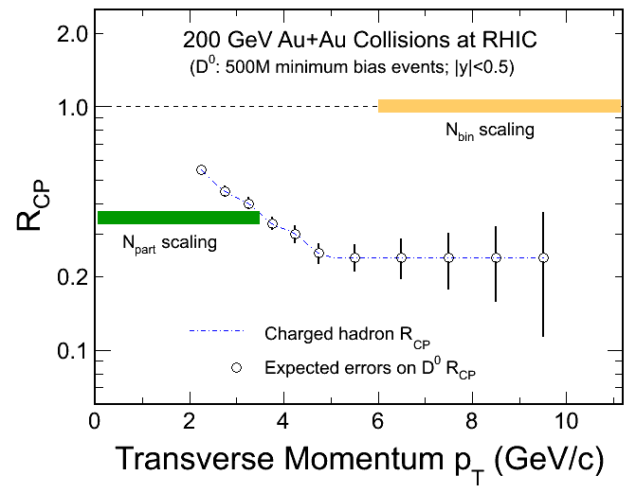
Heavy Flavor Tracker
TPC
SSD
IST
PXL
FGT
STAR Heavy Flavor Tracker Project.
Reconstruct secondary vertex.
Dramatically improve the precision of measurements.
Address physics related to heavy flavor.
v₂ : thermalization
R_{CP}: charm quark energy loss mechanism.

Slide 17
Systematic error study
Raw Counts – Difference between methods
nFitPoints - difference between
MC(nFitPts>25)/MC(nFitPts>15) and
Data(nFitPts>25)/Data(nFitPts>15)
3) DCA - difference between MC(dca<1)/MC(dca<2) and Data(dca<1)/Data(dca<2)

Slide 18
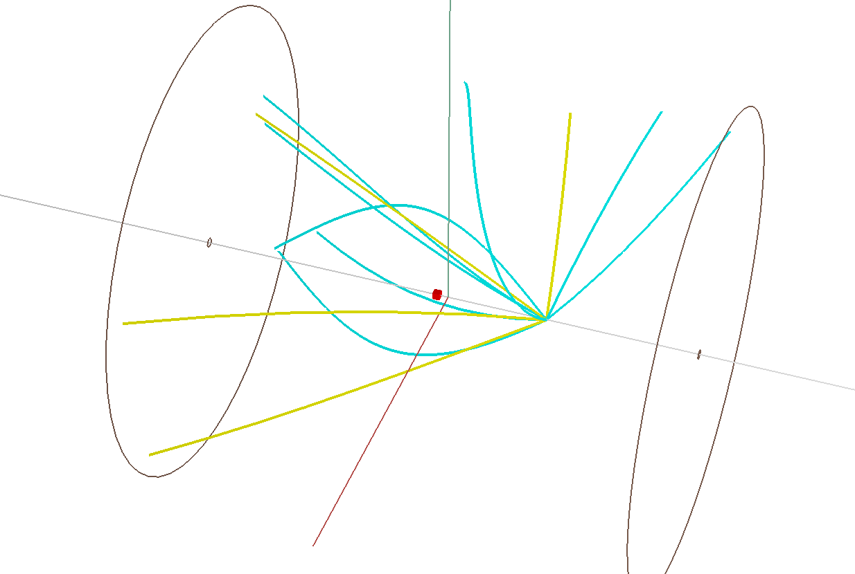
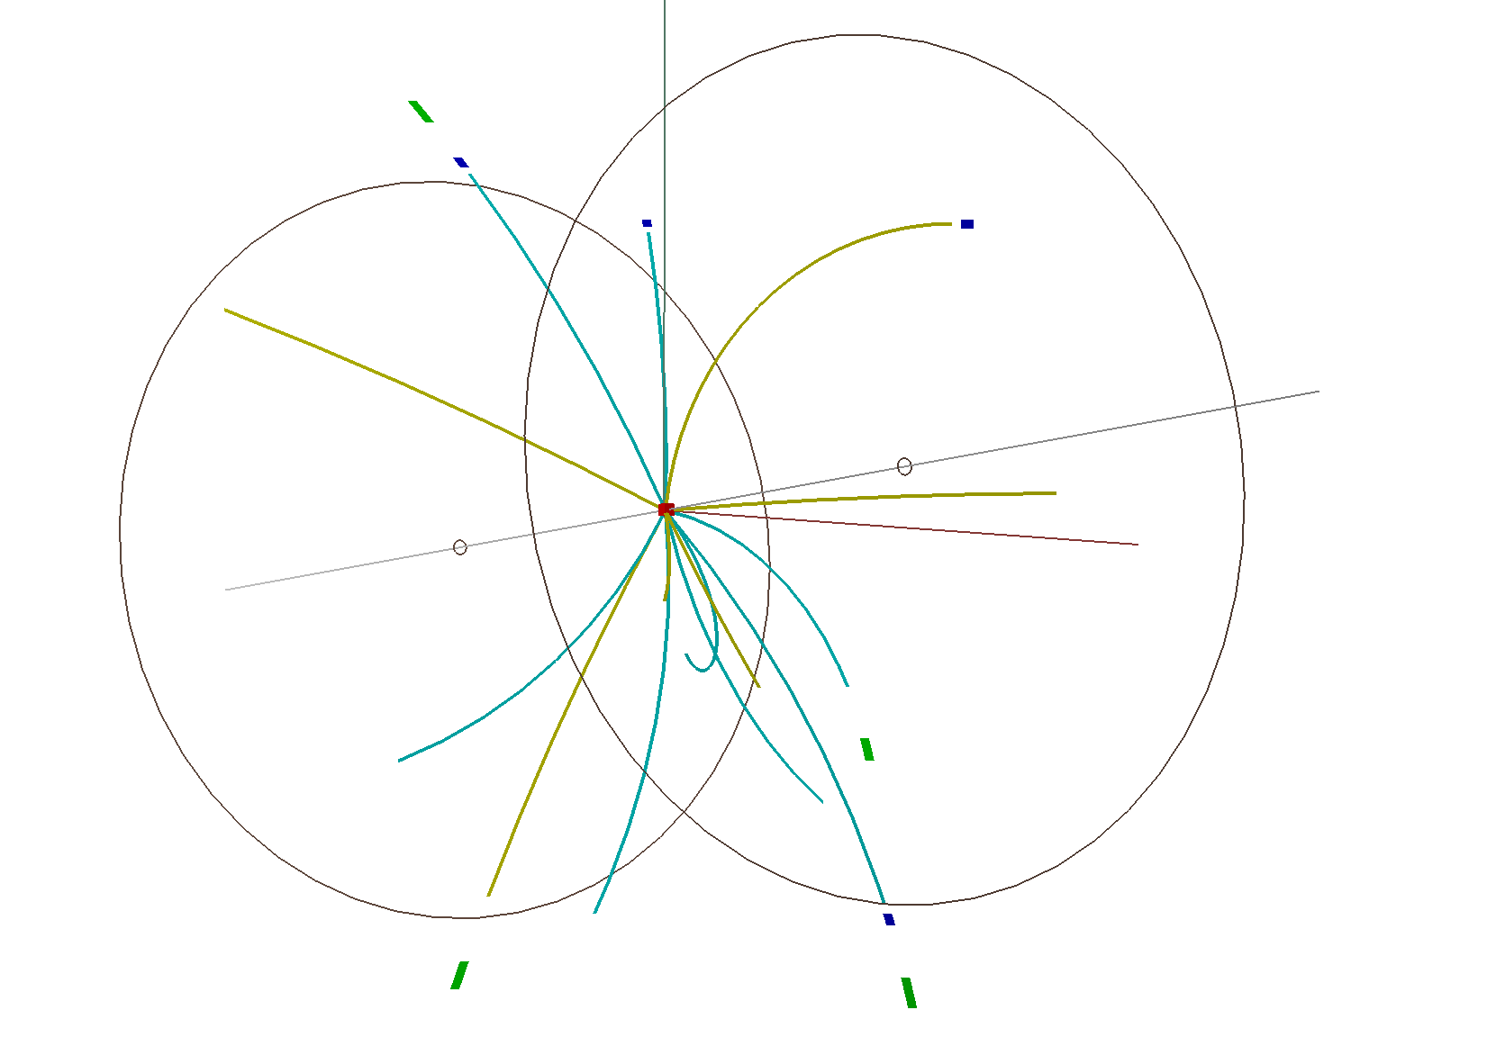
Pile-up removal
pp collisions peak luminosity L_{peak} = 5*10³¹ cm⁻²s⁻¹ in year 2009.
EventRate = L_{peak}*σ^{NSD}(30 mb) = 1.5 MHz
TPC readout ~ 80 μs => TPC sees tracks from 120‎ collisions. Pile-ups are removed by‎
‎ |VpdVz - TpcVz| < 6cm cut
‎ TPC PPV reconstruction algorithm
‎‎

Slide 19
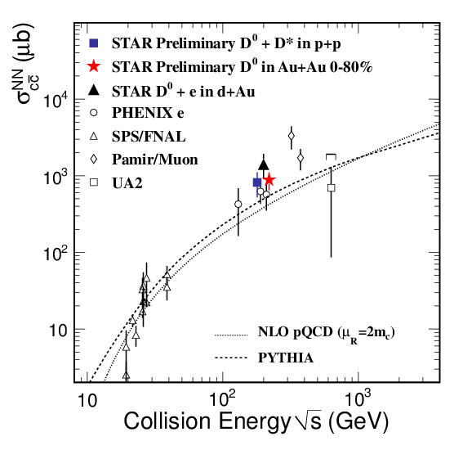
Charm cross section vs

