Slide 1
Measurements of ϒ Production and Nuclear Modification Factor at STAR
Anthony Kesich
University of California, Davis
STAR Collaboration

Slide 2
Outline
Motivation for measuring Upsilons
The Solenoidal Tracker At RHIC and its triggers
ϒ production cross section in p+p
New 2009 results!
ϒ production in d+Au
ϒ Nuclear Modification Factor in Au+Au
Updated with 2009 statistics!
Conclusions

Slide 3
Goal: Quarkonia states in A+A
Charmonia: J/Ψ, Ψ’, χ_{c} Bottomonia: ϒ(1S), ϒ(2S), ϒ(3S),χ_{B}
Key Idea: Quarkonia Melt in the plasma
Color screening of static potential between heavy quarks
Suppression of states is determined by T_{C} and their binding energy
Lattice QCD: Evaluation of spectral functions ⇒ T_{melting}
When do states melt?
A .Mocsy, Summer Quarkonium Workshop, BNL, 2011
H. Satz, HP06

Slide 4
Quarkonia at RHIC
Why do ϒ at RHIC instead of J/Ψ?
A cleaner probe compared to J/Ψ
co-mover absorption → negligible
recombination → negligible
σ_{cc} = ~800 µb, σ_{bb=} ~ 2µb
Challenge: low rate, rare probe
Large acceptance detector
Efficient trigger
Expectation:
ϒ(1S) no melting
ϒ(2S) likely to melt
ϒ(3S) melts

Slide 5
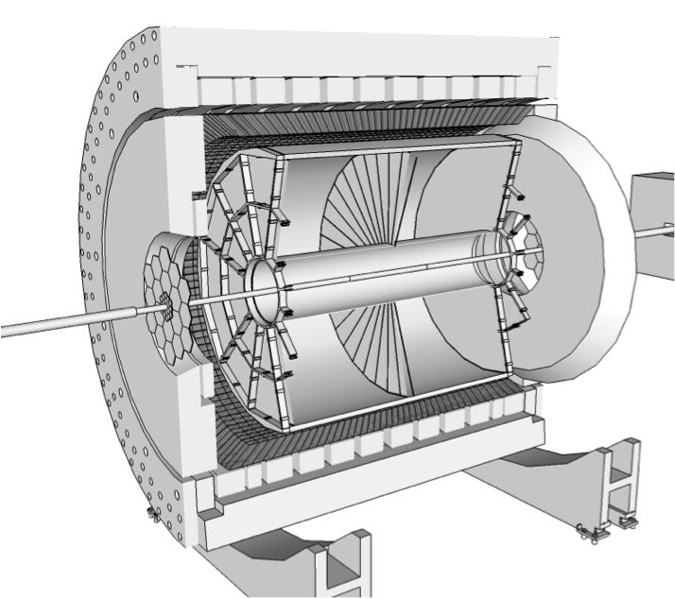
STAR
Time Projection Chamber
|η| < 1
Full φ coverage
Tracking and EID via Ionization
EM Calorimeter
|η| < 1
Full φ coverage
Electron ID via E/p
Event Triggering

Slide 6
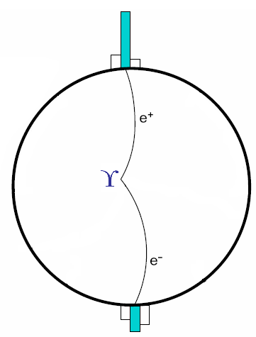
Triggering on ϒ decays
Level 0 Trigger (p+p,d+Au,Au+Au):
Hardware-based
Fires on at least one high tower
Level 2 Trigger (p+p,d+Au):
Software-based
Calculates:
Cluster energies
Opening angle
Mass
High rejection rate allowed us to sample entire luminosity

Slide 7
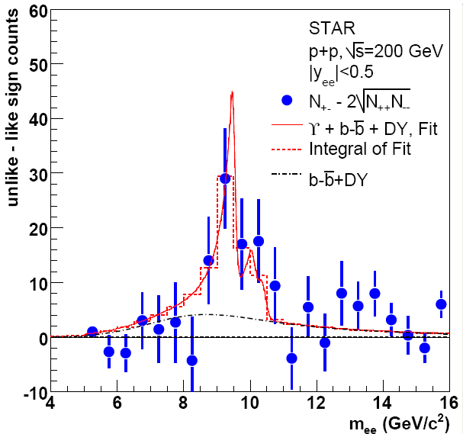
ϒ in p+p 200 GeV
2006
2009
Phys. Rev. D 82 (2010) 12004
∫L dt = 7.9 ± 0.6 pb⁻¹ N_{ϒ}(total)= 67±22(stat.)
∫L dt = 19.7 pb⁻¹ N_{ϒ}(total)= 145±26(stat.)
STAR Preliminary

Slide 8
ϒ in p+p 200 GeV, Comparisons
CEM: R. Vogt, Phys. Rep. 462125, 2008 CSM: J.P. Lansberg and S. Brodsky, PRD 81, 051502, 2010
STAR Preliminary
STAR √s=200 GeV p+p ϒ+ϒ′+ϒ″→e⁺e⁻ cross section consistent with pQCD and world data trend

Slide 9
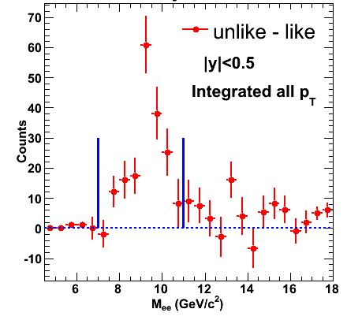
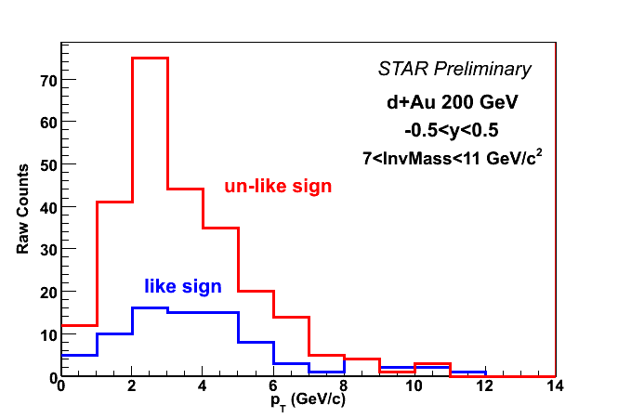
ϒ in d+Au 200 GeV
STAR Preliminary
Signal has ~8σ significance
p_{T} reaches ~ 5 GeV/c
∫L dt = 32.6 nb⁻¹ N_{ϒ+DY+bb}(total)= 172 ± 20(stat.)

Slide 10
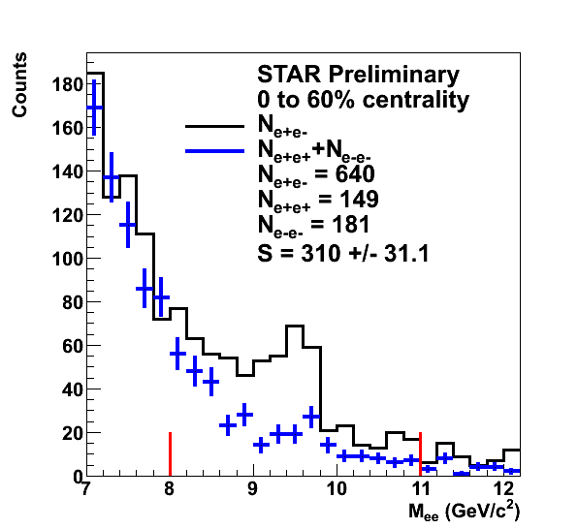
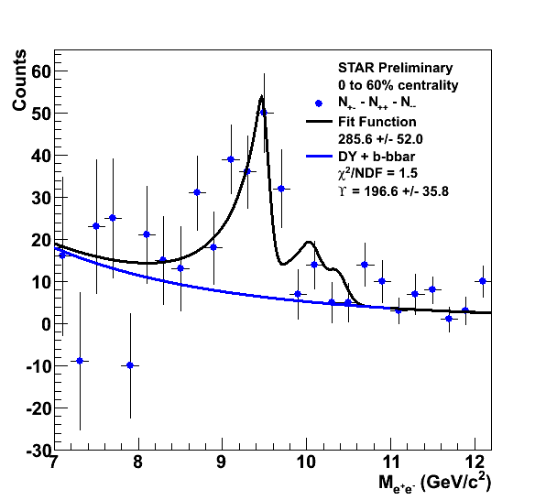
ϒ in Au+Au 200 GeV
Raw yield of ○→e⁺e⁻ with |y|<0.5 = 197 ± 36
∫L dt ≈ 1400 µb⁻¹

Slide 11
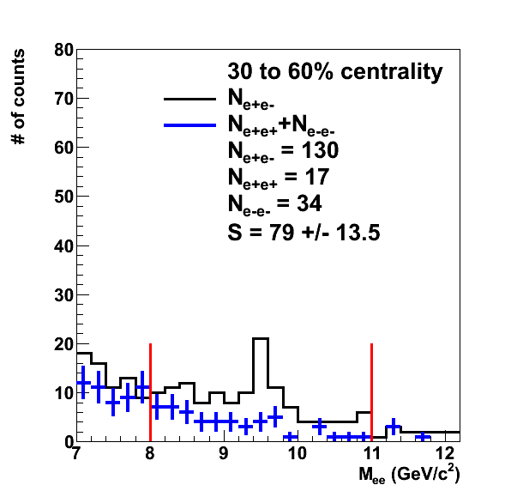
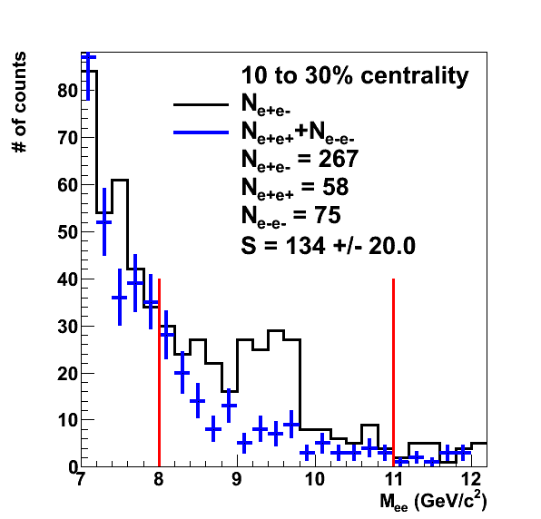
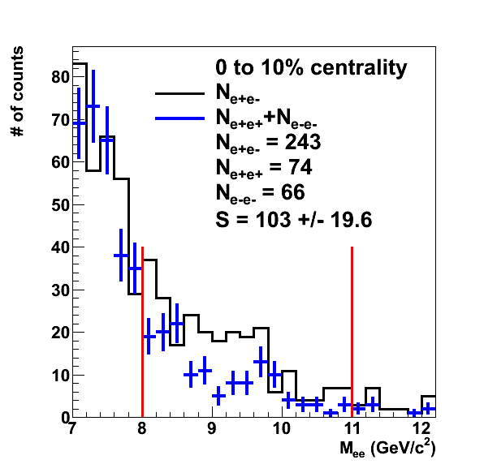
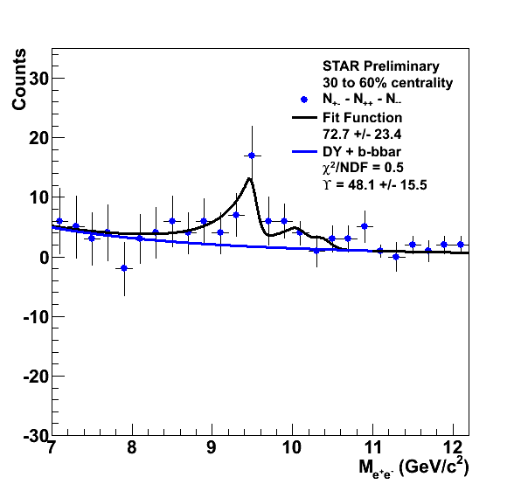
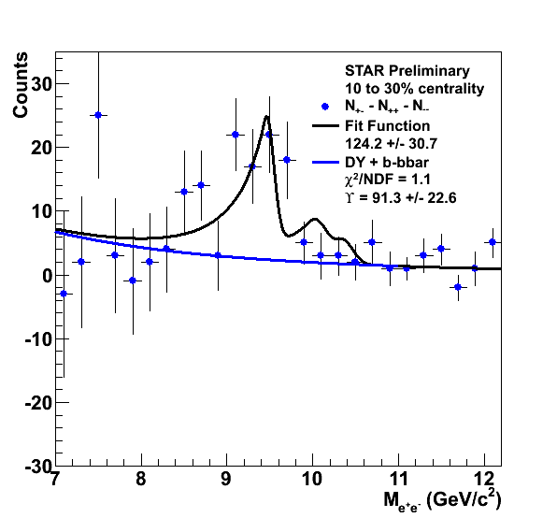
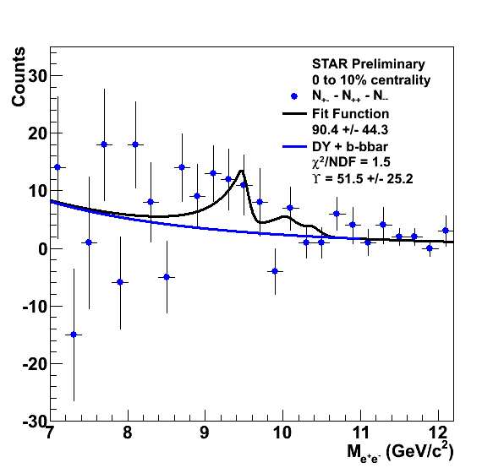
ϒ in Au+Au 200 GeV, Centrality
STAR Preliminary
STAR Preliminary
STAR Preliminary
Peripheral
Central

Slide 12
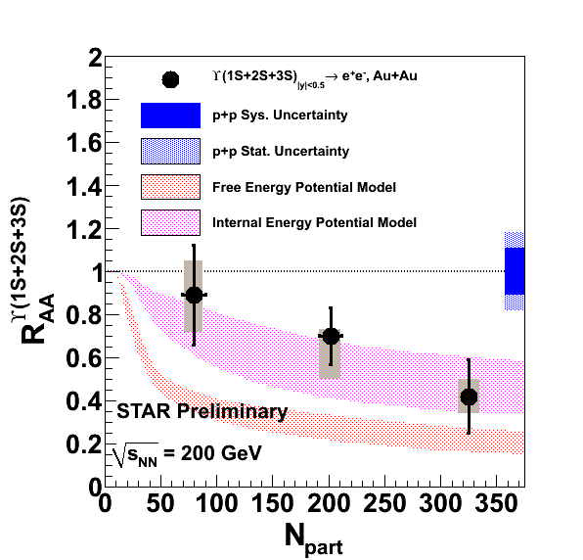
ϒ in Au+Au 200 GeV, R_{AA}
Models from M. Strickland and D. Bazow, arXiv:1112.2761v4
Dynamic model with fireball expansion and quarkonium feed-down
Results are consistent with complete 2S and 3S suppression in this model
Calculation included variation of initial η/S and T₀
Data indicates a T₀ in the range of 428-442 MeV and 1/4π< η/S < 3/4π

Slide 13
Conclusions
Measured ϒ production in p+p, d+Au, and Au+Au collisions at 200 GeV
Final d+Au results coming soon
Au+Au results consistent with 2S and 3S suppression
Increased Au+Au statistics from run 11 will further decrease R_{AA} uncertainties
Enhanced pp signal from 2009 will allow us to extend our measurement to |y|<1.0

Slide 14
Thank you

